Slide 1

Telecom
Analysis

Slide 2

Why EDA ?
Exploratory Data Analysis (EDA) is an approach to analyze the data using visual techniques. It is used to discover trends, patterns, or to check assumptions with the help of statistical summary and graphical representations.
Customer Churn is the rate at which a commercial customer leaves the commercial business and takes their money elsewhere. Understanding customer churn is vital to the success of a company and a churn analysis is the first step to understanding the customer.

Slide 3
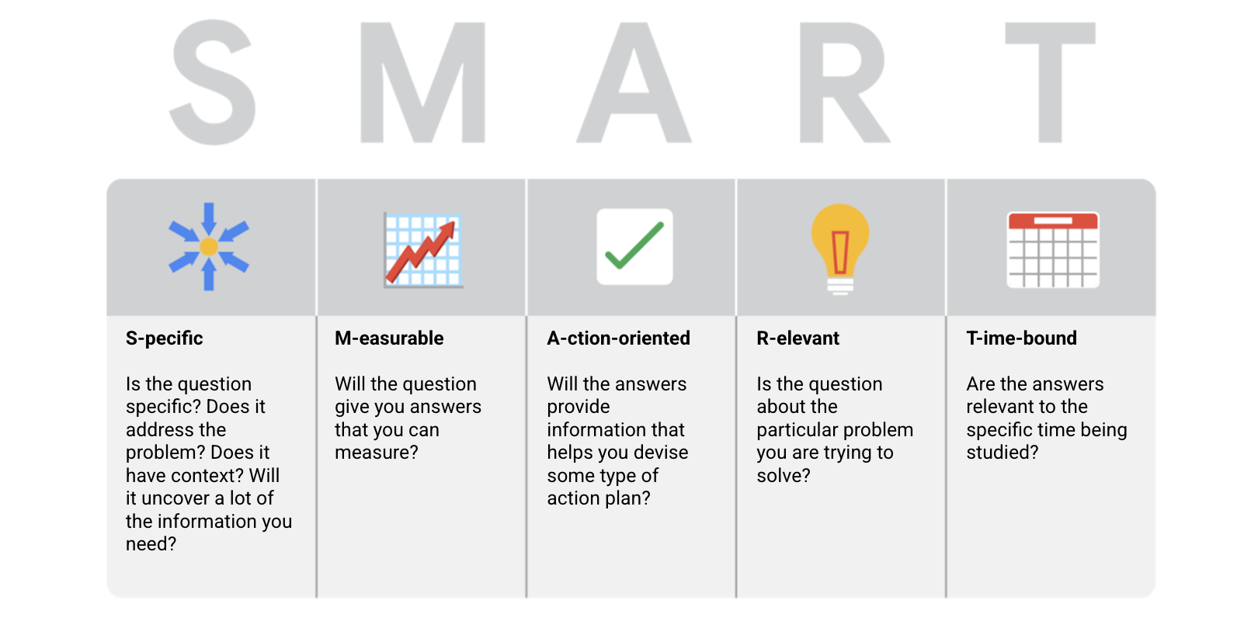

Slide 4
Overview
Objective: To Explore,understand and analyze telecommunication company customer data and identify the meaning insights in order to decrease the customer churn rate.
Data from 7043 customers (21 features):
Churn (Yes or No).
Customer account information (tenure, contract, payments, etc.).
Demographic Information (Partner, Gender, Age, etc.).
Add-on services provided by the platform.
Source: Surge classes,Telecom_churn_data.

Slide 5
Data Description
CustomerID : Unique ID’s for different customers.
Tenure :The time for which a customer has been using the service.
PhoneService :Whether a customer has a landline phone service along with the internet service.
Contract :The type of contract a customer has chosen.
PaperlessBilling :Whether a customer has opted for paperless billing.
PaymentMethod :Specifies the method by which bills are paid.
MonthlyCharges :Specifies the money paid by a customer each month.
TotalCharges :The total money paid by the customer to the company.
Churn : This is the target variable which specifies if a customer has churned or not.
Gender :The gender of a person.
SeniorCitizen :Whether a customer can be classified as a senior citizen.
Partner :If a customer is married/ in a live-in relationship.
Dependents :If a customer has dependents (children/ retired parents).
MultipleLines :Whether a customer has multiple lines of internet connectivity.
InternetService :The type of internet services chosen by the customer.
OnlineSecurity :Specifies if a customer has online security.
OnlineBackup :Specifies if a customer has online backup.
DeviceProtection:Specifies if a customer has opted for device protection.
TechSupport :Whether a customer has opted for tech support of not.
StreamingTV :Whether a customer has an option of TV streaming.
StreamingMovies:Whether a customer has an option of Movie streaming.

Slide 6
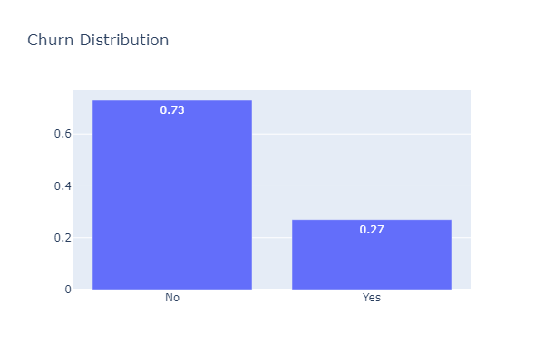
Target - Customer Churn distribution
Insights:
About 27% of the Telecom customers from our dataset end up churning.
Remaining 73% of the telecom customers didn’t churn

Slide 7
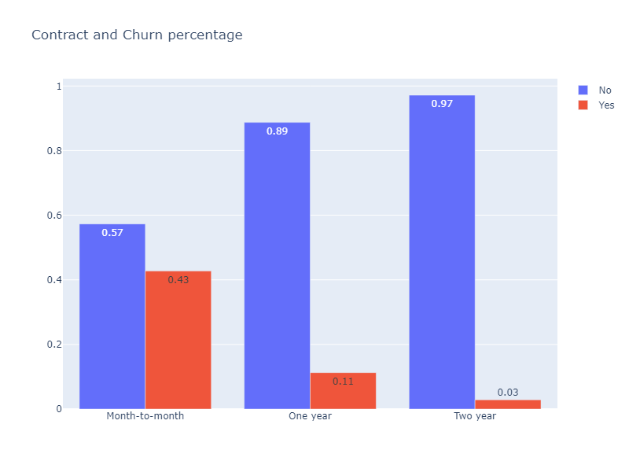
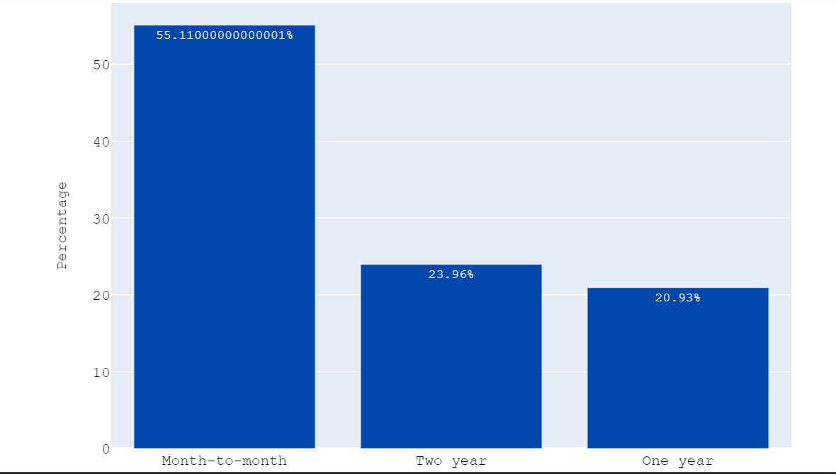
How Contract type influence the churn rate?
Insights:
More customers are likely to choose monthly contract types
Monthly customers are more likely to churn because of no contract terms, as they are free-to-go customers.
Churn decreases as contract lengths increase

Slide 8
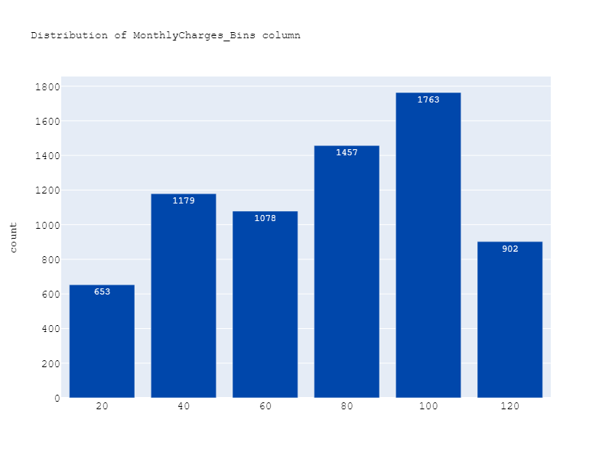
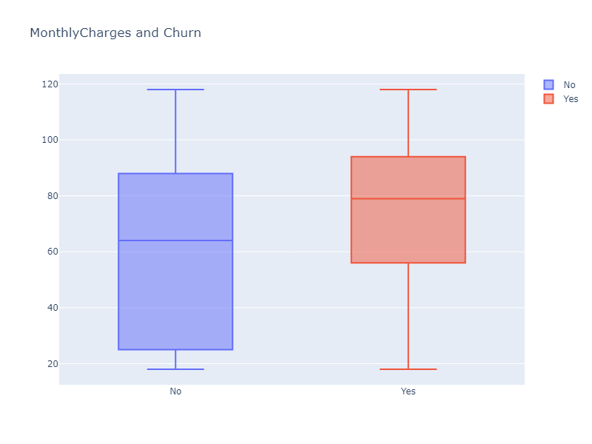
Does Raise in MonthlyCharges effect the churning?
Insights:
As monthly charges increase, the probability of customer churn increases
Customers who churn are most likely to have bills exceeding $60

Slide 9
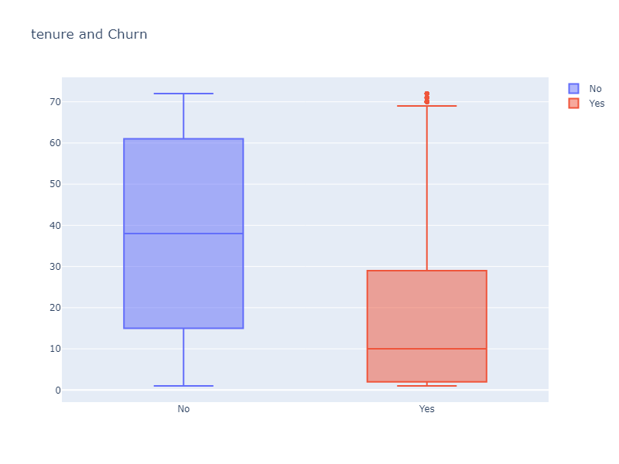
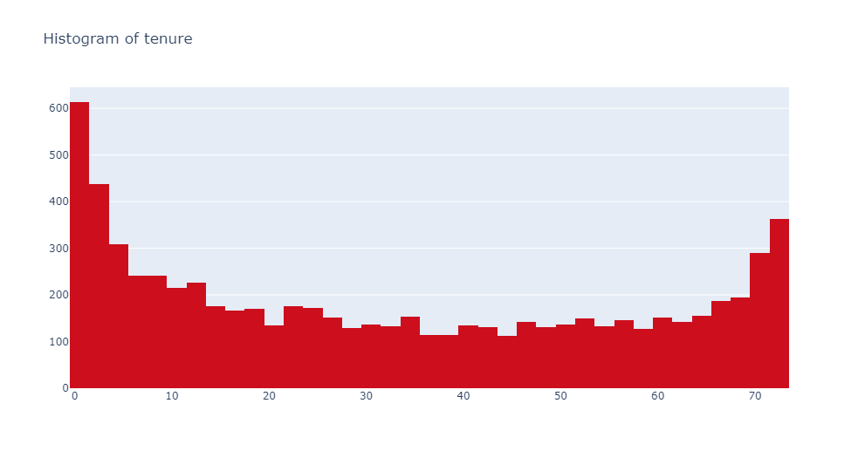
HYPOTHESIS is that the customer using the service for the longest time would like to Churn.
Insights:
As the Tenure increases,the probability of customer churn decreases
Customers have the highest probability of churning within the ﬁrst 20 months on the platform

Slide 10
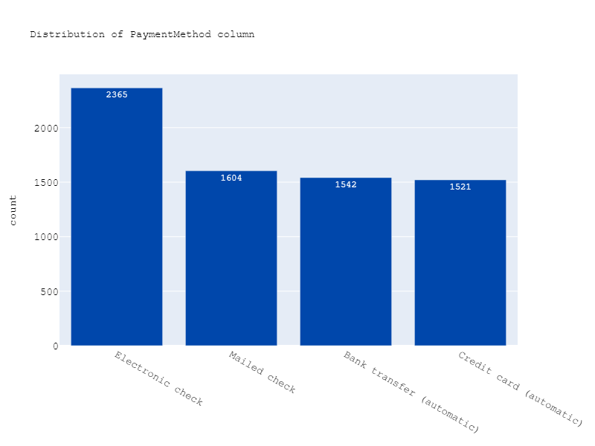
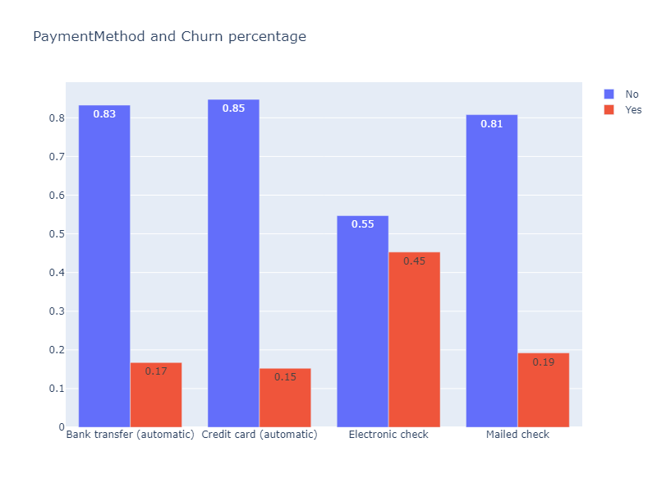
Does Payment Method and Churn rate have any correlation?
Insights:
The customers who use Electronic checks are more likely to churn than other customers.

Slide 11
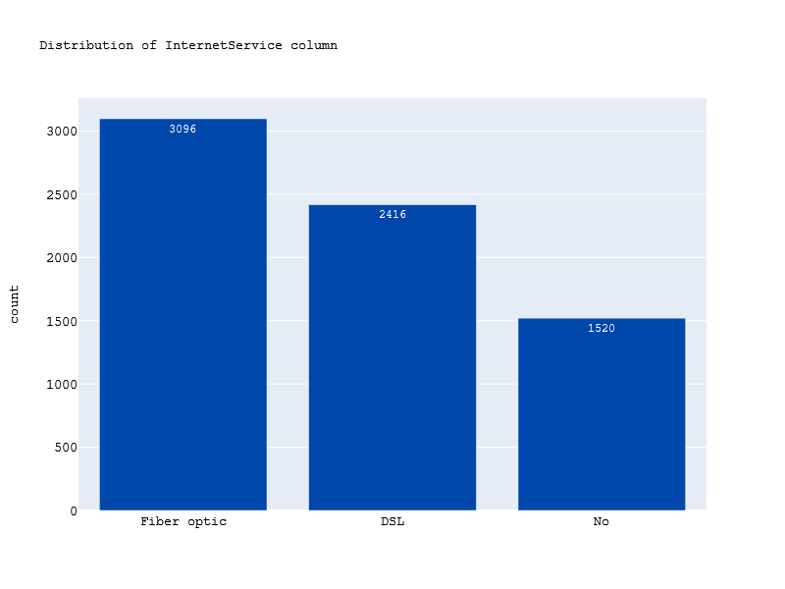
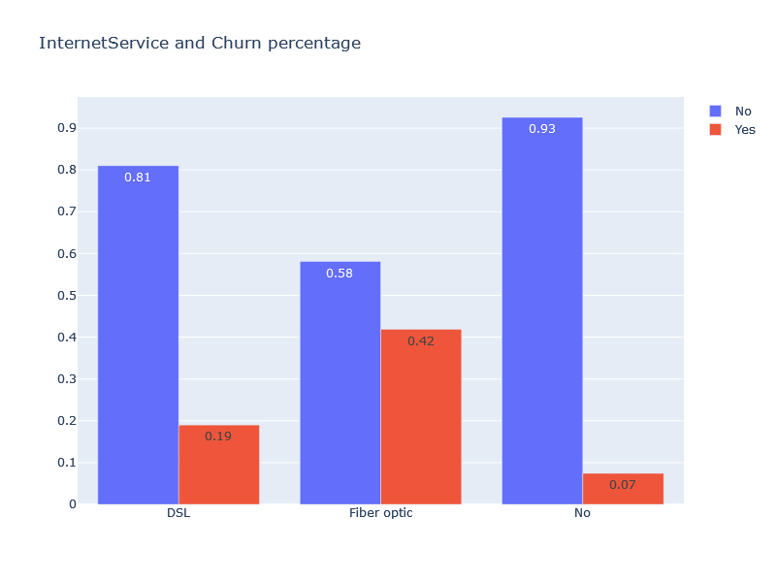
which Internet Service is mostly used?
Insights:
Most of the customers use Fibre optic for internet service.
Customers have the highest probability of churning who uses fibre optic.

Slide 12
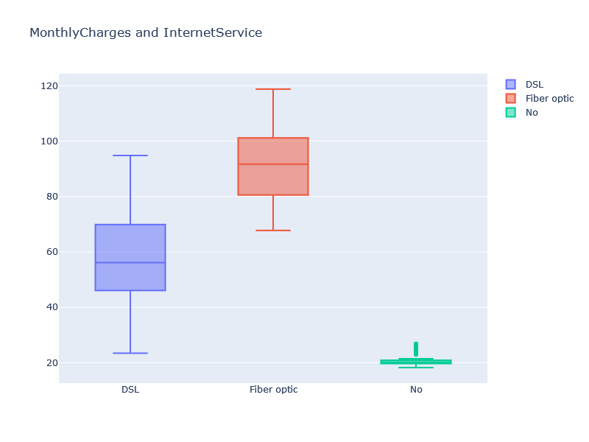
Internet Service vs MonthlyCharges
Insights:
The reason behind why customer leave who are using Fibre optic is that it increases the Monthly Charges.

Slide 13
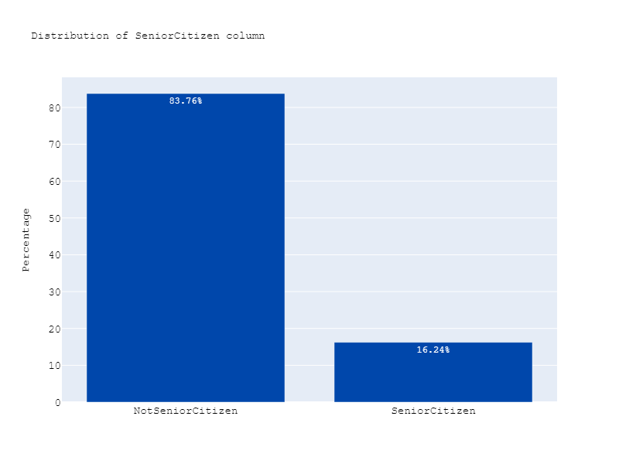
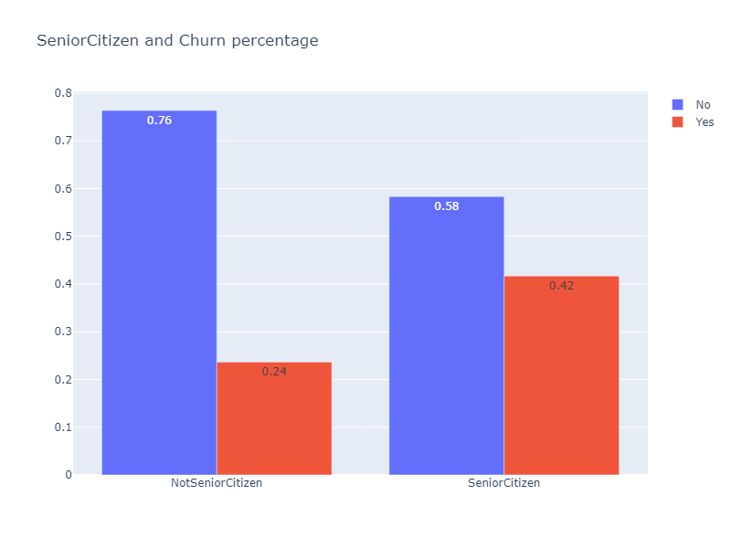
which category of Citizens churns the most ?
Insights:
Most of the customers are not senior citizens.
Senior citizens are most likely to churn

Slide 14
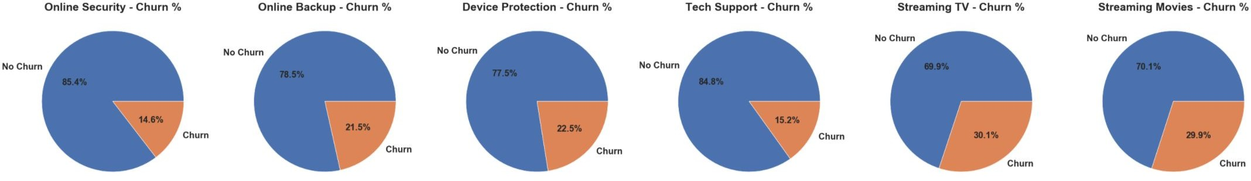
Add-On Services
Insights:
Customers with online security or tech support add-ons will churn the least
Customers with Streaming services (TV/Movies) will churn the most

Slide 15
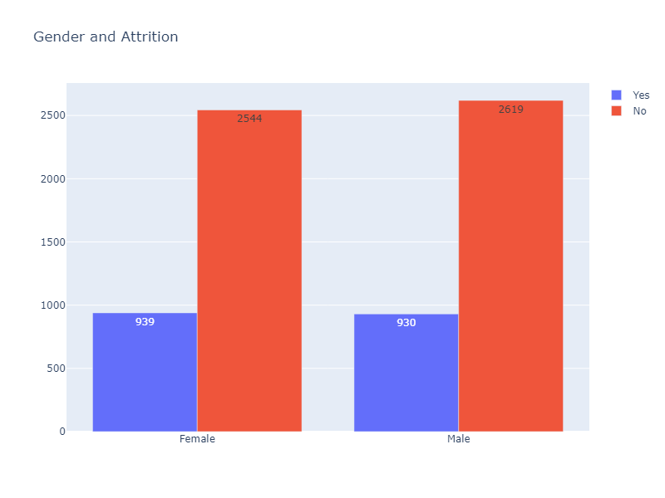
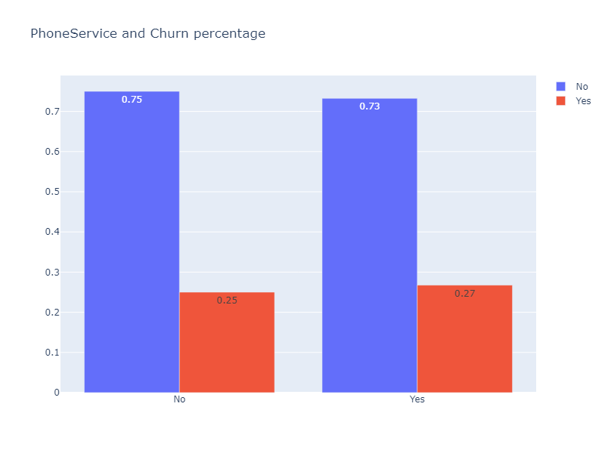
Do Gender and PhoneService influence the Churn rate..!!?
Insights:
These variables teen not to contribute much significantly

Slide 16
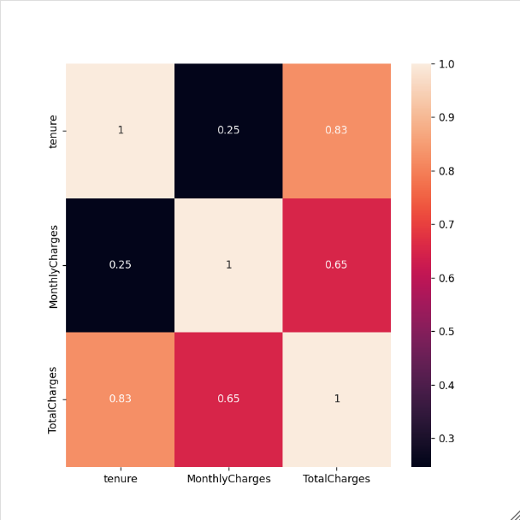
Heat Map(correlation among numerical variables)

Slide 17
Summary
A large proportion of customers opted for month-to-month contracts rather than year-long or two-year long contracts respectively.
It was found that the monthly charges for customers are highly correlated with whether the customers opted for a fiber optic connection.
Customers who are having less tenure are most likely to have the highest probability of churning within the ﬁrst 20 months on the platform.
Tech-Support & Online Security add-ons play a critical role in preventing churn, while streaming add-ons signiﬁcantly increase likelihood of churn.
SeniorCitizens are high churners as compared to non seniorCitizens.
The customers who use Electronic checks are more likely to
churn than other customers.

Slide 18
Conclusion
we can conclude that Monthly charges plays a crucial role in deciding the churn of customer.Apart from that payment mode,contract type,Internet service,Total charges ,tenure are also among top contributors.On other hand Gender,phone service,multiple lines ,dependents not tend to contribute as significantly.
Company can focus on variables that contribute significantly in determining if a customer is leaving or not.

Slide 19


