Slide 1

Day 9 — Multi‑Agent Collaboration
Toy Buyer/Seller Chat • CloudByteHub.ai
Building intelligent agents that negotiate, collaborate, and reach agreements autonomously

Slide 2
The Core Concept
Buyer Agent
Seller Agent
Smart Mediator
Has a specific budget constraint and seeks the best deal within their financial limits
Maintains a minimum acceptable price floor while maximizing profit margins
Routes messages between agents, enforces rules, and determines when deals close or negotiations timeout
This demo runs completely offline with no external API dependencies, making it perfect for controlled testing and development environments.

Slide 3
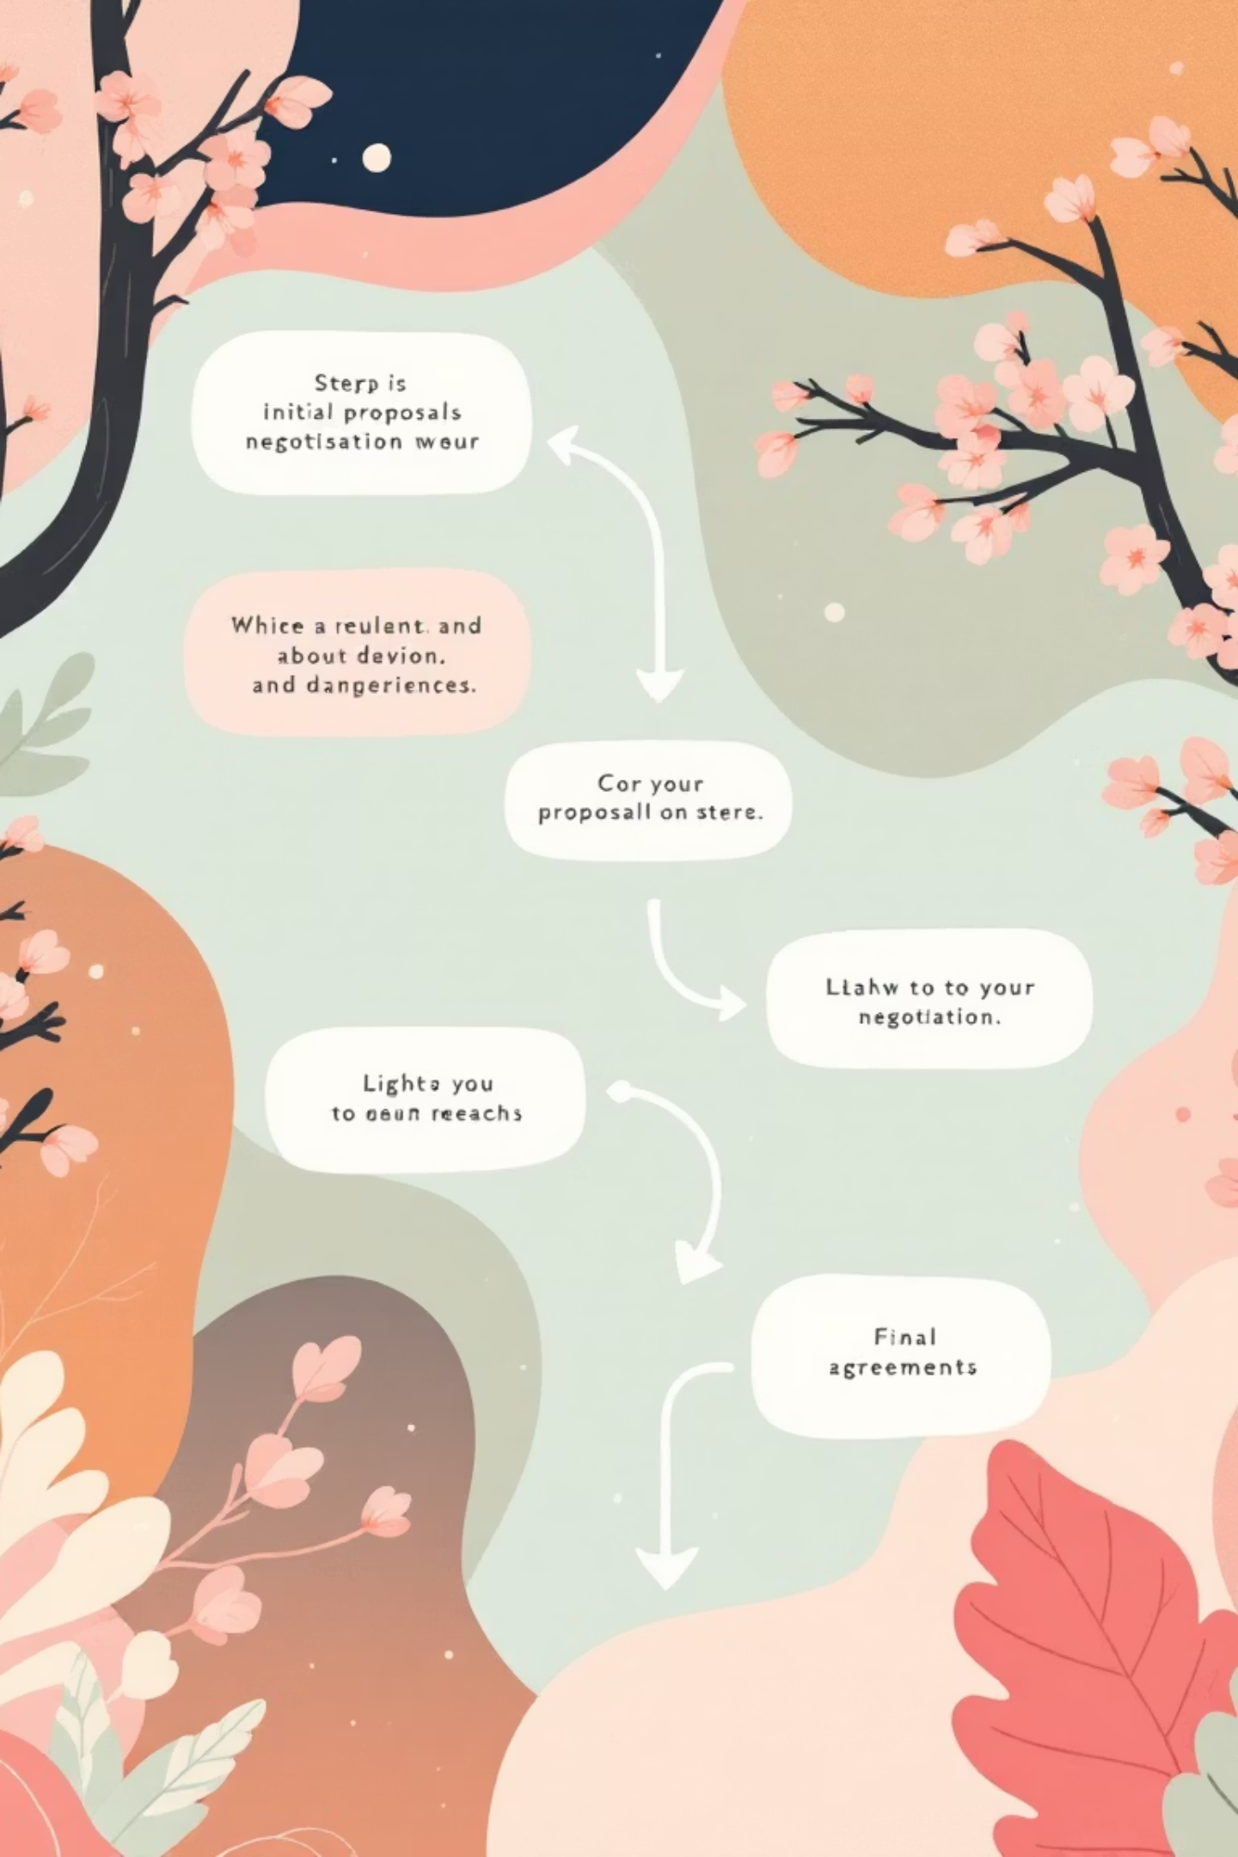
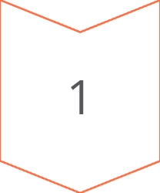
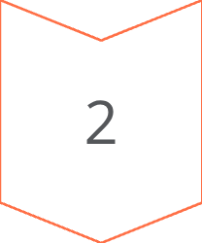
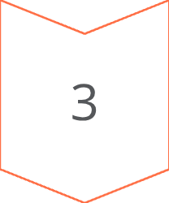
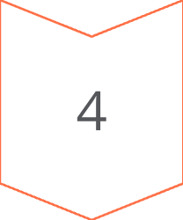
Negotiation Flow
Initial Offer
Buyer states desired quantity and target price based on budget constraints
Counter Proposal
Seller responds with list price and reveals minimum acceptable threshold
Active Negotiation
Both agents exchange counteroffers, adjusting prices and terms dynamically
Resolution
Process ends with mutual agreement on terms or timeout after maximum turns

Slide 4

Key Takeaways for Developers
Start Simple
Multi-agent systems don't require complexity—begin with clear roles, defined goals, and basic interaction rules
Maintain Control
A mediator component ensures system control, provides complete traceability through conversation transcripts, and prevents runaway interactions
Plan for Growth
Future extensions can include external tools like search APIs, calculators, or data validation services in upcoming development days

