Slide 1
COMPUTER ORGANIZATION AND ARCHITECTURE
NARAYANA VISHALI

Slide 2
MIPS CODE
A calculator MIPS code is used in this assignment.
Mars MIPS Simulator is used to simulate the above calculator code.
The code takes 3 operands and 2 operators of any choice from (+, -, *, /) between them. Operator precedence can be specified by the user else default precedence is considered.

Slide 3
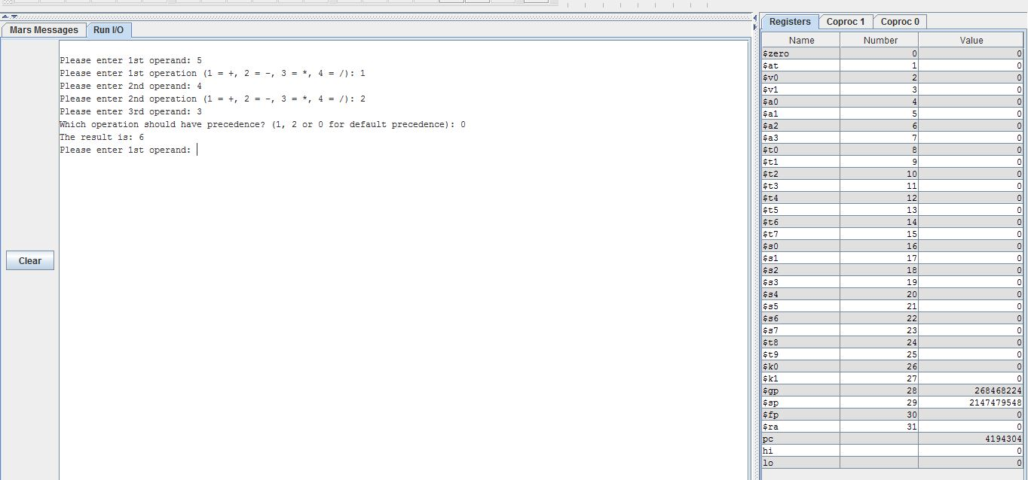
NORMAL TEST WITHOUT UI INJECTIONS

Slide 4
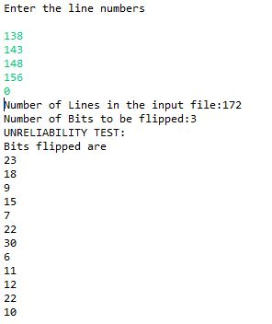
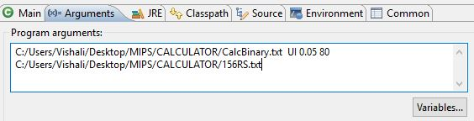
ERROR SIMULATOR
A java program is written to flip the bits randomly in 3 cases:
Unreliability, Insecurity, Unreliability & Insecurity
It takes the following arguments

Slide 5
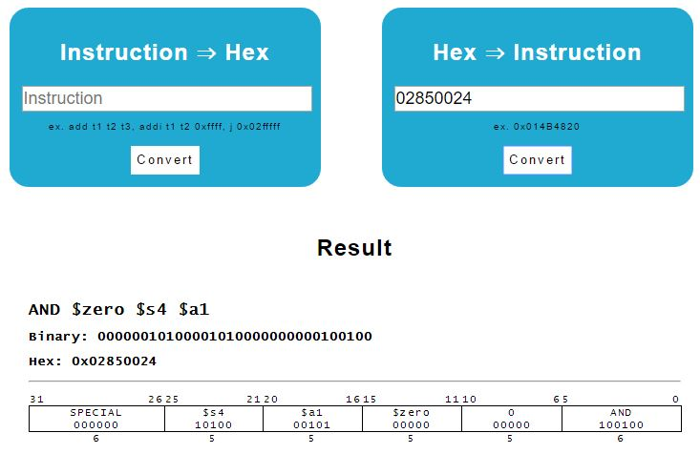
A java program is used to convert the binary file to hexadecimal file.
The hexadecimal instructions are converted back to MIPS instructions using online converter.

Slide 6
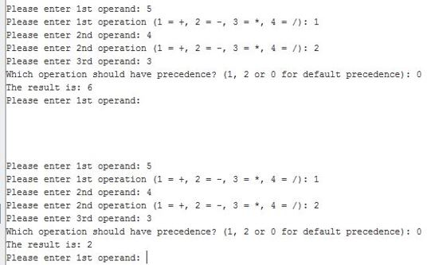
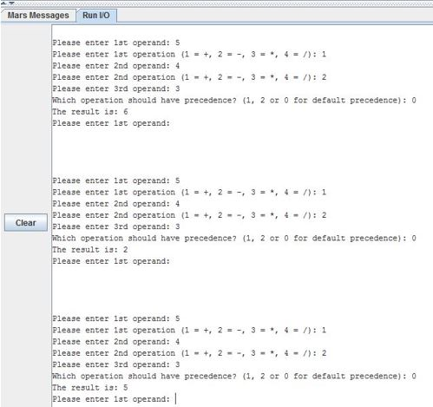
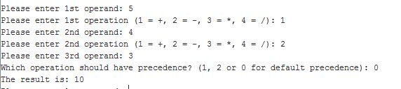
TEST CASES FOR UNRELIABILITY (WITH OUTPUT)

Slide 7

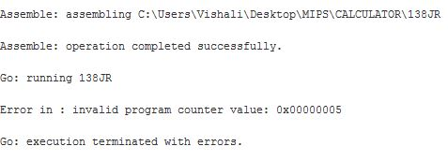
TEST CASES FOR UNRELIABILITY (WITH ERRORS)

Slide 8
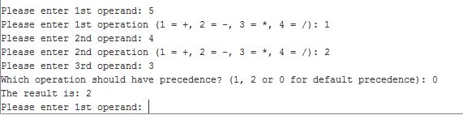
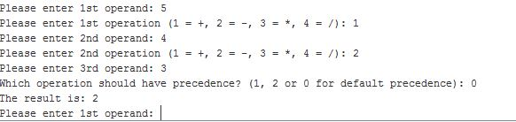
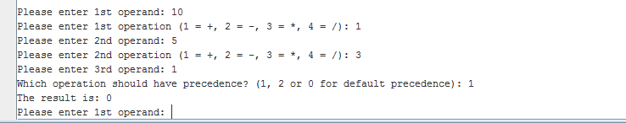
TEST CASES FOR INSECURITY (WITH OUTPUT)

Slide 9
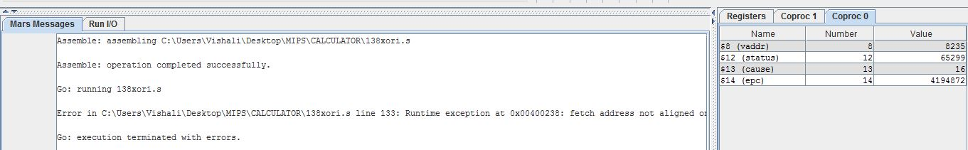
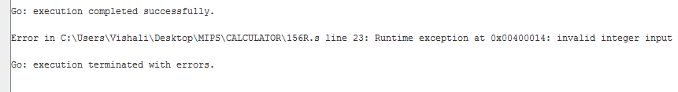
TEST CASES FOR INSECURITY (WITH ERRORS)

Slide 10
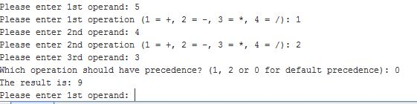
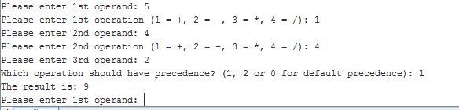
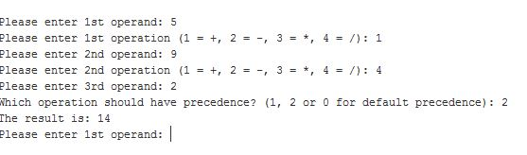
TEST CASES FOR UNRELIABILITY AND INSECURITY (WITH OUTPUT)

Slide 11
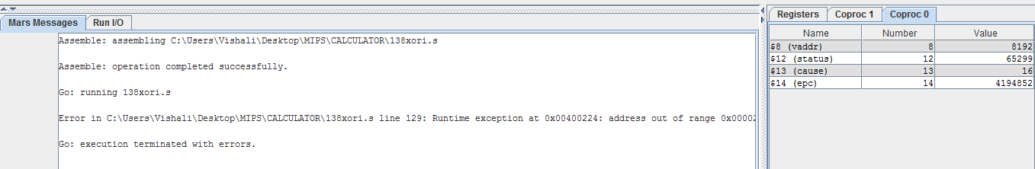
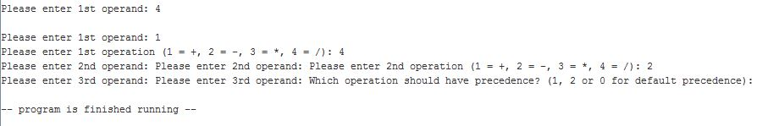
TEST CASES FOR UNRELIABILITY AND INSECURITY (WITH ERRORS)

Slide 12
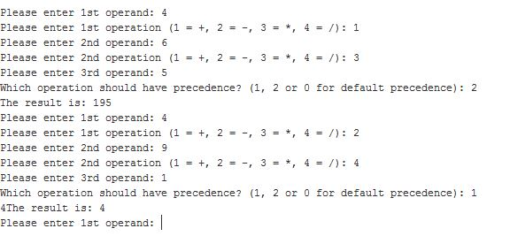
CLUSTERED UI RATE SAMPLE TEST CASES OUTPUT WITH 80/20

Slide 13
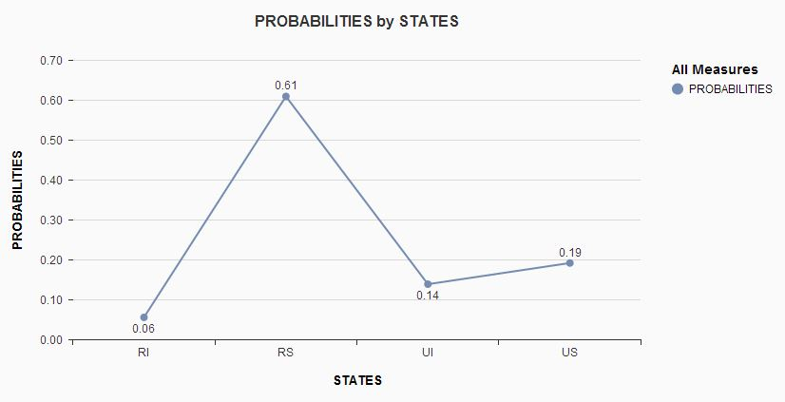
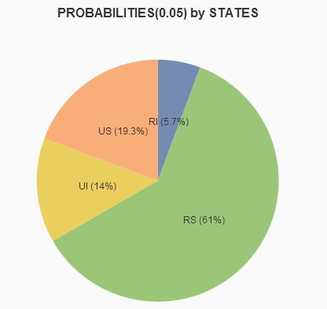
STATE PROBABILITIES

Slide 14
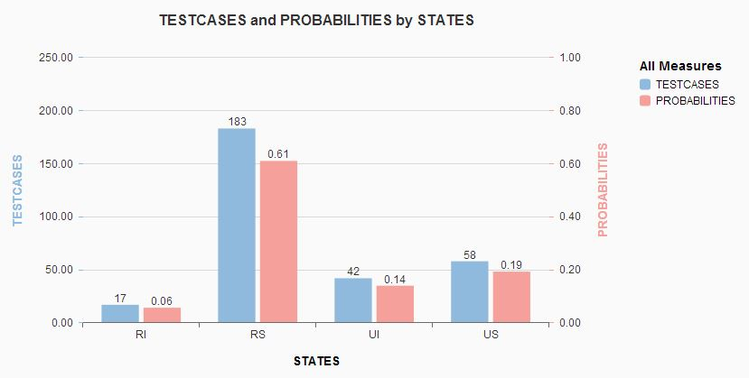
TEST CASES WITH STATES PROBABILITY

Slide 15
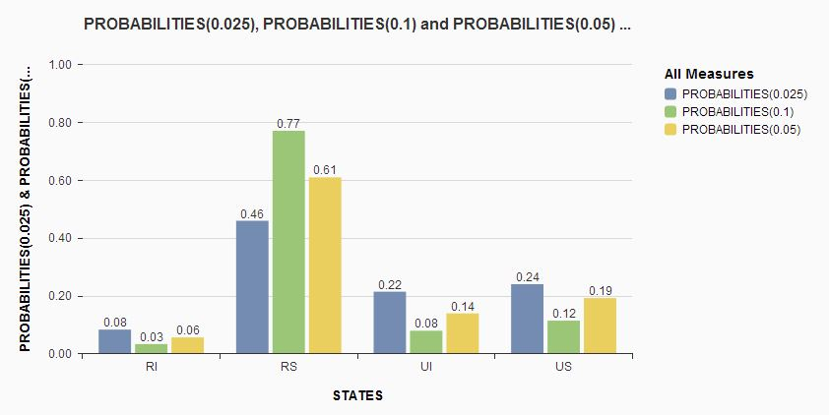
STATE PROBABILITIES WITH VARIOUS ERROR RATES

Slide 16

ANALYTICAL STUDY(TAKING TASK PERFORMANCE INTO CONSIDERATION)
Task Performance = $\frac{Progress after Error Injection}{Original Progress}$
= $\frac{1−P\left(U\right)−P\left(I\right)−P(UI)}{P(RS)}∗\frac{Instruction Count After Error Injection}{Original Instruction Count}$
Instruction count can increase or decrease based on the error rate. If the instruction count goes to infinity, the task completely fails.
If injected error changes the type of instruction [R->J] then the instruction count might increase in one case and if there is no change in the type, it remains the same.
Instruction count can vary with the same error rate depending upon the changes that took place after flipping.

Slide 17
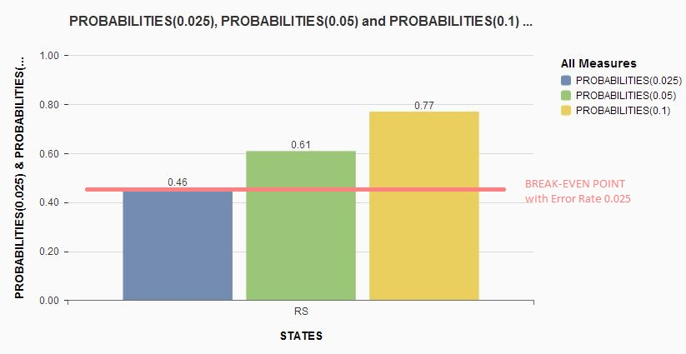
BREAK-EVEN POINT

Slide 18
Break-Even Point achieved considering 0.025% Error Injection is 0.46.
The process would be reliable and secured with a minimum 0.46 probability.
Break-Even varies with error injection. In our case 0.025% is the 1 bit flip occurrence.
As the error rate increases, process halts by returning errors.

Slide 19
Theoretical Probability
Probability varies with number of instructions and the error rate injection.
As the Number of instructions increases with the same error rate the probability changes. Let us say we have a MIPS code with 100 instructions and a MIPS code with 100k instructions, error injection 0.01% is negligible in first case.
The theoretical probability purely depends on the process considered.
Theoretical Probability α (Number of Instructions)*(Error Rate)

Slide 20


