Slide 1
Case study – ‘Flight Data Analysis’ US Department of Transportation
About this deck
This is prepared as response to flight data analysis case study
Notes:
Good afternoon, everyone! Today, I'm here to present my findings based on a multi-dimensional dataset of domestic flights in the United States. This dataset was made available by the US Department of Transportation for the year 2021

Slide 2




Introduction to the case study and overall objectives
Understanding data and identifying key features for analysis
This case study provides meaningful data-driven insights from domestic flight data of United States Bureau of Transportation Statistics
Insights and visualisations
Any other data sources that can be useful and benefits of having them
Notes:
At a high level, this analysis will provide an overview of my approach, which includes data preparation and feature selection. I will also share key insights and visualizations, as well as explore any other potentially valuable data sources.

Slide 3





Prominent Tools and Technologies were considered for this exercise across parameters
Unfavourable
Neutral
Favourable
Customization & Visualization
Scalability
Open Source availability
Python is used for the current data set analysis
Notes:
Tableau and Power BI offer a more user-friendly approach to customization and visualization, requiring minimal coding. On the other hand, Python provides extensive visualization capabilities through libraries like Matplotlib, offering fine-grained control over design. It's worth noting that Python is free and open source, while Tableau and Power BI typically require licenses.
Furthermore, Python boasts better scalability through the use of PySpark and Apache Spark, making it capable of handling enormous datasets, provided the right computer hardware, which sets it apart from Tableau and Power BI in terms of sheer data processing capabilities.

Slide 4
Across a Data storytelling Framework formulated for this exercise
Setting Objectives for the Analysis
1
Data Exploration and Correlation
2
Handling Missing Values and Performing Sanity Checks
3
Analysis and Visualizations
4
Inferences and key takeaways
5
Notes:
The framework I've adopted for this analysis comprises several key stages. I began with a set of initial objectives, understanding that these may evolve as the analysis progresses. The stages include:
Data Exploration and Analysis: This step involves delving into the dataset to understand its structure, characteristics, and initial patterns. It sets the foundation for the entire analysis.
Handling Missing Values and Sanity Checks: Addressing missing data and conducting sanity checks is crucial to ensure the quality and reliability of the dataset. This step helps maintain the integrity of the analysis.
Analysis and Visualizations: The heart of the analysis, where I performed in-depth examinations, derive insights, and create visualizations to communicate our findings effectively.
Key Takeaways: In the end, I summarized the most critical findings and insights that have emerged from the analysis, which will provide valuable insights and conclusions.

Slide 5
Data exploration and Correlation
2
Read CSV as Data Frame
1 million data points and 110 fields
Examining descriptions of each field
Plotting a Heat map to Identify Correlations
Missing Arrival Time Data for Cancellations and Diversions
Handling Missing Values: Remove or Impute?
Sanity Checks
Are the values rationale?
Notes:
The very first step of the analysis was to read the CSV in pandas as a dataframe and explore the shape. The dataset had over 1 million data points and 110 features.

Slide 6
Data exploration and Correlation
2
Read CSV as Data Frame
1 million data points and 110 fields
Examining descriptions of each field
Plotting a Heat map to Identify Correlations
Encompassed flight data in Quarter 4 of months November and December only
Multiple features of airline codes, origins, destinations, delays and arrival times can be bundled together
Missing Arrival Time Data for Cancellations and Diversions
Handling Missing Values: Remove or Impute?
Sanity Checks
Are the values rationale?
Notes:
Next, I examined the readme file that contained all necessary information regarding the fields. I concluded that the flight data encompassed Quarter 4 data of months November and December only – initial thoughts were that because the data consisted of only 2 months data of a particular year, it wouldn’t be ideal to use them for building predictive models as the traffic is comparatively more in December and as a consequence of this flight delays may be more.
Furthermore, many features like reporting_airline, DOT_ID, IATA_CODE, IATA_CODE, Flight_number, tail_number that uniquely identified airlines could be clubbed together as they serve the same purpose of uniquely identifying the flight. Similar conditions applied to origin and destination codes.

Slide 7
Data exploration and Correlation
2
Read CSV as Data Frame
1 million data points and 110 fields
Examining descriptions of each field
Plotting a Heat map to Identify Correlations
Missing Arrival Time Data for Cancellations and Diversions
Handling Missing Values: Remove or Impute?
Sanity Checks
Are the values rationale?
Notes:
The very first step was to simply plot a correlation plot or a heat map to identify how each features were related to others and how easily the likelihood of one feature could be predicted from others.

Slide 8
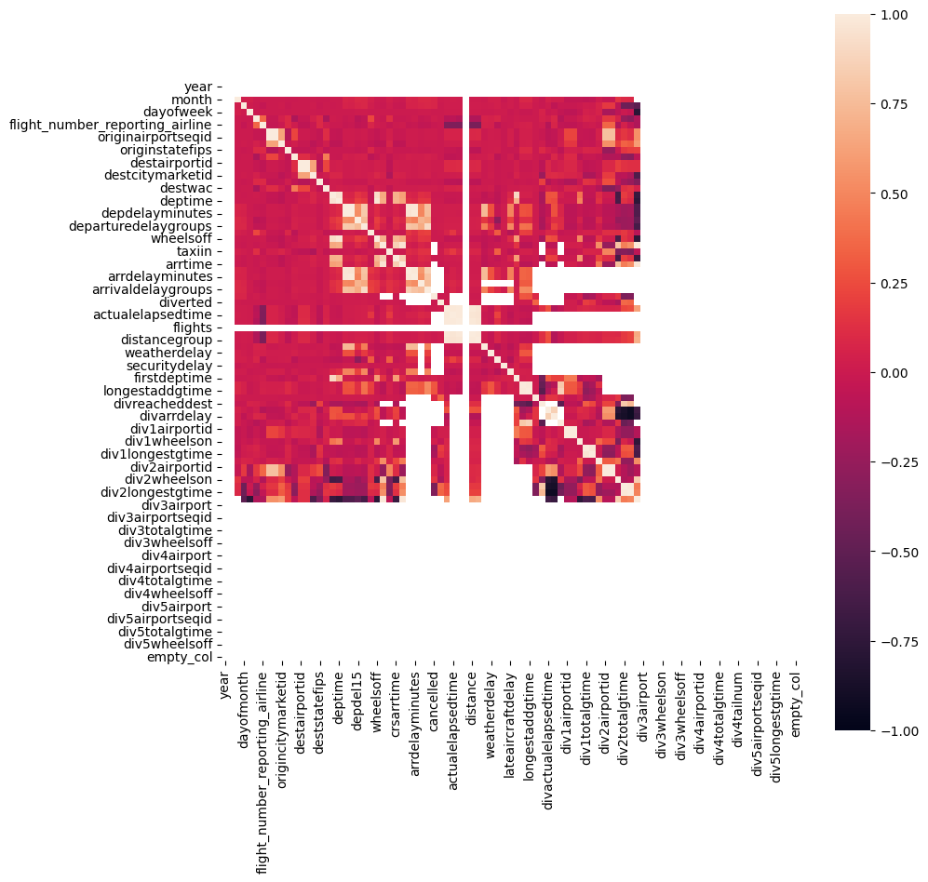
Data exploration and Correlation
2
Fig1: Correlation plot of the dataset
Notes:
As you can clearly see from this plot, there are a lot of missing values especially in the features towards the end.
Some features have high correlation and prove multi-collinearity
In order to have a better analysis, I transformed this into a light dataset containing 30 features.

Slide 9
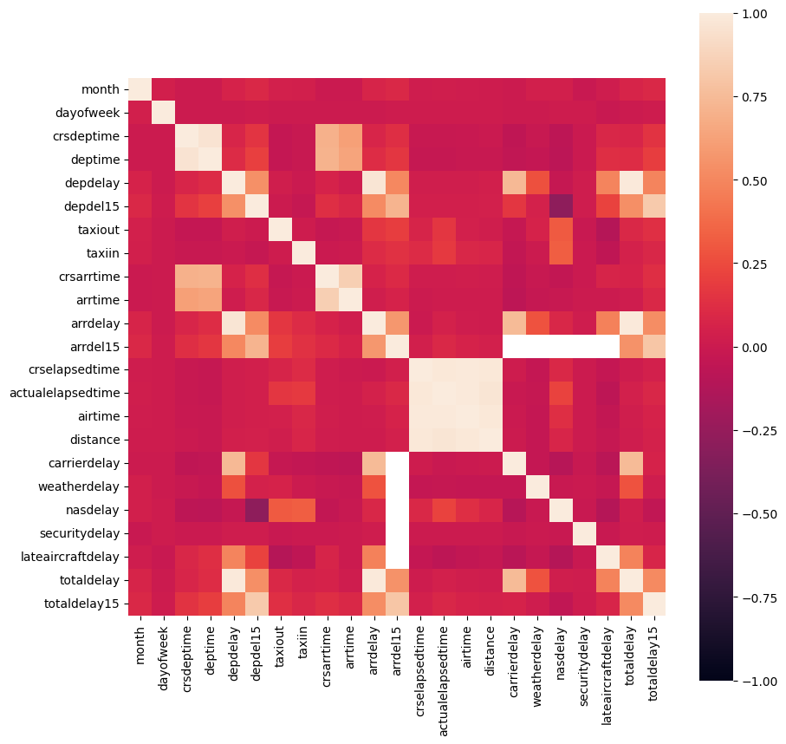
Data exploration and Correlation
2
A simplified version!
Key inferences
Strong Correlation between departing time and arrival time, arrival delays and departure delays.
Correlation between departing time and delays(useful in predicting future delays)
Fig2: Correlation plot of selected features
Notes:
Plot of a revised heatmap with 30 features.
Strong correlation between delays and scheduled departure and arrival times
This helps in building predictive models capable of predicting delays given a scheduled departure/arrival time (using decision trees/random forests)

Slide 10
Handling Missing Values and Performing Sanity Checks
3
Read CSV as Data Frame
1 million data points and 110 fields
Examining descriptions of each field
Plotting a Heat map to Identify Correlations
All data points, including arrival delays, departure delays, and arrival/departure times, were rational
Furthermore, all airport codes had unique airport IDs issued by the US DOT, indicating no reuse during this analysis period.
Missing Arrival Time Data for Cancellations and Diversions
Handling Missing Values: Remove or Impute?
Sanity Checks
Are the values rationale?
Notes:
Next, I checked if all the values taken for analysis were rationale. By this I mean to check if there were no negative values for departure and arrival times, distance, air time and other relevant factors.
An essential sanity check that I conducted involved verifying the uniqueness and complementarity of the Origin Airport ID (issued by the US DOT to uniquely identify airports) and the Origin Airport Code. This step ensures the reliability and consistency of the data, allowing us to confidently use these identifiers in our analysis.
Similar was the case for Destination and airlinecodes.

Slide 11
Handling Missing Values and Performing Sanity Checks
3
Read CSV as Data Frame
1 million data points and 110 fields
Examining descriptions of each field
Plotting a Heat map to Identify Correlations
Missing Arrival Time Data for Cancellations and Diversions
Handling Missing Values: Remove or Impute?
Sanity Checks
Are the values rationale?
Notes:
Addressing missing values is indeed a critical aspect of any analysis. While checking for missing values, a significant number of arrival times had missing values which had to be imputed or removed.

Slide 12
Handling Missing Values and Performing Sanity Checks
3
POTENTIAL
DATA LOSS !
Approx. 20,000 data points to be removed or imputed?
Notes:
But, if we address NA's now, it could potentially lead to loss of important data points of over 20,000 data points. Let's instead try to see if there is a rational explanation for some of these, i.e. if a flight is cancelled, it would logically follow that certain data points related to delays might not be applicable or available.

Slide 13
Handling Missing Values and Performing Sanity Checks
3
Read CSV as Data Frame
1 million data points and 110 fields
Examining descriptions of each field
Plotting a Heat map: Identifying Correlations
Missing Arrival Time Data for Cancellations and Diversions
Handling Missing Values:
Remove or Impute?
Sanity Checks:
Are the values rationale?

Slide 14
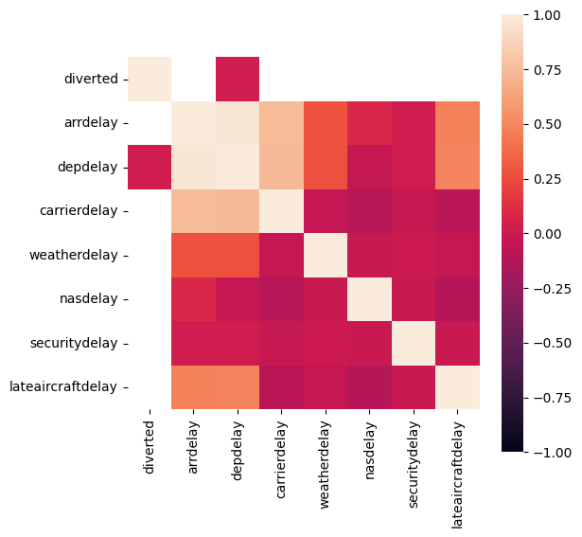

Handling Missing Values and Performing Sanity Checks
3
Fig3: Correlation plot of diverted vs delay
Fig4: Correlation plot of cancelled vs delayed
No correlation between cancelled, diverted and delayed fields inferred
Notes:
To explore this further, I generated a heatmap to investigate the relationship between diverted flights, canceled flights, and delays. As suspected, the heatmap confirmed that if a flight is canceled, there are no delay entries, leading to the observation that delay entries are synonymous with missing data (NA) in these cases. Consequently, the logical approach is to focus on selecting and analyzing the data for flights that were neither canceled nor diverted, ensuring that our analysis is based on meaningful and complete information.

Slide 15
Handling Missing Values and Performing Sanity Checks
3
Missing delay data
=
NULL
Removing data points of cancelled and diverted flights

Slide 16
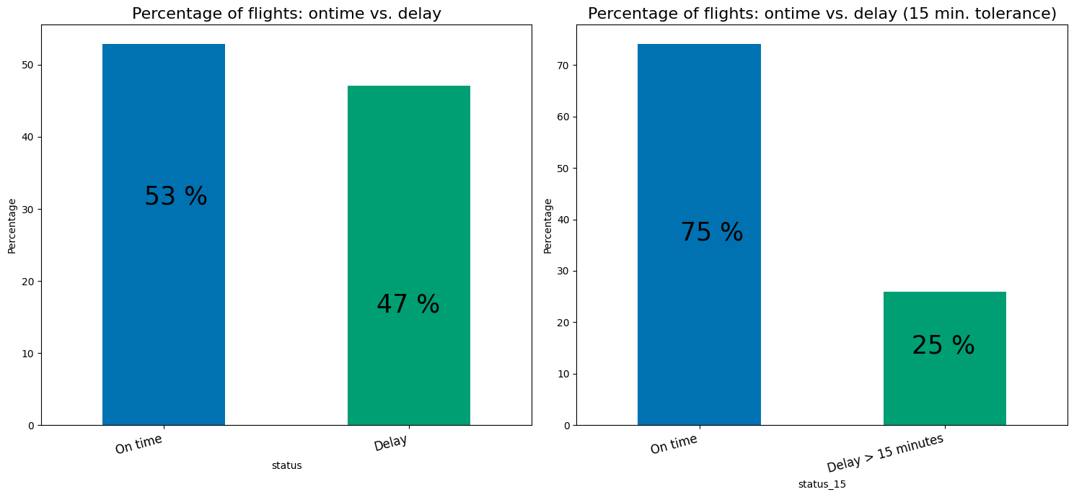
Analysis and Visualisations – On time vs delayed flights
4
22 %
Fig5: On-time vs Delay percentage plot
Fig6: On-time vs Delay(15 minute threshold) percentage plot
Notes:
let's dive into our initial analysis, focusing on the pivotal aspect of on-time versus delayed flights. Brace yourselves for a staggering revelation: a whopping 47% of the flights are marked as delayed in our preliminary assessment. But let's inject a dose of rationality and practicality into the equation.
Upon closer inspection, I realized that a mere delay of 1-2 minutes might not be a cause for concern for passengers. Consequently, I propose a modification to the analysis by introducing a 15-minute delay tolerance. This adjustment significantly refines our perspective, revealing that only 1 in 4 flights experiences a delay when considering this extended threshold. Now, that's a noteworthy shift in our understanding of the delay dynamics.

Slide 17
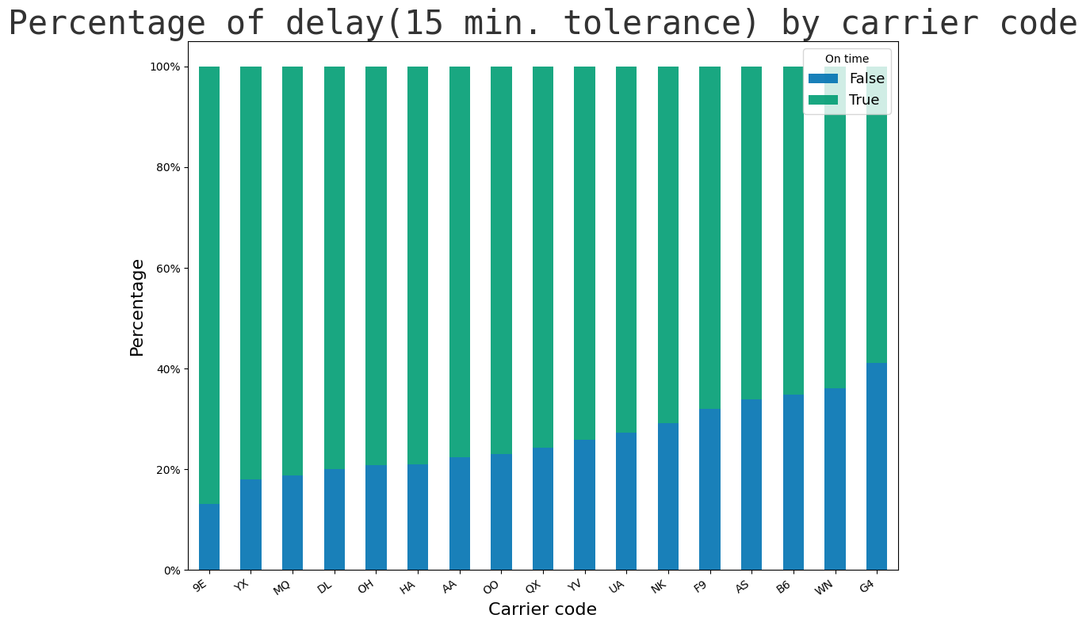
Analysis and Visualisations – Flight delays by carrier
4
Allegiant airlines has the lowest on-time percentage of 61 %
Pinnacle airlines has the highest on-time percentage of 86 %
Fig7: Delay percentage by carrier codes
Flight Codes
Notes:
In my quest to identify the punctuality champions and those lagging behind, I turned my attention to individual airlines. Allegiant Airlines emerges with the lowest on-time percentage, clocking in at 61%, while on the other end of the spectrum, Pinnacle Airlines takes the lead with an impressive 86% on-time performance. It's crucial to note that these findings are based on the analysis, considering a 15-minute delay tolerance. This insight provides valuable context to decide upon the reliability of different carriers within this specific timeframe.

Slide 18
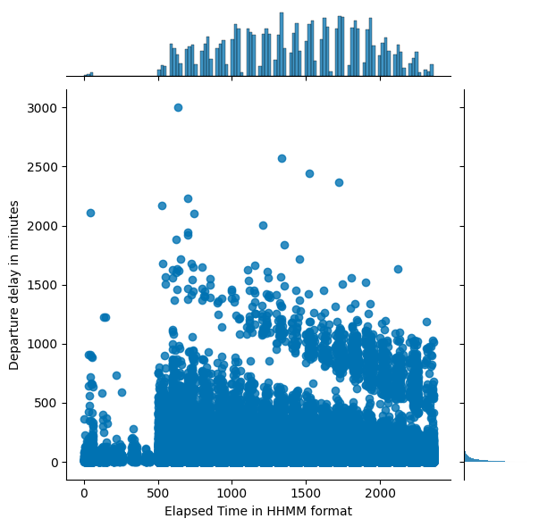
Analysis and Visualisations – Cascading effects of delay
4
Key Takeaways
Flight traffic sees a sharp rise from 5 AM in morning
As the day progresses there are more delays.
Delays are focussed on hourly manner – this can be due to how departures are scheduled
Data points are split into two groups. One possible explanation is that as the day progress, flights with shorter delays increases and cascade the effects on upcoming flights.
This eventually splits into flights with longer and shorter delays
Fig8: Scheduled departure time vs Total delay plot
Notes:
Let's talk about how delays in flights seem to have a domino effect. Picture this: from 5 AM onward, we see more and more flights running late. As the day goes on, the delays start piling up, and here's where it gets interesting.
If we zoom in on the timing of delays, it looks like they're happening in a kind of hourly rhythm. Why? Well, it seems linked to how flights are scheduled throughout the day. Now, when we break down the data, we notice two main groups of flights. One theory is that as the day rolls on, the flights with shorter delays become a sort of trigger, setting off a chain reaction that affects the next flights in line.
This whole thing eventually splits into two categories: flights with longer delays and those with shorter ones. So, in a nutshell, the time of day and the length of delays are playing a tag team, shaking up our flight schedules in more ways than one

Slide 19
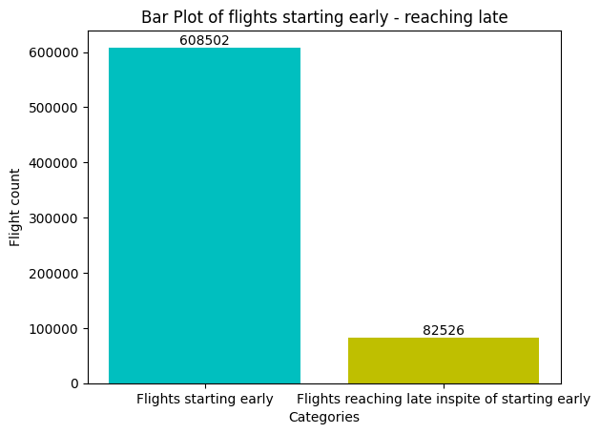

Analysis and Visualisations – Early Departures
4
13% late arrivals
2% arrive more than 15 minutes late – 1700 flights
What could be the reason
Fig9: Flight count vs types of flight plot
Notes:
Now, let's explore a fascinating angle in the analysis: the perks of starting flights early. The numbers are quite eye-opening. Surprisingly, 13% of flights that took off early still ended up arriving late. out of this, 2% faced delays of more than 15 minutes. That’s a whopping 1700 flights in just two months fell into this category.
Naturally, the question arises: why on earth is this happening? What's causing these early birds to miss their on-time targets?

Slide 20
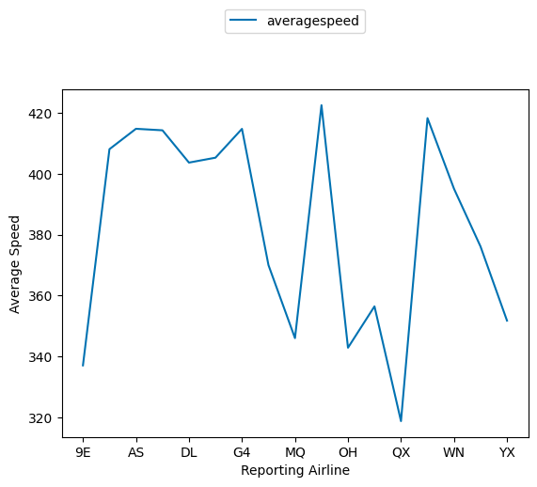
Analysis and Visualisations - Speed
4
Flights are moving at an unusually slow pace.
The average flying speed of US domestic flights is between 550 and 600 miles per hour.
Reasoning's can be:
Altitudes and speeds controlled by ATC
Quality of Flights
Holding patterns
Fig10: Speed vs Airline
Flight Codes
Notes:
As you might have guessed. Speed it is. These flights are cruising at an unexpectedly sluggish pace. Now, consider this: the typical flying speed for US domestic flights is between 550 to 600 miles per hour.
But why the slowdown? Let's toss around a few ideas:
First up, we've got the air traffic controllers (ATC) pulling the strings on altitudes and speeds. They might be throwing in some curveballs that affect the flight speed.
Then there's the quality of the flights themselves. Are we dealing with some old flights here? It's worth investigating if the aircraft conditions are contributing to this leisurely pace.
And let's not forget those holding patterns. Are flights circling around up there, burning precious time in the sky?
So, in a nutshell, the need for speed is real, and it seems like we've got a few potential culprits slowing things down.

Slide 21
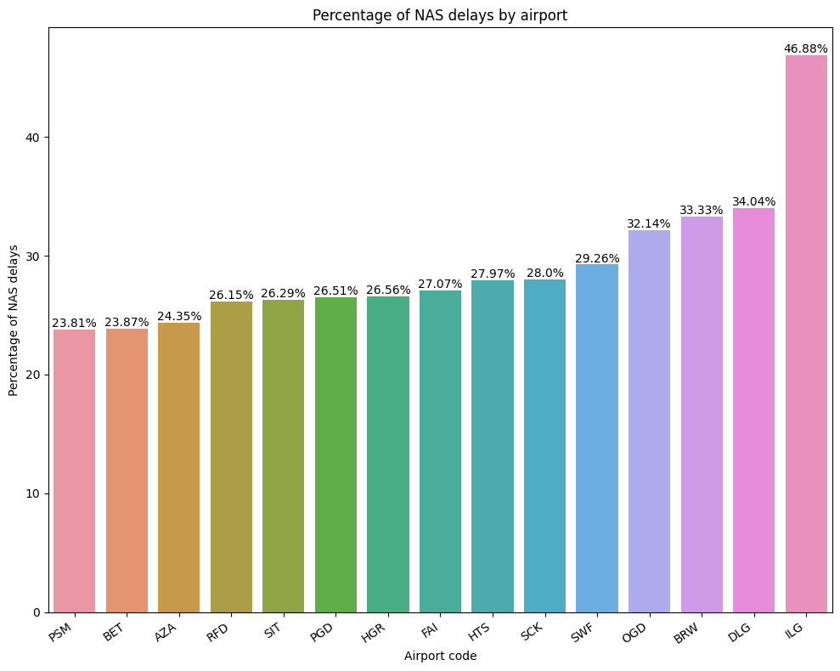
Analysis and Visualisations – National Airspace System delays
4
Wilmington Airport has the highest NAS delay.
NAS delays are mainly due to limited airport infrastructures, air traffic control staffing's, system capacity and congestions
Fig12: NAS delay percentage for top 10 airports

Slide 22
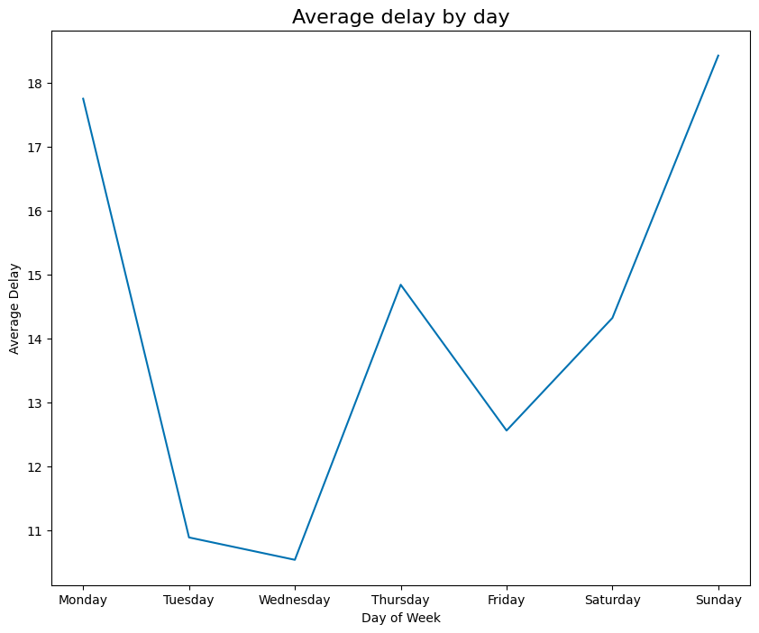
Analysis and Visualisations – Best days to travel in a week
4
People use air travels more during Sundays & Mondays. People usually return back after weekend getaways on Sundays.
Monday is a common day for business commuters to fly out to their work locations
Saturdays tend to be relatively less busy for flights in the US:
To make most of the weekend, people usually travel out on Thursdays or Fridays.
Hence, it is a good day for travelers to avoid crowd
Fig13: Average delay per weekdays
Notes:
Let's crack into finding the best days to fly in a week. Sundays are usually busy as they are prime for those returning from weekend getaways, and Mondays are the go-to for business commuters jetting off to their work destinations. If you want to reach on time Tuesday, Wednesdays and Saturday is your golden ticket. It tends to be a tad less bustling in the US airspace as most of the savvy travelers gear up and head to weekend getaways on Thursdays and Fridays. As a result, Saturdays tend to be less occupied, and airline operators may choose to bring in more offers or discounts to boost sales on this particular day.

Slide 23
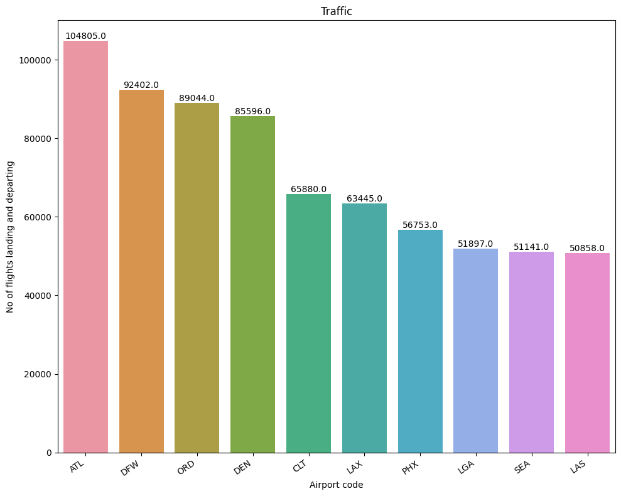
Analysis and Visualisations – Busiest Airport in USA
4
Hartsfield-Jackson Atlanta International Airport is the busiest airport in the United States :
Central locality of Atlanta facilitates connection flights
Hub of the 3rd largest airline carrier (Delta Airlines) in the US
Fig14: Busiest airport in the US
* Graph includes both arrival and departures
Notes:
Hartsfield-Jackson Atlanta International Airport takes the crown as the busiest airport in the whole United States with more than 100,000 flights departing and landing in 2 months. Why? Well, first off, it's in the middle of Atlanta, making it a prime spot for connecting flights.
And it's like the headquarters for the third-biggest airline in the US—Delta Airlines. So, picture this airport as a buzzing hub, with flights coming and going, connecting people all west and the east coast. If you're thinking about catching a flight, chances are, Hartsfield-Jackson is in the mix. It's the heart of the action!

Slide 24
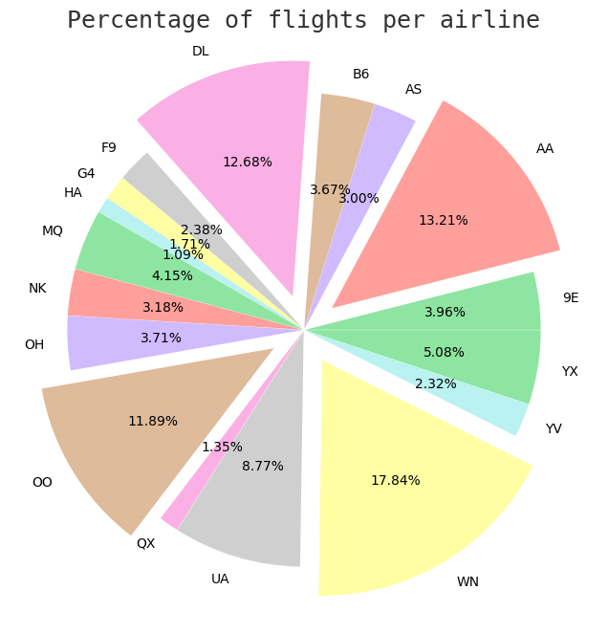
Analysis and Visualisations - Airlines' Flight Operations: By the Numbers
4
Southwest Airlines and American Airlines are among the biggest airlines in the United States.
Fig15: Flight count per airline pi chart
Notes:
Check out this pie chart breaking down the numbers on airline flight operations in the United States. Now, the big shot in the game? Southwest Airlines take the lead, claiming about 18% of the market.
Followed by American Airlines, Delta Airlines and Skywest Airlines with 13%, 12.6% and 11.8%, respectively playing in the big leagues too.

Slide 25
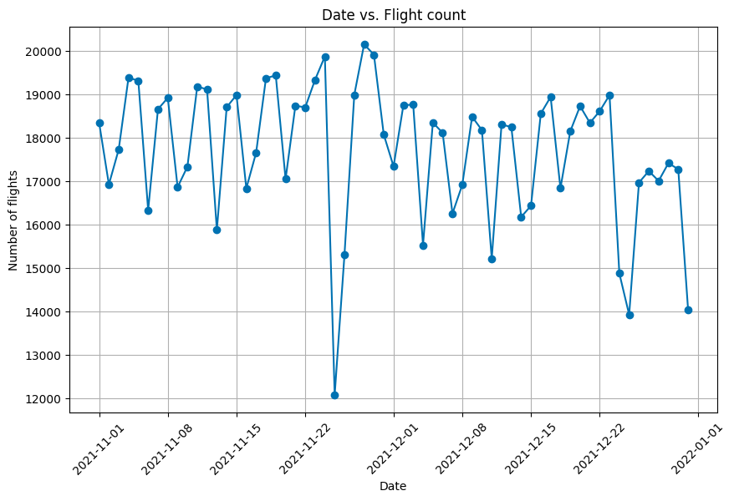
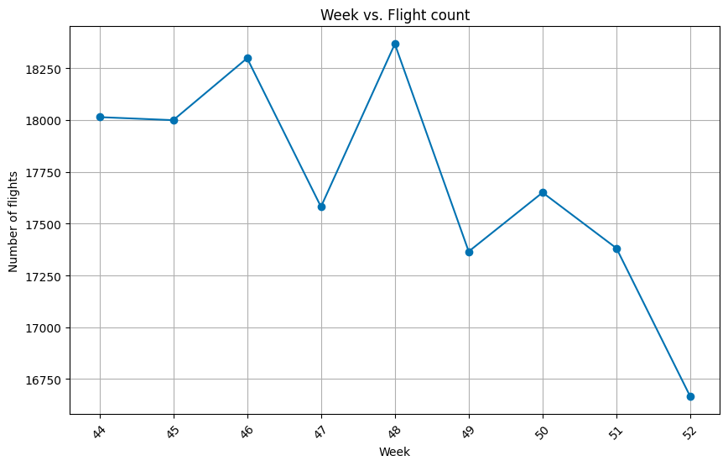
Analysis and Visualisations - Tracking Flight Trends During Christmas and New Year Weeks
4
Flights are less busier during Christmas and new year weeks as people prefer to stay and celebrate at home.
However there is a huge spike in flight numbers just before the Christmas week
Fig16: Daily distribution of flight count - two months
Fig17: Weekly distribution of flight count
Notes:
Let's dive into the flight trends during the Christmas and New Year weeks. When it comes to these festive weeks, the skies tend to be quieter. Why? Well, it seems people prefer to cozy up at home for the celebrations.
But, there's a plot twist. Right before the Christmas week hits, there's a sudden surge in flight numbers. Maybe it's last-minute gift shopping or people wanting to land at their holiday destinations just in time for the festivities.
So, a calm and quiet Christmas week in the air, but a bit of a sky traffic jam as everyone tries to catch those special occasions.

Slide 26
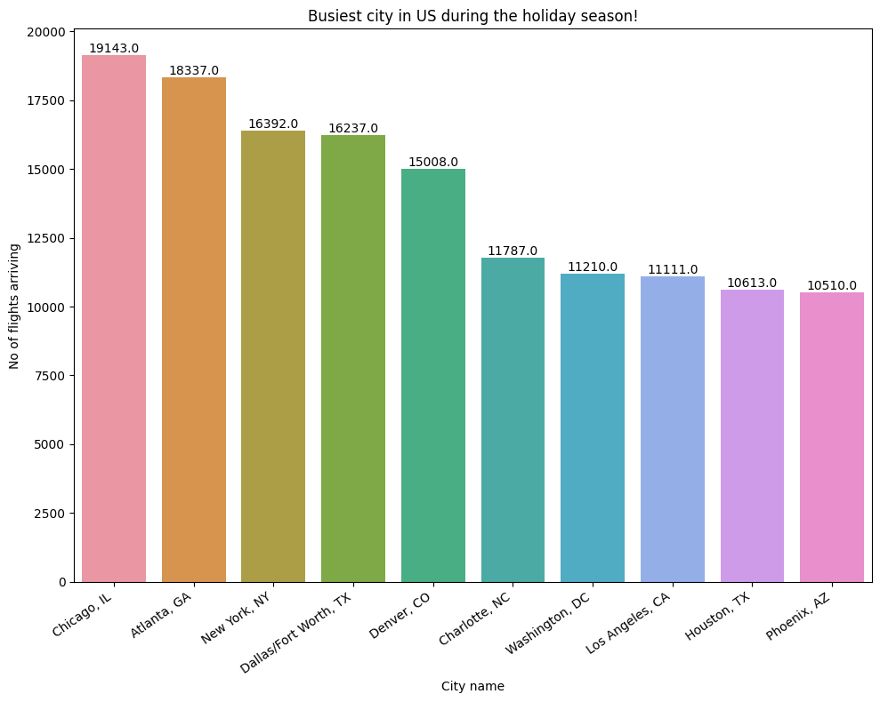
Analysis and Visualisations – Busiest city during Christmas and New Year Weeks
4
Chicago is the busiest airport having O’Hare – one of the largest connecting hub for holiday destinations
Family reunions and holiday shopping's
Fig18: Busiest cities during Xmas and new year weeks
Notes:
During these festive seasons, Chicago is the real hustle – having one of the busiest airport O’Hare with more than 20,000 flights arriving in couple of weeks. Well, it's not just business travelers passing through; it's all about family reunions and holiday shopping sprees. O'Hare becomes this vibrant crossroads where families come together, and people jet off to buy those perfect holiday gifts.

Slide 27
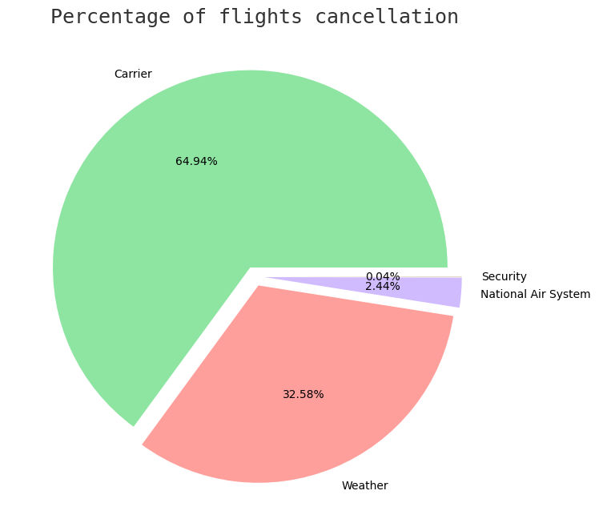
Analysis and Visualisations - Cancellations
4
Regular maintenance and inspections can reduce cancellations
Additional performance data could help in scheduling inspections hence reducing carrier cancellations
Utilizing weather data can aid in forecasting potential disruptions and suggesting intelligent rescheduling options to prevent such disruptions.
Fig14: Busiest airport in the US
Notes:
Check out this graph giving us the statistics of flight cancellations in the US for November and December. A staggering 65% of the total 17,000 i.e. almost 10,000 flights hit the cancellation button, and guess who’s responsible? The carriers take the lead, accounting for the majority.
Regular maintenance and inspections can be the superheroes here, helping in to reduce cancellations. It's like giving the planes a regular check-up, keeping them always in ready for action.
But that's not all. Imagine this: If we could gather performance data, we could schedule those inspections strategically, cutting down on carrier cancellations.
And by harnessing weather data, we can forecast disruptions and be smart about rescheduling, preventing those cancellations before they even happen.

Slide 28




Additional data sources to be considered for deeper analysis…..
4
Access to carbon emission data for each flight can provide valuable insights into the overall carbon footprint of air travel
Access to weather dataset could provide less disruption routes and reduce delays.
Access to flight performance dataset could schedule maintenance and inspections.
A dataset containing flight capacity and seat information could unlock new possibilities for analysis: Optimizing load factors, trends in seating preferences, improving efficiency
Access to flight rates information : pricing strategies, market trends, competitive benchmarking
Access to a dataset that includes carrier codes, airport codes and their corresponding names would be useful in easier data tracking and interpretations
Notes:
Expanding the dataset for a deeper analysis can unlock a treasure trove of insights. Here are some additional data sources to consider:
Carbon Emission Data:
Having access to carbon emission data for each flight can provide valuable insights into the environmental impact of air travel. It helps in understanding and mitigating the carbon footprint associated with different routes and airlines.
Weather Dataset:
Incorporating a comprehensive weather dataset can be a game-changer. It enables the identification of less-disrupted flight routes, leading to reduced delays and a smoother overall travel experience for passengers.
Flight Performance Dataset:
Access to flight performance data is crucial for scheduling maintenance and inspections. This dataset can offer insights into the health and efficiency of aircraft, ensuring they are in optimal condition for every flight.
Flight Capacity and Seat Information:
A dataset containing flight capacity and seat information opens up new possibilities. It allows for optimizing load factors, understanding trends in seating preferences, and ultimately improving the efficiency of each flight.
Flight Rates Information:
Including flight rates information provides a holistic view of the business side of air travel. This dataset can offer insights into pricing strategies, market trends, and competitive benchmarking, aiding airlines in making informed decisions.
By integrating these diverse datasets, the analysis becomes more comprehensive and insightful, addressing environmental concerns, operational efficiency, customer preferences, and business strategies in the aviation industry.

Slide 29
Sustainability vs Profit Analysis – Top 4 Airlines
4
Airline Carriers | Net Carbon Emissions per flight(Kg)
Alaska Airlines | 1.7 million
United Airlines | 1.42 million
Jet Blue Airlines | 1.4 million
Spirit Airlines | 1.25 million
Profitability
A
B
C
D
VS
Net emissions are calculated by taking the product of average airtime, average passenger count of flight, average emission per passenger per hour
A profitability vs emissions correlation can be plotted and flights that have low profitability and high emissions can be cut down
Assuming that on an average 100 passengers travel in a flight and the net emissions are around 90 kg C02 per person
Notes:
Conducting a sustainability vs. profit analysis based on net emissions can be a strategic move for airlines. Here's how it might unfold:
Net Emissions Calculation:
Net emissions can be calculated by multiplying the average airtime of flights by the average passenger count and the emission rate per passenger per hour. For instance, if 100 passengers travel for an average of 2 hours, with an emission rate of 90 kg CO2 per person per hour, the net emissions per flight would be 100 * 2 * 90 = 18,000 kg CO2.
Identifying High Emission Airlines:
Using this calculation, i've identified that Alaska Airlines, for example, produces the highest net carbon emissions during these months, reaching 1.7 million kg. This information is crucial for understanding the environmental impact of each airline.
Profitability vs. Emissions Correlation:
Plotting a correlation between profitability and emissions allows for a visual representation of how these factors align or diverge. Flights with low profitability and high emissions become focal points for potential adjustments.
Strategic Decision-Making:
Armed with this correlation, airlines can make strategic decisions. Flights that fall into the quadrant of low profitability and high emissions may be candidates for optimization, rerouting, or even considering alternative transportation modes.
Environmental Impact Reduction:
By cutting down flights that are both less profitable and environmentally impactful, airlines can actively contribute to reducing their overall carbon footprint, aligning with sustainability goals and potentially enhancing their reputation in an environmentally conscious market.

Slide 30


Summary – Key Takeaways
5
One in four domestic flights in the US are delayed
Pinnacle Airlines boasts the highest level of punctuality among all airlines
Delays cascade as the day progresses
Flights may experience delays due to reduced speed resulting from the impact of older engines
Airline carriers can introduce special offers and discounts to boost flight demand on
Central locations of Atlanta and Chicago contribute to their status as two of the busiest airports
Sustainability vs Profitability
Notes:
let's break down the key takeaways:
One in Four Flights Delayed:
A notable statistic reveals that one in four domestic flights in the United States faces delays. This highlights a substantial impact on the timeliness of air travel within the country.
Pinnacle Airlines Leads in Punctuality:
Pinnacle Airlines stands out with the highest level of punctuality among all airlines. This accomplishment sets them apart in terms of reliability and timely service.
Progressive Delays Throughout the Day:
Delays exhibit a cascading effect as the day progresses. This pattern emphasizes the importance of understanding and addressing the temporal dynamics of flight delays.
Impact of Reduced Speed on Delays:
Delays may be influenced by reduced flight speed, potentially attributed to the impact of older engines. This insight suggests a need for evaluating and updating aircraft technology.
Incentivizing Flight Demand:
Airlines can consider introducing special offers and discounts to stimulate flight demand during specific periods. This strategy may help balance load factors and enhance overall operational efficiency.
Busy Hubs in Atlanta and Chicago:
The central locations of Atlanta and Chicago contribute to their status as two of the busiest airports. These hubs play a crucial role in connecting flights and accommodating high passenger volumes.
Sustainability vs Profitability:
The correlation of sustainability and profitability emerges as a critical consideration. Balancing environmental impact with financial success becomes a key challenge for the aviation industry.

Slide 31
Thank You

Slide 32
Appendix – Flight Codes
IATA Carrier Code | ICAO Carrier Code | Carrier Name
HP | AWE | America West Airlines
MQ | EGF | American Eagle
NW | NWA | Northwest Airlines
OH | COM | Comair
OO | SKW | SkyWest Airlines
RU | BTA | ExpressJet Airlines
TZ | AMT | ATA Airlines
UA | UAL | United Airlines
US | USA | US Airways
WN | SWA | Southwest Airlines
XE | BTA | ExpressJet Airlines
YV | ASH | Mesa Airlines
IATA Carrier Code | ICAO Carrier Code | Carrier Name
9E | FLG | Pinnacle Airlines
AA | AAL | American Airlines
AQ | AAH | Aloha
AS | ASA | Alaska Airlines
B6 | JBU | JetBlue Airways
CO | COA | Continental Airlines
DH | BLR | Atlantic Coast Airlines
DL | DAL | Delta Air Lines
EV | CAA | Atlantic Southeast Airlines
F9 | FFT | Frontier
FL | TRS | AirTran Airways
HA | HAL | Hawaiian Airlines

Slide 33
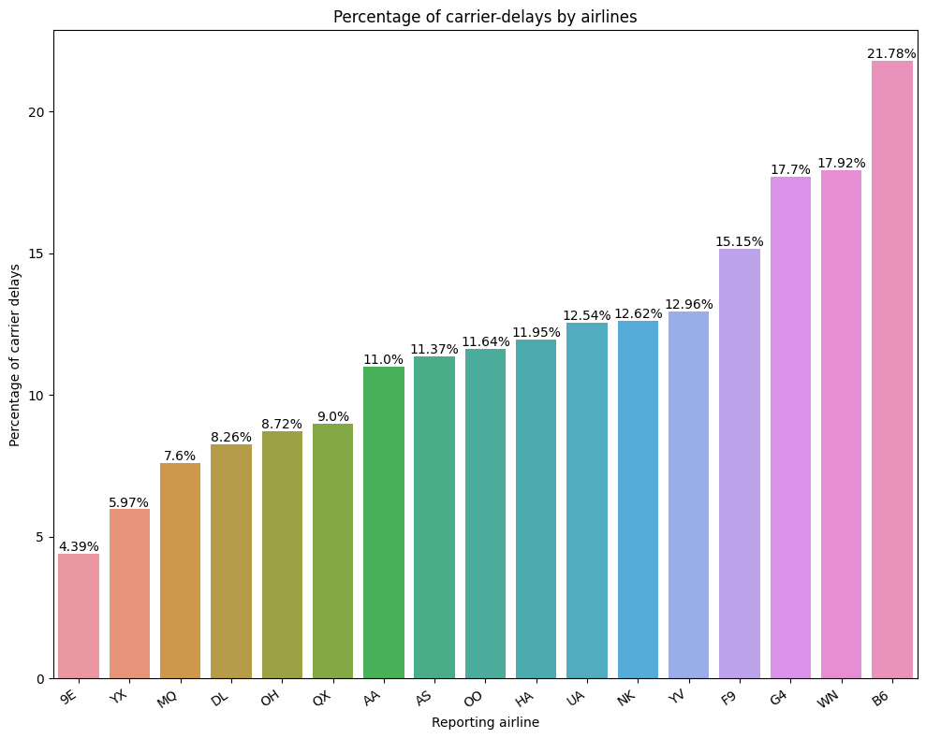
Analysis and Visualisations – Carrier delays
4
Jet Blue Airlines has the highest Carrier delay.
Carrier delays are mainly due to aircraft maintenance, crew scheduling and availability and other technical issues
Fig11: Carrier delay percentage per airline plot
Flight Codes

