Slide 1
$ helm create mychart
$ helm package --sign --key 'key' --keyring path/to/keyring.secret mychart
$ helm verify mychart-0.1.0.tgz
$ helm install --verify mychart-0.1.0.tgz

Slide 2
-----BEGIN PGP SIGNED MESSAGE-----
name: nginx
description: The nginx web server as a replication controller and service pair. version: 0.5.1
keywords:
https
http
web server
proxy source:
- https://github.com/foo/bar home: http://nginx.com
...
files:
nginx-0.5.1.tgz: “sha256:9f5270f50fc842cfcb717f817e95178f”
-----BEGIN PGP SIGNATURE-----
Version: GnuPG v1.4.9 (GNU/Linux)
iEYEARECAAYFAkjilUEACgQkB01zfu119ZnHuQCdGCcg2YxF3XFscJLS4lzHlvte WkQAmQGHuuoLEJuKhRNo+Wy7mhE7u1YG
=eifq
-----END PGP SIGNATURE-----

Slide 3
$ helm verify topchart-0.1.0.tgz
Error: sha256 sum does not match for topchart-0.1.0.tgz: "sha256:1939fbf7c10 23d2f6b865d137bbb600e0c42061c3235528b1e8c82f4450c12a7" != "sha256:5a391a90de 56778dd3274e47d789a2c84e0e106e1a37ef8cfa51fd60ac9e623a"

Slide 4

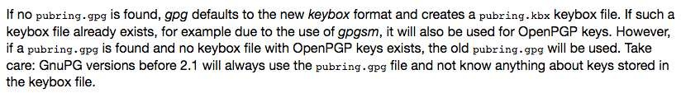
https://gnupg.org/faq/whats-new-in-2.1.html

Slide 5
$ gpg --export-secret-keys >~/.gnupg/secring.gpg
$ helm package --sign --key 'key' --keyring ~/.gnupg/secring.gpg mychart
$ gpg --export >~/.gnupg/pubring.pgp
$ helm verify mychart-0.1.0.tgz --keyring ~/.gnupg/pubring.pgp

Slide 6
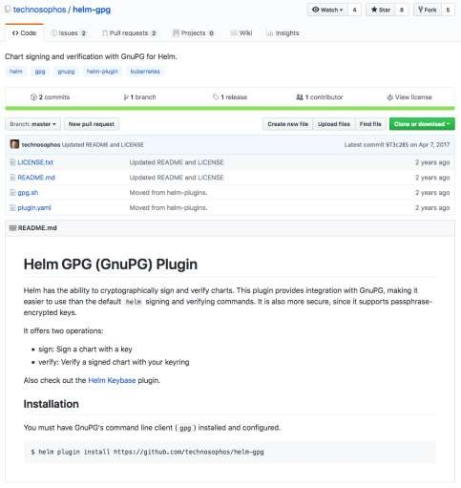
Sorry, no windows as it requires shell

Slide 7
$ helm package mychart
$ helm create mychart
$ helm gpg sign mychart-0.1.0.tgz
$ helm gpg verify mychart-0.1.0.tgz
$ helm install --verify mychart-0.1.0.tgz
CI NOT using smart card for key can still use previous methods

Slide 8
-----BEGIN PGP SIGNED MESSAGE----- Hash: SHA512
apiVersion: v1 appVersion: "1.0"
description: A Helm chart for Kubernetes
name: mychart version: 0.1.0
...
files:
mychart-0.1.0.tgz: sha256:352c6fa9f974983a5c1455059c82913c4da2b8de7e7c9211e3bd38330cf8fb0f
-----BEGIN PGP SIGNATURE-----
iQIzBAEBCgAdFiEEcR8o1RDh4Ly9X2v+lDboC/ukaQkFAlvOGJ4ACgkQlDboC/uk aQmcDA/+InIc/ybA472MxhY7pOU5AILyjFJnTC6Ky7YKMdWP9Ig+GFk/THKd5VJo bCwpUgtrXs1+nnNuiRN/53wd/ocYXQry/mAN7yZJDaKhqTX2Y2nRz7JHJKwDIwt3 i/herOby+l0h54kYaUyyCGpZidCJhTe79YvvFP9nLbfa5UGhL+rbAMSCV0D3fIwG FU01VPUsoOaiHvdE7snFLX2gdyvkgsFXhj4I6fT66EBaxL4zGS/1IidyfGZZ1N2Z 5MfXWBWfdJ2xcamR/6f32HckXq9yRGZHvT7VYobiwVptRvpkS3CTMMr9cwXAbj53 1L6INbQ+xlh121elzEBC1f91pf8BCgTnWXarfuMek0U/T0L1GBSUUL9aau1B7Cic 9Ql10EGZEm9erT/w4vRcVSGWdIqj1ks66mOv4Nz1CvC+AaMPUNxFlfwYT5B1iiB2
+8rzq0h3ZIER7/GNevG/G1r9O9DBBcEkx5MMFL4asutUk+VWsOKkPOT8d5QaoGiW MnV+1l3nOW2k8BOi4SkMQYBKLnznrC+WqKqLIruzSulM132GW7UbjKnP/2LiOVMh FMCUbo7DGVis39xHicm4PUT0As9m/zO2UezDbEKm9Vw7kw6pPBl2hfokMPyXWjGO 6glgCAIoEarVH8jqsjALAWKVyybjslVctVH172/m4LoTMrw4yJk=
=+L4T
-----END PGP SIGNATURE-----

Slide 9
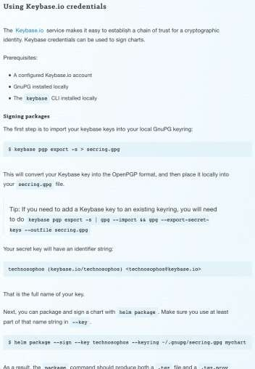

If you’re into that…

Slide 10
Semantic Versioning Example:
2.11.0
Increment for new features
Increment when API changes
Increment for bug fixes

Slide 11
Kubernetes
Helm v2
Tiller
Kubernetes
Helm v3

Slide 12
Tiller still stores data in cluster
Local Computer
Kubernetes
Tiller
Helm v2

Slide 13
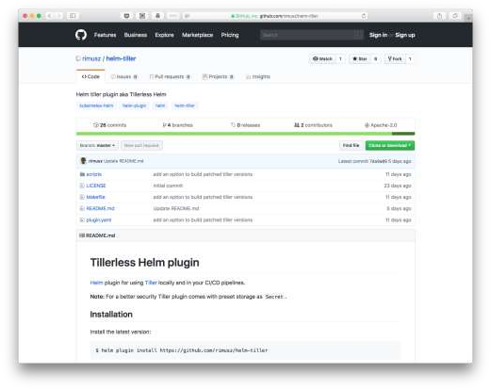

Slide 14

Helm v2 |  | State stored in ConfigMaps. Optionally setup to use Secrets.
 | Kubernetes
Helm v3 |  | State stored in Secrets and Custom Resources.
 | Kubernetes

Slide 15


Many Events
Access to data including:
These depend on the command being run and include: pre-create, post-create, pre-delete, pre-dependency-build,
post-dependency-build, pre-render, post-render, pre-install, pre-lint, pre-rollback, post-template…
… and many others
Chart data
Values
Capabilities
Files
Templates
Dependencies

Slide 16
A simple made up example:
function init(events) {
-- Initialize subcharts
subchart.init(events)
The Lua API is still under development
-- Do other stuff
events.on("pre-load", function () {
print("pre-load event")
})
}

Slide 17
Easy To Embed
Permission Scheme
The ext/permissions.yaml file:
Requirements:
Interpreter embedded in Helm
(Do not rely extra system software)
Cross platform Helm binaries (Windows, macOS, Linux)
Lua is a lightweight language designed primarily for embedded use in applications. Lua was designed for this!
lua:
network
io
The Helm CLI will ask for permission to use these libraries. Only permissible libs will be imported.

Slide 18
Library charts are noted in the library: directive in the requirements.yaml:
requirements:
name: apache version: 1.2.3
repository: http://example.com/charts
name: mysql version: 3.2.1
repository: http://another.example.com/charts libraries:
name: common
version: "^2.1.0"
repository: http://another.example.com/charts

Slide 19
title: Values type: object properties: name:
description: Service name type: string
protocol:
type: string port:
description: Port type: integer minimum: 0
image:
description: Container Image type: object
properties: repo:
type: string
tag:
type: string
required:
protocol
port
Example schema stored in a
values.schema.yaml file

Slide 20
apiVersion: v1 kind: Secret metadata:
name: {{ template "tensorflow-notebook.fullname" . }}
labels:
app: {{ template "tensorflow-notebook.name" . }} chart: {{ template "tensorflow-notebook.chart" . }} release: {{ .Release.Name }}
heritage: {{ .Release.Service }} annotations:
"helm.sh/hook": pre-install,pre-upgrade
type: Opaque data:
password: {{ .Values.jupyter.password | b64enc | quote }}
The pre-install and pre-upgrade hook are set

Slide 21
Normal Helm CLI model is a push
Computer outside Kubernetes
Kubernetes
Helm v3
Helm Controller Model (idea still in development)
Helm
Repository
Kubernetes
Helm v3 Controller

Slide 22
name: "last" version: "0.1.0"
usage: "get the last release name" description: "get the last release name"
command: "$HELM_BIN --host $TILLER_HOST list --short --max 1 --date -r" # New part:
platformCommand:
os: linux arch: i386
command: "$HELM_BIN list --short --max 1 --date -r"
os: windows arch: amd64
command: "$HELM_BIN list --short --max 1 --date -r"

Slide 23


Slide 24
helm init --plugins <file.yaml>
An Example Plugins file:
plugins:
name: helm-template
url: https://github.com/technosophos/helm-template
name: helm-value-store
url: https://github.com/skuid/helm-value-store
name: helm-diff
url: https://github.com/databus23/helm-diff

Slide 25
Run a local Helm repository
$ helm serve
Regenerating index. This may take a moment.
Now serving you on 127.0.0.1:8879

Slide 26

$ helm login https://repo.example.com
$ helm push mychart-0.1.0.tgz https://repo.example.com
The exact commands are still being worked out

Slide 27



{
"apiVersion": "v2", "entries": {
"artifactory": {
"ref": "https://kubernetes-charts-incubator.storage.googleapis.com/artifactory.json", "stable": {
"created": "2017-07-06T01:33:50.952Z",
"description": "Universal Repository Manager supporting all major packaging formats,\nbuild tools and CI servers.", "digest": "249e27501dbfe1bd93d4039b04440f0ff19c707ba720540f391b5aefa3571455",
"home": "https://www.jfrog.com/artifactory/",
"icon": "https://raw.githubusercontent.com/JFrogDev/artifactory-dcos/master/images/jfrog_med.png", "keywords": [
"artifactory", "jfrog"
],
"maintainers": [
{
"email": "[redacted]",
"name": "[redacted]"
}
],
"name": "artifactory", "sources": [
"https://bintray.com/jfrog/product/JFrog-Artifactory-Pro/view",
"https://github.com/JFrogDev"
],
"urls": [
"https://kubernetes-charts-incubator.storage.googleapis.com/artifactory-5.2.0.tgz"
],
"version": "5.2.0"
}
}
}
}
An example index.json file

Slide 28
Changes from v2:
No More Tiller
State Storage
Event Driven Architecture
Charts:
Extensions
Library Charts
Schemas for values files
Hook Annotations
Helm controller model
Plugins:
Handling Cross Platforms (like Windows)
Plugins in Lua
Easier installation
Repositories:
No more helm serve
Push to repositories
Performance improvements

