Slide 1

Internship Project Report
Domain: Data Science
Report by:
Narayanan.M
UNID: CRIN2301894

Slide 2
Project 1: Analyzing Amazon Sales data
Project Difficulties level : Advanced
Python link : https://colab.research.google.com/drive/1SqSROWNGsbvtdjFGAODqgryNtaiczVjc?usp=drive_link
Tableau Link: https://public.tableau.com/app/profile/narayanan.m4418/viz/AmazonSalesAnalysis_16894158077900/AmazonSalesDataAnalysis

Slide 3
Introduction
The biggest online retailer in the world and a well-known cloud service provider, amazon.
Sales, high performing sellers, and several other data indicators are all included in amazon sales statistics.
Around the world, there are millions of amazon sellers. The majority of them (47%) are self-employed and rely only on their amazon enterprises and e-commerce/retail firms for revenue.
The process of assessing customer behaviour, sales, and a number of other variables with the goal of improving decision-making via data is the subject of amazon sales data analysis.
It's essential to their ability to effectively maintain their operations and generate revenues, and they use several indicators to this end.

Slide 4
PROBLEM STATEMENT
Sales management has gained importance to meet increasing competition and the need for improved methods of distribution to reduce cost and to increase profits. Sales management today is the most important function in a commercial and business enterprise.
Analysis
As per the Problem statement, we have defined the several used cases to perform the analysis on which helps in not only understanding the meaningful relationships between attributes, but it also allows us to do our own research and come up with our findings.

Slide 5
Details of Data
Region
Country
Sales Channel
Order priority
Order Id
Ship date
Unit cost
Unit Price
Unit sold
Total Revenue
Total Cost
Total profit

Slide 6

Main KPI’s
Total no:of Region
Total no:of Countries
Total Order
Units Sold
Total Cost
Total profit
Total Revenue
KEY PERFORMANCE INDICATOR

Slide 7
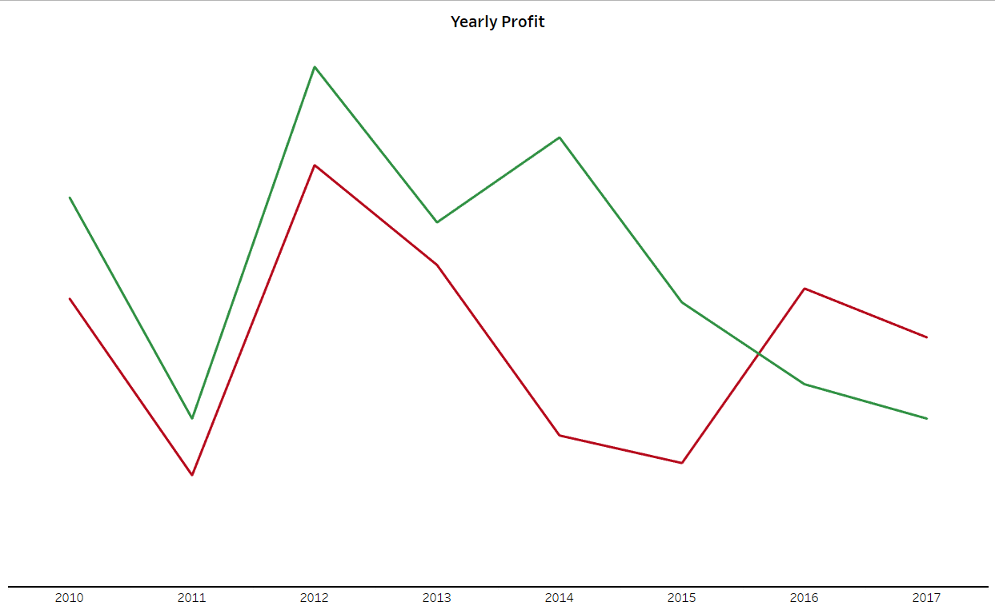

Visuals

Slide 8
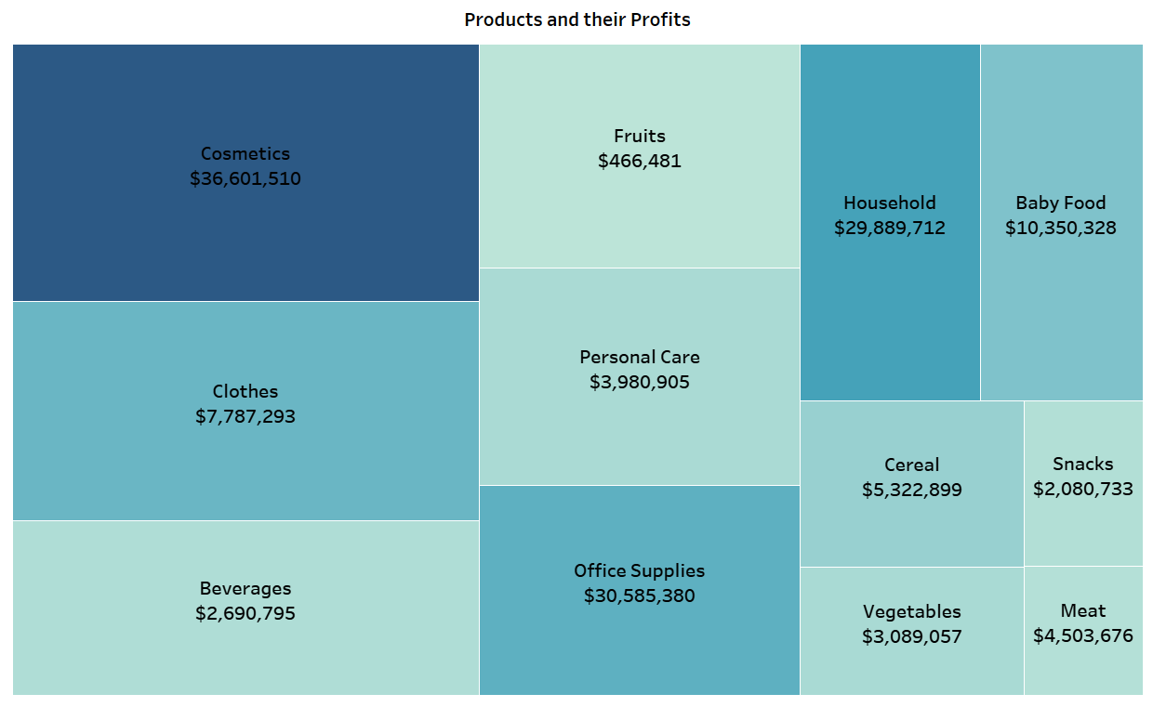


Slide 9
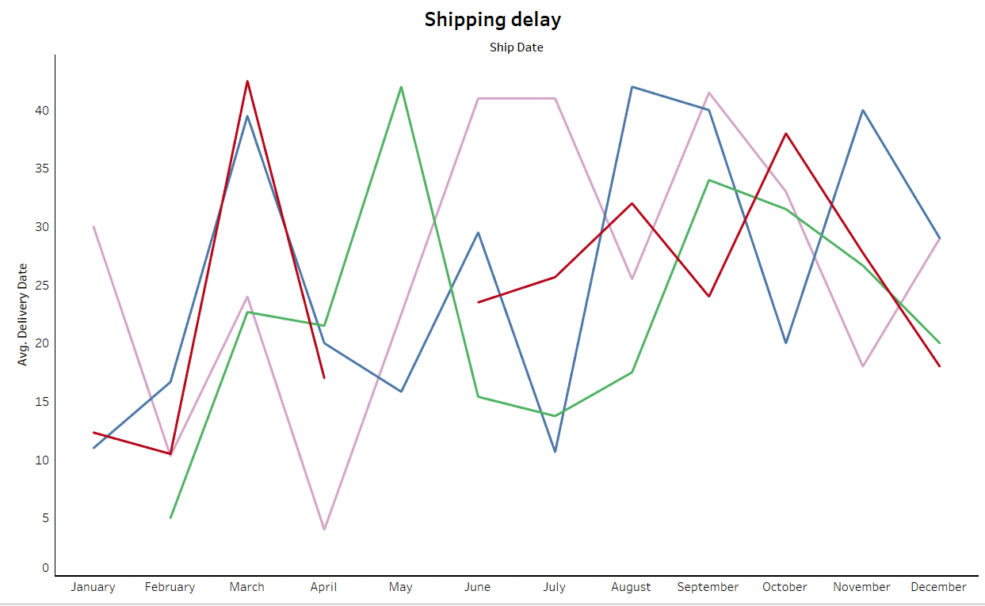
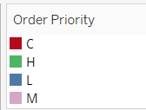

Slide 10
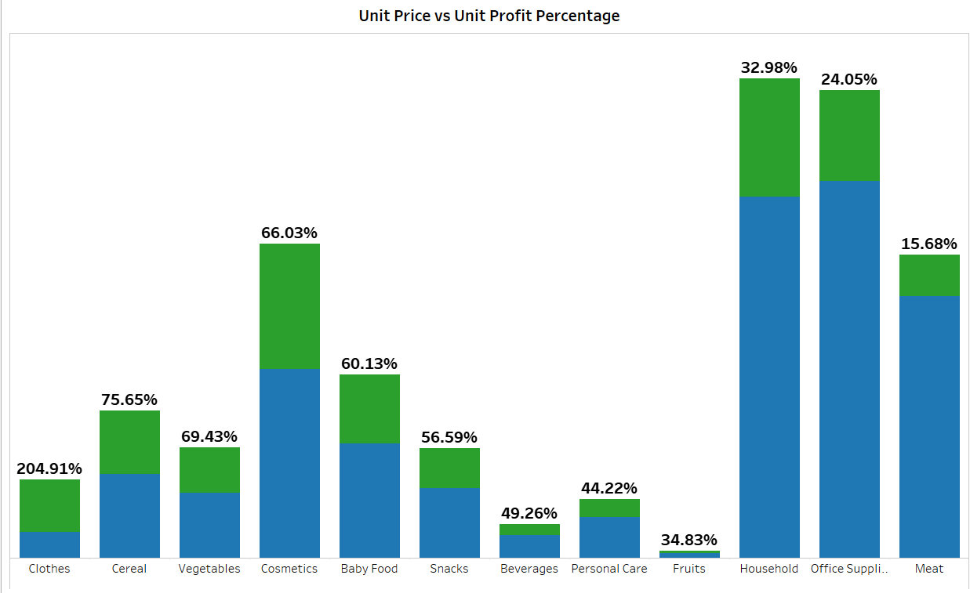


Slide 11
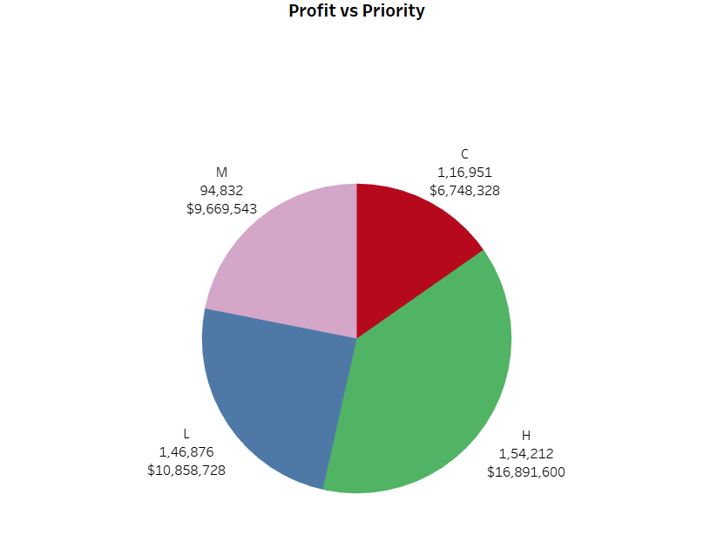
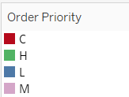

Slide 12
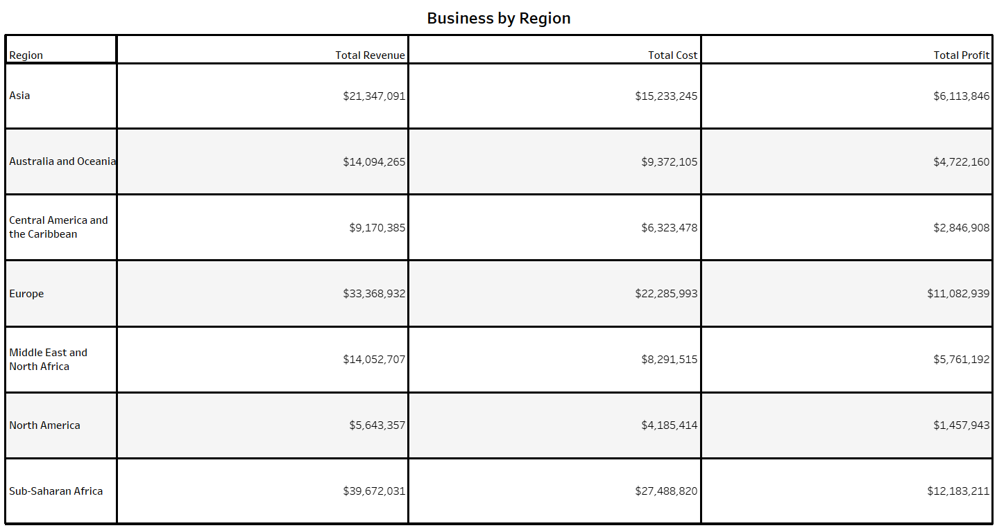

Slide 13
Insights
From Sales Trend analysis we note that the overall sales. have been decreasing and increasing.(Sales were observed especially low in the year 2016)
The Most High Selling & Profitable product types are:
Cosmetics----------- 36,601,510(in Dollars)
Office Supplies------ 30,585,380(in Dollars)
Household----------29,889,712(in Dollars)
The Least Selling & Least Profitable products are:
Fruits----------- 466,481(in Dollars)
Snacks----------- 2,080,733(in Dollars)
Beverages-------- 3,089,057(in Dollars)

Slide 14
The Online Sales surpassed Offline sales from middle of 2015 and the gap increased the following years.
Europe and Sub-Saharan Africa regions generate more profit compared to other regions.

Slide 15
Project 2: Google App store Data Analysis
Project Difficulties level : Intermediate
Python Link: https://colab.research.google.com/drive/1UneV2qvvw1s6o7t69LORKVrHruLa-rng?usp=drive_link
Tableau Link: https://public.tableau.com/app/profile/narayanan.m4418/viz/GooglePlayAnalysis_16879842869460/GooglePlayAnalysis?publish=yes

Slide 16
Introduction
The Google Play Store is a widely recognized online marketplace for Android applications, offering a vast range of apps for users to download and install on their devices.
With millions of apps available, the Google Play Store provides users with a diverse selection of categories, including games, productivity tools, social media platforms, and more .
Users can explore and discover new apps through various features and recommendations provided by the Google Play Store, enhancing their mobile experience.

Slide 17
PROBLEM STATEMENT
Technology is an increasing need nowadays and used everywhere.
One of the features of Technology is android.
Which we all use in our daily life.
Android is a mobile operating system based on a modified version of the Linux kernel and other open-source software, designed primarily for touchscreen mobile devices such as smartphones and tablets.
Do ETL: Extract-Transform-Load the dataset and find for me some information from this large data. This is a form of data mining.
Find key metrics and factors and show the meaningful relationships between attributes.
Do your own research and come up with your findings.

Slide 18
Details of Data
There are 13 columns in the dataset.
APP - Contains name of an app.
CATEGORY - Contains category of applications (Eg:'Games','Art and design etc..)
RATING - Contains info. about rating of each application.
REVIEWS - Contains count of total reviews given by users for each application.
SIZE - Contains size of an app.
INSTALLS - Contains info. about total Downloads for each app.

Slide 19
Main KPI’s
Total Reviews.
Total Installs paid and free.
Total apps.
Total Revenue.
KEY PERFORMANCE INDICATOR

Slide 20
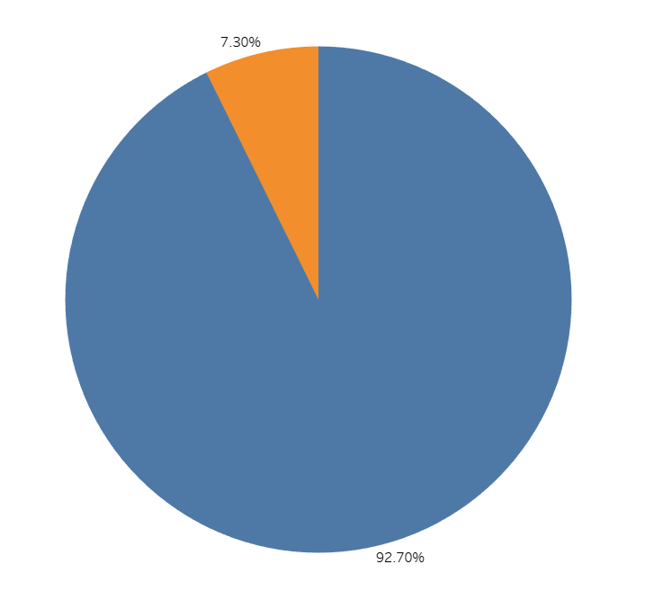

Visuals

Slide 21
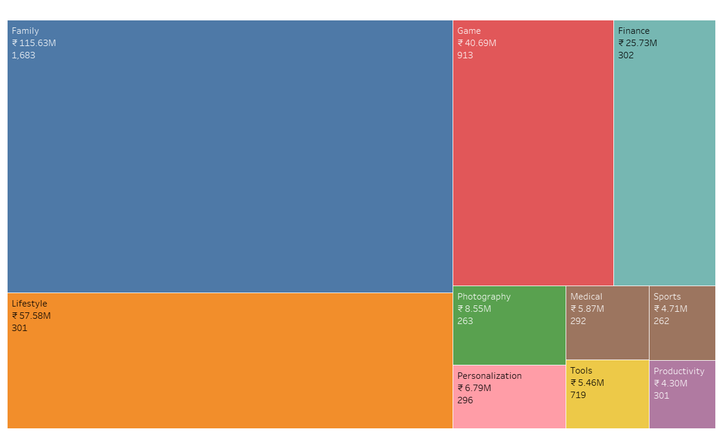
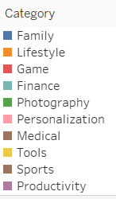

Slide 22
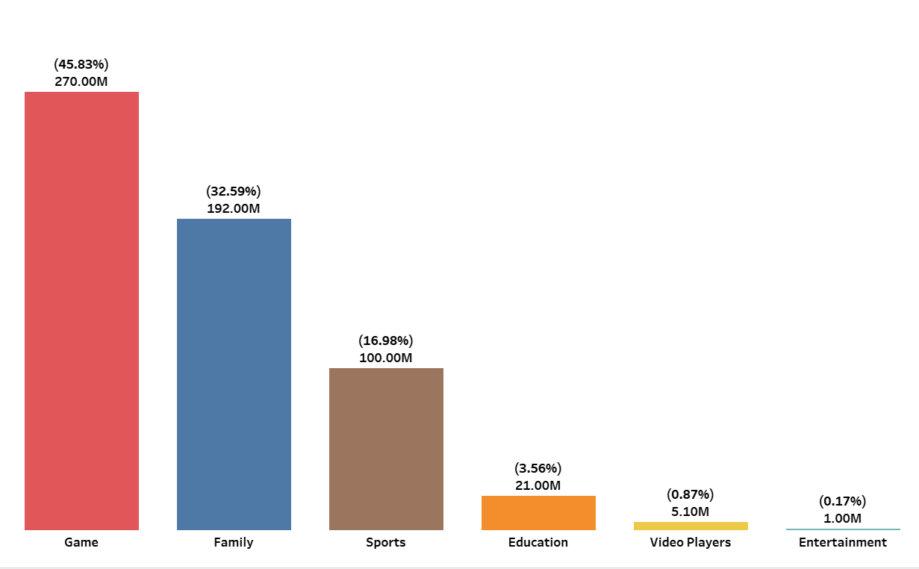
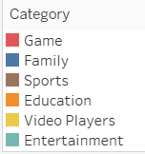

Slide 23
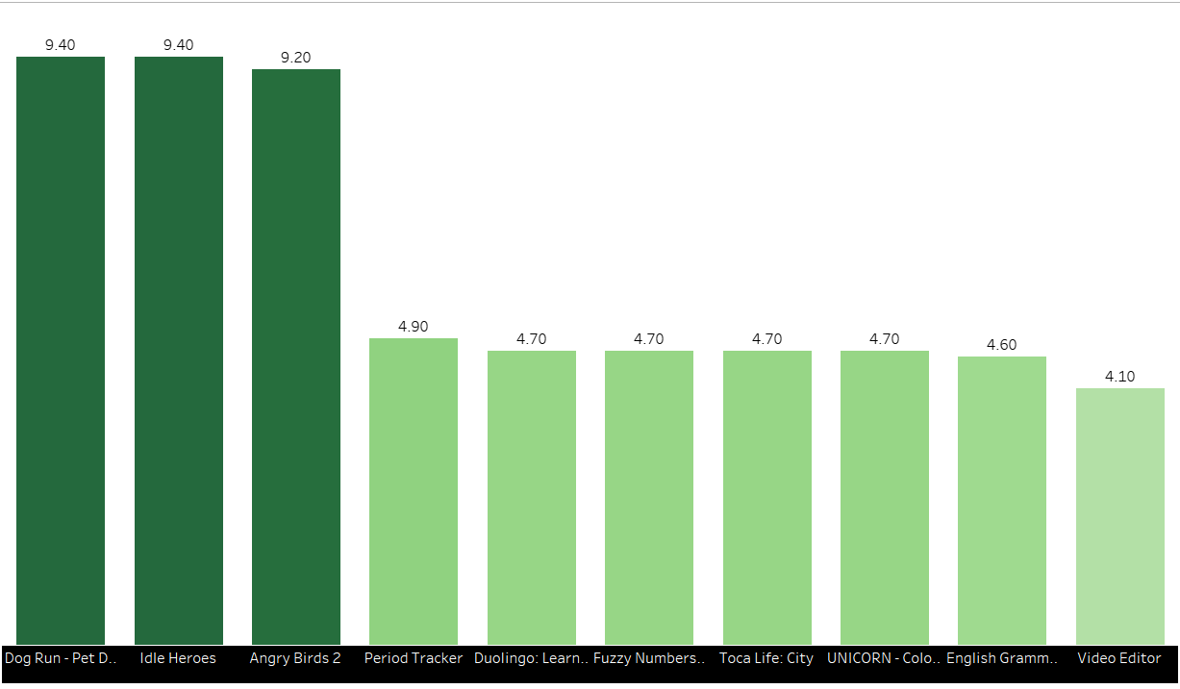

Slide 24
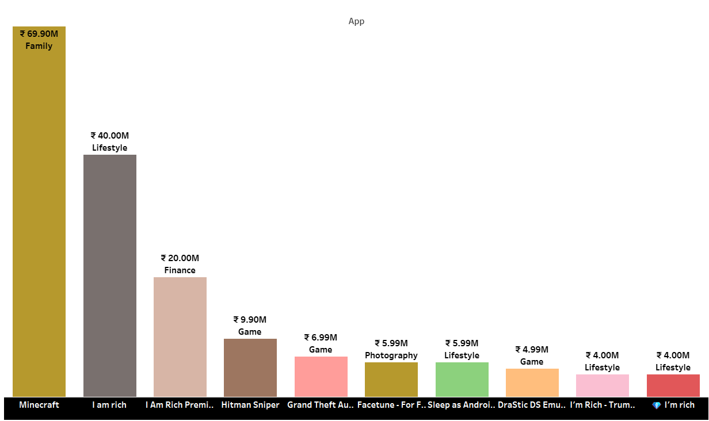

Slide 25
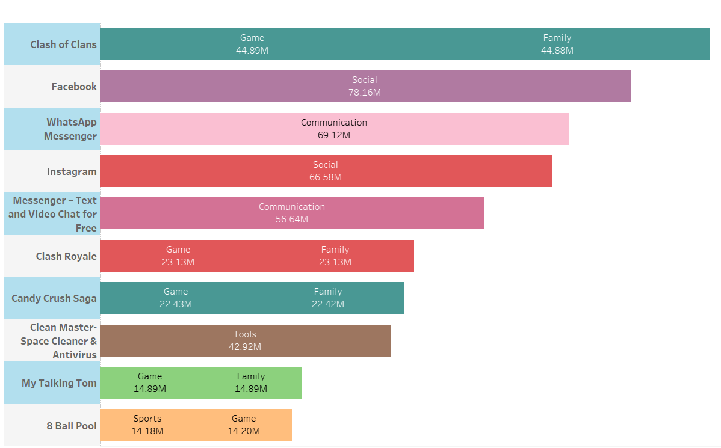

Slide 26
Insights
Free apps constitutes 92.70 % of the total apps and paid ones are at 7.30 %.This means Free apps are more in market than paid ones
The Most Revenue Generating apps are:
Minecraft----------- 69,900,000(in Indian Rupees)
I am rich------ 40,000,000(in Indian Rupees)
I am Rich premium----------20,000,200(in Indian Rupees)
The Most Reviewed apps are:
Family----------- 115,630,000(in Indian Rupees)
Lifestyle----------- 57,580,000(in Indian Rupees)
Games-------- 40,690,000(in Indian Rupees)

Slide 27
The Most Installed apps Categories are:
Game----------- 270,000,000(45.83% of total installs)
Family----------- 192,000,000(32.59% of total installs)
Sports-------- 100,00,000(16.98% of total installs)
The Most Rated apps are:
Dog Run – Pet Dog Simulator--- 9.40
Idle Heroes----------- 9.40
Angry Birds 2--------9.20
The Most Reviewed apps and their Categories are:
Clash of Clans-----------89,770,000 reviews-----Game,Family
Facebook-----------78,150,000 reviews------Social
Whats app messenger--------69,120,000 reviews----Communication

Slide 28
Thank You !
Email : narayananmannazhi10@gmail.com
Contact: 8089525158
(15 May to 15 August )

