Slide 1
CASE STUDY- BANK TELEMATKING CAMPAIGN
NARAYAN PATIL
ABADS 13

Slide 2
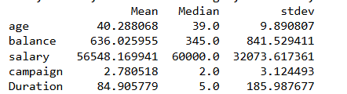
Descriptive Statistics
1. Age: The average age of respondents is approximately 40.28 years, with a median of 39 years and a standard deviation of 9.89 years, indicating a diverse age distribution. 2. Salary: The mean salary is about 56548 USD, with a median of USD 60000. The standard deviation of 32,073 USD suggests considerable variability in salary levels among individuals. 3.Account Balance: The average account balance is approximately 636 USD, with a median of 345 USD. The high standard deviation of 841 USD reflects significant disparities in account balances. 4.Campaign Effectiveness: The average number of campaigns contacted is around 2.8, with a median of 2 and a standard deviation of 3.12 indicating differing levels of engagement with campaigns. 5. Duration of Interactions: The average duration of interactions is approximately 85 seconds, with a median of 5 seconds and a high standard deviation of 185 seconds, suggesting variability in interaction lengths. 6.The mean and median in balance and duration are highly skewed which impacts it

Slide 3
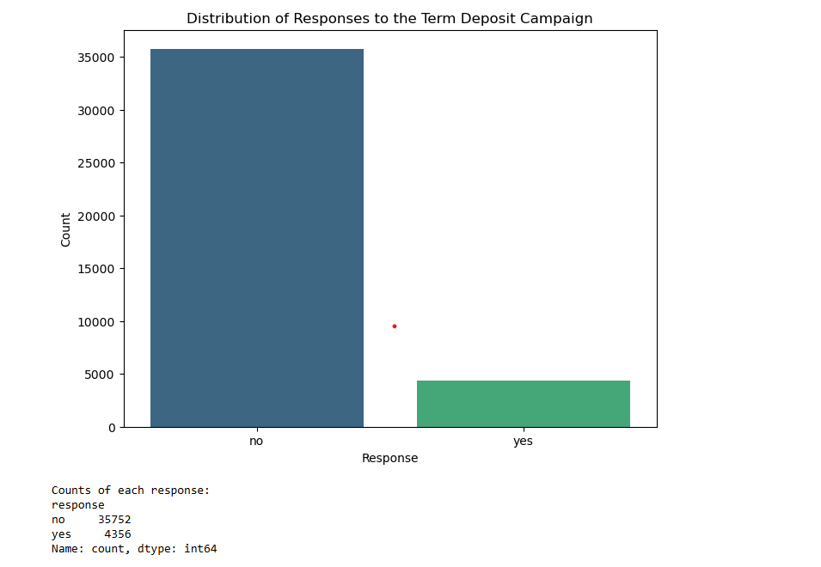
Descriptive Statistics contd..
It can be inferred that majority of the prople have not opted for the term deposit .the total contribution of such people is around 89% .
It can be inferred that majority of the prople have not opted for the term deposit .the total contribution of such people is around 89% .
Overall there is a very negative reaction to term deposit campaign and appropriate measures have to be taken

Slide 4

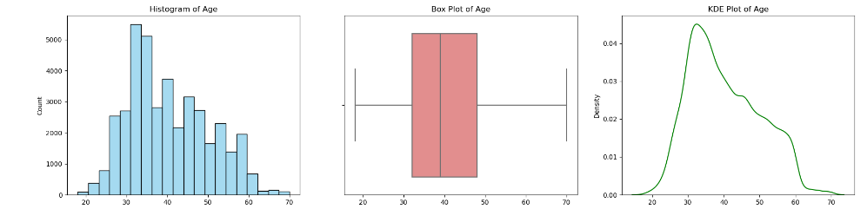
Univariate Analysis
Age
The age shows a mean of 40.28 years with a standard deviation of 9.89 years, indicating a fairly broad age range, from a minimum of 18 years to a maximum of 70 years.
The slight positive skewness (0.43) suggests that there are more younger individuals in the dataset, with fewer older respondents. This demographic diversity may have implications for understanding customer preferences and tailoring marketing strategies to different age groups.
The distribution of age can help us to generate and design specific schemes,offers,benefits to different sections of society

Slide 5
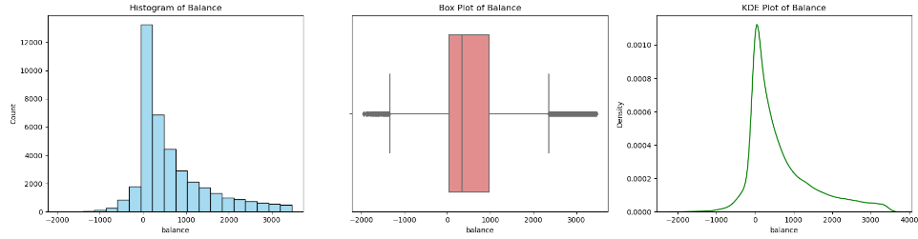
Univariate Analysis contd..
Balance
The balance shows a mean of 636 USD years with a standard deviation of 841 USD, suggesting that individual balances vary significantly from the average.
The right-skewed distribution suggests that there are a few individuals with notably high balances, which may represent wealthier or high-net-worth customers.
Negative balance indicates that there might be some customers who are already in debt and the bank needs to find our measures to recover that money
High-balance customers might be interested in investment or premium savings products, while those with negative balances might need financial assistance programs.

Slide 6
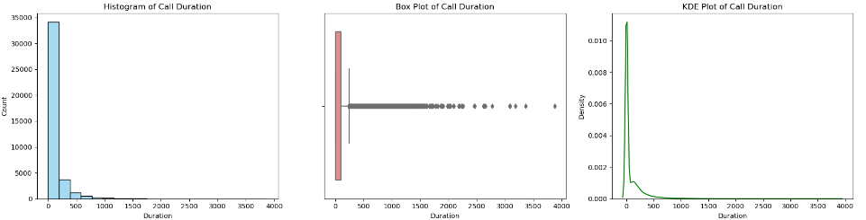
Univariate Analysis contd..
Duration
The duration shows a mean of 85 years with a Median of 5, suggesting indicating that while most calls are very short, a few long calls raise the average..
The high standard duration 186 indicate diverse levels of engagement, where a minority of customers spend more time discussing or learning about the bank's offerings.
The positive skewness value 1.30suggests that most calls are short, with a long tail to the right, representing occasional lengthy conversations.
Customers with longer call durations could indicate stronger interest, possibly worth further engagement or follow-ups. These individuals might be more receptive to promotional offers or detailed discussions about products.
Short Calls: Calls under a certain threshold (e.g., under 10 seconds) might imply declined or missed opportunities. A separate outreach strategy could be applied to these cases, potentially using alternative engagement methods like SMS or email..

Slide 7
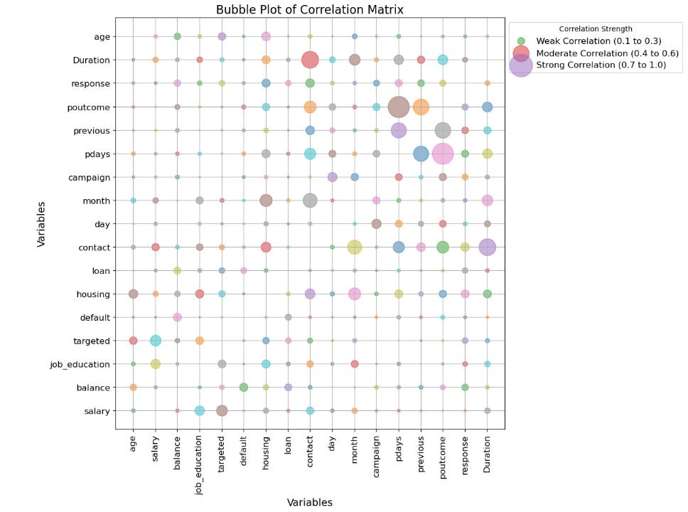
Bivariate Analysis
Pdays: 0.10
The strongest correlation factor Pdays suggests that customers have been contacted frequentely
Previous : 0.089
This indicates that even customers have been contacted frequently in previous campaigns
Balance: 0.085
This indicates that customers are not falling behind as far as balance is concerned

Slide 8
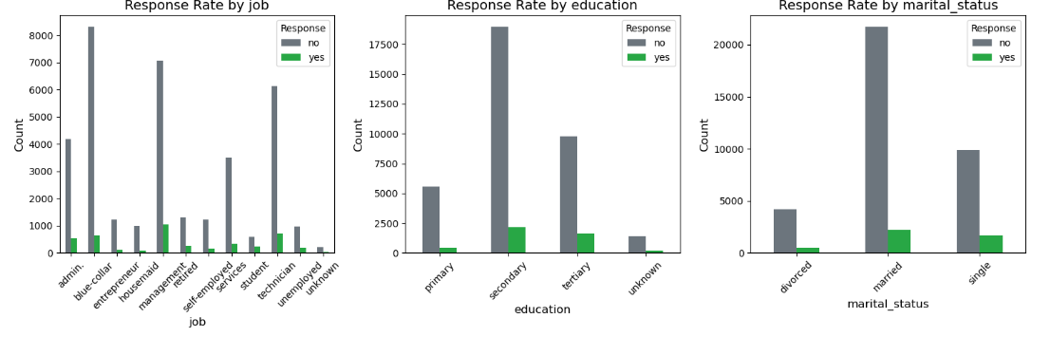
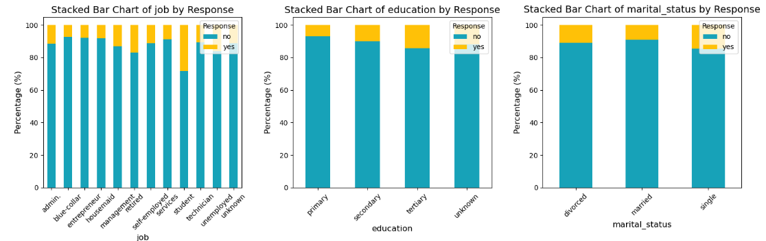
Bivariate Analysis contd…

Slide 9
Bivariate Analysis contd…
Response rate by Job
This field indicates that Blue collar job workers have got the highest negative response
Housemaids have given the most positive response also they rank 2nd parallelly in no response
Response rate by Martial status
This field indicates that married individuals have got the most negative responses followed by single
There is a non conclusive finding that martial status actually influence a person for a positive response
Response rate by Education
This field indicates most negative responses are from secondary grade followed by tertiary grade
Apparently the most positive responses are from secondary grade followed by tertiary grade
A question arises here are most calls directed toward secondary and tertiary grade education level customers

Slide 10
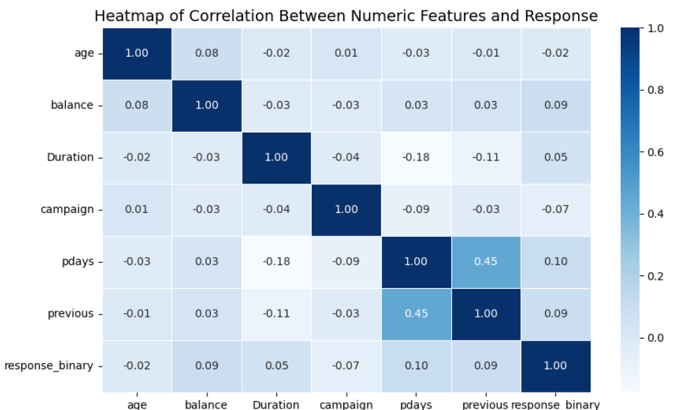
Bivariate Analysis contd…
This was previously studied as well when corelation was drawn
Pdays: 0.10
The strongest correlation factor Pdays suggests that customers have been contacted frequentely
Previous : 0.09
This indicates that even customers have been contacted frequently in previous campaigns
Balance: 0.09
This indicates that customers are not falling behind as far as balance is concerned

Slide 11
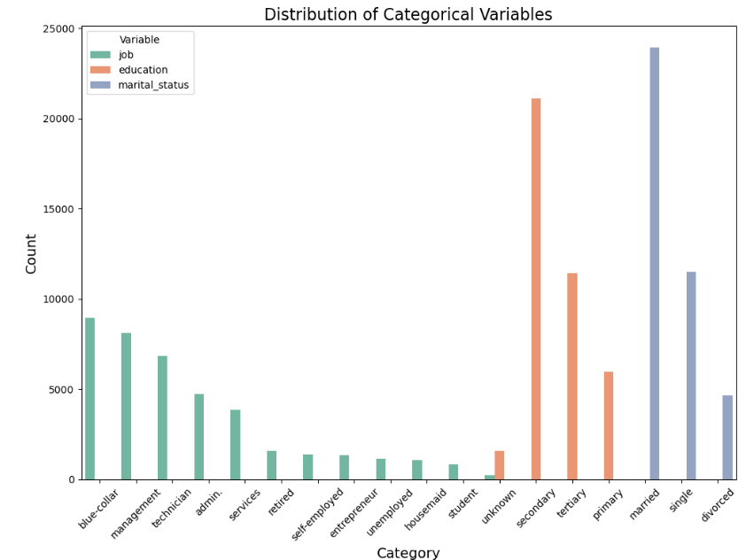
Categorical Variable Analysis
The data shows that blue-collar staff, management and technician background people have given the most positive responses
An attempt should be made to engage the economically ridden like maids,students,retired employees etc by means of certain schemes which can mutually benefit both bank and customers
Also to understand the economics better an awareness campaign should be launched among the primary and secondary education background customers
As suggested in point no 1 and 2 we should also see the engagement of people either single or divorced to actively engage in bank schemes

Slide 12
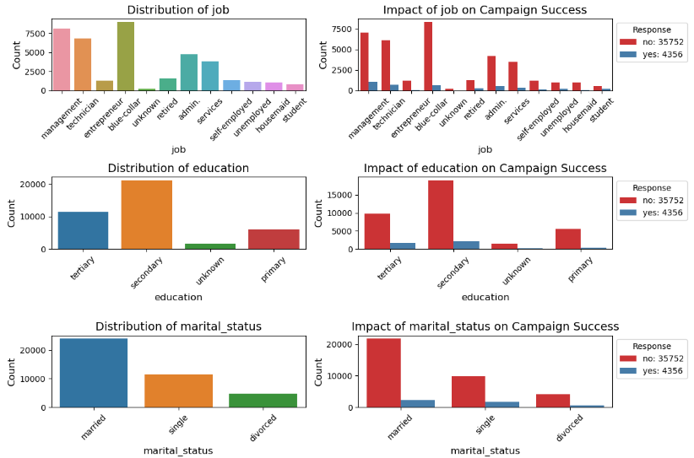
Categorical Variable Analysis contd…
Distribution of Job
Blue Collar – 22.3%
Management- 20.3%
Technician – 17.1%
Here it can be inferred that mostly of the reviews almost 60% have come from bluecollar,management and technician background
Distribution of education
Secondary : 52.6%
Tertiary : 28.5%
Primary : 14.9%
Unknown : 4%
Here it can be inferred that mostly of the active participation comes from the secondary category here an effort needs to be made to improvise the involvement of primary category customers

Slide 13
Categorical Variable Analysis contd…
Distribution of Martial status
Married – 59.7%
Single - 28.7%
divorced – 11.6%
Here it can be inferred that mostly of the reviews almost 60% have come from married people there is a dire need for certain schemes, discounts to be made available to rope in the other 2 categories as well
Impact of Job on campaign Sucess
For blue-collar: 23% "Yes", 23% "No“
For Management: 24.6% "Yes", 19.8% "No“
For Technician: 16.4% "Yes", 17.2% "No"
It is found that management people are more likely to respond than other categories ,there is purely a reach issue wherein responses are either not generated or not collected properly

Slide 14
Categorical Variable Analysis contd…
Impact of education on campaign Success
Primary : 9.5% "Yes", 15.6% "No“
Secondary : 48.9% "Yes", 53.1% "No“
Tertiary: 27.4% "Yes", 37.3% "No"
It is found that most of the secondary people are highly responsive whatever may be the feedback which implies there has been very little marketing across the other 2 categories
Impact of Marital status on campaign Success
Married : 50.4% "Yes", 60.8% "No“
Single : 27.6% "Yes", 38% "No“
divorced : 11.5% "Yes", 11.6% "No“
Here again as above it can be inferred that mostly of the reviews almost 60% have come from married people there is a dire need for certain schemes, discounts to be made available to rope in the other 2 categories as well

Slide 15
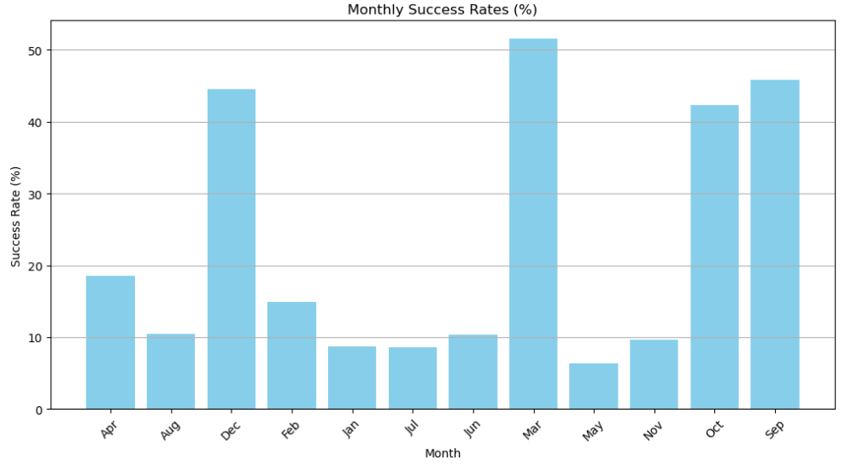
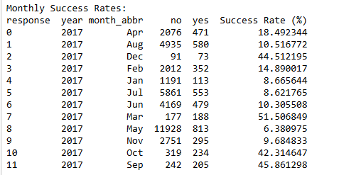
Temporal Analysis

Slide 16
Temporal Analysis Contd…
As seen from the data there is high variation among the data points
March has got the highest success rate 51% followed by September 45%
May has got the lowest success rate followed by July
Months of May,July,January,November have exhibited a very low success rates

Slide 17
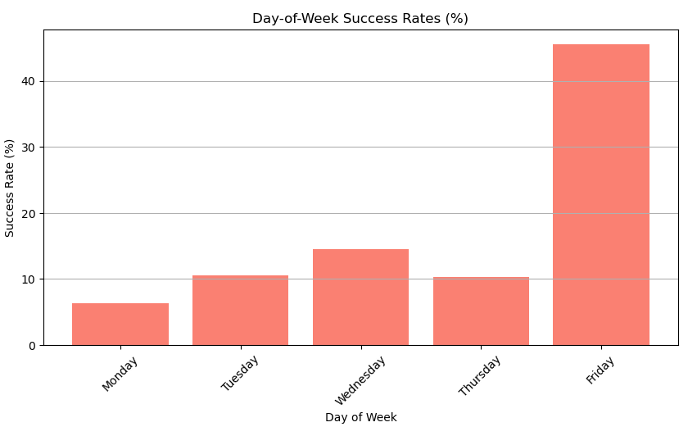
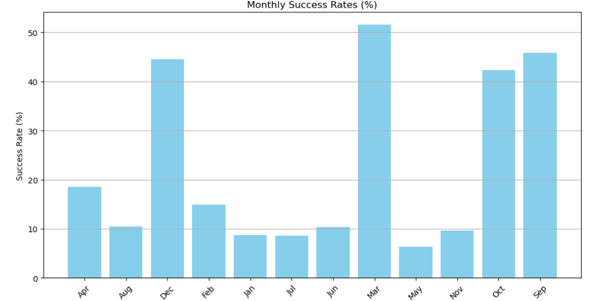
Temporal Analysis Contd…

Slide 18
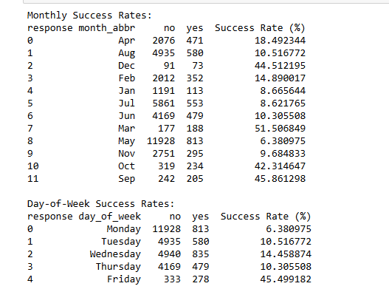
Temporal Analysis Contd…
It Can be inferred that month of December,March,October and September have been more successful in terms of campaign
Similarly, day of Friday has been most successful in terms of campaign, we need to get people engaged in other days also

Slide 19
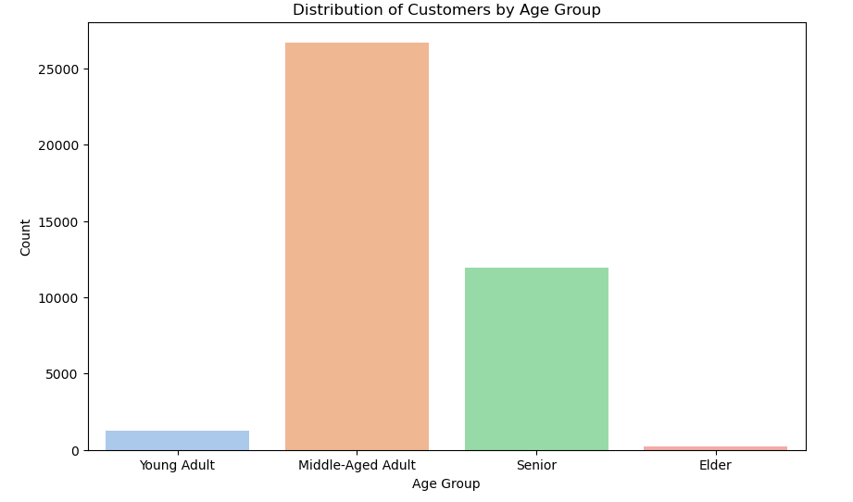
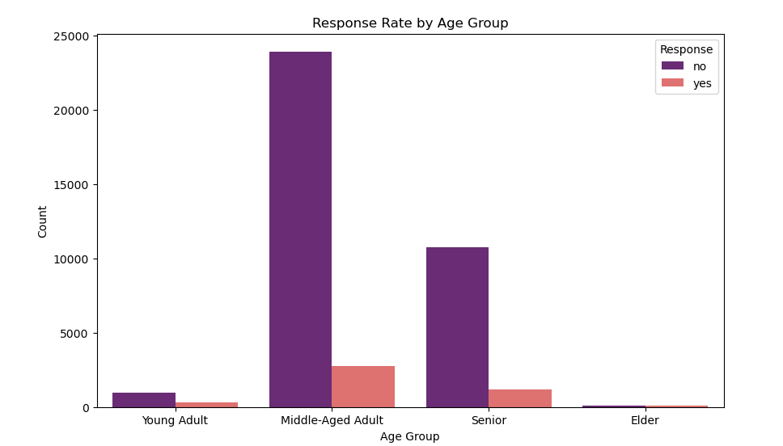
Feature engineering
Distribution of age by Customers Group
It can be seen that middle aged adults have responded more more into the campaign than the rest of the categories
Also Middle aged adults have given the more negative responses followed by senior people
We need to make some schemes for young adults and elders as this the population who posses very low or even do not make any form of salaried income
The Senior level must be also looked upon with some lucrative schemes as this is the population where in much of income shall lie

Slide 20
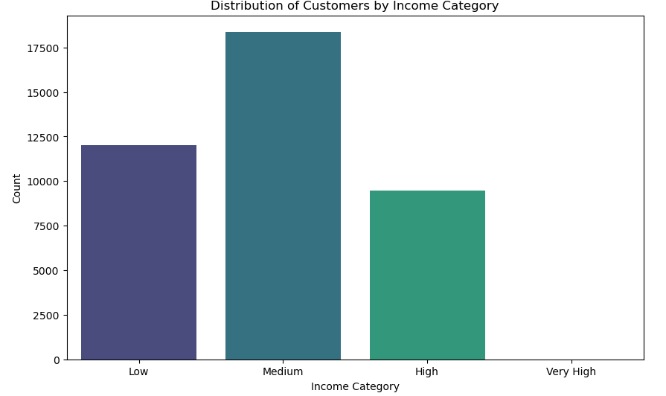
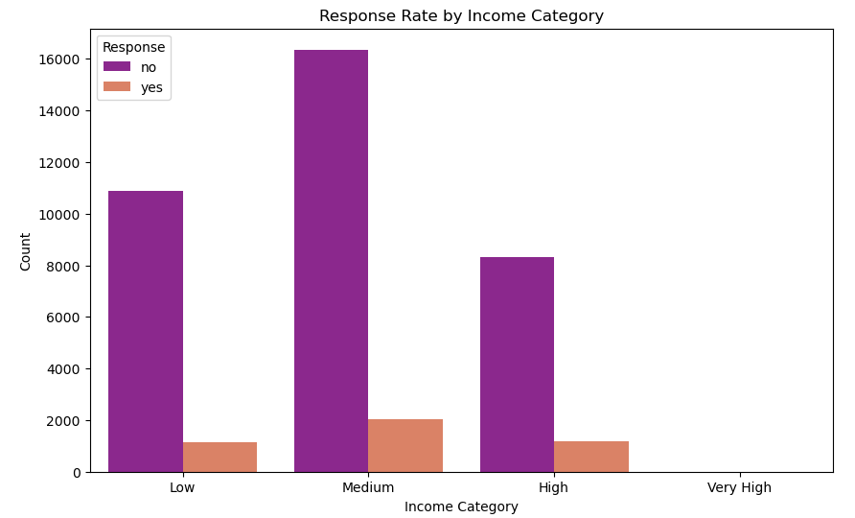
Feature engineering Contd…
Distribution of age by income category
It can be seen that medium value customers top the list for responses followed by low and high category
Also it can be seen that across all categories there is a string negative response which is impacting the overall business
It is also surprising to see that Very high value customer have chosen to maintain their distance towards any schemes the bank has released
The work needs to be done on the customers from High and very high background

Slide 21
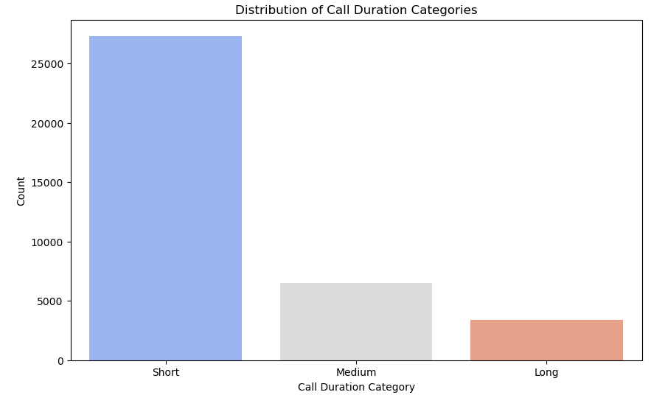
Feature engineering contd..
Distribution of call duration categories
It can be seen that there are very few short calls
This indicates very few customer retention
Also it may be an indicator that our staff needs some training on communication skills

Slide 22
Feature engineering contd..
Distribution of call duration categories
It can be seen that there are very few short calls
This indicates very few customer retention
Also it may be an indicator that our staff needs some training on communication skills

Slide 23
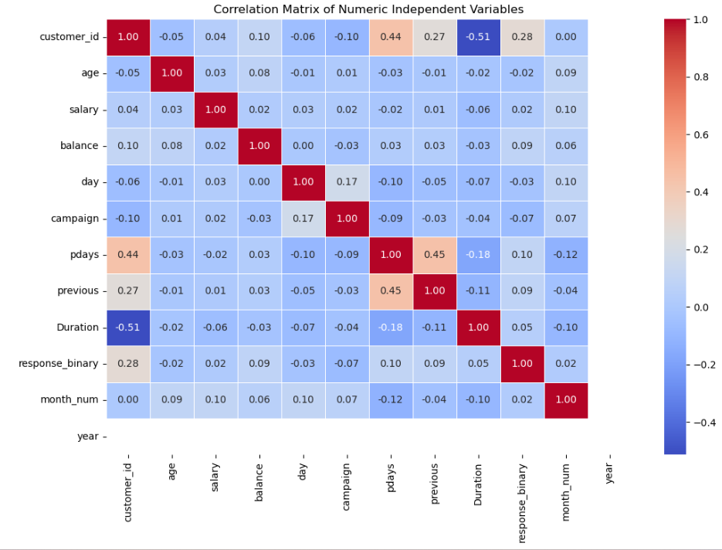
Co-relation Analysis
It Can be inferred from the correlation matrix that most of the variable smelt a weak correlation
The strongest positive correlation in the matrix is between Pdays and Previous ie 0.45 It indicates a moderate relationship between the number of days since the last campaign and the number of previous contacts. This is expected, as a higher pdays value likely corresponds to a more recent previous contact.
A small positive correlation between day and campaign 0.16 suggests a slight relationship between the day of the campaign and the number of contacts during the campaign.
The weak negative correlation between pdays and campaign -0.09 indicates a slight inverse relationship between the number of days since the last contact and the number of contacts during the campaign.
A negative correlation with response with campaign -0.07 that customers contacted multiple times in a short period are less likely to respond positively, likely due to fatigue or annoyance.

Slide 24
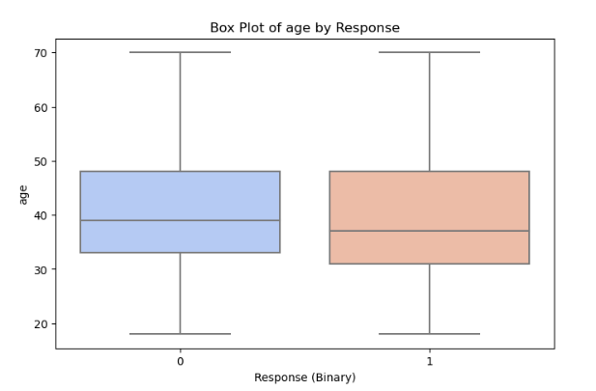
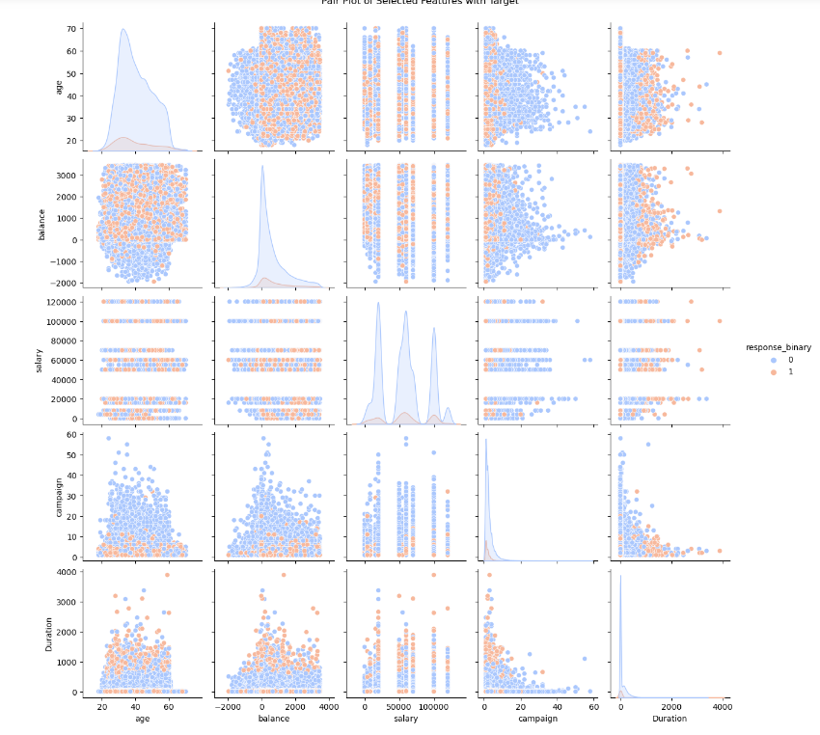
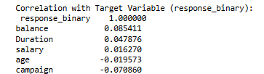
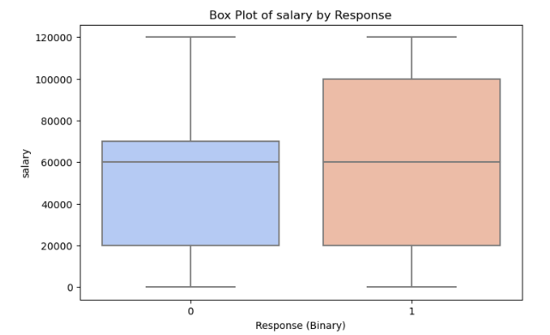
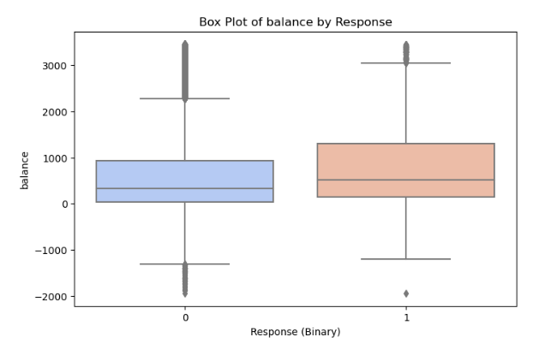
Co-relation Analysis contd…

Slide 25
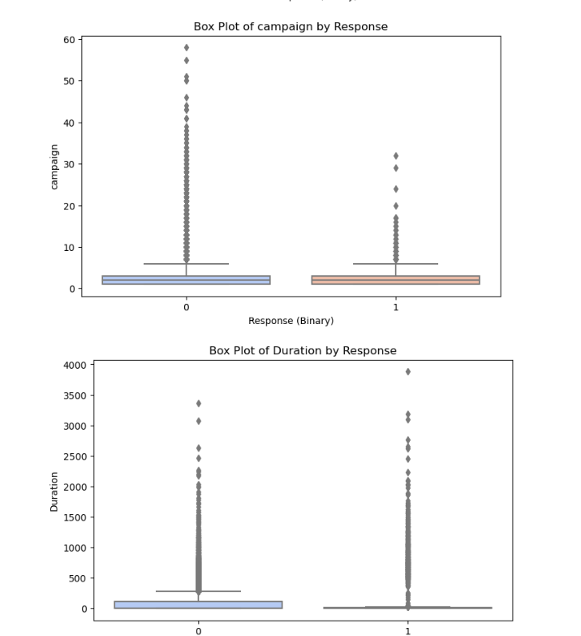
Co-relation Analysis contd…
Separation by Duration: The pair plot reveals a clear separation for Duration based on response. Customers who responded positively (response_binary=1) generally have longer call durations, reinforcing the importance of engaging conversations.
Balance Distribution: A concentration of higher balances is visible among customers who responded positively. This supports the finding from the correlation that higher balances are associated with a higher likelihood of a positive response.
Interactions: While age and salary pair plot alone don’t show strong patterns, combinations with other variables like balance might yield more predictive power.
Duration Box Plot: Shows a much wider range of values for customers who responded positively, with a median Duration substantially higher than for those who did not respond. This underscores that lengthier calls are a key factor in response likelihood.
Balance Box Plot: Positive responders tend to have slightly higher balances on average, though there are outliers and variability. This supports balance as a modest but positive influencer.
Campaign Box Plot: The negative responders show a higher number of calls, with a lower median in the positive responders, which aligns with the concept of diminishing returns from excessive call attempts.

Slide 26
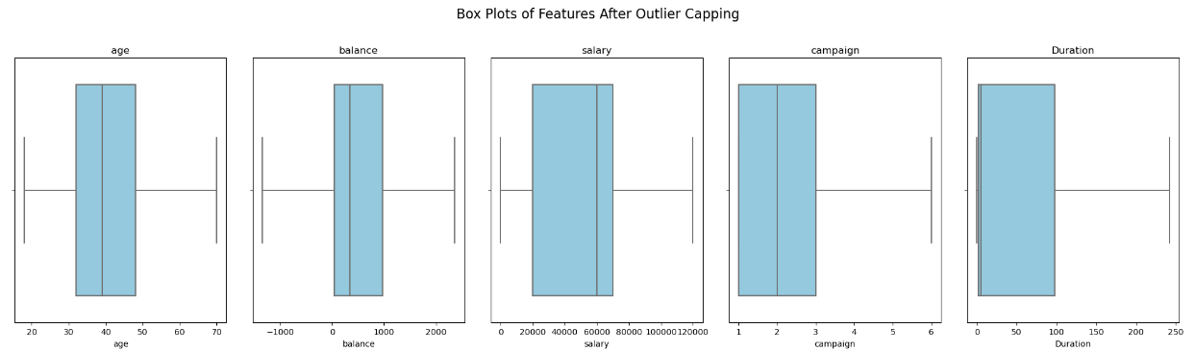
Outlier Detection and Handling
Outliers for age,balance ,salary, Campaign ,duration, campaign are already removed

Slide 27
THANK YOU

