Slide 1
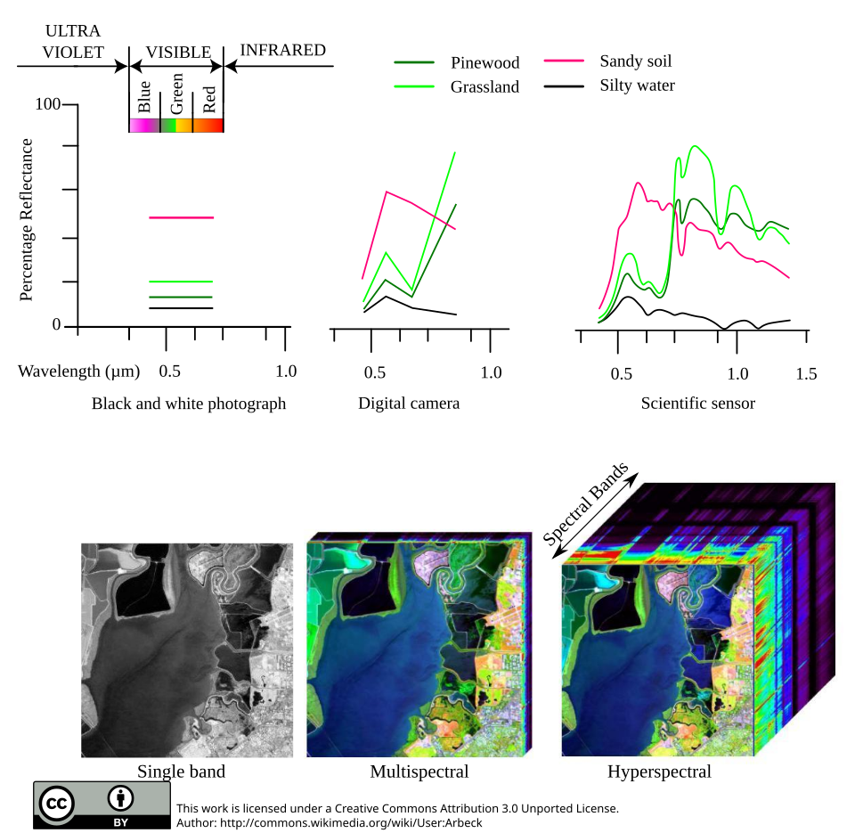
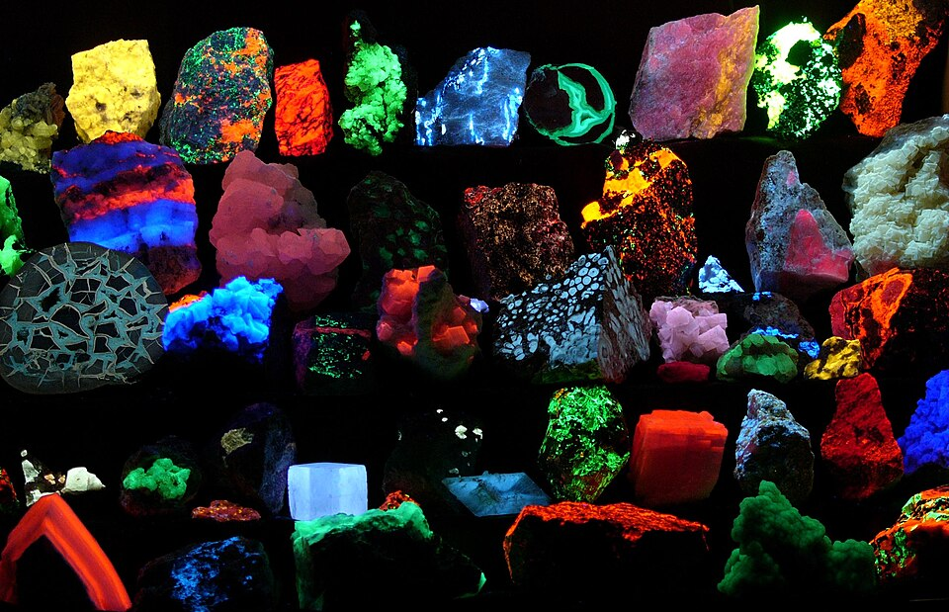
Deep Learning for Dimensionality Reduction in
Multi-Excitation Hyperspectral Imaging
Master's Thesis Defense
Narek Meloyan
American University of Armenia · 2026
Supervisor: Prof. Narine Sarvazyan
Image: Wikimedia Commons (CC BY-SA) — see credits slide
Notes:
Good afternoon. My name is Narek Meloyan, and today I'll present my Master's thesis on deep learning for dimensionality reduction in multi-excitation hyperspectral imaging. This work was supervised by Professor Narine Sarvazyan. Over the next ~30 minutes I'll start with a broad introduction to hyperspectral imaging, walk through how fluorescence imaging works, explain why we need the 4D extension I studied, present the deep-learning framework I built, and show experimental results on two biological fluorescence datasets.

Slide 2
Outline
• 1. From human vision to hyperspectral imaging
• 2. HSI in the biomedical setting
• 3. Fluorescence: what it is, how we capture it
• 4. Why single-excitation fluorescence HSI is not enough
• 5. ME-HSI: the 4D extension, and its own challenges
• 6. Existing band-selection methods and why they fall short
• 7. The proposed framework: 3D CAE + perturbation + MMR
• 8. Two datasets: Lichens and Collagen Sponges
• 9. Results & validation
• 10. Discussion, limitations, conclusion
Master's Thesis Defense — Narek Meloyan — 2026
2 / 31
Notes:
Here's the plan. The first six slides build the context — what HSI is and why we care about ME-HSI in the biomedical context. The middle third explains the method I developed. The final third presents experimental results on two datasets and the validation. I'll keep the intro brisk so we spend most of the time on the contribution and results.

Slide 3
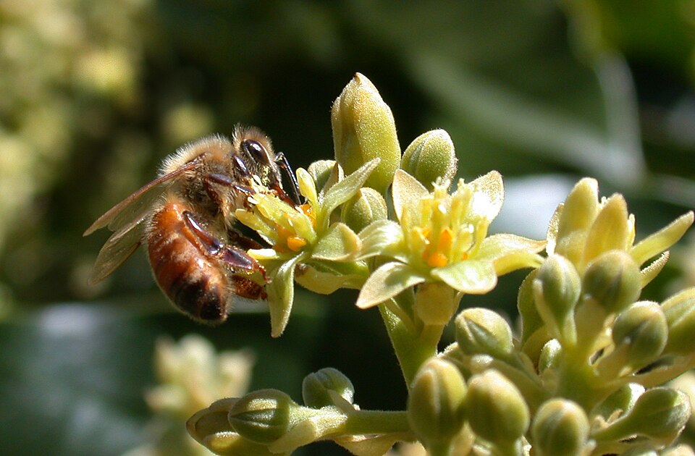
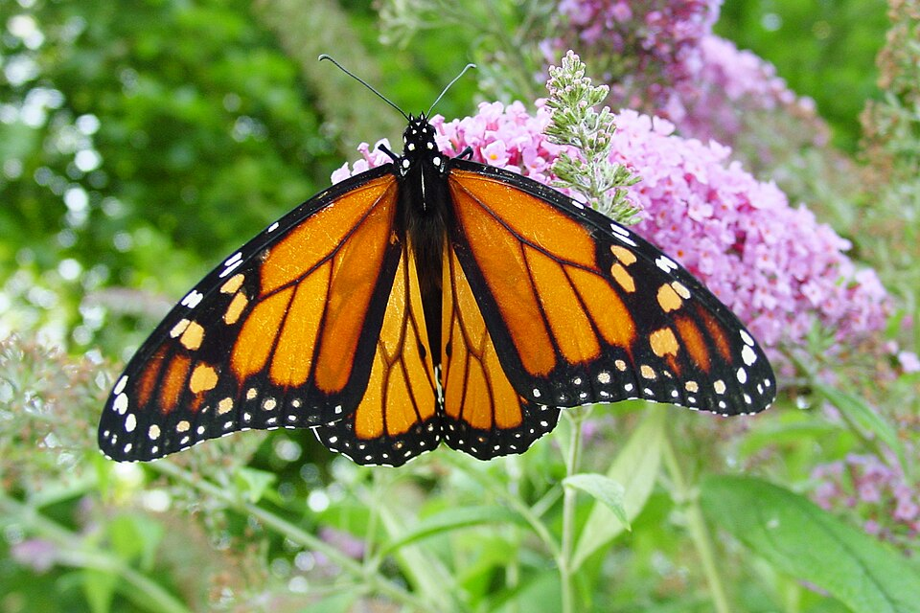
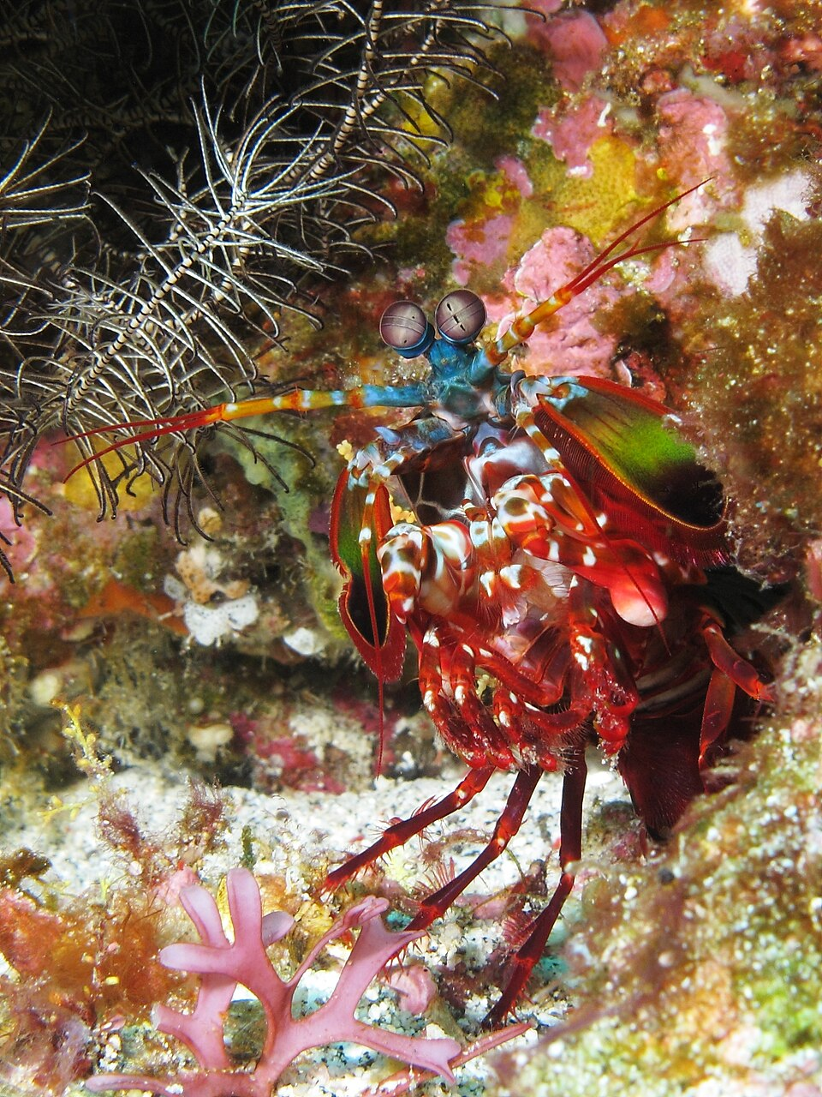
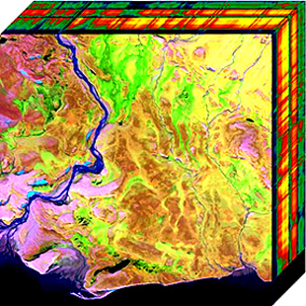
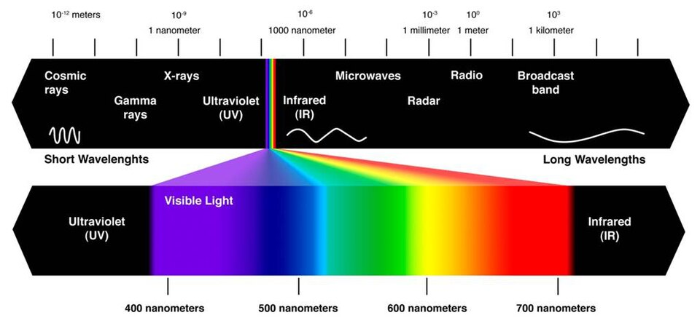
How we see — and how we don't
Honeybee
Butterfly
Mantis shrimp
Hyperspectral camera
3 cones (UV, blue, green) sees UV patterns
5 – 9 photoreceptors broad spectral range
12 – 16 photoreceptors + polarisation
100 – 300+ channels continuous spectrum
More channels → more discrimination. A hyperspectral camera is to colour vision what colour vision is to greyscale.
Image: Photos: Wikimedia Commons CC BY-SA — see credits slide
Master's Thesis Defense — Narek Meloyan — 2026
3 / 31
Notes:
To anchor what hyperspectral imaging is, it helps to start with how different organisms see. Humans see in three channels — red, green, blue — and that's why a digital camera also has three. Honeybees see in three channels too, but shifted into the UV; flowers that look uniform to us have intricate UV nectar guides bees can see. Butterflies have around 9 photoreceptor types, and the mantis shrimp famously has 12-to-16 — plus it can detect light polarisation. Each step up means more discrimination — you can tell apart materials that looked identical at the lower channel count. A hyperspectral camera takes this all the way: 100 to 300 contiguous spectral channels, sampling the full visible-to-near-infrared spectrum continuously rather than binning it into 3 broad bands. That's the basic 'why' of HSI.

Slide 4
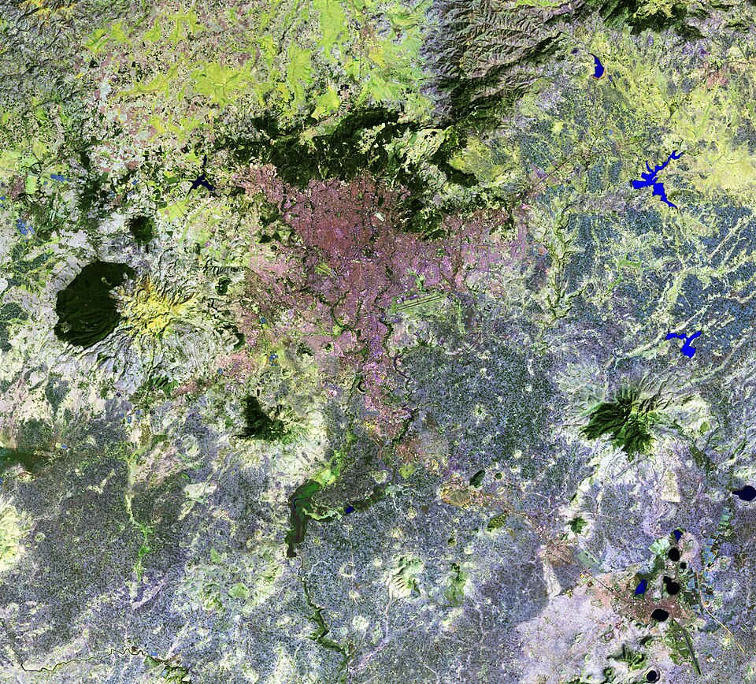
What hyperspectral imaging buys you
Applications across science and industry
Why all of these?
• Remote sensing: mineralogy, vegetation, water quality
• Agriculture: ripeness, disease, soil moisture
• Food industry: contamination, freshness, fraud
• Art conservation: pigment ID, hidden layers
• Pharmaceutical: powder homogeneity, tablet QA
• Defence: camouflage detection
• Forensics: trace evidence, fingerprints
• Biomedicine: tissue classification, surgical guidance
Materials have characteristic spectral fingerprints. Two surfaces that look identical to the eye can be told apart by their full spectrum. HSI gives a per-pixel spectrum — a 'mini-lab' at every point.
Landsat-5 false-colour (Ethiopia) Vegetation = red, water = blue
Image: Landsat-5 false-colour, NASA / USGS, public domain (Wikimedia)
Master's Thesis Defense — Narek Meloyan — 2026
4 / 31
Notes:
Once you have hundreds of channels per pixel, HSI shows up everywhere. Geologists use it to identify minerals from satellite data. Farmers use it to spot crop disease before it's visible. The food industry uses it to detect contamination on processing lines. Art conservators use it to identify pigments and reveal underdrawings beneath painted surfaces. The defence community uses it for camouflage and target identification. And — what this thesis cares about — biomedicine. The common thread is that materials carry characteristic spectral fingerprints. Two surfaces that look identical to the human eye can be told apart by their full spectrum. HSI essentially gives you a miniature laboratory measurement at every pixel.

Slide 5
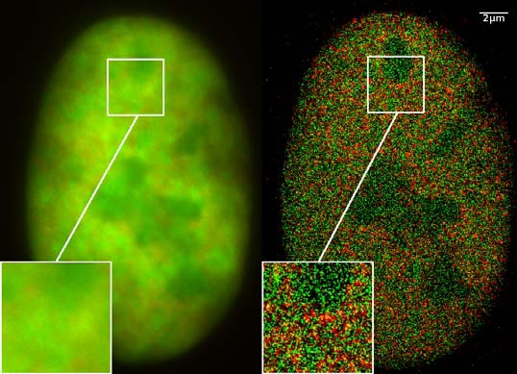
Why biomedicine cares about HSI
• Conventional imaging (RGB, MRI, CT) tells you WHERE things are — not WHAT they are made of
• Biological tissues differ chemically: healthy vs. diseased, malignant vs. benign, well-perfused vs. ischemic
• These chemical differences are invisible in RGB but visible in the spectrum
• Clinical use cases:
– Tumour-margin assessment during surgery
– Real-time tissue classification in endoscopy
– Wound assessment, burn depth estimation
– Skin-cancer screening, retinal disease
– Histopathology label-free analysis
• Goal: label-free, non-invasive characterisation of tissue in vivo
Fluorescence microscopy: label-free contrast at the cellular scale
Image: GFP super-resolution micrograph: C. Cremer, Wikimedia CC BY-SA
Master's Thesis Defense — Narek Meloyan — 2026
5 / 31
Notes:
Biomedicine cares about HSI because conventional medical imaging — RGB, MRI, CT — tells you where structures are but not what they're made of. Biological tissues differ chemically: healthy vs diseased, malignant vs benign, well-perfused vs ischemic. Those chemical differences are often invisible in RGB but visible in the full spectrum. Use cases include tumour margin assessment during surgery, where the surgeon needs to know in real time whether to cut here or there; endoscopic tissue classification; burn-depth estimation; skin cancer screening; and label-free histopathology. The overarching goal is non-invasive, label-free characterisation of tissue, in vivo.

Slide 6
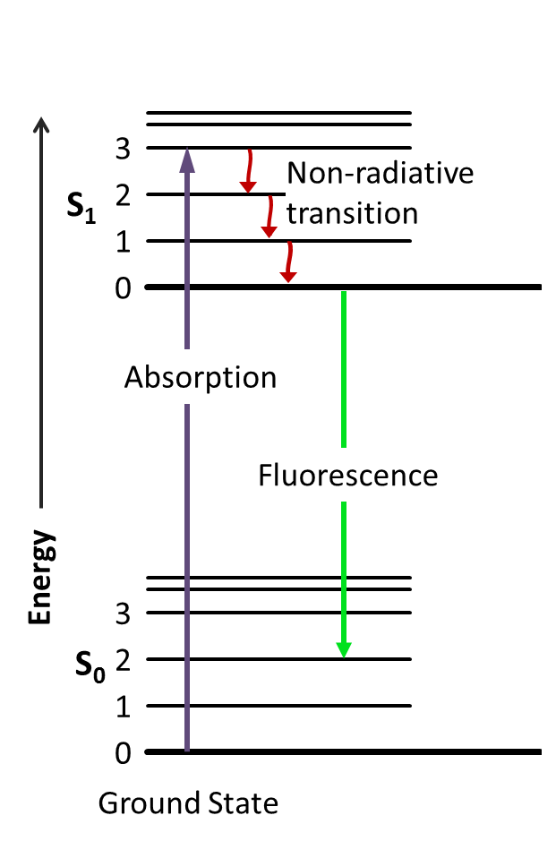
Fluorescence: how molecules emit light
The physical process
• 1. High-energy photon absorbed
• 2. Electron jumps to excited state
• 3. Some energy lost as heat
• 4. Electron drops back, emits new photon
• 5. λ_emission > λ_excitation (Stokes shift)
Real minerals under UV — each fluorophore emits a different colour
Biological fluorophores:
Jablonski diagram of fluorescence
• NADH 340/460 · Collagen 330/400
• Elastin 325/410 · Tryptophan 280/350
• Flavins 450/525 · Chlorophyll 430/680
Image: Jablonski diagram + fluorescent minerals (H. Grobe): Wikimedia CC BY-SA
Master's Thesis Defense — Narek Meloyan — 2026
6 / 31
Notes:
Fluorescence is the physical process I exploit. Here's how it works in five steps. A high-energy photon (UV or short-visible) hits a molecule and gets absorbed. That kicks an electron up to a higher energy state. The molecule rapidly loses a little of that energy as vibration — heat — then the electron drops back down, releasing a NEW photon. Because of that vibrational loss, the emitted photon has less energy — longer wavelength — than the photon that excited it. This wavelength shift is called the Stokes shift. The signature of each fluorophore is the SHAPE of its emission curve. The right panel lists some biological fluorophores you can detect this way — NADH and flavins tell you about cellular metabolism, collagen and elastin about extracellular matrix, lipofuscin about aging. These are label-free contrast agents — the body provides them.

Slide 7
Single-excitation fluorescence HSI
UV / blue light source (fixed λ_ex)
Biological sample
HSI camera emission @ many λ_em
3D cube (x, y, λ_em)
→
→
→
• Result: at every pixel, a 1D emission spectrum — a chemical fingerprint
• Each tissue type shows a characteristic emission curve at the chosen λ_ex
• Already enables: tissue typing, NADH-redox mapping, autofluorescence contrast
• Compared to RGB:
– 24+ channels of molecular info per pixel vs. 3 RGB channels
– Label-free — no exogenous dye injection
A spectral cube — 1 spectrum / pixel
Image: Hyperspectral cube illustration: Wikimedia Commons CC BY-SA
Master's Thesis Defense — Narek Meloyan — 2026
7 / 31
Notes:
Single-excitation fluorescence HSI works like this. You shine a fixed-wavelength UV or blue light source on a biological sample. Some molecules absorb the light and re-emit fluorescence at longer wavelengths. A hyperspectral camera captures that emission at many wavelengths simultaneously. The output is a 3D data cube: two spatial dimensions and one emission-wavelength dimension. At every pixel you now have a full emission spectrum — a molecular fingerprint. Compared to RGB, you've gone from 3 colour channels to 20 or more channels of molecular information per pixel, and crucially this is label-free — you don't need to inject exogenous dyes. So single-excitation HSI already enables tissue typing, NADH-redox mapping, basic autofluorescence contrast. The question is: is that enough?

Slide 8
Why a single excitation is not enough
• Many biological fluorophores overlap in emission
– Collagen emits near 400 nm, elastin near 410 nm
– NADH near 460 nm, lipofuscin tails through the same region
• From the emission spectrum ALONE, you can't always tell who's emitting
• Different fluorophores have different absorption profiles — they respond strongly to DIFFERENT excitations
• A single-excitation acquisition picks one slice of this 2D landscape and discards the rest
• Result: confused tissue classification when overlapping fluorophores are present
The disambiguation problem
Fluorophore A: peaks at ~450 nm Fluorophore B: peaks at ~460 nm → Emission spectra OVERLAP heavily. But: A absorbs strongly at 340 nm B absorbs strongly at 280 nm → Different EXCITATIONS produce different emission ratios. Vary the excitation to disambiguate.
Master's Thesis Defense — Narek Meloyan — 2026
8 / 31
Notes:
The problem is that biology stacks fluorophores on top of each other. Collagen emits near 400 nanometers; elastin near 410; NADH near 460; lipofuscin tails through the same region. From the emission spectrum alone — one slice through this landscape — you often can't tell which fluorophore is responsible for a signal. But different fluorophores absorb at different wavelengths — they have different excitation profiles. Even if their emissions overlap, you can disambiguate them by exciting at different wavelengths and watching how the emission ratio changes. A single-excitation acquisition discards this information entirely. The fix — and the focus of this thesis — is to vary the excitation as well.

Slide 9
Multi-Excitation HSI: the 4D extension
• Acquire the same scene at MANY excitation wavelengths sequentially
• Each pixel now has TWO spectral dimensions:
– emission λ_em (as before)
– excitation λ_ex (new)
• A pixel's data is no longer a curve — it's a 2D excitation-emission matrix (EEM)
• Each fluorophore has a characteristic EEM "signature"
• Overlapping emission curves now separate when you also vary excitation
Data shape:
I(x, y, λ_em, λ_ex)
Example: • 8 excitations • 24 em bands each • 192 layers / pixel • 1040×925 → ~184 M points / frame
Single → multi → hyperspectral (ME-HSI adds another axis on top)
Image: Spectral cube comparison: Wikimedia Commons CC BY-SA
Master's Thesis Defense — Narek Meloyan — 2026
9 / 31
Notes:
The fix is multi-excitation HSI — ME-HSI. Instead of one fixed excitation, you sequentially acquire the same scene under MANY excitation wavelengths. Now each pixel has two spectral dimensions: emission as before, plus excitation. A single pixel's data is no longer a 1D curve — it's a 2D excitation-emission matrix, or EEM. Each fluorophore has a characteristic EEM signature; this is the gold-standard fluorescence fingerprint used in analytical chemistry. When two fluorophores overlap in emission, their EEM signatures still differ. The downside is data volume: for an 8-excitation by 24-emission acquisition, you get 192 spectral layers per pixel. For a megapixel image, that's nearly 200 million data points per frame.

Slide 10
ME-HSI's new challenges
• Data explosion: 192+ spectral layers per pixel ⇒ acquisition time, storage, computation all scale up
• Acquisition is sequential — slow; not ideal for moving samples or live tissue
• Physical artifacts:
– Rayleigh scattering at λ_em ≈ λ_ex creates invalid bands (1st order)
– 2nd-order harmonics at λ_em ≈ 2·λ_ex add more invalid bands
– Variable number of valid emission bands per excitation
• Spectral redundancy: most (λ_ex, λ_em) cells carry overlapping information
• Cross-excitation correlations: the JOINT structure between excitations is precisely what 3D HSI methods cannot see
• Detector noise dominates at low-signal regions and long excitations
Master's Thesis Defense — Narek Meloyan — 2026
10 / 31
Notes:
ME-HSI is powerful but brings its own challenges. Data explosion is the first — 192-plus spectral layers per pixel translates to acquisition delays, storage, and computational cost. Acquisition is sequential — slow, not ideal for moving samples. Then there are physical artifacts: Rayleigh scattering at the excitation wavelength and its second-order harmonic create invalid bands that have to be masked out, leaving variable numbers of valid emission bands per excitation. Most of the remaining (excitation, emission) cells carry overlapping or redundant information. And critically, the JOINT structure between excitations — which is what makes ME-HSI valuable in the first place — is exactly what traditional 3D HSI band selection methods cannot see. So we need analytical tools designed for the 4D structure. That's the gap this thesis addresses.

Slide 11
Existing band-selection methods
• Four standard families in 3D HSI literature:
– Filter (variance, entropy, correlation): cheap, no task signal
– Wrapper (sequential forward selection, genetic algorithms): expensive, label-hungry
– Embedded (LASSO, attention): jointly learn weights and selection — need labels
– Deep (BS-Net, attention models): learn-to-select via reconstruction
• Three common limitations when applied to ME-HSI:
– Most assume a 3D structure (x, y, λ) — they don't model cross-excitation correlation
– Most treat bands independently — they miss the joint (λ_ex, λ_em) signal
– Most need labels — supervised, label-hungry, can't be deployed on unlabeled data
• → Gap: no unsupervised, 4D-aware method that captures cross-excitation correlations
Master's Thesis Defense — Narek Meloyan — 2026
11 / 31
Notes:
The band-selection literature is mature for 3D HSI, with four standard families: filter methods like variance and entropy ranking, wrapper methods like sequential forward selection or genetic algorithms, embedded methods like sparse LASSO and attention mechanisms, and deep methods like BS-Net. All have known issues though. Most assume a 3D input structure and treat bands independently — they don't model the joint (excitation, emission) structure distinctive to ME-HSI. And most either require labels or carry no task signal at all. There is no published method that's both unsupervised AND 4D-aware. That's the gap my thesis fills.

Slide 12
Contributions of this thesis
• Architectural: a 3D convolutional autoencoder for 4D ME-HSI
– Parallel encoder branches per excitation handle variable emission counts after Rayleigh cutoff
– Excitation-averaging operator captures cross-excitation correlations in a shared latent representation
• Methodological: perturbation-based wavelength attribution
– Finite-difference Jacobian of reconstruction w.r.t. latent dimensions
– Produces a causal influence matrix in the (λ_ex, λ_em) space
– MMR diversity term prevents redundant selections
• Empirical: evaluation on Lichens (4 classes, 192 bands) and Collagen Sponges (3 classes, 158 bands)
• Validation: robustness vs 10,000 random selections + classifier-family generalization across 10 algorithms
Master's Thesis Defense — Narek Meloyan — 2026
12 / 31
Notes:
My contributions are fourfold. First, architectural: a 3D convolutional autoencoder with parallel encoder branches per excitation. This handles the variable emission counts after Rayleigh cutoff cleanly, and excitation-averaging in the shared latent space captures the joint cross-excitation correlations. Second, methodological: a perturbation-based attribution that's essentially a finite-difference Jacobian of the reconstruction with respect to latent dimensions, combined with Maximum Marginal Relevance for diversity. Third, empirical evaluation on two distinct datasets — lichens, with four morphological classes, and collagen sponges, with three crosslinker concentration classes. Fourth, validation: I tested both the load-bearing nature of the selection (via 10,000 random comparison on lichens) and its classifier-family generalisability (via 10 downstream classifiers on collagen sponges). Together these answer the four reviewer-grade concerns about unsupervised band selection.

Slide 13
Method overview: three stages
Stage 1 Representation learning
Stage 2 Attribution
Stage 3 Selection
3D CAE with parallel excitation branches → shared latent z ∈ ℝ²⁰
Latent-space perturbation produces influence matrix Δ(λ_ex, λ_em)
MMR greedy: λ·Rel(w) − (1−λ)·max Sim → top-K bands
→
→
• Entirely unsupervised: no labels used in any of the three stages
• Output: an ordered list of K (λ_ex, λ_em) pairs — threshold at any K
• Same pipeline applies to both datasets without retuning
Master's Thesis Defense — Narek Meloyan — 2026
13 / 31
Notes:
The framework has three stages. Stage one is representation learning: the 3D CAE learns a 20-dimensional shared latent representation of the 4D cube. Stage two is attribution: I perturb each top latent dimension and measure the reconstruction sensitivity at each (excitation, emission) cell — this is a finite-difference approximation of the Jacobian. Stage three is selection: Maximum Marginal Relevance balances per-band relevance with diversity, outputting an ordered list of K bands. Critically, no labels enter any stage. The same pipeline applies to both datasets without changing a single hyperparameter.

Slide 14
Stage 1: 3D CAE with parallel branches
• One Conv3D encoder branch per excitation λ_ex
– Input: cube X⁽ⁱ⁾ of shape (H, W, N_em(λ_ex))
– Filter size 5 × 5 × min(5, N_em); k₁ = 20 filters
• Adaptive pooling standardises the spectral dim to 1
• Excitation averaging → shared latent z ∈ ℝ²⁰
– h̄ = (1 / N_ex) Σᵢ h⁽ⁱ⁾
– Captures cross-excitation correlations — the ME-HSI-specific 4D signal
• Symmetric Conv3D decoder reconstructs each excitation
• Loss: masked MSE; 64×64 patches; Adam at lr=10⁻³; converges in 25-30 epochs
Why parallel branches?
• Variable N_em per excitation
– Rayleigh cutoff: each λ_ex has a different valid band count
– A monolithic kernel would need padding + masking complications
• Excitation averaging captures
– cross-excitation correlations
– the ME-HSI-specific 4D signal
– patterns invisible to per-band methods
Master's Thesis Defense — Narek Meloyan — 2026
14 / 31
Notes:
Stage one in detail. The architecture is a 3D CAE with one parallel encoder branch per excitation wavelength. Each branch applies a 3D convolution with 20 filters; the kernel size is 5×5 spatially and min-of-5-or-Nem spectrally to handle the variable emission counts after Rayleigh cutoff. After adaptive pooling each excitation has a feature map of the same shape, and those are averaged into a shared 20-dimensional latent representation. The key design choice: parallel branches handle variable emission counts cleanly, and excitation averaging is what makes this 4D-aware. A monolithic kernel would need messy padding and masking. The decoder mirrors the encoder, and we train with masked MSE on 64×64 patches.

Slide 15
Stage 2: Latent-space perturbation
• After training, rank top-k latent dims by variance or PCA loading
• For each top-k dim d: perturb the code: z⁺_d = z + ε·σ_d·e_d and z⁻_d = z − ε·σ_d·e_d
• Decode both → measure reconstruction sensitivity at every (λ_ex, λ_em)
Δ_d(λ_ex, λ_em) = |G(z⁺_d) − G(z⁻_d)| / (2·ε·σ_d)
(finite-difference approximation of |∂G/∂z_d|)
• Aggregate across dims weighted by dim score: Influence(λ_ex, λ_em) = Σ score(d) · mean_ε Δ_d(λ_ex, λ_em)
• This is a CAUSAL attribution: it measures what the network actually depends on
• Unlike variance ranking, this can find LOW-variance but discriminative bands
Master's Thesis Defense — Narek Meloyan — 2026
15 / 31
Notes:
Stage two is the methodological core. The trained autoencoder has a compressed representation we can probe. I rank the top-k latent dimensions by variance or PCA loading. For each top dim, I perturb the code by plus and minus epsilon times sigma_d, decode both, and measure the reconstruction difference at every (excitation, emission) cell. This is essentially a finite-difference approximation of the Jacobian of the decoder with respect to that latent dim. Sum across dims weighted by their scores and you get the influence matrix. Crucially this is a CAUSAL attribution — it measures what the network actually depends on, not just what's variable. Variance ranking would miss low-variance but discriminative bands; perturbation finds them.

Slide 16
Stage 3: Maximum Marginal Relevance selection
• Pure top-K by influence would cluster — adjacent (λ_ex, λ_em) pairs are spectrally redundant
• MMR (Carbonell & Goldstein 1998) balances relevance with diversity:
MMR(w) = λ · Rel(w) − (1 − λ) · max_{w' ∈ S} Sim(w, w')
• Rel(w) = normalized influence from Stage 2
• Sim(w, w') = cosine similarity between spectral profiles at the two bands
• λ = 0.5 (balanced — pure relevance over-clusters, pure diversity ignores signal)
• Greedy selection: pick K bands iteratively, each maximizing MMR over the remainder
Master's Thesis Defense — Narek Meloyan — 2026
16 / 31
Notes:
Stage three is selection. If I just took the top-K by influence I'd get a cluster of highly correlated, adjacent bands. Instead I use Maximum Marginal Relevance, originally from the information-retrieval literature. MMR balances per-band relevance against diversity with a parameter lambda that controls the trade-off. Relevance is the normalized influence score; diversity is the cosine similarity between the spectral profiles at the two bands. Lambda = 0.5 gives a balanced result. Greedy iteration: pick K bands one at a time, each maximizing MMR over what hasn't been selected yet.

Slide 17
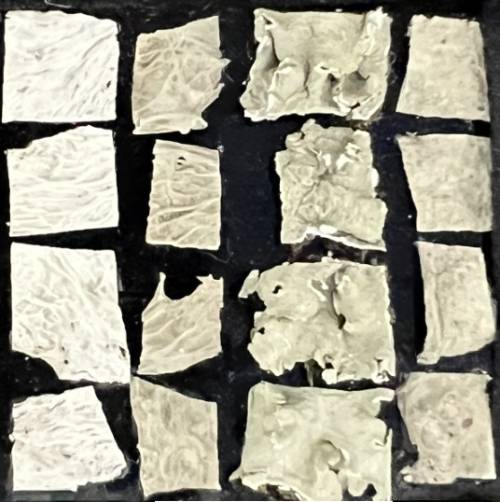
Dataset 1: Lichens (primary, supervised)
• Lichen specimens — fungus + photosynthetic partner symbiotic organism
• Autofluorescence reflects both components
• Acquisition:
– 8 excitations: 310, 325, 340, 365, 385, 400, 415, 430 nm
– Emission: 420 – 720 nm @ 10 nm step
– LED-based source + Nuance FX camera
• After Rayleigh cutoff: 192 valid (λ_ex, λ_em) pairs
• Ground truth: 4 morphological classes, ~190k annotated pixels
• Spatial: 1040 × 925 pixels
4 lichen species used in this study
Master's Thesis Defense — Narek Meloyan — 2026
17 / 31
Notes:
The primary dataset is lichens. Lichens are composite organisms — fungus plus a photosynthetic partner — and their autofluorescence captures both components, which makes them a natural fluorescence test case. We acquired on a custom LED-based source paired with a Nuance FX hyperspectral camera. Eight excitation wavelengths from 310 to 430 nanometers, emission from 420 to 720 nanometers at 10 nm step. After Rayleigh cutoff we have 192 valid (excitation, emission) pairs. Four morphological classes; about 190,000 annotated pixels in a 1040 by 925 image. This is our primary benchmark.

Slide 18
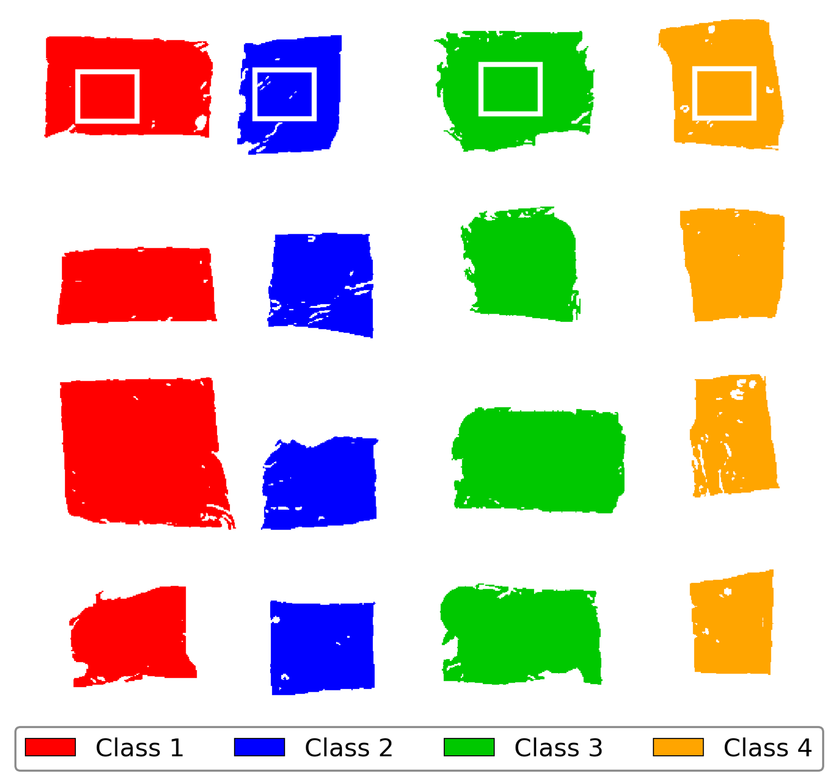
Lichens: ground truth and ROI training set
• 16 specimens in a 4 × 4 grid
• Columns = morphological class
• 4 small ROIs (top row) = training pixels
• Rest of each specimen = test set
– 11.5k train
– ~180k test
• ROIs used ONLY for the downstream classifier — selection is unsupervised
Master's Thesis Defense — Narek Meloyan — 2026
18 / 31
Notes:
Here's the ground truth layout. 16 specimens arranged in a 4 by 4 grid where columns correspond to the 4 morphological classes. The small rectangular ROIs in the top row are the supervised training pixels — about 11,500 of them. The rest of each specimen is the test set, roughly 180,000 pixels. The ROIs are used only for the downstream KNN classifier that validates the selection — the selection pipeline itself sees no labels at any stage.

Slide 19
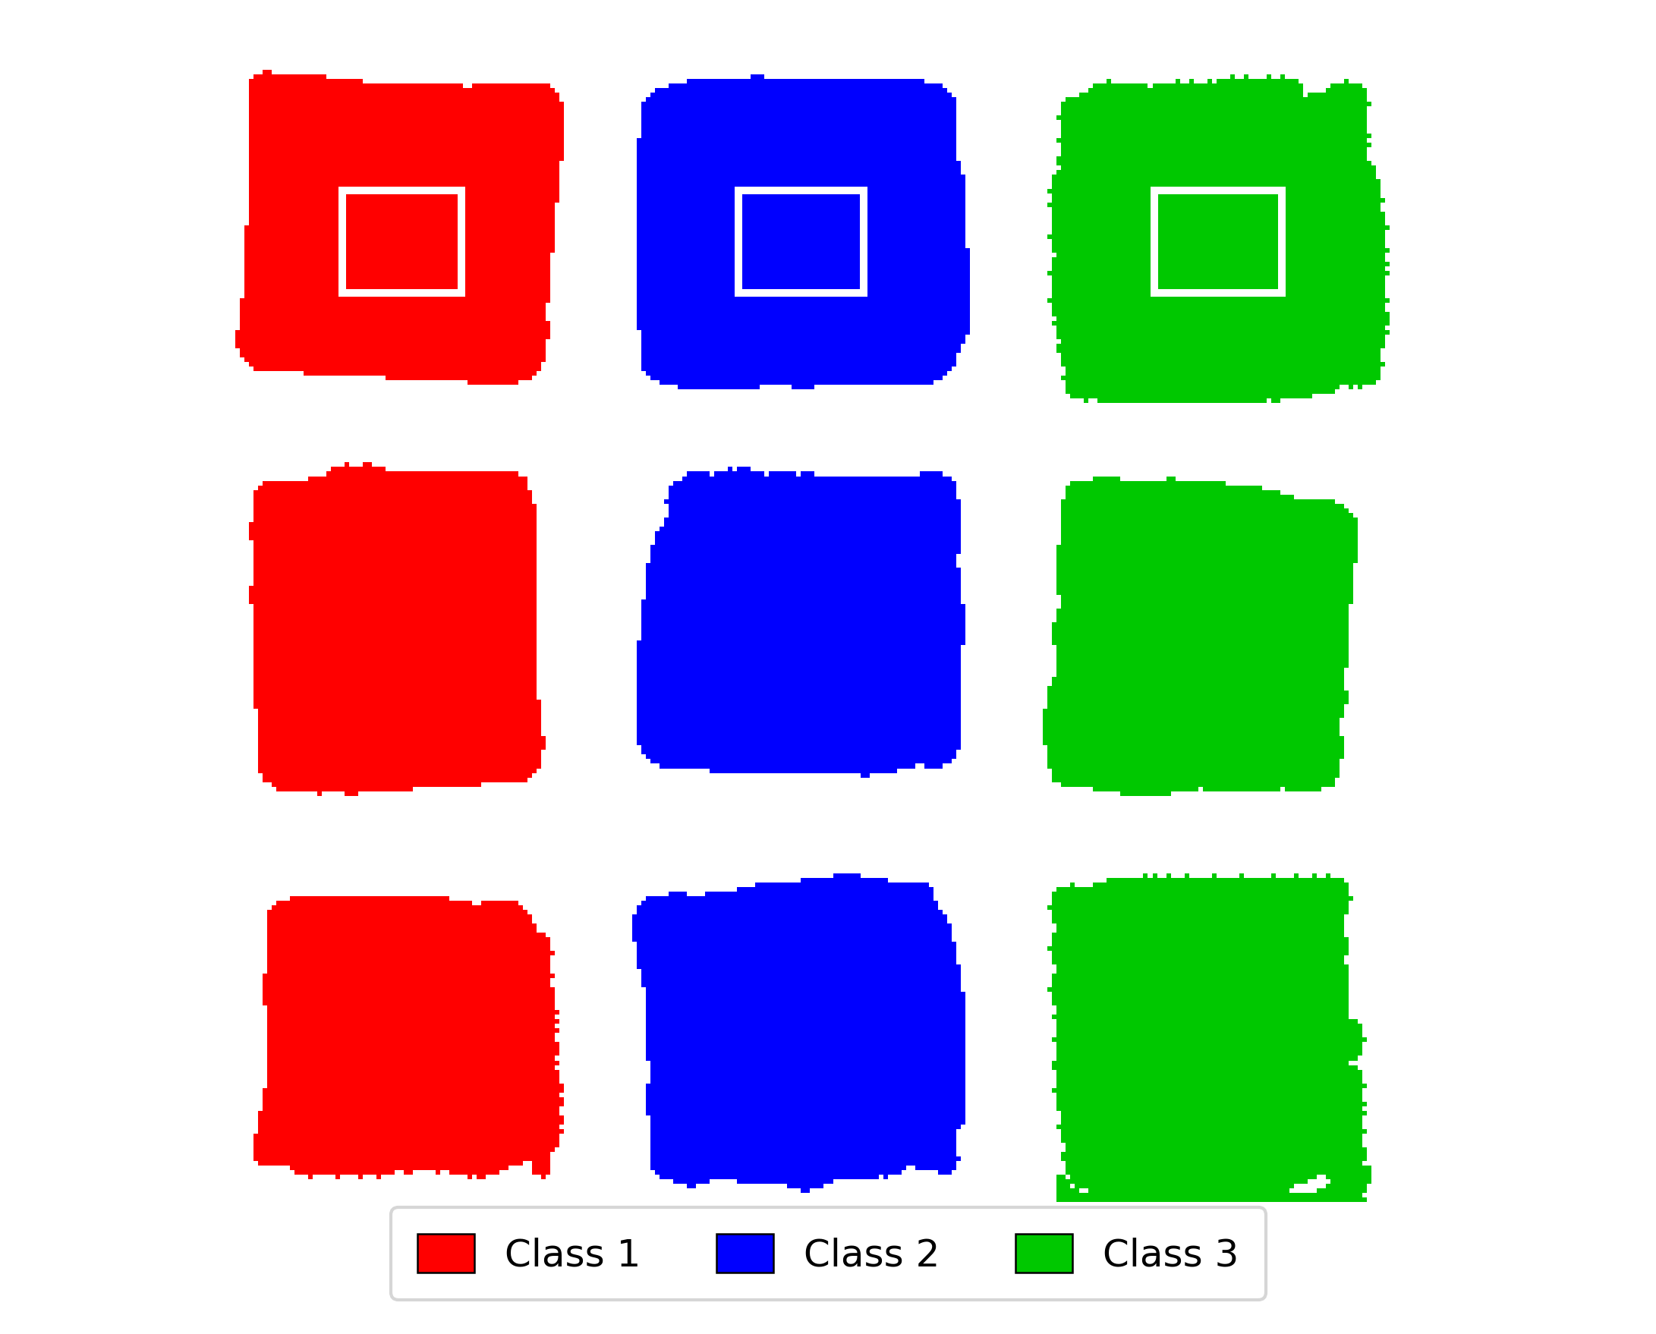
Dataset 2: Collagen Sponges (secondary, supervised)
• Collagen sponge samples prepared at 3 crosslinker concentrations
– Crosslinker concentration modulates fibril organization
– Produces measurable shifts in emission peak & intensity
• Tests cross-domain transfer (lichen → collagen chemistry)
• Acquisition:
– 6 excitations: 310, 325, 340, 365, 385, 400 nm (fewer than Lichens)
– Same camera + same emission grid
• After Rayleigh cutoff: 158 valid (λ_ex, λ_em) pairs
• Ground truth: 3 concentration classes, ~40k annotated pixels
3 × 3 grid: 3 crosslinker classes × 3 replicates
Master's Thesis Defense — Narek Meloyan — 2026
19 / 31
Notes:
The second dataset is Collagen Sponges. These are collagen sponge samples at three different crosslinker concentrations — the crosslinker modulates the fibril organization, producing measurable shifts in emission peak position and intensity. The key question this dataset answers is whether the framework, tuned on lichen biology, transfers to a chemically distinct fluorophore family without modification. Six excitation channels were used instead of eight — the longer-UV excitations added negligible signal in preliminary tests. After Rayleigh cutoff we have 158 valid pairs — a different grid from Lichens, so the selection task is genuinely new. The image on the right shows the 3 by 3 specimen layout, with the small interior ROIs in the top row marking the supervised training pixels.

Slide 20
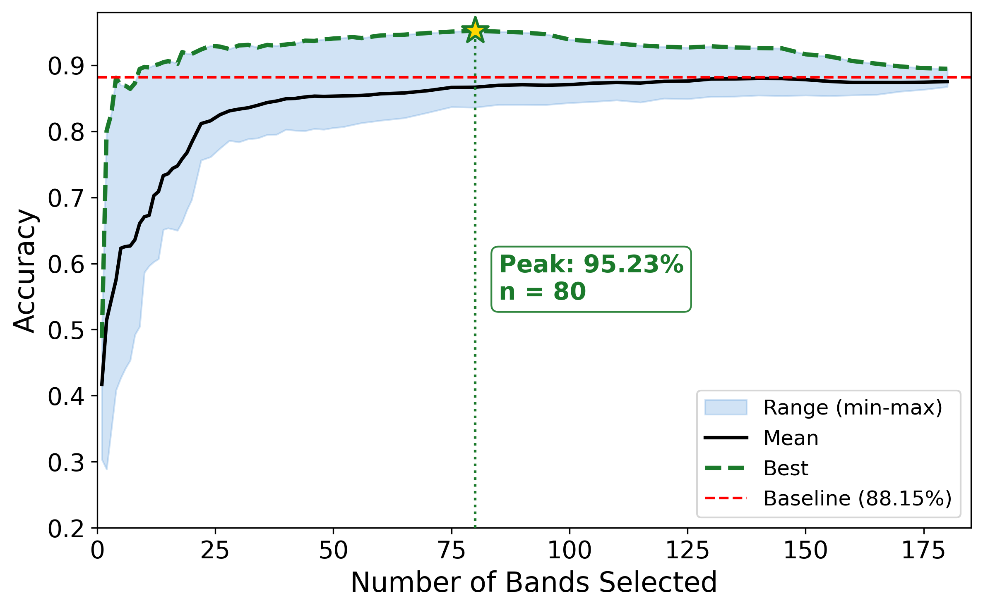
Lichens: accuracy vs. number of selected bands
• Headline results:
– 192 bands (baseline): 88.2%
– 80 bands: 95.2% (+7.0 pp, 58% reduction)
– 13 bands: 90.2% (+2.0 pp)
– 9 bands: 89.4% (+1.2 pp, 95% reduction)
• Above-baseline accuracy from K = 9 up to K ≈ 100
• Curve PEAKS at intermediate K — too many bands actively hurts
Master's Thesis Defense — Narek Meloyan — 2026
20 / 31
Notes:
Here's the headline Lichens result — the accuracy envelope from the full 3,072-config sweep. Each shaded band shows the range of accuracies different attribution configurations achieve at that K, the solid black line is the mean, and the dashed green line is the best configuration at each K. The dashed red line is the 192-band baseline at 88.2 percent. The selected bands actually exceed the baseline across a wide range. At 80 bands we hit 95.2 percent — 7 percentage points above baseline at 58 percent data reduction. At 9 bands we still beat baseline at 89.4 percent with 95 percent data reduction. The curve actually PEAKS at intermediate K — using too many bands hurts classification because they add noise.

Slide 21
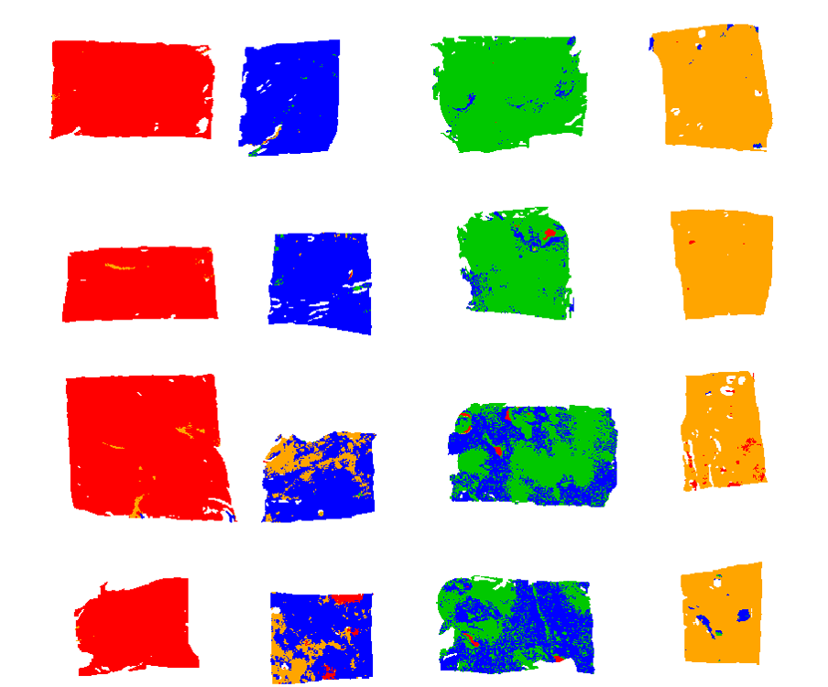
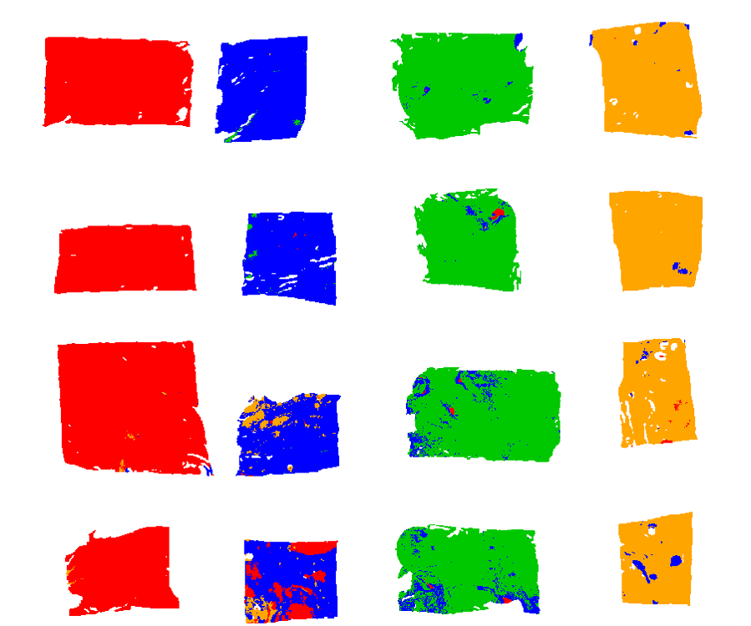
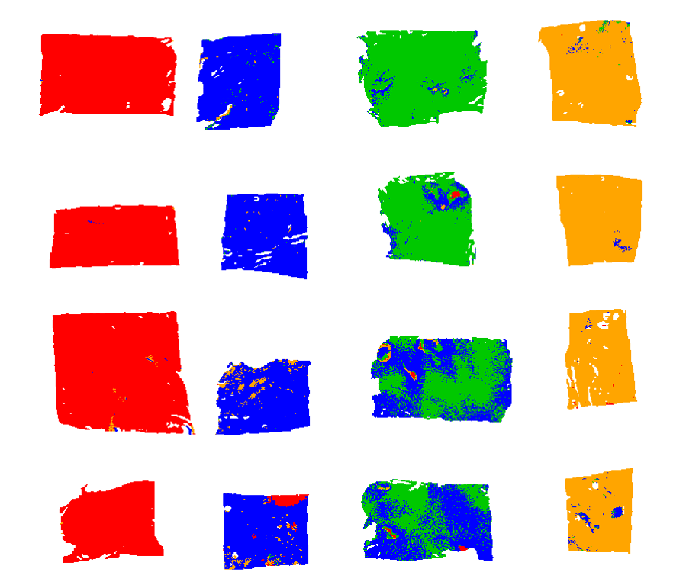
Lichens: spatial classification maps
Baseline (all 192 bands) 88.2% accuracy
K=80 (58% reduction) 95.2% accuracy
K=9 (95% reduction) 89.4% accuracy
Spatial homogeneity improves with selection; specimen boundaries sharpen at K=80
Master's Thesis Defense — Narek Meloyan — 2026
21 / 31
Notes:
Same result visualized as classification maps. Each map shows the pixel-wise predicted class for the 16 specimens. The baseline uses all 192 bands at 88.2 percent — you can see some boundary noise. The 80-band selection at 95.2 percent has visibly cleaner spatial structure and sharper specimen boundaries. The 9-band selection at 89.4 percent is still visually competitive with the baseline despite using 95 percent less data. The visual confirmation matters — the framework isn't just numerically better, it produces spatially cleaner outputs.

Slide 22
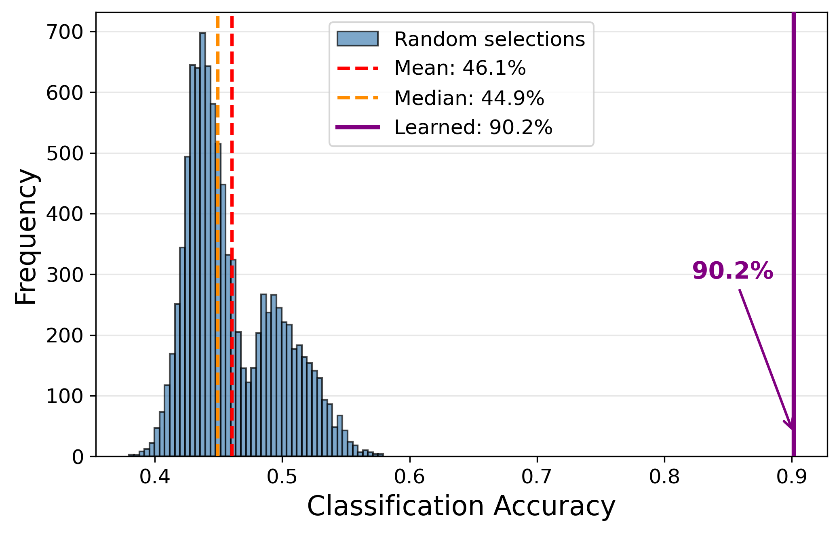
Lichens: validation against 10,000 random selections
• Compared the 13-band selection vs. 10,000 random 13-band combinations
• Random mean: 46.1% (median 44.9%)
• Random max: 57.9%
• Learned selection: 90.2%
• 12σ separation from random mean
• p ≪ 10⁻²⁰ — NOT chance
• Selection IS load-bearing — not a lucky subset
Master's Thesis Defense — Narek Meloyan — 2026
22 / 31
Notes:
First validation: are these results just lucky? I sampled 10,000 random 13-band combinations from the 192 available and applied the same downstream classifier. The random distribution has a mean of 46.1 percent and a max of 57.9 percent. Our learned selection hits 90.2 percent — 12 standard deviations above the random mean. The p-value is vanishingly small. The framework is identifying genuinely informative bands, not lucky combinations.

Slide 23
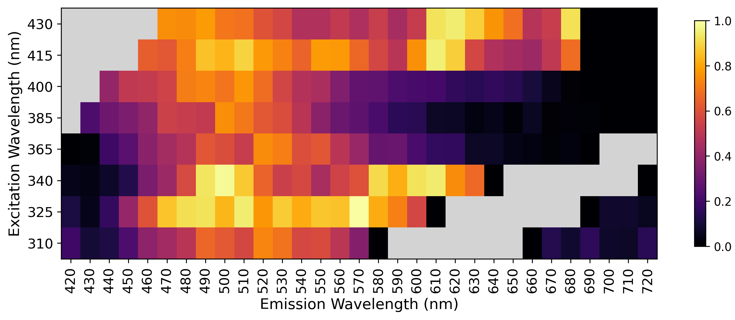
Lichens: which wavelengths matter?
• Mean importance across all above-baseline configs
• Hot region: 480 – 620 nm emission, 325 – 400 nm excitation
• Matches chlorophyll & lichen autofluorescence physics
• 9-band optimal config selects ONE band per excitation — directly actionable for sensor design
Master's Thesis Defense — Narek Meloyan — 2026
23 / 31
Notes:
This heatmap shows mean wavelength importance across all above-baseline configurations. Bright cells are consistently top-ranked; dark cells are rarely selected. The hot region spans roughly 480 to 620 nanometers emission with excitations 325 to 400 doing most of the work. This matches what we know about lichen autofluorescence physics — chlorophyll and related fluorophores emit in this range. And importantly, the 9-band optimal configuration selects exactly ONE band per excitation source. That's directly actionable for sensor design: you could build a system with 9 filters, one per LED, and recover this performance.

Slide 24
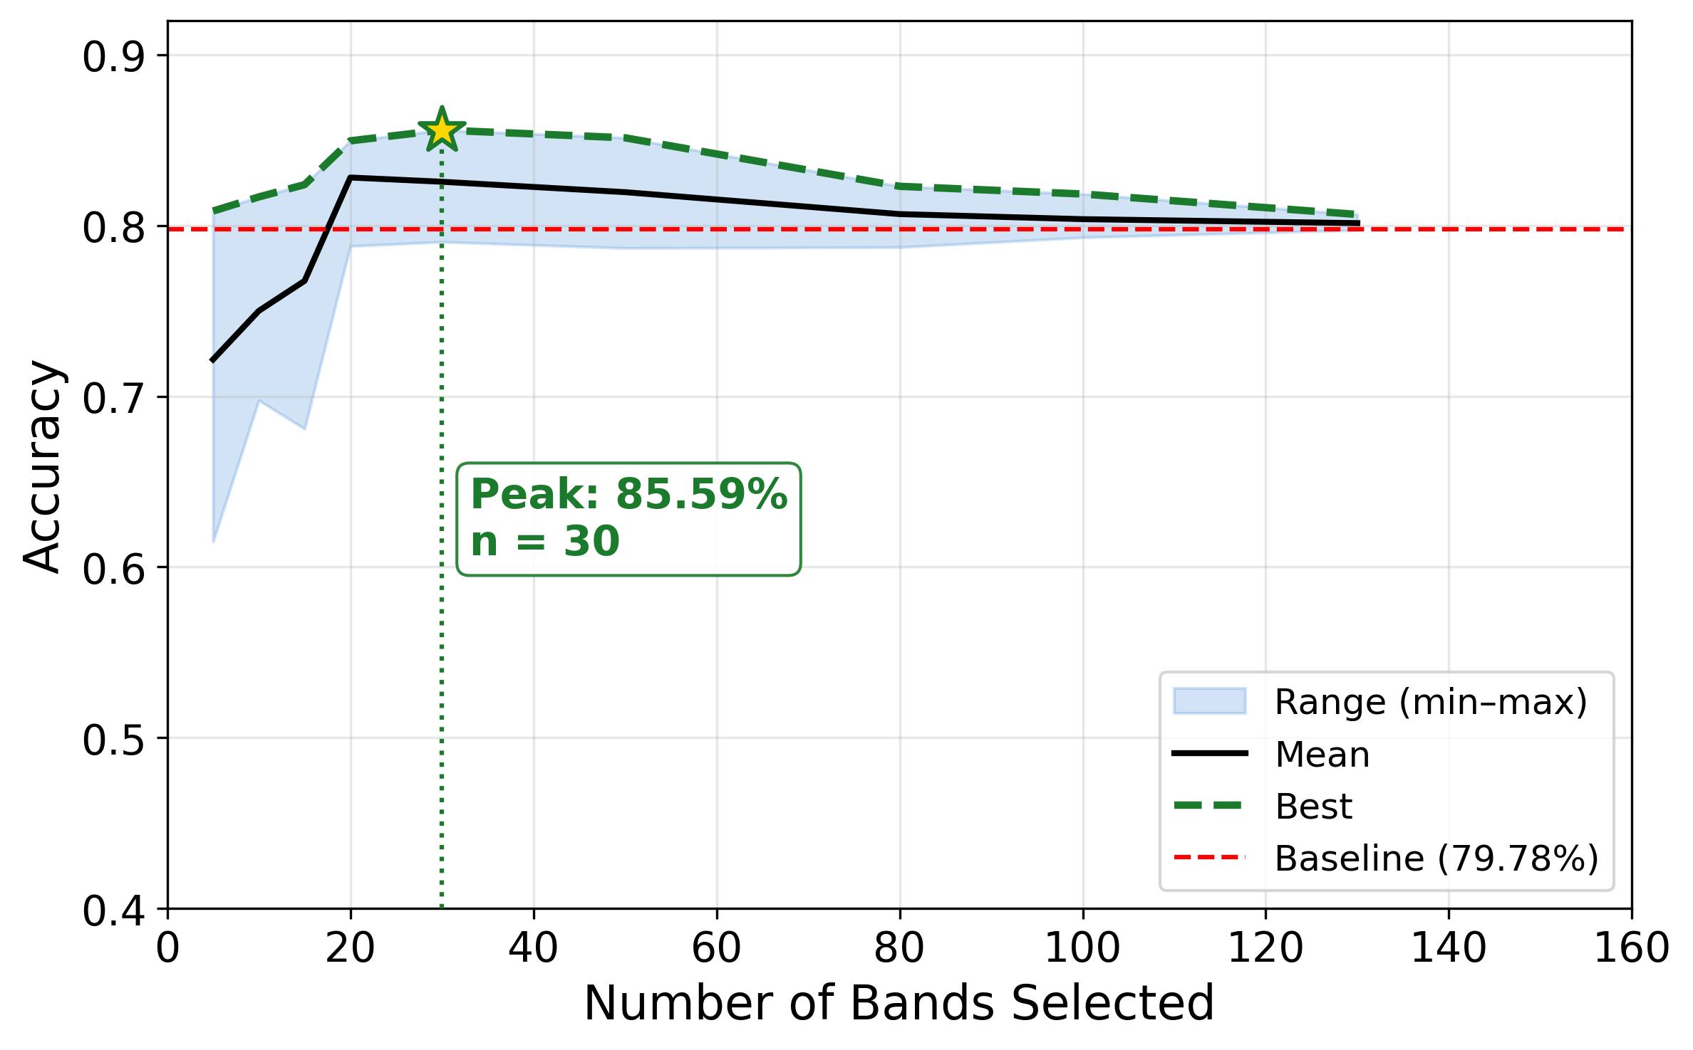
Collagen Sponges: accuracy vs. selected bands
• 158 bands (baseline): 79.8%
• 5 bands: 80.9% (+1.1 pp)
• 10 bands: 81.7% (+1.9 pp)
• 15 bands: 82.4% (+2.6 pp)
• 20 bands: 85.0% (+5.2 pp)
• 30 bands: 85.6% (+5.8 pp) — peak
• Every K from 5 to 130 exceeds baseline
• Same pipeline, no retuning
Master's Thesis Defense — Narek Meloyan — 2026
24 / 31
Notes:
Now Collagen Sponges. Same pipeline, no retuning. The 158-band baseline is 79.8 percent. With just 5 bands we already exceed it at 80.9 percent. The peak is at 30 bands with 85.6 percent — 5.8 percentage points above baseline at 81 percent data reduction. Every K from 5 to 130 exceeds the baseline. This is important because it shows the framework transfers across sample chemistries — lichen and collagen autofluorescence have different fluorophore populations, but the same selection method works on both.

Slide 25
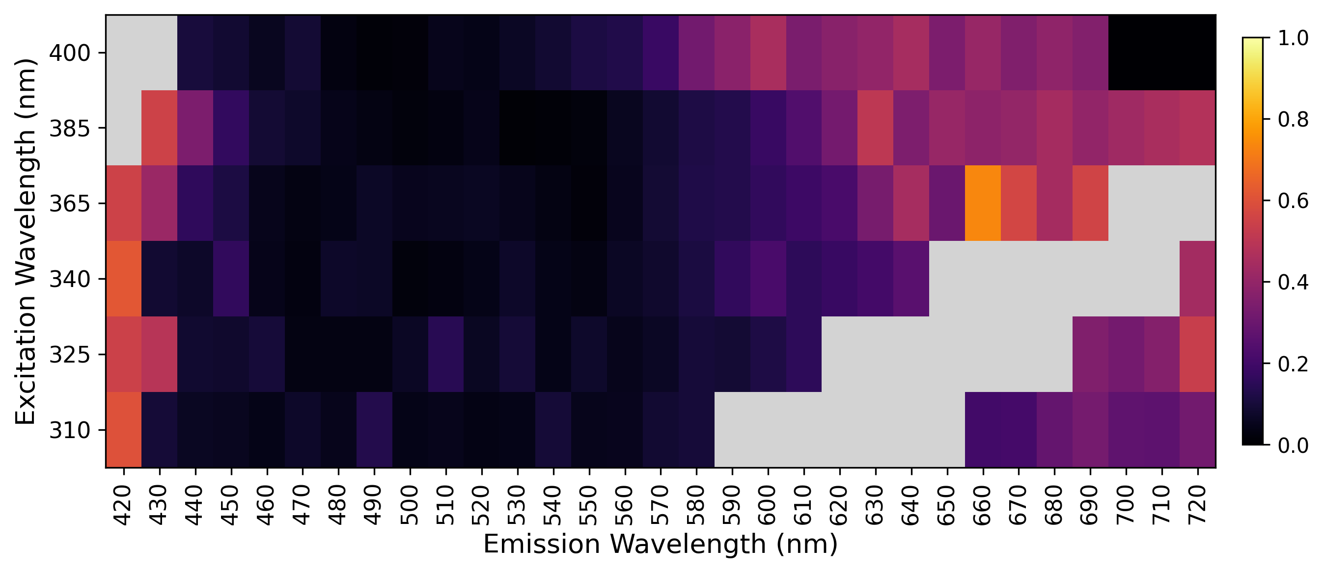
Collagen Sponges: wavelength importance map
• 6 excitations × emission bands
• Hot region:
– 600 – 690 nm emission
– 365 – 400 nm excitation
• Matches collagen autofluorescence physics:
– Crosslinker-modulated AGE emission
– Native collagen near short-wave edge
• Grey: Rayleigh-invalid cells
Master's Thesis Defense — Narek Meloyan — 2026
25 / 31
Notes:
Same wavelength importance heatmap structure as Lichens but for Collagen Sponges. Bright = consistently top-ranked across configurations. The hot region concentrates at 600 to 690 nanometers emission under 365 to 400 nanometer excitation. There's a secondary band at the short-wavelength edge across all excitations. This matches the chemistry: the long-wavelength region captures advanced glycation end-product cross-link emission, which scales with crosslinker concentration; the short-wave shoulder is native collagen fluorescence. Grey cells are Rayleigh-invalid positions.

Slide 26
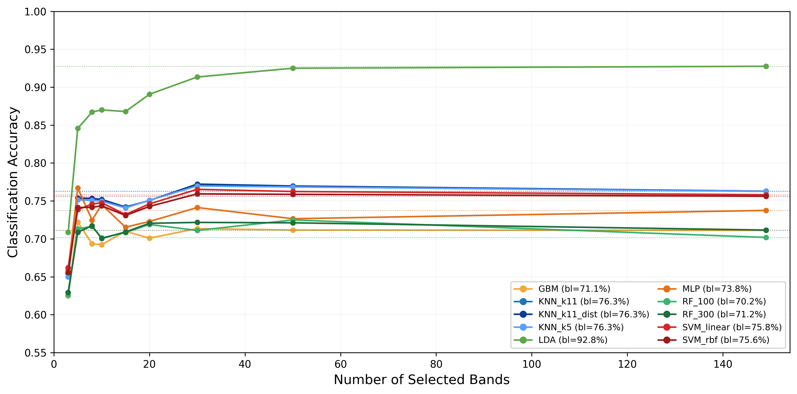
Collagen Sponges: classifier-family generalization
• Same selection, 10 different classifiers:
– KNN (5, 11) — uniform + distance
– LDA
– SVM (linear, RBF)
– MLP
– Random Forest (100, 300)
– Gradient Boosting
• 9 of 10 classifiers benefit
• LDA peaks: 92.5% on K=50 (vs. 92.8% on all 158)
• Selected bands carry PORTABLE information — not KNN-tuned
Master's Thesis Defense — Narek Meloyan — 2026
26 / 31
Notes:
Second validation: classifier-family generalization. To test whether the gains depend on the specific KNN classifier used for scoring, I evaluated ten different classifiers on the same selection — two KNN variants, LDA, two SVM kernels, MLP, two Random Forest sizes, and Gradient Boosting. Nine of ten benefit from the selection. The most striking result: Linear Discriminant Analysis at K=50 hits 92.5 percent accuracy, which is within 0.3 percentage points of the 92.8 percent it achieves on all 158 bands. The linearly separable structure of the data is essentially preserved by the selection. The bands are intrinsically informative, not tuned to one classifier.

Slide 27
Discussion: what does this mean?
• Across two ME-HSI datasets (lichens, collagen sponges):
– Selected wavelengths consistently MEET or EXCEED the full-spectrum baseline
– At 80 – 95% data reduction — i.e. fewer channels, faster inference
• Three reasons it works:
– Causal attribution: perturbation measures what the network DEPENDS on, not just what's variable
– Joint 4D representation: cross-excitation correlations captured by parallel branches + averaging
– Diversity-aware MMR: prevents redundant clustered selections
• Cross-domain transfer:
– Same pipeline, no retuning, works on two chemically distinct samples
– Only the dim-scoring strategy (PCA-k=3 for Lichens, variance-k=1 for Collagen) needs per-dataset choice
Master's Thesis Defense — Narek Meloyan — 2026
27 / 31
Notes:
So what does this mean. Across both datasets, the selected wavelengths meet or exceed the full-spectrum baseline at 80 to 95 percent data reduction. Three reasons this works. First, perturbation gives a causal attribution — it measures what the network actually depends on, unlike variance which just measures variability. Second, the parallel-branch architecture with averaging is what makes this 4D-aware — it captures cross-excitation correlations that per-band methods miss. Third, MMR's diversity term prevents the kind of clustered selections that pure relevance-ranking produces. The same pipeline works on both datasets without retuning. The only meaningful per-dataset knob is the dimension-scoring strategy — Lichens prefers PCA with k=3, Collagen Sponges prefers variance with k=1.

Slide 28
Limitations & honest scope
• Computational cost:
– Full pipeline ~2 hr on RTX 4070 for Lichens (~30 min train + ~90 min sweep)
– 75% of compute is the perturbation phase — embarrassingly parallel, ~3× speedup possible
– One-time per sample type — amortised over downstream inference (K/192 ≈ 21× faster at K=9)
• Black-box attribution:
– Perturbation tells WHICH bands matter, not WHY (in chemical terms)
– Linking selections to specific fluorophores still requires domain expertise
• Threshold selection:
– User must specify K — automated elbow detection is future work
• Dataset breadth:
– Two ME-HSI fluorescence datasets; extending to remote-sensing HSI is future work
Master's Thesis Defense — Narek Meloyan — 2026
28 / 31
Notes:
Honest limitations. First, computational cost: training plus the perturbation sweep takes about 2 hours on our RTX 4070 for Lichens. Seventy-five percent of that is the perturbation phase — which is embarrassingly parallel, and an optimised implementation could shave another 3x. The cost is one-time per sample type, and it's amortised over all downstream inferences — those are about 21 times faster at K=9. Second, the attribution is black-box in the chemical sense — perturbation tells which bands matter, not always why; mapping our selections to specific fluorophores still requires domain expertise. Third, the user has to specify K — we don't auto-detect the elbow. Fourth, dataset breadth: I evaluated on two ME-HSI fluorescence datasets here; extending to remote-sensing HSI is future work.

Slide 29
Conclusion & future directions
• Summary:
– First deep-learning wavelength selection method designed for 4D ME-HSI
– Three stages: parallel-branch 3D CAE + perturbation attribution + MMR diversity
– Lichens: 95.2% @ K=80 (108% of baseline) | 89.4% @ K=9 (95% reduction)
– Collagen Sponges: 85.6% @ K=30 (107% of baseline)
– Validated via robustness vs 10,000 random AND classifier-family generalization (10 classifiers)
• Future work:
– Larger ME-HSI corpus: more sample types, more excitation grids
– Automated K selection via reconstruction-knee or stability criteria
– Interpretable attribution: link selected bands to fluorophore databases
– Uncertainty quantification via variational autoencoders
Master's Thesis Defense — Narek Meloyan — 2026
29 / 31
Notes:
To conclude. The contribution: the first deep-learning wavelength selection method designed specifically for 4D ME-HSI. Three stages: a parallel-branch convolutional autoencoder, perturbation-based attribution, and MMR diversity. On Lichens, 95 percent accuracy with 80 of 192 bands, or 89 percent with just 9 of 192. On Collagen Sponges, 86 percent with 30 of 158 bands. Validated via two complementary procedures — random-baseline robustness on Lichens and ten-classifier generalization on Collagen Sponges. Future directions include larger datasets, automated K selection, fluorophore-level interpretation, and uncertainty quantification via variational autoencoders.

Slide 30
Image credits & acknowledgments
Third-party images used in this presentation
• All third-party images sourced from Wikimedia Commons under Creative Commons licenses
• Slide 3 — vision in nature:
– Honeybee on flower; Male monarch butterfly; Mantis shrimp (Gilli Banta reef); EM spectrum band
• Slide 4 — HSI applications: Landsat-5 false-colour, Ethiopia (NASA / USGS, public domain)
• Slide 5 — biomedicine: GFP super-resolution micrograph, Christoph Cremer
• Slide 6 — fluorescence: Jablonski diagram; Fluorescent minerals under UV, Hannes Grobe
• Slides 1, 7, 9 — HSI cubes: Mono / Multi / Hyperspectral spectral signatures illustration
• Full attribution table: MasterThesis_Narek_Meloyan/images_third_party/CREDITS.md
Project figures (datasets, results, classification maps) are original work generated from the spectral-select pipeline.
Master's Thesis Defense — Narek Meloyan — 2026
30 / 31
Notes:
Quick acknowledgment slide. All the conceptual / vision-biology / fluorescence-physics images used in the introduction are from Wikimedia Commons under Creative Commons licenses; the satellite image is NASA / USGS public domain. Project figures — the datasets, results, classification maps, accuracy envelopes, wavelength heatmaps — are all original work generated by the spectral-select pipeline. Full attribution table lives in the repository.

Slide 31
Thank you
Questions?
Code: github.com/Nard248/spectral-select
narek_meloyan@edu.aua.am
Notes:
Thank you for your attention. I'd be happy to take questions. Code is available on GitHub if anyone wants to look at the implementation; my email is on the slide for follow-up.

