Slide 1
PyTorch Tutorial

Slide 2
1. git clone https://github.com/Nardien/samsung_text_classification 2. cd samsung_text_classification 3. jupyter notebook => 인터넷 창 열림 => dependencies.ipynb 클릭 => shift + enter

Slide 3

What is PyTorch?
Developed by Facebook
Python first
Dynamic Neural Network
This tutorial is for PyTorch 0.2.0
Endorsed by Director of AI at Tesla

Slide 4
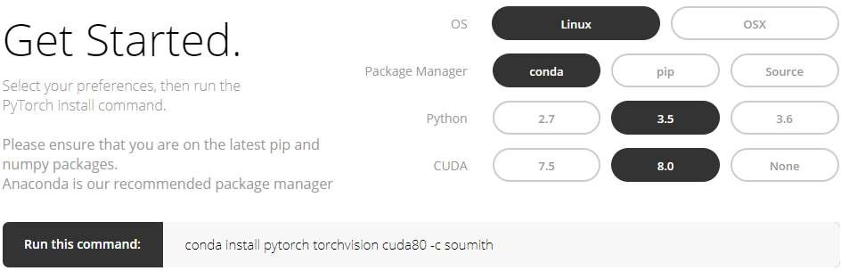
Installation
PyTorch Web: http://pytorch.org/

Slide 5
Packages of PyTorch
This Tutorial
Package
Description
torch torch.autograd
a Tensor library like Numpy, with strong GPU support
a tape based automatic differentiation library that supports all differentiable Tensor operations in torch
a neural networks library deeply integrated with autograd designed for maximum flexibility
an optimization package to be used with torch.nn with standard optimization methods such as SGD, RMSProp, LBFGS, Adam etc.
python multiprocessing, but with magical memory sharing of torch Tensors across processes. Useful for data loading and hogwild training.
DataLoader, Trainer and other utility functions for convenience
torch.nn
torch.optim
torch.multiprocessing
torch.utils torch.legacy(.nn/.optim)
legacy code that has been ported over from torch for backward compatibility reasons

Slide 6
Outline
Neural Network in Brief
Concepts of PyTorch
RNN
Comparison with TensorFlow

Slide 7
Neural Network in Brief
Supervised Learning
– Learning a function f, that f(x)=y
Trying to learn f(.), that f(x)=y Data Label
X1 Y1
X2 Y2
… …

Slide 8
Neural Network in Brief
Big Data
Batch 1
Batch 2
Neural Network
1 Epoch
Batch 3
Data
W_{i}
…
Batch N
N=Big Data/Batch Size

Slide 9
Neural Network in Brief
Big Data
Forward Process: from data to label
Batch 1
Forward
Batch 2
Neural Network
1 Epoch
Batch 3
Data
W_{i}
Label’
…
Batch N
N=Big Data/Batch Size

Slide 10
Neural Network in Brief
Big Data
Forward Process: from data to label
Batch 1
Forward
Batch 2
Neural Network
1 Epoch
Batch 3
Data
W_{i}
Label’
Loss
Label
…
Batch N
N=Big Data/Batch Size

Slide 11
Neural Network in Brief
Big Data
Forward Process: from data to label
Batch 1
Forward
Batch 2
Neural Network
1 Epoch
Batch 3
Data
W_{i}-> W_{i+1}
Label’
Loss
Label
…
Batch N
Optimizer
N=Big Data/Batch Size
Backward
Backward Process: update the parameters

Slide 12
Neural Network in Brief
Inside the Neural Network Forward
Data
…
W W W W W Label’
_{Backward} Gradient
Forward
Neural Network
Data
W_{i}-> W_{i+1}
Label’
Loss
Label
Optimizer
Backward

Slide 13
Neural Network in Brief
Inside the Neural Network Forward
Data
…
W W W W W Label’
_{Backward} Gradient
Forward
Neural Network
Data
W_{i}-> W_{i+1}
Label’
Loss
Label
Data in the Neural Network
Optimizer
Tensor (n-dim array)
Gradient of Functions
Backward

Slide 14
Concepts of PyTorch
Modules of PyTorch
Data:
Tensor
Forward
Neural Network
Function:
Data
W_{i}-> W_{i+1}
Label’
Loss
Label
NN Modules
Optimizer
Loss Function
Optimizer
Backward

Slide 15
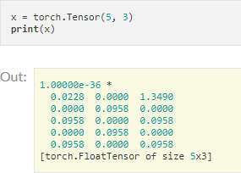
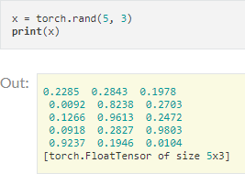
Concepts of PyTorch
Modules of PyTorch • Similar to Numpy
Data:
Tensor
Function:
NN Modules
Optimizer
Loss Function

Slide 16
Concepts of PyTorch
Modules of PyTorch
Data:
Tensor
Function:
NN Modules
Optimizer
Loss Function
Operations
z=x+y
torch.add(x,y, out=z)
y.add_(x) # in-place

Slide 17
Concepts of PyTorch
Modules of PyTorch • Numpy Bridge
Data:
Tensor
To Numpy
a = torch.ones(5)
b = a.numpy()
Function:
NN Modules
Optimizer
Loss Function
To Tensor
a = numpy.ones(5)
b = torch.from_numpy(a)

Slide 18
Concepts of PyTorch
Modules of PyTorch • CUDA Tensors
Data:
Tensor
Move to GPU
x = x.cuda()
y = y.cuda()
x+y
Function:
NN Modules
Optimizer
Loss Function

Slide 19
Concepts of PyTorch
Modules of PyTorch
Data:
Tensor
Forward
Neural Network
Function:
Data
W_{i}-> W_{i+1}
Label’
Loss
Label
NN Modules
Optimizer
Loss Function
Optimizer
Backward

Slide 20
Neural Network in Brief
Inside the Neural Network Forward
Data
…
W W W W W Label’
_{Backward} Gradient
Forward
Neural Network
Data
W_{i}-> W_{i+1}
Label’
Loss
Label
Data in the Neural Network
Optimizer
Tensor (n-dim array)
Gradient of Functions
Backward

Slide 21
•
http://pytorch.org/tutorials/beginner/blitz/neural_networks_tutorial.html#define-the-network

Slide 22
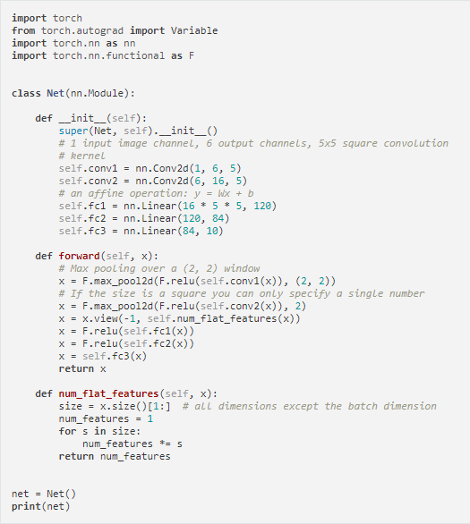
Define modules (must have)
Build network (must have)
•
http://pytorch.org/tutorials/beginner/blitz/neural_networks_tutorial.html#define-the-network

Slide 23
x
[Channel, H, W]: 1x32x32->6x28x28
conv1
relu pooling
Define modules (must have)
conv2
relu
pooling
Build network (must have)
fc1
relu
fc2 relu
fc3
•
http://pytorch.org/tutorials/beginner/blitz/neural_networks_tutorial.html#define-the-network

Slide 24
x
conv1
[Channel, H, W]: 6x28x28
relu
pooling
Define modules (must have)
conv2
relu
pooling
Build network (must have)
fc1
relu
fc2 relu
fc3
•
http://pytorch.org/tutorials/beginner/blitz/neural_networks_tutorial.html#define-the-network

Slide 25
x
conv1 relu
[Channel, H, W]: 6x28x28 -> 6x14x14
pooling
Define modules (must have)
conv2
relu
pooling
Build network (must have)
fc1
relu
fc2 relu
fc3
•
http://pytorch.org/tutorials/beginner/blitz/neural_networks_tutorial.html#define-the-network

Slide 26
x
conv1
relu pooling
Define modules (must have)
[Channel, H, W]: 6x14x14 -> 16x10x10
conv2
relu
pooling
Build network (must have)
fc1
relu
fc2 relu
fc3
•
http://pytorch.org/tutorials/beginner/blitz/neural_networks_tutorial.html#define-the-network

Slide 27
x
conv1
relu pooling
Define modules (must have)
conv2
[Channel, H, W]: 16x10x10
relu
pooling
Build network (must have)
fc1
relu
fc2 relu
fc3
•
http://pytorch.org/tutorials/beginner/blitz/neural_networks_tutorial.html#define-the-network

Slide 28
x
conv1
relu pooling
Define modules (must have)
conv2
relu
[Channel, H, W]: 16x10x10 -> 16x5x5
pooling
Build network (must have)
fc1
relu
fc2 relu
fc3
•
http://pytorch.org/tutorials/beginner/blitz/neural_networks_tutorial.html#define-the-network

Slide 29
x
conv1
relu pooling
Define modules (must have)
conv2
relu
pooling
Build network (must have)
Flatten the Tensor
16x5x5
fc1
relu
fc2
Tensor: [Batch N, Channel, H, W]
relu
fc3
•
http://pytorch.org/tutorials/beginner/blitz/neural_networks_tutorial.html#define-the-network

Slide 30
x
conv1
relu pooling
Define modules (must have)
conv2
relu
pooling
Build network (must have)
fc1
relu
fc2 relu
fc3
•
http://pytorch.org/tutorials/beginner/blitz/neural_networks_tutorial.html#define-the-network

Slide 31
x
conv1
relu pooling
Define modules (must have)
conv2
relu
pooling
Build network (must have)
fc1
relu
fc2 relu
fc3
•
http://pytorch.org/tutorials/beginner/blitz/neural_networks_tutorial.html#define-the-network

Slide 32
x
conv1
relu pooling
Define modules (must have)
conv2
relu
pooling
Build network (must have)
fc1
relu
fc2 relu
fc3
•
http://pytorch.org/tutorials/beginner/blitz/neural_networks_tutorial.html#define-the-network

Slide 33
x
conv1
relu pooling
Define modules (must have)
conv2
relu
pooling
Build network (must have)
fc1
relu
fc2 relu
fc3
•
http://pytorch.org/tutorials/beginner/blitz/neural_networks_tutorial.html#define-the-network

Slide 34
x
conv1
relu pooling
Define modules (must have)
conv2
relu
pooling
Build network (must have)
fc1
relu
fc2 relu
fc3
•
http://pytorch.org/tutorials/beginner/blitz/neural_networks_tutorial.html#define-the-network

Slide 35
Concepts of PyTorch
Modules of PyTorch • NN Modules (torch.nn)
Data:
Modules built on Variable
Gradient handled by PyTorch
Tensor
Common Modules
Convolution layers
Linear layers
Pooling layers
Dropout layers
Etc…
Function:
NN Modules
Optimizer
Loss Function

Slide 36
NN Modules
Convolution Layer
N-th Batch (N), Channel (C)
torch.nn.Conv1d: input [N, C, W] # moving kernel in 1D
torch.nn.Conv2d: input [N, C, H, W] # moving kernel in 2D
torch.nn.Conv3d: input [N, C, D, H, W] # moving kernel in 3D
Example:
torch.nn.conv2d(in_channels=3, out_channels=16, kernel_size=3, padding=1)

Slide 37
NN Modules
Convolution Layer
N-th Batch (N), Channel (C)
torch.nn.Conv1d: input [N, C, W] # moving kernel in 1D
torch.nn.Conv2d: input [N, C, H, W] # moving kernel in 2D
torch.nn.Conv3d: input [N, C, D, H, W] # moving kernel in 3D
Input for Conv2d
^{H}in ^{W}in
^{C}in
*: convolution

Slide 38

NN Modules
Convolution Layer
N-th Batch (N), Channel (C)
torch.nn.Conv1d: input [N, C, W] # moving kernel in 1D
torch.nn.Conv2d: input [N, C, H, W] # moving kernel in 2D
torch.nn.Conv3d: input [N, C, D, H, W] # moving kernel in 3D
Input for Conv2d 1st kernel
k
k
^{C}in
^{H}in
*
^{W}in
^{C}in
*: convolution

Slide 39
NN Modules
Convolution Layer
N-th Batch (N), Channel (C)
torch.nn.Conv1d: input [N, C, W] # moving kernel in 1D
torch.nn.Conv2d: input [N, C, H, W] # moving kernel in 2D
torch.nn.Conv3d: input [N, C, D, H, W] # moving kernel in 3D
Input for Conv2d 1st kernel
k
k
^{C}in
^{H}out
^{H}in
*
=
^{W}out
1
^{W}in
^{C}in
*: convolution

Slide 40
NN Modules
Convolution Layer
N-th Batch (N), Channel (C)
torch.nn.Conv1d: input [N, C, W] # moving kernel in 1D
torch.nn.Conv2d: input [N, C, H, W] # moving kernel in 2D
torch.nn.Conv3d: input [N, C, D, H, W] # moving kernel in 3D
Input for Conv2d 1st kernel
k
k
^{C}in
^{H}out
^{H}in
*
=
^{W}out
p=1
1
^{W}in
^{C}in
d=1 k=3
s=1, moving step size
*: convolution

Slide 41
NN Modules
Convolution Layer
p=1
N-th Batch (N), Channel (C)
torch.nn.Conv1d: input [N, C, W] # moving kernel in 1D
torch.nn.Conv2d: input [N, C, H, W] # moving kernel in 2D
torch.nn.Conv3d: input [N, C, D, H, W] # moving kernel in 3D
Input for Conv2d 1st kernel
k
k
^{C}in
^{H}out
^{H}in
*
=
^{W}out
p=1
1
^{W}in
^{C}in
d=1 k=3
s=1, moving step size
*: convolution

Slide 42
NN Modules
Convolution Layer
p=1
N-th Batch (N), Channel (C)
torch.nn.Conv1d: input [N, C, W] # moving kernel in 1D
torch.nn.Conv2d: input [N, C, H, W] # moving kernel in 2D
torch.nn.Conv3d: input [N, C, D, H, W] # moving kernel in 3D
k=3
Input for Conv2d 1st kernel
k
k
^{C}in
^{H}out
^{H}in
*
=
^{W}out
p=1
1
^{W}in
^{C}in
d=1 k=3
s=1, moving step size
*: convolution

Slide 43

NN Modules
Convolution Layer
p=1
N-th Batch (N), Channel (C)
torch.nn.Conv1d: input [N, C, W] # moving kernel in 1D
torch.nn.Conv2d: input [N, C, H, W] # moving kernel in 2D
torch.nn.Conv3d: input [N, C, D, H, W] # moving kernel in 3D
k=3
s=1
Input for Conv2d 1st kernel
k
k
^{C}in
^{H}out
^{H}in
*
=
^{W}out
p=1
1
^{W}in
^{C}in
d=1 k=3
s=1, moving step size
*: convolution

Slide 44

NN Modules
Convolution Layer
N-th Batch (N), Channel (C)
torch.nn.Conv1d: input [N, C, W] # moving kernel in 1D
torch.nn.Conv2d: input [N, C, H, W] # moving kernel in 2D
torch.nn.Conv3d: input [N, C, D, H, W] # moving kernel in 3D
Input for Conv2d 1st kernel
k
k
^{C}in
…
^{H}out
^{H}in
*
=
^{W}out
1…
^{W}in
^{C}in
C -th kernel
k
out
^{H}out
=
*
k
*: convolution
C
^{W}out
in
1

Slide 45
NN Modules
Convolution Layer
N-th Batch (N), Channel (C)
torch.nn.Conv1d: input [N, C, W] # moving kernel in 1D
torch.nn.Conv2d: input [N, C, H, W] # moving kernel in 2D
torch.nn.Conv3d: input [N, C, D, H, W] # moving kernel in 3D
Input for Conv2d 1st kernel
k
k
^{C}in
…
^{H}out
^{H}in
*
=
^{W}out
^{H}out
1
…
^{W}in
^{C}in
C -th kernel
k
out
^{W}out
^{H}out
C
=
out
*
k
*: convolution
C
^{W}out
in
1

Slide 46

NN Modules
Convolution Layer
N-th Batch (N), Channel (C)
torch.nn.Conv1d: input [N, C, W] # moving kernel in 1D
torch.nn.Conv2d: input [N, C, H, W] # moving kernel in 2D
torch.nn.Conv3d: input [N, C, D, H, W] # moving kernel in 3D
Input for Conv2d 1st kernel
k
k
^{C}in
…
^{H}in
*
# of parameters
^{W}in
^{C}in
C -th kernel
k
out
*
k
*: convolution
^{C}in

Slide 47
NN Modules
Linear Layer
torch.nn.Linear(in_features=3, out_features=5)
y=Ax+b

Slide 48
NN Modules
Dropout Layer
torch.nn.Dropout(p)
Random zeros the input with probability p
Output are scaled by 1/(1-p)
If dropout here

Slide 49
NN Modules
Pooling Layer
torch.nn.AvgPool2d(kernel_size=2, stride=2, padding=0)
torch.nn.MaxPool2d(kernel_size=2, stride=2, padding=0)
s=2, moving step size
k=2
p=0
d=1 k=2
s=2, moving step size

Slide 50
Concepts of PyTorch
Modules of PyTorch • NN Modules (torch.nn)
Data:
Modules built on Variable
Gradient handled by PyTorch
Tensor
Variable (for Gradient)
Common Modules
Convolution layers
Linear layers
Pooling layers
Dropout layers
Etc…
Function:
NN Modules
Optimizer
Loss Function

Slide 51
Concepts of PyTorch
Modules of PyTorch • Optimizer (torch.optim)
SGD
Adagrad
Adam
RMSprop
– …
9 Optimizers
Data:
Tensor
Variable (for Gradient)
Function:
NN Modules
Optimizer
Loss Function
Loss (torch.nn)
L1Loss
MSELoss
CrossEntropy
– …
18 Loss Functions

Slide 52
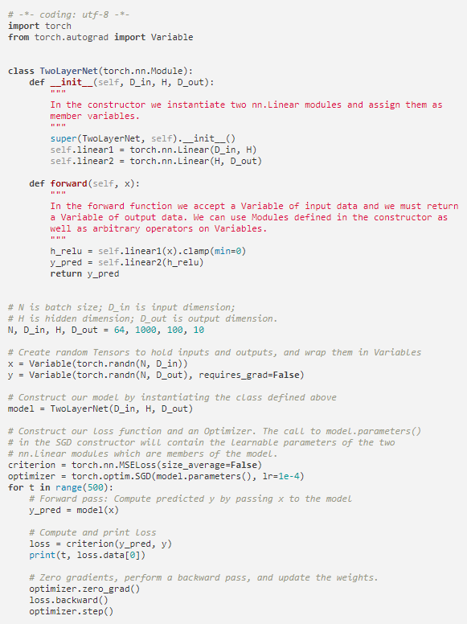
What We Build?
Define modules (must have)
Build network (must have)
http://pytorch.org/tutorials/beginner/pytorch_with_examples.html#pytorch-optim

Slide 53
What We Build?
D_in=1000
D_out=100
Define modules (must have)
…
…
…
y_pred
Build network (must have)
H=100
http://pytorch.org/tutorials/beginner/pytorch_with_examples.html#pytorch-optim

Slide 54


What We Build?
D_in=1000
D_out=100
Define modules (must have)
…
…
…
y_pred
Build network (must have)
H=100
Don’t Update y (y are labels here) Construct Our Model
Optimizer and Loss Function
http://pytorch.org/tutorials/beginner/pytorch_with_examples.html#pytorch-optim

Slide 55
What We Build?
D_in=1000
D_out=100
Define modules (must have)
…
…
…
y_pred
Build network (must have)
H=100
Don’t Update y (y are labels here) Construct Our Model
Optimizer and Loss Function
Reset Gradient Backward Update Step
http://pytorch.org/tutorials/beginner/pytorch_with_examples.html#pytorch-optim

Slide 56
Saving Models
First Approach (Recommend by PyTorch)
# save only the model parameters
torch.save(the_model.state_dict(), PATH)
# load only the model parameters
the_model = TheModelClass(*args, **kwargs)
the_model.load_state_dict(torch.load(PATH))
Second Approach
torch.save(the_model, PATH) # save the entire model
the_model = torch.load(PATH) # load the entire model
http://pytorch.org/docs/master/notes/serialization.html#recommended-approach-for-saving-a-model

Slide 57
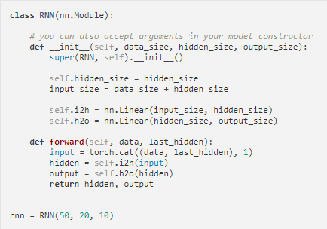
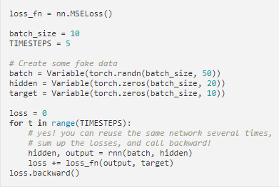
Recurrent Neural Network (RNN)
output
hidden
self.i2h
input_size=50+20=70
input
http://pytorch.org/tutorials/beginner/former_torchies/nn_tutorial.html#example-2-recurrent-net

Slide 58
Recurrent Neural Network (RNN)
Same module (i.e. same parameters)
output
among the time
hidden
self.i2h
input_size=50+20=70
input
http://pytorch.org/tutorials/beginner/former_torchies/nn_tutorial.html#example-2-recurrent-net

Slide 59
Comparison with TensorFlow
Properties | TensorFlow | PyTorch
Graph | Static Dynamic (TensorFlow Fold) | Dynamic
Ramp-up Time | - | Win
Graph Creation and Debugging | - | Win
Feature Coverage | Win | Catch up quickly
Documentation | Tie | Tie
Serialization | Win (support other lang.) | -
Deployment | Win (Cloud & Mobile) | -
Data Loading | - | Win
Device Management | Win | Need .cuda()
Custom Extensions | - | Win
Summarized from https://awni.github.io/pytorch-tensorflow/

