Slide 1
Natural Language Inference
Dongbok Lee
MLAI, KAIST

Slide 2
What Are We Going to Learn
The contents of this lecture is as follows:
1. Natural Language Inference (NLI) task, and its dataset
2. Basic models for NLI
3. Code for NLI task using Pytorch
(Code is available at https://github.com/bentrevett/pytorch-nli)

Slide 3
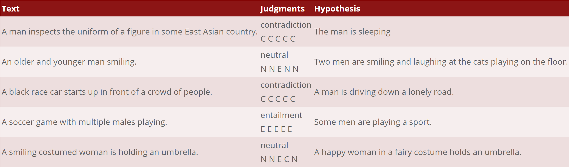
What is the NLI?
Natural Language Inference (NLI) is a task of classifying the relationship between two sentences.
We are going to use the Stanford Natural Language Inference (SNLI) dataset which is provided in https://nlp.stanford.edu/projects/snli/.

Slide 4
What is the NLI?
The given task for the SNLI dataset is “Classifying” the relationship between two sentences to entailment or neutral or contradictive.
A man is playing a soccer.
Classifier
Entailment?
Or Neutral?
Or Contradictive?
A man is sleeping.

Slide 5

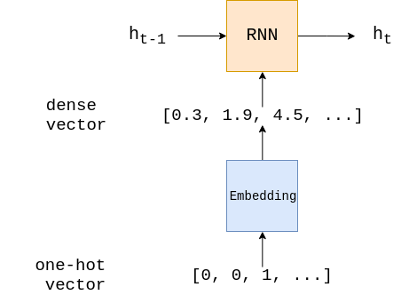
Model Overview
We are going to implement basic model.
In our model, the summation of word embeddings is assumed to be representation of whole sentence.
summation
A
man
is
sleeping

Slide 6
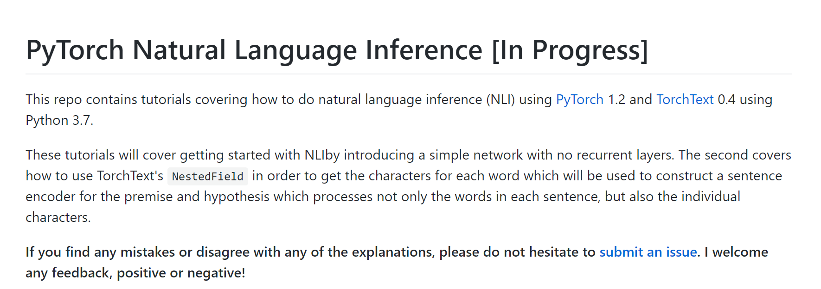
Code Review
This code is based on the code https://github.com/bentrevett/pytorch-nli.

Slide 7
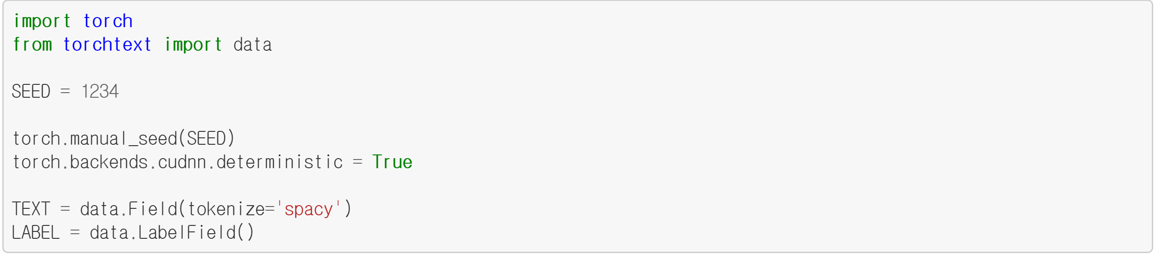
Preparing Data
The three important components for deep learning are Data, Model, and Optimizer.
First, let’s build the data for classification. We use torchtext for text data.
First of all, import PyTorch and data object from torchtext.
Import PyTorch and data object
https://github.com/bentrevett/pytorch-nli

Slide 8
Preparing Data
Then, set seeds for random operation reproducibility.
Set Seeds
https://github.com/bentrevett/pytorch-nli

Slide 9
Preparing Data
Then, utilize the data object from torchtext.
“Field” is one of the main concepts of torchtext.
These define how your data should be processed.
The data consists of both the raw string of two sentences and relationship.
Set Field for text data
https://github.com/bentrevett/pytorch-nli

Slide 10
Preparing Data
Here, tokenize=‘spacy’ means the data field using ‘spacy’ as tokenizer.
LabelField is the special type of Field that handles label (sentiment).
Set Field for text data
https://github.com/bentrevett/pytorch-nli

Slide 11
Preparing Data - Tokenizer
What is tokenizer?
“Token” means “meaningful words”.
“Tokenizer” makes sentence to tokens.
tokenize
“A man is sleeping”
[“A”, “man”, “is”, “sleeping”]
tokenize
“A man is playing soccer”
[“A”, “man”, “is”, “playing”, “soccer”]
https://github.com/bentrevett/pytorch-nli

Slide 12
Preparing Data
In torchtext, SNLI dataset is provided.
We can simply download using one line of code.
This code automatically downloads both SNLI train/dev/test dataset.
It costs about 1 minute to download the dataset.
Download SNLI dataset
https://github.com/bentrevett/pytorch-nli

Slide 13
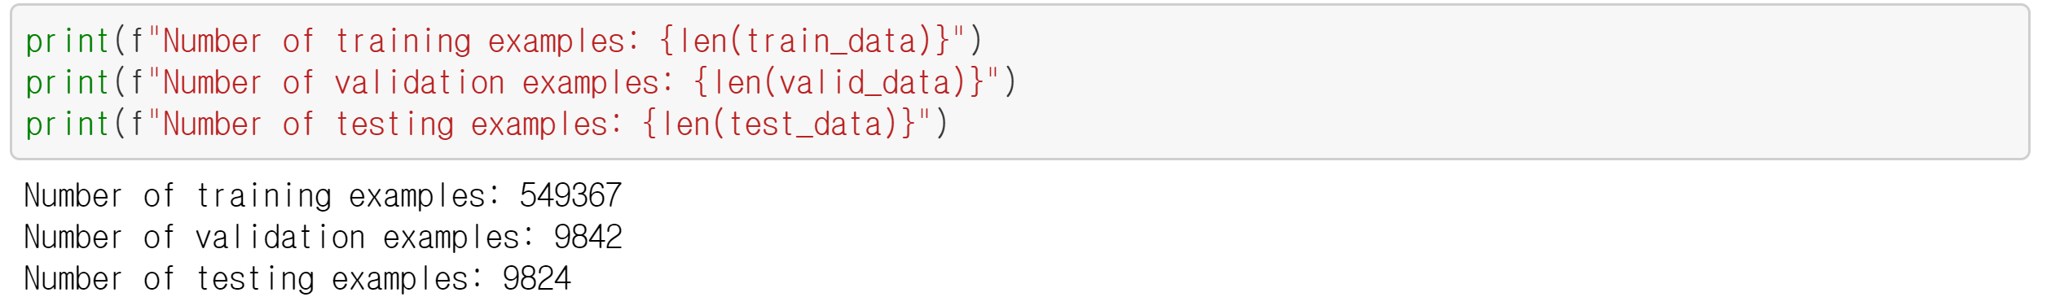
Preparing Data
We can see how many examples are in each split by checking their length.
Count the number of data and print it
https://github.com/bentrevett/pytorch-nli

Slide 14
Preparing Data
We can also check an example.
The example includes two “tokenized” sentences and label.
Print 0-th example
Label
https://github.com/bentrevett/pytorch-nli

Slide 15
Preparing Data
We can also check an example.
The example includes two “tokenized” sentences and label.
https://github.com/bentrevett/pytorch-nli

Slide 16
Preparing Data
We can also check an example.
The example includes two “tokenized” sentences and label.
https://github.com/bentrevett/pytorch-nli

Slide 17
Preparing Data
We can also check an example.
The example includes two “tokenized” sentences and label.
https://github.com/bentrevett/pytorch-nli

Slide 18
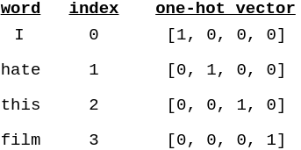
Preparing Data - Vocabulary
Then, we have to build a vocabulary. This is a effectively a look up table where every unique word in dataset has a corresponding integer index.
https://github.com/bentrevett/pytorch-nli

Slide 19
Preparing Data - Vocabulary
Because machine learning model cannot operate on strings, each index is used to construct an one-hot vector for each word.
An one-hot vector is a vector where all of the elements are 0, except one, which is 1.
https://github.com/bentrevett/pytorch-nli

Slide 20
Preparing Data - Vocabulary
Problem of one-hot vector is that the dimension of the vector increases as the number of unique words increases.
For instance, the number of unique English words are about 100,000.
In this case, the length of each one-hot vector is 100,000, which is too large!
…
Length = 100,000
https://github.com/bentrevett/pytorch-nli

Slide 21
Preparing Data - Vocabulary
The way to address this problem is cutting down our vocabulary, only taking the top n most common words and replace less common words to <unk> token (which means unknown).
…
Length = 100,000
https://github.com/bentrevett/pytorch-nli

Slide 22
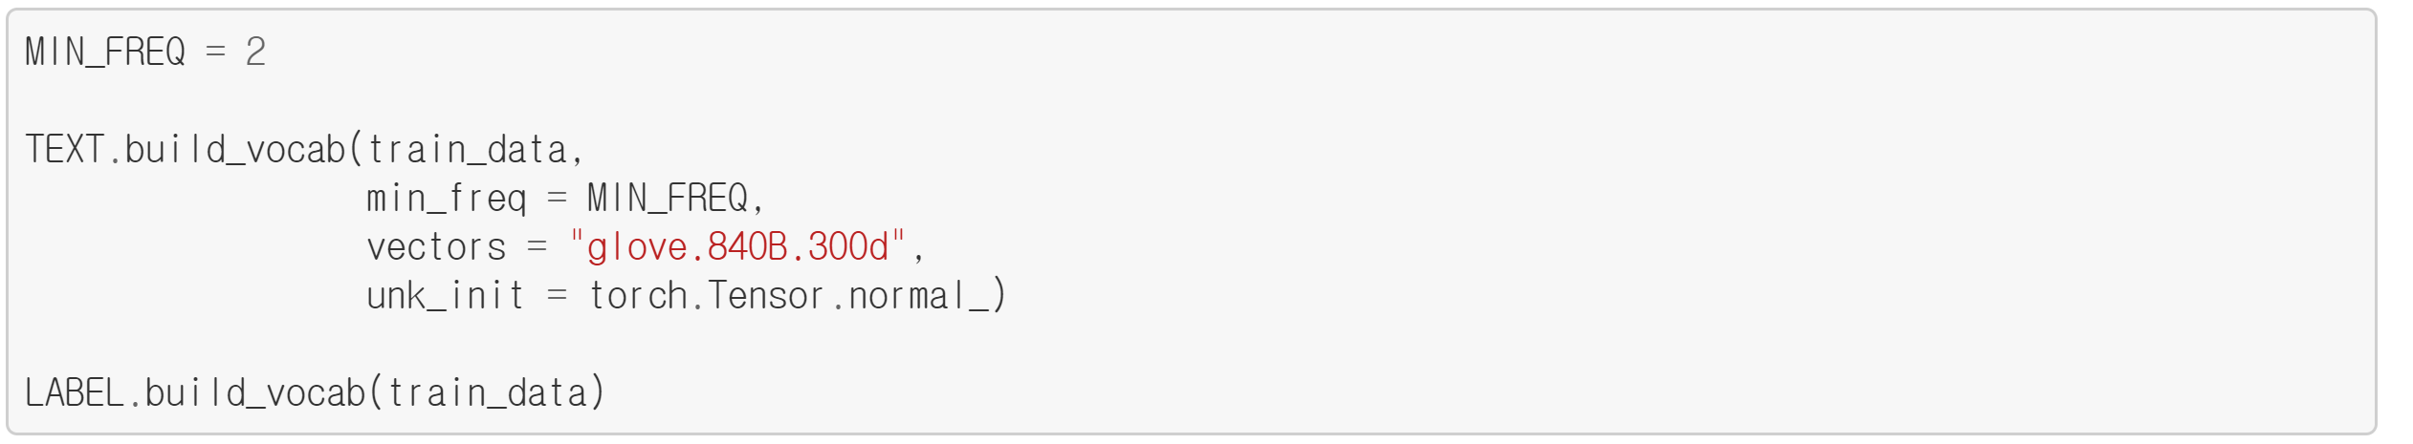
Preparing Data
This code is for building vocabulary using training dataset.
MIN_FREQ is the minimum frequency of word that will be included in our vocab.
Therefore, in this example, words of 0 or 1 frequency are excluded in the vocabulary.
Minimum frequency
https://github.com/bentrevett/pytorch-nli

Slide 23
Preparing Data
This code is for building vocabulary using training dataset.
MIN_FREQ is the minimum frequency of word that will be included in our vocab.
Therefore, in this example, words of 0 or 1 frequency are excluded in the vocabulary.
Build vocab
https://github.com/bentrevett/pytorch-nli

Slide 24
Preparing Data
This code is for building vocabulary using training dataset.
MIN_FREQ is the minimum frequency of word that will be included in our vocab.
Therefore, in this example, words of 0 or 1 frequency are excluded in the vocabulary.
Build vocab for label
https://github.com/bentrevett/pytorch-nli

Slide 25
Preparing Data
We can see the number of words included in the vocabulary.
The number of vocabulary
https://github.com/bentrevett/pytorch-nli

Slide 26
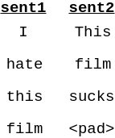
Preparing Data - <pad> token
<pad> token is needed for batch operation.
To make batch of data, the length of data included in same batch should be the same.
For examples, if we make data batch using sent1 and sent2, <pad> token is added at the end of sent2 to ensure each sentence in the batch is the same size.
https://github.com/bentrevett/pytorch-nli

Slide 27
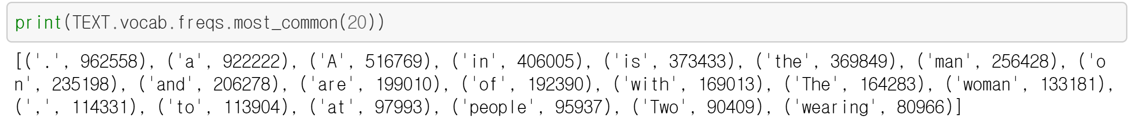
Preparing Data
We can view the most common words in the vocabulary and their frequencies.
For example, word “people” occurs 95937 times in the training dataset and word “wearing” occurs 80966 times in the training dataset.
https://github.com/bentrevett/pytorch-nli

Slide 28
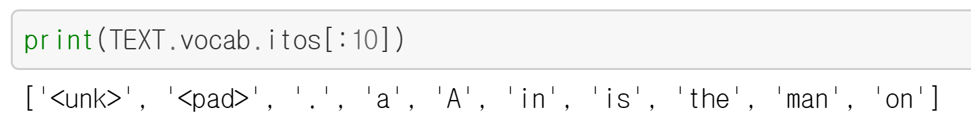
Preparing Data
We can also see the vocabulary directly using either stoi (string to int) or itos (int to string) method.
In code example, 0-th word is ‘<unk>’, 1-st word is ‘<pad>’, 2-nd word is ‘.’, and so on…
https://github.com/bentrevett/pytorch-nli

Slide 29
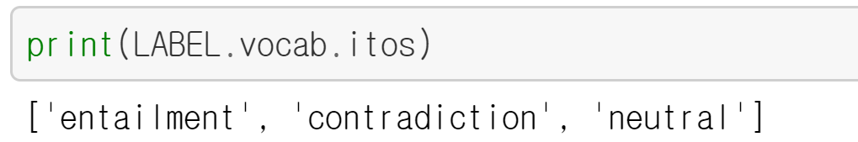
Preparing Data
We can also check the labels, ‘entailment’, ‘contradiction’, and ‘neutral’.
‘entailment’ occurs 183416 times, ‘contradiction’ occurs 183187 times, and ‘neutral’ occurs 182767 times.
https://github.com/bentrevett/pytorch-nli

Slide 30
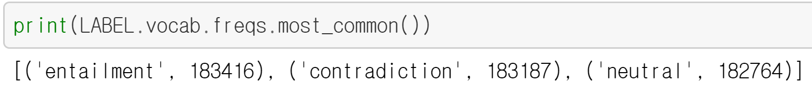
Preparing Data
We can also check the labels, ‘entailment’, ‘contradiction’, and ‘neutral’.
‘entailment’ occurs 183416 times, ‘contradiction’ occurs 183187 times, and ‘neutral’ occurs 182767 times.
https://github.com/bentrevett/pytorch-nli

Slide 31
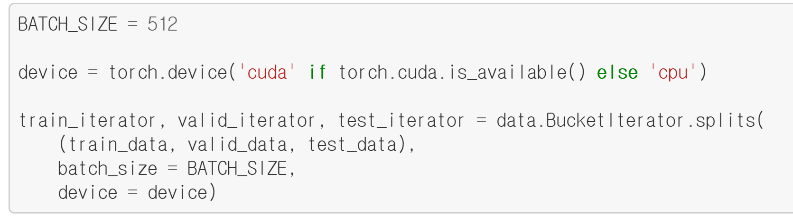
Preparing Data
The final step of preparing the data is creating the iterators.
We iterate over these in the training/evaluation loop, and they return a batch of examples at each iteration.
“BucketIterator” is a special type of iterator that will return a batch of examples where each example is of a similar length, minimizing the amount of padding per example.
Build Iterators
https://github.com/bentrevett/pytorch-nli

Slide 32
Preparing Data
We set 512 for mini-batch size.
Here, the “device” is either CPU or GPU.
If there is detected GPU, iterator is placed on the GPU.
Mini-batch size
https://github.com/bentrevett/pytorch-nli

Slide 33
Preparing Data
We set 512 for mini-batch size.
Here, the “device” is either CPU or GPU.
If there is detected GPU, iterator is placed on the GPU.
https://github.com/bentrevett/pytorch-nli

Slide 34
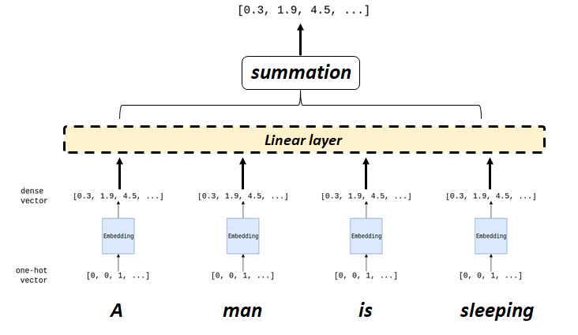
Build the Model
From now on, we will build the model for NLI.
What we need for the model is three layers: “Embedding Layer”, “Linear Layer”, “FC Layer”.
FC layer
https://github.com/bentrevett/pytorch-nli

Slide 35
Build the Model
Here, the embedding layer is used to transform our sparse one-hot vector into a dense embedding vector.
This embedding layer is simply a single fully connected layer.
FC layer
https://github.com/bentrevett/pytorch-nli

Slide 36
Build the Model
The Linear layer linearly projects the representation of two sentences with ReLU activation.
FC layer
https://github.com/bentrevett/pytorch-nli

Slide 37
Build the Model
Then embeddings of each sentence are summed to represent to each sentence.
FC layer
https://github.com/bentrevett/pytorch-nli

Slide 38
Build the Model
The FC layer takes representation of two sentences.
Then, it finally predicts the relationship, label of two sentences.
FC layer
https://github.com/bentrevett/pytorch-nli

Slide 39
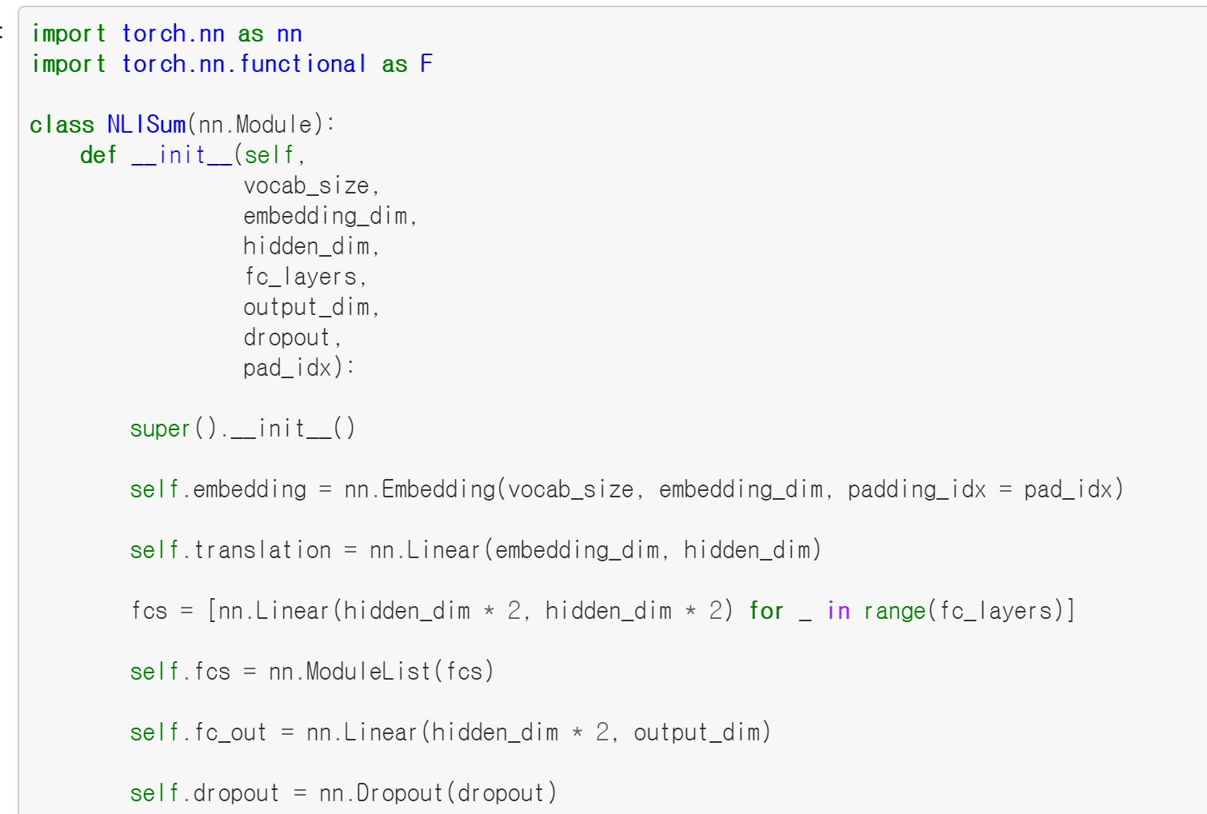
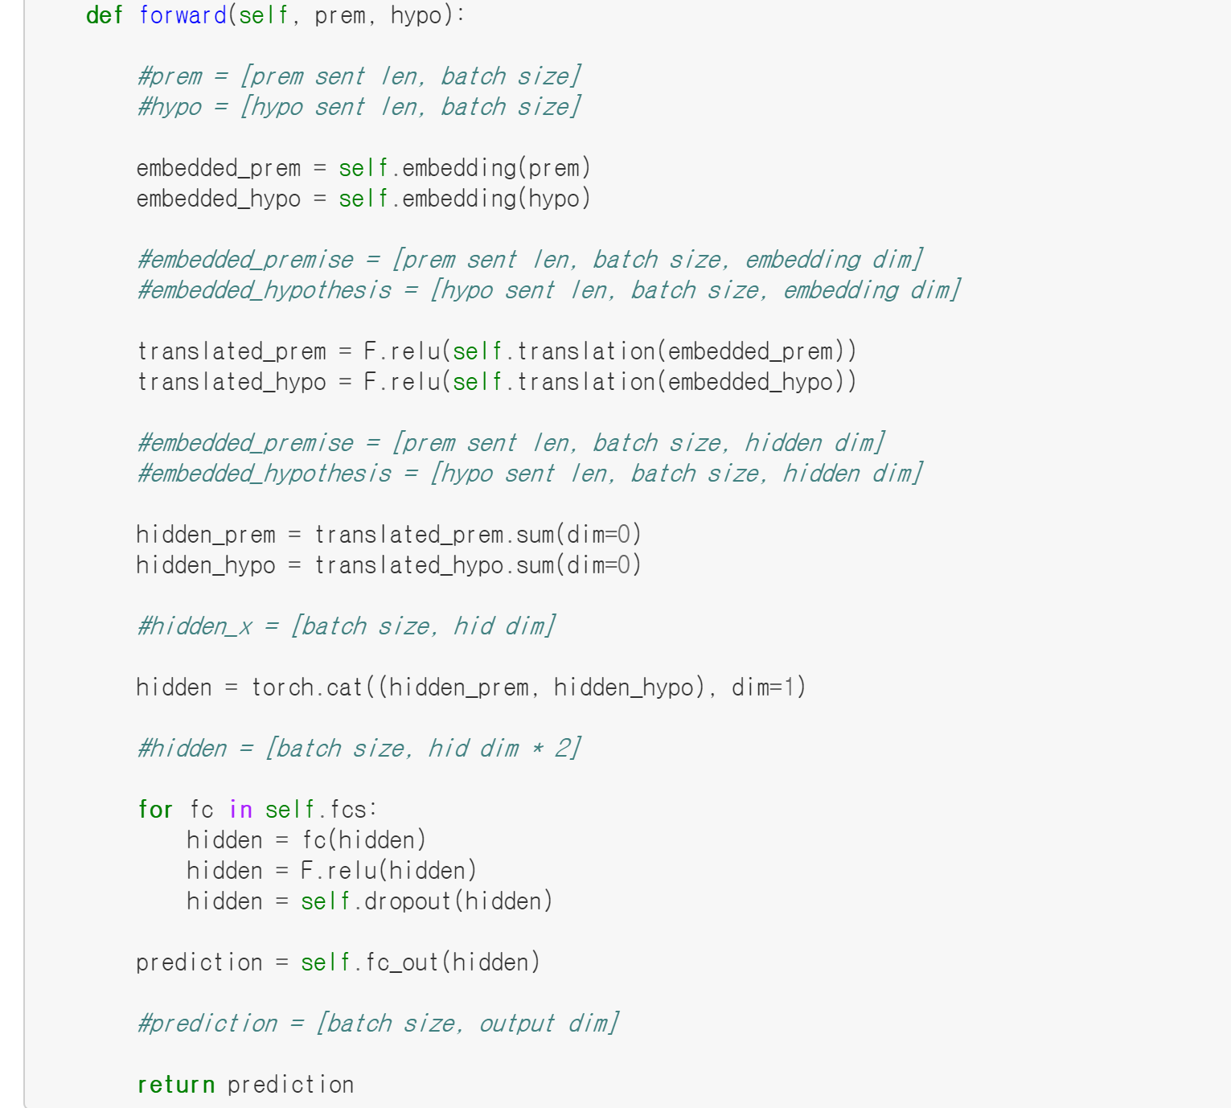
Build the Model
This is code for our classifier model class.
https://github.com/bentrevett/pytorch-nli

Slide 40
Build the Model
In __init__ function, we need to define each component – Embedding Layer, Linear Layer, and FC layer.
Embedding Layer
Linear Layer
FC Layer
https://github.com/bentrevett/pytorch-nli

Slide 41
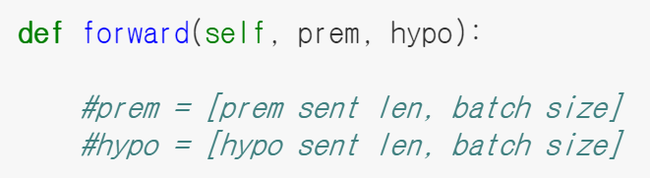
Build the Model
The forward method is called when we feed examples into our model.
Each batch (prem, hypo) is two tensors of which size is [sentence length, batch size].
That is a batch of sentences, each having each word converted into a one-hot vector.
Input batch
Input size
https://github.com/bentrevett/pytorch-nli

Slide 42
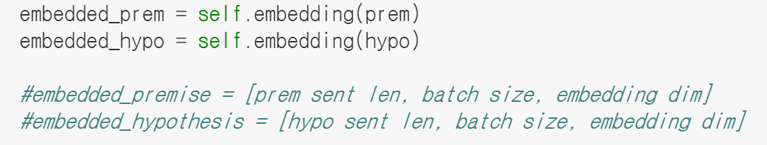
Build the Model
The input batch is then passed through the embedding layer to get embedded, which gives us a “dense vector representation” of our sentences.
embedded_prem, hypo are tensors of size
[sentence length, batch size, embedding dim].
Embedding input to “embedded”
https://github.com/bentrevett/pytorch-nli

Slide 43
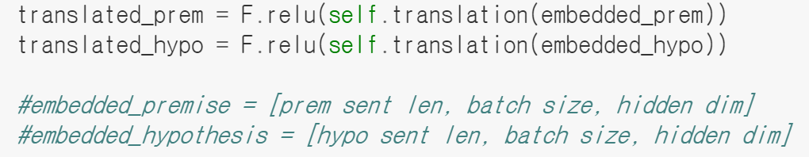
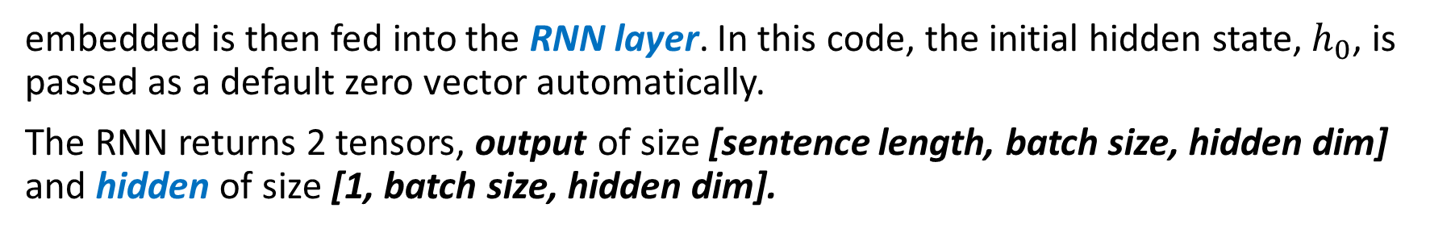
Build the Model
embedded is then fed into the RNN layer. In this code, the initial hidden state, $h_{0}$, is passed as a default zero vector automatically.
The RNN returns 2 tensors, output of size [sentence length, batch size, hidden dim] and hidden of size [1, batch size, hidden dim].
Linear Layer
https://github.com/bentrevett/pytorch-nli

Slide 44
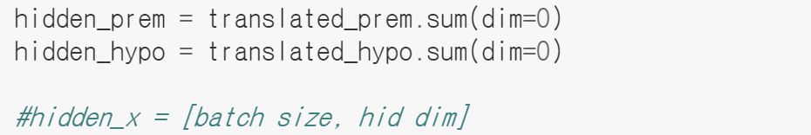
Build the Model
Then, each output of linear layer is summed along 0 dimension.
The representation of each sentence is summation of word embeddings projected by linear layer.
summation
https://github.com/bentrevett/pytorch-nli

Slide 45
Build the Model
Then, each output of linear layer is summed along 0 dimension.
The representation of each sentence is summation of word embeddings projected by linear layer.
summation
https://github.com/bentrevett/pytorch-nli

Slide 46
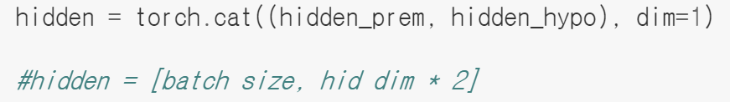
Build the Model
The representations are concatenated to be fed into FC layers.
The size of concatenation is [batch size, hidden dim * 2].
concatenation
https://github.com/bentrevett/pytorch-nli

Slide 47
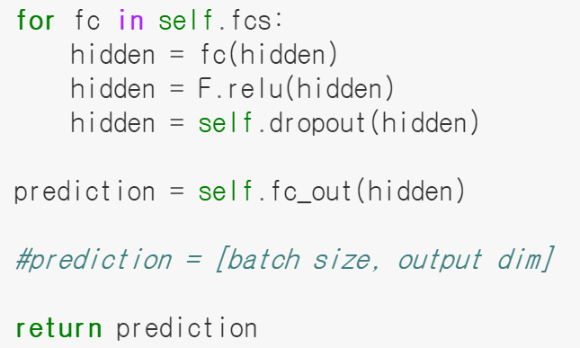
Build the Model
For loop is used to deal with multiple linear layers in our FC layer.
ReLU, and Dropout is utilized in our FC layer.
multi-layer
https://github.com/bentrevett/pytorch-nli

Slide 48
Build the Model
For loop is used to deal with multiple linear layers in our FC layer.
ReLU, and Dropout is utilized in our FC layer.
Linear layer
ReLU activation
Dropout
https://github.com/bentrevett/pytorch-nli

Slide 49
Build the Model
Finally, our model predicts one of three labels.
Prediction layer
https://github.com/bentrevett/pytorch-nli

Slide 50
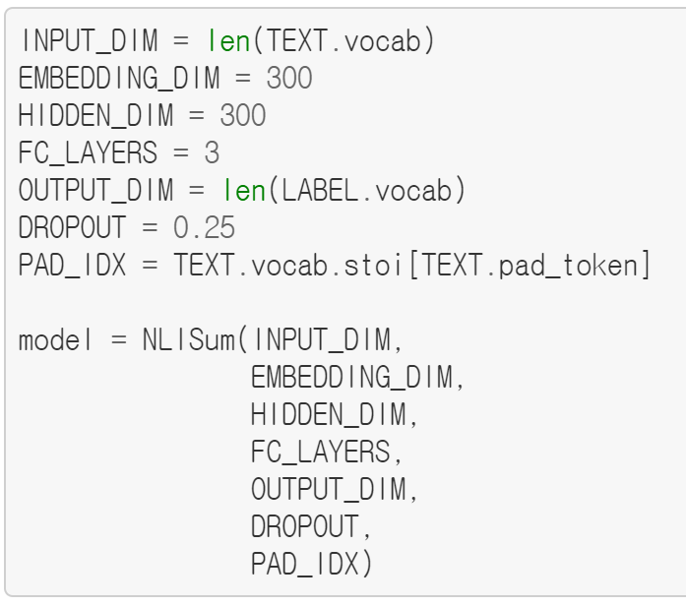
Build the Model
We now create an instance of our model class (NLISum).
If you want, you can change HIDDEN_DIM, FC_LAYERS, DROPOUT.
Build the model
https://github.com/bentrevett/pytorch-nli

Slide 51
Build the Model
We now create an instance of our model class (NLISum).
If you want, you can change HIDDEN_DIM, FC_LAYERS, DROPOUT.
Changeable hyper-parameters
https://github.com/bentrevett/pytorch-nli

Slide 52
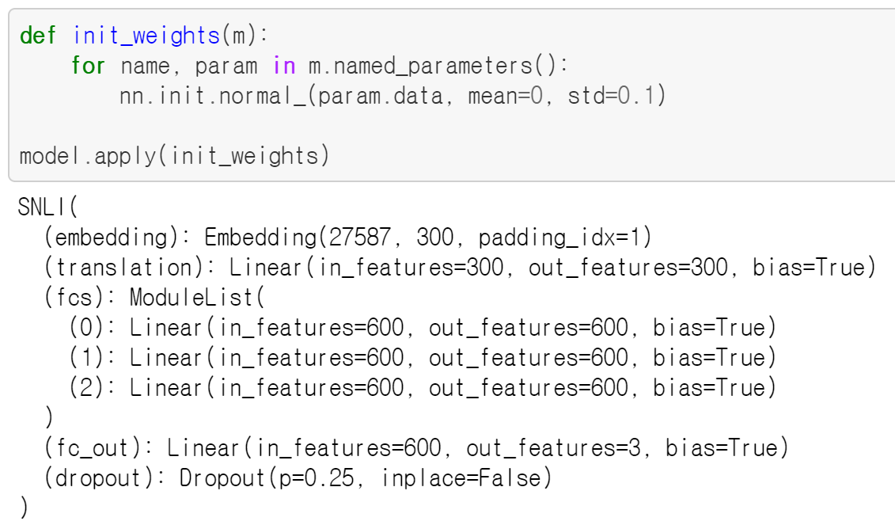
Build the Model
Let’s initialize parameters in our model with normal distribution.
We are going to use normal distribution with mean 0 and standard deviation 0.1.
Initialize parameters
https://github.com/bentrevett/pytorch-nli

Slide 53
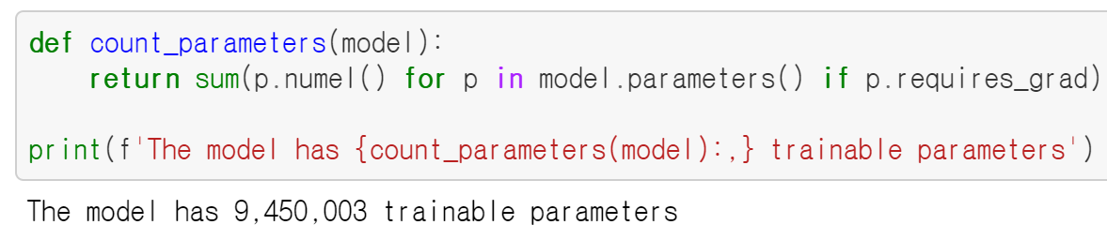
Build the Model
Let’s create a function that will tell us how many trainable parameters our model has so we can compare the number of parameters across different models.
We can see that our model has 9,450,003 trainable parameters.
https://github.com/bentrevett/pytorch-nli

Slide 54
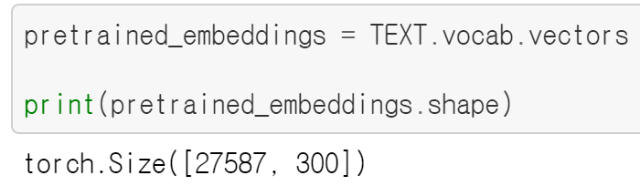
Build the Model
For NLI model, we will use pretrained embeddings of glove vector.
Load pretraining word embeddings using pytorchtext.
Load glove vector
https://github.com/bentrevett/pytorch-nli

Slide 55
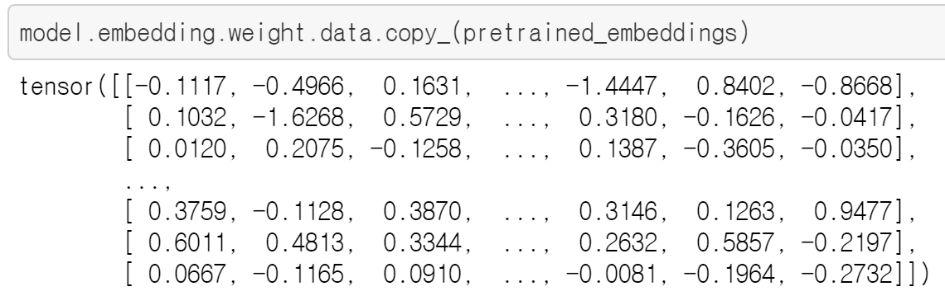
Build the Model
Copy weights of pretrained embeddings into weights of embedding layer in our model.
copy embeddings
https://github.com/bentrevett/pytorch-nli

Slide 56
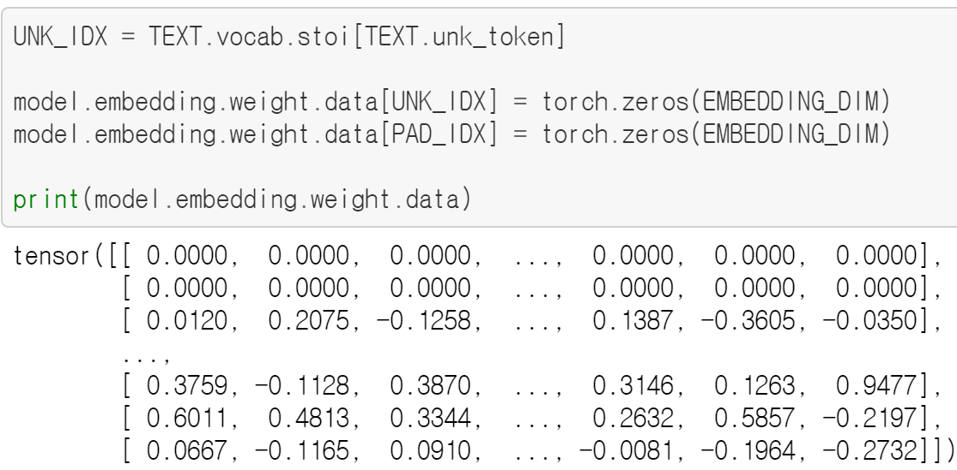
Build the Model
Word embeddings for Unknown token, and PAD token is reset to zero vector.
zero vector
https://github.com/bentrevett/pytorch-nli

Slide 57

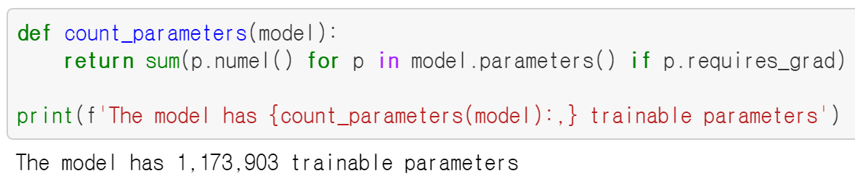
Build the Model
Sometimes we do not train embedding layer for several reasons.
For example, regularization effects can be expected.
After excluding embedding layer, trainable parameters is dramatically reduced.
Do not train
https://github.com/bentrevett/pytorch-nli

Slide 58
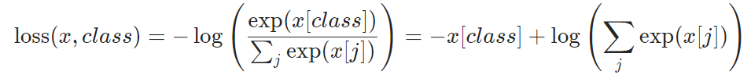
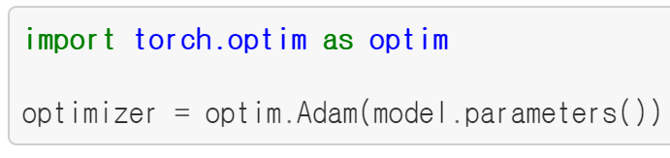

Train the Model
Now, we’ll set up the training and then train the model.
Here, we’ll use one of advanced optimizer, called Adam.
We’ll use CrossEntropyLoss for training our model.
Set the optimizer
Set loss for model
https://github.com/bentrevett/pytorch-nli

Slide 59
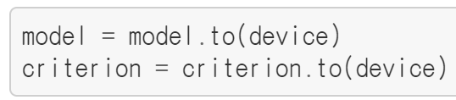
Train the Model
Set model and its loss to device.
If possible, we are going to use GPU for training model.
Set device
https://github.com/bentrevett/pytorch-nli

Slide 60
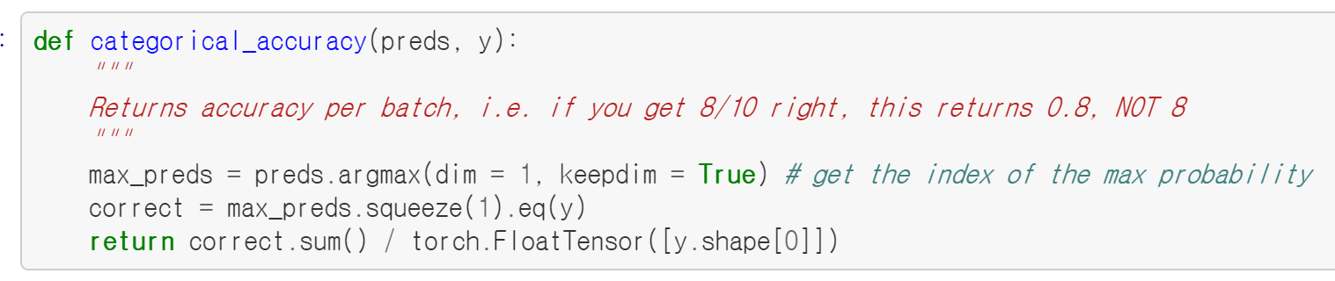
Train the Model
In addition to loss, we need to calculate accuracy, which is the measurement for classifier performance.
Calculate accuracy
https://github.com/bentrevett/pytorch-nli

Slide 61
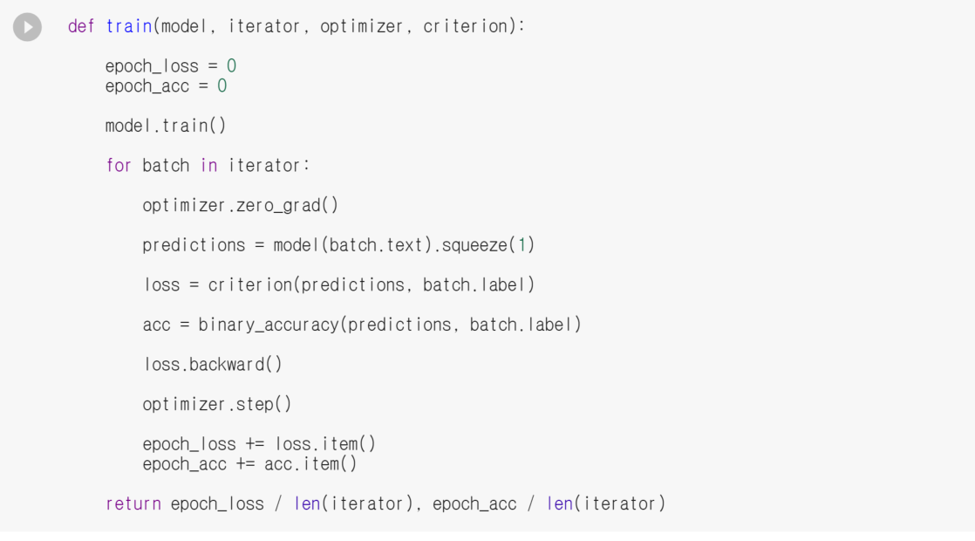
Train the Model
This is the train function which iterates over all examples, one batch at a time.
https://github.com/bentrevett/pytorch-nli

Slide 62
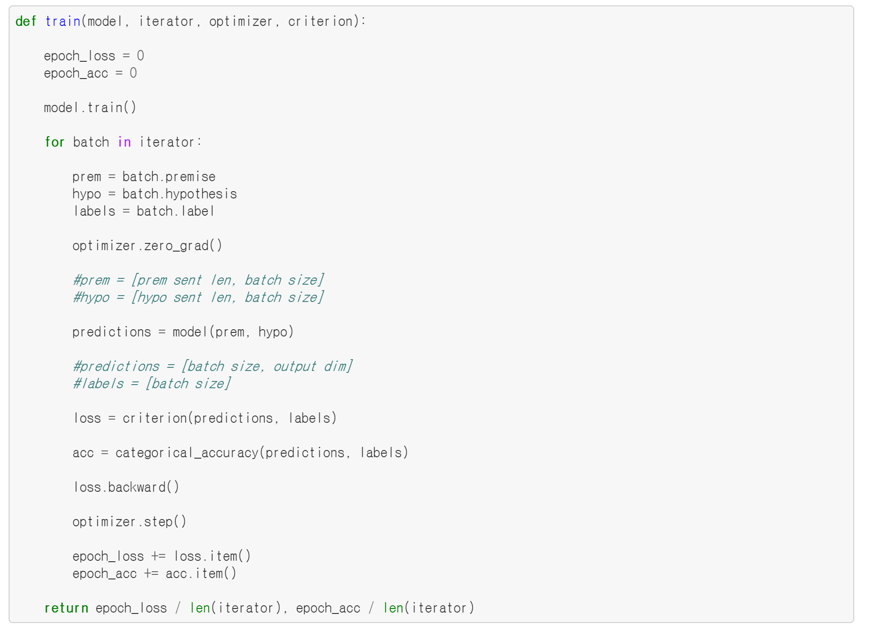
Train the Model
Training mode
Batch iteration
zero gradient
Model forward
Calculate loss
Calculate accuracy
Backward loss
Update parameters
Set mode to “training mode”
https://github.com/bentrevett/pytorch-nli

Slide 63
Train the Model
Training mode
Batch iteration
zero gradient
Model forward
Calculate loss
Calculate accuracy
Backward loss
Update parameters
Batch iteration
https://github.com/bentrevett/pytorch-nli

Slide 64
Train the Model
Training mode
Batch iteration
zero gradient
Model forward
Calculate loss
Calculate accuracy
Backward loss
Update parameters
zero gradient
https://github.com/bentrevett/pytorch-nli

Slide 65
Train the Model
Training mode
Batch iteration
zero gradient
Model forward
Calculate loss
Calculate accuracy
Backward loss
Update parameters
Model forward
https://github.com/bentrevett/pytorch-nli

Slide 66
Train the Model
Training mode
Batch iteration
zero gradient
Model forward
Calculate loss
Calculate accuracy
Backward loss
Update parameters
calculate loss
https://github.com/bentrevett/pytorch-nli

Slide 67
Train the Model
Training mode
Batch iteration
zero gradient
Model forward
Calculate loss
Calculate accuracy
Backward loss
Update parameters
calculate accuracy
https://github.com/bentrevett/pytorch-nli

Slide 68
Train the Model
Training mode
Batch iteration
zero gradient
Model forward
Calculate loss
Calculate accuracy
Backward loss
Update parameters
Loss backward
https://github.com/bentrevett/pytorch-nli

Slide 69
Train the Model
Training mode
Batch iteration
zero gradient
Model forward
Calculate loss
Calculate accuracy
Backward loss
Update parameters
Update parameters
https://github.com/bentrevett/pytorch-nli

Slide 70
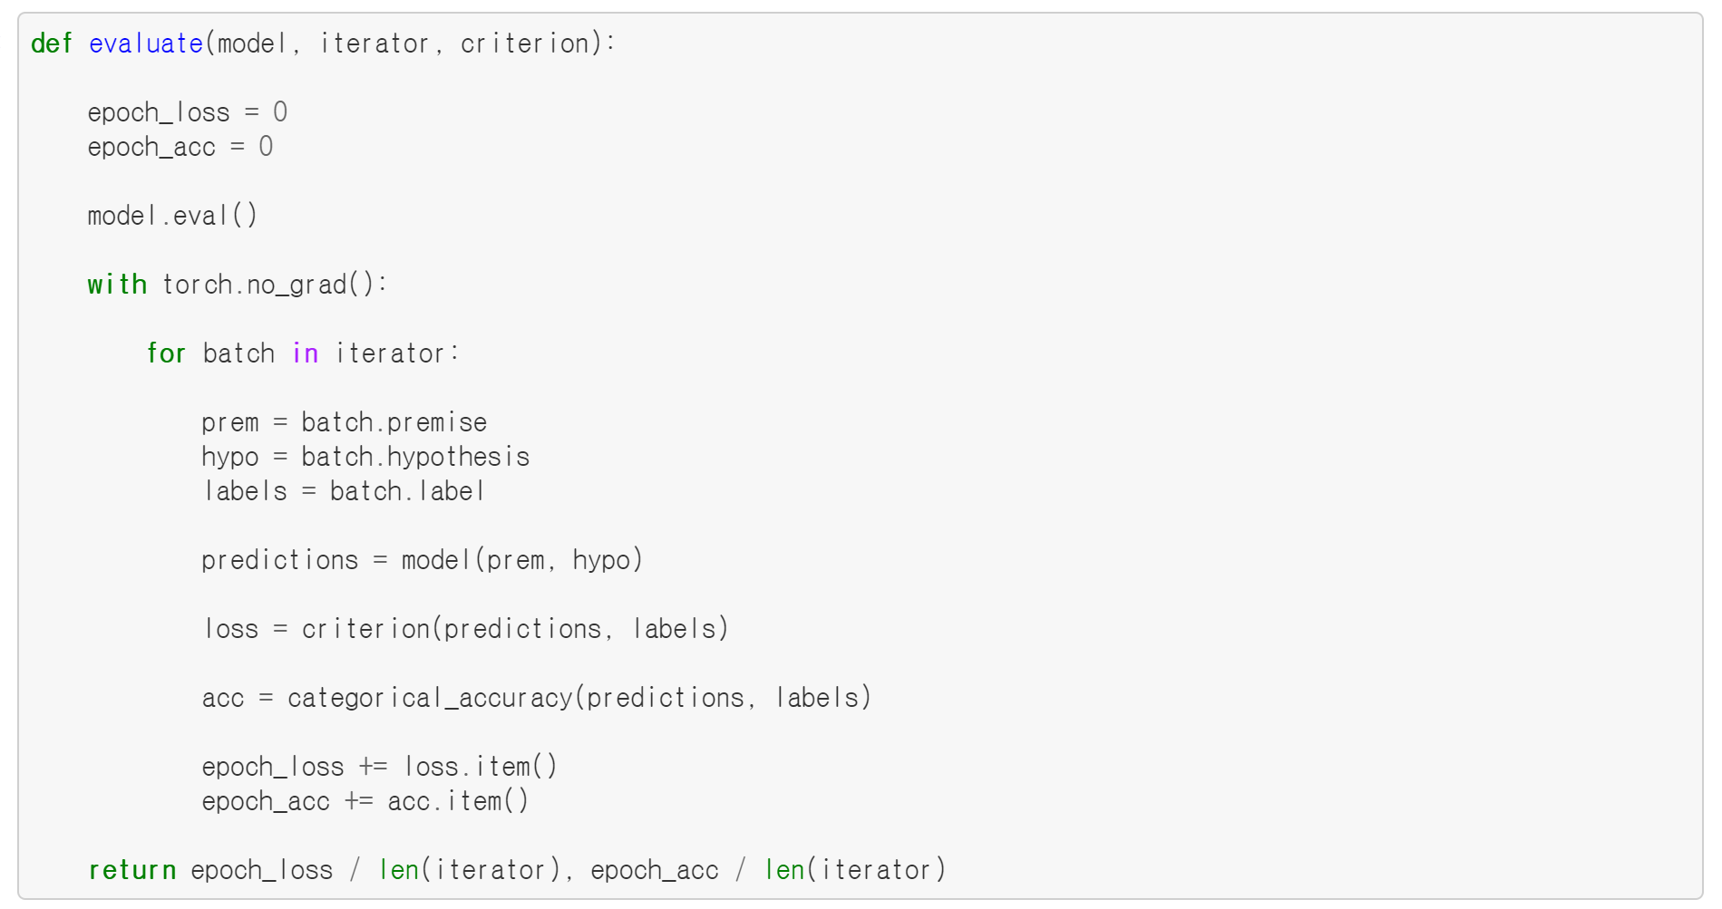
Evaluate the Model
Eval mode
Batch iteration
Model forward
Calculate loss
Calculate accuracy
eval model
https://github.com/bentrevett/pytorch-nli

Slide 71
Evaluate the Model
Eval mode
Batch iteration
Model forward
Calculate loss
Calculate accuracy
Batch iteration
https://github.com/bentrevett/pytorch-nli

Slide 72
Evaluate the Model
Eval mode
Batch iteration
Model forward
Calculate loss
Calculate accuracy
Model forward
https://github.com/bentrevett/pytorch-nli

Slide 73
Evaluate the Model
Eval mode
Batch iteration
Model forward
Calculate loss
Calculate accuracy
Calculate loss
https://github.com/bentrevett/pytorch-nli

Slide 74
Evaluate the Model
Eval mode
Batch iteration
Model forward
Calculate loss
Calculate accuracy
Calculate accuracy
https://github.com/bentrevett/pytorch-nli

Slide 75
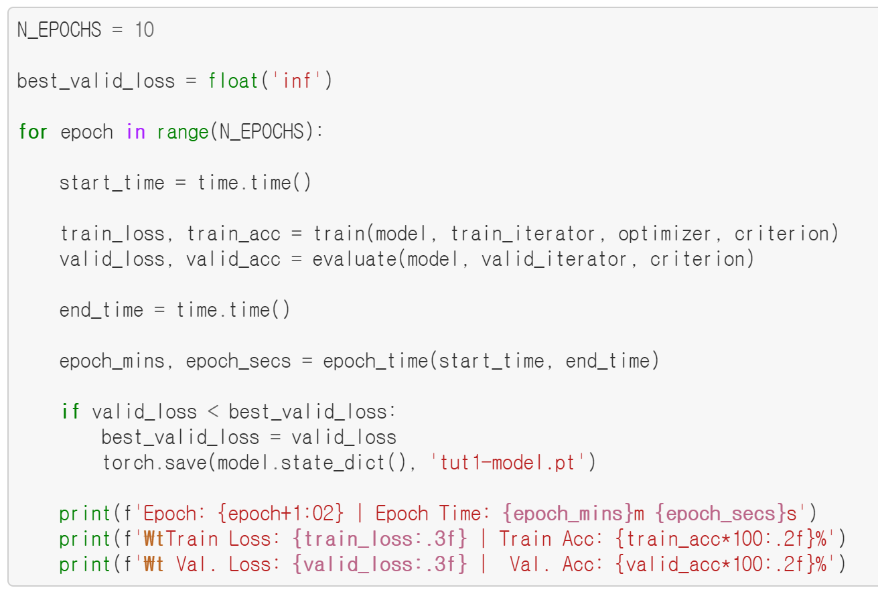
Train the Model
We train the model through multiple epochs, an epoch being a complete pass through all examples in the training and validation sets.
Training and Evaluation
https://github.com/bentrevett/pytorch-nli

Slide 76
Train the Model
We save the model with the least valid loss across all epochs.
Save the model
https://github.com/bentrevett/pytorch-nli

Slide 77
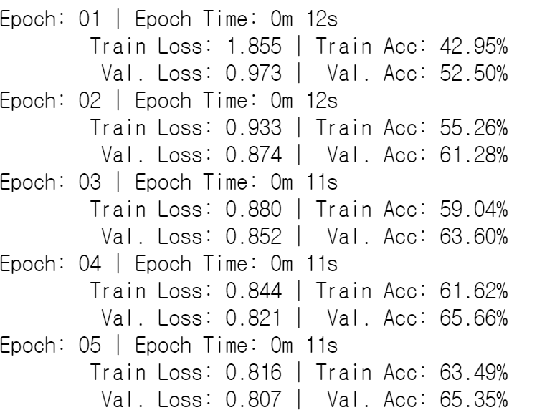
Train the Model
The desirable output of full pipeline is like this:
Accuracy
https://github.com/bentrevett/pytorch-nli

Slide 78
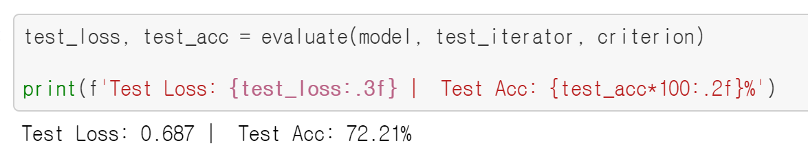
Test the Model
Then, we can measure performance with evaluate function.
Test
https://github.com/bentrevett/pytorch-nli

Slide 79
Assignment 1
In our implementation, the summation of word embeddings is assumed to be representation of sentence.
What about mean?
summation
mean?
A
man
is
sleeping
https://github.com/bentrevett/pytorch-nli

Slide 80
Assignment 1
For assignment1, what we should change in code?
HINT:
https://github.com/bentrevett/pytorch-nli

Slide 81
Assignment 1
Change code in forward function, train and evaluate changed model.
https://github.com/bentrevett/pytorch-nli

Slide 82
Assignment 2
How about using LSTM instead of summation?
summation
LSTM?
A
man
is
sleeping
https://github.com/bentrevett/pytorch-nli

Slide 83

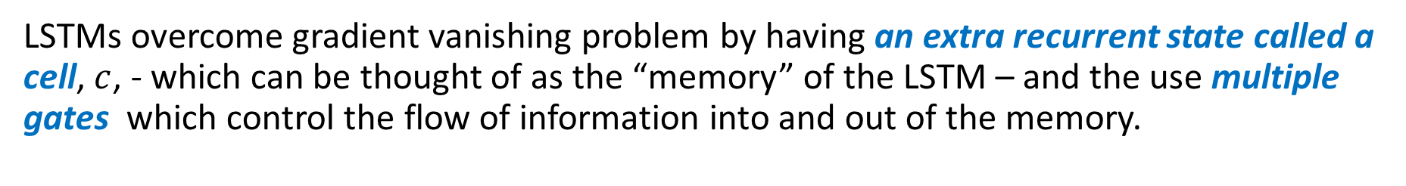




Assignment 2
LSTMs overcome gradient vanishing problem by having an extra recurrent state called a cell, $c$, - which can be thought of as the “memory” of the LSTM – and the use multiple gates which control the flow of information into and out of the memory.
$$C_{t}$$
$$C_{t−1}$$
Tanh
LSTM
Sigmoid
Sigmoid
Tanh
Sigmoid
$$h_{t−1}$$
$$h_{t}$$
$$x_{t}$$
[Hochreiter and Schmidhuber97] S. Hochreiter, J. Schmidhuber, Long Short-Term Memory. Neural Computation 1997
https://github.com/bentrevett/pytorch-nli

Slide 84
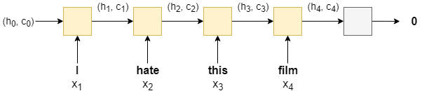
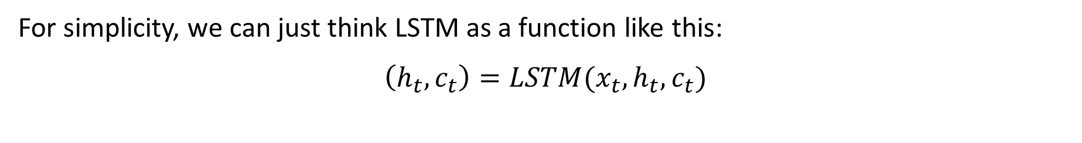
Assignment 2
For simplicity, we can just think LSTM as a function like this:
$$\left(h_{t}, c_{t}\right)=LSTM(x_{t}, h_{t}, c_{t})$$
[Hochreiter and Schmidhuber97] S. Hochreiter, J. Schmidhuber, Long Short-Term Memory. Neural Computation 1997
https://github.com/bentrevett/pytorch-nli

Slide 85
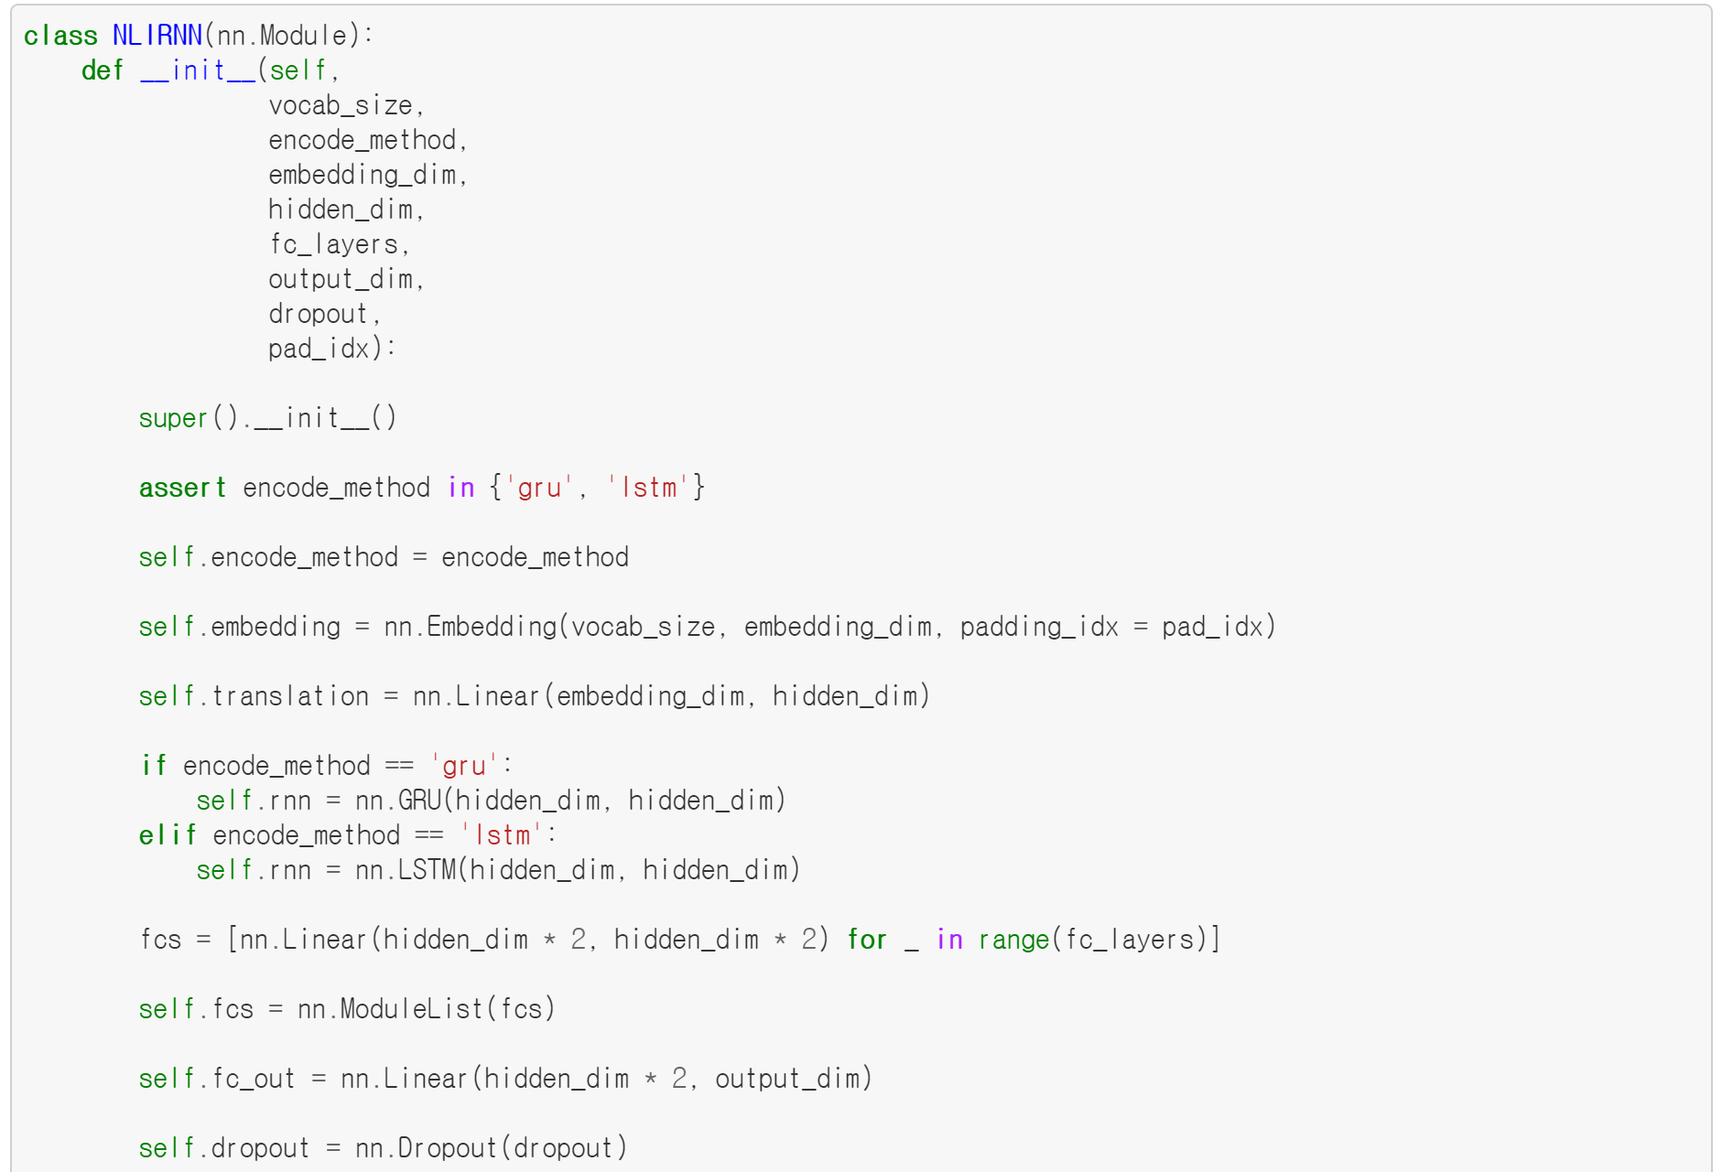
Assignment 2
How about using LSTM instead of summation?
We are going to provide model code as follows:
https://github.com/bentrevett/pytorch-nli

Slide 86
Assignment 2
However, model initialization code should be changed in this case.
Change the code, train and evaluate the model.
https://github.com/bentrevett/pytorch-sentiment-analysis

