Slide 1
Construction Site Safety
Object Detection
Person
97%
Hardhat
YOLO11 • Computer Vision • Final Project
Detecting people, PPE and construction-site objects using bounding boxes and confidence scores.
10 classes
30 epochs
Train + Test
Prepared from the project notebook and training results.

Slide 2
Project Goal & Workflow
A simple end-to-end object detection pipeline.
1
2
3
4
5
Dataset
→
Train
→
Validate
→
Test
→
Output
Construction-site images + YOLO labels
Fine-tune YOLO11n on our data
Monitor precision, recall and mAP
Run detection on unseen images
Class + confidence + bounding box
Final requirement achieved: the model takes an image and clearly shows detected objects, class names, confidence scores and bounding boxes.

Slide 3
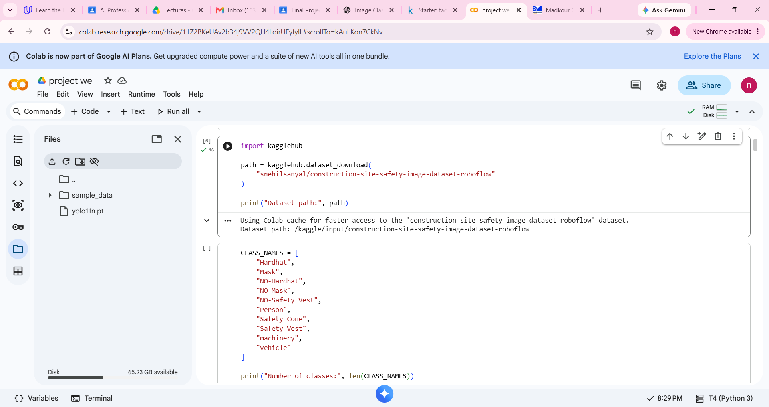
Dataset Introduction
Construction Site Safety Image Dataset (Roboflow format).
Dataset summary
Images from construction-site environments.
10 object classes including Person, Hardhat, Safety Vest, Safety Cone, machinery and vehicle.
YOLO labels are stored as text files for each image.
The data is split into train, validation and test folders.
10 classes
YOLO labels

Slide 4
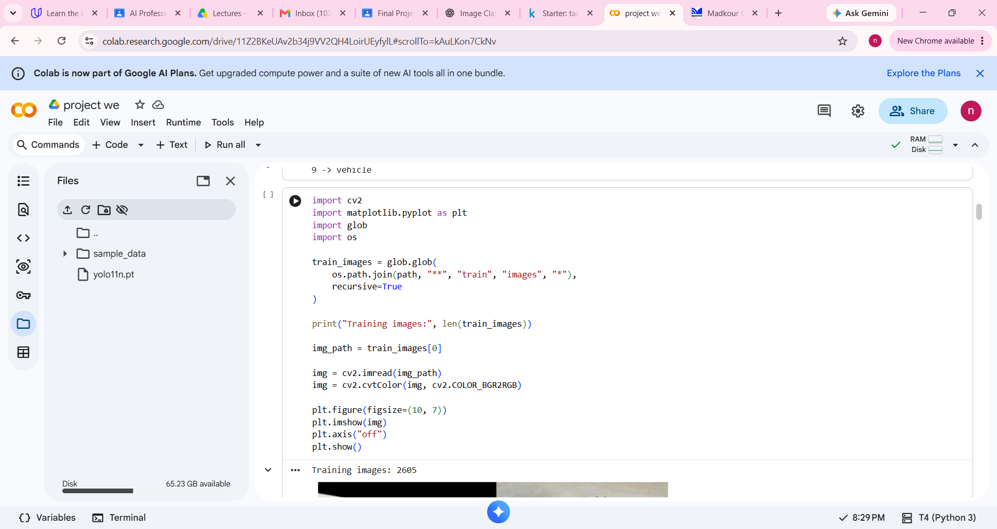
Dataset Samples
We first inspected the training images before training the model.
Important code
train_images = glob.glob(...)
print('Training images:', len(train_images))
img = cv2.imread(img_path)
plt.imshow(img)
What this does
• Finds the training images.
• Counts them.
• Reads one image with OpenCV.
• Displays a sample with Matplotlib.
2605 train images

Slide 5
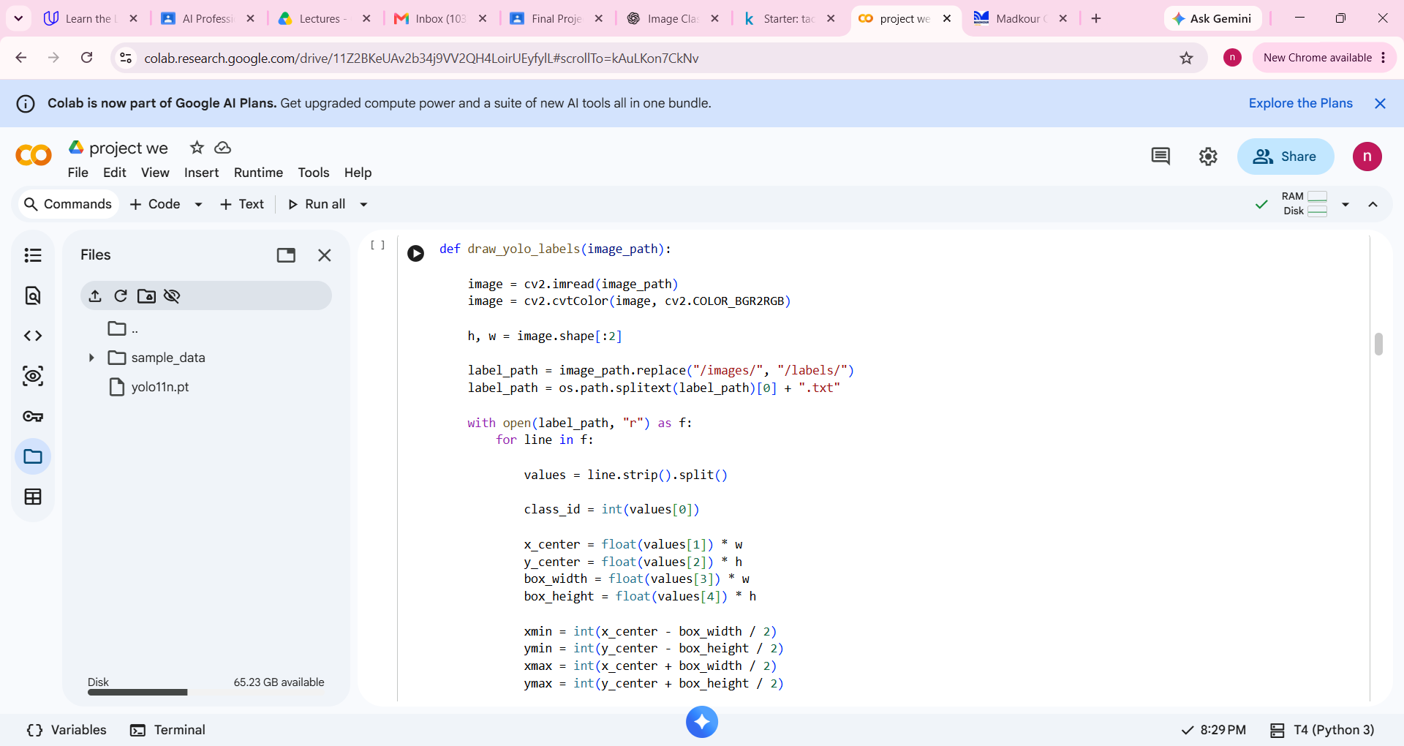
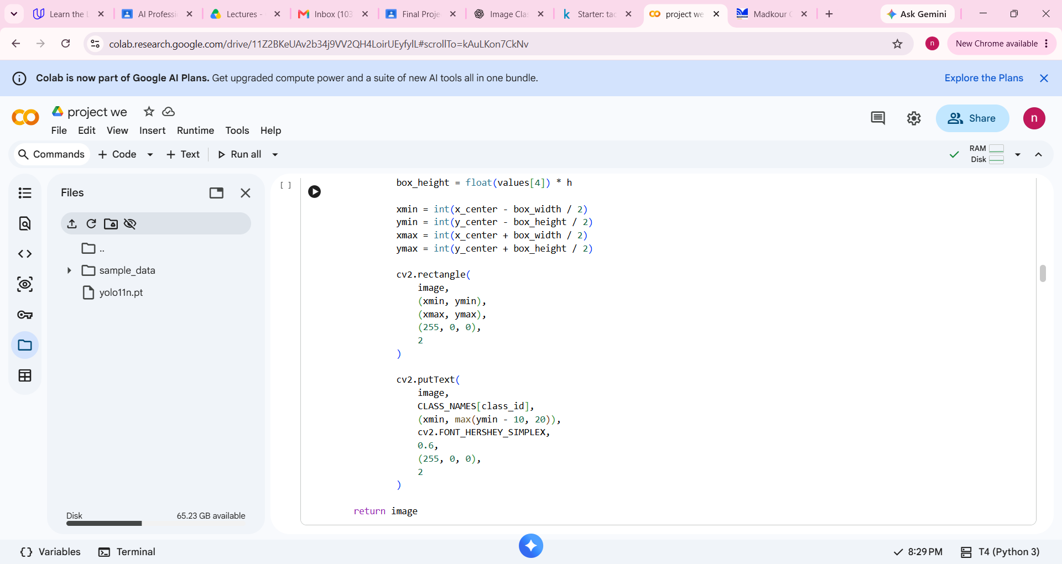
Labels & Data Preprocessing
YOLO labels are converted into visible bounding boxes for inspection.
YOLO label format
class_id x_center y_center width height
The coordinates are normalized (0–1). The code multiplies them by image width/height, converts them to pixel coordinates, and draws rectangles around each object.
Preprocessing in this notebook
Read image with OpenCV.
Convert BGR → RGB for display.
Read the matching .txt label file.
Convert normalized box coordinates to pixels.

Slide 6
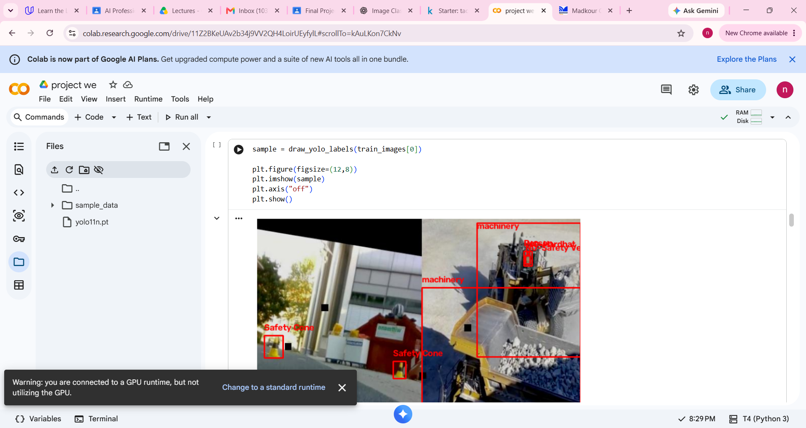
Ground-Truth Bounding Boxes
Before training, we verified that the dataset labels match the objects in the images.
Why this step matters
Confirms that image-label pairs are correct.
Shows the true class names before training.
Helps detect bad or missing annotations early.
Example classes visible
machinery • Safety Cone • Person • Hardhat

Slide 7
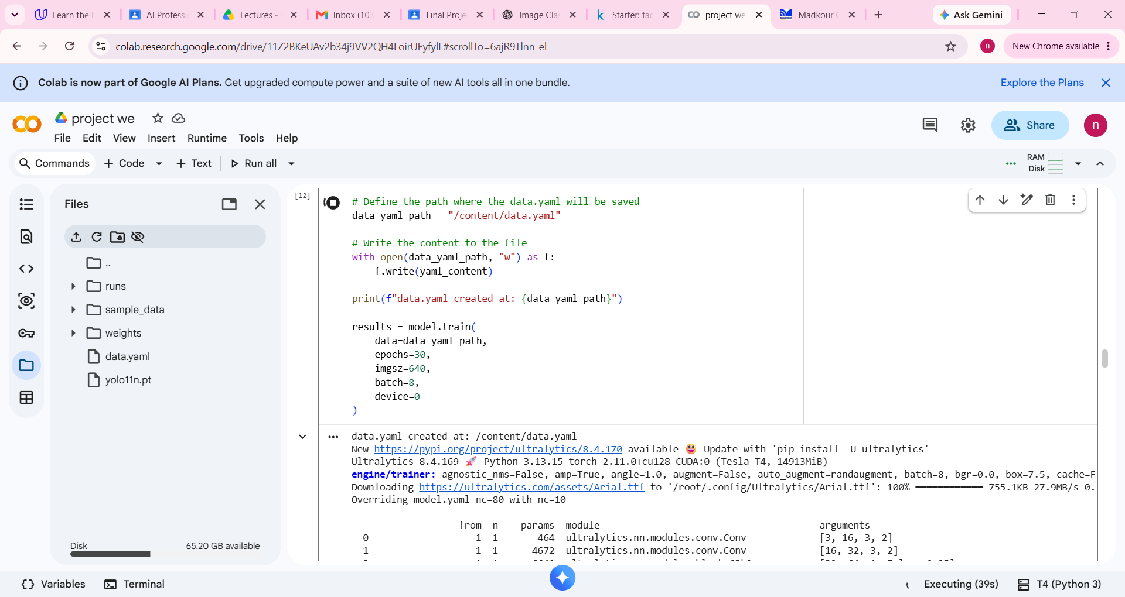
Model Architecture & Training
YOLO11n is used as a pretrained one-stage detector, then fine-tuned on our dataset.
Input image
→
Backbone
→
Feature fusion
→
Detection head
→
Boxes + classes
Training configuration
results = model.train(
data=data_yaml_path,
epochs=30,
imgsz=640,
batch=8,
device=0
)
Pretrained weights give a strong starting point; training updates the weights using our construction-site images.

Slide 8
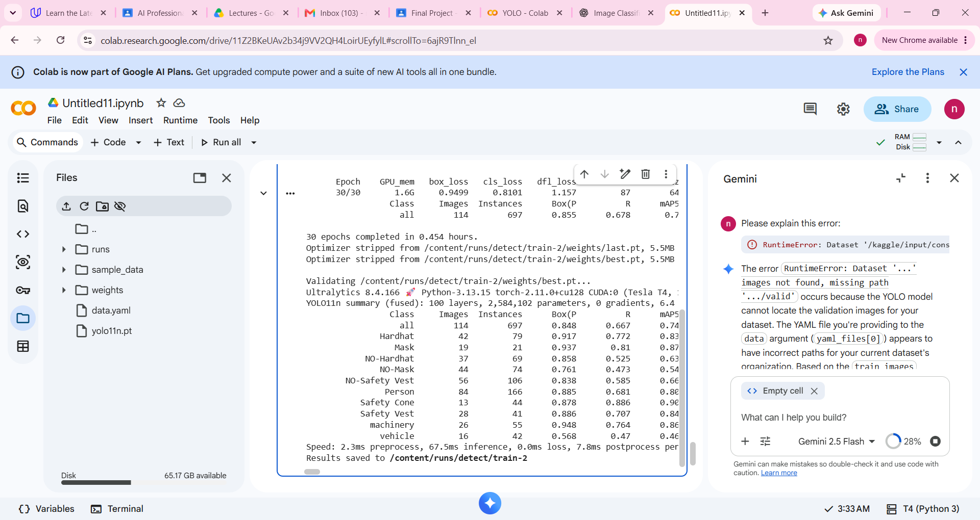
Evaluation & Results
The validation output shows class-wise precision, recall and mAP values.
Key metrics
Precision
How many predicted detections are correct.
Recall
How many true objects are found.
mAP50
Detection quality at IoU = 0.50.
mAP50–95
Stricter average over multiple IoU thresholds.
The model completed 30 epochs and saved the best weights as best.pt.

Slide 9
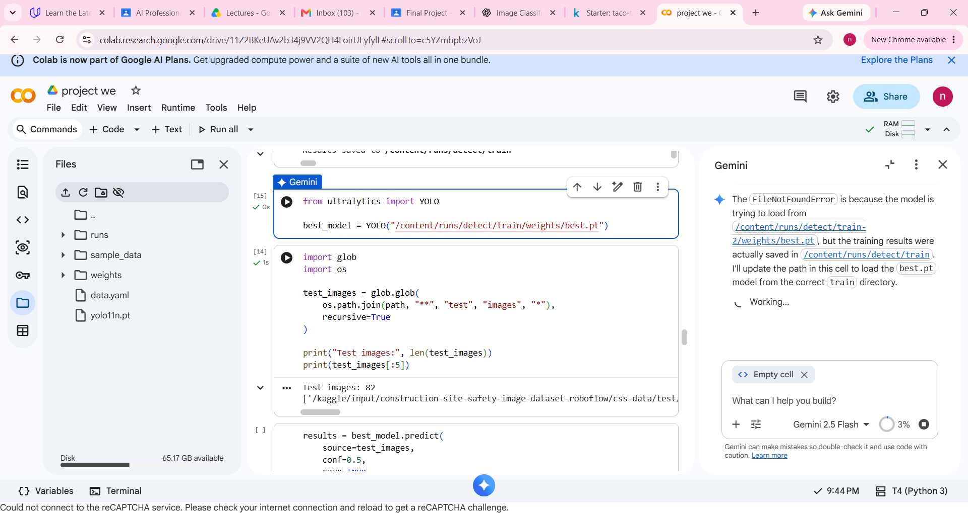
Testing on Unseen Images
The best trained model is loaded and used on the test split.
Important code
best_model = YOLO('.../best.pt')
results = best_model.predict(
source=test_images,
conf=0.5,
save=True
)
Explanation
Uses the best trained weights.
Runs inference on unseen test images.
Ignores predictions below 50% confidence.
Saves the annotated results.

Slide 10
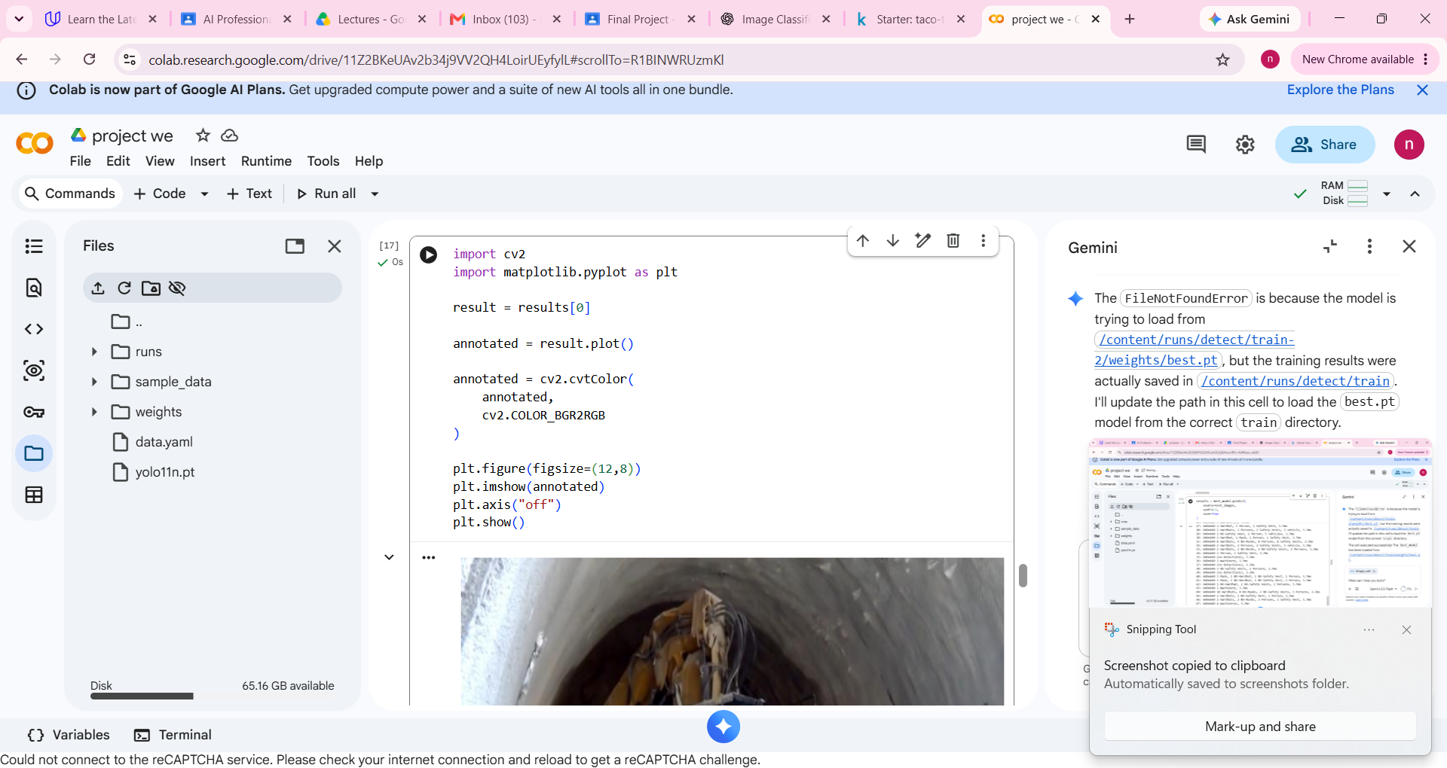
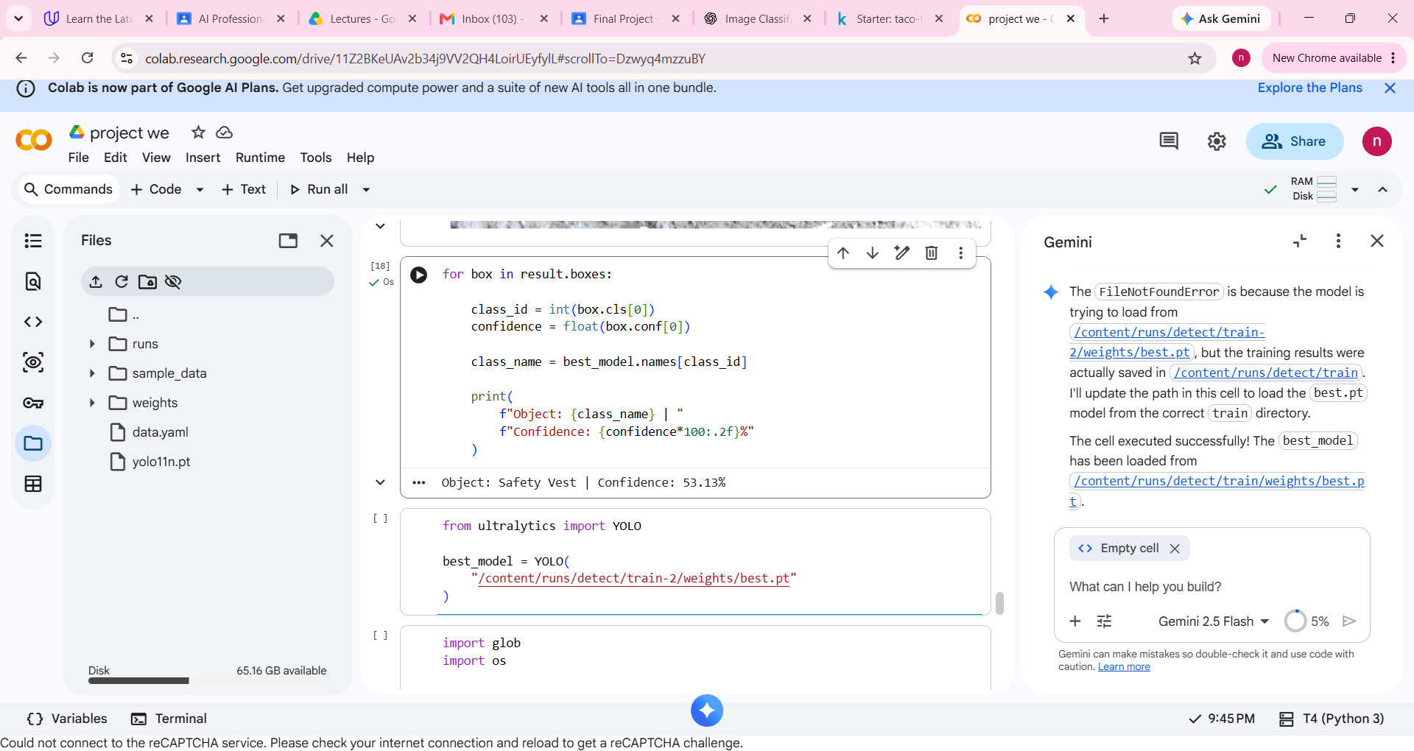
Final Prediction / Detection
The final output includes the object class, confidence score and bounding box.
Final result
Object: Safety Vest
Confidence: 53.13%
Bounding box: displayed on the image
This directly satisfies the project requirement: detect → identify → score → draw.

Slide 11
Conclusion
A complete and simple YOLO object-detection workflow.
Dataset
Construction-site images with 10 labeled classes.
Training
YOLO11n fine-tuned for 30 epochs.
Evaluation
Precision, recall and mAP measured on validation data.
Final output
Bounding boxes, class names and confidence scores on test images.
YOLO is fast, easy to deploy, and effective for real-time safety monitoring scenarios.

