Slide 1

Notes:
Logo source: https://www.unipi.it/wp-content/uploads/Raggruppa-3020.svg
Institutional reference: https://www.unipi.it/identita-visiva-delluniversita-di-pisa/logo-delluniversita-di-pisa/

Slide 2
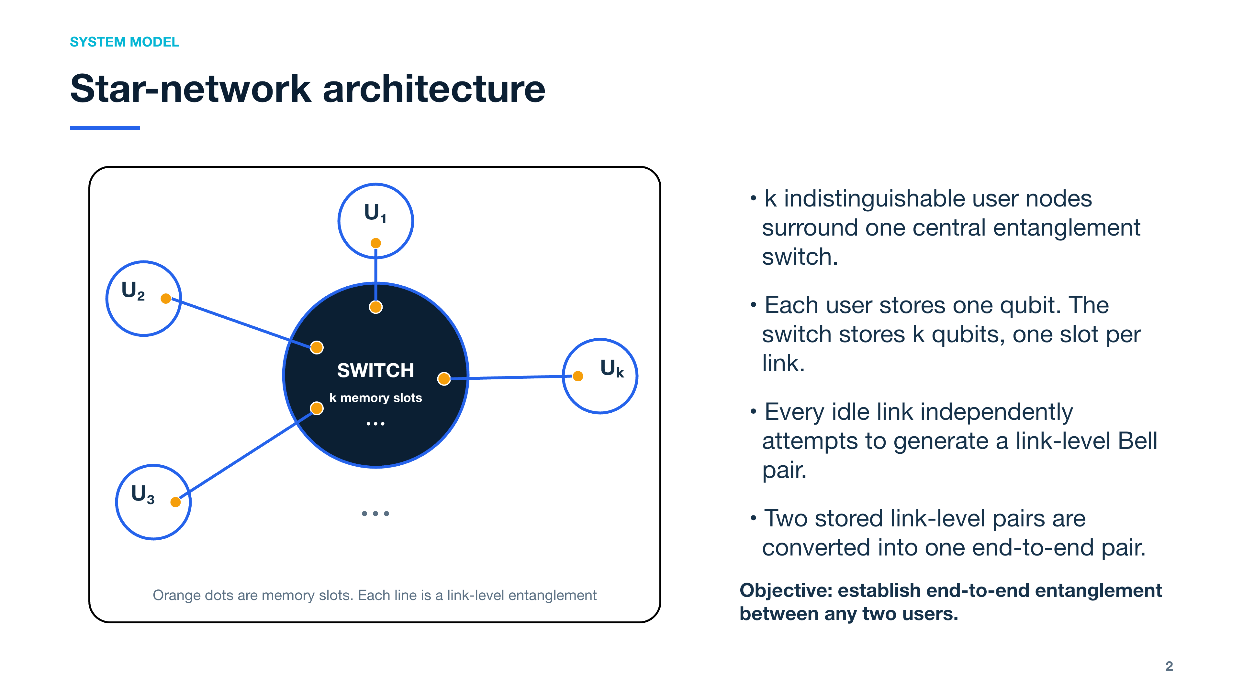
Notes:
[Sources]
- Assignment 10 - Entanglement Switch, Section 1, provided project brief.

Slide 3
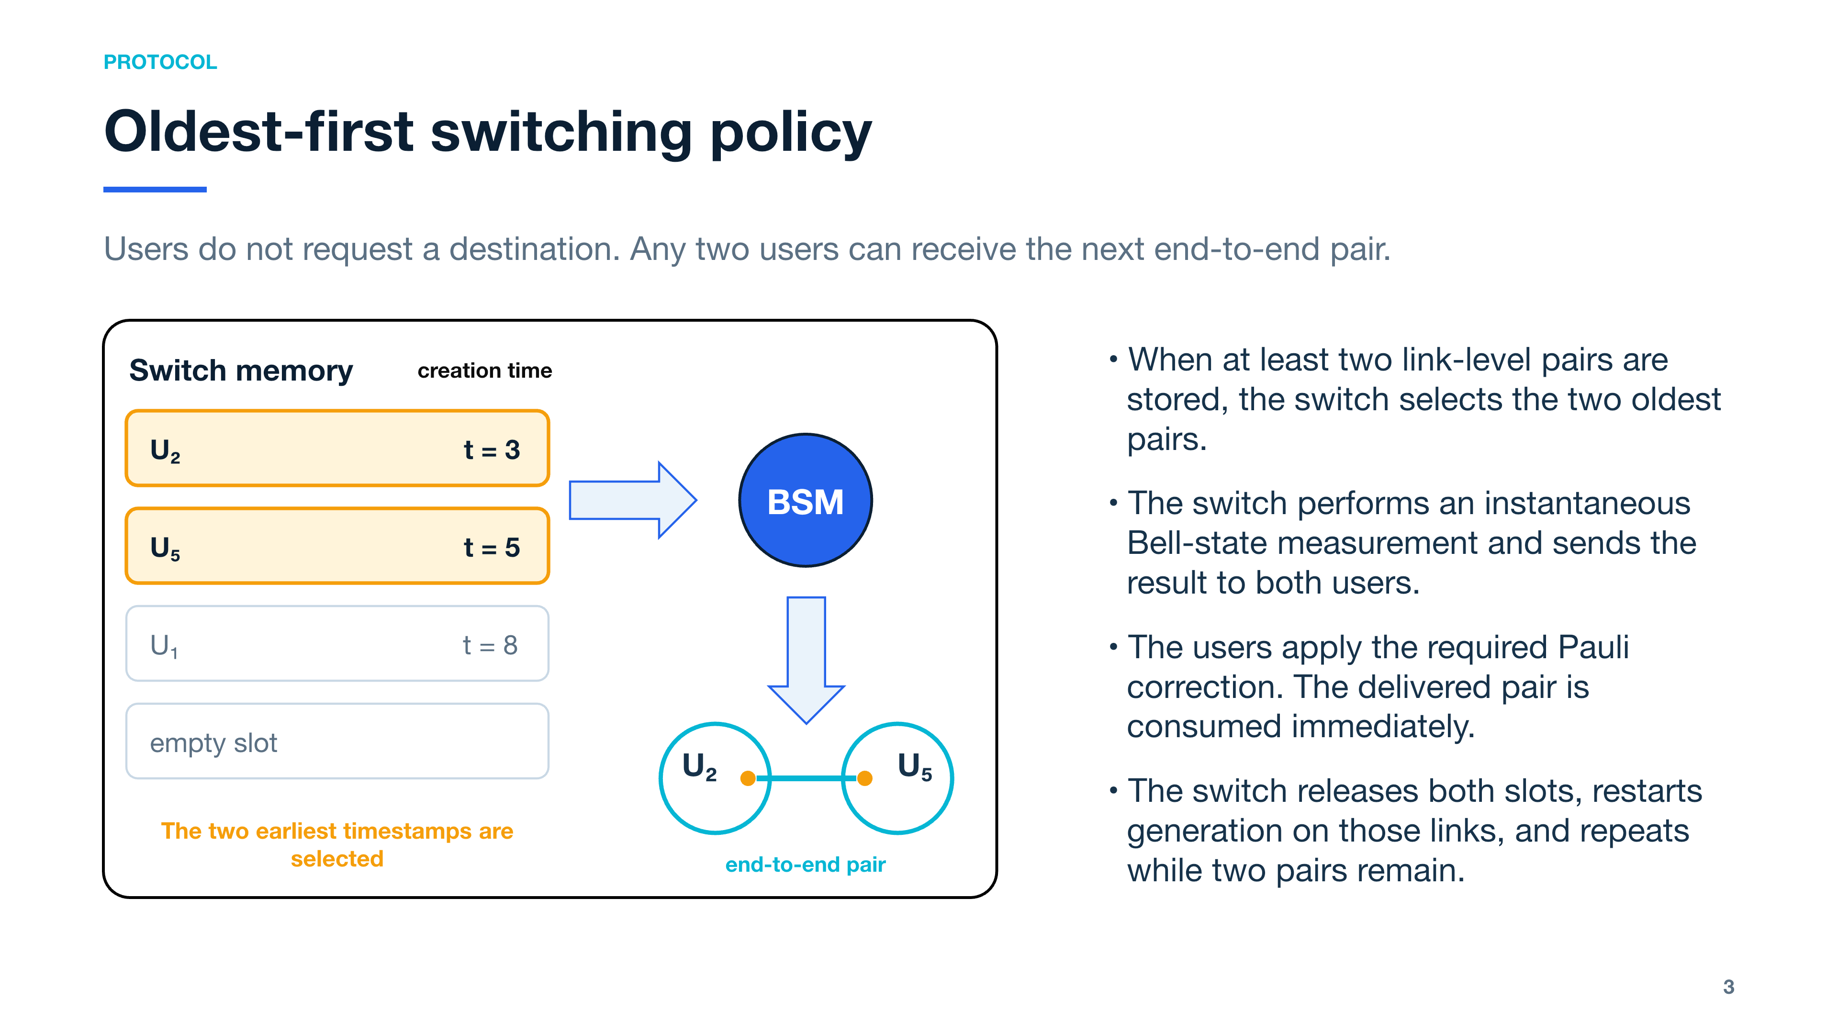
Notes:
[Sources]
- Assignment 10 - Entanglement Switch, Section 1, provided project brief.

Slide 4
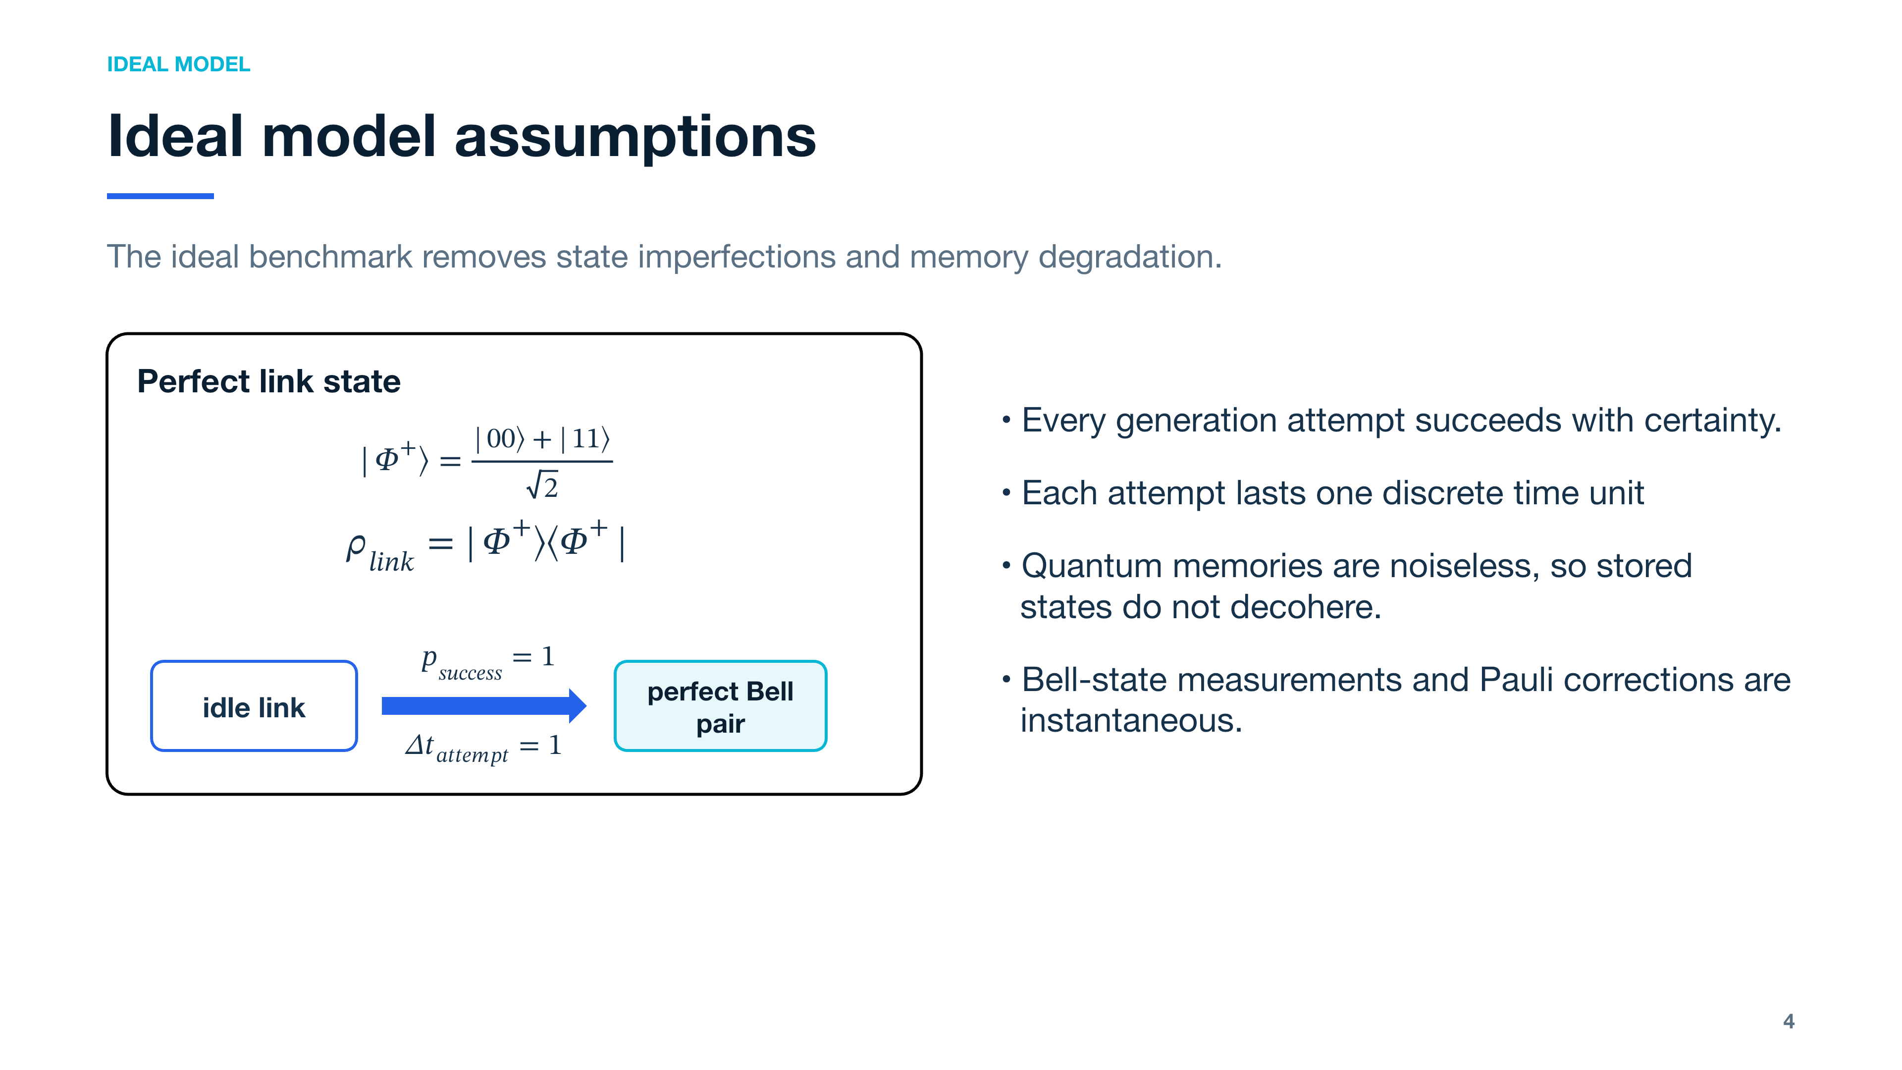
Notes:
[Sources]
- Assignment 10 - Entanglement Switch, ideal-model assumptions in the provided project brief.

Slide 5
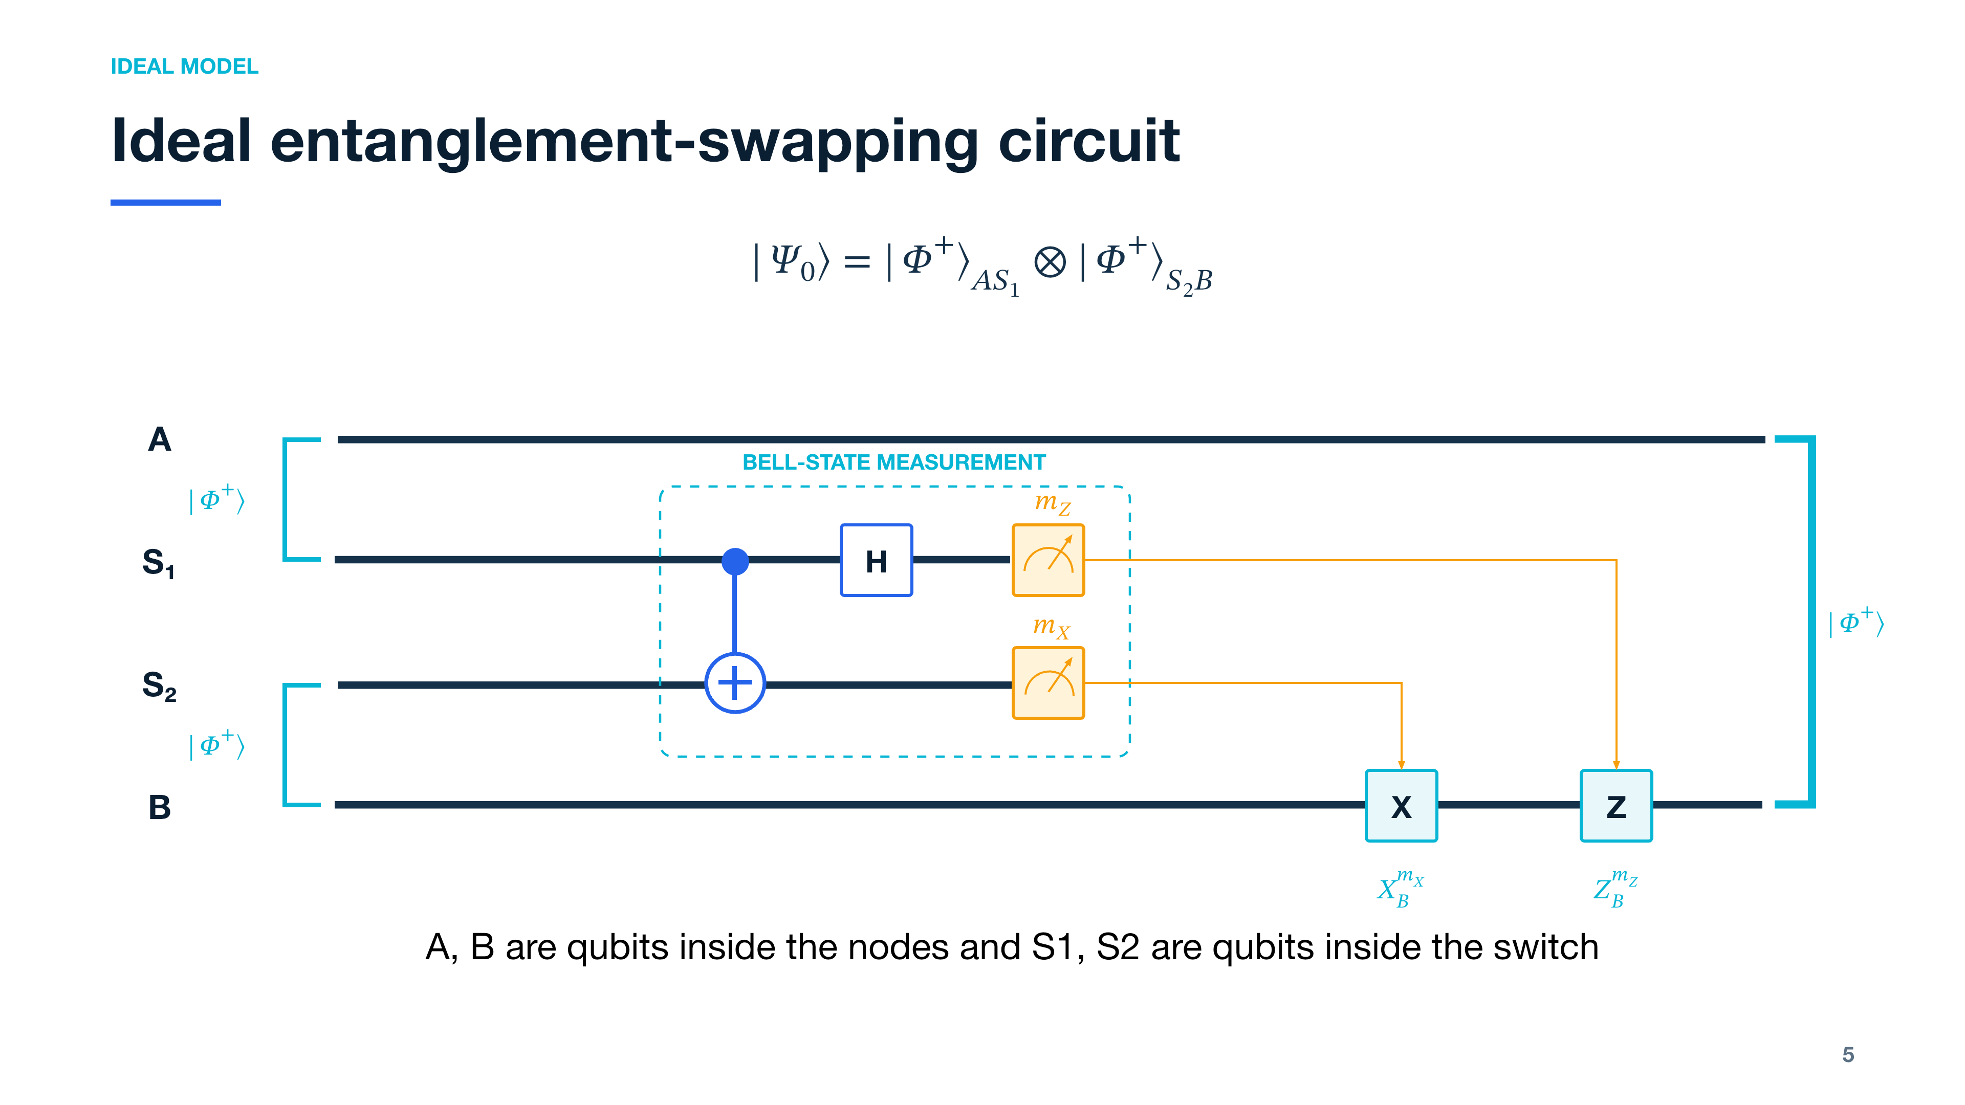
Notes:
[Sources]
- Entanglement-swapping derivation for two ideal Bell pairs, calculated for this project.
- The BSM convention uses CNOT from S1 to S2, followed by H on S1 and computational-basis measurements.

Slide 6
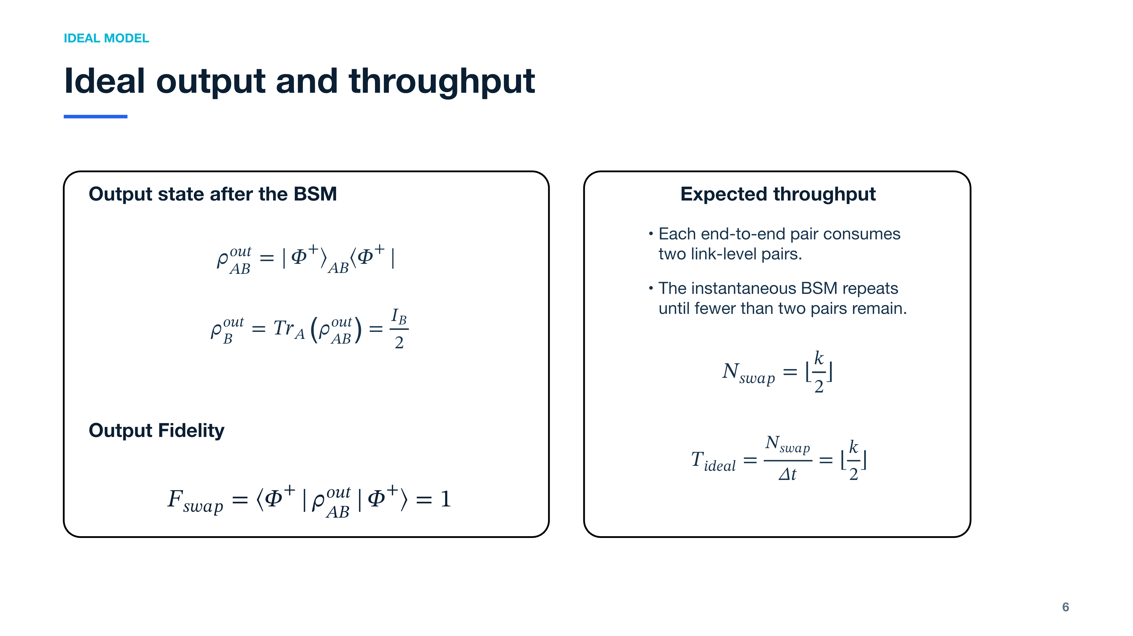
Notes:
[Sources]
- Ideal entanglement-swapping state and fidelity derived for this project.
- Throughput follows from the one-time-unit generation model and the consumption of two link-level pairs per swap.

Slide 7
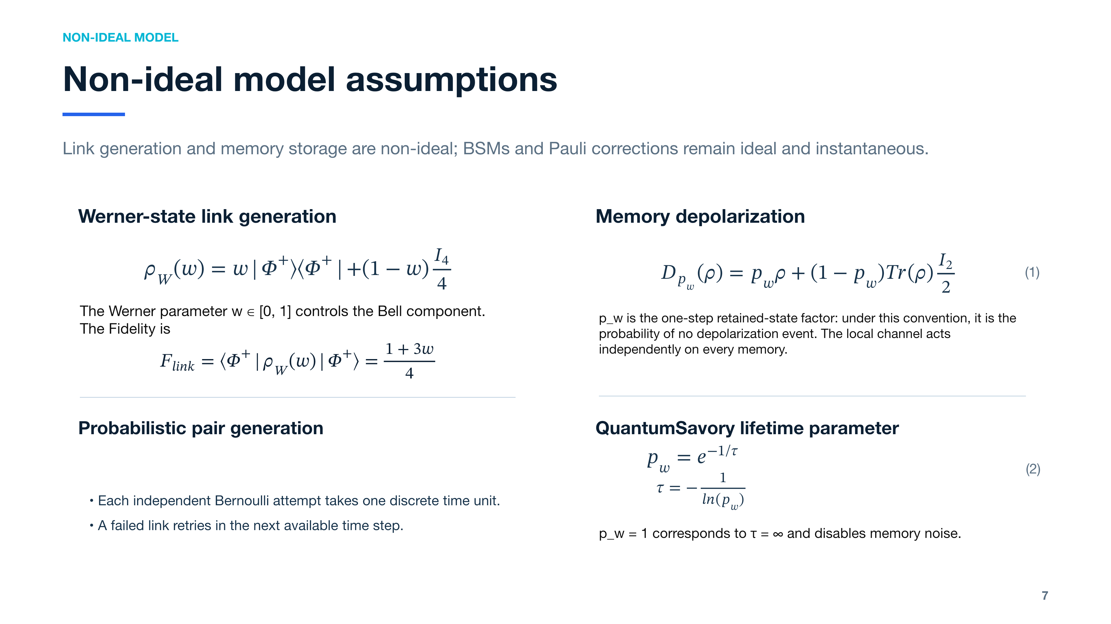
Notes:
[Sources]
- Assignment 10 - Entanglement Switch, Section 3: Non-ideal model.
- QuantumSavory.jl Depolarization(τ): the probability of no depolarization event after time t is exp(-t/τ).
- Formula (6) uses I₂/2 so that the single-qubit channel preserves the trace.

Slide 8
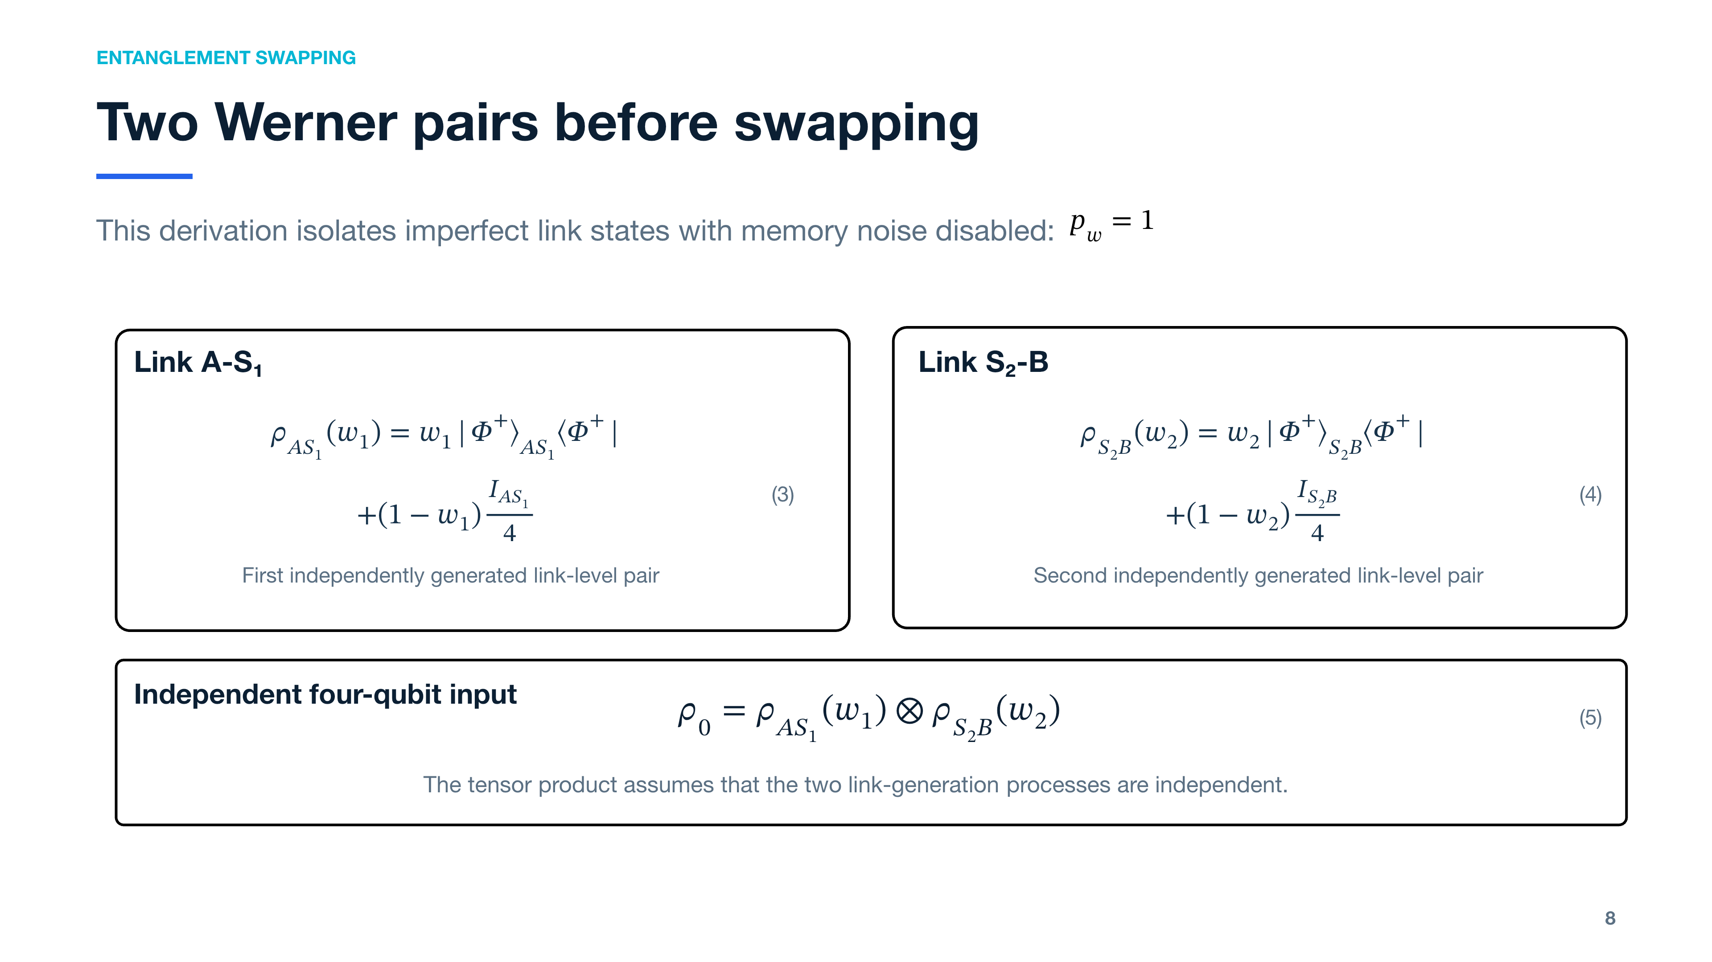
Notes:
[Sources]
- Werner-state model and independent link generation from Assignment 10, Section 3.
- Memory depolarization is intentionally disabled on this slide to isolate the effect of imperfect link states.

Slide 9
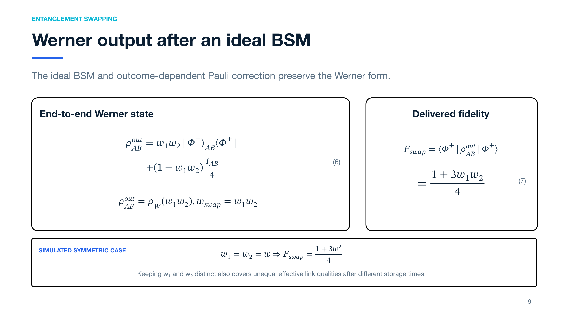
Notes:
[Sources]
- Entanglement-swapping derivation for two independent Werner states, calculated for this project.
- With an ideal BSM and outcome-dependent Pauli correction, the second Werner pair implements a depolarizing teleportation channel. Since Tr_S1[ρ_AS1(w1)] = I_A/2, the two Werner parameters multiply and the output is ρ_W(w1 w2).

Slide 10
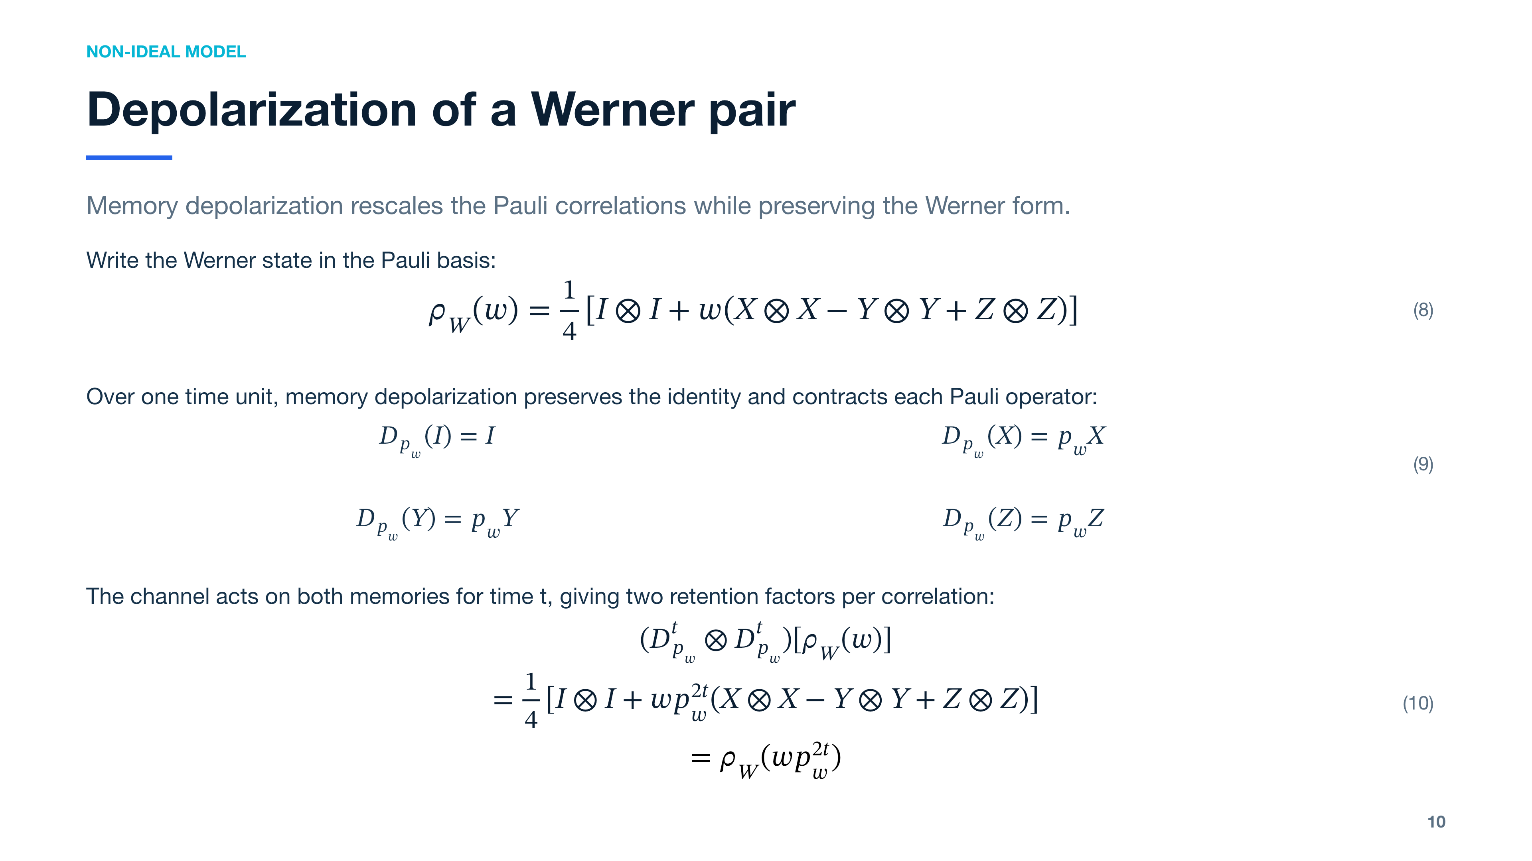
Notes:
[Sources]
- Derivation for this project using the local single-qubit depolarizing channel defined on slide 7.
- Each qubit contributes p_w^t to a Pauli-Pauli correlation, giving p_w^(2t) for a Bell pair stored in two independent memories.

Slide 11
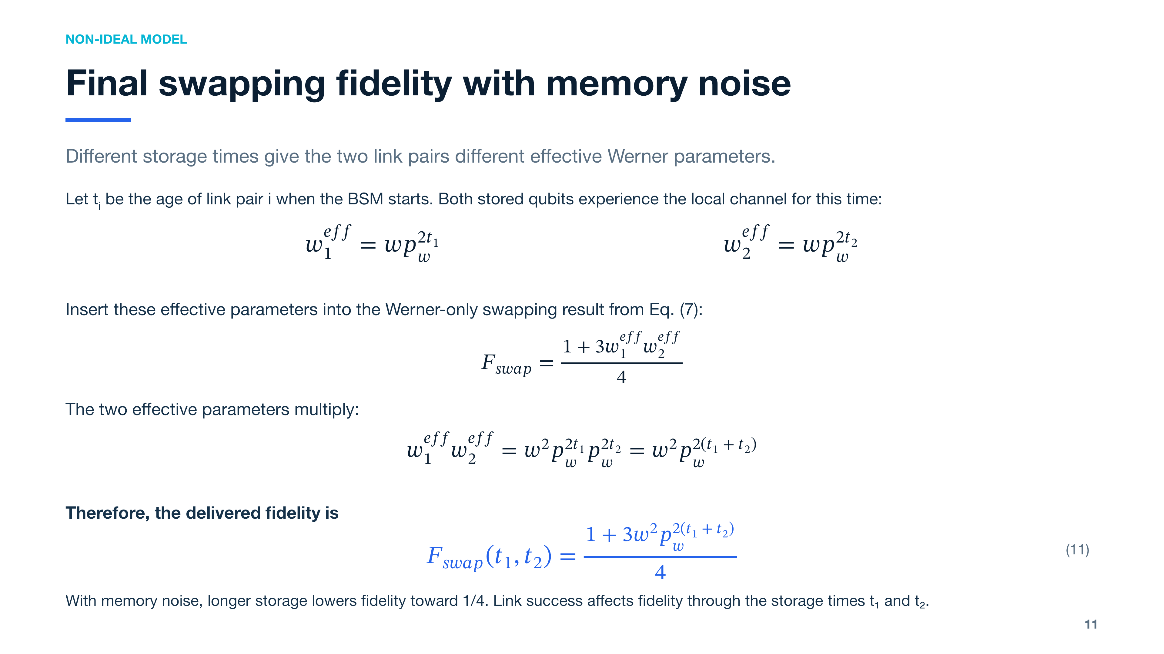
Notes:
[Sources]
- Combination of Eq. (10) with the ideal-BSM Werner swapping result on slide 9.
- The link-generation success probability changes the distribution of t1 and t2 rather than appearing explicitly in Eq. (11).

Slide 12
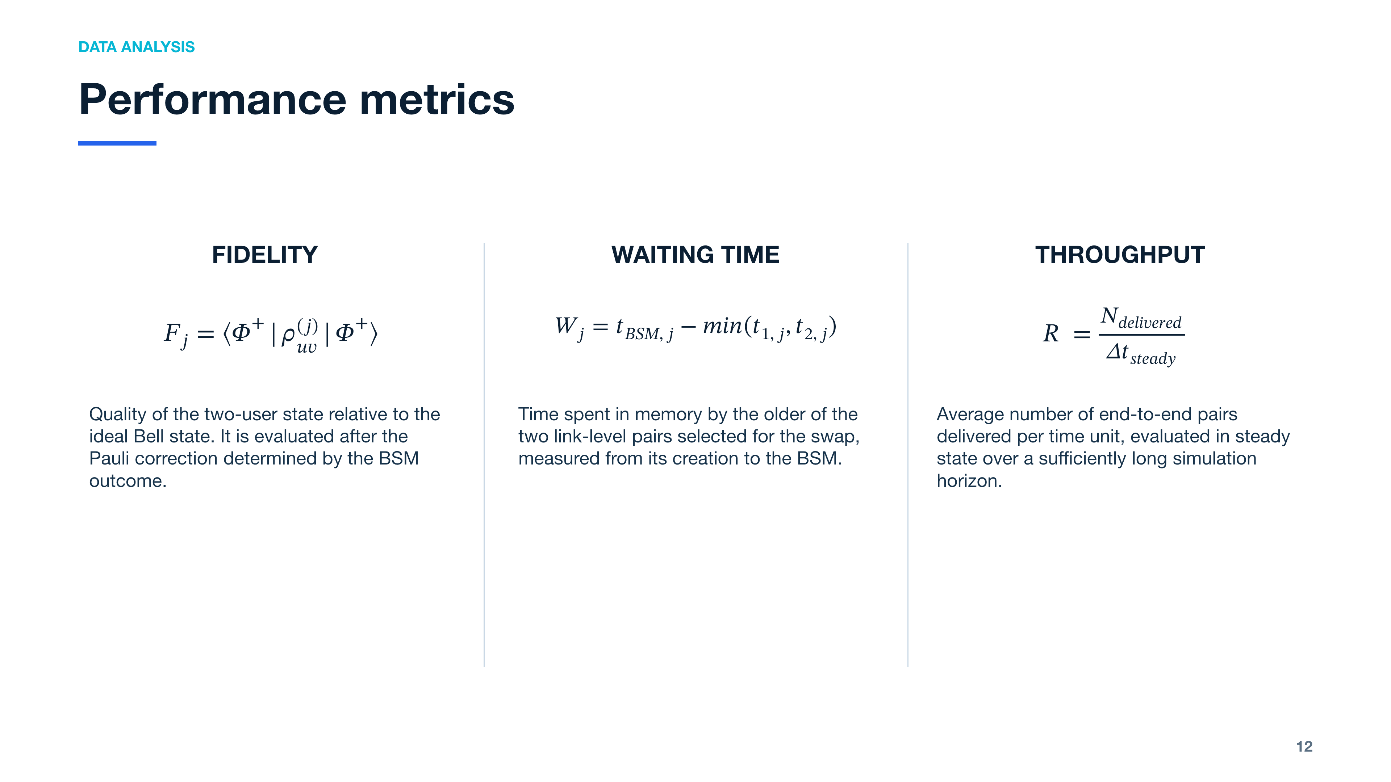
Notes:
[Sources]
- Assignment 10 - Entanglement Switch, Section 4: Performance metrics.
- The operational formulas restate the document definitions. Fidelity and waiting time are averaged over delivered pairs; throughput is evaluated in steady state.

Slide 13
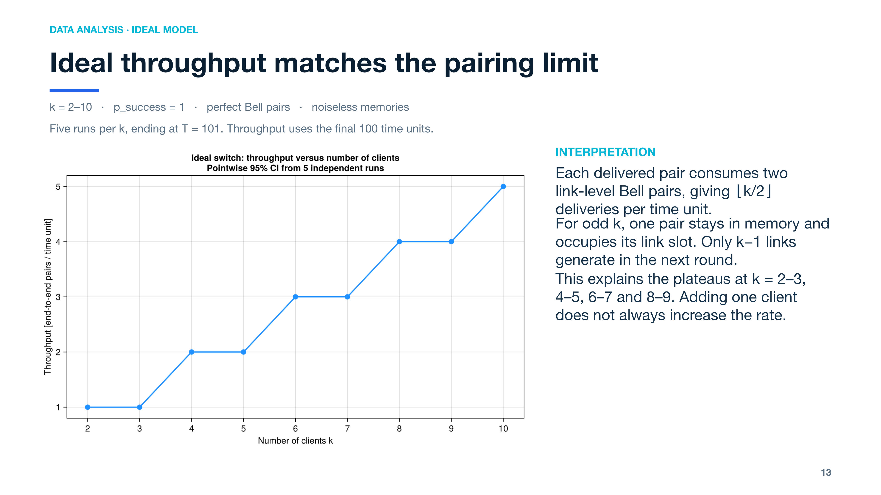
Notes:
[Sources]
- results/ideal_switch/throughput_vs_clients.png
- entanglement_switch/ideal_benchmark_analysis.jl
- The benchmark uses five independent seeded runs per k, T=101 and warm-up=1.
Interpretation source: entanglement_switch/ideal_benchmark_analysis.jl
Each delivered pair consumes two link-level Bell pairs, giving ⌊k/2⌋ deliveries per time unit.
For odd k, one pair stays in memory and occupies its link slot. Only k−1 links generate in the next round.
This explains the plateaus at k = 2–3, 4–5, 6–7 and 8–9. Adding one client does not always increase the rate.

Slide 14
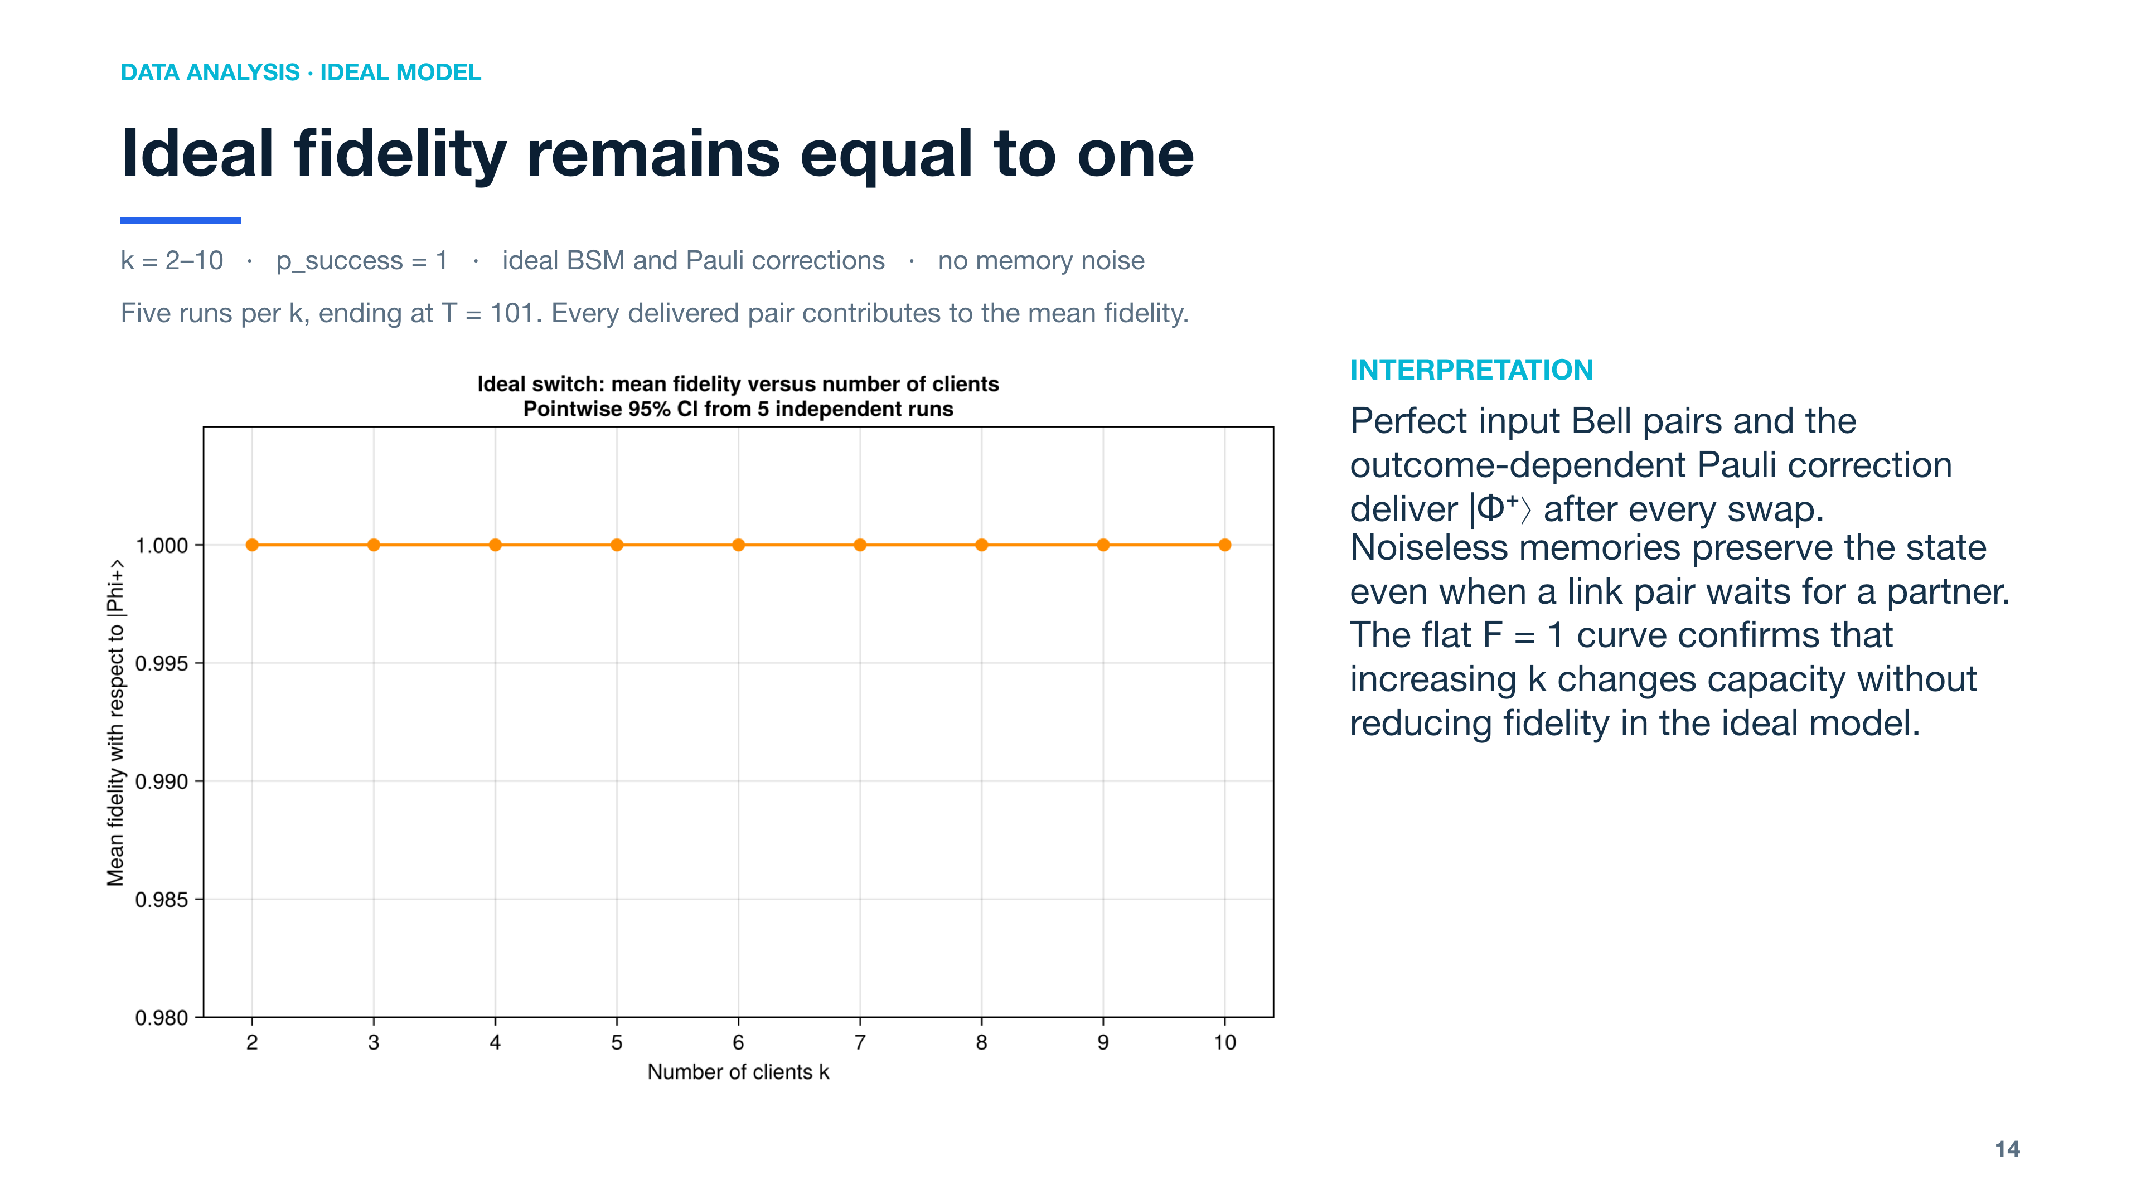
Notes:
[Sources]
- results/ideal_switch/mean_fidelity_vs_clients.png
- entanglement_switch/ideal_benchmark_analysis.jl
- Fidelity is evaluated over all delivered pairs; warm-up only affects throughput.
Interpretation source: entanglement_switch/ideal_benchmark_analysis.jl
Perfect input Bell pairs and the outcome-dependent Pauli correction deliver |Φ⁺⟩ after every swap.
Noiseless memories preserve the state even when a link pair waits for a partner.
The flat F = 1 curve confirms that increasing k changes capacity without reducing fidelity in the ideal model.

Slide 15
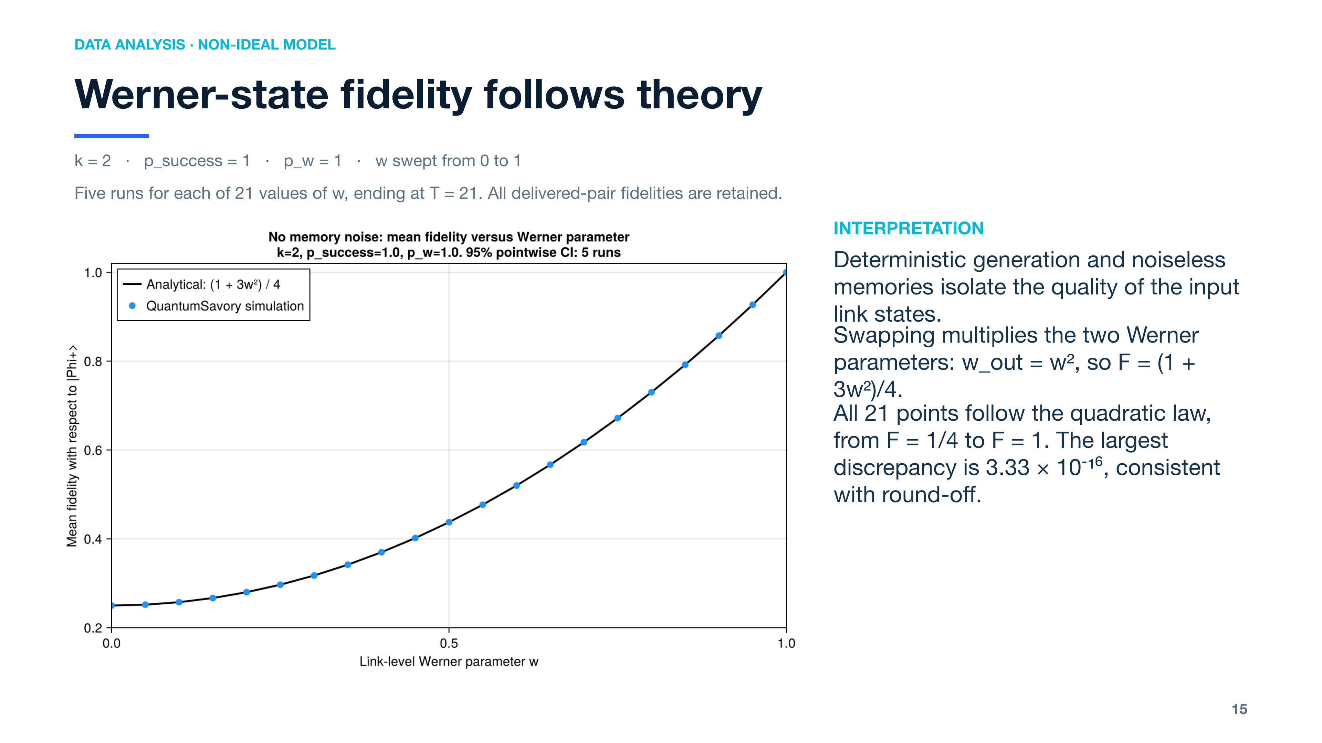
Notes:
[Sources]
- results/nonideal_switch/mean_fidelity_vs_w.png
- entanglement_switch/nonideal_benchmark_analysis.jl
- Defaults: 21 w values, T=21, five independent runs, k=2, p_success=1, p_w=1.
Interpretation source: entanglement_switch/nonideal_benchmark_analysis.jl, print_benchmark_analysis()
Deterministic generation and noiseless memories isolate the quality of the input link states.
Swapping multiplies the two Werner parameters: w_out = w², so F = (1 + 3w²)/4.
All 21 points follow the quadratic law, from F = 1/4 to F = 1. The largest discrepancy is 3.33 × 10⁻¹⁶, consistent with round-off.

Slide 16
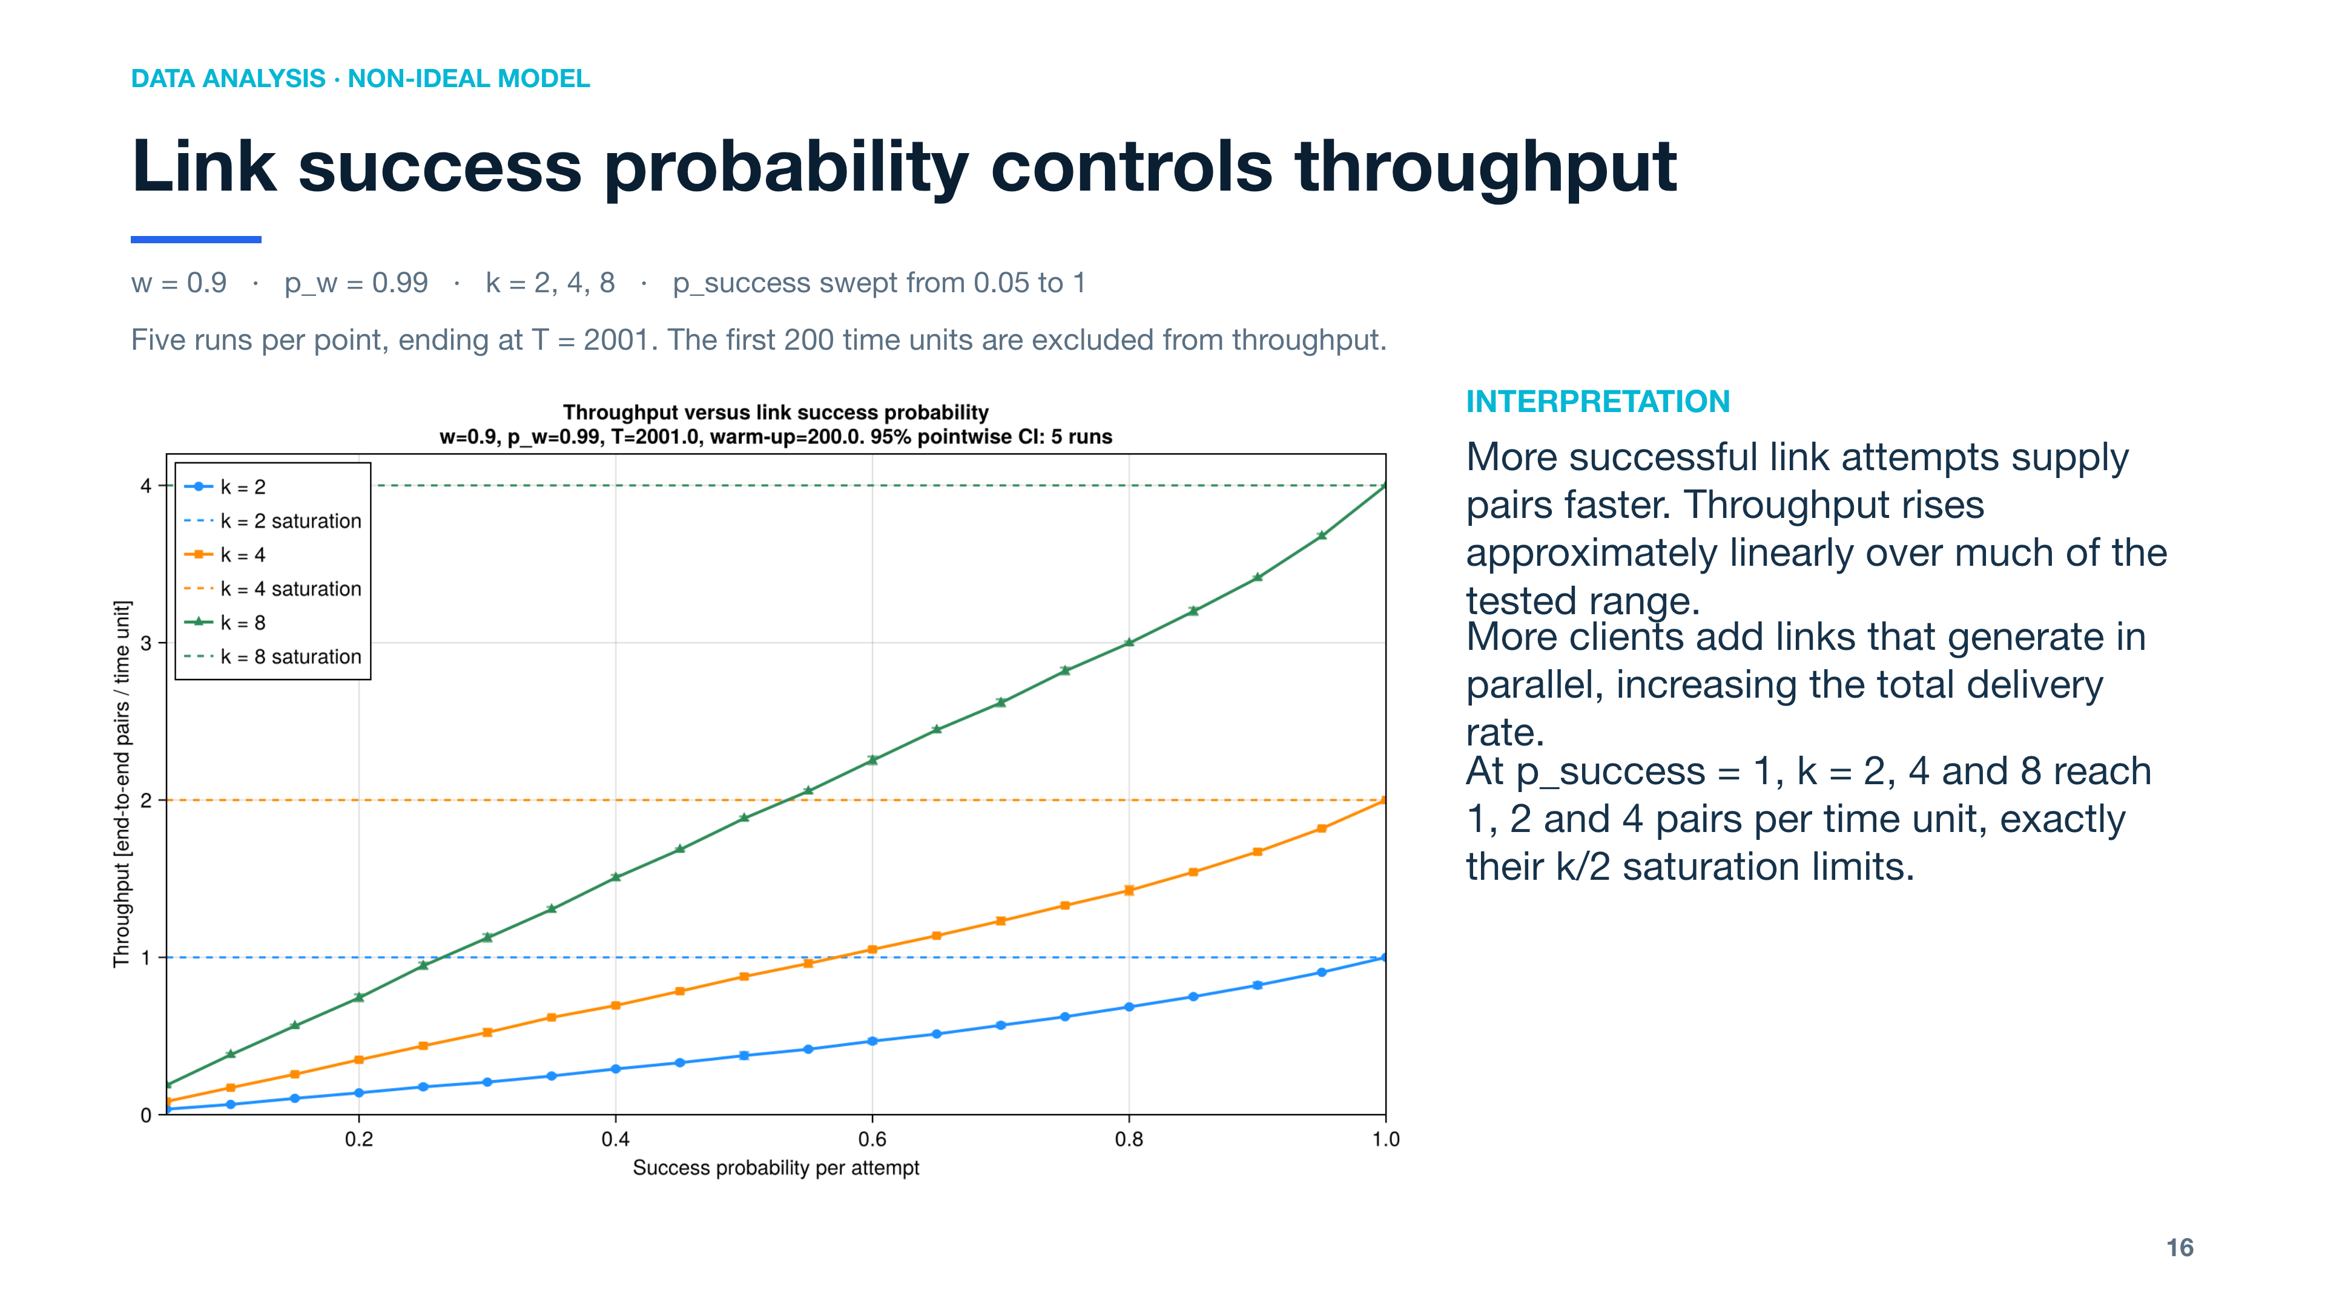
Notes:
[Sources]
- results/nonideal_switch/throughput_vs_success_probability.png
- entanglement_switch/nonideal_benchmark_analysis.jl
- The 200-unit warm-up is a practical, conservative transient exclusion rather than an analytically derived threshold.
Interpretation source: entanglement_switch/nonideal_benchmark_analysis.jl, print_benchmark_analysis()
More successful link attempts supply pairs faster. Throughput rises approximately linearly over much of the tested range.
More clients add links that generate in parallel, increasing the total delivery rate.
At p_success = 1, k = 2, 4 and 8 reach 1, 2 and 4 pairs per time unit, exactly their k/2 saturation limits.

Slide 17
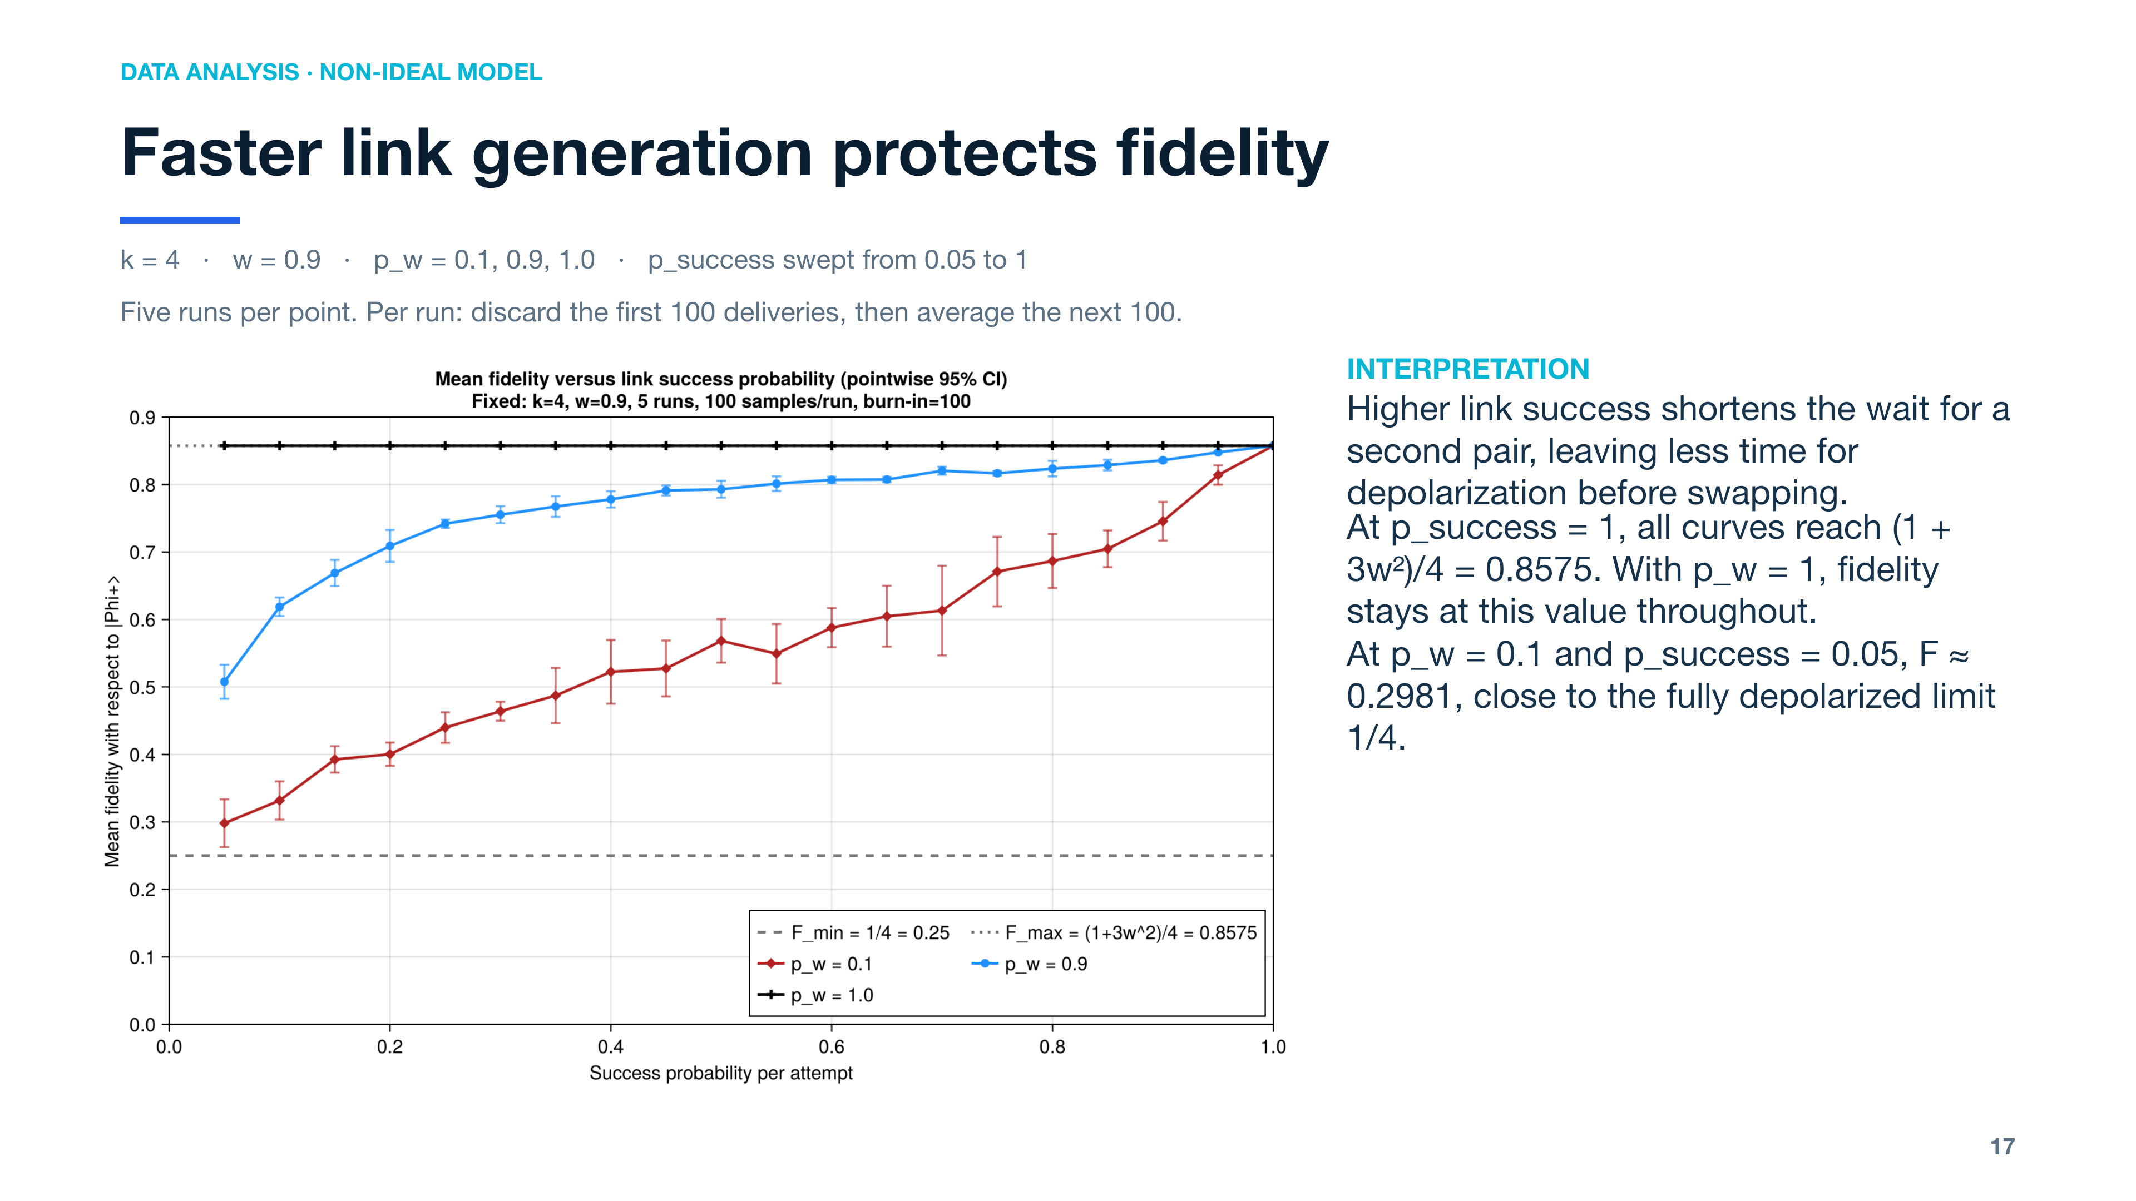
Notes:
[Sources]
- results/nonideal_switch/mean_fidelity_vs_success_probability.png
- entanglement_switch/nonideal_benchmark_analysis.jl
- Run length is adaptive and therefore varies by point; it is a multiple of 100 simulated time units.
- The fixed 100-event burn-in is a common transient filter, not an analytically derived convergence threshold.
Interpretation source: entanglement_switch/nonideal_benchmark_analysis.jl, print_benchmark_analysis()
Adaptive runs advance in 100-unit chunks until enough samples are available. The mean uses the specified retained sample slice.
Higher link success shortens the wait for a second pair, leaving less time for depolarization before swapping.
At p_success = 1, all curves reach (1 + 3w²)/4 = 0.8575. With p_w = 1, fidelity stays at this value throughout.
Smaller p_w strengthens memory noise and makes fidelity more sensitive to waiting.
At p_w = 0.1 and p_success = 0.05, F ≈ 0.2981, close to the fully depolarized limit 1/4.

Slide 18
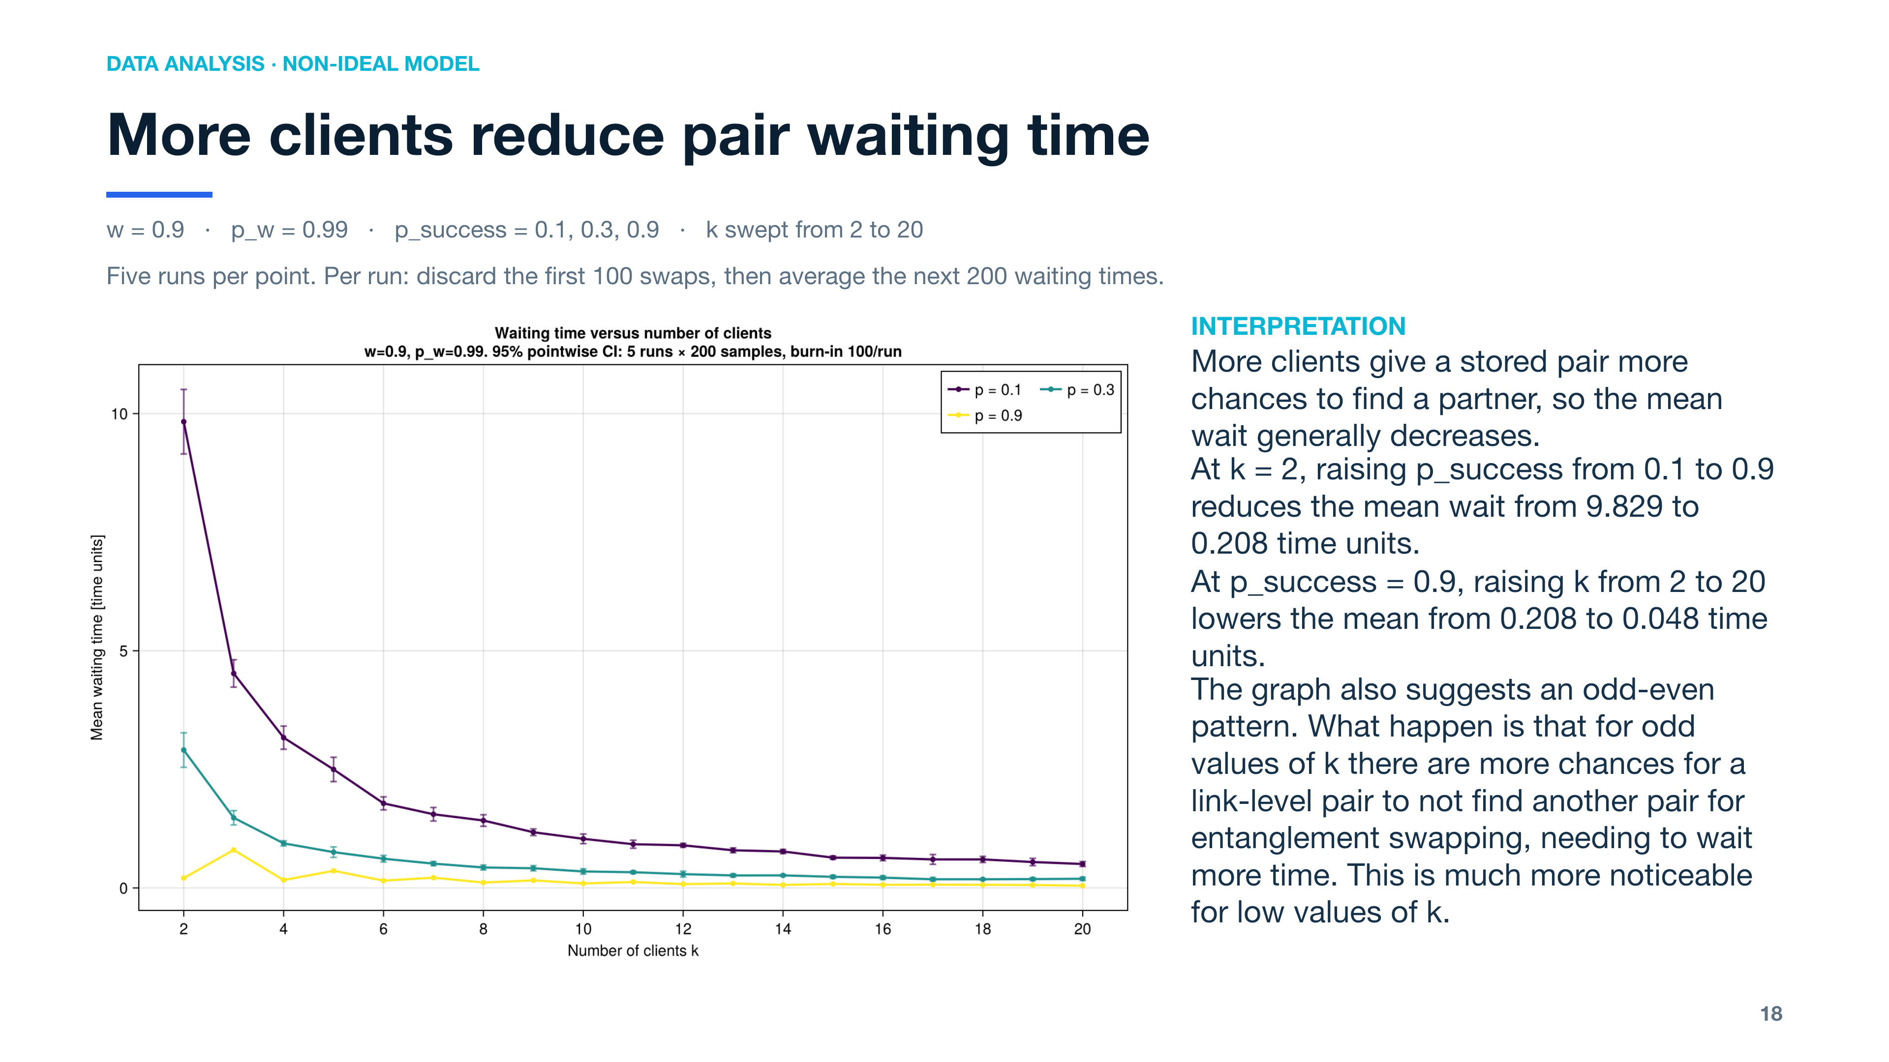
Notes:
[Sources]
- results/nonideal_switch/waiting_time_vs_number_of_users.png
- entanglement_switch/nonideal_benchmark_analysis.jl
- Run length is adaptive and varies by point; it is a multiple of 100 simulated time units.
- The 100-event burn-in is a fixed common transient filter, followed by 200 retained samples per run.
Interpretation source: entanglement_switch/nonideal_benchmark_analysis.jl, print_benchmark_analysis()
Adaptive runs advance in 100-unit chunks until enough samples are available. The mean uses the specified retained sample slice.
More clients give a stored pair more chances to find a partner, so the mean wait generally decreases.
At k = 2, raising p_success from 0.1 to 0.9 reduces the mean wait from 9.829 to 0.208 time units.
At p_success = 0.9, raising k from 2 to 20 lowers the mean from 0.208 to 0.048 time units.
The high-success curve suggests longer waits for odd k than nearby even k. This remains a visual observation.

