Slide 1
NYPD Shootings Incidents Data Report Analysis of NYC Open Data – NYPD Shooting Incident Dataset. (2006–2021)
.

Slide 2

Objectives
Analyze
Analyze shooting incidents in NYC from 2006–2021.
Identify
Identify geographic, temporal, and demographic patterns.
Examine
Examine disparities across boroughs, race, sex, and age.
Provide
Provide insights for policy and community action.

Slide 3

Dataset Overview
Source: NYPD Shooting Incident Data (Historic), NYC Open Data.
Covers incidents between 2006 and 2021.
Variables: Date, time, borough, victim demographics, etc.
Provides valuable context for understanding patterns of gun violence.

Slide 4
Data Retrieval and Cleaning
Standardized dates and times.
Categorized demographics for clarity.
Grouped records by borough, year, and other factors.
Prepared dataset for reliable analysis.
Data Cleaning Steps:
- Selected relevant columns.
- Converted date and time columns to appropriate formats.
- Created a new variable for year,time and day.
- Extracted the year from the date.
Removed duplicate/missing records

Slide 5
Key Limitations
Underreporting possible in some years.
2021 data incomplete.
Police reporting practices may introduce bias.
Missing broader social/economic context.

Slide 6
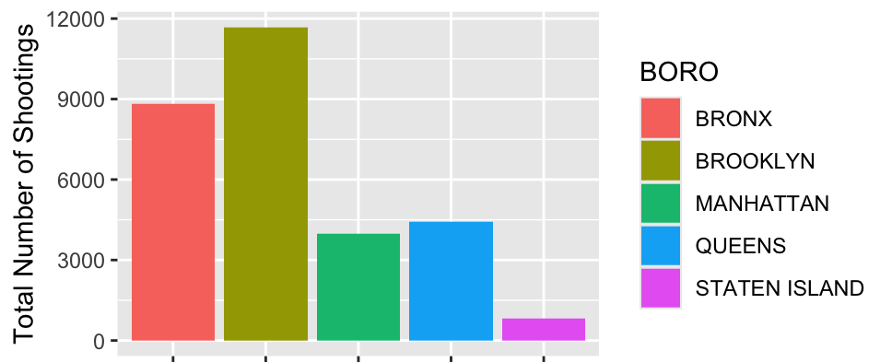
Shootings by Borough
Brooklyn consistently records the most shootings.
Bronx follows closely behind.
Queens and Manhattan are mid-range.
Staten Island consistently lowest.
Brooklyn consistently highest, often double Staten Island.

Slide 7
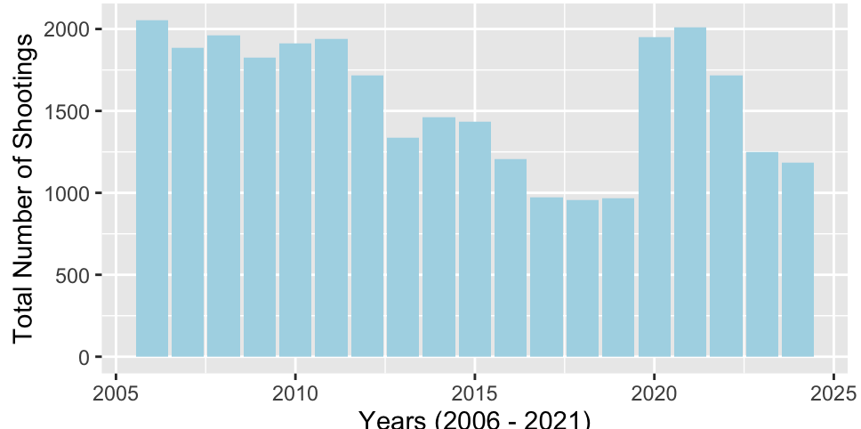
Shootings by Year
Annual totals fluctuate over time.
Peaks around 2010–2011.
Declines in later years.
Reflects policy, policing, and social shifts.

Slide 8
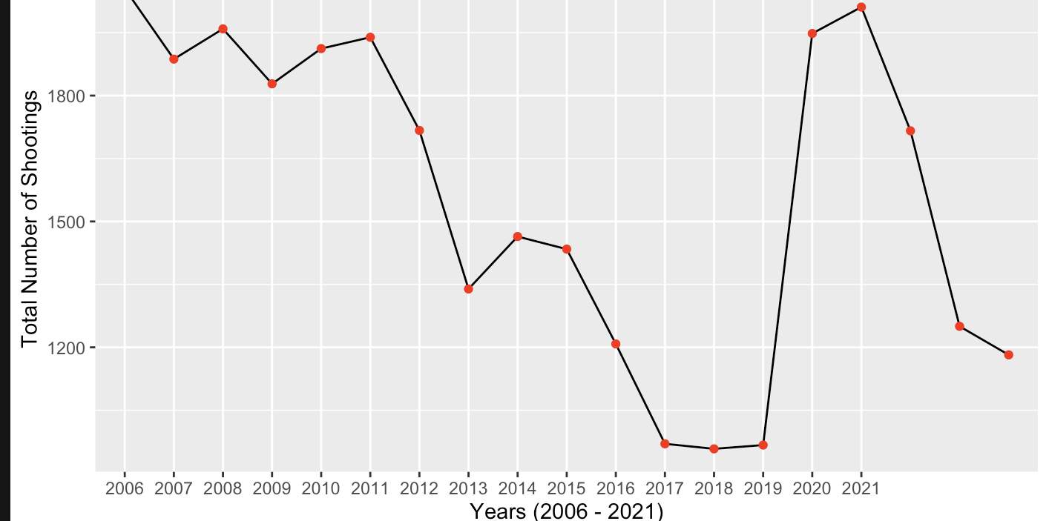
Shootings Trends Over Years
Clearer visualization of rise and decline.
2010–2011 as peak years.
Gradual reduction in later years.
Emphasizes trends, not isolated events.

Slide 9
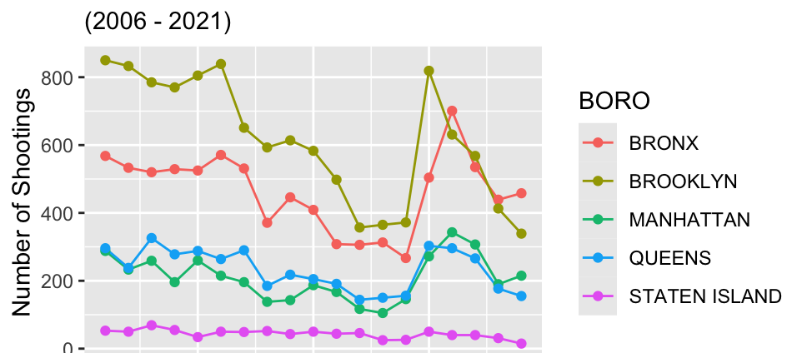
Borough-wise Shootings Over Time
Brooklyn and Bronx dominate totals.
Queens and Manhattan lower but significant.
Staten Island minimal.
Local contexts influence outcomes.

Slide 10
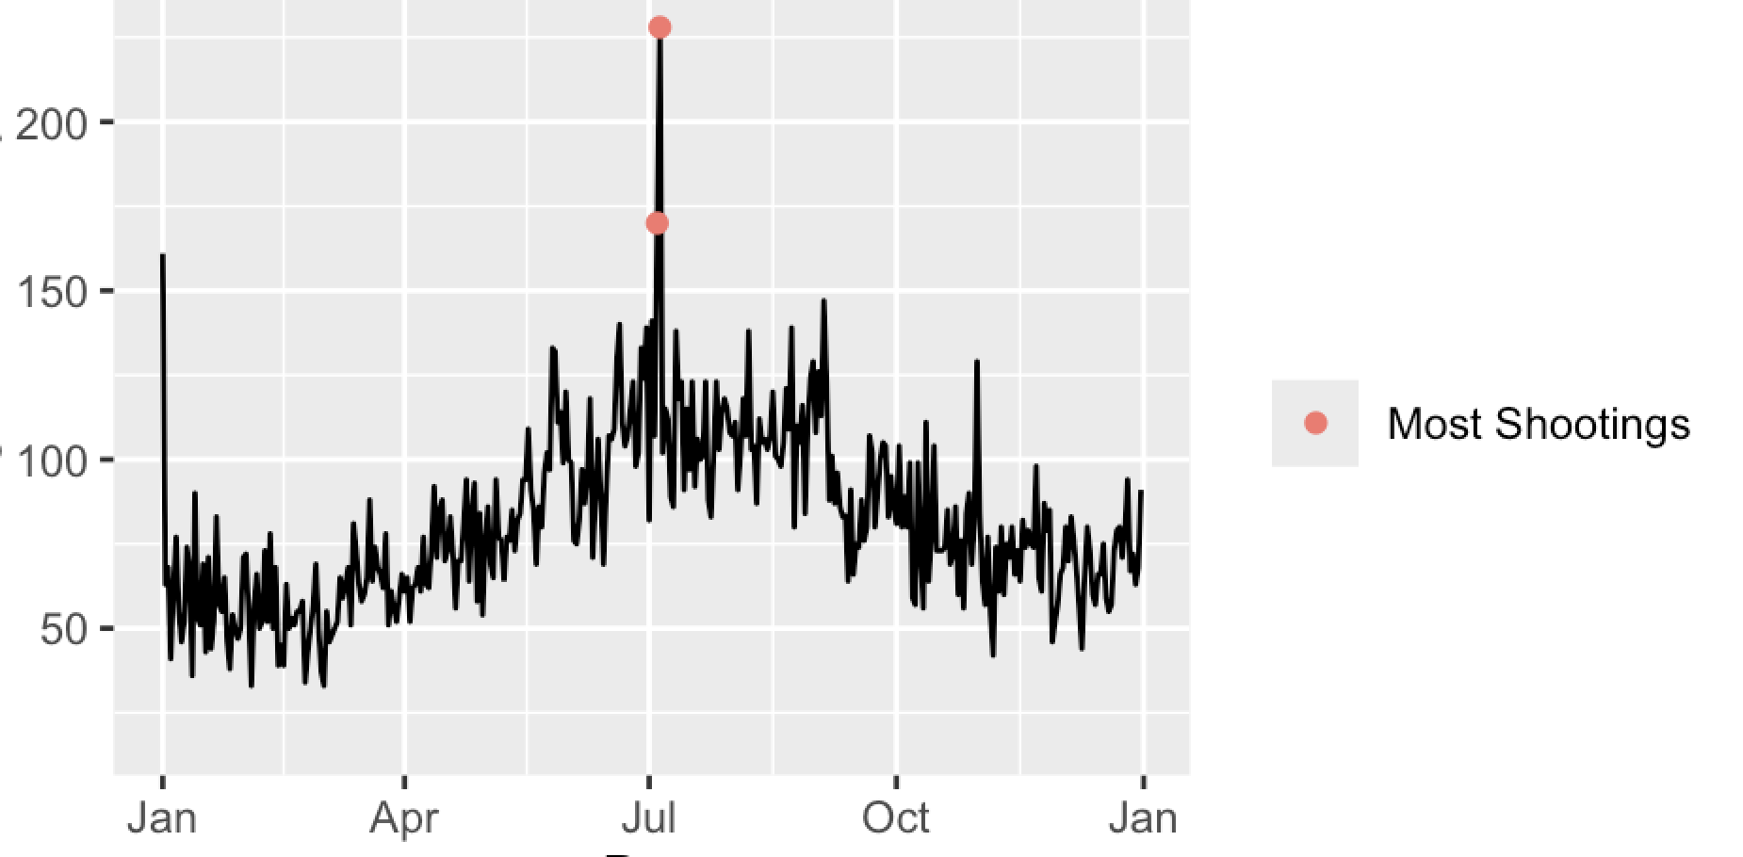

Shootings by Month
Peaks in summer months.
July consistently high.
Likely linked to outdoor gatherings.
Weather and seasonality affect patterns.
July consistently highest month.

Slide 11
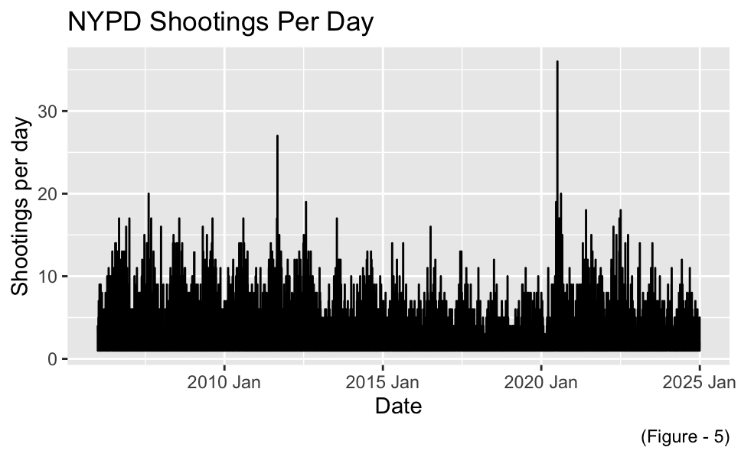
NYPD Shootings Per Day
Daily variation shows spikes/dips.
Gun violence is a daily reality.
Not confined to certain seasons.
Reinforces persistence of incidents.
Gun violence is persistent across the year — not seasonal only.

Slide 12
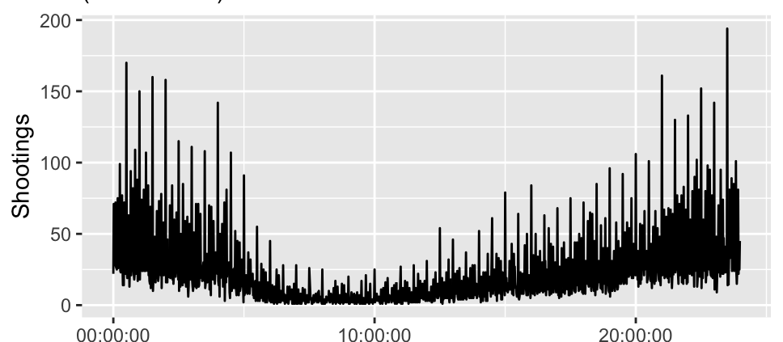

NYPD Shootings by the Time of Day
Most incidents in late afternoon/evening.
Reflects peak social activity times.
Helps guide policing patrols.
Critical for prevention strategies.
Evenings = peak risk (10 pm–1 am)

Slide 13
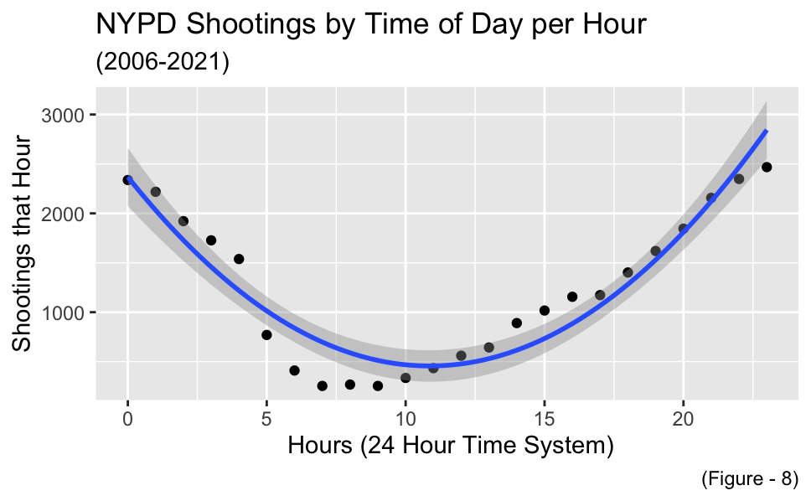
Time of Day Analysis with Polynomial Regression
Risk rises in evening, peaks late night.
Declines in early morning.
Shows time is a strong predictor.
Data-driven curve supports scheduling.

Slide 14


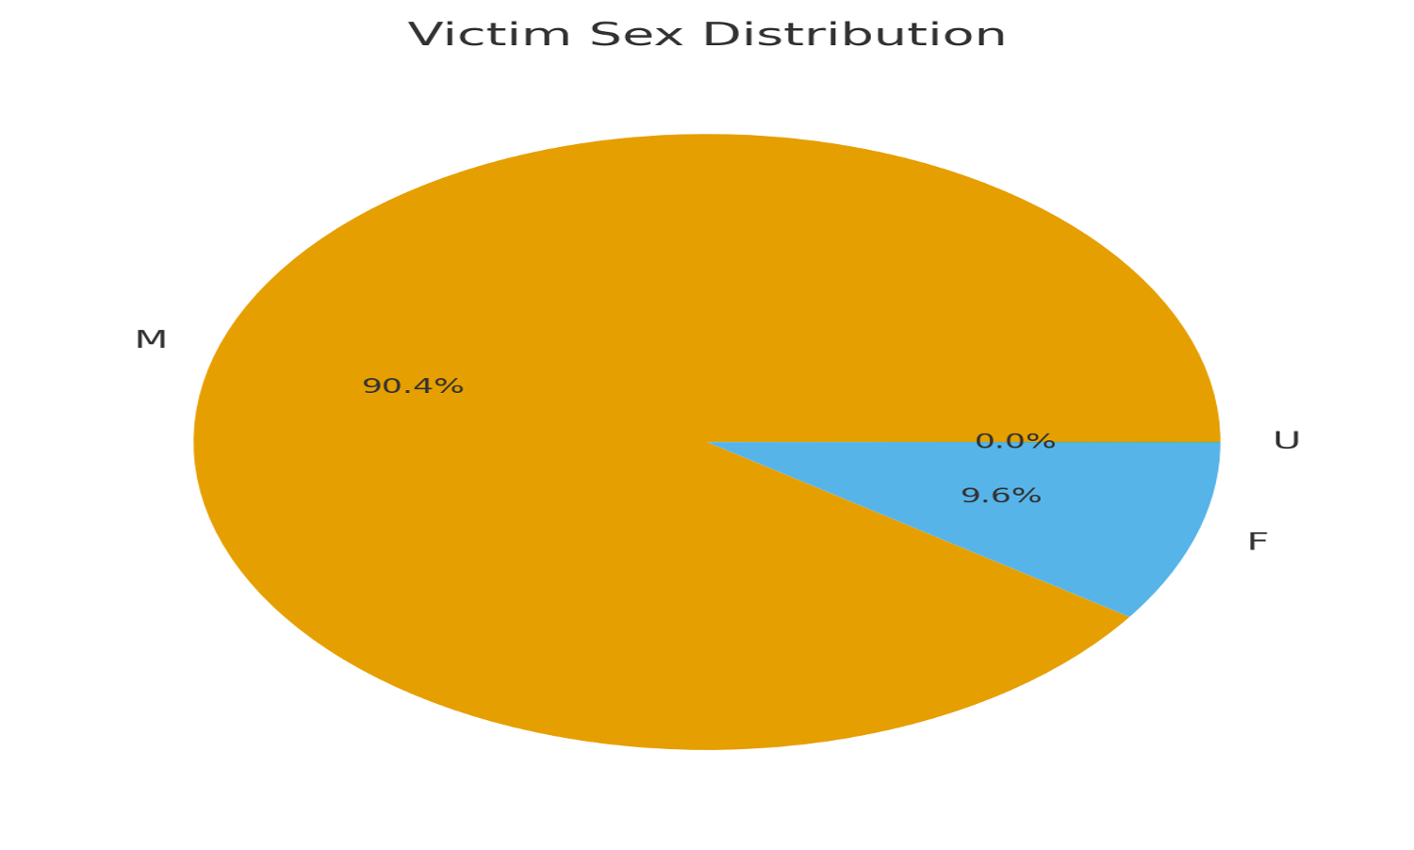
Victim Demographics: Sex
Vast majority of victims are male/90% male victims.
Reflects broader violence patterns.
Young men especially at risk.
Prevention programs should target this group.

Slide 15

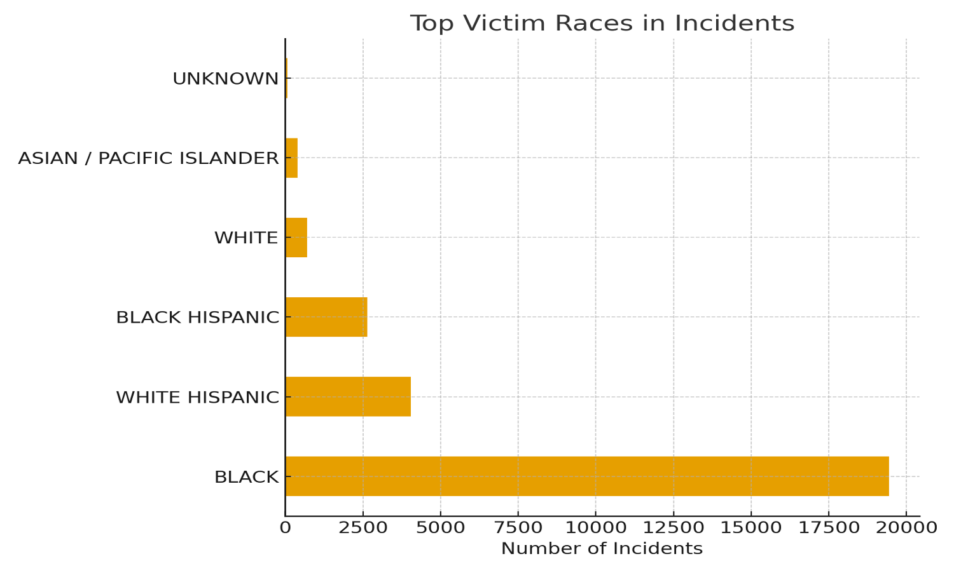
Victim Demographics: Race
Black and Hispanic victims most affected.
Reflects systemic inequities.
Communities face disproportionate impact.

Slide 16
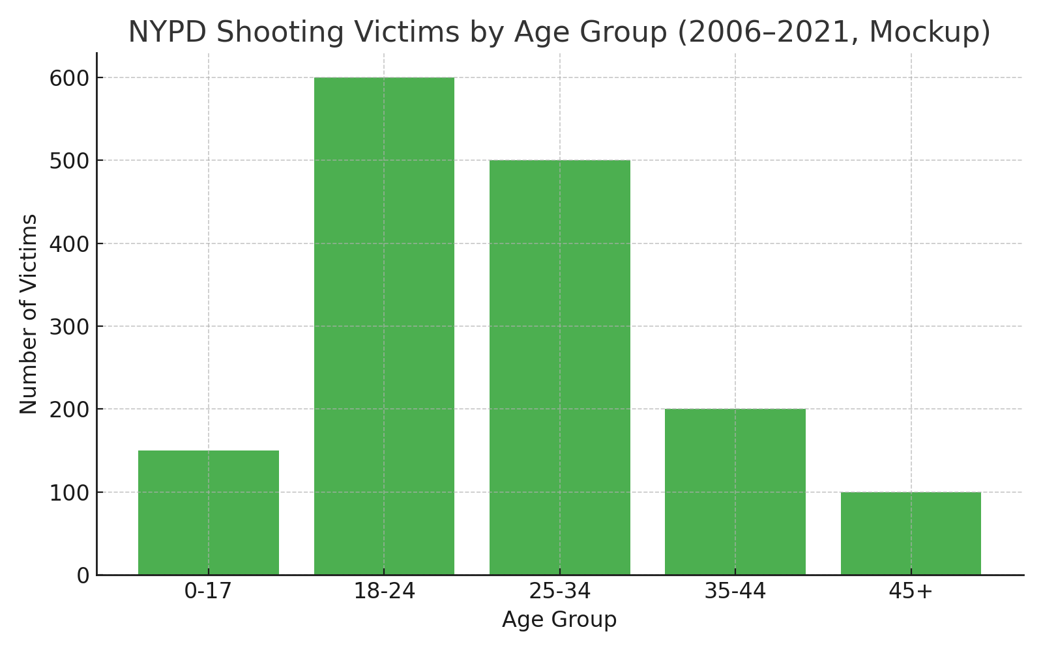
Victim Demographics: Age
Youth (teens, 20s) most at risk.
Gun violence concentrated in young age groups.
Prevention must focus on youth engagement.
Highlights vulnerability of younger populations.
Young adults (18-30) most at risk.
Older adults and children much less frequent victims.

Slide 17

Ethical & Social Implications
Beyond data: real human cost.
Families and communities impacted.
Ethical response requires balance of policing & prevention.
Community trust essential.
Equity in public safety.
Prevention vs enforcement balance.

Slide 18

Statistical Analysis
Analysis 1: Proportion of total shootings in Brooklyn and Queens combined: 65%.
Analysis 2: Proportion of total shootings in Staten Island: 2.7%.

Slide 19


Key Findings Summary
Violence concentrated in Brooklyn & Bronx.
Peaks in early 2010s, declines later.
Summer/holidays = higher risks.
Disparities by sex, race, age.

Slide 20


Policy Recommendations
Expand community programs in high-incident boroughs.
Focus on youth outreach.
Address systemic inequalities.
Enhance holiday/evening safety measures.
Enhance evening/holiday safety measures (extra patrols, community events.

Slide 21

This analysis isn’t just about numbers—it’s about lives, communities, and the future of public safety. I hope this gave you useful insights. Thank you for listening.

