Slide 1
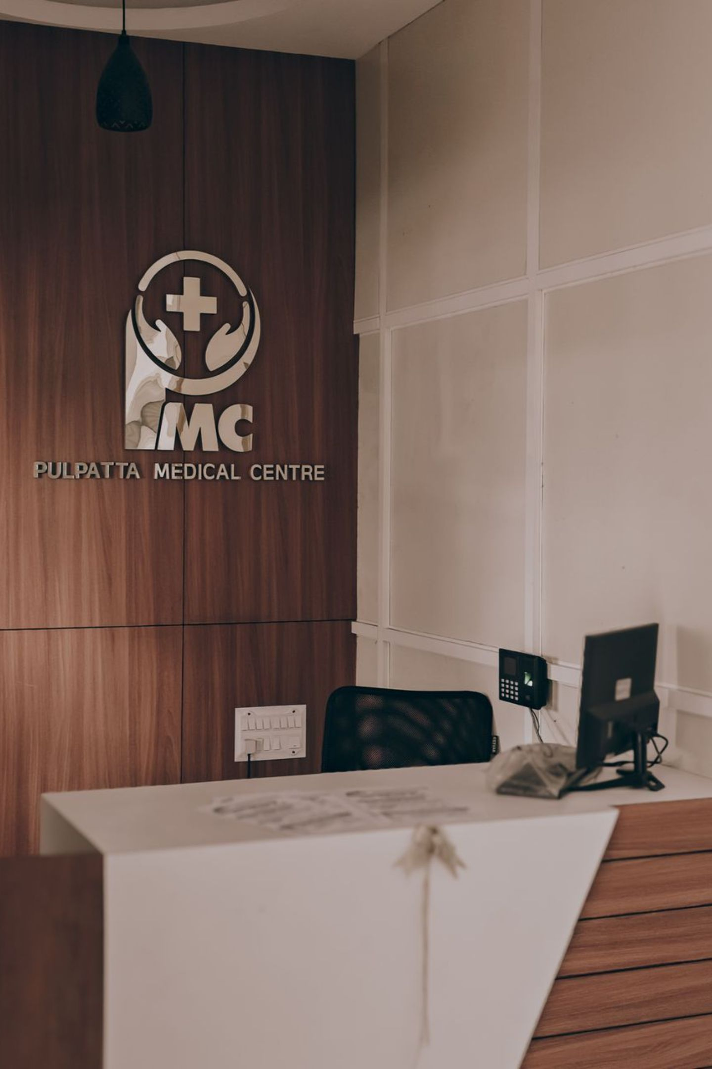
Hospital Patient Management System
A Lightweight, C-Based Patient Record Management & Automated Billing Solution
MINI PROJECT PRESENTATION

Slide 2
Project Team & Responsibilities
This project was developed collaboratively by a team of four, with clearly defined roles across core development and quality assurance.
Core Development Team
Analysis & Quality Team
Naren Karthick G & Madhan Kumar Y
Engineered core data structures (struct Patient), file handling persistence (patients.txt), memory allocation, and module integration for CLI operations.
Grascy Jennifer J R & Keerthika B
Designed the automated billing calculation engine, temp-file updating protocols, user validation routines, and system test scenarios.

Slide 3

Project Abstract
The Hospital Patient Management System replaces error-prone manual paper registers with an efficient, lightweight C console application — bringing digital recordkeeping to small and medium healthcare facilities.
Digital Recordkeeping
Replaces manual paper-based hospital registers with an efficient C console application for streamlined patient data entry and retrieval.
Data Persistence
Utilises file I/O operations to securely store, retrieve, and update patient data across sessions using plain text files.
Automated Financials
Computes room stay charges and medication expenses with instant automated bill generation, eliminating manual calculation errors.
High Efficiency
Operates with lightweight text file processing for fast search and updates without any external database overhead.

Slide 4
Key Features Overview
The system offers four core features that cover the complete patient lifecycle — from admission to discharge and billing.
Patient Admission
Quick Search
Captures Patient ID, Name, Age, Disease, Room Number, Days Admitted, Daily Charges, and Medication Costs in a single structured record.
Retrieves specific patient information instantly using a unique Patient ID scanned over persistent records in patients.txt.
Dynamic Updates
Instant Billing
Updates existing patient files seamlessly using file staging (temp.txt) to preserve data integrity during modifications.
Calculates total stay charges and medication expenses into a clean, formatted digital billing receipt in real time.

Slide 5

System Architecture
Structured C Implementation
The system is built upon a modular execution model written in standard C programming language. It leverages composite data structures (struct) to represent patient entities and standard C libraries (stdio.h, stdlib.h, string.h) for memory and file manipulation.
File handling operations (fopen, fprintf, fscanf) are used to persist records in plain text format (patients.txt), ensuring data survives across program sessions without any external database dependency.
Core Libraries
Data Storage
stdio.h · stdlib.h · string.h
Plain text file — patients.txt

Slide 6
Core Code Modules
The system is organised into five distinct functions, each responsible for a specific operation on patient records.
1
addPatient()
Opens patients.txt in append mode ("a") and logs new struct record entries seamlessly to the persistent file.
2
displayPatients()
Reads stored data sequentially ("r") using fscanf and outputs a clean, formatted tabular summary of all patients.
3
searchPatient()
Filters file entries by a user-specified Patient ID and renders a comprehensive patient detail card on screen.
4
updatePatient()
Writes updated data to temp.txt and renames it to replace the original records safely, preventing data loss.
5
generateBill()
Computes (days × dailyRate) + medicineCost dynamically to output a total billing summary for the patient.

Slide 7

Sample Patient Dataset
The following table illustrates how patient records are stored and displayed by the system. Each record contains all relevant clinical and billing information in a structured format.
ID
Patient Name
Age
Disease
Room No.
Days
Daily Rate
Med. Cost
1
Ram
45
Diabetes
304
4
₹2,120.00
₹2,210.00
2
Sam
35
Heart Disease
305
2
₹1,150.00
₹2,450.00
All monetary values are stored as floating-point numbers and formatted to two decimal places for accurate billing output.

Slide 8
Automated Billing Logic
Financial Calculation Formula
Worked Example — Ram (ID: 1)
The total bill amount for any admitted patient is calculated automatically using the following formulation:
Total Bill = (Days Admitted × Daily Room Rate) + Medication Cost
This computation is performed at runtime by the generateBill() function, ensuring zero manual calculation errors.
Room Stay Charges
4 days × ₹2,120.00 = ₹8,480.00
Medication Cost
Prescribed medicines = ₹2,210.00
Grand Total
₹8,480.00 + ₹2,210.00 = ₹10,690.00

Slide 9
Technical Advantages
The system's architecture offers several compelling technical benefits that make it suitable for deployment in resource-constrained healthcare environments.
Zero-Dependency Persistence
Atomic File Updates
No requirement for external database drivers (e.g., MySQL, SQLite). Runs on pure C file stream mechanisms, making it portable and easy to run on any standard compiler environment.
Prevents file corruption during update procedures by staging temporary entries into temp.txt before executing atomic remove() and rename() C file operations.
Lightweight Execution
Simple Maintainability
Minimal memory footprint with no GUI overhead. The console-based CLI interface ensures fast operations even on low-specification hardware commonly found in smaller clinics.
Written entirely in standard C with clear modular functions. Any developer familiar with C can understand, debug, and extend the system without specialised training.

Slide 10


Development Roadmap
The project was executed in four structured phases, ensuring a methodical progression from requirements gathering to a fully tested and optimised system.
1
Phase 1
Requirements gathering and data structure definition — designing the struct Patient to capture all necessary patient fields accurately.
2
Phase 2
File I/O programming — implementing Add, Search, and Display record functionalities with persistent storage in patients.txt.
3
Phase 3
Update routine development using temp.txt staging and building the automated billing engine for real-time cost computation.
4
Phase 4
System testing, sample dataset verification, and performance optimisation to ensure reliability across all use cases.
All four phases have been completed successfully. The system is fully functional with verified sample data and a working billing module.

