Slide 1
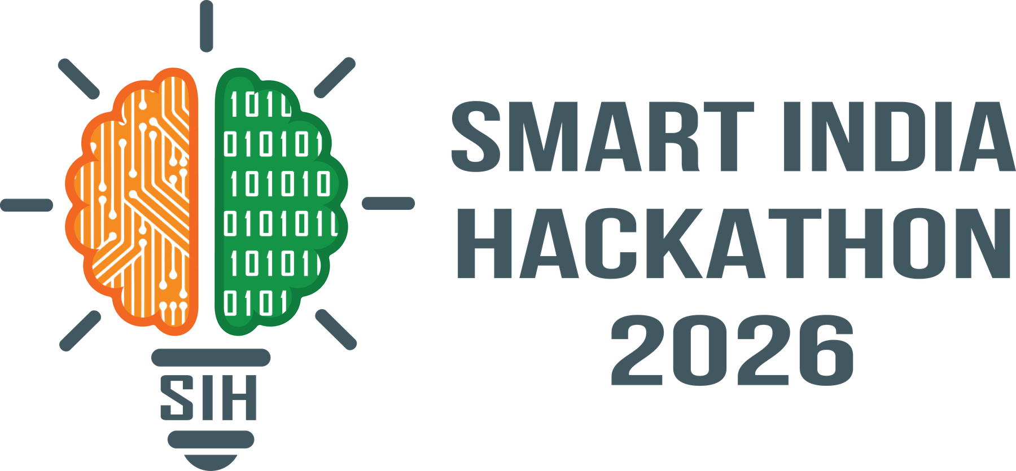

SMART INDIA HACKATHON 2026
TITLE PAGE
• Problem Statement ID - SIH26204
• Problem Statement Title - Student Innovation
• Theme - Travel & Tourism
• PS Category - Software
• Team ID - (to be allotted)
• Team Name – SafarMitra
Notes:
Title page. Add the Team ID once the portal allots it.

Slide 2
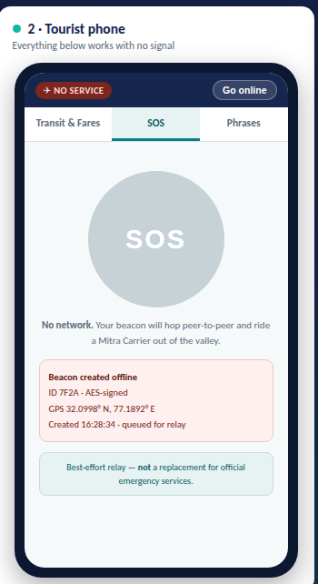
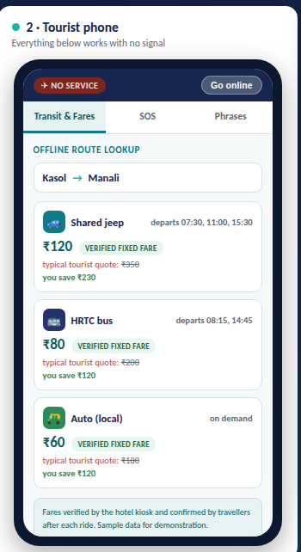
SafarMitra
TransitMitra: Offline-First Travel Safety & Mobility Mesh for Network Dead Zones
Problem:
Our Idea :
Remote tourist belts suffer a connectivity blackout — no network means no maps and no way to call for help; unmapped jeeps and autos overcharge tourists; and a language barrier blocks asking locals. Travellers avoid these places, so rural hotels, homestays and transport operators lose their income.
TransitMitra is an offline-first travel companion that works with zero internet, no SIM and no new telecom towers. Hotels become trusted data kiosks, and ordinary buses and jeeps become moving data carriers that carry emergency signals out of dead zones.
Proposed Solution :
Innovation/Uniqueness:
Hotel “Mitra Kiosk” sync — on check-in the hotel device pushes the regional transit map, verified fares and emergency directory to the guest phone over Wi-Fi Direct / BLE.
Verified transit & fares — hotel-verified routes, timings and fixed fares for buses, shared jeeps and autos, ending tourist overcharging.
Store-and-forward SOS — in dead zones a signed beacon hops phone-to-phone and rides a passing bus until it reaches network, then auto-alerts authorities with GPS.
Offline language help — regional phrasebook with on-device text-to-speech.
“Mitra Carrier” — scheduled buses & jeeps act as data mules, so an SOS leaves the valley on a predictable backbone, not by luck.
Hospitality becomes the network — hotels are static data nodes; no new telecom infrastructure needed.
One mesh, three jobs — SOS carrier, live fare/timing source and moving relay.
Delay-Tolerant design works where every other travel app goes dark.
Working prototype — offline fare lookup & SOS
2
Notes:
Problem, idea, proposed solution and uniqueness. Centre images are screenshots of the working prototype.

Slide 3
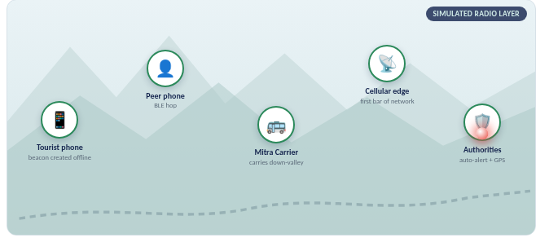
SafarMitra
TECHNICAL APPROACH
Technologies Used
FLOW CHART
Languages: Dart, Kotlin, Java, Python, C/C++, SQL.
Mobile: Flutter / Android native (entry-level Android supported).
P2P transport: Google Nearby Connections, Wi-Fi Aware / Wi-Fi Direct, BLE advertising.
Long range: LoRa / Meshtastic relay nodes (₹300–500 each, km range).
Data: SQLite, CRDT conflict-free offline merge, DTN store-and-forward (RFC 5050).
AI / voice: TensorFlow Lite, on-device text-to-speech for offline phrasebook.
Security: AES-signed, rate-limited SOS beacons; hotel-verified fare records.
Prototype: self-contained HTML/CSS/JS demo console, runs fully offline.
Store-and-forward SOS relay — beacon escapes the dead zone by physically travelling out
Methodology
GitHub link: github.com/<your-username>/transitmitra
Live demo :
<your-username>.github.io/transitmitra
YouTube video :
Link
Sync at hotel kiosk → offline data on phone.
Beacon created offline → BLE peer hop → Mitra Carrier → cellular edge → authorities.
Pilot 1 circuit → add LoRa relays → scale via State Tourism departments.
Above 60% of the prototype is completed
3
Notes:
Technical approach. Replace the GitHub / Pages / YouTube placeholders with your real links before submitting.

Slide 4
SafarMitra
FEASIBILITY AND VIABILITY
Feasibility
Commercial Feasibility
Runs on the cheap entry-level Android phones tourists already carry.
Uses free peer-to-peer radios already in every phone — no new telecom towers, no spectrum licence.
Range extended by LoRa relay nodes costing only ₹300–500 each.
Hotels and homestays adopt the kiosk free of cost, giving ready distribution.
Proven research base: Delay-Tolerant Networking, MIT DakNet, KioskNet.
Market: rural and offbeat tourism is a fast-growing segment currently held back by network dead zones.
Near-zero running cost — the network is the phones travellers already own.
Revenue path: hotel subscriptions, State Tourism-department sponsorship of relay nodes.
Technical readiness: working prototype today; 0–3 month pilot on a single tourist circuit.
Scales to any off-grid belt by adding regional map and fare packs.
Challenges
Strategy
Sparse phone density — an SOS may wait for a carrier to pass.
Short BLE / Wi-Fi range in mountainous terrain.
Fake fare entries or spoofed SOS beacons.
Battery drain from continuous radio scanning.
Keeping offline data trustworthy across devices.
Register buses and jeeps as scheduled “Mitra Carriers” and place LoRa relays at stops — a deterministic backbone instead of luck.
Honest best-effort delivery model; SOS augments, never replaces, official emergency services.
Hotel-verified fares plus post-ride traveller confirmation; AES-signed, rate-limited beacons.
Adaptive duty-cycling and low-power BLE advertising; bulk sync only at the kiosk.
CRDT conflict-free merge with tamper-evident sync across nodes.
4
Notes:
Feasibility, commercial viability, the real risks judges probe, and our mitigations.

Slide 5
SafarMitra
IMPACT AND BENEFITS
Direct Impact on Target Users
Economic & Strategic Benefits
Tourists & solo travellers: confidence to explore off-grid, with fair fares and an offline safety net; language help to speak with locals.
Hotels, homestays & eco-resorts: become the trusted network hub — a real reason for guests to book remote stays, raising footfall and revenue.
Informal transport operators: shared jeep, bus and auto drivers gain visible, verified demand and dignified, transparent pricing.
Women, families and first-time travellers: a safety net in areas they would otherwise avoid entirely.
Channels tourism spending directly into the rural economy — hospitality and informal transport.
Requires zero new telecom infrastructure, so cost per additional village is negligible.
Ends the “tourist tax”: verified fares can save a traveller ₹200+ on a single shared-jeep ride.
Scales across states by adding regional map and fare packs — one app, every off-grid belt.
Encourages low-impact, distributed tourism away from overcrowded hotspots.
Strategic Impact
Social & Environmental Benefits
Builds an indigenous, offline safety and mobility layer for Indian tourism that depends on no foreign infrastructure.
Directly supports Digital India, the Vibrant Villages Programme and Dekho Apna Desh.
Advances Atmanirbhar Bharat by turning existing phones and public transport into national digital infrastructure.
Safer travel for women, families and solo tourists in low-connectivity regions.
Bridges language and culture between travellers and local communities.
Spreads tourist load away from crowded honeypot destinations, reducing local environmental strain.
5
Notes:
Impact on each stakeholder group, economic and strategic benefits, and national-mission alignment.

Slide 6
SafarMitra
Research and Analysis
Gap & Problem Identification
Literature Survey & Benchmarking
Large stretches of India’s hill, forest and border tourist belts remain network dead zones, leaving travellers without maps or a way to call for help.
Existing offline maps (e.g. Google Maps offline) carry no informal transit routes, no verified fares and no peer-to-peer safety layer.
Informal shared-jeep and auto fares are unpublished, so tourist overcharging is routine and undocumented.
Delay-Tolerant Networking and the Bundle Protocol (RFC 5050) — store-and-forward messaging over intermittent links.
DakNet (MIT Media Lab) and KioskNet — buses and kiosks proven as physical “data mules” bringing connectivity to rural villages.
Haggle and pocket-switched networking research — opportunistic phone-to-phone message relay.
Benchmark vs satellite SOS (iPhone 14+/Android): those need clear sky, premium handsets and paid plans; our mesh runs on cheap Android under tree cover.
Technology Validation
Prototype Results & Policy Alignment
Google Nearby Connections and Wi-Fi Aware are production Android APIs for offline peer-to-peer transport.
Meshtastic / LoRa provides low-cost, kilometre-range off-grid mesh radio.
On-device TTS (TensorFlow Lite, Piper) enables offline regional-language voice.
CRDTs give conflict-free merge of offline-edited fare and route data.
Our working prototype demonstrates the full flow end-to-end: hotel-to-phone offline sync, offline fare lookup, and a multi-hop SOS relay reaching authorities.
Demo runs with zero internet connectivity, validating the offline-first architecture.
Aligns with Digital India, Vibrant Villages Programme, Dekho Apna Desh and Atmanirbhar Bharat.
Note: SOS relay is a best-effort augmentation, not a replacement for official emergency services.
6
Notes:
Research grounding, benchmarking against alternatives, technology validation and prototype results.

