Slide 1
Retail Store Sales Performance & Inventory Optimization

Slide 2
Agenda
1
Business Challenges
2
Project Objectives
3
Data & Methodology
4
Dashboard Analysis
5
Forecasting & Revenue Analysis
6
Key Findings
7
Recommendations & Conclusion

Slide 3
Business Challenges
Key operational and analytical challenges faced by the retail chain
Inconsistent Sales Performance
Inventory Optimization Issues
Sales varied across stores and regions
Difficult to identify top-performing location
Revenue optimization became challenging
Frequent stockouts affected product availability
Excess inventory increased holding costs
Inventory planning lacked efficiency
ERP Data Visibility Challenges
Profitability & Discount Pressure
Large ERP data was difficult to analyze
Limited visibility into operational insights
Decision-making became slower
Heavy discounts reduced profit margins
Profitability varied across categories
Inefficient planning affected revenue growth

Slide 4
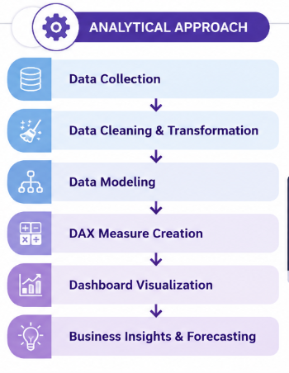
Project Objectives
Analyze sales performance across stores and regions
Identify inventory turnover and stockout risks
Evaluate profitability and discount impact
Understand customer purchasing behaviour
Forecast future sales trends for strategic planning

Slide 5
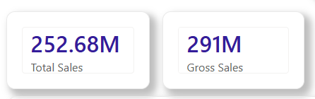
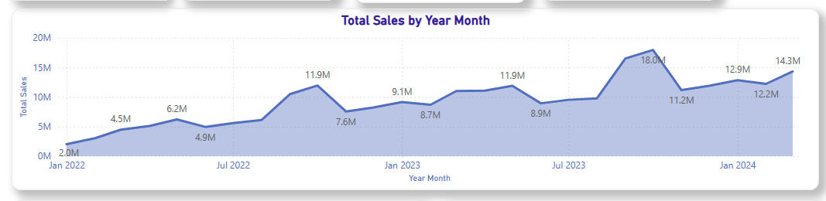
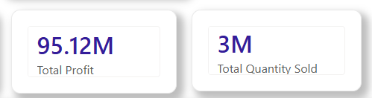
DASHBOARD ANALYSIS
Executive Overview
1
KPI CARDS
2
SALES TREND
Total Sales
Gross Sales
Total Profit
Quantity Sold
Sales showed a steady upward trend across the analyzed period.
Revenue growth remained consistent with seasonal fluctuations in demand.

Slide 6
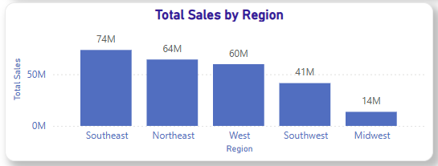
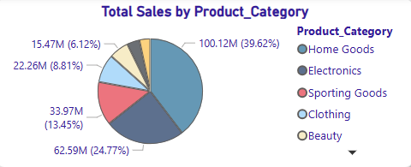
DASHBOARD ANALYSIS
Executive Overview
1
REGION SALES
2
CATEGORY CONTRIBUTION
Southeast region recorded the highest overall sales contribution.
Sales performance varied significantly across different regions.
Home Goods contributed the largest share of total sales.
Electronics and Grocery categories showed strong revenue performance.

Slide 7
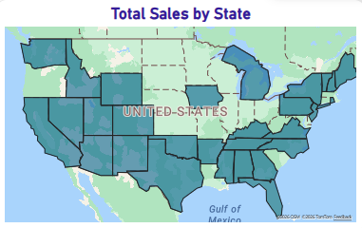
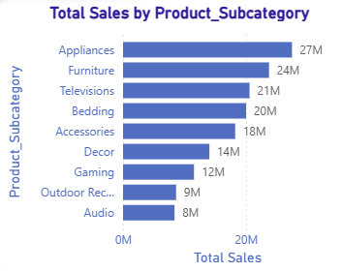
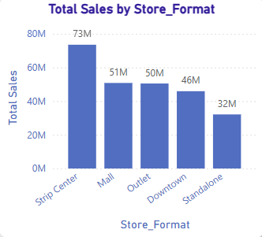
DASHBOARD ANALYSIS
Store Performance Analysis
STORE LOCATION MAP
SALES BY STORE FORMAT
SALES BY PRODUCT SUBCATEGORY
1
2
3
Sales activity was concentrated in western and southeastern regions.
Store performance varied significantly across geographical locations.
Strip Center and Mall stores generated the highest revenue contribution.
Outlet stores showed comparatively lower sales performance.
Appliances and Furniture emerged as top-performing subcategories.
Product demand patterns differed across categories and store locations.

Slide 8
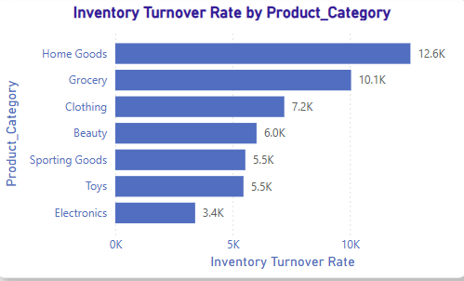
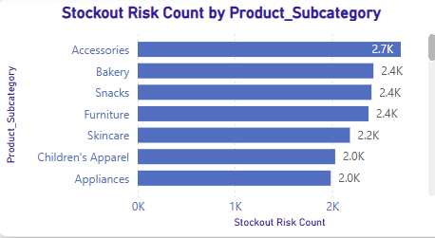
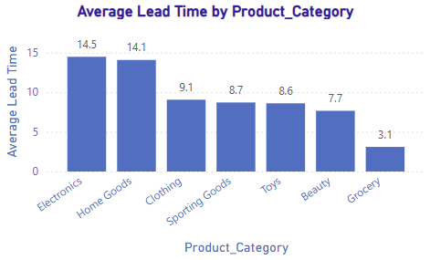
DASHBOARD ANALYSIS
Inventory Optimization Analysis
1
INVENTORY TURNOVER RATE
2
STOCKOUT RISK COUNT
3
AVERAGE LEAD TIME
Home Goods and Grocery categories showed the highest inventory turnover.
High turnover products indicated strong customer demand and sales velocity.
Accessories and Bakery products faced the highest stockout risks.
Frequent stockouts impacted product availability and operational efficiency.
Electronics products had longer replenishment lead times compared to other categories.
Longer lead times increased the risk of delayed inventory replenishment.

Slide 9
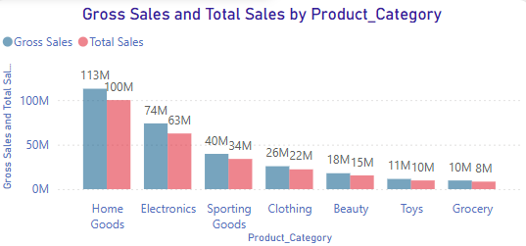
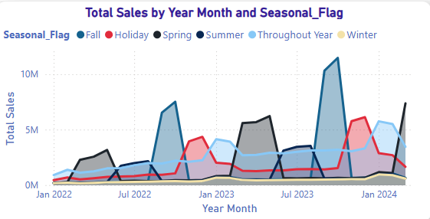
DASHBOARD ANALYSIS
Product & Profitability Analysis
1
GROSS SALES vs TOTAL SALES
2
SEASONAL SALES PATTERN
Home Goods generated the highest gross and total sales contribution.
Discounts created noticeable differences between gross and net sales across categories.
Fall and Spring seasons showed major spikes in sales performance.
Seasonal demand patterns significantly influenced monthly sales trends.

Slide 10
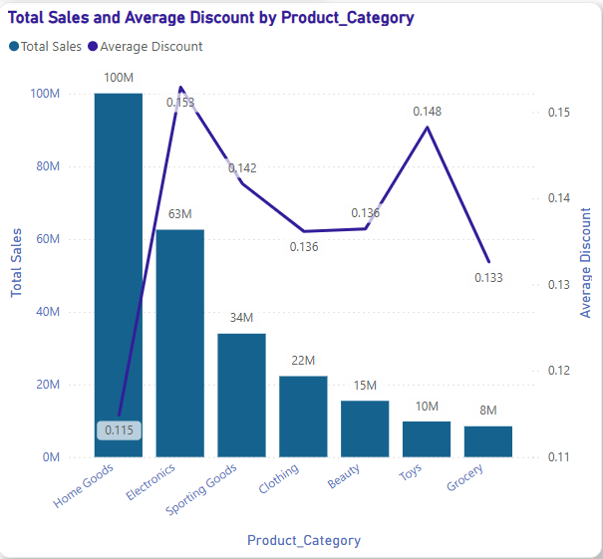
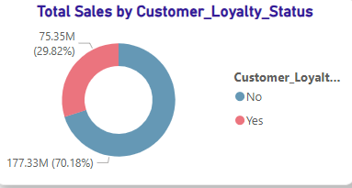
DASHBOARD ANALYSIS
Customer & Discount Analysis
1
CUSTOMER LOYALTY STATUS
2
SALES & AVERAGE DISCOUNT ANALYSIS
Loyal customers contributed the majority of total sales revenue.
Customer loyalty programs positively influenced purchasing behavior.
Electronics products received the highest average discounts.
Discount strategies significantly impacted category-wise sales performance.

Slide 11
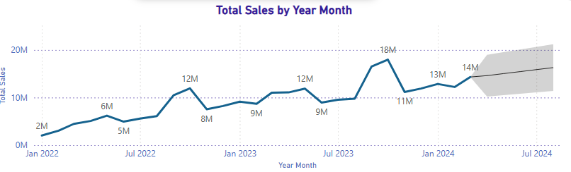
Forecasting & Revenue Analysis
Customer & Discount Analysis
1
SALES FORECASTING
Forecasted sales trends indicated continued business growth in upcoming periods.
Seasonal demand patterns strongly influenced future sales projections.

Slide 12
Key Findings
Sales demonstrated strong year-over-year growth across most regions.
Southeast region generated the highest overall sales contribution.
Home Goods emerged as the leading product category in revenue and profit.
Accessories and Bakery products experienced frequent stockout risks.
Loyal customers contributed a significant share of total purchases.
Sales forecasts indicated continued business growth potential.

Slide 13
Recommendations & Conclusion
Improve inventory planning for high stockout-risk products.
Focus marketing and expansion strategies on high-performing regions.
Optimize discount strategies to improve profit margins.
Strengthen loyalty programs to increase repeat purchases.
Leverage forecasting insights for demand and inventory planning.

