Slide 1
◆
Narendra Sirvi
SESSION 21 · DEVOPS FINAL CAPSTONE
StockDesk
An end-to-end, cloud-native DevOps lifecycle — from a FastAPI + React + PostgreSQL app to a monitored, GitOps-managed Kubernetes platform on AWS EKS.
FastAPI
React
PostgreSQL
Docker
Terraform
EKS
Helm
ArgoCD
Prometheus
Notes:
StockDesk is a hardware inventory tracker used to demonstrate a full DevOps lifecycle. The app is simple on purpose — the engineering around it is the deliverable.

Slide 2
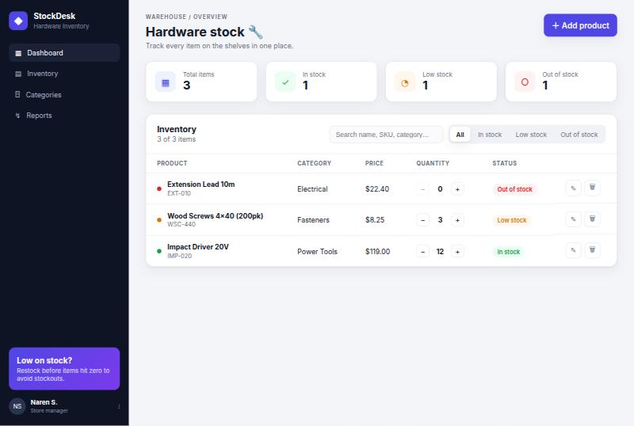
What is StockDesk?
A hardware-store inventory tracker: products have a name, SKU, category, quantity and price, and their stock status is derived automatically from the quantity on hand.
Frontend
Backend
Database
React + Vite SPA served by unprivileged Nginx
FastAPI (Python 3.12) REST API, SQLAlchemy ORM
PostgreSQL 16 with Alembic migrations
StockDesk dashboard — derived stock status: in-stock (green), low (amber), out (red)
Notes:
Three-tier app; stock status auto-derived. The screenshot is the real running dashboard.

Slide 3
End-to-end delivery architecture
1
2
3
4
5
6
Develop
CI
GHCR
Terraform
Helm / ArgoCD
Observe
Git push
Test · Scan · Build
SHA-tagged images
VPC + EKS
Deploy & reconcile
Prometheus + Grafana
AWS EKS Cluster · namespace: stockdesk · ap-south-1
Ingress-NGINX
Frontend ×2
AWS ELB · / → frontend · /api → backend
React build on Nginx (ClusterIP)
Backend ×2
PostgreSQL
FastAPI · HPA 2→6 @ 60% CPU
StatefulSet-style + 5Gi gp3 PVC
Notes:
Commit flows left to right into AWS; inside EKS, ingress routes to two frontend and two backend pods, backed by Postgres, scaled by an HPA, observed by Prometheus/Grafana.

Slide 4
Technologies used
Application
Containers
FastAPI · React/Vite · PostgreSQL · SQLAlchemy · Alembic
Docker multi-stage · Docker Compose · non-root images
CI/CD
DevSecOps
GitHub Actions · GitHub Container Registry (GHCR)
Trivy · Bandit (SAST) · Gitleaks · pip/npm audit (SCA)
Infrastructure
Orchestration
Terraform · AWS VPC · EKS · NAT · managed node group
Kubernetes 1.34 · Helm · Ingress-NGINX · HPA
Observability
GitOps
Prometheus · Grafana · ServiceMonitor · alert rules
ArgoCD — pull-based, self-healing continuous delivery
Notes:
The full toolchain by concern — each maps to a graded module.

Slide 5
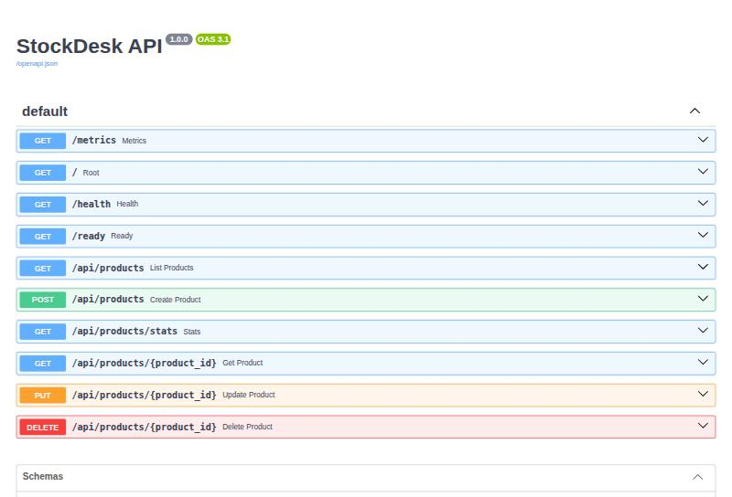
Application & testing · M1 / M2
FastAPI + React + PostgreSQL — 9 REST endpoints, 11 passing tests.
Full CRUD on /api/products + stats
Stock status derived from quantity
11 Pytest cases on an isolated SQLite DB
pytest.ini + conftest.py fixtures
Alembic version-controls the schema
Tests gate the pipeline — green before build
FastAPI auto-generated API docs at /docs
Notes:
Nine endpoints, eleven tests. Swagger shows the live API surface.

Slide 6
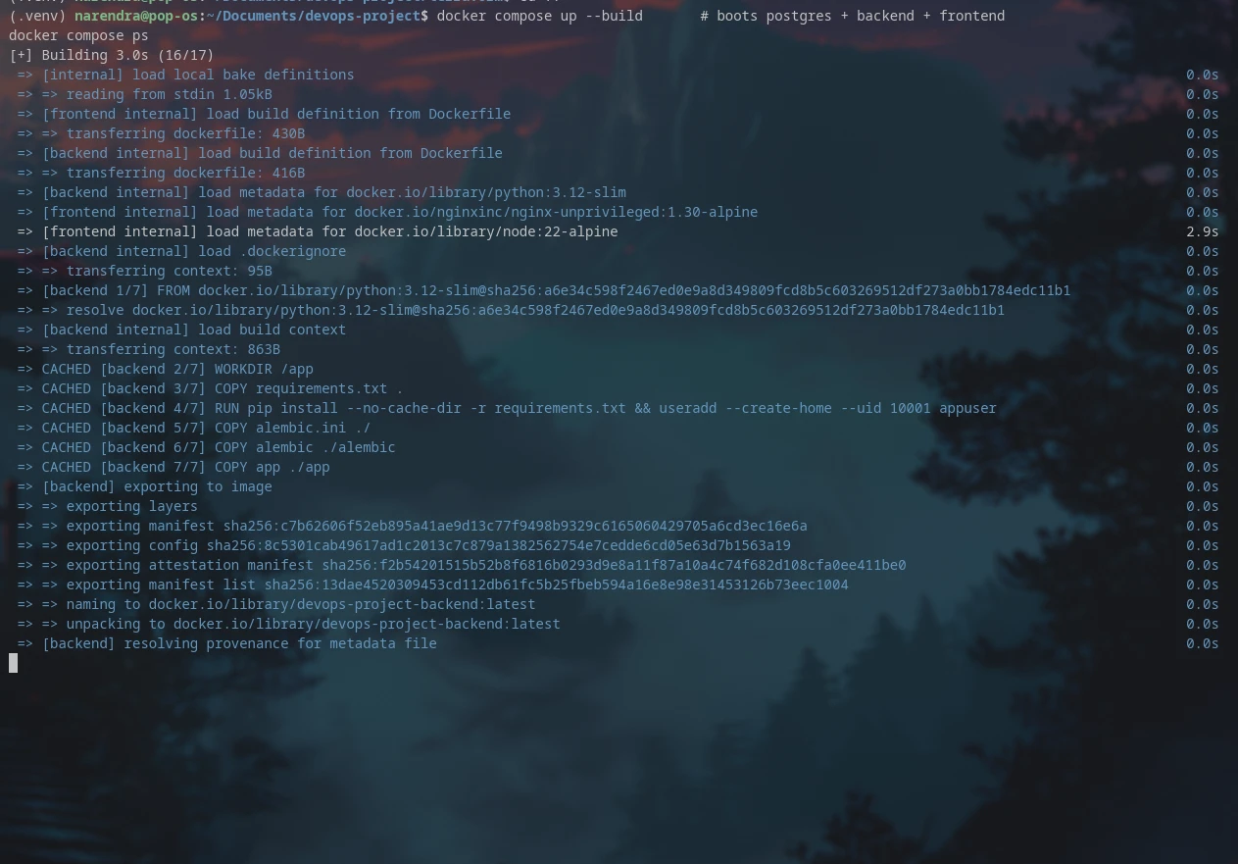
Containerization · M4
Hardened multi-stage images; the whole stack in one command.
Multi-stage builds — slim runtime images
Non-root: backend UID 10001, Nginx on :8080
docker compose up --build boots all 3 tiers
.dockerignore keeps .git / .venv out of layers
docker compose up --build — backend + frontend + Postgres
Notes:
Two hardened images, a single compose command for the full stack.

Slide 7
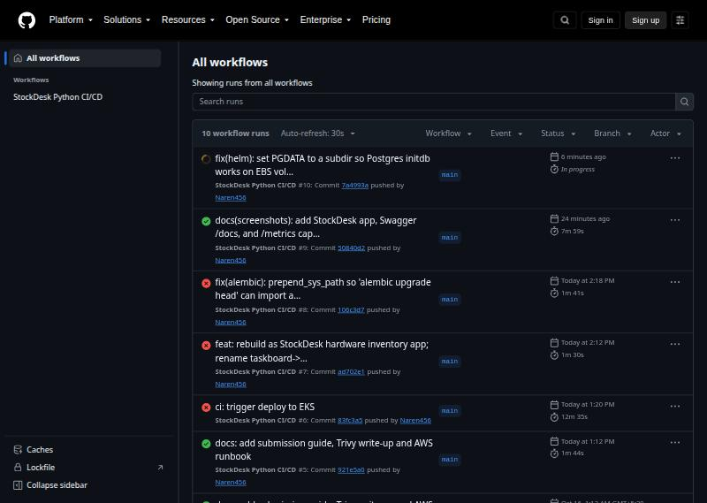
CI/CD pipeline · M5
GitHub Actions on every push to main: test → scan → build → push → deploy.
Pytest + Vite build gate the pipeline
Trivy CVE scan (HIGH/CRITICAL)
Images tagged by exact commit SHA — never :latest
Pushed to GitHub Container Registry (GHCR)
Deploy job runs helm upgrade to EKS
GitHub Actions — green pipeline runs on main
Notes:
Five gated stages; images tagged by SHA for full provenance; green runs shown.

Slide 8
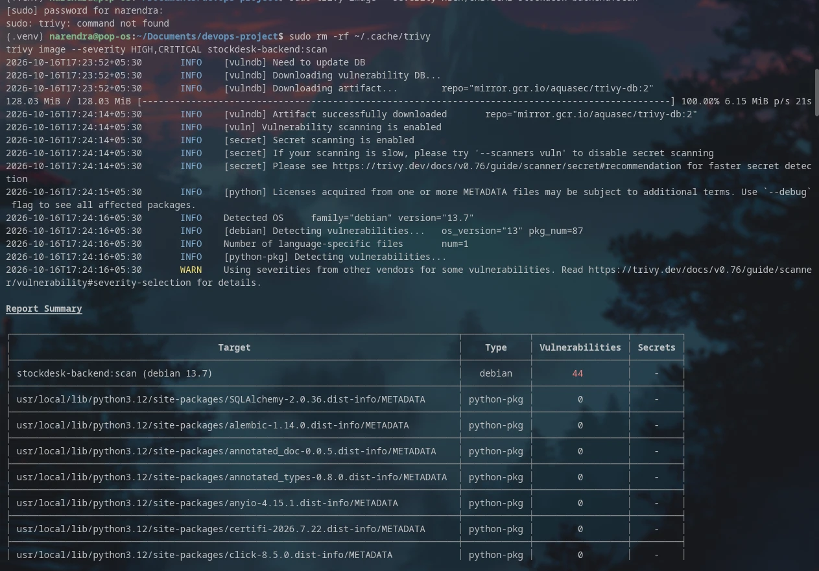
DevSecOps — security shifted left · M6
Five security controls run before anything ships.
Gitleaks — secret scanning in commits
Bandit — Python SAST
pip / npm audit — dependency SCA
Aqua Trivy — container image CVEs
Gate fails only on fixable HIGH/CRITICAL
Trivy — 44 HIGH / 0 CRITICAL, all no-fix base-image OS CVEs
Notes:
Five controls; the gate uses --ignore-unfixed so it blocks only actionable CVEs.

Slide 9
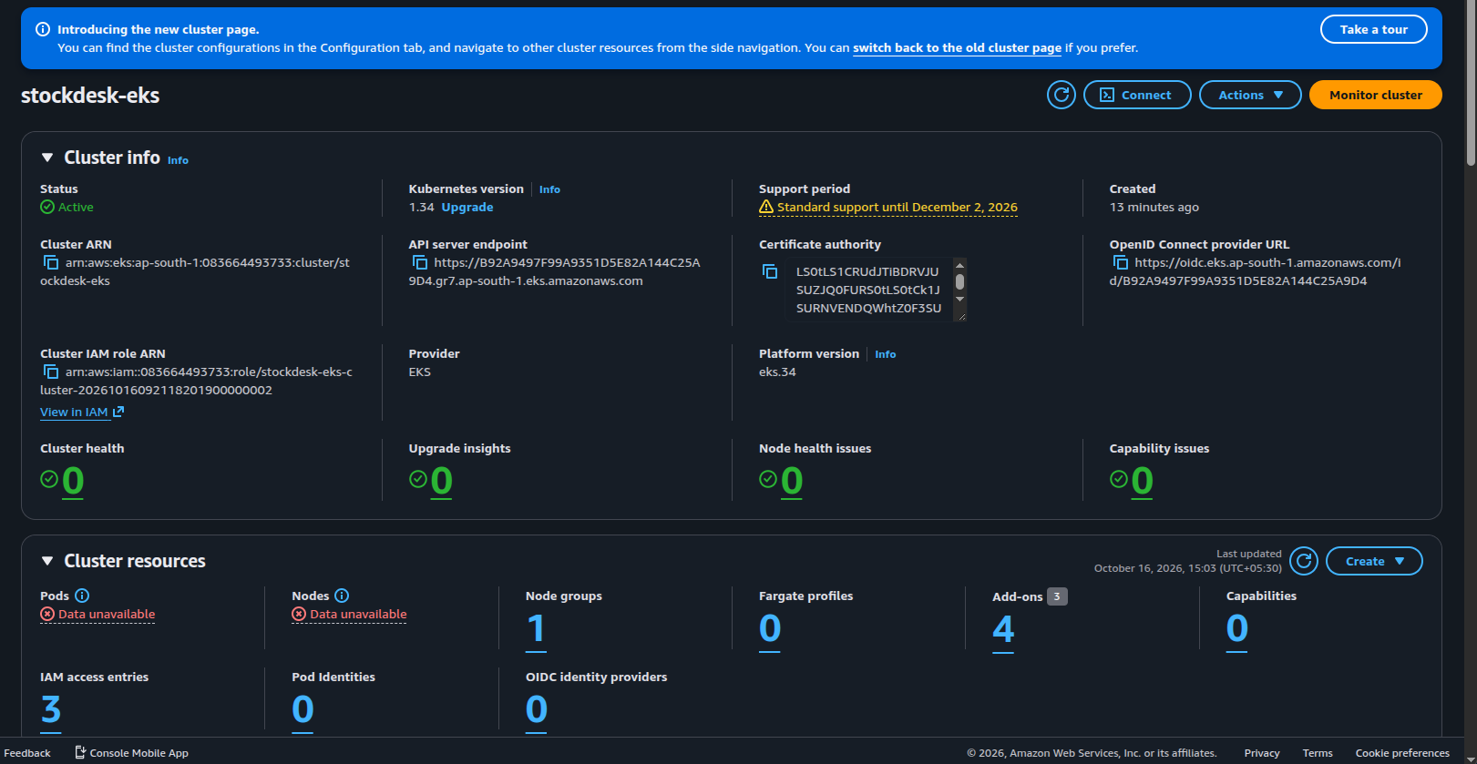
Infrastructure as Code · M7
Terraform provisions the whole AWS footprint in ap-south-1.
VPC 10.20.0.0/16 — 2 public + 2 private subnets + NAT
EKS 1.34 with a 2-node managed group
IAM roles, OIDC provider & KMS key
terraform.tfvars.example — no secrets committed
terraform destroy → 0 resources, $0 cost
AWS Console — stockdesk-eks Active (v1.34), Project=stockdesk tags
Notes:
Everything in AWS is code — one apply to build, one destroy to remove.

Slide 10
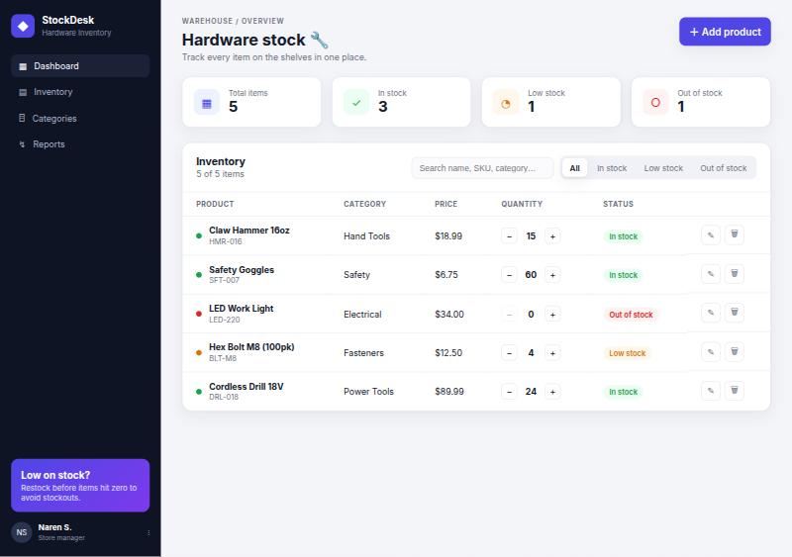
Kubernetes & Helm · M8
One Helm chart deploys a production-shaped app.
Namespace + chart + dev/prod values
2 replicas each for backend & frontend
ClusterIP services for all three tiers
Ingress: / → frontend · /api → backend
HPA scales backend 2 → 6 at 60% CPU
Raw kubernetes/00–10 provided too
StockDesk served through the EKS Ingress ELB
Notes:
A single Helm chart; HPA and Ingress make it production-shaped.

Slide 11
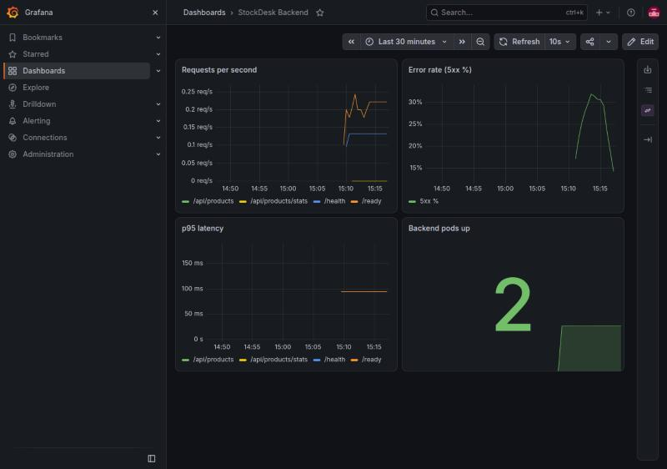
Monitoring & observability · M9
Prometheus + Grafana on the four golden signals.
FastAPI instrumented — request counts & latency
Prometheus scrapes /metrics every 15s
ServiceMonitor wires in the backend targets
Grafana: RPS, 5xx rate, p95 latency, pods up
Alert rules: BackendDown & High5xxErrorRate
Grafana — StockDesk Backend dashboard (live data)
Notes:
Metrics flow app → Prometheus → Grafana; the dashboard shows live traffic.

Slide 12
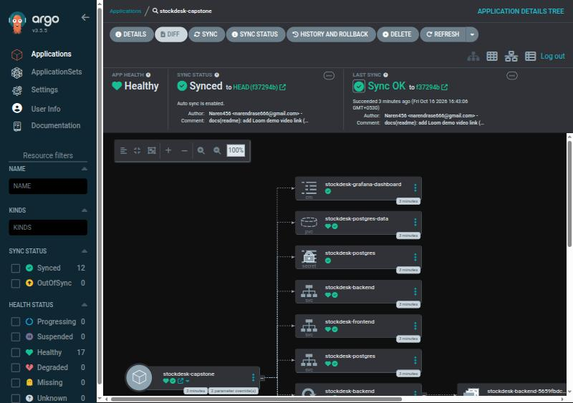
GitOps with ArgoCD · bonus
Declarative, self-healing continuous delivery on top of Helm.
Git is the single source of truth
ArgoCD watches helm/stockdesk
Automated sync + prune
Self-heals manual kubectl drift
Result: Synced & Healthy (17 resources)
ArgoCD — stockdesk-capstone Synced & Healthy
Notes:
ArgoCD adds declarative GitOps beyond the rubric — the real-world pattern.

Slide 13
Results
10 / 10
11
Green
modules delivered
tests passing
CI/CD pipeline
18
$0
1
evidence screenshots
AWS cost after destroy
Loom demo walkthrough
Notes:
Every module covered with real, captured evidence, a green pipeline, and a clean AWS account.

Slide 14
CONCLUSION
From laptop to monitored production
A simple app carried through the full DevOps lifecycle: containers, tested CI/CD, DevSecOps scanning, Terraform-provisioned EKS, Helm, GitOps, and observability.
Real bugs found by actually deploying:
alembic prepend_sys_path — migrations couldn't import app in-container
Postgres PGDATA subdir — initdb fails on an EBS volume's lost+found
Demo: loom.com/share/17e254cf0a774a64ac4bbb830a0a734e
Repo: github.com/Naren456/devops-project
Thank you
Notes:
Full lifecycle delivered. The two fixes show that deploying for real surfaces issues tests never will. Thanks — happy to demo live.

