Slide 1

GramAi
Where language precision meets effortless learning.
Team – Narendra , Mayank, Mallesh

Slide 2

Vision
At GramAi, our vision is to enhance users' writing, communication, and listening skills through a variety of tools. We believe that strong writing and communication skills are essential, as they empower individuals to effectively express their knowledge and ideas.

Slide 3
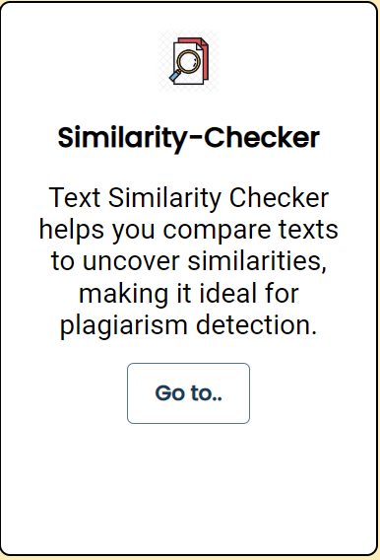
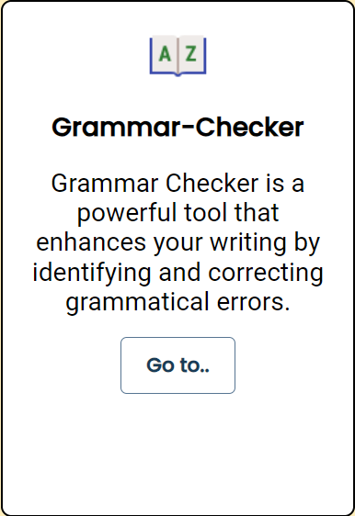
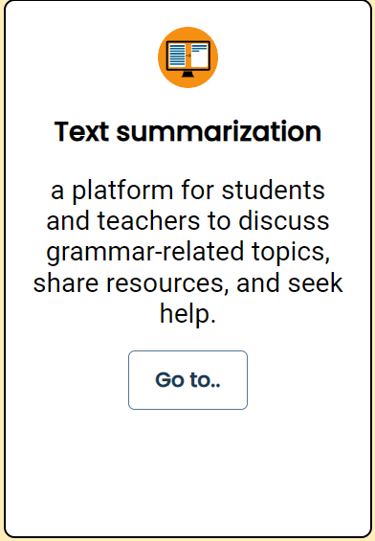
Features

Slide 4
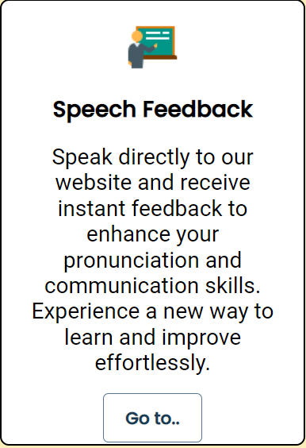
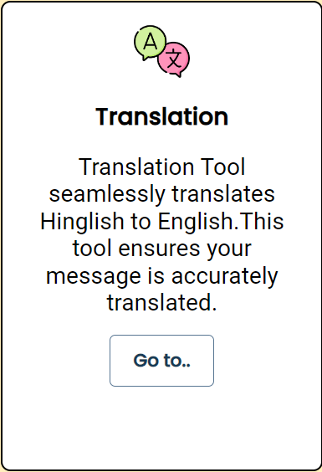
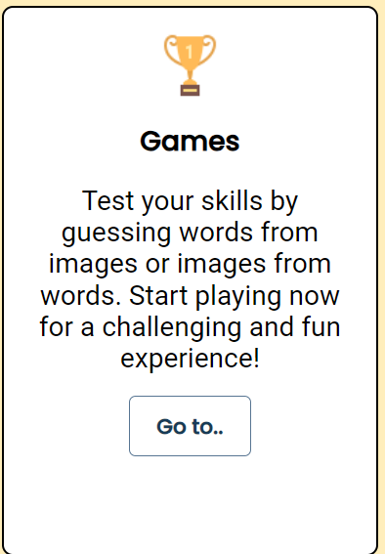
Features

Slide 5
Tools used
Html
Css
Javascript
Database(postgresql)
Python(Libraries)
Nltk
Sqlalchemy
Fastapi
Language tool python
Sklearn
Google generativeai

Slide 6
If you can't explain it simply you don't understand it well enough
“
”
Albert Einstein

Slide 7

Thank you
Team - GramAi

