Slide 1
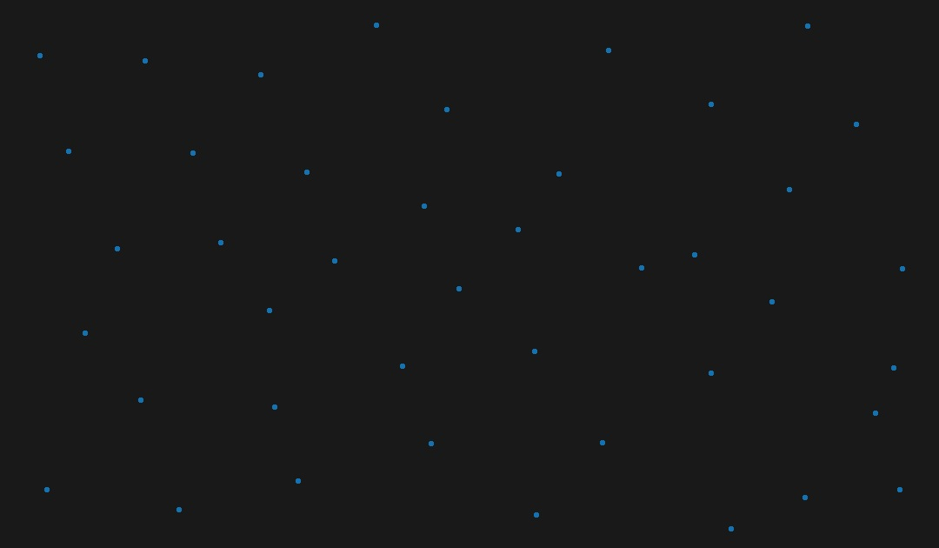

Drone-X
how do we teach a robot to learn?
- Jayaram J
- Jayakrishnan Nampoothiri C.N.
- Aadil Jayasy

Slide 2
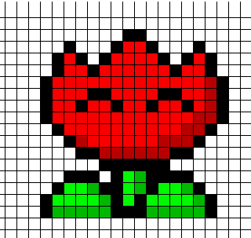
Contents
Modules
Drone Simulation
N.E.A.T. module
Data Flow
Algorithm
Genetic Algorithms
Neural Networks
NeuroEvolution
N.E.A.T.

Slide 3
Modules
Our project has mainly 2 modules.
The Drone Simulation Module which displays and controls the graphics of the drone traversing a random environment
The Artificial Intelligence module which implements the N.E.A.T algorithm from scratch and uses it to control the drone.

Slide 4
The Simulation Module
The purpose of this module is to handle the various graphics and physics simulations of the drone traversing a randomly generated environment.
Made in C++ using OpenGL, SOIL and SDL libraries.
OpenGL for graphics
SOIL for image and texture rendering.
SDL for other media like sound effects if any.

Slide 5
The Artificial Intelligence Module
The purpose of this module is to take in the inputs to the neural network from the simulation module, compute the output and relay it back to the simulation for the drone to make the appropriate move.
In this module, we implement the “NeuroEvolution through Augmenting Topologies” algorithm from scratch.
Completely made in pure C++14

Slide 6
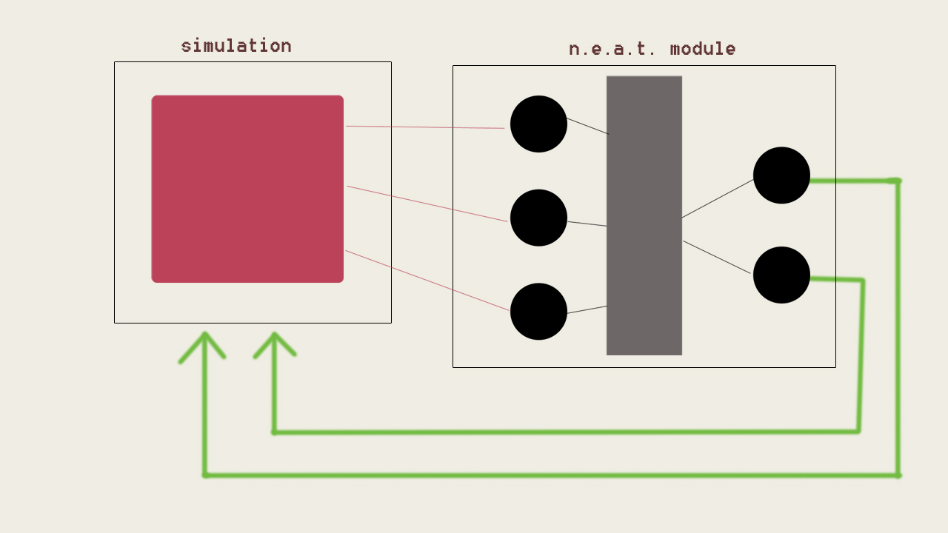
Data Flow

Slide 7
The N.E.A.T. Algorithm

Slide 8
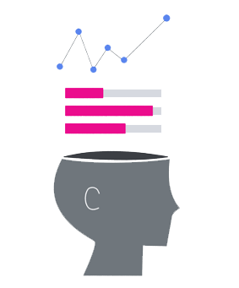
Neural Networks
A neural network is a computer system modelled on the human brain and nervous system.
Comprises of 4 main components:
An input layer
One or more hidden layers of neurons.
An activation function (usually a sigmoid function)
An output layer

Slide 9
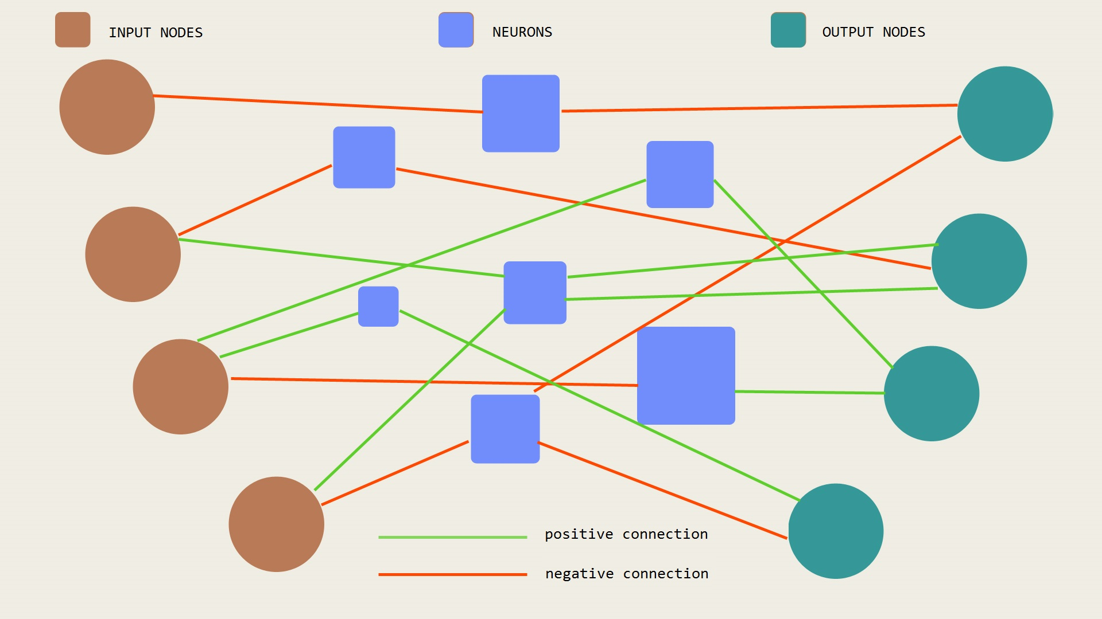
This is what a 4-input 4-output feedforward neural network looks like.
The neuron layer in the middle is hidden.
We can have multiple layers of neurons for deep learning.

Slide 10
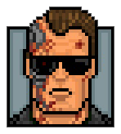
What are genetic algorithms?
A genetic algorithm is a search heuristic which mimics the process of natural selection in evolution.
It is routinely used to generate useful solutions to optimization and search problems.
Genetic algorithms use techniques inspired by natural evolution, such as inheritance, mutation, selection and crossover.

Slide 11
Main operations of a GA
Most genetic algorithms have mainly 3 operations in common:
Reproduction/Selection
Crossover
Mutation
To properly explain NEAT, we must understand how these operations work.
Lets say we have random population of members who are encoded as binary strings.
We evaluate each member by a fitness function and assign a fitness value to it. Fitness value is the measure of how good that member is at performing a given task.

Slide 12
Reproduction/Selection
Lets say our two fittest members chosen are
0000 0001 0101 1010 Genotype 1
1100 1010 1111 1001 Genotype 2
The fittest members are chosen (by a probability distribution) to reproduce and form the next generation of the population.
Now that we have 2 genotypes, we apply the crossover operation to them.

Slide 13
Crossover
Our two fittest members chosen are
0000 0001 0101 1010 Genotype 1
1100 1010 1111 1001 Genotype 2
The crossover rate is the probability that these two genotypes will crossover.
To apply the crossover function, we select a random bit along the genotype length. (say 5). We swap the trailing halves of the genomes after the 5th bit. So the new members formed are:
0000 0 010 1111 1001 Child 1
1100 1 001 0101 1010 Child 2

Slide 14
Mutation
Two children formed from the last step are
0000 0010 1111 1001 Child 1
1100 1001 0101 1010 Child 2
The mutation rate is the probability that all the bits are flipped in a member.
Now that we have 2 genotypes, we apply the mutation operation to them. They become:
1111 1101 0000 0110 Child 1
0011 0110 1010 0101 Child 2

Slide 15
Generations and evolution
Starts with 20 random binary strings (initial population (gen 1)).
Evaluate fitness of each member
Select the current top 2 fittest members.
Apply crossover if applicable.
Apply mutation if applicable.
Repeat step 2,3,4 till we get 20 new genotypes of the new generation.
Keep evolving till our desired output is obtained(i.e. high fitness).

Slide 16
Neuroevolution
NeuroEvolution is a way of using genetic algorithms to evolve the hidden layer of the neural network.
NeuroEvolution, like most genetic algorithms start with a random number of neurons, evaluate fitness, crossover, mutate and breeds new generations of the hidden layer which performs better and better than the last generation.

Slide 17
N.E.A.T.
The NEAT Algorithm is a revolutionary and highly significant approach to machine learning.
Up till now, the experiment of the learning process began with deciding the number of nodes of the hidden neural network beforehand.
In the case of neuroevolution, it starts with a random number of neurons.
NEAT argues that, by evolving the network topology along with the optimal weights, we can save time wasted by humans on deciding a particular topology for a Neuro Evolution problem.
NEAT evolves the topologies of the hidden layer by starting off with no nodes in the hidden layer and then adding connections and additional nodes only if they improve performance.

Slide 18
Genotype to Phenotype Encoding
In NEAT, a genome is the data structure representation of the network.
The genome is converted to the network by decoding the genome.
This is a step in evolution called genotype to phenotype conversion where our DNA is converted to our physical traits.

Slide 19
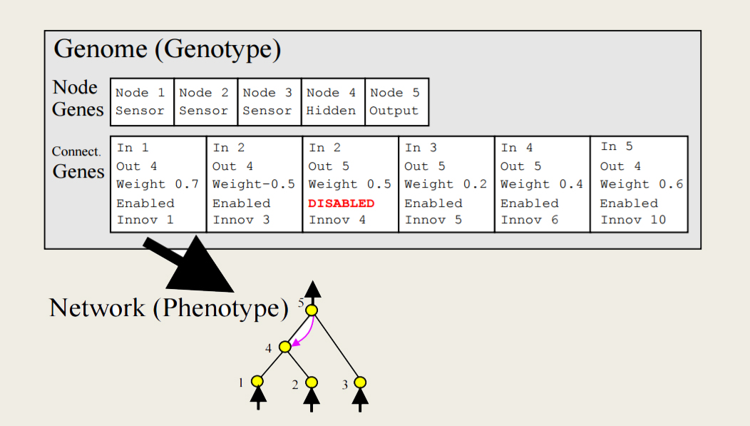
Graph Encoding

Slide 20
Steps of evolution
NEAT starts with no neurons in the hidden layer between the input and the output layer. All the inputs are connected to all the outputs initially.
The connections are all initially assigned random weights.
An initial genesis population of say 20 such genotypes are initialized.
Fitness is evaluated for each genotype.
The fittest genotypes are selected, crossed over and mutated.
Like this, a new population of 20 genotypes (the next generation) is made.
The operation of mutation and crossover are of special interest to us.

Slide 21
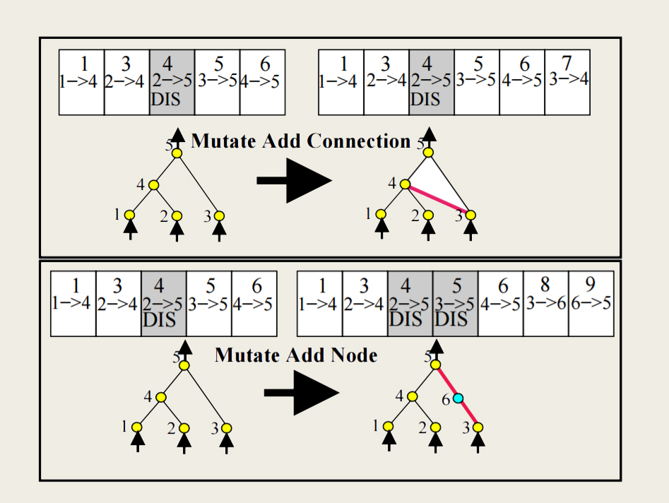
Two types of Mutation

Slide 22
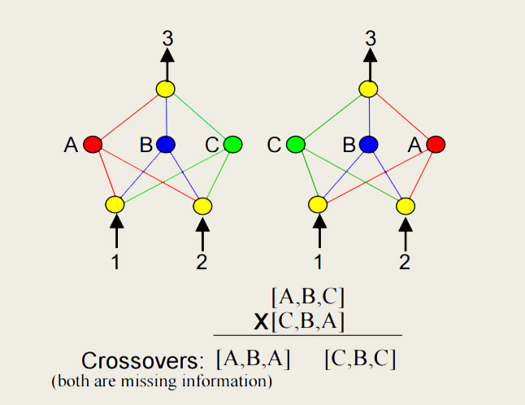
Competing Conventions Problem

Slide 23
How does NEAT solve this?
NEAT solves the problem of competing conventions by the use of innovation numbers and a special crossover function.
The innovation number is just a simple global counter variable.
When mutation occurs, the new connection additions to the genome are assigned an innovation number.
When two genotypes are to be crossed over, we align the genes with the same innovation numbers and pick either one of the two choices by a coin toss function.
The genes with the same innovation numbers are more likely to have a similar effect on the network, so not much data is lost like in the CC problem.

Slide 24
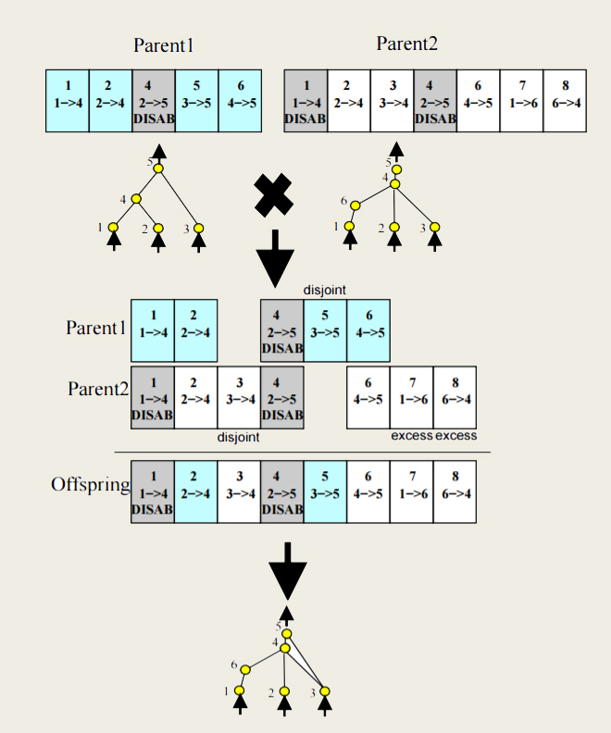
The special crossover function

Slide 25
The special crossover function
The steps involved in the crossover function are:
Align genes with similar innovation numbers.
This splits the genes into 3 sets {aligned, disjoint, excess}
Cointoss and choose from the aligned genes.
Retain all the excess and disjoint genes.
Construct offspring from these genes.
We can see that, in this way, no genes (information) are lost to a inefficient crossover function.

Slide 26
How we apply NEAT to control our drone
To start, we need to decide what the inputs to the neural network and the outputs are.
We have planned to experiment with 4 inputs and 4 outputs initially:
The normalized x-coordinate of the drone.
The normalized y-coordinate of the drone.
The normalized x-coordinate of the drone.
The normalized y-coordinate of the drone.
The outputs are:
Up
Down
Left
Right

Slide 27
thank you.

