Slide 1
An Interoperable Framework for API heterogeneity in mobile cloud storage systems
Mentor: Dr. T.Mala
Assistant Professor ( Senior Grade)
By
S.Narendra Kumar (2010115087)
S.Pragadheesh Chander(2010115094)
M.Santhosh Kumar(2010115100)

Slide 2
Outline
Overview of the project
Limitation of existing work
Modules
Architecture
Detailed design
Implementation
Results
Performance evaluation

Slide 3
Overview of the project
This project, Mobile Cloud Middleware (MCM), provides an interoperable framework between cloud vendors addressing the issues of API Heterogeneity.
It is indeed, a one stop solution to access various cloud storage services through a standard, well defined and an easy to use approach, for mobile developers and users,
This project is targeted for mobile systems, and is compatible to various platforms (eg: Android, iOS)

Slide 4
Limitation of existing work
yet to write properly!!
To include – orchestration and ????
Orchestration between various cloud services has not been implemented
Performance of the search is not optimal and metadata storage and maintenance

Slide 5
Modules
Manager
Interoperability Engine
TP handler
Session Invoker
Cache Invoker
API Setup
Session Management
Cache Management
Transaction Space
Adapter File System
Mobile API set

Slide 6
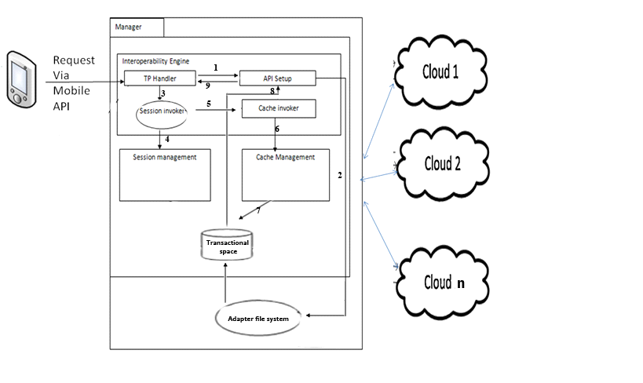
Architecture

Slide 7
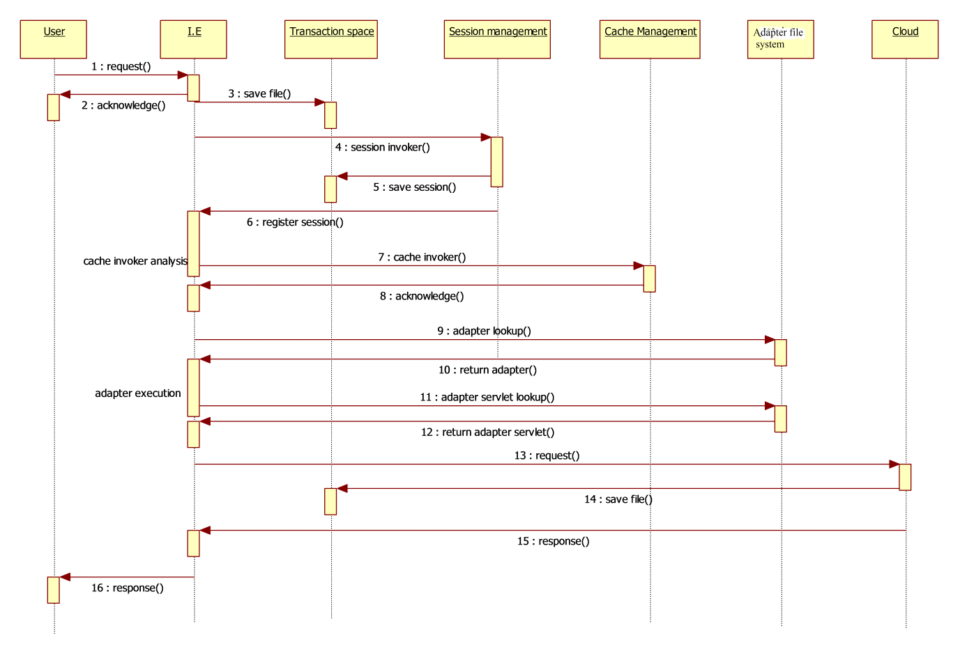
Detailed design

Slide 8
Interoperability engine
TP Handler module:
Input :
Request from the Mobile device using Mobile API set.
Requests to the System will be based on the REST protocol.
Request will contain information such as
Name of the Service provider
Service requested
Configuration parameters
Files
Cloud credentials
Eg : ( Google drive, download , Android 4.2.0, final.doc, username , password).

Slide 9
Interoperability engine
Process : Handles the incoming request to the system.
Retrieves the information from the request.
Output :
Sends an acknowledge message after receiving the request.
The acknowledge to the mobile device is sent using the asynchronous notification
After acknowledging the request, It stores the file in the transactional space.

Slide 10
Interoperability engine
Session invoker
Input
The request received by TP handler.
Process
It transfers the control to the session management module passing the request parameters.
Output
After the completion of session creation it acknowledges the process so as to move on to the cache management module.

Slide 11
Interoperability engine
Cache invoker
Input
Once the session creation is completed, this module is invoked.
Process
Analyses the request on whether the file requested is to be cached or not.
Analysis can be based on various factors such as number of times requested, number of times appeared in different vendors.
Output
Invokes the cache management module based on the decision on whether to invoke cache management module.

Slide 12
Interoperability engine
API Setup
This module is invoked after the cache management.
Input
name of cloud vendor and required function from request parameter.
Process :
This module sets up the configuration so as to communicate to the cloud provider.
This set up is done by creating adapters for that particular cloud vendor.

Slide 13
Interoperability engine
Transaction space
Transaction space is a transient storage space storing the progress of the requests.
It is used to store the files of request temporarily.

Slide 14
Session management
Session management is invoked by the session invoker module of the
Interoperability engine.
Input :
Request parameters.
Process :
Creates a session for every request made by users.
Session consists of
Unique session key.
User OS configurations and cloud credentials.

Slide 15
Session management
Unique session key is auto generated for further reference.
OS configuration and cloud credentials of a particular user is sent
along with the request and is transferred while invocation.
Output
These sessions are stored in transaction space.
Cleared upon the completion of the request.

Slide 16
Cache management
Invoked by the cache invoker module of the interoperability engine.
Input
File to be cached
Used to cache the frequently requested files.
For example, files that are to be uploaded to many clouds for backup can be cached.
Cuts out the redundant communications to the mobile device.
Process
Implemented using Redis
Redis is an in-memory key-value store for small chunks of arbitrary data.
It caches the frequently requested file in the server so that when user request for the particular file, it need not be fetched from cloud whereas the one that resides on server will grant the request.

Slide 17
Adapter File Systems
Adapters
Adapters are executable interfaces.
consist of the client ID, secret key that are required to setup a standard communication to that particular cloud vendor.
stored in a separate file system.
Once the adapters are executed, the requested function is looked up and executed..
These adapter servlets contain the routines and functions which are used to invoke specific function of the cloud vendors.
Adapter servlets are also stored in a Separate file system.

Slide 18
Adapter File Systems
Output
the status of executed function is sent to the TP handler.
If the files are to sent back to the device (in case of download), it puts the file in transactional space.
TP handler sends the status and the file to the mobile device.

Slide 19
Mobile API setup
Android client application is created to access the REST services deployed.
The user sends the request and the request parameters are identified by TP Handler.
Based on the request, the service is invoked and after completion of the processes the client receives the acknowledgement.

Slide 20
Implementaion – Mobile client
The client application developed in android accesses the server through URL link
For every service requested by the user, the user must be authenticated in order to access the particular cloud service.
A token will be generated for every service invocation by the user.
The authentication process is done by the cloud vendor itself. After passing the authentication process the task is carried out in the server.

Slide 21
Implementation – Server setup
The server is set to accept the incoming request and based on the request parameter the suitable tasks are performed.
The server is deployed over the World Wide Web which provides different URLs for different service invocation.
The service is deployed over the following URL
http://www.middleware.narendrakumar619.cloudbees.net

Slide 22
Implementation – Cloud services
File management in cloud storage services requires the developer verification from the cloud vendor.
An application is set up on the cloud vendor so that it allows communication from local clients to access the server.

Slide 23
Results
The service resides at the url,
http://www.middleware.narendrakumar619.cloudbees.net
Upload a file
http://www.middleware.narendrakumar619.cloudbees.net/rest/cloud/upload
Download a file
http://www.middleware.narendrakumar619.cloudbees.net/rest/cloud/download

Slide 24
Results
List files
http://www.middleware.narendrakumar619.cloudbees.net/rest/cloud/list
Search files
http://www.middleware.narendrakumar619.cloudbees.net/rest/cloud/search
Transfer files
http://www.middleware.narendrakumar619.cloudbees.net/rest/cloud/transfer

Slide 25
Performance Evaluation

Slide 26
References
[1] A V Parameswaran and Asheesh Chaddha, "Cloud Interoperability and Standardization", SETLabs Briefings, Vol.7 No.7, pp.19-27, 2009.
[2] Dana Petcu, Marian Neagul, "Building an Interoperability API for Sky Computing", International Conference on High Performance Computing and Simulation (HPCS), pp.405-411, 2011.
[3] Hoang T. Dinh, Chonho Lee and Dusit Niyato, "A Survey on Mobile Cloud Computing: Architecture, Applications and Approaches", Wireless communications and Mobile Computing, Vol.13, Issue 18, pp.1587-1611, December 2013.
[4] Huber Flores, Satish Narayana Srirama and Carlos Paniagua, "A Generic Middleware Framework for Handling Process Intensive Hybrid Cloud Services from Mobiles", 9th International Conference on Advances in Mobile Computing and Multimedia, pp.87-94, 2011

Slide 27
References
.
[5] Huber Flores, Satish Narayana Srirama, "Mobile Cloud Middleware", Elseiver, Vol. 92, pp. 82–94, 2013.
[6] Peng Xiao and Yanping Zhang, "CS-Mobile: A Cloud-based Distributed Storage Middleware for Mobile Devices", International Journal of Smart Home, vol.7 No.1, pp.13-22, 2013.
[7] Zhizhong Zhang, Chuan Wu and David W.L. Cheung, " A Survey on Cloud Interoperability: Taxonomies, Standards, and Practice", Newsletter ACM SIGMETRICS Performance Evaluation Review Archive, Vol.40 Issue 4, 2013.
[8] Zohreh Sanael, Saeid Abolfazli, Abdullah Gani, "Heterogeneity in Mobile Cloud Computing: Taxonomy and Open Challenges", IEEE Communication Survey and Tutorials, Vol.16 Isssue 1, pp.369-392, 2012.

