Slide 1
CSE 575 Class Project Presentation Yelp Trend Propagation:
Team Members
Akhil Ravichandran (1211257187, aravic12@asu.edu, 20)
Gurumurthy Raghuraman (1211150041, graghura@asu.edu, 20)
Narendra kumar Sampath kumar (1211068609, nsampat1@asu.edu, 20) Subramanian Venkateswaran (1211211544, svenka71@asu.edu, 20)
Ravikiran Tangirala (1211062122, rtangir3@asu.edu, 20)

Slide 2
Introduction
Suppose you write a good review about a newly opened restaurant. How do you spread the information?
We solve this problem using yelp review dataset.

Slide 3
Challenges
Will the users who receive the information about the new restaurant have the same liking as the reviewer?
How much and how far will the information spread ?
How will we maximize this spread?

Slide 4
Data Processing
Using Yelp data, we have users, their reviews and the restaurants they reviewed
Used SQLite, queried to get restaurants with 5 star rating, users with more than 50 fans and written more than 50 reviews
Fans preferred over Friends (to get most influential node based on content)

Slide 5
Solution (Twitter Rank)
A paper was presented similar to our topic but for twitter dataset.
Based on the paper, we applied Latent Dirichlet Allocation to find the 10 hidden topics and corresponding bag of words in the Yelp dataset corpus.
Built a User Topic matrix which displays the number of Words of each user in each topic.

Slide 6
Solution (Twitter Rank)
▪User Topic Matrix Example:
 | T1 | T2 | T3 | T4 | T5 | T6 | T7 | T8 | T9 | T10
User1 | 15 | 25 | 13 | 19 | 22 | 16 | 12 | 23 | 25 | 26
User2 | 10 | 8 | 15 | 17 | 11 | 15 | 21 | 24 | 16 | 18
User3 | 12 | 9 | 14 | 15 | 8 | 16 | 23 | 21 | 11 | 12
User4 | 8 | 16 | 23 | 21 | 10 | 12 | 17 | 11 | 21 | 24
User5 | 6 | 8 | 14 | 12 | 11 | 14 | 17 | 19 | 22 | 25
User6 | 8 | 9 | 11 | 17 | 12 | 11 | 9 | 8 | 17 | 14
User7 | 11 | 8 | 15 | 14 | 18 | 15 | 21 | 21 | 17 | 19
User8 | 15 | 12 | 17 | 19 | 22 | 6 | 8 | 9 | 12 | 15
User9 | 19 | 13 | 16 | 14 | 12 | 11 | 22 | 8 | 7 | 4

Slide 7
Solution (Twitter Rank)
Now we build the adjacency matrix on the dataset based on the friend relationship of the users.
The edge weights are assigned for each topic according to the following formula

Slide 8
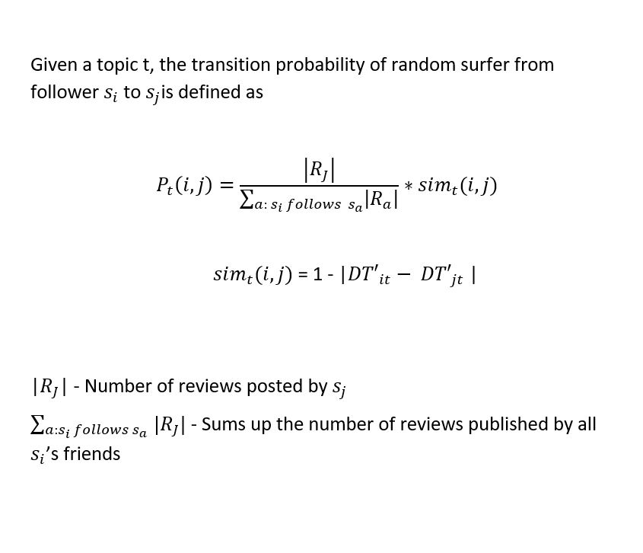
Solution (Twitter Rank)

Slide 9



Solution (Twitter Rank)
Apply Pagerank according to the equation below for each topic adjacency matrix.
Considerable weightage is given to reviewers topic of interest by varying the parameter .
Aggregation of Topic specific Pagerank is done using the formula

Slide 10
Solution (Twitter Rank)
Now we get K-most influential users using the ranking scores obtained.
The influential users are the set of users who have good connectivity in the large graph

Slide 11
Our Approach
Apply LDA to form User Topic Matrix i.e the contribution of each user to each topic.
Apply K-means to cluster users based on their topic interest.
Apply Pagerank to get the most influential node in that particular cluster.

Slide 12
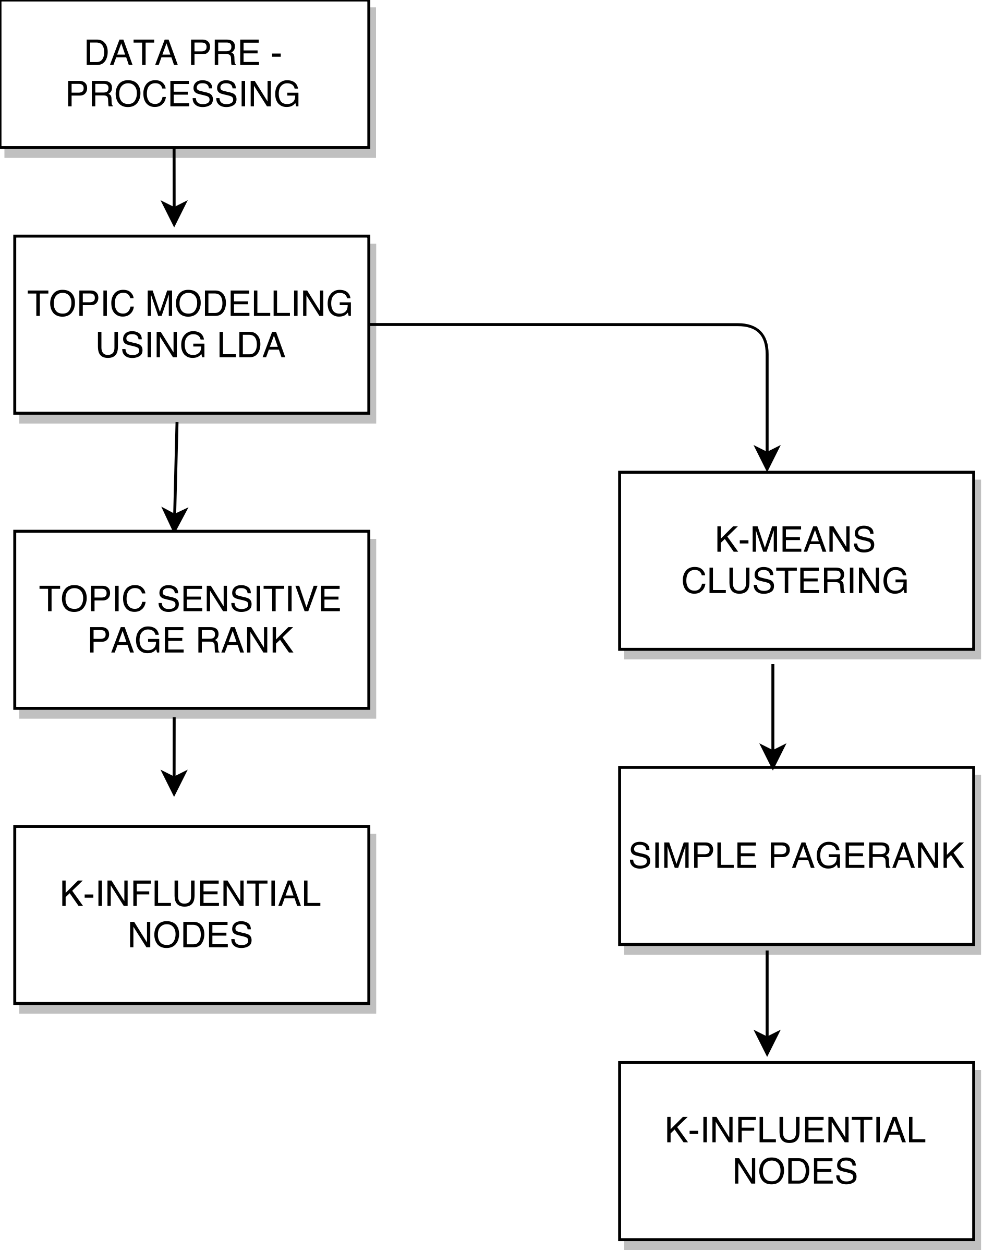
Existing and our approach

Slide 13

K value selection
The number of cluster is obtained by Elbow method as shown in the plot (K value vs Objective function)
Objective Function:

Slide 14
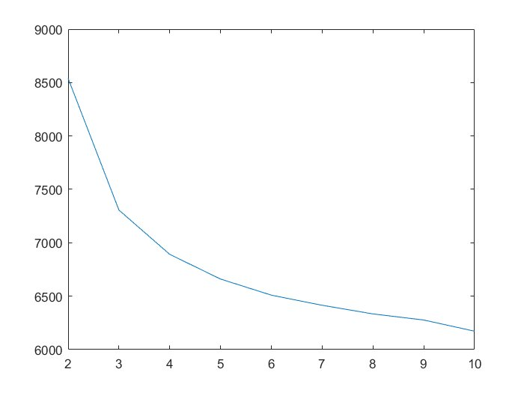
K-means PR
The optimal K value is chosen as 5

Slide 15
Active users vs Influential users
Topic | TR Influential Users | Active Users
pizza, bread, vegan, soup, potato | nXMMoDzXRByQiWH9cf-FAQ, Wc5L6iuvSNF5WGBlqIO8nw, BA9SDRZGyRcUMxTdUTVhmw, PcPminF0bIUsKjUh9e4DMQ, 8DGFWco9VeBAxjqsuh1aSw | vxR_YV0atFxIxfOnF9uHjQ, H5d_nFqzwrREE-YduK2ABg, eAJ3Ip0vh-zuk_BmcmchYA, el3TmKFEFzZOcNbCw2FNlQ, Bsbumyr3Of8BauN2URK4bg
chicken cheese salad fresh lunch | nXMMoDzXRByQiWH9cf-FAQ, BA9SDRZGyRcUMxTdUTVhmw, Wc5L6iuvSNF5WGBlqIO8nw, PcPminF0bIUsKjUh9e4DMQ, 8DGFWco9VeBAxjqsuh1aSw | GABWrw5Et9jubriKwMUDbw, Azkt7v-m9iBLjMZtCMxorg, s5F0viIdrelfeDtcMM65PQ, 8v3aEuuHEJU_8h0OgmsfDA, W83aZrDrYKwycCHB_eOYYg
sweet dessert night delicaci chocolate | nXMMoDzXRByQiWH9cf-FAQ, Wc5L6iuvSNF5WGBlqIO8nw, BA9SDRZGyRcUMxTdUTVhmw, PcPminF0bIUsKjUh9e4DMQ, 8DGFWco9VeBAxjqsuh1aSw | H5d_nFqzwrREE-YduK2ABg, el3TmKFEFzZOcNbCw2FNlQ, HmILc-lgVKZS7mWNdYCSJw, 9v83UksZrkThOiE584GRBQ, Bsbumyr3Of8BauN2URK4bg
day tabl side,dish top night happi meal | nXMMoDzXRByQiWH9cf-FAQ, BA9SDRZGyRcUMxTdUTVhmw, Wc5L6iuvSNF5WGBlqIO8nw, PcPminF0bIUsKjUh9e4DMQ, 8DGFWco9VeBAxjqsuh1aSw | T5KBc5QbwZ-Oj9ApE4vZJA, s5F0viIdrelfeDtcMM65PQ, coKnuxLznH0FHb34m4ZLCw, vxR_YV0atFxIxfOnF9uHjQ, HVJgTH5qu0goywOHNpOjPA
drink bar restaurant friday friend | nXMMoDzXRByQiWH9cf-FAQ, BA9SDRZGyRcUMxTdUTVhmw, Wc5L6iuvSNF5WGBlqIO8nw, PcPminF0bIUsKjUh9e4DMQ, 8DGFWco9VeBAxjqsuh1aSw | fZY97UjlP-iv35beOl_OfQ, nffEoRhzQYVIL3Y6bFhcGA, mjOKUSdIqxFPSYMB-MmS9g, tCbEkK11lnqeaNVkhlurrQ, TwjiWvK0ZP15lzGC049oIQ

Slide 16
Testing 1
For each test user, assign the user to the cluster with the smallest distance to the centroids.
Obtain the most influential node in that cluster. Now compare the results obtained with the results of TwitterRank Algorithm.
Test user:
TYwQtORbORzcX22xdYBx1g
Most Influential User in TwitterRank Algorithm:
nXMMoDzXRByQiWH9cf-FAQ
Most Influential User in K-means PR:
folPdHjHOS0g5UxNSgtWVQ

Slide 17
Testing 1
Test Users (5 different Users) | TR PageRank Most Influential User | Our Approach (K-means PR)
dessert, star,visual, salad, quiet, atmosphere | sandwich, tea, coffee, salad, bread, fruit, dessert | atmosphere, star,gaze, view,perfect, milk,make
pizza,beef, pie, italian | sandwich, tea, coffee, salad, bread, fruit, dessert | sauc, burger, fast, chicken, time
coffee, price, area, locat | sandwich, tea, coffee, salad, bread, fruit, dessert | sober,trust,scarf,best,definit
salad, delici, food | sandwich, tea, coffee, salad, bread, fruit, dessert | restaurant, yummi, soup , hot
burger,cake,food,sweet, good,buffet | sandwich, tea, coffee, salad, bread, fruit, dessert | pizza, caramel, smoothie

Slide 18
Results 1
Test data Topic words:
flawless,dessert,fire,love,star,visual,sinc,info,good,tast,amaz,quick,gorgeou,place,dinner,person,friend,quiet,area,glass,salad,challeng,almost,atmospher,simpli,via,salon,half,keep,fill,immedi,vibey,call,filet,hill,fountain,easili,group,better,top,view,
Topic Sensitive PR:
food,order,friend,great,salad,healthi,littl,back,menu,sandwich,pretti,price,tea,say,option,use,mom,reason,enjoy,friendli,coffee,fri,flavor,fruit,bread,thai,rate,server,vegan,bar,asian,feel,recommend,glad,fish,last,wish,home,much,work,total,select,excel,meal,chicken,wasn,stevia,tast,dessert,pictur
K-means PR:
cappuccino,better,blue,heart,atmospher,tad,shop,consist,liter,master,fresh,time,spend,drive,short,tradit,want,stinkin,someon,though,star,gaze, view,perfect,sure,nice,color,milk,make,fell,love,thing,steam,back,seat,oz,afternoon,s,hello,shini,path,espresso,beaten,nutti,bake,close,expect,fri,awesom

Slide 19
Results 2
Distance/Similarity for K Influential nodes:
Test data Node Index: 1010
Node Index | Euclidean Distance | Jaccard Coefficient | Dice Coefficient
6 | 30.659 | 0.275 | 0.424
13 | 31.686 | 0.25 | 0.41
18 | 29.597 | 0.27 | 0.427
37 | 26.153 | 0.3 | 0.462
8 | 30.806 | 0.26 | 0.419
Node Index | Euclidean Distance | Jaccard Coefficient | Dice Coefficient
676 | 7.141 | 0.536 | 0.684
938 | 5.568 | 0.59 | 0.761
998 | 6.164 | 0.542 | 0.767
767 | 5.196 | 0.657 | 0.816
659 | 7.937 | 0.511 | 0.641

Slide 20
Results 2
Using Jaccard Coefficient and Dice Coefficient to compute the acceptance ratio.
Based on 50 random reviewer taken, we calculated Hit accuracy.
Jaccard Coefficient Hit Ratio: 32% in TR , 68% in K means PR
Dice Coefficient Hit Ratio: 36.77% in TR ,63.3 % in K means PR

Slide 21
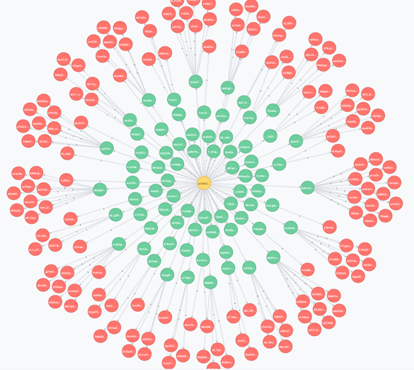

Top Influential User Network: PR

Slide 22
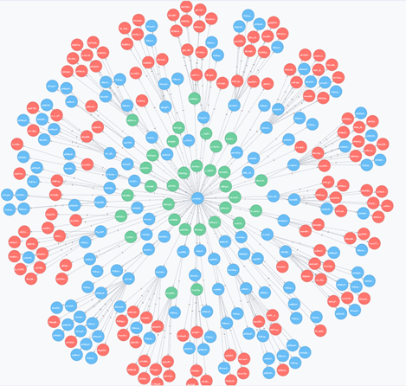
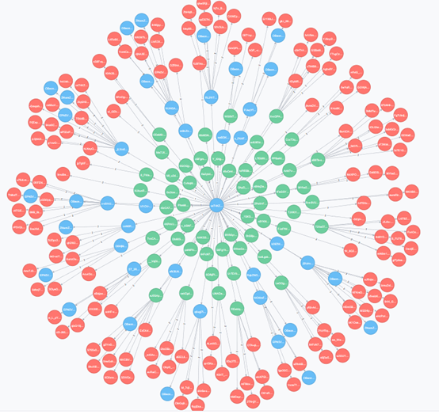

Dissemination Visualization
K-means algorithm
Twitter-Rank algorithm

Slide 23
K Influential User’s Connections
No Of Connections:
K-means PR TwitterRank
User Index | No Of Connections
676 | 13
938 | 11
998 | 10
767 | 35
659 | 28
User Index | No Of Connections
6 | 28
13 | 42
18 | 114
37 | 194
8 | 91

Slide 24
Correctness & Proof
Pick a random user with very less Pagerank score
Connect the random user with most influential users
Recompute the Pagerank

Slide 25
Correctness & Proof
Updated Rank:
User | Original Rank | Rank Score | Updated Rank | Updated Rank Score
1029 | 1042 | 0.000027 | 193 | 0.001012
959 | 1052 | 0.000003 | 93 | 0.002421
1018 | 1045 | 0.000025 | 70 | 0.00322
1013 | 1048 | 0.000016 | 147 | 0.001495
1007 | 1047 | 0.000023 | 78 | 0.002922
98 | 1049 | 0.000014 | 15 | 0.009701
982 | 1043 | 0.00025 | 63 | 0.00377

Slide 26
Conclusion:
Pros:
Similarity score is better between reviewer and the influential users.
Information spreads to more relevant users.
Cons:
Time Complexity.
Difficult to find right number of clusters.
Trade off between complexity and dissemination.

Slide 27
Future Work
GMM can be used instead of K-means as it starts with some prior (Soft Clustering)
Doc2Vec can be used instead of LDA for more accurate Topic Distillation
pLSI can be used instead of LDA which helps in finding underlying topics (pLSI is MAP of LDA)

Slide 28
References
Brin, S., Page, L., Motwani, R., and Winograd, T. 1999. The PageRank citation ranking: Bringing order to the Web. Tech. rep. 1999-66, Stanford Digital Library Technologies Project. http://dbpubs.stanford.edu:8090/pub/1999-66.
David M. Blei , Andrew Y. Ng , Michael I. Jordan, Latent dirichlet allocation, The Journal of Machine Learning Research, 3, p.993-1022, 3/1/2003
Jianshu Weng , Ee-Peng Lim , Jing Jiang , Qi He, TwitterRank: finding topic-sensitive influential twitterers, Proceedings of the third ACM international conference on Web search and data mining, February 04-06, 2010, New York, New York, USA [doi>10.1145/1718487.1718520]
"Wordhoard - Comparing Texts". Wordhoard.northwestern.edu. N.p., 2017. Web. 14 Apr. 2017.

Slide 29
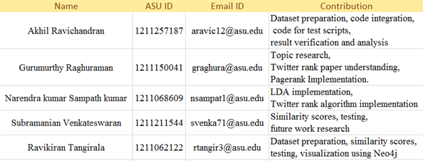
Team Contributions

