Slide 1
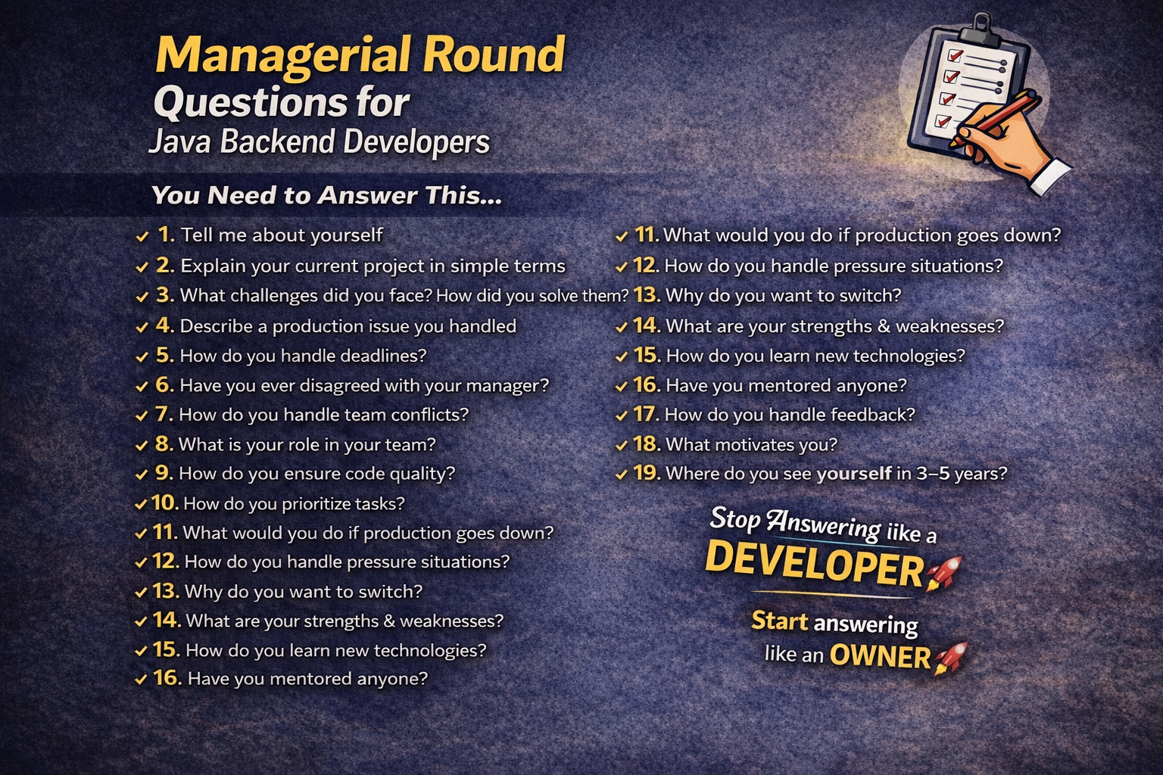
Managerial Round Mastery

Slide 2
The Problem
Most developers clear technical rounds
But fail in managerial round
Reason:
- Poor communication
- No ownership
- Weak examples

Slide 3
Golden Rule
Stop answering like a Developer
Start answering like an Owner

Slide 4
STAR Method
S - Situation
T - Task
A - Action
R - Result
Always structure your answers

Slide 5
Tell Me About Yourself
Short intro
Your role & skills
Key achievement
Ownership mindset

Slide 6
Why Do You Want to Switch?
Growth mindset
Looking for scale
More ownership
Avoid negativity

Slide 7
Why Should We Hire You?
Ownership mindset
End-to-end delivery
Production experience
Business impact

Slide 8
Explain Your Project
Domain + Tech stack
Your role
Scale of system
Impact you created

Slide 9
Challenges & Production Issues
Explain real problem
Your action
Result with impact
Use numbers if possible

Slide 10
Team & Conflict Handling
Stay professional
Communicate clearly
Focus on solution
Respect opinions

Slide 11
Prioritization
Business impact first
Production issues > Features
Clear communication

Slide 12
Production Down Scenario
Stay calm
Analyze logs
Fix / rollback
Communicate
Find root cause

Slide 13
Final Advice
Use real examples
Keep answers structured
Be confident
Think like an owner

Slide 14
Call To Action
Comment 'ANSWERS' for full guide
Follow for more interview tips

