Slide 1
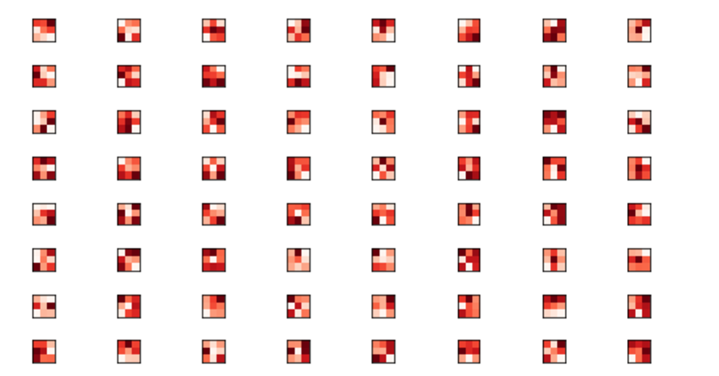
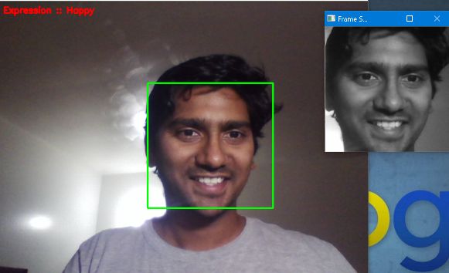
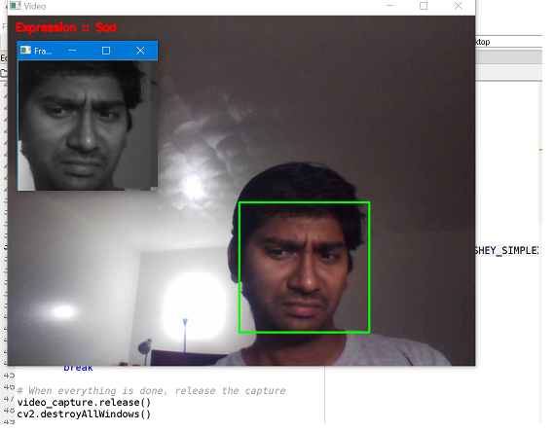
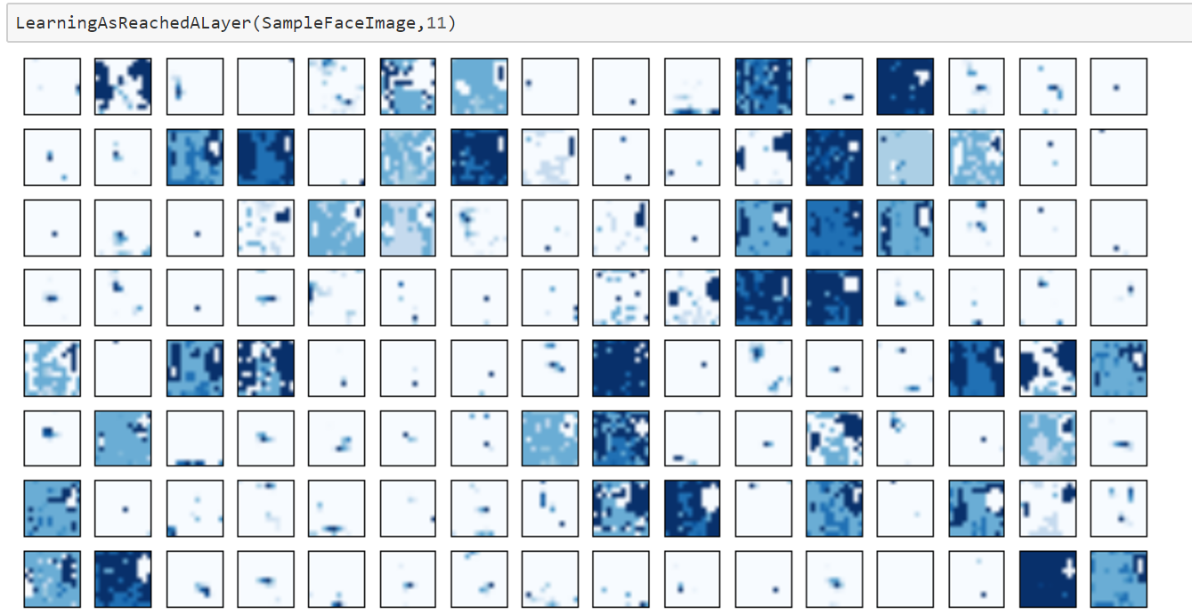
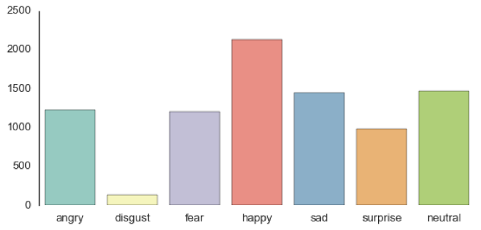
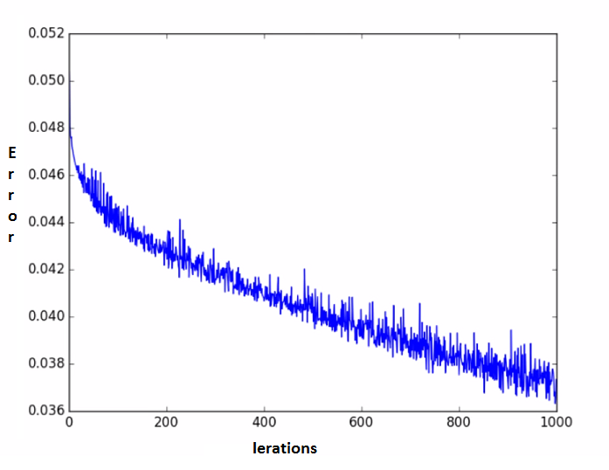
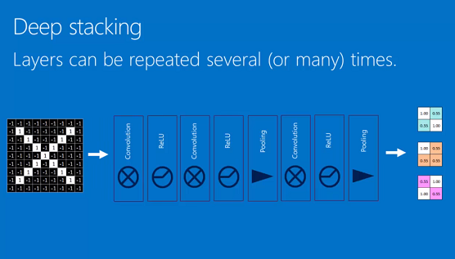
FACE EXPRESSION RECOGNITION
Naren Suri
Computer Vision Class Project
BACKGROUND
MATERIALS AND METHODS
RESULTS
Human facial expressions can be categorized into 7 emotions which are sad, surprise, fear, anger, disgust, and neutral.
If machines can see human and understand human emotions we can better help a customer at service desk or at a restaurant. This can also help the scientists of NASA at a space station to understand the stress and strain of an astronaut from expressions instead of using the other invasive medical tests.
Though the expression recognition seems a simple task to humans, but it’s not really an easy task for the machines for various reasons.
With Neural Networks, the process of parameter tuning with high computing power is helping humans to solve some problems and face expression recognition is one of them.
1. Images used are 1 X 48 X 48
2. Solved the Class Imbalance Problem
Deep Neural Network:
Used 3 Hidden layers with each layer having the 2000, 1000 and 500 hidden units respectively.
Used TensorFlow for optimization
Convolutional Neural Network:
Used 3 convolution and Pool Layers with RELU as the activation Unit.
Used Max Pooling of 2X 2
The Fully connected DNN is Dense with 64 X 2
Real Time Expression Detection:
Used HAAR like Cascade features to detect the human face from a live fed camera.
Used the CNN model trained to classify the frame fed to the camera for expression prediction.
Results From Neural Net has given 63%.
CNN has given 68% Accuracy.
Prediction of Expressions using the CNN model trained
Implementation Methods
Deep Neural network in python with implementations for both forward and backward propagations code. The algorithm is trained and tested on private test data obtained from Kaggle.
Trained a Deep Neural network in TensorFlow with softmax regression.
Convolutional Neural network with Keras and Theano. Analyzed the filters those generated by the CNN in the above model.
HAAR cascade features to detect human’s faces real time through the web-cam or video or images.
The detected face through one of the means discussed above is then sent to the CNN model that is already trained for prediction of the expression.
CONCLUSIONS
Relatively, CNN has better performance compared to DNN in terms of Accuracy.
The Accuracy may be further improved with more hidden layers (hyper parameters) and more iterations.
Future:
We can use the Recurrent Neural Network and train the model with the calendar events and the facial expression of the human to understand items in the calendar that cause a specific expression in human, and we may try helping humans with better schedule or better advise.
Data set has above expressions as 7 as classes
The error vs iteration as the model gets trained
A Typical CNN Model
Image Credit - Brandon Rohrer

