Slide 1

KAKATIYA INSTITUTE OF TECHNOLOGY & SCIENCE,WARANGAL (An AUTONOMOUS Institute under KAKATIYA UNIVERSITY – Warangal) Opp :Yerragattu Gutta, Hasanparthy,Warangal-506015, Telangana, INDIA. DEPARTMENT OF COMPUTER SCIENCE & ENGINEERING(NETWORKS)
Major Project
TITLE : Privacy-Preserving Data Sharing in Multi-Cloud using Homomorphic Encryption
8CSN1B5
Team members –
B22CN046 | T.Sai Charan
B22CN020 | D.UmaMahesh
B22CN036 | K.Manideep
B23CN133L | B.Narendar
B22CN004 | P.Nikhil
B21CN050 | V.Abhinay
Supervisor:
Dr.R.Naveen Kumar
Asst.Professor
Dept. CSN
Major project

Slide 2
Content-
Introduction
Remarks of Stage-I Presentation
Objective
Proposed Methodology
Experimental Work
Results & Discussion
Conclusion
8. Reference

Slide 3
Introduction
Problem: Data shared with cloud servers is often at risk of privacy breaches and unauthorized access, as traditional encryption (like AES, RSA) requires decryption before computation. This exposes sensitive data to cloud providers.
Motivation: With the growing use of cloud computing for data storage and analytics, there is a need for a secure system that allows computations on sensitive data without revealing the original information to the cloud.
Approach: Implement a Homomorphic Encryption (HE)-based system where data is encrypted at the client side and securely processed across multiple cloud servers (Render & Replit) without decryption, ensuring privacy-preserving data sharing and computation.

Slide 4
Remarks of Stage-I presentation
Clearly explains the motivation behind using homomorphic encryption to enable secure computation on encrypted data without exposing the original information to cloud providers.
Demonstrates a solid understanding of data privacy challenges in cloud environments and how multi-cloud architecture enhances security, reliability, and fault tolerance.
The guide suggested researching and identifying real-world organizations or companies currently using homomorphic encryption (e.g., in hospitals, educational institutions, or industries) to strengthen the practical relevance of the project.
Overall, the work is progressing well and on the right track.

Slide 5
Real-World Organisations Using Homomorphic Encryption
Asan Medical Center (South Korea) — Healthcare: Applied homomorphic encryption for secure patient data analytics.
Microsoft Corporation (USA) — Technology / Cloud Services: Developed the SEAL homomorphic encryption library and integrated it into cloud data analytics.
IBM Corporation (USA) — Technology / Research: Conducted field trials implementing Fully Homomorphic Encryption (FHE) for secure cloud data processing.
Duality Technologies (USA) — Privacy-Preserving Data Solutions / FinTech: Provides encrypted computation solutions for finance and healthcare data sharing.
Trustwell Hospitals & University Visvesvaraya College of Engineering (India) — Healthcare & Education: Research collaboration using homomorphic encryption for disease prediction and analytics.

Slide 6
Objectives
Develop an end-to-end secure computation framework using Homomorphic Encryption (HE).
Enable data processing directly on encrypted data without decryption, ensuring privacy preservation.
Design a multi-cloud architecture to enhance data security, reliability, and fault tolerance.
Achieve accurate computation results with minimal performance overhead and no exposure of sensitive data to cloud providers.

Slide 7
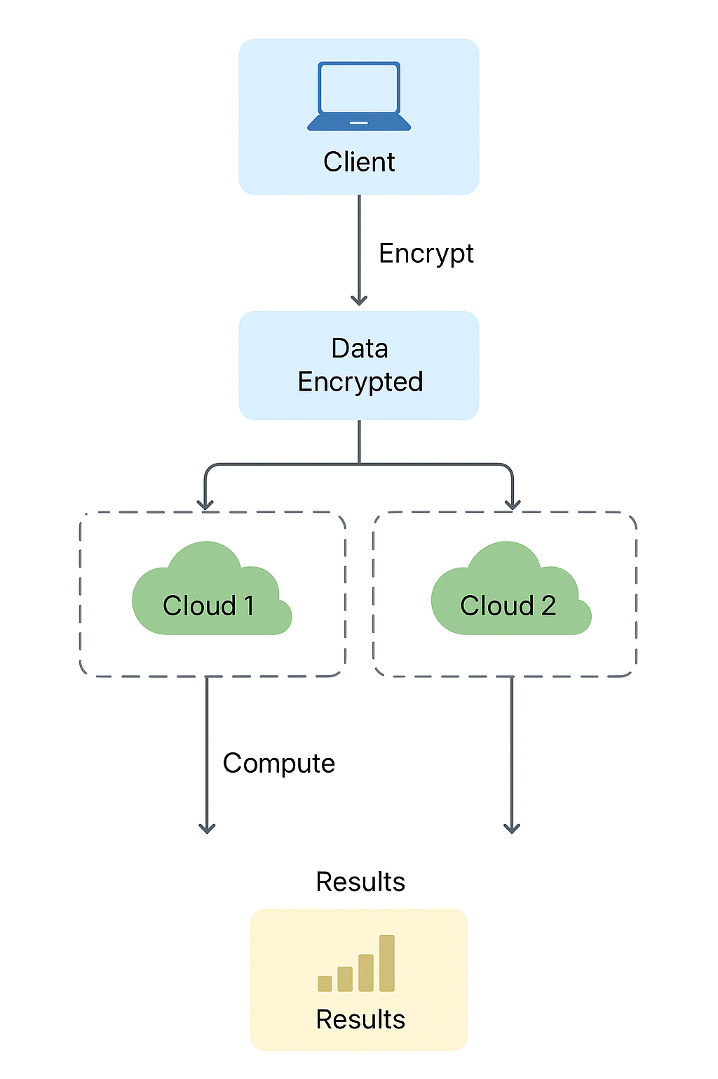
Methodology
Architecture:
Multi-cloud setup with two independent cloud servers (Render & Replit).
Each cloud performs secure computations using Homomorphic Encryption (HE).
A client module encrypts the data before sending it to the clouds.
Encryption & Processing:
Input data is encrypted using the CKKS homomorphic encryption scheme.
Encrypted data is sent to both clouds for parallel computation.
Each cloud performs operations (e.g., sum, average) directly on encrypted data — without decryption.
Decryption & Results:
Encrypted results from both clouds are sent back to the client.
The client decrypts the results using the secret key to obtain the final values.

Slide 8
Experimental Work
Code Modules:
Client Module: Handles encryption and decryption using the CKKS homomorphic encryption scheme.
Cloud Server Modules (Render & Replit): Perform encrypted computations (sum) on the received data without decrypting.
Multi-Client Script: Connects the client with both cloud servers, sends encrypted data, and collects encrypted responses.
Folder Structure:
HE_TENSEAL/ → Contains client-side files for encryption, computation, and decryption.
HE_Cloud_API/ → Cloud 1 (Render) server for secure encrypted computation.
HE_Cloud_API_REPLIT/ → Cloud 2 (Replit) server for parallel secure computation.
cipher_store/ → Stores encrypted data, context files, and computed results.
.

Slide 9
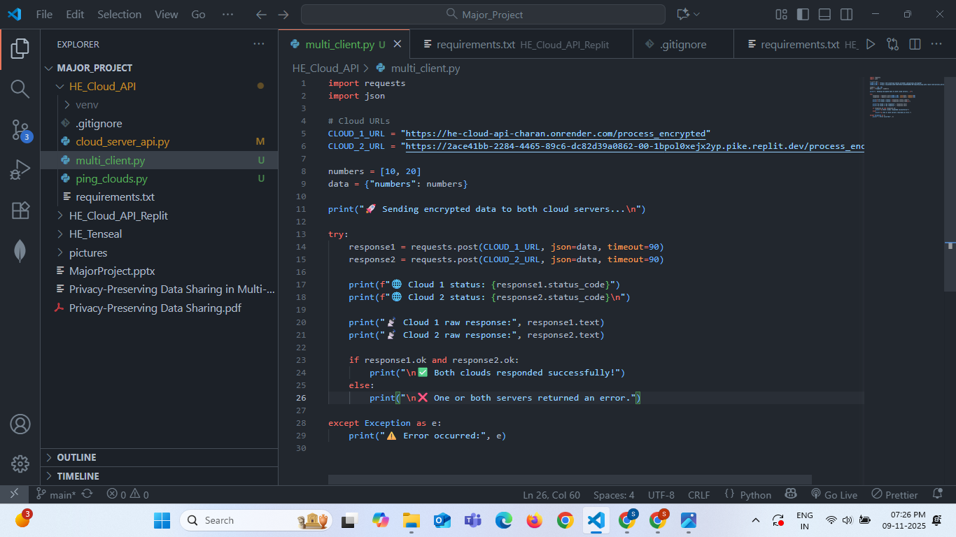
Experimental Work
Pre-Configured Libraries:
TenSEAL: For homomorphic encryption and encrypted vector operations.
Flask: For building and hosting cloud APIs.
NumPy & Requests: For numerical operations and API communication.

Slide 10
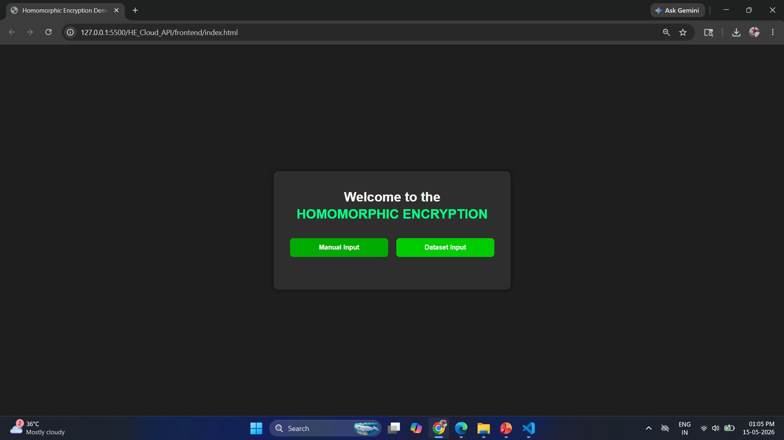
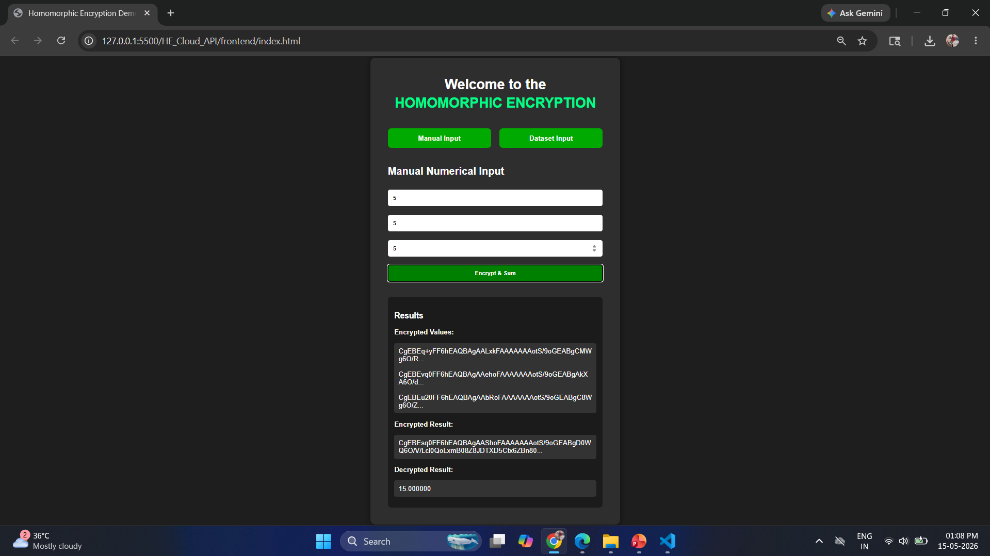
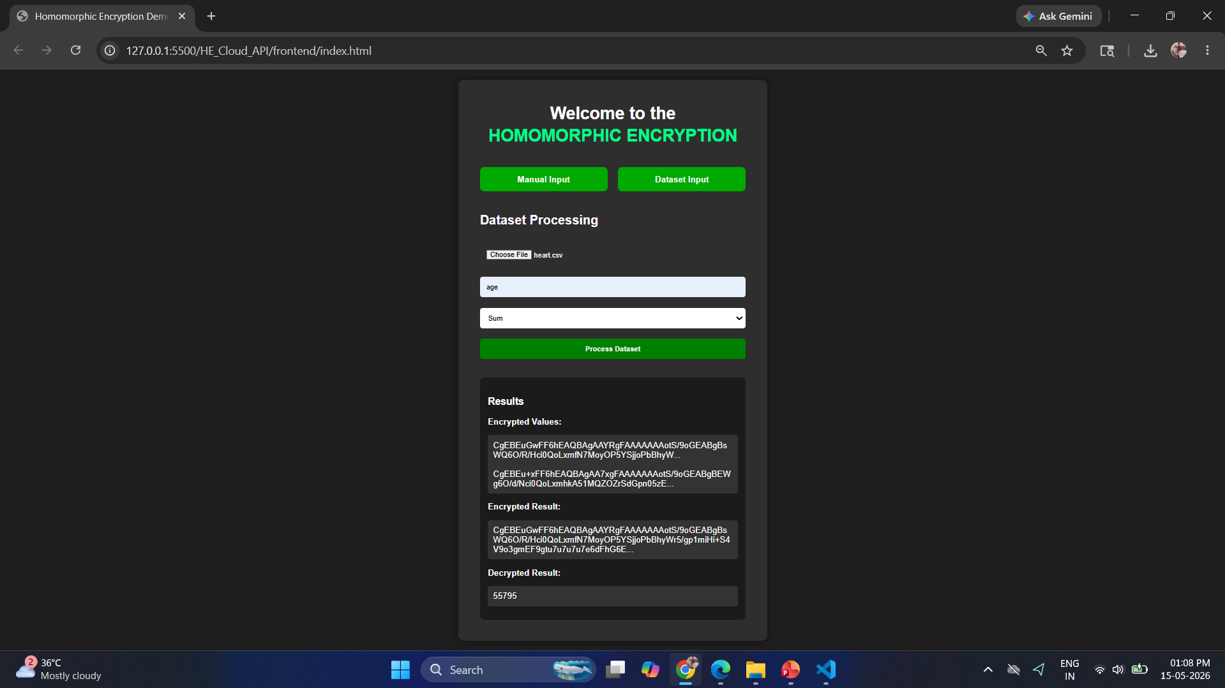

Slide 11
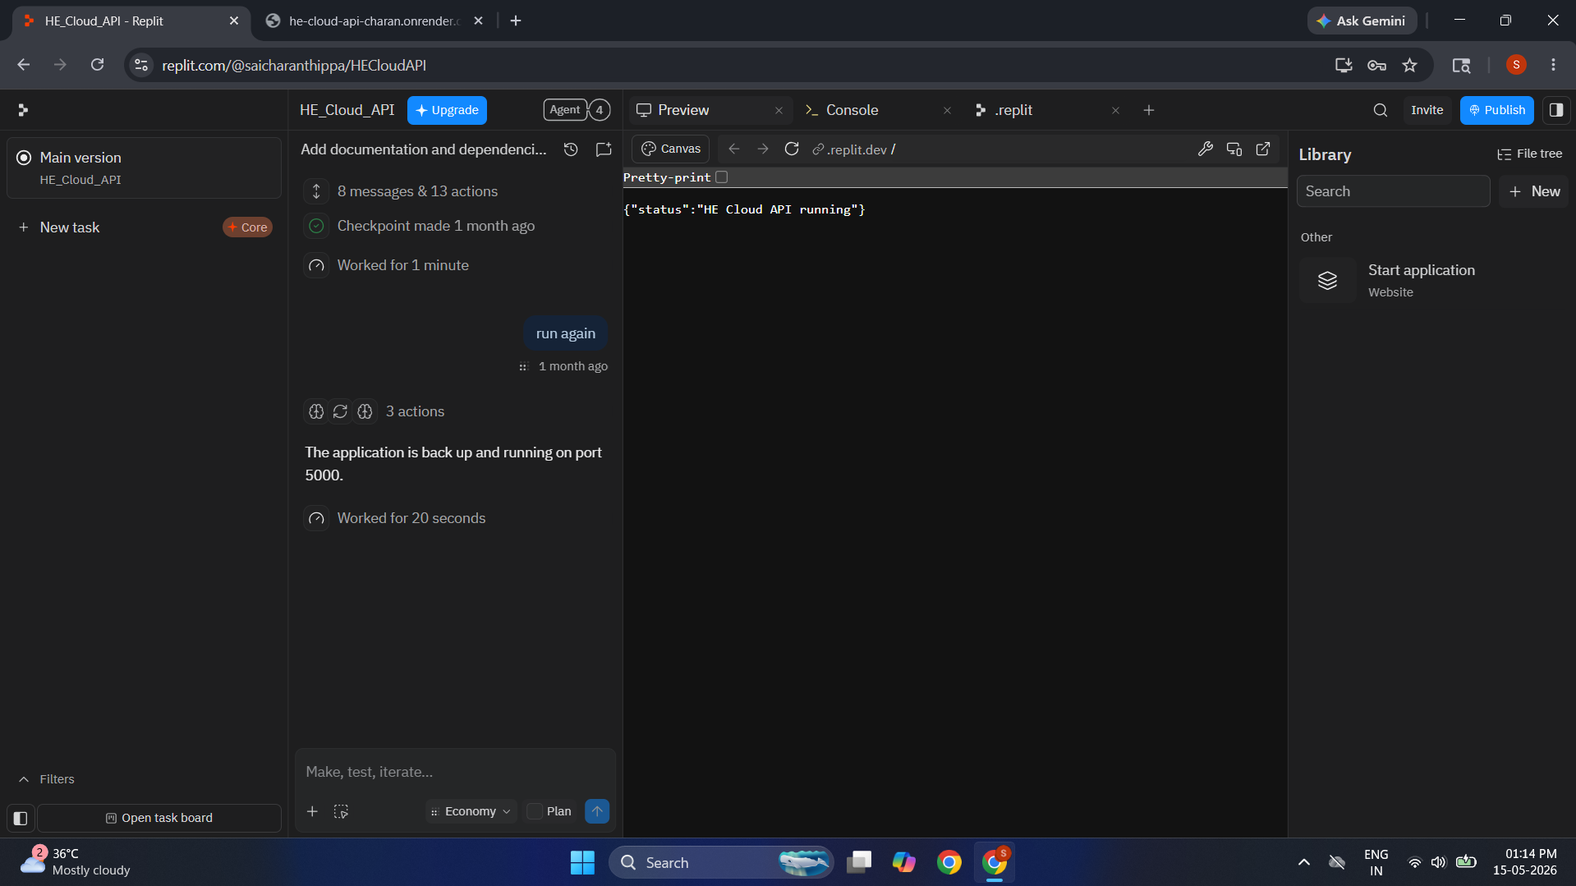


Slide 12
Results & Discussion
The proposed multi-cloud homomorphic encryption system 100% done, and successfully ensures data privacy while performing computations.
Both cloud servers (Render and Replit) process data securely and independently, providing consistent results.
Example result:
Input: [10, 20, 30]
Cloud 1 & Cloud 2 Outputs:
Sum = 60.0 units.
The client decrypts the results correctly, confirming that computations were performed on encrypted data.
Demonstrates data confidentiality, fault tolerance, and reliability — even if one cloud fails, the other can continue computation.
Overall, the system provides secure, scalable, and privacy-preserving computation suitable for real-world applications like hospitals, finance, and universities.

Slide 13
Conclusion
A privacy-preserving data-sharing framework using homomorphic encryption across multiple cloud servers was 50% successfully developed.
The system allows secure computations directly on encrypted data without revealing the original information to any cloud provider.
Using a multi-cloud approach improves data reliability, availability, and fault tolerance.
Experimental results confirmed that both clouds produced accurate and consistent results while maintaining full data confidentiality.
The framework demonstrates strong potential for real-world applications in sectors like healthcare, finance, and education, where data privacy is critical

Slide 14
REFERENCE
Craig Gentry, “Fully Homomorphic Encryption Using Ideal Lattices,” STOC, 2009.
Cheon, J.H., Kim, A., Kim, M., Song, Y. (2017). “Homomorphic Encryption for Arithmetic of Approximate Numbers (CKKS Scheme),” ASIACRYPT.
Microsoft Research, “TenSEAL: A Library for Homomorphic Encryption on Tensor Operations,” GitHub Repository, 2020.
Alabdulatif, A., et al. (2021). “Privacy-Preserving Data Aggregation for Cloud-Assisted IoT Applications Using Homomorphic Encryption.”
Base Paper: “Privacy Preserving Data Sharing through Multi-Cloud using Homomorphic Encryption.”

Slide 15
THANK YOU !

