Slide 1


Paindla Narendar Reddy
Technical Trainer
AIML Workshop
Day-3

Slide 2
Paindla Narendar Reddy
Technical Trainer
Clustering
Clustering is a machine learning technique used to:
Group similar data points together
Identify hidden patterns in data
Analyze data without output labels
Clustering belongs to Unsupervised Learning

Slide 3
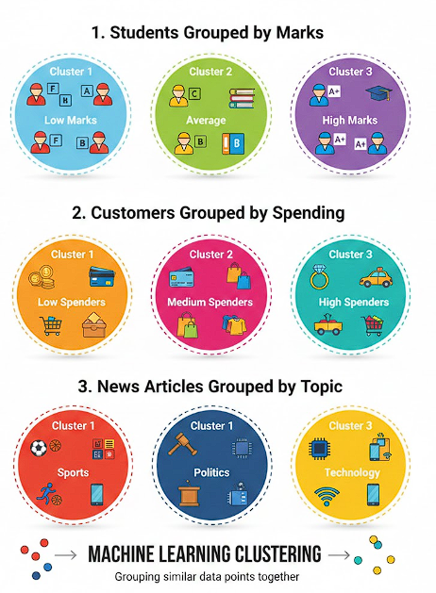
Paindla Narendar Reddy
Technical Trainer
Example

Slide 4
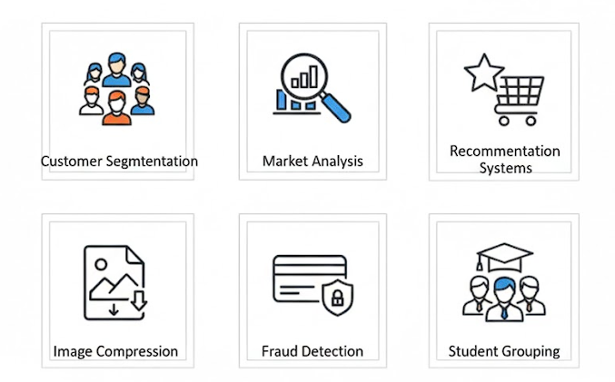
Paindla Narendar Reddy
Technical Trainer
Real time Applications

Slide 5
Paindla Narendar Reddy
Technical Trainer
Why clustering is important ?
No labeled data required
Finds hidden structure in data
Helps businesses make decisions
Reduces large data into meaningful groups

Slide 6
Paindla Narendar Reddy
Technical Trainer
Types of clustering
K-Means Clustering ⭐
Hierarchical Clustering
DBSCAN
Mean Shift Clustering

Slide 7
Paindla Narendar Reddy
Technical Trainer
K-Means
What is K-Means Clustering?
K-Means Clustering is an unsupervised machine learning algorithm used to:
Group similar data points into K clusters.
K → number of groups
Means → average (centroid)
It groups data based on similarity.
Why it is called “K-Means”?
K = number of clusters
Mean = center of cluster (average value)
Each cluster has a centroid (center point).

Slide 8
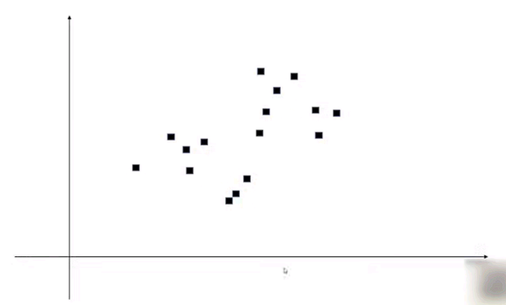

Paindla Narendar Reddy
Technical Trainer
K-Means

Slide 9
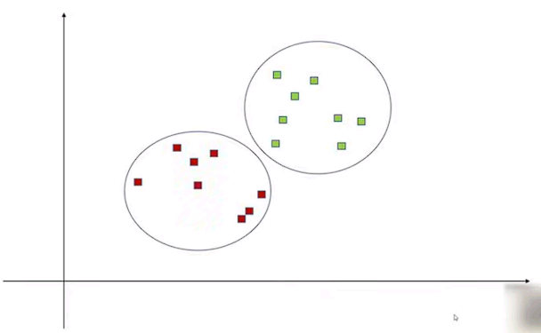

Paindla Narendar Reddy
Technical Trainer
K-Means

Slide 10
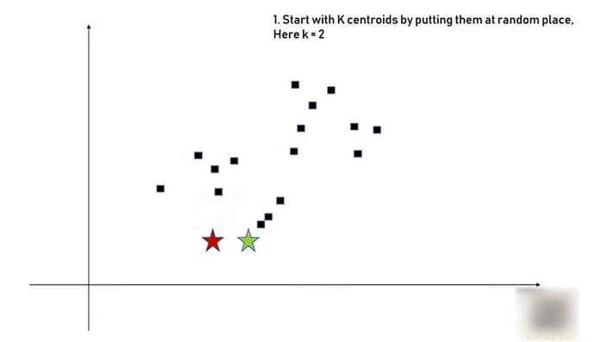

Paindla Narendar Reddy
Technical Trainer
K-Means

Slide 11
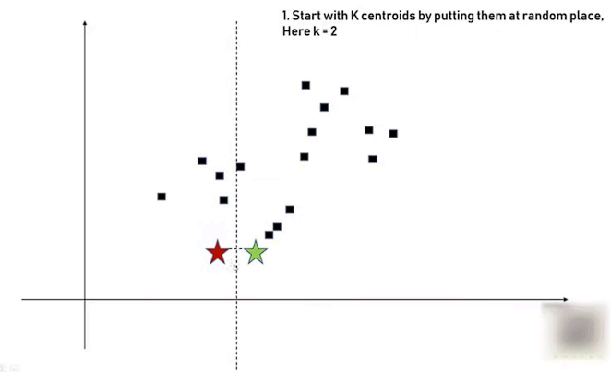

Paindla Narendar Reddy
Technical Trainer
K-Means

Slide 12
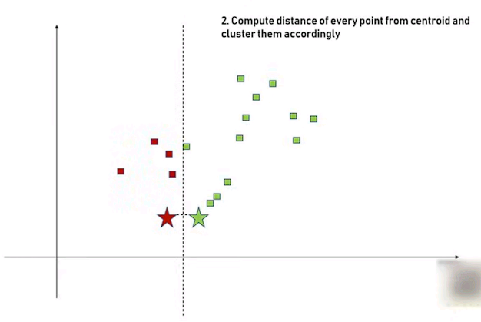

Paindla Narendar Reddy
Technical Trainer
K-Means

Slide 13
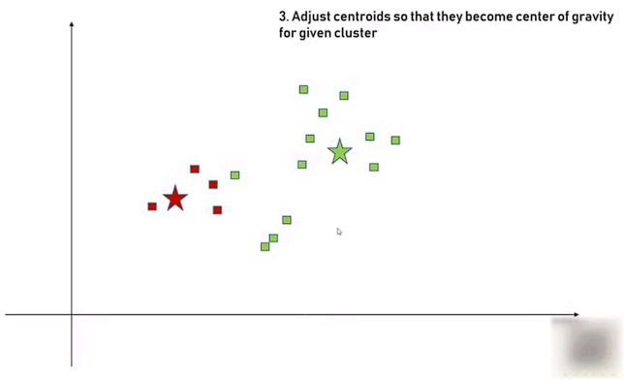

Paindla Narendar Reddy
Technical Trainer
K-Means

Slide 14
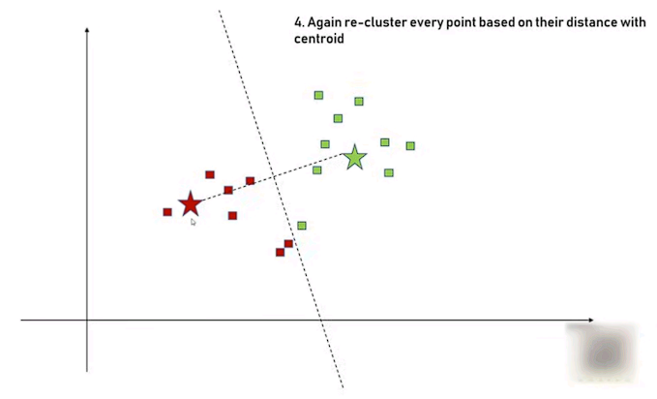

Paindla Narendar Reddy
Technical Trainer
K-Means

Slide 15
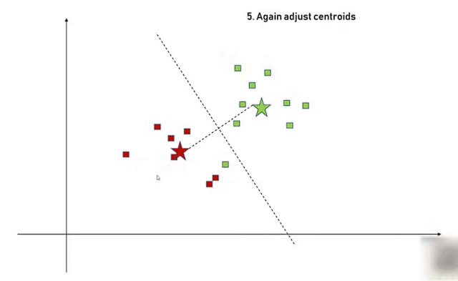

Paindla Narendar Reddy
Technical Trainer
K-Means

Slide 16
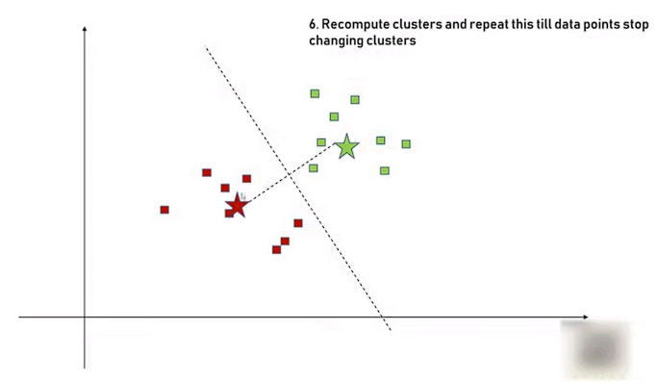

Paindla Narendar Reddy
Technical Trainer
K-Means

Slide 17
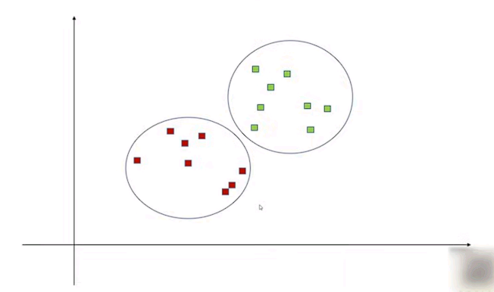

Paindla Narendar Reddy
Technical Trainer
K-Means

Slide 18
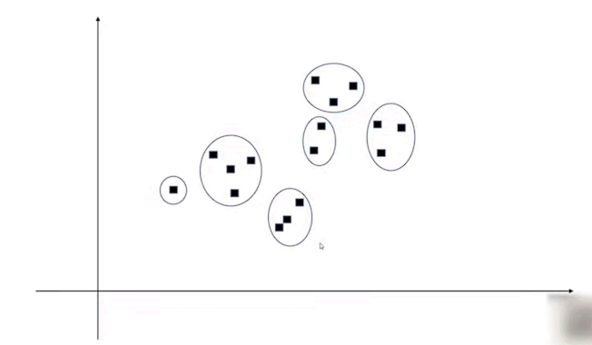

Paindla Narendar Reddy
Technical Trainer
K-Means
How to determine correct number of clusters (k) ?

Slide 19
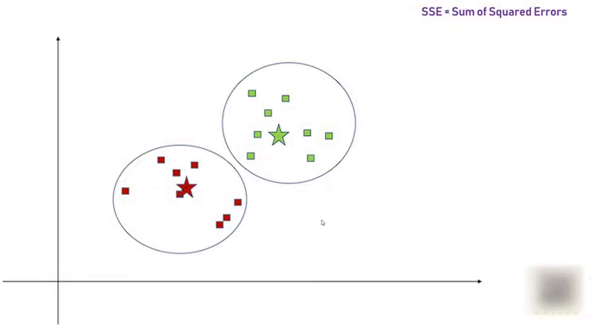


Paindla Narendar Reddy
Technical Trainer
K-Means

Slide 20
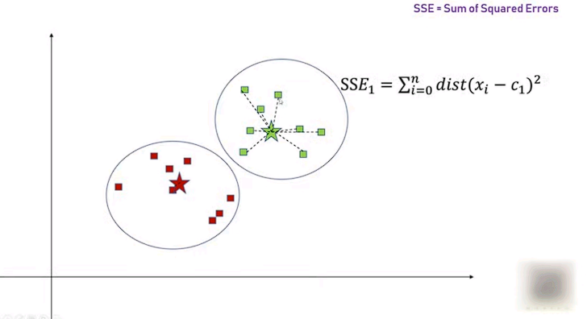

Paindla Narendar Reddy
Technical Trainer
K-Means

Slide 21
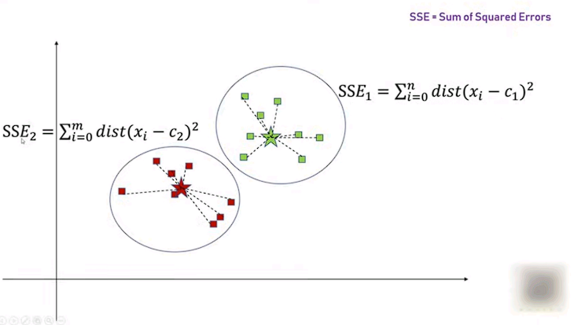

Paindla Narendar Reddy
Technical Trainer
K-Means

Slide 22
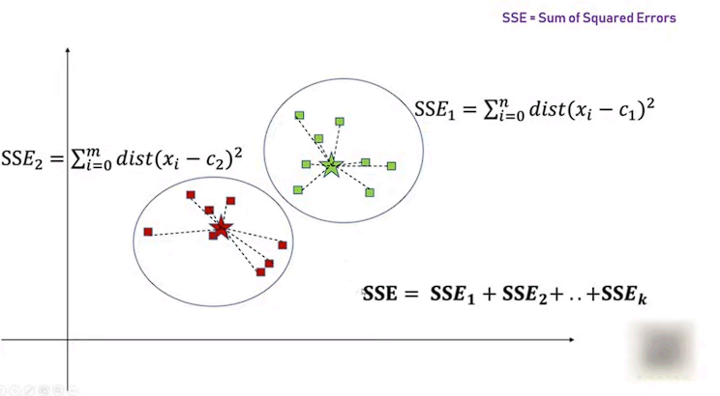
Paindla Narendar Reddy
Technical Trainer
K-Means

Slide 23
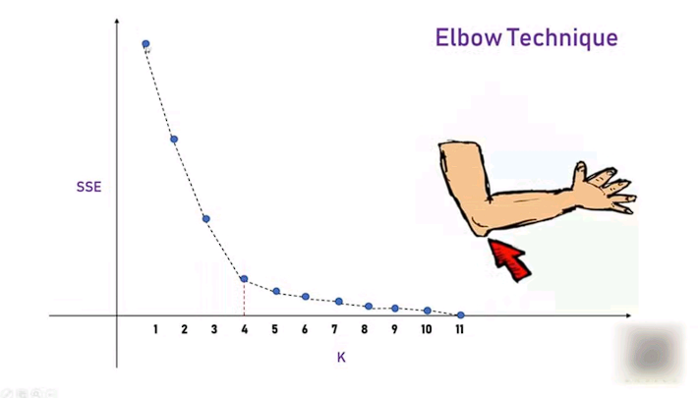
Paindla Narendar Reddy
Technical Trainer
K-Means

Slide 24
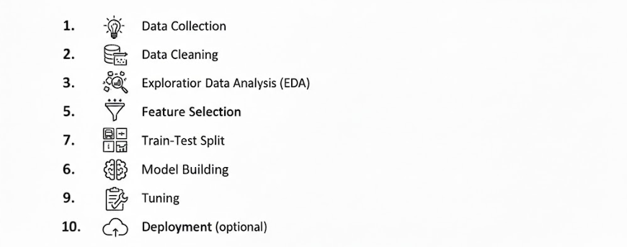
Paindla Narendar Reddy
Technical Trainer
ML WORKFLOW

Slide 25
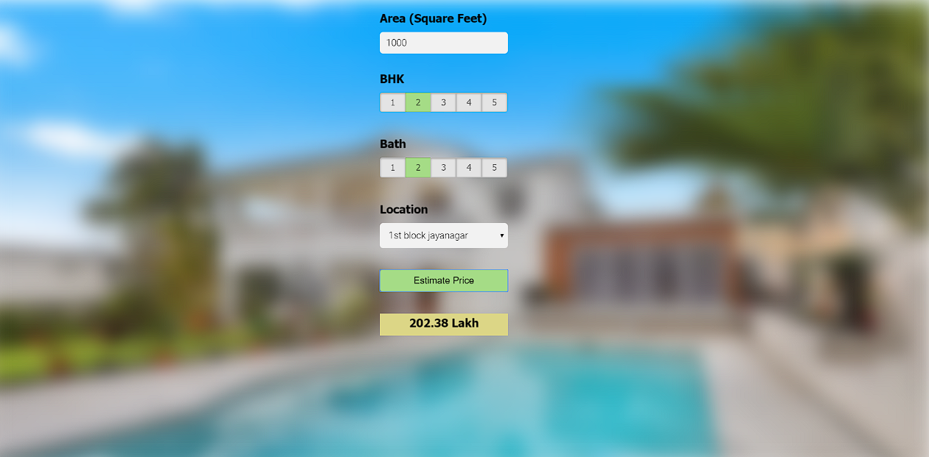
Paindla Narendar Reddy
Technical Trainer
Capestone project

