Slide 1
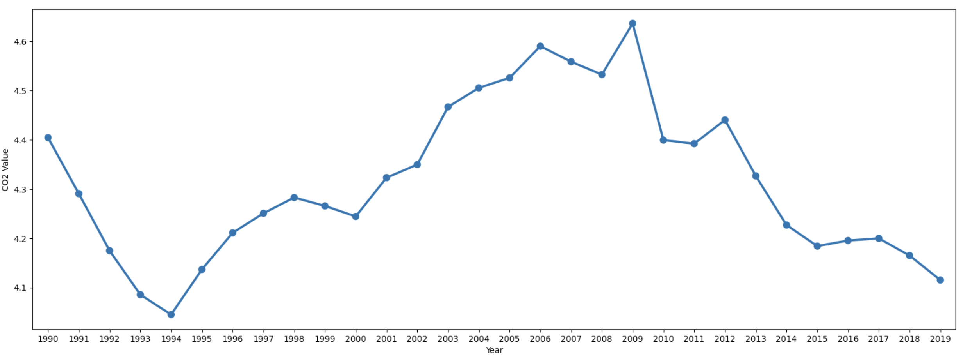
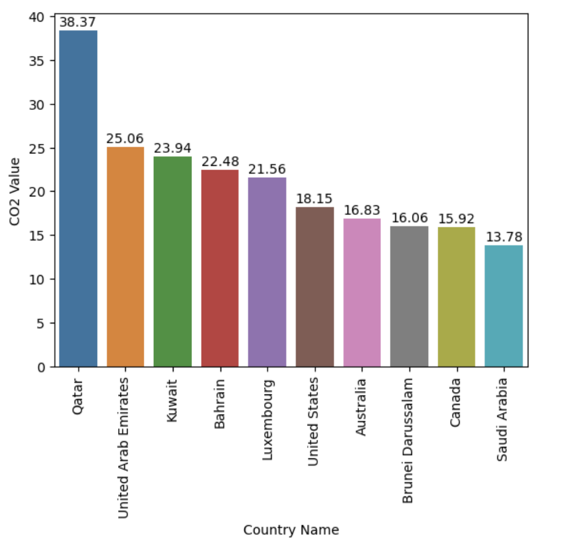
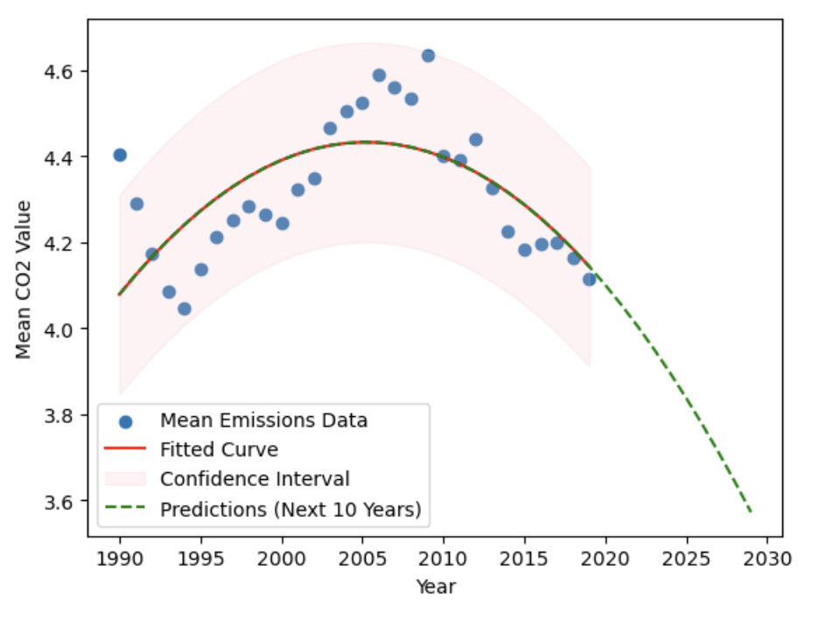
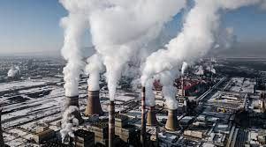

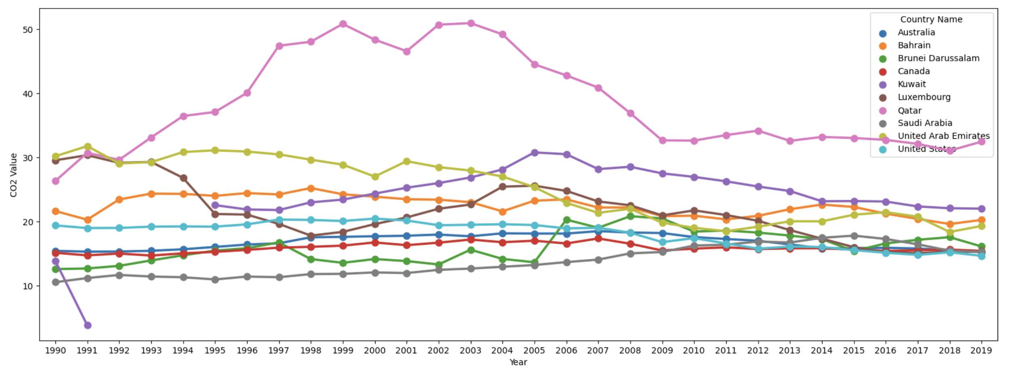
Explore the Global Carbon Landscape
John Smith, MD¹; Jane Doe, PhD²; Frederick Jones, MD, PhD^{1,2}
¹University of Affiliation, ²Medical Center of Affiliation
Introduction
Dataset
CO2 Value by year
Embark on a voyage through the intricate world of global carbon emissions with our poster, looking over the evolution of environmental footprints. This visual narrative shows dynamic trends, shedding light on the big issue of CO2 emissions worldwide. Deep dive into the nuanced exploration of top emitters, traversing time and nations. Our presentation aims to provide a good understanding, showing awareness and advocacy for sustainable practices. Join us on this compelling journey towards a greener and much more environmentally conscious future
The dataset used in this analysis is from world bank and contains important information about CO2 emissions across different countries over multiple years. It has variables such as "Country Name," "Region," "Year," and "CO2 Value."
As can be seen here the trend Is uneven, it peaked around in 2009 and was at all time low at 1994.
CO2 Value by Country
Here as can be seen that the rich countries like Qatar, UAE which have abundance of oil have the most CO2 emissions and are dominating our list.
Origin of CO2 emissions….
Carbon dioxide emissions primarily arise from burning fossil fuels for energy, deforestation, industrial processes, and agricultural activities. These human-driven factors contribute to climate change by increasing greenhouse gas concentrations in the atmosphere.
Uneven CO2 emission trend: Peaks in 2009, hits all-time low in 1994.
Dominance of rich oil nations: Qatar, UAE lead in emissions, reflecting fossil fuel abundance.
Middle East dominance: Qatar consistently tops, revealing sustained emissions for nearly two decades.
Challenge in emission reduction: Despite global efforts, some countries exhibit persistent or increasing emissions.
Urgency for sustainable practices: Highlights the need for comprehensive global strategies to address climate change and promote environmental sustainability.
Observations!!!
CO2 Value by Year of each Country
Uneven CO2 emission trend seen: Peaks in 2009, hits all-time low in 1994.
Dominance of rich oil nations: Qatar, UAE top in emissions, showing fossil fuel abundance.
Middle East dominance: Qatar consistently tops, showing sustained emissions for almost two decades.
Challenge in emission reduction: Despite all the global efforts, some countries still show persistent or increasing emissions.
Urgency for sustainable practices: the need for good global strategies to address climate change and also promote environmental sustainability.
Here we see again how middle east dominates the chart with Qatar being on top, for majority of the countries we can see how the emission instead of dropping is consistent for almost 20 years.
Model fitting
Curve fitting, mainly cubic polynomial regression, involves making data using a cubic equation. This method optimizes parameters to best match the observed data points, showing trends and predicting future values. The cubic curve accommodates much more complex patterns and relations, giving a versatile tool in data analysis and forecasting, as can be seen here our model showing confidence interval with prediction of next 30 years.
Contact
References
[name]
[organization]
[address]
[email]
[phone]

