Slide 1
Design specification
Packaging Station Monitor
IIoT sensing, supervision and indication
Pradeeb A/L Manogaran
Narentiransharma A/L Baskhara dass
Syahin haleef bin shaik abdullah
TMS202/04 Assignment 2 Question 2
01
Notes:
Introduce the individual CA2 project. Describe the design specification as the required written deliverable for Question 2. This deck supports a walkthrough of that written specification. The hardware build and live demonstration are assessed separately in Question 1.
Sources
Wawasan Open University, TMS202/04 Assignment 2, September 2026, Question 2 and marking rubric.

Slide 2
Contents
01
Introduction and operating scope
04
Logic flow chart
02
System design
05
Network architecture
03
Component list and specifications
06
Wiring schematic
07
Implementation and validation
The accompanying Word document contains the full design specification.
Design specification
02
Notes:
The contents slide matches the eight required sections when the table of contents itself is included. The component list spans two slides to retain each hardware requirement. The diagrams describe the same bench and the closing slides show commissioning criteria.
Sources
Wawasan Open University, TMS202/04 Assignment 2, September 2026, Question 2 and marking rubric.

Slide 3
Station purpose and scope
The operator can see whether a package is present and whether the station temperature is within its limit.
Package detection
Temperature supervision
Indication control
A PNP sensor reports item presence at the sensing point.
A probe will supply readings for the trend and a configurable high-temperature alert.
NP9 latches an inspection hold. The C# app can reset the hold, enable or disable over MQTT.
Introduction
03
Notes:
Explain how a local indicator and remote view help different operators. The scope covers sensing and low-voltage indication. Machine motion and safety interlocks are outside this bench exercise. A physical probe and indicator still require their specific wiring and commissioning.
Sources
Wawasan Open University, TMS202/04 Assignment 2, September 2026, Question 2 and marking rubric.
CA2 package, PLC/Integration.md, implemented CODESYS CA2 AI1/DI1 project, and CA2 live session observations.

Slide 4
Controller inputs and indicator logic
Signal | Controller mapping | Lab status
PNP package sensor | DI2 %IX0.1 | Package detection observed
NP9 inspection hold | DI1 %IX0.0 | Press and release observed in MQTT
Signal generator | AI1 %IW3, 0–10 V | Mapped to voltage using raw ÷ 3276
Temperature and quality | Probe channel and validity pending | Probe commissioning pending
LED output | Requires confirmed compatible 24 V output | Physical response pending
Indicator logic
Item present AND control enabled AND temperature valid
System design
04
Notes:
Point to DI2 for package detection and DI1 for the NP9. AI1 uses the 0 to 32760 process-image span for 0 to 10 V. An independent meter comparison is a separate acceptance test. The temperature and physical output rows describe pending hardware work. The LED formula is the PLC design and the physical output must be demonstrated.
Sources
CA2 package, PLC/Integration.md, implemented CODESYS CA2 AI1/DI1 project, and CA2 live session observations.

Slide 5
Controller and field components
Component | Function on the station | Rating or confirmation
WAGO CC100 | Acquire I/O and run CODESYS logic | 751-9301
DIN-rail power supply | Supply the controller and field circuits | 24 V DC, check current and protection
NP9 push button | Latch inspection hold via DI1 | Check contact and rated supply
PNP sensor | Package presence at DI2 | Confirm fitted sensing range and wiring
Temperature sensor probe | Station temperature acquisition | Identify probe type, range and channel
LED indicator | Show the enabled package state | Compatible 24 V load and confirmed DO
Digital display meter | Local indication of a matched quantity | Confirm supply, input and scale
Component list and specifications
05
Notes:
Identify the model and ratings on the fitted components before wiring. The LED must be compatible with the selected output. The display meter remains open until its input and supply ratings are confirmed. Document the model and operating range of the actual probe.
Sources
Wawasan Open University, TMS202/04 Assignment 2, September 2026, Question 2 and marking rubric.
CA2 package, PLC/Integration.md, implemented CODESYS CA2 AI1/DI1 project, and CA2 live session observations.

Slide 6
Terminations and communications
Component | Function on the station | Rating or confirmation
Rail terminal block and bridge | Distribute supply and common | Check pitch, ratings and isolation
Terminal strip block | Label and terminate field circuits | Record positions and conductor sizes
Multi-channel RS485 Modbus RTU/TCP converter | Interface the compatible temperature channel | Confirm selected mode, signal and register
USB-to-RS485 converter | PC diagnostics during serial commissioning | Use one active master per segment
Ethernet cable | Connect the controller and router | Verify link and routing
Router | Link PLC, broker and engineering PC on the lab LAN | Verify subnet, approved access and reachability
Component list and specifications
06
Notes:
Show how the converter and diagnostic adapter are used after the probe type and register are known. Commission one serial master at a time. The separate AI1 generator is an analogue 0 to 10 V input. The converter is specified for the pending temperature path.
Sources
Wawasan Open University, TMS202/04 Assignment 2, September 2026, Question 2 and marking rubric.
CA2 package, PLC/Integration.md, implemented CODESYS CA2 AI1/DI1 project, and CA2 live session observations.

Slide 7
Acquisition and control flow
Read inputs
Apply local conditions
Calculate indicator
PNP, NP9, AI1 and temperature quality
NP9 latches hold. A hold or invalid temperature disables.
Require item, enable and valid temperature.
Evaluate temperature
Update the dashboard
Publish PLC state
Raise at ≥40 °C. Clear below 39 °C.
Refresh values, last valid reading and data age.
MQTT JSON with state, value and quality fields.
Reset hold and Enable are separate commands
Release NP9 and select Reset hold. The indicator stays disabled. A fresh Enable request requires valid temperature and a cleared hold.
Logic flow chart
07
Notes:
Trace an input update through the PLC and dashboard. The PLC starts with enable off. Pressing NP9 sets and latches inspection hold and clears enable. Releasing NP9 leaves the hold latched. Reset hold sends ASCII R and clears the hold only once NP9 is released. Reset leaves enable off. A separate ASCII 1 enables only when temperature is valid, NP9 is released and the hold has cleared. ASCII 0 disables. The high-temperature alert holds its state from 39 °C to below 40 °C.
Sources
CA2 package, PLC/Integration.md, implemented CODESYS CA2 AI1/DI1 project, and CA2 live session observations.
CA2 package, CA2_Lab_Validation.md and Software/VERIFICATION.md.

Slide 8
Network architecture
Wired inputs
CODESYS WebVisu
DI2 PNP, DI1 NP9 and analogue AI1
Local PLC values and indicators
WAGO CC100
192.168.101.191
CODESYS PLC_PRG
Temperature path
C# web application
Probe and converter wiring pending
Visual Studio on the PC, port 5131
Beaver MQTT broker
192.168.101.59:1883
Lab router and Ethernet
MQTT consumers
Beaver dashboard and PW6 console
Telemetry and commands share the broker route. Physical LED response is pending.
Network architecture diagram
08
Notes:
The lab router carries Ethernet and TCP connections. Follow the solid arrow from the WAGO to the broker and then to the PC. The command returns through the same broker on a separate topic and must be demonstrated with physical output wiring. The dashed probe connection awaits confirmation. The diagram shows the current laboratory endpoints, which should be checked when the bench changes.
Sources
CA2 package, PLC/Integration.md, implemented CODESYS CA2 AI1/DI1 project, and CA2 live session observations.

Slide 9
Station wiring paths
24 V DC supply
Controller supply
Field connections
DIN-rail terminal block and bridge
Verify 24 V and common connections
Use the labelled terminal strip
PNP and NP9
CC100 I/O
24 V LED indicator
PNP to DI2 and button to DI1
0–10 V generator to AI1
Confirm compatible output and return
Temperature probe
RTU/TCP converter
CC100 fieldbus
Confirm probe type and channel
Verify interface, format and scaling
Confirm final serial or Ethernet link
Meter wiring and physical LED terminal numbers are pending bench verification.
Provisional wiring schematic
09
Notes:
This is a functional wiring view. Check the manufacturer manuals and physical labels to produce the final terminal-level schematic. Identify protective devices, conductors and return paths. Verify installed ratings and isolate power before inspecting continuity. A USB-to-RS485 adapter is used for diagnostics as needed. The meter lacks a confirmed signal and supply, and the LED needs a verified compatible output.
Sources
Wawasan Open University, TMS202/04 Assignment 2, September 2026, Question 2 and marking rubric.
CA2 package, PLC/Integration.md, implemented CODESYS CA2 AI1/DI1 project, and CA2 live session observations.

Slide 10
MQTT settings and C# implementation
Telemetry subscription
beaver-iot/mqtt@default/mqtt-device/PLC_111
Control publication
tms202/PLC_111/control/enable
Telemetry fields
Command payloads
Voltage, package state, reported LED and enable. CA2 adds NP9 pressed, inspection hold and temperature quality.
ASCII R resets hold, 1 enables and 0 disables. The dashboard waits for matching PLC telemetry.
The MQTT topic suffix and the JSON device_id identify different parts of the message.
Implementation
10
Notes:
Explain why the broker route ends in PLC_111 while the payload can label the device PLC_001. The live client runs in Visual Studio and uses the local dashboard on port 5131. Point out np9_pressed, np9_hold, temperature_c and temperature_ok. The application keeps the last valid temperature separately. The commands are one ASCII byte, QoS 1 and non-retained. Keep broker credentials out of the presentation.
Sources
CA2 package, PLC/Integration.md, implemented CODESYS CA2 AI1/DI1 project, and CA2 live session observations.
CA2 package, CA2_Lab_Validation.md and Software/VERIFICATION.md.

Slide 11
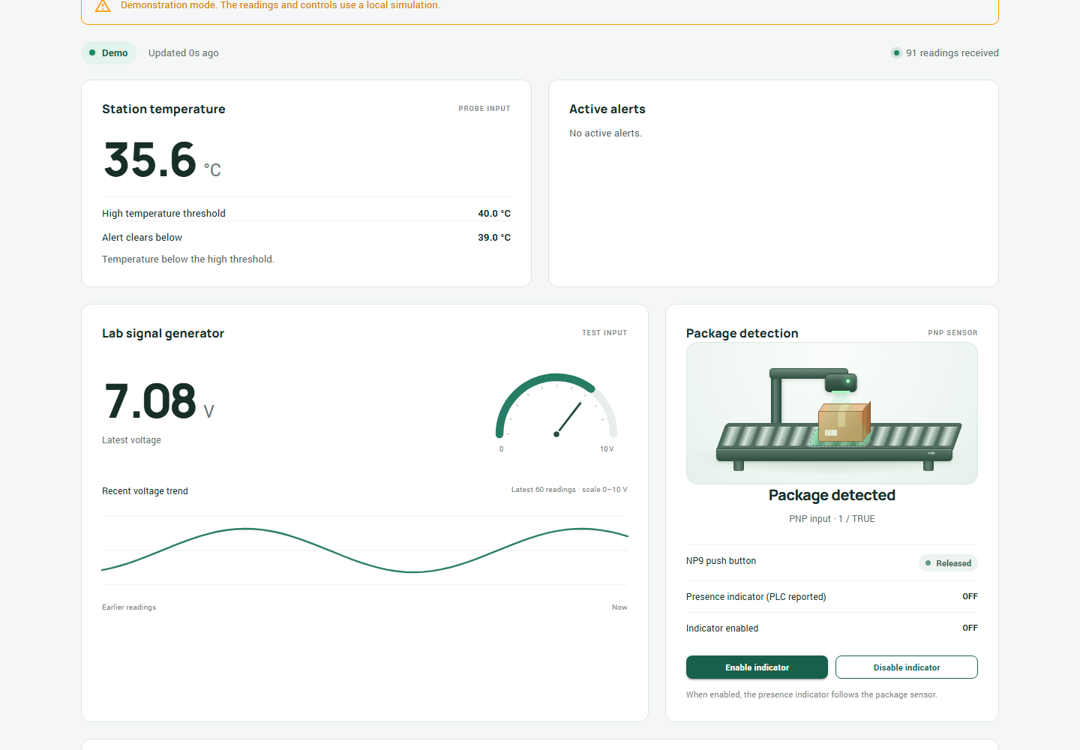
Dashboard and live observations
Earlier lab observations
DI2 and NP9 changed live. With a nominal 5 s PLC interval, some MQTT gaps were 17–19 s.
Live PLC revision
The PLC is in RUN and data is reaching the dashboard. State changes trigger publication, with a 1 s heartbeat target.
Software checks
PLC build had zero errors or warnings. All 41 local C# checks passed.
Dashboard capture in Demo mode
Implementation evidence
11
Notes:
Use the labelled Demo capture to orient the audience. It shows the earlier interface in simulation. The previous live checks observed DI2 and NP9 input changes and some MQTT arrival gaps of 17 to 19 seconds under a nominal five-second PLC interval. The new CODESYS application is in RUN and live data is reaching the dashboard. Digital state changes trigger publication and the heartbeat target is one second. Actual arrival depends on MQTT delivery. The dashboard flags stale telemetry after 15 seconds without an accepted reading. The C# checks were local and the probe and physical LED commissioning remain open.
Sources
CA2 package, PLC/Integration.md, implemented CODESYS CA2 AI1/DI1 project, and CA2 live session observations.
CA2 package, CA2_Lab_Validation.md and Software/VERIFICATION.md.
CA2-animated-dashboard.png, earlier CA2 Demo mode capture.

Slide 12
Remaining bench validation
Check | Acceptance evidence
Temperature path | Identify the probe and converter. Map the verified path and compare its reading with a reference.
Threshold and recovery | Demonstrate a live raise at 40 °C, a held alarm at 39 °C and recovery below 39 °C.
Physical command response | Show NP9 hold, release, Reset hold and separately Enable or Disable. Compare the physical LED with PLC feedback.
Fault and recovery | Observe stale or invalid quality, retain the last valid value with age, then show recovery.
As-built documentation | Complete the wiring drawing and hardware specifications using the actual bench configuration.
Record observed settings, timestamps and evidence in the written specification.
Implementation and acceptance
12
Notes:
Close with the actual pending tests. Once the probe and physical LED are available, use the CA2 lab validation table to capture the full results. Run a safe simulated fault and record both alert and recovery. Photograph actual hardware only when it can be identified and its relation to the test is clear. Use the Word document for the full Question 2 design specification.
Sources
Wawasan Open University, TMS202/04 Assignment 2, September 2026, Question 2 and marking rubric.
CA2 package, CA2_Lab_Validation.md and Software/VERIFICATION.md.

