Slide 1
AUTOWALA .Com – Your One-Stop Transport Booking Solution
Seamless Booking for Autos, Bikes, and Cabs
Presented by
G. Narendra Reddy
Ch. Pradeep
Ch. Lakshmi Nandan
guided by
Dr. K. Jayasakthi Velmurugan

Slide 2
INDEX
Problem statement
Introduction
Objective
Existing system
Proposed system
Flowchart for proposed system
Softwares used
Modules
Conclusion

Slide 3
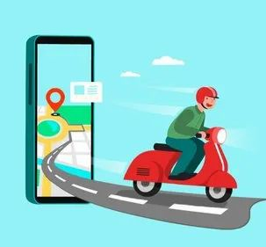
PROBLEM STATEMENT
In today's fast-paced world, finding reliable and efficient transportation can be a challenge.
People often face issues like:
Long wait times for vehicles
Inconvenience of multiple apps for different vehicle types
Unpredictable pricing and service quality
In many urban areas, finding reliable and convenient transportation options can be a significant challenge.
difficulty in locating available drivers, and lack of transparency in pricing.
drivers canceling services or asking for extra money is crucial for maintaining trust and satisfaction in your transportation booking platform

Slide 4
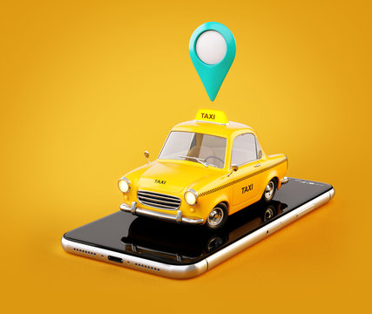
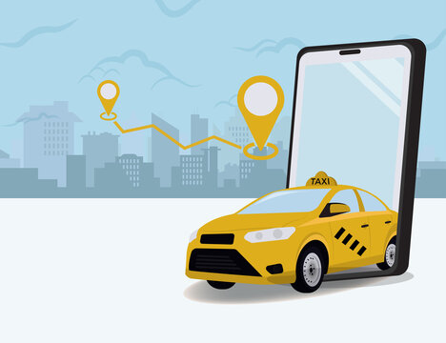
INTRODUCTION
Auto wala addresses these issues by providing a unified platform for booking autos, bikes, and cabs.
Our goal is to make transportation booking: Convenient
One app for all types of transportation
Transparent: Clear pricing and service quality standards
With the rapid urbanization and the increasing reliance on technology, a robust and user-friendly cab booking system has become a necessity for urban commuters
The Auto wala Cab Booking System aims to address this demand by providing a seamless platform for users to register, log in, and book cabs with ease.
The Auto wala Cab Booking System is designed to offer a comprehensive solution for both users and administrators
For users, it provides an intuitive interface to manage their transportation needs, from registration and logging in to booking cabs and viewing booking history. For administrators, it offers powerful tools to manage users and bookings, ensuring smooth operation and optimal service delivery.

Slide 5
OBJECTIVE
Introduce "Auto wala," a comprehensive platform for booking autos, bikes, and cabs.
Ensure accurate estimated times of arrival (ETAs) and reliable vehicle availability Reduces wait times and uncertainty, leading to a more dependable and efficient service.
Develop a robust, user-friendly, and secure web-based cab booking system named "Autowala" to enhance the convenience and efficiency of booking cabs
The system will address the shortcomings of existing systems by providing a streamlined user experience, efficient booking processes, and reliable service delivery.

Slide 6
Existing system
Existing systems often fail to provide real-time updates on cab availability, leading to instances where users book a cab only to find out later that no cabs are available.
Users frequently experience booking failures due to technical glitches or system downtime, which can be highly inconvenient.
Storing sensitive information, such as passwords and payment details, without proper encryption can expose users to significant risks.
Storing sensitive information, such as passwords and payment details, without proper encryption can expose users to significant risks.

Slide 7
Proposed system
Simplified Registration: Users can quickly register by providing essential details (name, email, phone number, password). The process is designed to be quick and user-friendly, reducing the drop-off rate.
Secure Login: Registered users can log in securely using their email and password. Passwords are encrypted to ensure security.
Personalized User Profiles: Enables users to create, modify, and input personal information, settings, and generate and display ride suggestions and archives, all relevant and specific.Real-Time Notifications: Gives notification on the status of the ride, the arrival time of the driver, and any change, and thus keeps the users active during the journey.
Customer Support:
Multiple Support Channels: Provide users with various support channels, including chat, email, and phone support, to address their queries and issues promptly.
Quick Response Times: Ensure that users receive timely assistance, enhancing their overall experience with the service.
Establish clear agreements with drivers about cancellation policies. Include penalties for frequent cancellations to discourage this behavior
Set fixed rates for different types of rides to prevent drivers from asking for extra money.

Slide 8
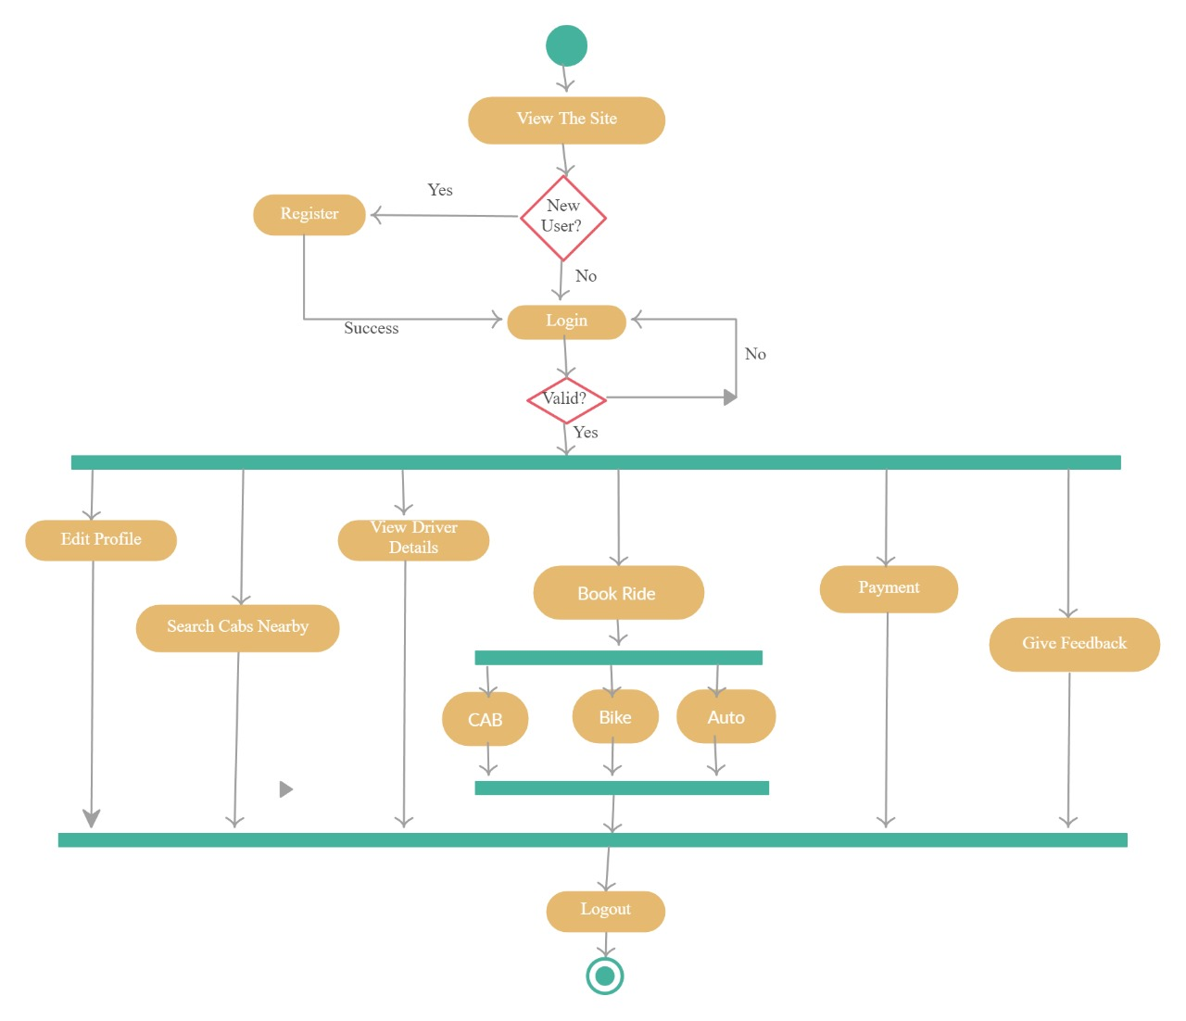
Flow chart for proposed system

Slide 9


SOFTWARES USED
Xampp control panel
is a free and open-source cross-platform web server solution stack package developed by Apache Friends. It provides a local development environment for building and testing PHP-based applications. XAMPP stands for X (cross-platform), A (Apache), M (MySQL), P (PHP), and P (Perl).
Chrome browser
making it an essential tool for
web development and testing.

Slide 10
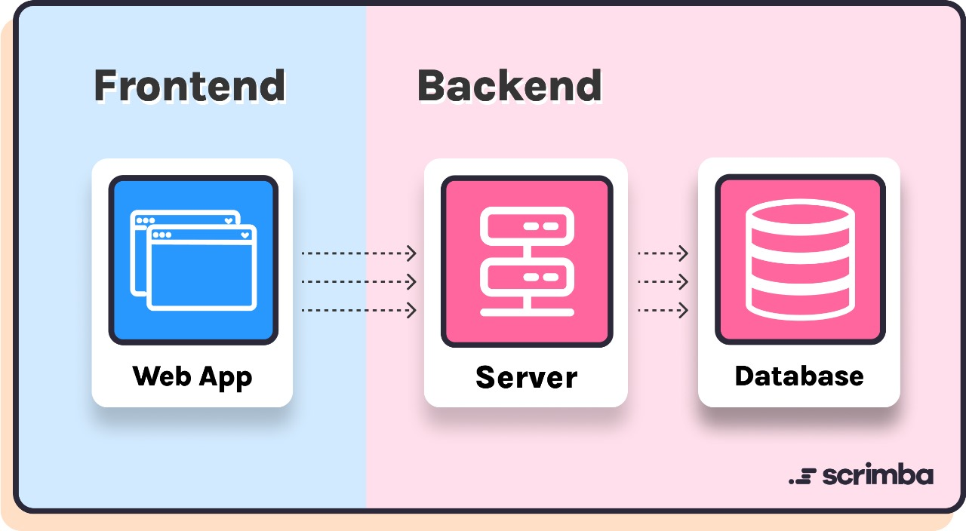
Modules
Frontend:
HTML: Structure of web pages.
CSS: Styling and layout of the web interface.
JavaScript: Client-side scripting for dynamic interactions and form validations
Backend:
PHP: Server-side scripting to handle user requests, process data, and interact with the database.
MySQL: Database management system to store user information, booking details, and other necessary data.

Slide 11

OUTPUTS
Home page

Slide 12
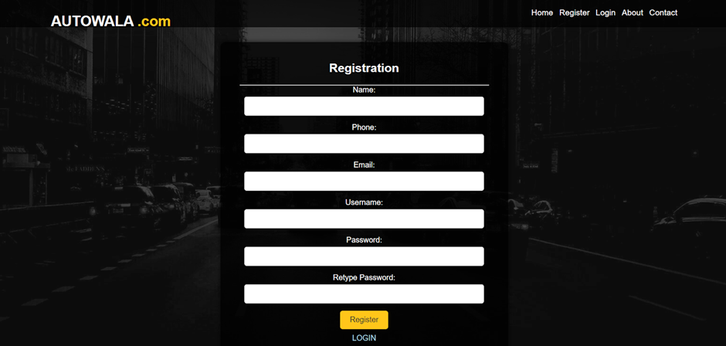
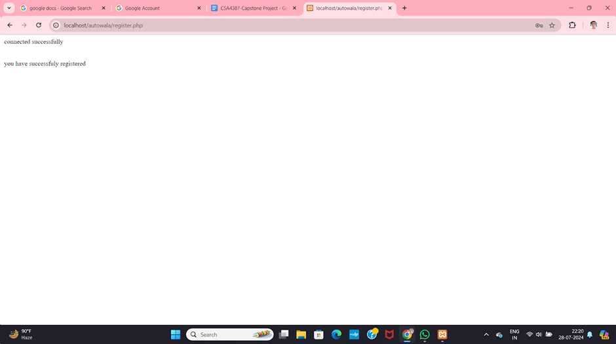
OUTPUT
Registration page
Server Response

Slide 13
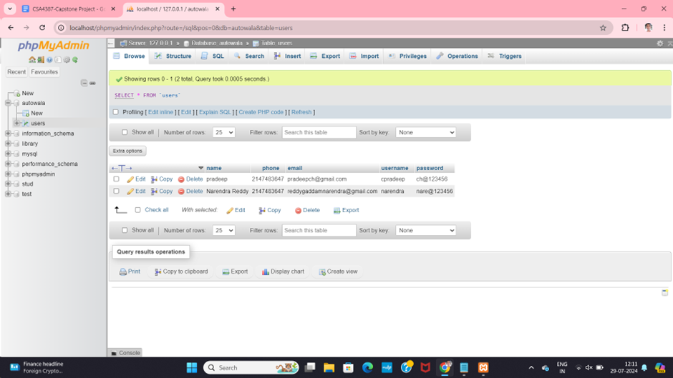
OUTPUT
DATABASE

Slide 14
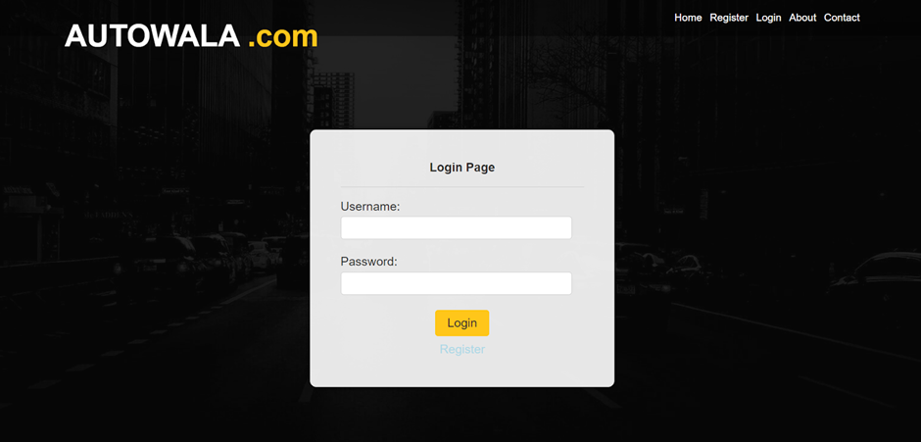
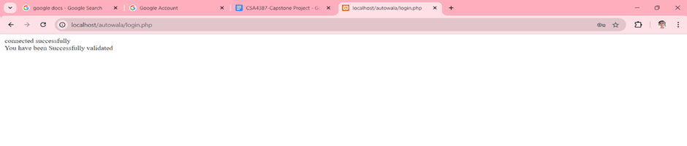
OUTPUT
Login page
Server Response

Slide 15
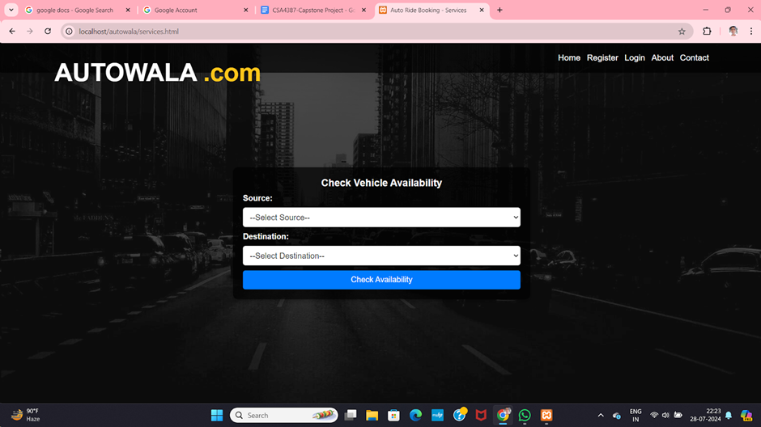
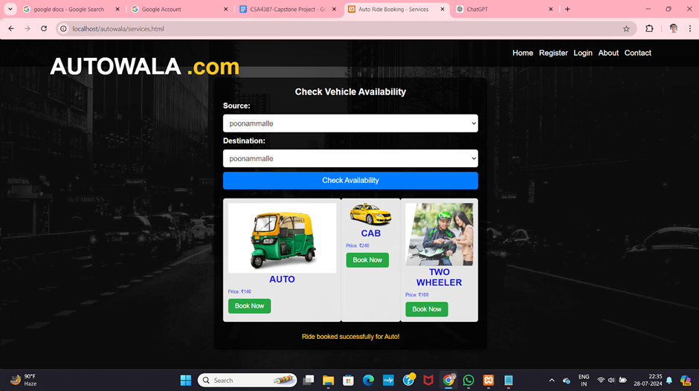
Services page

Slide 16
CONCLUSION
AUTOWALA.com stands at the forefront of urban transportation innovation, offering a unified and dynamic platform that integrates cabs, autos, and bikes into a seamless user experience.
By leveraging a modular design, the platform ensures high efficiency, flexibility, and scalability, addressing both current and future mobility needs.
Its advanced features—such as real-time tracking, dynamic pricing, and secure payment processing—combine to deliver a superior travel experience while tackling urban congestion and environmental impact.
As it stands, AUTOWALA.com not only meets but exceeds the demands of modern city commuters, setting a new standard in urban transportation management

Slide 17
Thank You

