Slide 1
Saltstack
Manika bedi

Slide 2
What is Saltstack?
SaltStack is an open-source configuration management and remote execution engine.
It remotely executes commands across all machines.
It is a python based software.
Thomas S Hatch is the creator and the principal architect of SaltStack.
SaltStack uses the ZeroMQ messaging library to process high-speed requirements for all networking layers.
Salt is simple, scalable and fast.

Slide 3
Saltstack continued
Salt is a very powerful automation framework.
Salt architecture is based on the idea of executing commands remotely.
Salt is designed to allow users to explicitly target and issue commands to multiple machines directly.
Salt is based around the idea of a Master, which controls one or more Minions.
The Salt Master runs on Linux by default, but any operating system can be a minion, and currently Windows, VMware vSphere and BSD Unix variants are well supported.

Slide 4
Need for saltstack
SaltStack is built for speed and scale.
This is why it is used to manage large infrastructures with tens of thousands of servers at LinkedIn, WikiMedia and Google.
Assume you have ten or maybe even 100 servers.
Imagine logging in one at a time to each server individually, issuing the same commands on those 100 machines and then editing the configuration files on all 100 machines becomes very tedious task.
SaltStack provides you exactly the solution for all such problems.
Notes:
Let us assume you have ten or maybe even 100 servers. Imagine logging in one at a time
to each server individually, issuing the same commands on those 100 machines and then
editing the configuration files on all 100 machines becomes very tedious task. To overcome
those issues, you would love to update all your servers at once, just by typing one single
command. SaltStack provides you exactly the solution for all such problems.

Slide 5
Features of SaltStack
Fault tolerance
Flexible
Scalable Configuration Management
Parallel Execution model
Python API
Easy to Setup
Language Agnostic
Notes:
Fault tolerance – Salt minions can connect to multiple masters at one time by
configuring the master configuration parameter as a YAML list of all the available
masters. Any master can direct commands to the Salt infrastructure.
• Flexible –The entire management approach of Salt is very flexible. It can be
implemented to follow the most popular systems management models such as
Agent and Server, Agent-only, Server-only or all of the above in the same
environment.
• Scalable Configuration Management – SaltStack is designed to handle ten
thousand minions per master.
• Parallel Execution model – Salt can enable commands to execute remote
systems in a parallel manner.
• Python API – Salt provides a simple programming interface and it was designed
to be modular and easily extensible, to make it easy to mold to diverse applications.
• Easy to Setup – Salt is easy to setup and provides a single remote execution
architecture that can manage the diverse requirements of any number of servers.
• Language Agnostic – Salt state configuration files, templating engine or file type
supports any type of language.

Slide 6
Benefits of SaltStack
Robust
Authentication
Secure
Fast
Virtual Machine Automation
Infrastructure as data, not code
Notes:
Robust – Salt is powerful and robust configuration management framework and
works around tens of thousands of systems.
• Authentication – Salt manages simple SSH key pairs for authentication.
• Secure – Salt manages secure data using an encrypted protocol.
• Fast – Salt is very fast, lightweight communication bus to provide the foundation
for a remote execution engine.
• Virtual Machine Automation – The Salt Virt Cloud Controller capability is used
for automation.
• Infrastructure as data, not code – Salt provides a simple deployment,
model-driven configuration management and command execution framework.

Slide 7
Introduction to ZeroMQ
Salt is based on the ZeroMQ library and it is an embeddable networking library.
It is lightweight and a fast messaging library.
ZeroMQ is a broker-less peer-peer message processing.
ZeroMQ comes with the following five basic patterns:
Synchronous Request/Response
Asynchronous Request/Response
Publish/Subscribe
Push/Pull
Exclusive Pair
Notes:
Synchronous Request/Response – Used for sending a request and receiving
subsequent replies for each one sent.
• Asynchronous Request/Response – Requestor initiates the conversation by
sending a Request message and waits for a Response message. Provider waits for
the incoming Request messages and replies with the Response messages.
• Publish/Subscribe – Used for distributing data from a single process (e.g.
publisher) to multiple recipients (e.g. subscribers).
• Push/Pull – Used for distributing data to connected nodes.
• Exclusive Pair – Used for connecting two peers together, forming a pair.

Slide 8
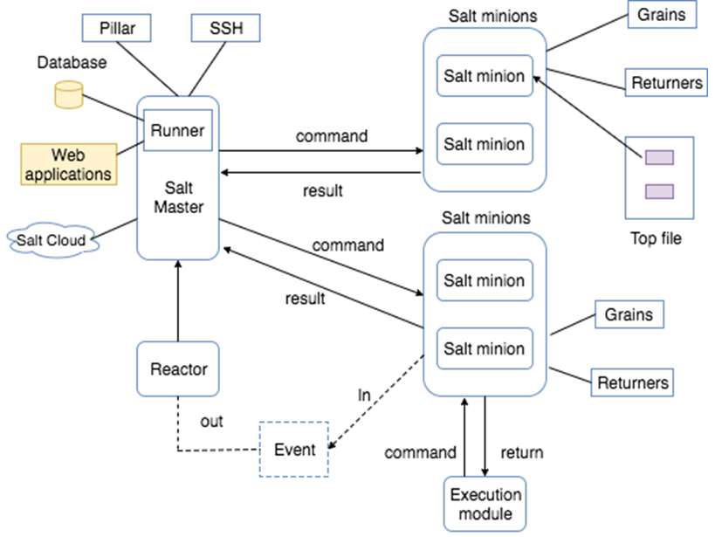
SALTSTACK ARCHITECTURE
Notes:
The architecture of SaltStack is designed to work with any number of servers, from local
network systems to other deployments across different data centers. Architecture is a
simple server/client model with the needed functionality built into a single set of daemons.
SaltMaster – SaltMaster is the master daemon. A SaltMaster is used to send
commands and configurations to the Salt slaves. A single master can manage
multiple masters.
• SaltMinions – SaltMinion is the slave daemon. A Salt minion receives commands
and configuration from the SaltMaster.
• Execution – Modules and Adhoc commands executed from the command line
against one or more minions. It performs Real-time Monitoring.
Formulas – Formulas are pre-written Salt States. They are as open-ended as Salt
States themselves and can be used for tasks such as installing a package,
configuring and starting a service, setting up users or permissions and many other
common tasks.
• Grains – Grains is an interface that provides information specific to a minion. The
information available through the grains interface is static. Grains get loaded when
the Salt minion starts. This means that the information in grains is unchanging.
Therefore, grains information could be about the running kernel or the operating
system. It is case insensitive.
• Pillar – A pillar is an interface that generates and stores highly sensitive data
specific to a particular minion, such as cryptographic keys and passwords. It stores
data in a key/value pair and the data is managed in a similar way as the Salt State
Tree.
• Top File - Matches Salt states and pillar data to Salt minions.
• Runners – It is a module located inside the SaltMaster and performs tasks such
as job status, connection status, read data from external APIs, query connected
salt minions and more.
• Returners – Returns data from Salt minions to another system.
• Reactor – It is responsible for triggering reactions when events occur in your
SaltStack environment.
• SaltCloud – Salt Cloud provides a powerful interface to interact with cloud hosts.
• SaltSSH – Run Salt commands over SSH on systems without using Salt minion

Slide 9
SaltStack – Installation
An Access Control System provides options for a user or a group to execute a task with permissions.
A Salt access control system is used to configure access to non-administrative control interfaces.
You can apply this process to all the systems.
This control helps the non-administrative users to execute the Salt commands.
Salt interfaces are of the following three types:
Publisher ACL system
External Auth system
Peer system

Slide 10
SaltStack – Access Control System

Slide 11
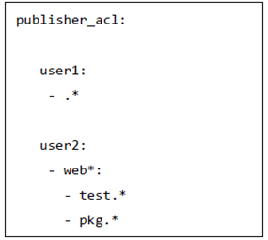
Publisher ACL System
A Publisher ACL system allows access to the users other than root to execute Salt commands on minions from the master.
The publisher ACL system is configured in the master configuration file via the publisher_acl configuration option.
user1 is allowed to execute anything.
user2 is allowed to use test and pkg, but only on “web*” minions.
Notes:
Here,
• user1 is allowed to execute anything.
• user2 is allowed to use test and pkg, but only on “web*” minions.

Slide 12
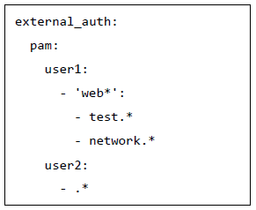
External Auth System
The external auth system is used to provide access to execute salt commands on specific minions through external authorization system like PAM, LDAP, etc.
user1 is allowed to execute functions in the test and network modules on the minions that match the web* target.
user2 is allowed to execute all the functions.

Slide 13
Enable the External Auth System in Command
Salt server provides an option ‘–a’ to enable external authentication.
salt -a pam web\* test.ping
The -a pam option is used to enable PAM external authentication.
Salt Server will ask for authentication details whenever we execute the command.
To restrict Salt Server from asking the authentication details for the first time only, we can use the -T option.
salt –T -a pam web\* test.ping
Notes:
This -T option caches the authentication details for the next 12 hours (default setting) and
use it to authenticate the users.

Slide 14
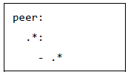
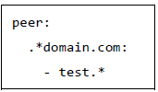
Peer System
Salt minions can pass commands using the peer interface.
The peer interface is configured through the master configuration file either to allow minions to send commands from the master using the peer configuration section or to allow minions to execute runners from the master using the peer_run configuration.
The simple configuration to be defined in master file is as here:
To assign minions to specific ID’s, the configuration needs to be defined as shown here:
Notes:
The simple configuration to be defined in master file is as above:
Here, It enables communication for all minions, but it is only recommended for very secure
environments.

Slide 15
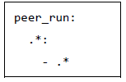
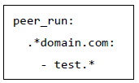
peer_run Configuration
This configuration is to allow minions to execute runners from the master using the peer_run option on the master file.
The following example is to allow access to all minions and to all the runners.
To assign minions to a specific ID, the configuration needs to be defined as given below:

Slide 16
How to Execute Commands
To execute test.ping on all the minions, use the salt-call command along with the publish.publish module.
salt-call publish.publish \* test.ping
To execute runner, use the salt-call command along with the publish.runner module.
salt-call publish.runner manage.up

Slide 17
SaltStack – Job Management
Salt has the capability of high-speed communication with a large number of systems.
This approach helps Salt to make a powerful multitasking system.
Salt can run jobs on more than one systems, so Salt uses job management technique to manage each job running on all the systems.

Slide 18
What is a Job ID?
Salt has cache directory, cachedir.
Inside this, a directory that minions maintain is called as the proc directory.
It is located in the following directory /var/cache/salt/proc.
The proc directory is used to maintain all the files.
When these files are executed, they assign with a unique job ID.
This job id helps to identify the current running jobs on the minion and allow the jobs to be looked up.

Slide 19
SALTUTIL Module
Salt introduces a new module that is called as the Saltutil job management process.
This module contains different functions to manage jobs.
These functions are used to manage jobs at the minion level.
running – Returns all the running jobs data that are found in the proc directory.
find_job – Returns specific data about a certain job based on the job id.
signal_job – Allows a given job id(jid) to be sent a signal.
term_job – Sends a termination signal for the specified job.
kill_job – Sends a kill signal for the specified job.

Slide 20
Jobs Runner
The jobs runner contains functions to make viewing data easier and cleaner. It has different functions.
ACTIVE Function: The Active function is used to identify which jobs are still running and check what systems have completed a job and what systems are still being waited on. It is executed using the following command,
salt-run jobs.active
LOOKUP_JID Function: The lookup_jid runner will display the data for the current looking job. These jobs are configured via the keep_jobs option in the master configuration. It is executed using the following command.
salt-run jobs.lookup_jid <job id number>
LIST_JOBS Function: The List_jobs function is used to list out the job data for jobs. It is expressed by the following command:
salt-run jobs.list_jobs

Slide 21
Job Scheduling
The schedule system exposes the execution of any execution function on minions or any runner on the master.
It is performed by the following methods:
Schedule – The schedule option in either the master or the minion config files.
Minion pillar data – It refreshes the minion pillar data using the saltutil.refresh_pillar command.
The schedule state or schedule module.

Slide 22
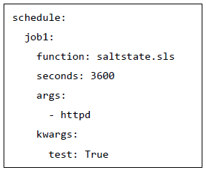
SALT STATES
Salt states are executed on the minion.
You can pass the positional arguments and provide a YAML dict of the named arguments in the config file as shown
job1 will execute the function saltstate.sls with the specified arguments, httpd for every hour.
The test: True is the additional argument for the httpd command that
is defined in saltstate.sls.

Slide 23
SaltStack – Salt File Server
The Salt file server is a stateless ZeroMQ server.
It is built into the Salt master.
A Salt file server is used for distributing files from master to minions.
It contains different modules.

Slide 24

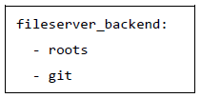
File Server Backend
The file server backend allows the Salt file server to act as a transparent interface to other file server like a local file system, Git version control system, etc.
A Git file server backend can be enabled by using the following configuration in the master file.
To enable multiple backend file system, we can use the following configuration.

Slide 25
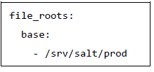
Local File System
For using this system, we have to use the following code.

Slide 26

Git File System
For using this system, we have to use the following code.

Slide 27
Requesting Files
Salt has the option to request files for specific environments.
salt://path/to/file?saltenv=base

Slide 28
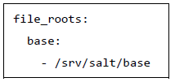
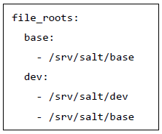
File Server Configuration
Salt files can be allocated within many root directories and accessed by specifying both the file path and the environment to search.
The individual environments can span across multiple directory roots.
Environment
The default environment is base.
This environment is defined and is used to download files when no other environment is specified.
You can also use multiple environments as shown

Slide 29
CP Module
The CP module is the main module to manipulate the Salt file server.
The salt-cp command can also be used to distribute files presented by the Salt file server.
GET_FILE
The cp.get_file function can be used on the minion to download a file from the master.
It is defined as shown in the following code block.
salt '*' cp.get_file salt://vimrc /etc/vimrc
The above command instructs all Salt minions to download the vimrc file and copy it to /etc/vimrc.

Slide 30
Enable Template
You can enable template option in get_file as follows:
salt '*' cp.get_file "salt://vimrc" /etc/vimrc template=jinja

Slide 31
Apply Compression
To use compression, use the gzip named argument.
The valid values are integers from 1 to 9, where 1 is the minimum compression and 9 is maximum value.
The command is defined as follows:
salt '*' cp.get_file salt://vimrc /etc/vimrc gzip=5

Slide 32
GET_DIR
The cp.get_dir function can be used on the minion to download an entire directory from the master.
It is defined in the following code block.
salt '*' cp.get_dir salt://etc/mysql /etc
The cp.get_dir supports template rendering and gzip compression arguments.
If you want, you can assign as well.

Slide 33
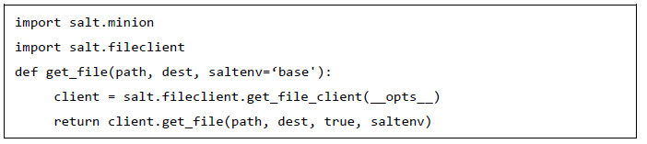
FILECLIENT Module
Salt provides a python module that helps to access the salt file server.
The salt/fileclient.py module is used to set up the communication from the minion to the master.
The sample code to get files is as follows:
Notes:
Here,
• opts is available when the module is run in the salt environment. Otherwise, we
should provide the configuration path – /etc/salt/minion.
• path refers to the path of the source file in salt file server.
• dest refers the destination path of the file.
• saltenv refers to the environment

Slide 34
SaltStack – Git as a File Server
Git is an open-source distributed version control system.
It can be used to keep a track of changes in any files.
Salt sends files from Git repositories using the Git file server.
You can configure Git to the fileserver_backend list option and if you need to configure one or more repositories, you can do so by using the gitfs_remotes option.

