Slide 1
CSE6012 - Image Processing And Analysis
Brain tumour detection
Vudatha Venkata Narendra 18BCE0515
Sharmila S 20MSC0048
Slot: F2 + TF2
Guided by: Dr Vijayarajan V

Slide 2
Abstract
Cancer, when it affects the most complex organ in the human body -Brain coined as a Brain tumor. Any growth of abnormal cells in a closed area like the brain will affect the major parts of our body and hence curing rate is very minimal. The exact cause of most brain tumors is unknown and the best way to avoid is prevention. The early diagnosis is still the best treatment usually done by CT (computed tomography) and MRI (magnetic resonance imaging). There are several methods to diagnose tumor but most of them are inaccurate, this affects the curing rate of the patients. Hence an accurate methodology is required to diagnose the tumor. In our system, the images obtained from the MRI are loaded in MATLAB for image sharpening and enhancement. the image will be converted from grayscale to binary image which then are processed with image division techniques like Watershed transform and Threshold segmentation. These results are then passed to perform the morphological operations by which we able to locate the tumors cells.

Slide 3
Keywords :-
Brain Tumour Detection
MRI Images
Feature Extraction
Pre-processing
Watershed segmentation
Morphological Operations
Tumour

Slide 4
Introduction :-
Cancer was the deadliest disease before the development of technology and remains to be the second leading cause of death worldwide. One-sixth of every death is due to cancer according to WHO and affects the mid and low-income countries a lot almost 70%. Development of unusual substance among the tissues in brain is coined as Tumour. Tumour Cells is a strange huddle of tissues wherein cells develop and duplicate wildly and apparently unchecked by the instruments that control the typical cells. Brain tumours are of two different types which may be primary or spreadable, and may be malignant or cordial. Tumours which spread vigorously commonly called metastatic which will spread from to other parts of body drastically.

Slide 5
Methodlogy :-
The algorithm has two stages, first is pre-processing of given MRI image and after that segmentation and then perform morphological operations. Steps of algorithm are as following: -
1) We Give the MRI picture of cerebrum as input.
2) Firstly, Convert the image to black and white (Gray scale) image.
3) Compute edge division technique.
4) Evaluate the watershed segmentation.
5) Determine the morphological activities.
6) Tumour region will be displayed as the output.

Slide 6
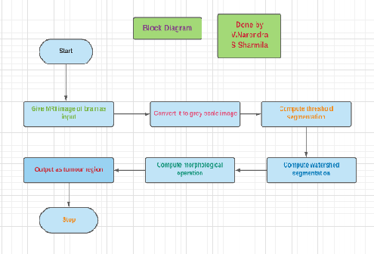
Block diagram :-
.

Slide 7
Code :-
%Code by Narendra and Sharmila
%Code for finding tumour in brain
I=imread('C:\Users\Nenkata Narendra\Desktop\brain_tumour-1.jpg');
figure, imshow(I); title('Brain MRI Image');
I = imresize(I,[200,200]);
%convert from rgb to grey
I= rgb2gray(I);
%now make the filter from grey to white black based on threshold
I= im2bw(I,.6);
figure, imshow(I);title('Thresholded Image');

Slide 8
Watershed
yfilter = fspecial('sobel');
xfilter = yfilter';
rempad_y = imfilter(double(I), yfilter, 'replicate');
rempad_x = imfilter(double(I), xfilter, 'replicate');
res_matrix = sqrt(rempad_x.^2 + rempad_y.^2);
Label_mat = watershed(res_matrix);
Labelmat_rgb = label2rgb(Label_mat);
figure, imshow(Labelmat_rgb), title('Watershed segmented image ')

Slide 9
Morphological operations
se = strel('disk', 20);
Io = imopen(I, se);
Ie = imerode(I, se);
Iobr = imreconstruct(Ie, I);
Iobrd = imdilate(Iobr, se);
Iobrcbr = imreconstruct(imcomplement(Iobrd), imcomplement(Iobr));
Iobrcbr = imcomplement(Iobrcbr);

Slide 10
Cont.
I2 = I;
fgm = imregionalmax(Iobrcbr);
I2(fgm) = 255;
se2 = strel(ones(5,5));
fgm2 = imclose(fgm, se2);
fgm3 = imerode(fgm2, se2);
fgm4 = bwareaopen(fgm3, 20);
I3 = I;
bw = im2bw(Iobrcbr);
figure
imshow(bw), title('only tumor')

Slide 11
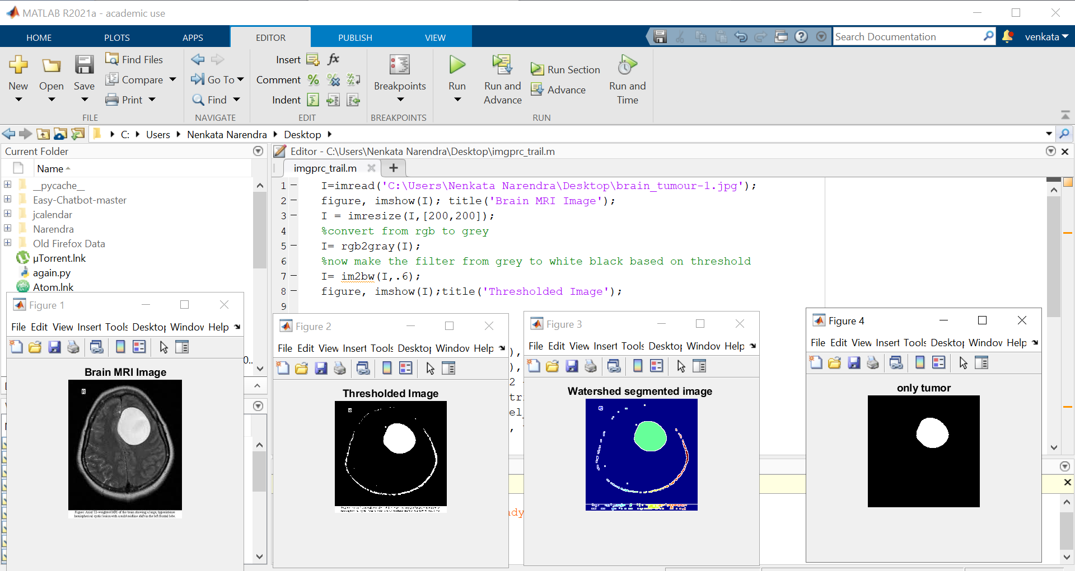
Output screenshots :-

Slide 12
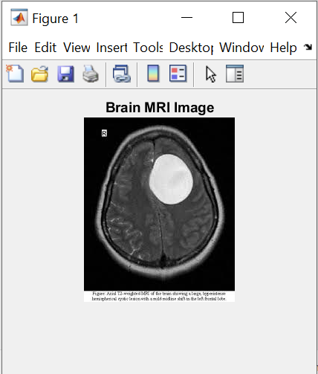
Original image

Slide 13
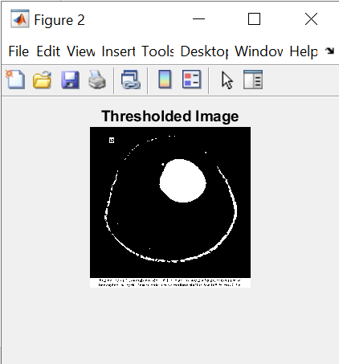
Threshold image

Slide 14
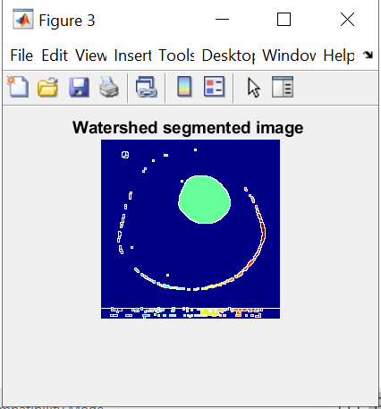
Watershed image

Slide 15
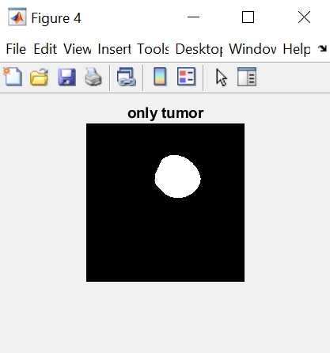
With tumour

Slide 16
Conclusion
The concept of a segmented brain tumour has been introduced. To begin, we employed image processing techniques to remove noise and enhance the image which will enlarge the segmentation accuracy level. With the proposed system we able to determine whether the given MRI brain image constitutes the well-being healthy brain or tumor brain .In light of the restricted data base, the proper recognition obtained is satisfactory and further work will be carried through with large sets of datasets .

Slide 17
References
1. Cui, B., Xie, M., & Wang, C. (2019, October). A Deep Convolutional Neural Network Learning Transfer to SVM-Based Segmentation Method for Brain Tumor. In 2019 IEEE 11th International Conference on Advanced Infocomm Technology (ICAIT) (pp. 1-5). IEEE.
2. Abbas, K., Khan, P. W., Ahmed, K. T., & Song, W. C. (2019, October). Automatic Brain Tumor Detection in Medical Imaging using Machine Learning. In 2019 International Conference on Information and Communication Technology Convergence (ICTC) (pp. 531-536). IEEE.
3. Halder, A., & Dobe, O. (2016, September). Detection of tumor in brain MRI using fuzzy feature selection and support vector machine. In 2016 International Conference on Advances in Computing, Communications and Informatics (ICACCI) (pp. 1919-1923). IEEE.

Slide 18
4.Baranwal, S. K., Jaiswal, K., Vaibhav, K., Kumar, A., & Srikantaswamy, R. (2020, July). Performance analysis of Brain Tumour Image Classification using CNN and SVM. In 2020 Second International Conference on Inventive Research in Computing Applications (ICIRCA) (pp. 537-542). IEEE.
5.Mathew, A. R., & Anto, P. B. (2017, July). Tumor detection and classification of MRI brain image using wavelet transform and SVM. In 2017 International Conference on Signal Processing and Communication (ICSPC) (pp. 75-78). IEEE.
6. Gurbină, M., Lascu, M., & Lascu, D. (2019, July). Tumor detection and classification of MRI brain image using different wavelet transforms and support vector machines. In 2019 42nd International Conference on Telecommunications and Signal Processing (TSP) (pp. 505-508). IEEE.
7. Kharrat, A., & Mahmoud, N. E. J. I. (2019). Feature selection based on hybrid optimization for magnetic resonance imaging brain tumor classification and segmentation. Applied Medical Informatics., 41(1), 9-23.
8. Badran, E. F., Mahmoud, E. G., & Hamdy, N. (2010, November). An algorithm for detecting brain tumors in MRI images. In The 2010 International Conference on Computer Engineering & Systems (pp. 368-373). IEEE.
9. Divyamary, D., Gopika, S., Pradeeba, S., & Bhuvaneswari, M. (2020, March). Brain Tumor Detection from MRI Images using Naive Classifier. In 2020 6th International Conference on Advanced Computing and Communication Systems (ICACCS) (pp. 620-622). IEEE.
10. Rase, S., & Bijwe, K. (2017). A survey on detection of brain tumor from MRI Brain Images. International Journal of Management, IT and Engineering, 7(1), 35-41.

