Slide 1

PROJECT ON
RETAIL BANKING TRANSACTION ANALYSIS
A Database Using MySQL
Presented by :
Alupana Narendra Reddy

Slide 2
Agenda
➢ Business Problem
➢ Problem Statement
➢ Objectives
➢ Data Description
➢ ER Diagram
➢ SQL Analysis Framework
➢ Basic Analysis
➢ Customer Insights
➢ Account & Branch Analysis
➢ Transaction Analysis
➢ Loan Analysis
➢ Card & Product Engagement
➢ Key Business Insights
➢ Conclusion & Future Scope
➢ Business Recommendation
02

Slide 3
Business Problem
➢ A retail bank manages interconnected information across customers, accounts, branches, transactions, loans, loan payments and cards.
➢ Management needs a structured way to understand customer behaviour, account activity, transaction patterns, loan performance and product usage.
➢ A relational MySQL database connects these business entities and supports repeatable SQL analysis.
➢ The analysis should convert operational banking records into useful business understanding and decisions.
03

Slide 4
Problem Statement & Objectives
Problem Statement
Develop a structured MySQL database and use SQL analysis to understand customer relationships, account usage, transaction behaviour, loan performance and card engagement.
Objectives
➢ Build and validate the relational database from the ER model.
➢ Answer Sprint 3 basic analysis questions.
➢ Formulate and answer Sprint 4 objective-based questions.
➢ Interpret SQL outputs into findings, recommendations and business insights.
04

Slide 5
Data Description
Table Name | Description
customers | Customer master data
accounts | Bank account information
branches | Branch master data
loans | Loan portfolio information
loan_payments | Loan repayment history
cards | Card product information
transactions | Customer account activity
500 customers • 700 accounts • 40 branches • 300 loans • 2,000 loan payments • 600 cards • 5,000 transactions
05

Slide 6
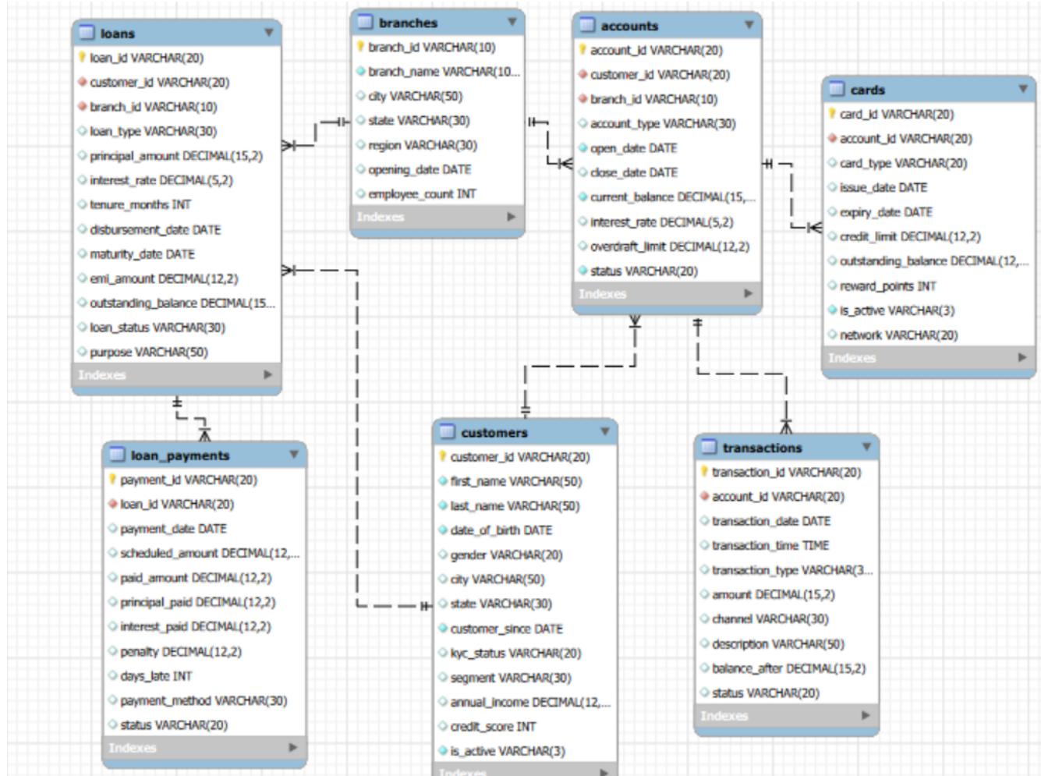
ER Diagram
06

Slide 7
SQL Analysis Framework
Analysis Area | Focus
Customer Insights | Segmentation, demographics, income, credit score, activity and tenure
Account & Branch | Account types, balances, status, branch activity and interest rates
Transaction Analysis | Transaction types, channels, amounts, descriptions and time
Loan Performance | Loan types, balances, status, delays, penalties and payment methods
Card & Engagement | Card types, credit limits, balances, reward points and cross-product usage
07

Slide 8
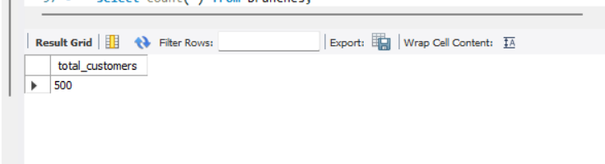
SQL ANALYSIS
How many customers are there in the database?
Query :
Output :
Explanation :
The query counts every record in the customers table. The output shows 500 customers, giving the bank a clear view of the size of its customer base.
RETAIL BANKING TRANSACTION ANALYSIS
08

Slide 9
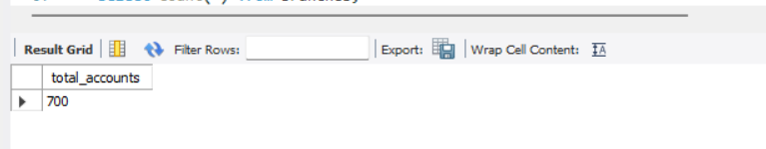
SQL ANALYSIS
How many accounts are there in the database?
Query :
Output :
Explanation :
The query counts every record in the accounts table. The output shows 700 accounts, indicating the overall number of accounts maintained in the database.
RETAIL BANKING TRANSACTION ANALYSIS
09

Slide 10
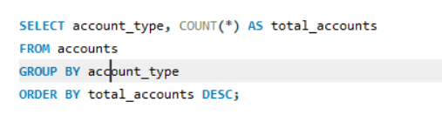
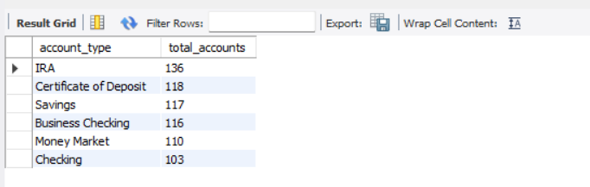
SQL ANALYSIS
What are the different account types and how many accounts does each type have?
Query :
Output :
Explanation :
The query groups accounts by account_type and sorts the categories by account count. IRA is the most common type with 136 accounts, followed by Certificate of Deposit and Savings.
RETAIL BANKING TRANSACTION ANALYSIS
10

Slide 11
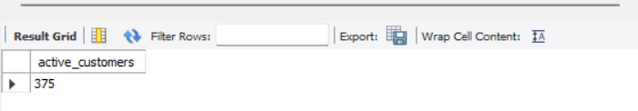
SQL ANALYSIS
How many customers are currently active?
Query :
Output :
Explanation :
The query filters customers where is_active is 'Yes' and counts them. The output shows 375 active customers, which helps measure the currently engaged customer base.
RETAIL BANKING TRANSACTION ANALYSIS
11

Slide 12
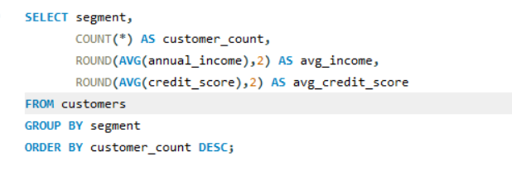
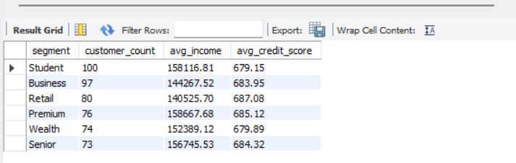
SQL ANALYSIS
How do customer segments differ by customer count, average income and credit score?
Query :
Output :
Explanation :
The query groups customers by segment and calculates customer count, average income and average credit score. Student is the largest segment with 100 customers, while Premium has the highest average income.
RETAIL BANKING TRANSACTION ANALYSIS
12

Slide 13

SQL ANALYSIS
How many years, on average, have customers been with the bank?
Query :
Output :
Explanation :
The query calculates customer tenure from customer_since to the latest transaction date. The result is 7.38 years on average, showing that customers have a long-term relationship with the bank.
RETAIL BANKING TRANSACTION ANALYSIS
13

Slide 14
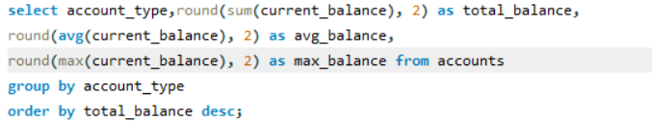
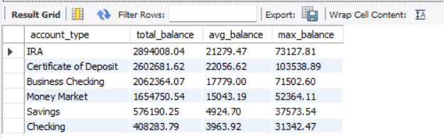
SQL ANALYSIS
Which account types have the highest total and average balances?
Query :
Output :
Explanation :
The query groups accounts by account type and compares total, average and maximum balances. IRA has the highest total balance, while Certificate of Deposit has the highest average balance.
RETAIL BANKING TRANSACTION ANALYSIS
14

Slide 15
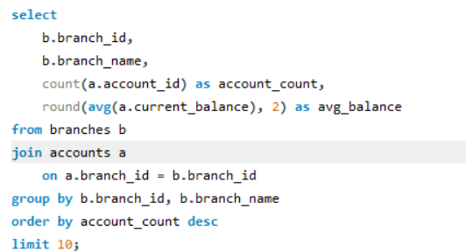
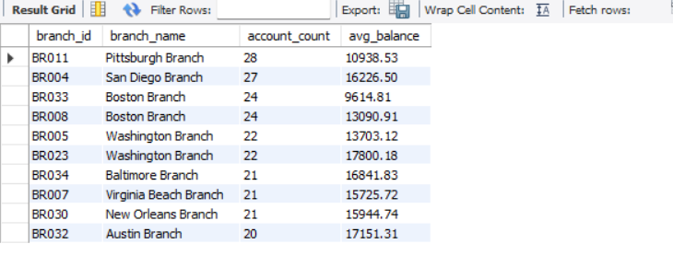
SQL ANALYSIS
Which branches have the highest number of accounts?
Query :
Output :
Explanation :
The query joins branches with accounts, counts accounts for each branch and ranks them in descending order. Pittsburgh Branch has the highest account count in the displayed result.
RETAIL BANKING TRANSACTION ANALYSIS
15

Slide 16
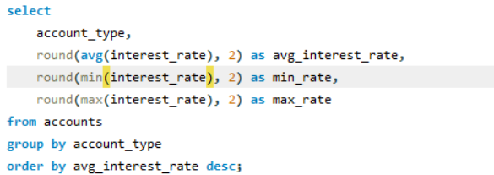
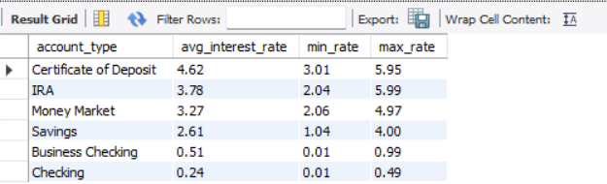
SQL ANALYSIS
Which account types have the highest average interest rates?
Query :
Output :
Explanation :
The query groups accounts by account type and compares average, minimum and maximum interest rates. Certificate of Deposit has the highest average interest rate at 4.62%.
RETAIL BANKING TRANSACTION ANALYSIS
16

Slide 17
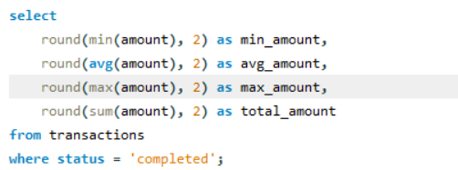

SQL ANALYSIS
What are the minimum, average, maximum and total completed transaction amounts?
Query :
Output :
Explanation :
The query calculates the minimum, average, maximum and total value of completed transactions. The average completed transaction amount is 6,502.70 and the total is 10,976,552.36.
RETAIL BANKING TRANSACTION ANALYSIS
17

Slide 18
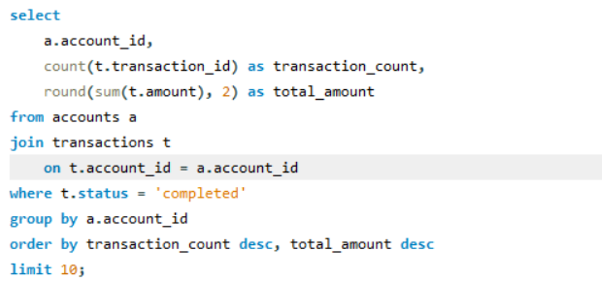
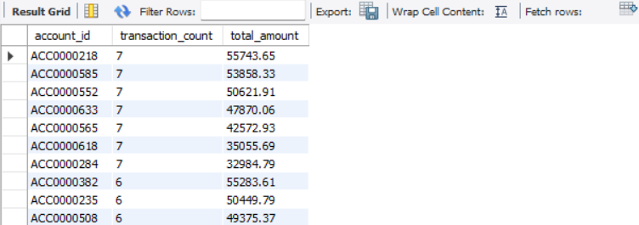
SQL ANALYSIS
Which accounts have the highest number of completed transactions?
Query :
Output :
Explanation :
The query joins accounts with transactions, keeps completed transactions and ranks accounts by transaction count. The displayed result shows several accounts with the highest frequency of 7 completed transactions.
RETAIL BANKING TRANSACTION ANALYSIS
18

Slide 19
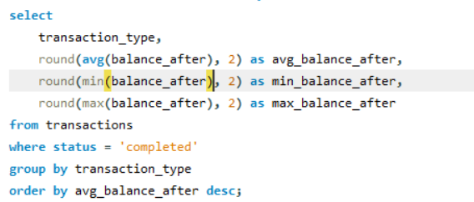
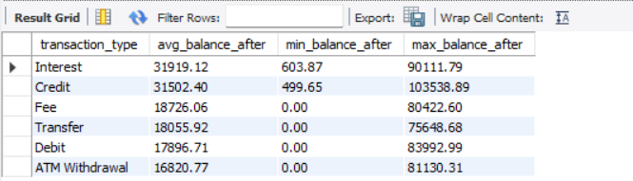
SQL ANALYSIS
How do transaction types affect the average account balance after a transaction?
Query :
Output :
Explanation :
The query groups completed transactions by transaction type and compares the average balance after the transaction. Interest transactions have the highest average balance after completion.
RETAIL BANKING TRANSACTION ANALYSIS
19

Slide 20
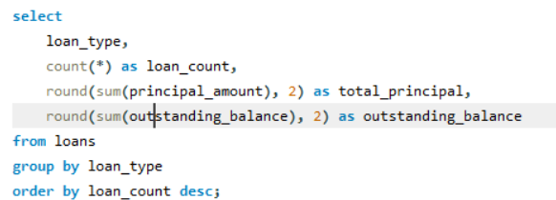
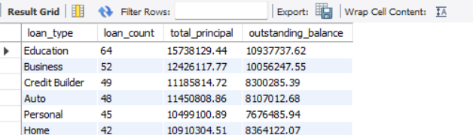
SQL ANALYSIS
Which loan types have the highest loan counts and outstanding balances?
Query :
Output :
Explanation :
The query groups loans by loan type and compares the loan count, total principal and outstanding balance. Education is the largest loan category in the displayed output.
RETAIL BANKING TRANSACTION ANALYSIS
20

Slide 21
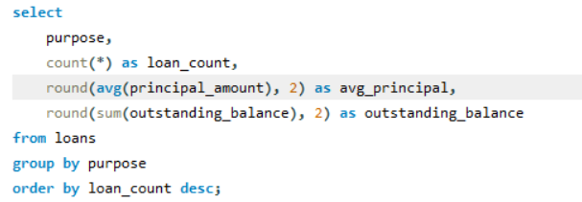
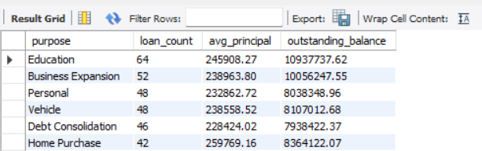
SQL ANALYSIS
Which loan purposes are most common and what are their average principal amounts?
Query :
Output :
Explanation :
The query groups loans by purpose and compares the loan count, average principal and outstanding balance. Education is the most common purpose with 64 loans.
RETAIL BANKING TRANSACTION ANALYSIS
21

Slide 22
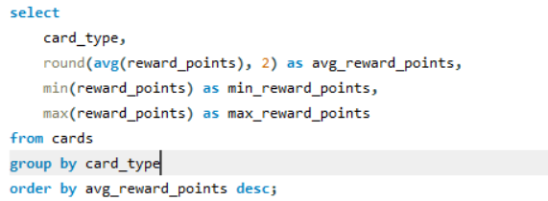
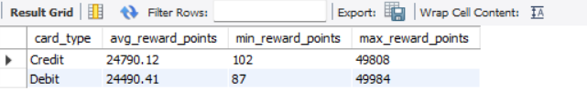
SQL ANALYSIS
How do reward points differ between credit and debit cards?
Query :
Output :
Explanation :
The query groups cards by card type and compares average, minimum and maximum reward points. Credit cards have a slightly higher average reward-point value than debit cards.
RETAIL BANKING TRANSACTION ANALYSIS
22

Slide 23
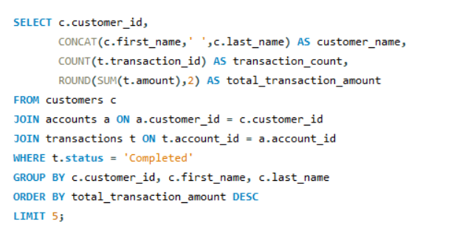
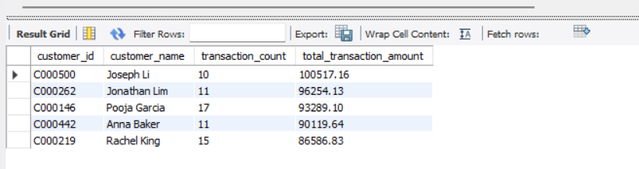
SQL ANALYSIS
Which customers have the highest completed transaction value?
Query :
Output :
Explanation :
The query joins customers, accounts and transactions, keeps only completed transactions, and ranks customers by total transaction amount. Joseph Li has the highest completed transaction value in the shown result.
RETAIL BANKING TRANSACTION ANALYSIS
23

Slide 24
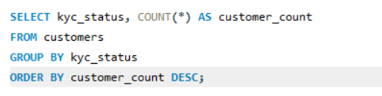
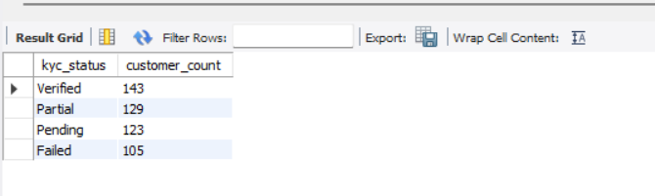
SQL ANALYSIS
What is the distribution of customers by KYC status?
Query :
Output :
Explanation :
The query groups customers by KYC status and counts each category. Verified has the largest group with 143 customers, followed by Partial, Pending and Failed.
RETAIL BANKING TRANSACTION ANALYSIS
24

Slide 25
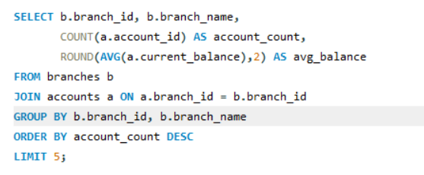
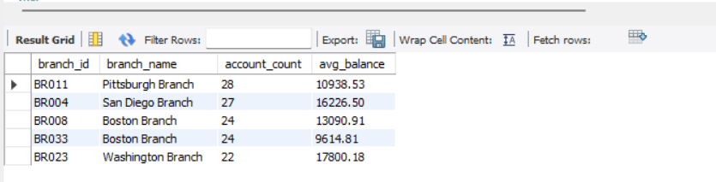
SQL ANALYSIS
Which branches have the highest number of accounts?
Query :
Output :
Explanation :
The query joins branches with accounts and ranks branches by account count. Pittsburgh Branch has the highest count in the shown result with 28 accounts.
RETAIL BANKING TRANSACTION ANALYSIS
25

Slide 26
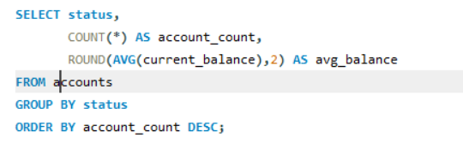
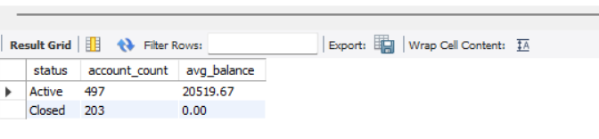
SQL ANALYSIS
How many accounts are active versus closed, and what is the average balance?
Query :
Output :
Explanation :
The query groups accounts by status and calculates the average balance. Active accounts total 497 with an average balance of 20,519.67, while closed accounts total 203.
RETAIL BANKING TRANSACTION ANALYSIS
26

Slide 27
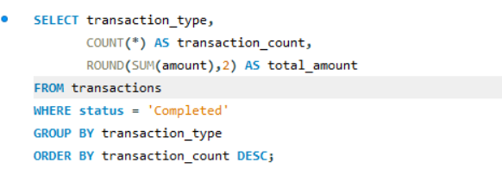
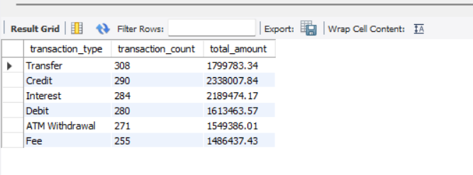
SQL ANALYSIS
Which transaction types are most common among completed transactions?
Query :
Output :
Explanation :
The query filters completed transactions, groups them by transaction type and calculates both count and total amount. Transfer is the most common completed transaction type with 308 transactions.
RETAIL BANKING TRANSACTION ANALYSIS
27

Slide 28
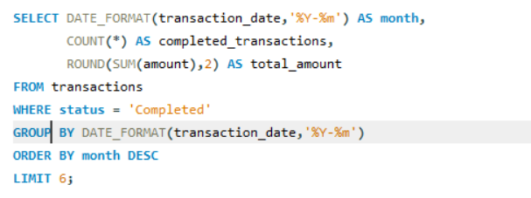
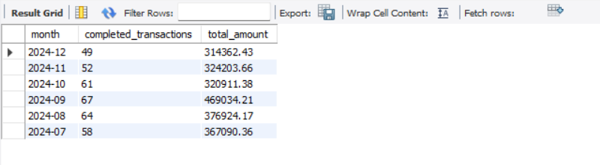
SQL ANALYSIS
What are the latest six months of completed transaction activity?
Query :
Output :
Explanation :
The query groups completed transactions by month and returns the latest six months. September 2024 has the highest transaction count among these six months, with 67 completed transactions and a total amount of 469,034.21.
RETAIL BANKING TRANSACTION ANALYSIS
28

Slide 29
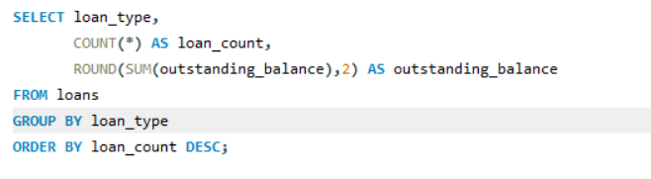
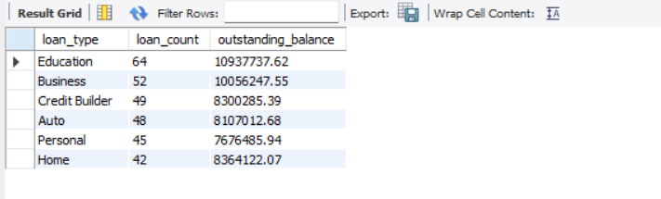
SQL ANALYSIS
Which loan types have the highest number of loans and outstanding balances?
Query :
Output :
Explanation :
The query groups loans by loan type and compares both loan count and outstanding balance. Education loans have the highest volume with 64 loans, while Education also has the highest outstanding balance in the displayed result.
RETAIL BANKING TRANSACTION ANALYSIS
29

Slide 30
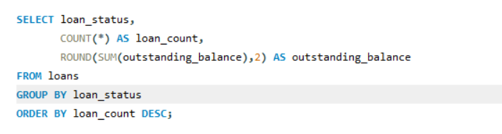
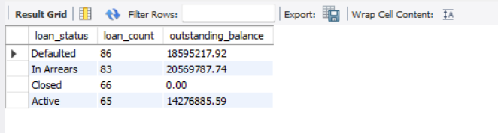
SQL ANALYSIS
How is outstanding loan balance distributed by loan status?
Query :
Output :
Explanation :
The query groups loans by status and sums outstanding balances. In Arrears has the highest outstanding balance at 20,569,787.74, followed by Defaulted.
RETAIL BANKING TRANSACTION ANALYSIS
30

Slide 31
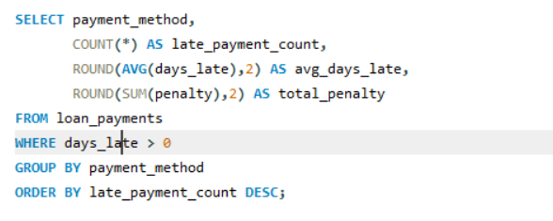
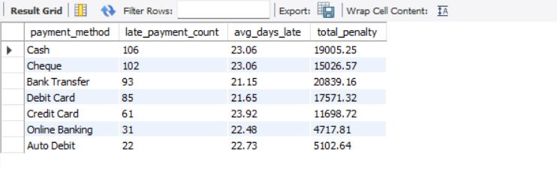
SQL ANALYSIS
Which payment methods have the highest number of late payments?
Query :
Output :
Explanation :
The query considers only payments with days_late greater than zero and groups them by payment method. Cash has the highest number of late payments with 106, followed by Cheque with 102.
RETAIL BANKING TRANSACTION ANALYSIS
31

Slide 32
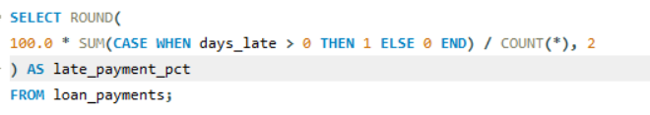
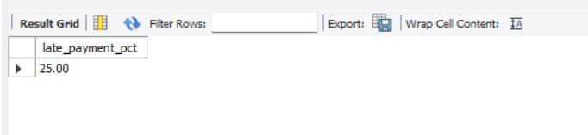
SQL ANALYSIS
What percentage of loan payments were late?
Query :
Output :
Explanation :
The query counts all loan payments with days_late greater than zero and divides by total loan payments. The result is 25.00%, meaning one quarter of the payment records were late.
RETAIL BANKING TRANSACTION ANALYSIS
32

Slide 33
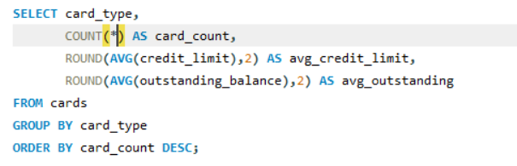
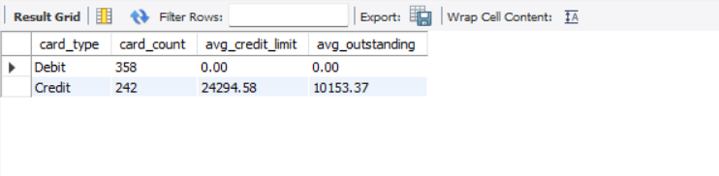
SQL ANALYSIS
How do card types differ in count, average credit limit and outstanding balance?
Query :
Output :
Explanation :
The query groups cards by card type and calculates card count, average credit limit and average outstanding balance. Debit cards are more numerous, while Credit cards have a positive average credit limit and outstanding balance.
RETAIL BANKING TRANSACTION ANALYSIS
33

Slide 34
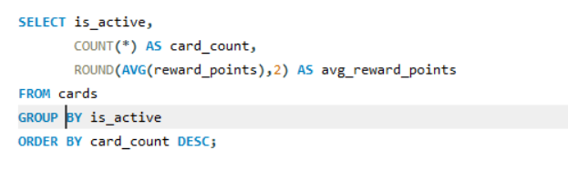
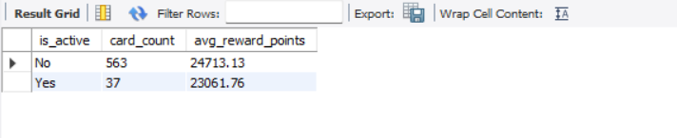
SQL ANALYSIS
How many cards are active versus inactive, and what are the average reward points?
Query :
Output :
Explanation :
The query groups cards by the is_active flag. The output shows 563 inactive cards and 37 active cards, with average reward points of 24,713.13 and 23,061.76 respectively.
RETAIL BANKING TRANSACTION ANALYSIS
34

Slide 35
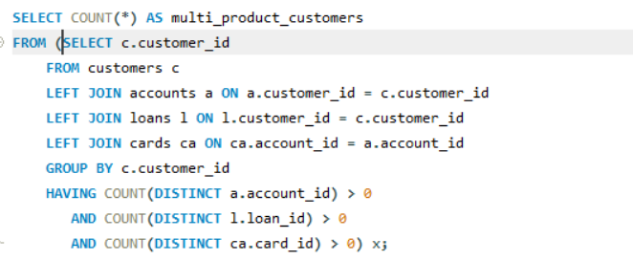

SQL ANALYSIS
How many customers use accounts, loans and cards together?
Query :
Output :
Explanation :
The query connects customers to accounts, loans and cards and counts customers who have all three product relationships. The result is 124 multi-product customers.
RETAIL BANKING TRANSACTION ANALYSIS
35

Slide 36


SQL ANALYSIS
Which customers hold the largest number of bank accounts?
Query :
Output :
Explanation :
The query joins customers and accounts, groups by customer and keeps customers with more than one account. Anna Jones has the highest count in the shown result with 8 accounts.
RETAIL BANKING TRANSACTION ANALYSIS
36

Slide 37
Key Business Insights
➢ 500 customers, 700 accounts, 40 branches, 300 loans, 2,000 loan payments, 600 cards and 5,000 transactions are present in the supplied data.
➢ Student is the largest customer segment with 100 customers; Premium has the highest average annual income.
➢ IRA is the most common account type with 136 accounts.
➢ Online is the leading completed transaction channel; Transfer is the leading completed transaction type by count.
➢ Education loans have the highest loan count; In Arrears loans have the highest outstanding balance.
➢ 25.00% of loan payment records are late.
➢ 124 customers have at least one account, loan and card relationship.
37

Slide 38
Conclusion & Business Recommendation
Conclusion
The project demonstrates an end-to-end SQL workflow: understand the banking business, build a relational database, analyze real banking activity, interpret outputs and translate findings into business decisions.
Recommendations
➢ Strengthen engagement strategies for high-value customer groups and large segments.
➢ Review branch and account activity for service opportunities.
➢ Prioritize early-warning actions for loans in arrears and repeated late payments.
➢ Use cross-product relationships for relevant account, card and loan opportunities.
Challenges Faced
CSV import validation, date/null handling, data types, relational joins and preserving accurate business logic across linked tables.
38

Slide 39
THANK YOU

