Slide 1
Predict Collision Severity
Coursera – IBM Data Science Capstone Project
Narendra Jayaram

Slide 2
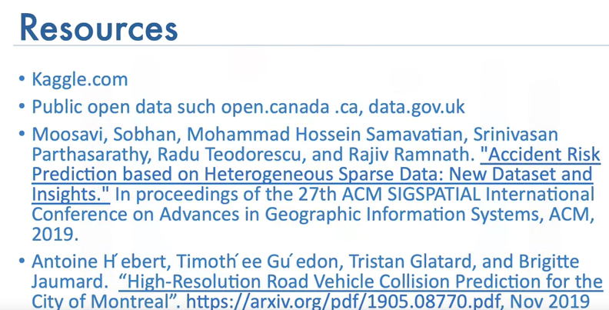
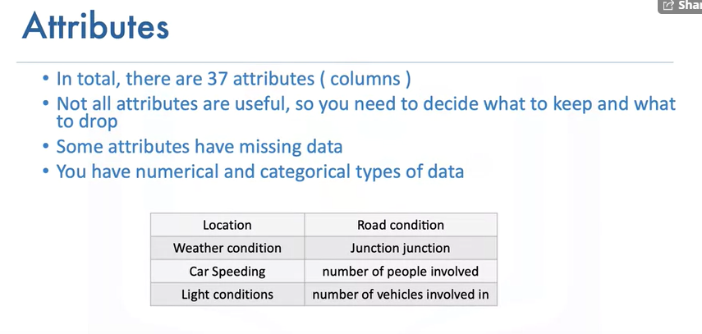
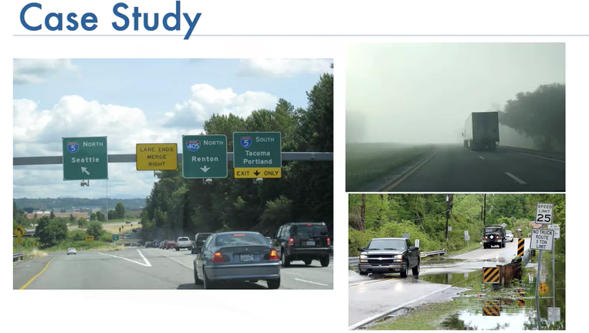
Study

Slide 3
Problem Statement
To model the prediction of severity of an accident based on factors that are included in such an event.
This project will look at predicting the probability and severity of vehicular accidents based on weather and other characteristics, using historic collision data.
The thing is, traffic collisions aren't accidents - they're preventable through smarter street design, targeted enforcement, partnerships, and thoughtful public engagement. Together, we can make Seattle's streets safer for everyone

Slide 4
INTRODUCTION:
What’s new?
In February 2020, we released phase 2 of our Bike and Pedestrian Safety Analysis, to look at bicycle and pedestrian incident trends. This tool helps us proactively make safety enhancements across the city. This groundbreaking approach helps us prioritize locations, anticipate issues, and make decisions informed by data.
On December 10, Mayor Jenny A. Durkan announced a series of steps to improve safety on City streets and reaffirm the City's commitment to achieving the Vision Zero goal of ending traffic deaths and serious injuries by 2030. Mayor Durkan announced the City will reduce speed limits to 25 miles per hour (mph) throughout the city, double the number of safety-enhanced traffic signals, invest in engineering changes to create safer streets, create a new crash review task force, and launch additional traffic safety education and enforcement tactics. Read our 2019 update to learn more. While we're excited to implement these steps, we also want to take a moment to remind everyone that we all have a role to play in improving safety. As you're traveling Seattle's streets, look out for yourself and for each other. Recognize that every intersection is unique, so stay alert. If you're driving, pay attention, slow down, and expect people are walking and biking in every part of the city at all times of the day.

Slide 5
DATA
Data used for modeling comes from historic collision records maintained by the SDOT Traffic Management Division
>195,000 samples from January 2004 to May 2020
36 different features that describe:
Date, time and position of collisions
Codes used by the DOT and state to categorize collisions
Incident characteristics such as number of people, or vehicles
Environmental conditions at the time of the collision
Driver behaviors such as speeding, inattentiveness or drug/alcohol use
Clear target variable, with cases labeled as either ‘1-property damage only’ or ‘2injury collision’  This makes it ideal for supervised classification models

Slide 6
Methodology
Exploratory Analysis
Feature selection
Data cleansing, processing and balancing
Model training and evaluation

Slide 7
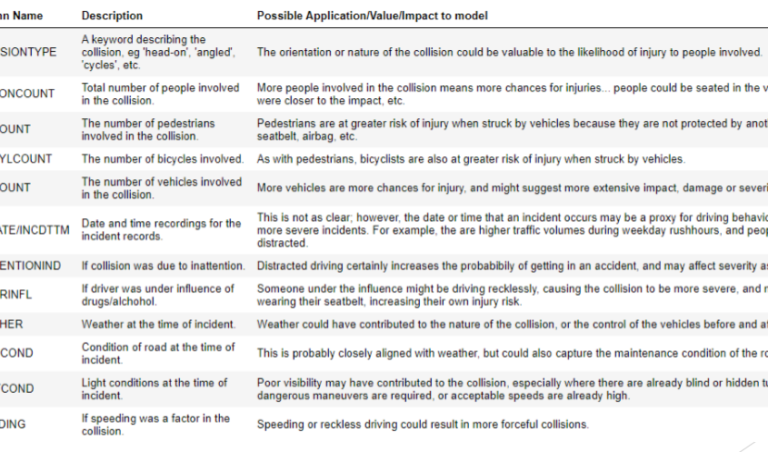
Initial Feature Selection
12 features were initially identified as potential modeling features, including: collision type, weather, road and lighting conditions, date and time, etc.

Slide 8
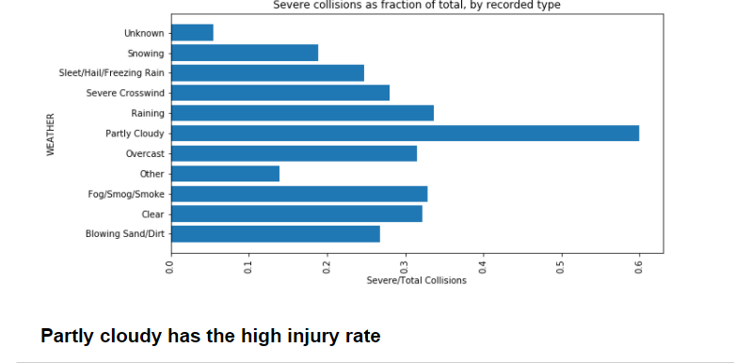
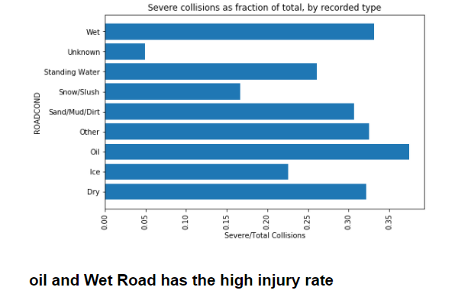
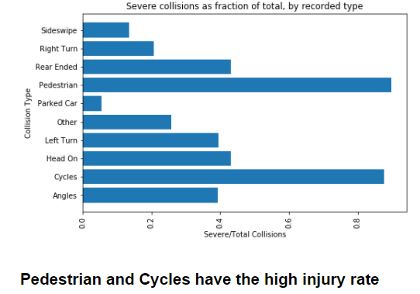
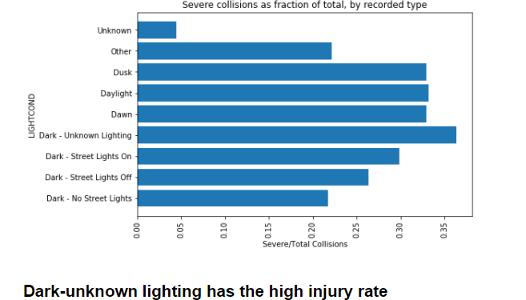
Exploratory Analysis

Slide 9
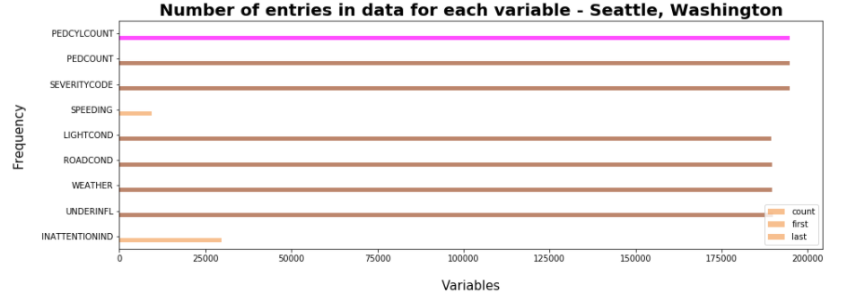
Exploratory Analysis

Slide 10
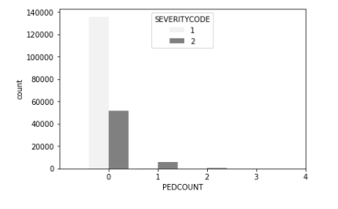
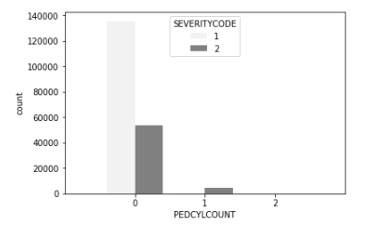
Exploratory Analysis
When bicycles are involved, injuries are more likely to occur.
pedestrian and bicycle count showed obvious associations with injury rate, but these would make redundant features because collision type already captures these scenarios
when the pedcount is >1 (at least one pedestrian is involved) injuries are more likely to occur
Type of Collision

Slide 11
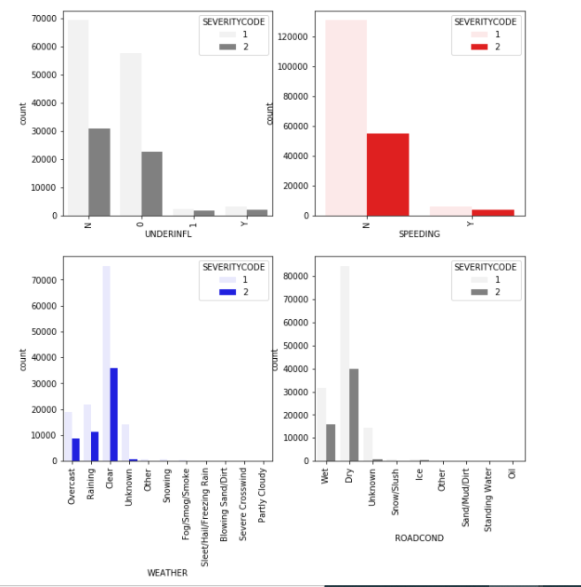
Exploratory Analysis
Type of Collision
Meanwhile, contrary to expectation, Weather, Road and Light conditions didn’t show remarkable patterns with respect to the rate of injury in collisions

Slide 12
Final Feature Selection
The parameters selected for model training included:
Collision type – converted to one-hot encoding for the 10 unique types
Person count – samples separated by 3 person threshold (more = 1, less = 0)
Vehicle count – samples separated as 2-vehicle or otherwise (yes = 1, no = 0)
Time – samples separated into rush-hour or non-rush-hour periods (yes = 1, no = 0)
Inattention – existing Yes/No field, converted to 1/0
Under influence – existing format mixed Y/N and 1/0, converted to 1/0
Speeding – existing Y/N field, converted to 1/0

Slide 13
Data Cleansing and processing
~4900 samples with blank COLLISIONTYPE and UNDERINFL :>>removed
~5500 samples with PERSONCOUNT of 0
>>removed
~25500 samples with no recorded time (default timestamp 00:00:00) 
>>removed
PERSONCOUNT, VEHCOUNT and INCDTTM manipulated to create simplified features that split the samples according to:
More or less than 3 people involved
Collisions involving 2 vehicles or other
Collisions occurring during or outside of AM/PM rush-hour periods
COLLISIONTYPE transformed into one-hot encoding

Slide 14
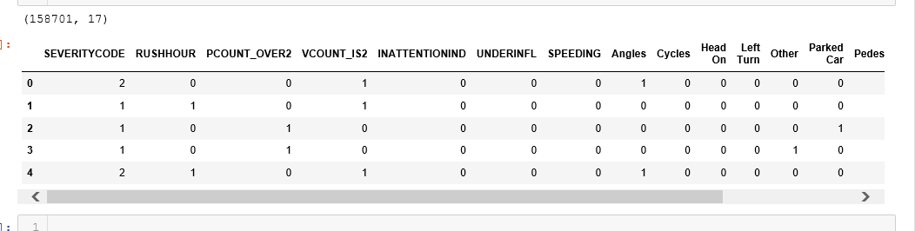
Final Dataset
Final dataset of 17 one-hot encoded features
48052 (x2) samples from each class
No normalization required

Slide 15
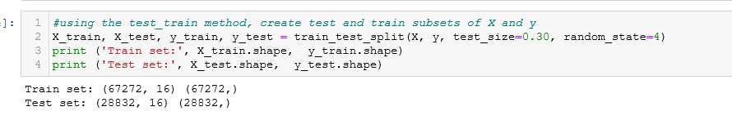
Modeling
4 different classification algorithms used: KNN, Decision Tree, SVM and Logistic Regression
Data was split into train (70%) and test (30%) sub-sets
Parameter tuning (optimization) completed as necessary within each algorithm
kernel function (SVM), solver and regularization (LR)
Best model from each method evaluated using: simple accuracy, Jaccard similarity, F1-score, log-loss

Slide 16
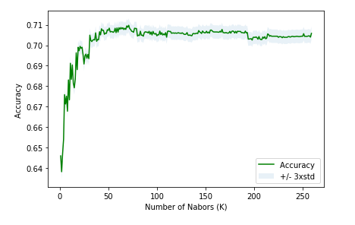
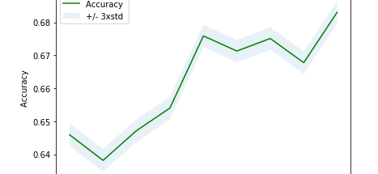
Modeling - K-nearest Neighbor
k-value optimized by iterating through different values and plotting model accuracy
Model performance was choppy on both macro & micro ranges of k
k=71 selected
The best accuracy was with 0.7097965766609438 with k= 71

Slide 17
Modeling - Decision Tree
 | precision | recall | f1-score | support
1 | 0.760 | 0.590 | 0.660 | 14449
2 | 0.660 | 0.820 | 0.730 | 14383
micro avg | 0.700 | 0.700 | 0.700 | 28832
Macro avg | 0.710 | 0.700 | 0.700 | 28832
Weighted avg | 0.710 | 0.700 | 0.700 | 28832
Random Forest method used with no pre-set parameters

Slide 18

Modeling – Support Vector Machine
Models train with ‘linear’, ‘radial-based (rbf)’, ‘polynomial’ and ‘sigmoid’ kernel functions
‘Test Accuracy for SVM with RBF kernel: 0.7075594401956193
Test Accuracy for SVM with Polynomial kernel: 0.7079756516310286
Test Accuracy for SVM with Sigmoid kernel: 0.6331096196868009
Test Accuracy for SVM with Linear kernel: 0.7044378544300505
‘linear’ model selected due to accuracy and slightly more balance predictions between target classes

Slide 19
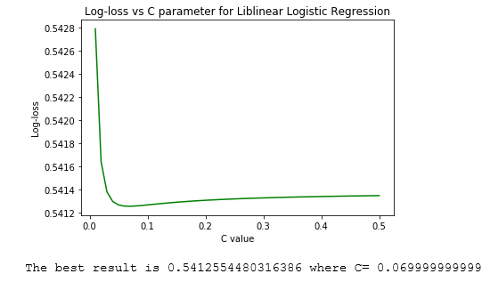
Modeling Logistic Regression
Models trained for ‘liblinear’, ‘newton-cg’ and ‘sag’ solver functions
C parameter optimized for selected ‘liblinear’ model by iterating through values and plotting log-loss
The best result is 0.5412 where C= 0.0699
Final C value taken as 0.069 due to higher overall prediction accuracy

Slide 20
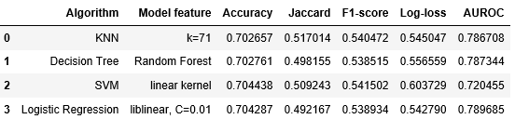
Results
Performance metrics consistent across all models – unexpected
Likely due to the specific features selected; some disorder still exists resulting in maximum achievable accuracy near 0.70
Logistic Regression model performed best in 2 of 5 metrics; KNN in other 2; SVM 1

Slide 21

Conclusions
4 models built to predict collision severity using data from Seattle DOT and popular classification algorithms
Prediction accuracy over 0.71 for each
Slight variations in sensitivity to predicting more severe collisions
Optimum model could depend on:
Conservative or liberal requirements re: impact of severe collisions
Time consumption: KNN, SVM and Decision Tree models were slow to process
Next steps:
The thing is, traffic collisions aren't accidents - they're preventable through smarter street design, targeted enforcement, partnerships, and thoughtful public engagement. Together, we can make Seattle's streets safer for everyone
Alternative features could be used from the same dataset
Apply models to data from other sources or DOTs to evaluate effectiveness
Explore impact of additional collision characteristics, such as vehicle make/model, posted vs actual vehicle speed, airbag release

