Slide 1

MVP PRESENTATION
FleetFlow: Modular Fleet & Logistics Management System
A rule-based digital platform to optimise fleet lifecycle, driver safety, and financial performance — built for operational excellence.
Team Lead & Architect
Narendra Purohit
Backend Developer
Bhavesh Tirgar
Frontend & DB Integration
Dixit Luvani
Testing & Analytics
Hardik Saraviya

Slide 2
THE PROBLEM
Manual Processes Are Costing You
Traditional fleet management relies on paper logbooks and disconnected spreadsheets — creating costly gaps across operations, compliance, and finance.
Unreliable Maintenance Tracking
Delayed Dispatch & Cargo Mismatch
Vehicle health updates are delayed or missed entirely, increasing breakdown risk.
Trip assignments are slow and cargo-to-capacity validation is done manually — or not at all.
No Compliance Visibility
Fragmented Financial Data
Driver licences and safety records are tracked informally, with no audit trail.
Fuel costs, maintenance expenses, and operational ROI lack centralised oversight.

Slide 3

OBJECTIVE
One Platform. Full Control.
FleetFlow is designed to eliminate fragmentation by bringing every operational dimension — fleet, drivers, trips, costs — into a single rule-based system.
Digitise Fleet & Trips
Driver Safety & Licensing
End-to-end digital management of vehicles and dispatch workflows.
Monitor driver compliance, licence validity, and safety scores in real time.
Maintenance & Fuel Costs
Real-Time Analytics
Track every operational expense with automated status flags and logs.
Actionable insights for ROI, fuel efficiency, and cost-per-km decision-making.

Slide 4

TARGET USERS
Built for Every Stakeholder in the Fleet
Role
Core Responsibility
Fleet Manager
Monitor vehicle health, scheduling, and availability
Dispatcher
Assign drivers, validate cargo capacity, manage trips
Safety Officer
Review licences, compliance records, and safety scores
Financial Analyst
Audit fuel usage, maintenance spend, and ROI
Role-based access control ensures each user sees only what is relevant to their function — keeping the system focused and secure.

Slide 5
CORE SYSTEM PAGES
Eight Modules. One Unified System.
FleetFlow is structured around eight purpose-built pages, each covering a distinct operational domain.
1
Login & Authentication
Secure RBAC access for all user roles.
2
Command Centre
Live fleet KPI overview and dashboard.
3
Vehicle Registry
Full CRUD operations and status control.
4
Trip Management
Dispatch workflow with cargo validation.
5
Maintenance Logs
Auto-triggers "In Shop" flag on entry.
6
Expense & Fuel Logs
Operational cost tracking per vehicle.
7
Driver Profiles
Safety scores and compliance data.
8
Analytics Reports
ROI, efficiency metrics, and cost-per-km.

Slide 6
TECH STACK
Modern, Reliable, Deployable Anywhere
Core Technologies
Architecture & Deployment
Django Framework
Modular MVC
Robust Python backend with built-in ORM and admin.
Clean separation of Models, Views, and Controllers for maintainability and scaling.
PostgreSQL
Flexible Deployment
Reliable relational database for structured fleet data.
Deployable on AWS, Render, Railway, or localhost — adapting to any infrastructure requirement.
HTML / CSS / JS
Responsive frontend with Bootstrap or React optional.

Slide 7
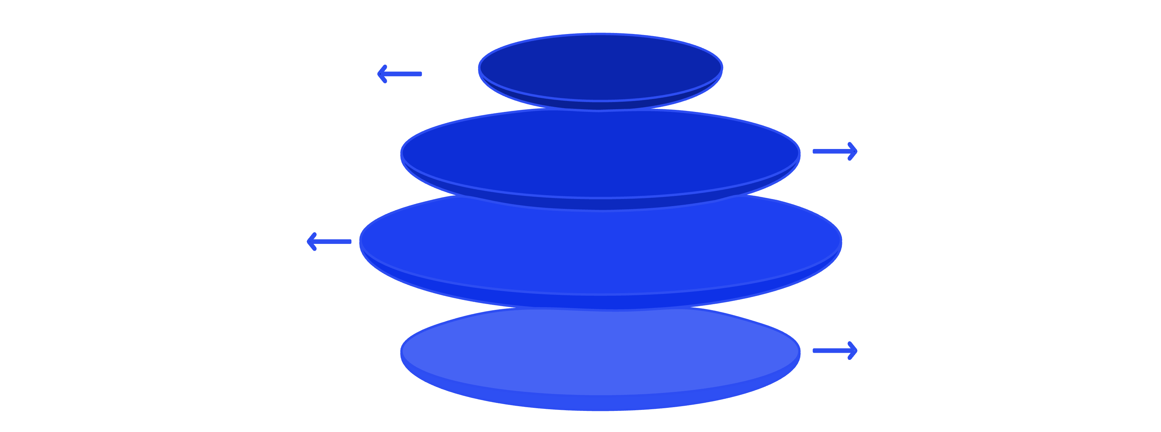
SYSTEM ARCHITECTURE
Four Layers. Seamlessly Integrated.
Frontend UI
Role-based dashboards for Admin, Dispatcher, Analyst
Backend Django
Business logic, workflow, validation
PostgreSQL DB
Vehicles, drivers, trips, maintenance, expenses
Analytics Layer
ROI, fuel efficiency, cost-per-km
The layered architecture ensures clean separation of concerns — the frontend handles presentation, Django enforces business rules, PostgreSQL stores structured data, and the analytics layer surfaces actionable insights for decision-makers.

Slide 8
KEY WORKFLOW
From Vehicle Registration to ROI — In Six Steps
Add Vehicle
Status automatically set to Available.
Add Driver
Licence number validated on entry.
Assign Trip
Cargo weight checked against vehicle capacity.
Trip Completed
Odometer reading updated automatically.
Log Maintenance
Vehicle auto-flagged as In Shop.
Analytics Module
Cost, fuel efficiency, and ROI updated in real time.

Slide 9

INNOVATION & IMPACT
Smarter Operations. Measurable Results.
Rule-Based Automation
Live Status & Compliance
Business logic enforced at every step — reducing manual errors and ad hoc decisions.
Real-time vehicle availability and driver compliance visible to every authorised user.
Unified Financial View
Enterprise-Ready Scale
Fuel, maintenance, and operational costs consolidated in a single source of truth.
Modular architecture designed to grow — from a small fleet to a large enterprise operation.

Slide 10




TEAM & FUTURE SCOPE
The Team Behind FleetFlow
Narendra Purohit
Bhavesh Tirgar
Dixit Luvani
Hardik Sarvaiya
Team Leader
Backend Developer
Frontend
Database Integration
Future Scope
📱 Mobile App — Dedicated app for drivers and dispatchers on the go.
☁️ Full Cloud Deployment — Scalable infrastructure for enterprise workloads.
📊 AI-Based Optimisation — Intelligent route planning and cost prediction.
🧩 ERP Integration — Connect with external enterprise resource planning systems.

