Slide 1


Analytic Tools & Decision Making: Final -Project
Project Proposal, Descriptive Statistics and EDA of 2021 Kaggle Machine Learning & Data Science Survey.

Slide 2
Section: 002 Group: 6
Team Members:
1. Narendra Somasi
2. Mounika PeddayerramaReddy
3. Pavan kalyan karri
4. Srinidhi Kasireddy
5. Sai Susmitha Vanarasa

Slide 3
With this survey we can identify the major streams which are using the technology and can be used by businesses which can decide whether they can adopt the technology based on their requirement and competition of this technology in the market.
It can help future data scientists how they can break into field and can know what's happening with machine learning in different industries.
Rather than assumptions we can accurately predict the usage of Data science and machine learning in industries.
Motivation for this Project

Slide 4
Problem Statement
This Survey is to deeply explore (through data) the impact, priorities, or concerns of a specific group of data science and machine learning practitioners.
That group can be defined in the macro (for example: anyone who does most of their coding in Python) or the micro (for example: female data science students studying machine learning in master programs).

Slide 5

Project Proposal
We will create a data story about a subset of the data science community represented in this survey, through a combination of both narrative text and data exploration and analysis, which will provide feedback to industries and future data scientists to enter the field.

Slide 6
Analysis Questions
1.What type of people like age, Gender , Formal education and Years of experience are using DS & ML ?
2.which Tools & skills making impact and people want to become familiar with ?
3.In Which Industry people are using these skills much ?
4.Does this Kaggle survey determine the impact and priorities of DS & ML practitioners ?

Slide 7
DATASET DESCRIPTION
Source
The analysis will be based 2021 Kaggle Machine Learning & Data Science Survey dataset obtained from Kaggle.
The dataset included data for the year 2021.
The Link of the Dataset https://www.kaggle.com/c/kaggle-survey-2021/data.
CONTENTS
This dataset contains information taken from survey about the use of data science and machine learning among different users
There are a total of 25975 observations and 369 columns

Slide 8
EXPLORATORY DATA ANALYSIS
(EDA)

Slide 9
Describing the Data
This dataset is taken from industry-wide survey that presents a truly comprehensive view of the state of data science and machine learning.
The survey was live from 09/01/2021 to 10/04/2021
The 2021 Kaggle DS & ML Survey received 25,973 usable responses from participants in 171 different countries and territories.

Slide 10
How was the data collected
The data is collected from the survey conducted by Kaggle
This is their 5th year conducting an in-depth user survey & publicly sharing the results.
Over 25,000 data scientists and ML engineers submitted responses on their backgrounds and day to day experience everything from educational details to salaries to preferred technologies and techniques.

Slide 11
SAMPLE-SURVEY QUESTIONS
Number | Question
Q1 | What is your age (# years)?
Q2 | What is your gender?
Q3 | In which country do you currently reside?
Q4 | What is the highest level of formal education that you have attained or plan to attain within the next 2 years?
Q5 | Select the title most similar to your current role (or most recent title if retired)

Slide 12
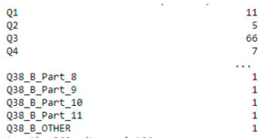
Unique values in each column

Slide 13
Data Segments
The Dataset is segmented into groups such as Age , Gender , Years of Experience etc.
Programming languages like Python, Java, C , C++.
Based on Countries etc.

Slide 14
Data Imbalance
There are few records in the dataset which are imbalanced, as the observations in each country or territory received less than 50 respondents, grouped them into a group named "Other"

Slide 15
Inclusion Criteria
Considering the Data:
Geographically : Across the Globe
Time Period : 09/01/2021 to 10/04/2021
Parameters : Age, Experience, Current Position, Country, Gender, Programming Languages, Company size, Company type and yearly Compensation etc.

Slide 16
Preliminary visualizations

Slide 17
EDA Code Repository
We have done EDA Analysis for the Dataset and uploaded in our code repository in GitHub
Use below link which route to Repository
https://github.com/Narendra- Somasi/DAB103_21F/blob/main/DAB103_FINAL-PROJECT-EDA.ipynb

Slide 18
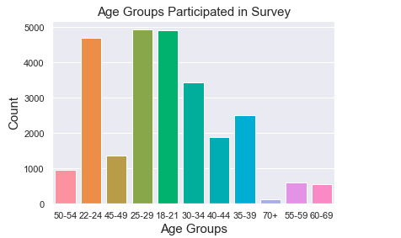
Age-Groups

Slide 19
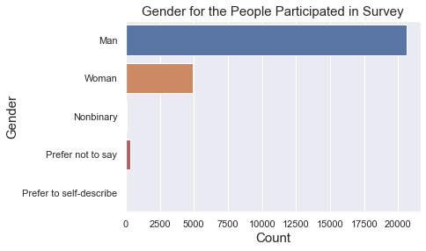
Gender Distribution

Slide 20
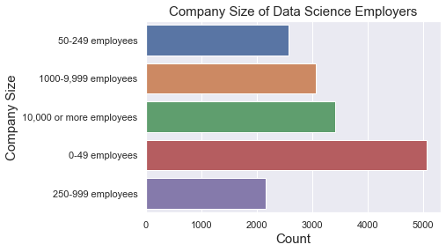
Company Size of Data Science Employers

Slide 21
Data Cleaning And Transformation

Slide 22
DC & T -Code Repository
We have done our Data Cleaning and Transformation for the Dataset and uploaded in our code repository in GitHub
Use below link which route to Repository
https://github.com/Narendra-Somasi/DAB103_21F/blob/main/Data%20Cleaning%20and%20Transformation.ipynb

Slide 23
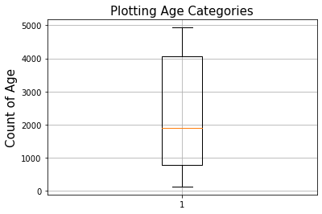
Outliers-Check

Slide 24
Data Transformation
Survey have multiple choice questions
only a single choice can be selected were recorded in individual columns.
Multiple selection questions (multiple choices can be selected) were split into multiple columns

Slide 25
Data Analysis

Slide 26
1.What type of people like age, Gender , Formal education and Years of experience are using DS & ML ?
Analysis shows us which groups are mostly using DS & ML
Below visualizations shows that age groups 18-29 are high
Male practitioners are considerably high than Female.
Most of them having less than 4 years of experience and holding a Bachelor’s or Master’s degree.

Slide 27
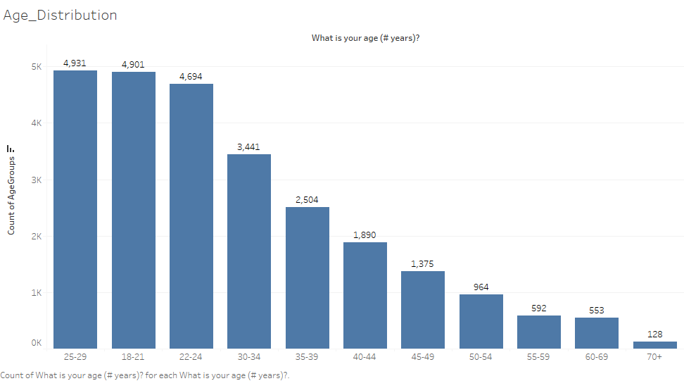

Slide 28
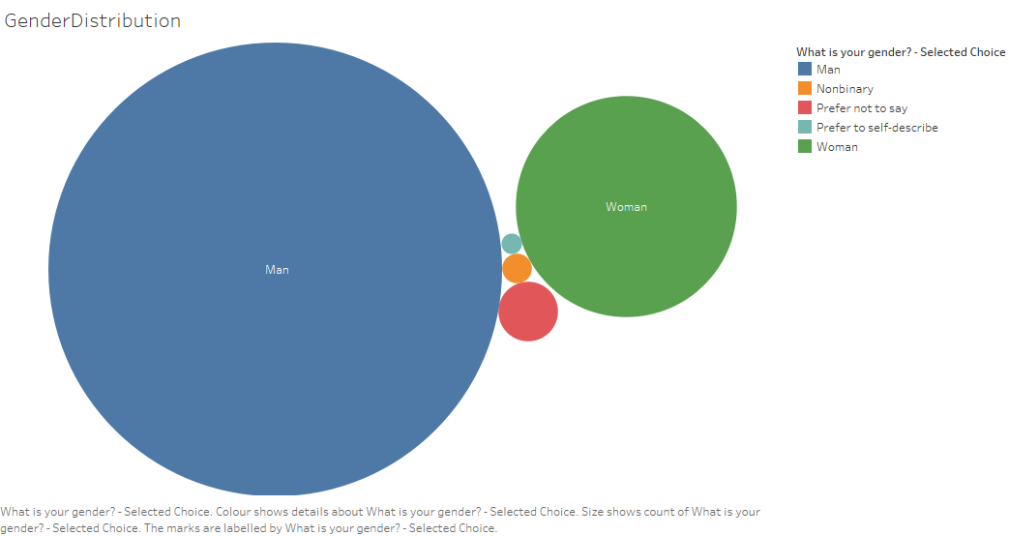

Slide 29
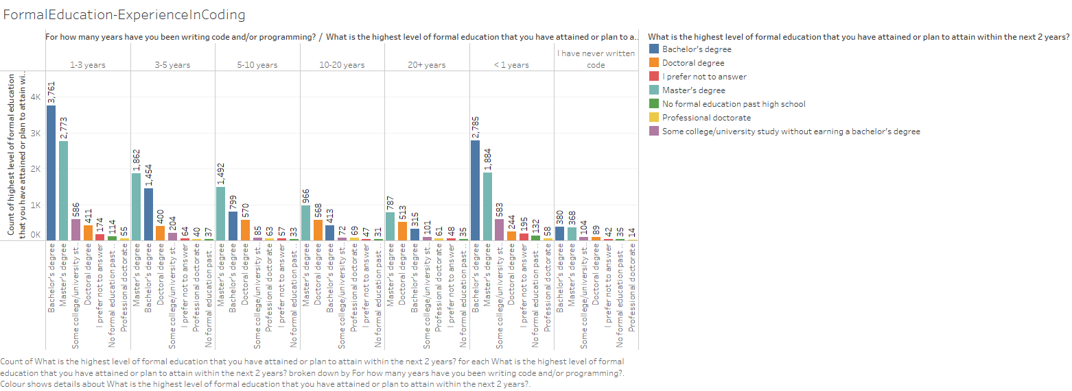

Slide 30
2.which Tools & skills making impact and people want to become familiar with ?
From the Analysis concluded that :
Python is used very often for Data Science projects.
Most of the groups recommended Python is best language for Data Scientist aspirants.
Data Scientist’s are preferably using tools like Jupiter notebook, Excel, R-studio and Google sheets.
Personal Laptop is the most platform used for Data science Projects.

Slide 31
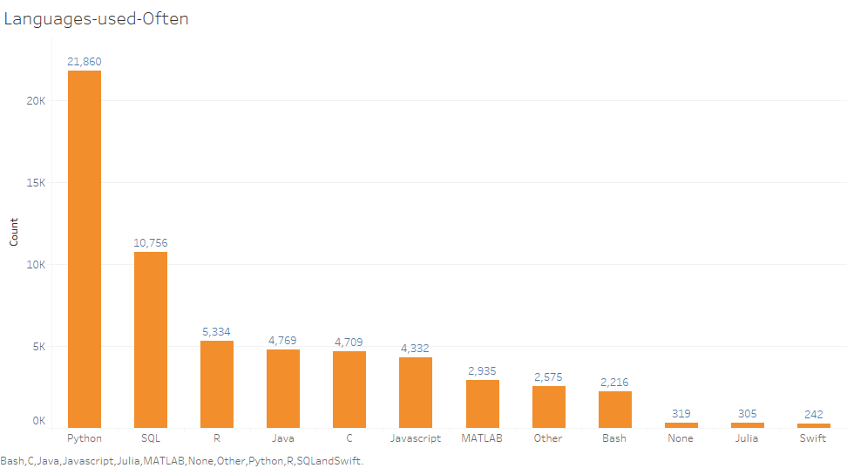

Slide 32
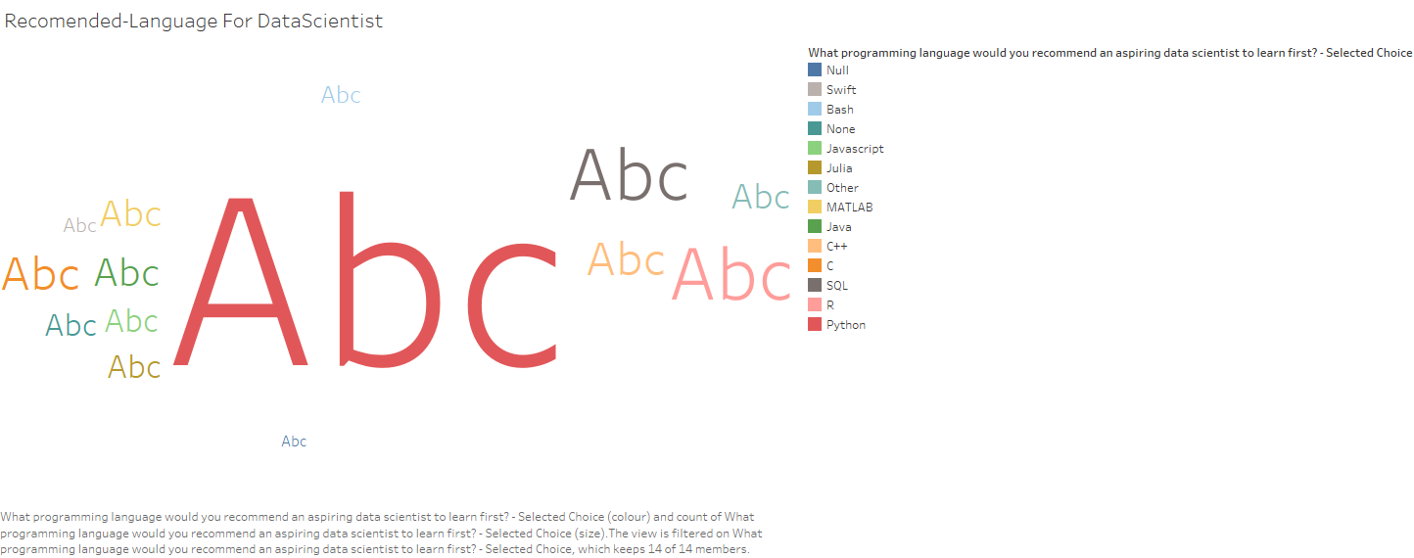

Slide 33
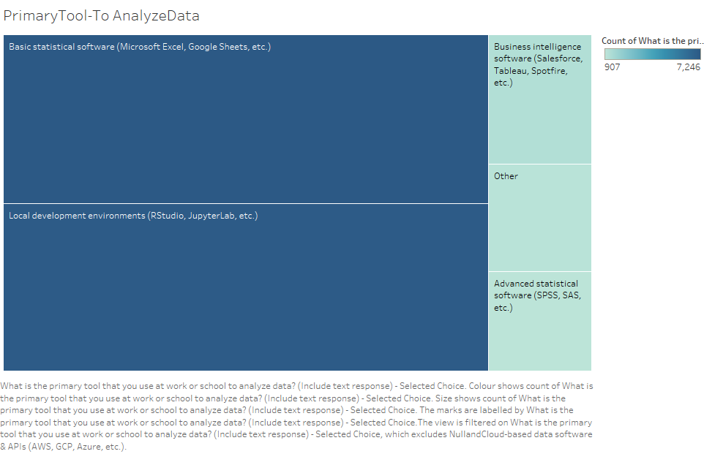

Slide 34
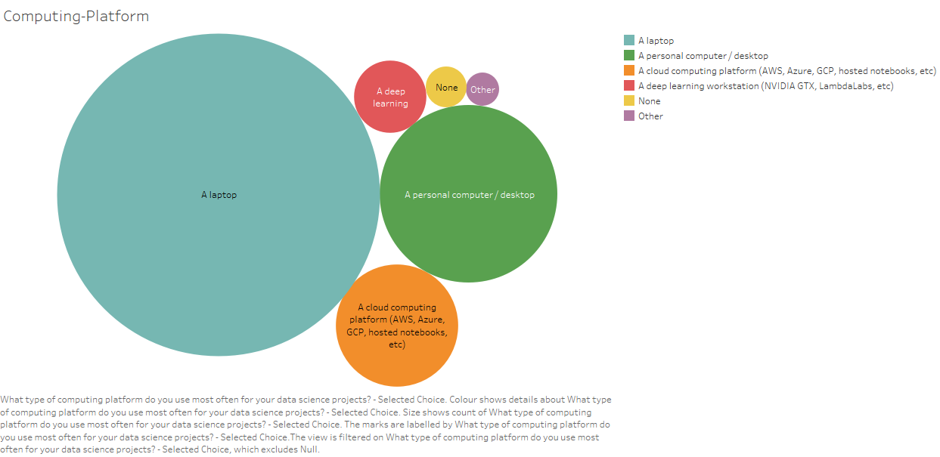

Slide 35
3.In Which Industry people are using these skills much ?
From the Analysis Concluded that :
Computers /Technology industry is majorly using DS & ML techniques.
Academics / Education is also likely using these techniques more
Most of the small-sized companies incorporate DS & ML techniques.

Slide 36
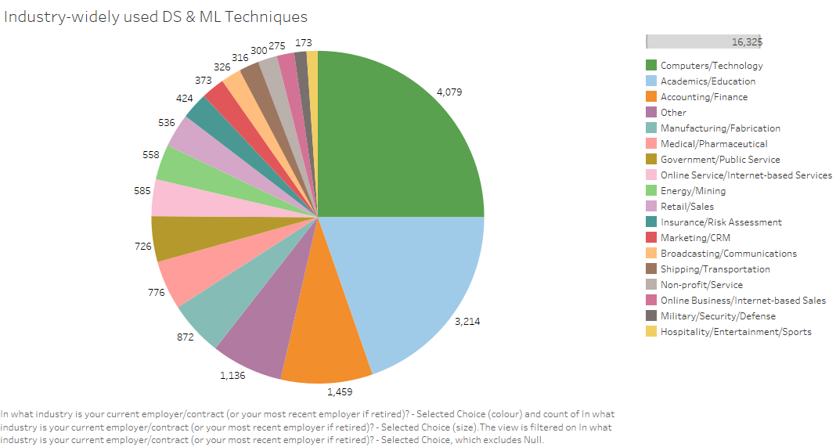

Slide 37
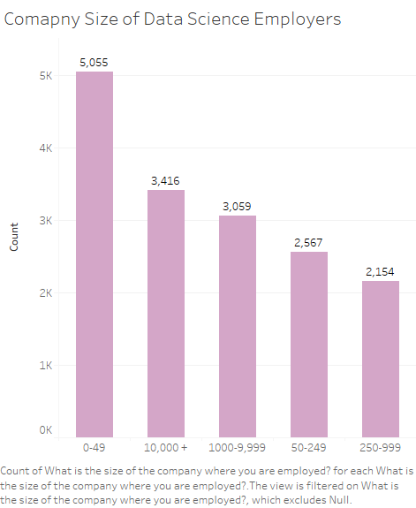

Slide 38
4.Does this Kaggle survey determine the impact and priorities of DS & ML practitioners ?
Yes, from all the analysis and visualizations we can say that
- Python is most used & recommended language for every DS practitioner.
- 18-29 Age groups are major part of this survey and using DS & ML techniques.
- Computer & Education industries mostly incorporated DS & ML technologies
- Most of the DS & ML practitioners are holding either Bachelor’s or Master’s Degree.
- Small sized companies are working on Data Science projects.

Slide 39
References
Tableau Ref :
1.https://www.youtube.com/watch?v=8V2LL9oNHXQ - To load CSV file to Tableau
2.https://www.youtube.com/watch?v=ufZELPvQbcw - How to use multiple columns
Code Ref :
3. https://www.youtube.com/watch?v=WuNGsB16Dzo - how to drop rows and columns
4. https://www.kite.com/python/answers/how-to-convert-a-pandas-dataframe-row-to-column-headers-in-python
5. https://www.geeksforgeeks.org/python-delete-rows-columns-from-dataframe-using-pandas-drop/?ref=lbp
6. https://stackoverflow.com/questions/23996118/replace-special-characters-in-a-string-python

Slide 40
Recommendations
- As this survey contains 40 + questions, its quite tough to do consider all in our analysis to provide better conclusions.
- On by splitting survey questions into 2 half parts would be more easier to make conclusions.
- Column names could have been made short for clear and simple view to understand.

