Slide 1

Bapatla Engineering College :: Bapatla,(Autonomous)
Department of Computer Science and Engineering
Unveiling the Superiority of the React JS
using Doctor Appointment Application
PRESENTED BY : TEAM - A3
J. NARENDRA (Y20ACS462)
B. ANIL (Y20ACS411)
B.KARTHIK BABU (Y20ACS420)
A. RADHA KRISHNA (Y20ACS405)
Under the Guidance of :-
Dr. P. PARDHASARADHI
Professor, CSE Department.

Slide 2

CONTENTS
Abstract
Existing System
Proposed System
Design
Implementation
Result
Conclusion

Slide 3
ABSTRACT
In today's digital age, with faster internet speeds and high-performing devices becoming the norm, there's a growing demand for swift and efficient applications.
JS frameworks and librarirs like ReactJS, AngularJS, and VueJS plays a vital role.
ReactJS stands out as popular choice for front-end development, owing to its effectiveness
Empowers developers to efficiently pass data to applications while maintaining state clarity within the DOM.
Trough our project, we aim to showcase the benefits of utilizing react in frontend development, demonstrated via a doctor appointment application

Slide 4



EXISTING SYSTEM
Existing web applications which are designed using traditional frameworks or technologies like Angular, PHP and JSP.
During the stage of development or in run-time environment these applications show some inconvenience to the developer or user.
Frontend interactivity challenges occur.
Syntax complexity challenges.

Slide 5
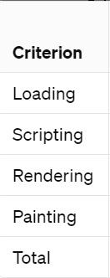
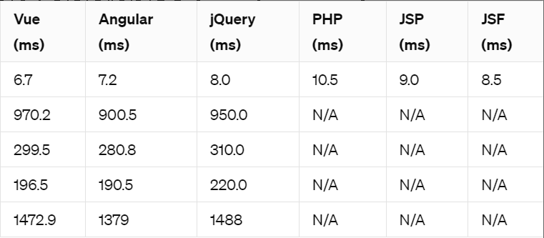
EXISTING SYSTEM (continues..)
Some of the notable frontend challenges of existing systems.

Slide 6

PROPOSED SYSTEM
Some of the major advantages of React framework in Web Development environment.
Simple and short learning curve
React is Fast and Agile
React introduced JSX
Big development community

Slide 7
PROPOSED SYSTEM(continues..)
Well known features of React which conveys its efficiency in frontend development
Reusable components
Large community
Highly efficient due to virtual DOM and component-based architecture.

Slide 8
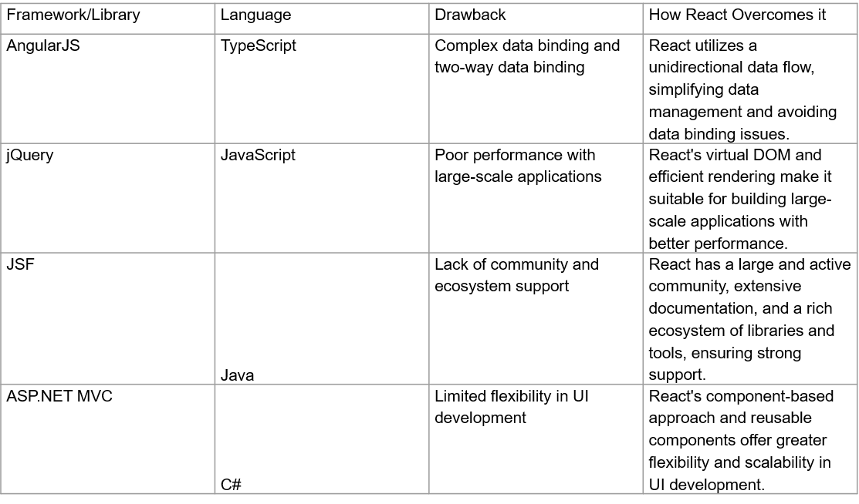
PROPOSED SYSTEM (continues...)
React masters web developing environment by overcoming the notable drawbacks mentioned in the table below.

Slide 9
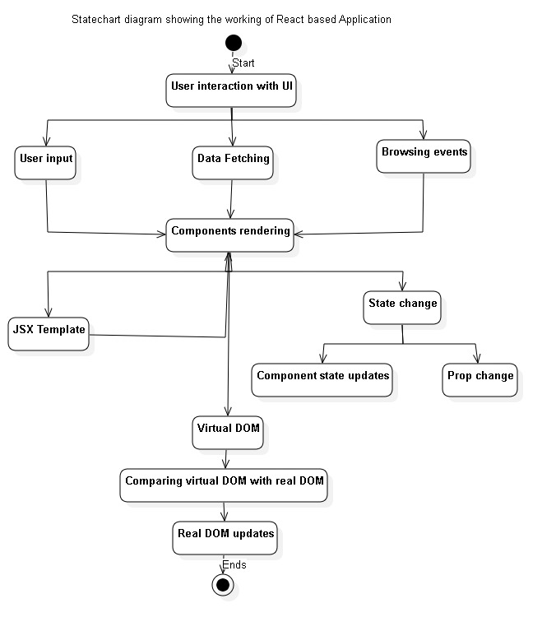
DESIGN

Slide 10
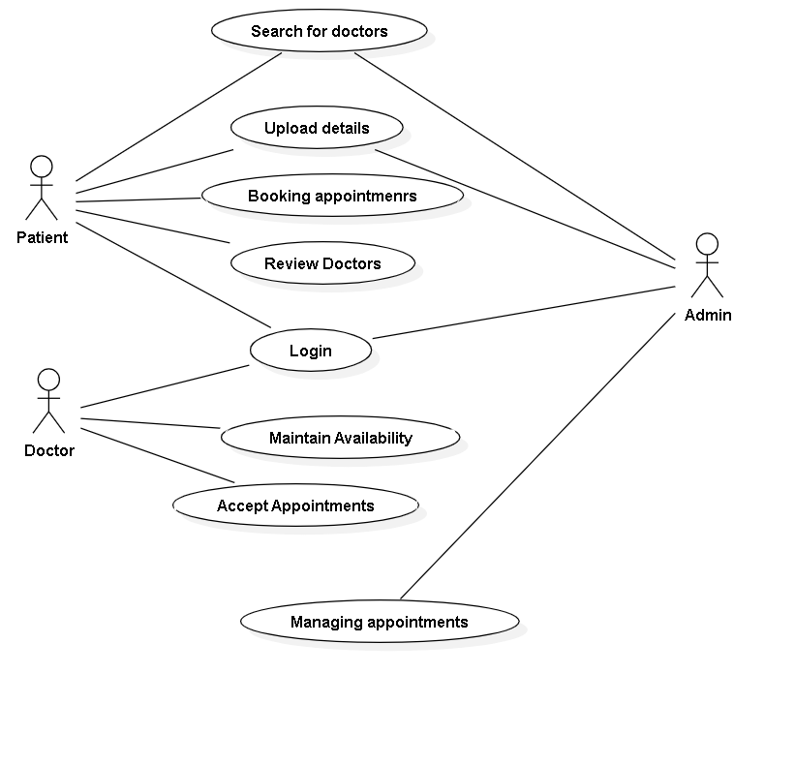
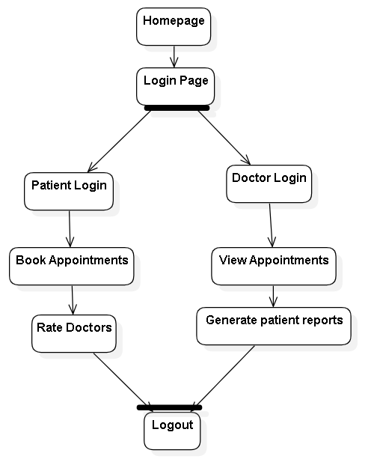
DESIGN
Use case diagram for a doctor appointment booking application developed using React.js.
Statechart Diagram

Slide 11
IMPLEMENTATION
Existing system implementation
url : Php Project repo
Proposed System implementation
url : proposed system project repo

Slide 12
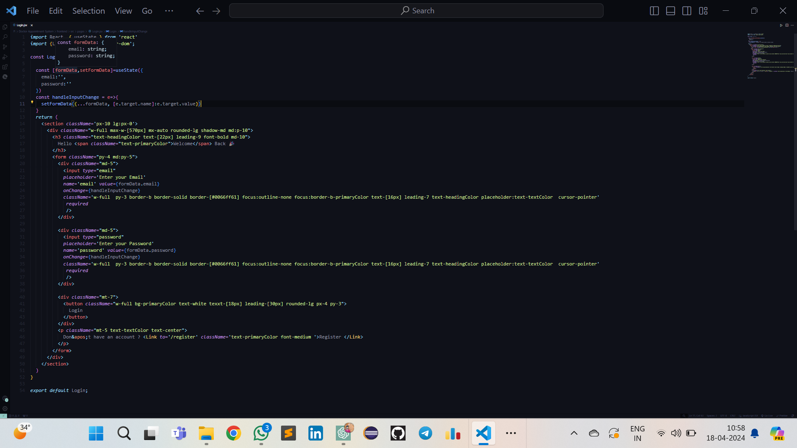
A demo Login page Code in React

Slide 13
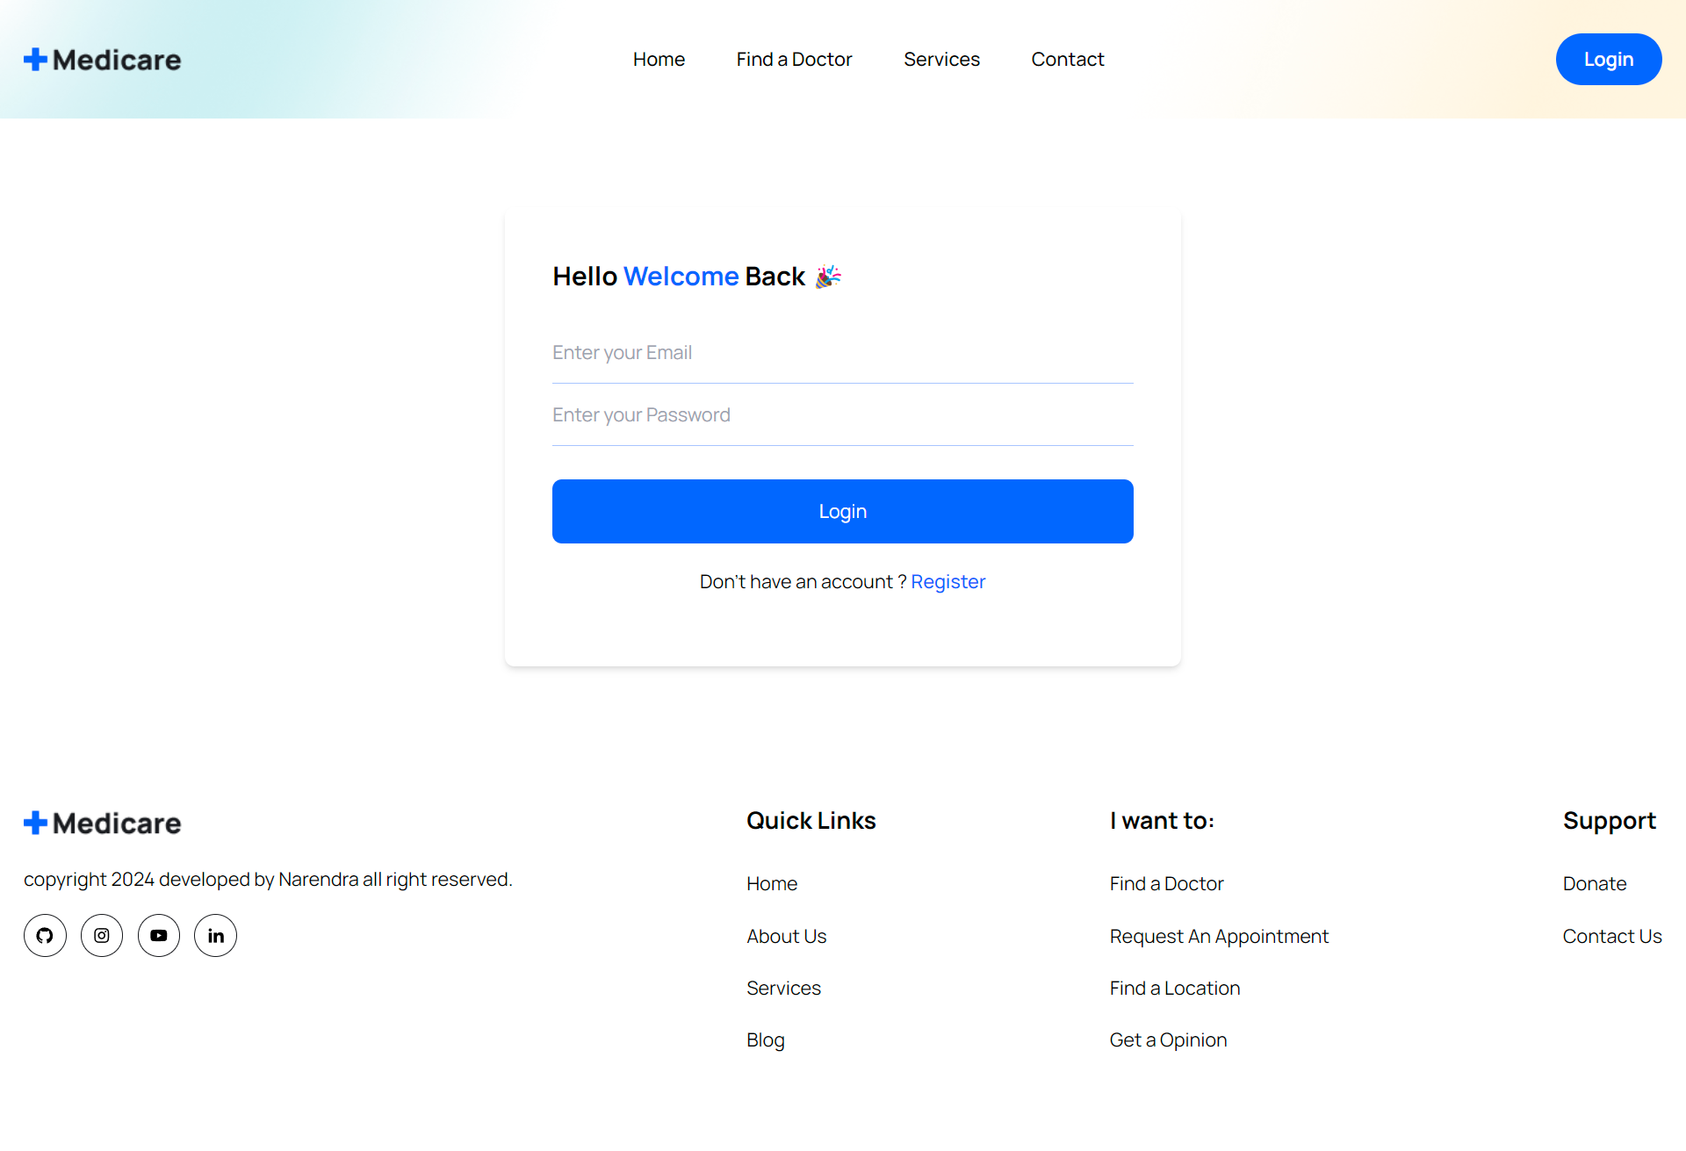
Sample Out of react Login page

Slide 14
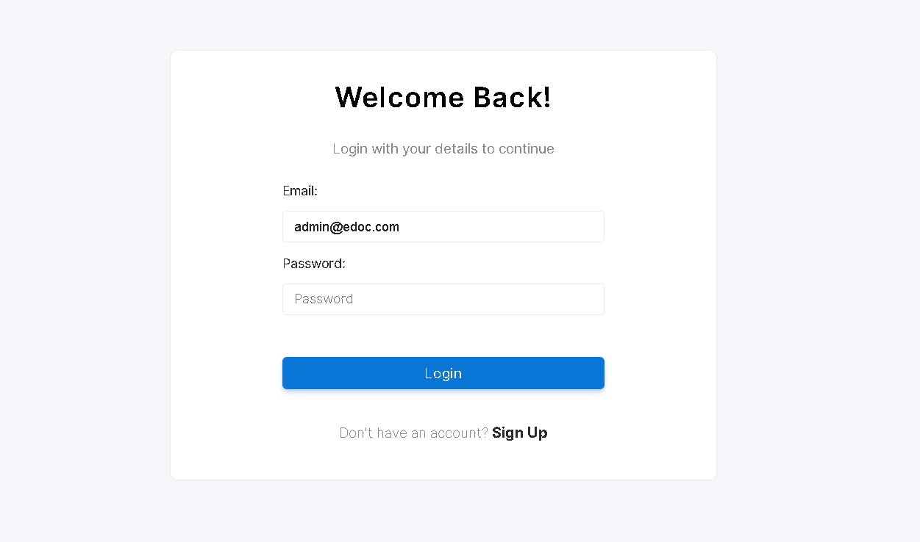

Slide 15
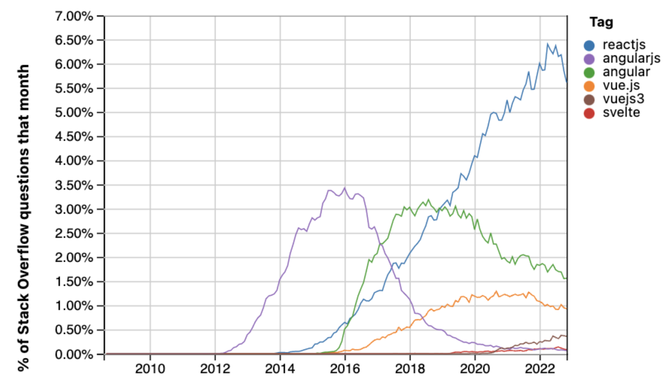
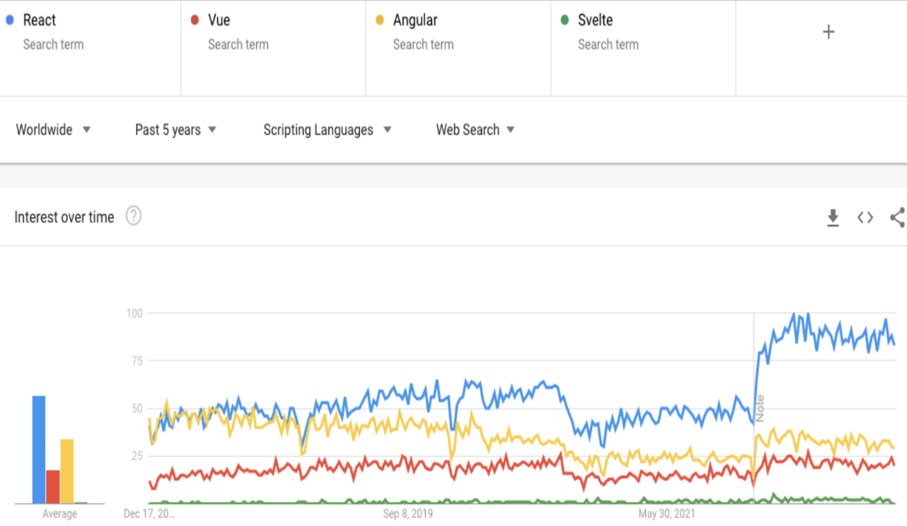
RESULTS
Based on analysis from popular sources like Stack Overflow and Google Trends, it's evident that React dominates the frontend development landscape.

Slide 16
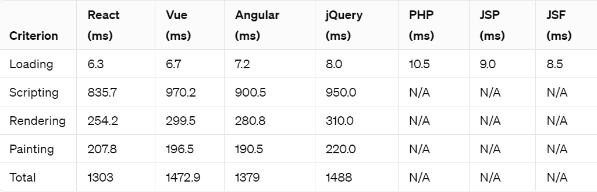
RESULTS (continues..)
After the execution of existing systems (which are developed using php, angular) and the proposed system (which is developed using React) we can find the difference in terms of loading, scripting and rendering etc.,

Slide 17
CONCLUSION
In conclusion, ReactJS presents itself as a transformative force in web development, offering unparalleled efficiency and performance.
As the technology continues to evolve, React's significance is poised to grow further, promising a bright future for developers keen on mastering its intricacies.
React’s seamless Virtual DOM, and extensive ecosystem make it the superior choice for developing frontend-centric web applications compared to other frameworks

Slide 18
THANK YOU

