Slide 1

Trade Statistics of India
Data Analytics(CS61061)
Novel Dataset Creation
(Group 24)
Team Members:
Narendra Kumar (25CS60R18)
Prithvirajsinh G. Jadav (25CS60R62)
Manav Chaniyara (25CS60R87)

Slide 2
Problem Statement
India’s import and export data is available, but raw and scattered across web portals.
Difficult for entrepreneurs, policymakers, and analysts to directly use.
Lack of standardized dataset that contains the imported or exported commodity with the information such as from which country it is imported or where it is exported, quantity and month and year.

Slide 3
Project Objectives
Collect & Organize the trade statistics
Generate a clean, consistent dataset
Dataset analysis

Slide 4
Data Collection
Data Source: https://www.commerce.gov.in/
Tools used:
Jupyter Notebook : For Dataset Creation
BeautifulSoup : Web scraping
Pandas : for merging, filtering
Tableau and Power BI : Data Analysis
Da

Slide 5
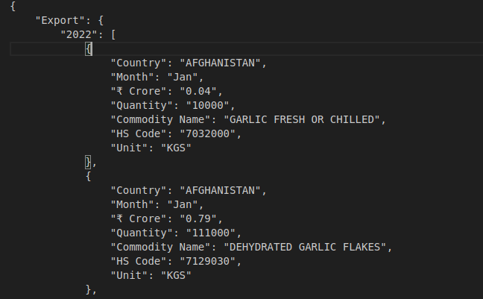
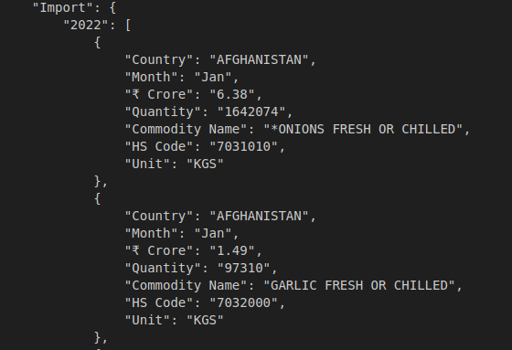
We have collected the Trade data of year 2022 to 2024 for both Import and Export in India.
Our Dataset content ~6 Million Filtered data.
Example

Slide 6
Flowchart
Access the Website
Use the primary source for gathering of raw data
Fetch the Raw data
Gather the raw data
Refine data
Merge the data collected from the multiple files in structured manner.
Data Analysis
Analyse the data using the tools such as Power BI, Tableau

Slide 7
Trade Analysis

Slide 8
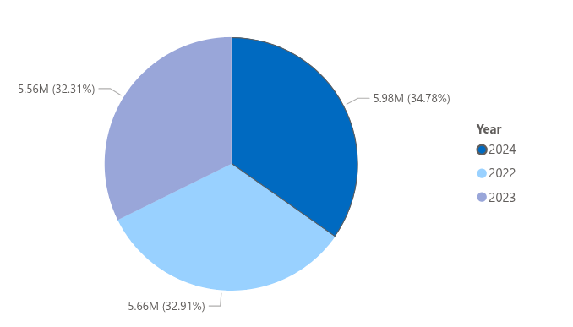
Year-Wise Total Import in Crores

Slide 9
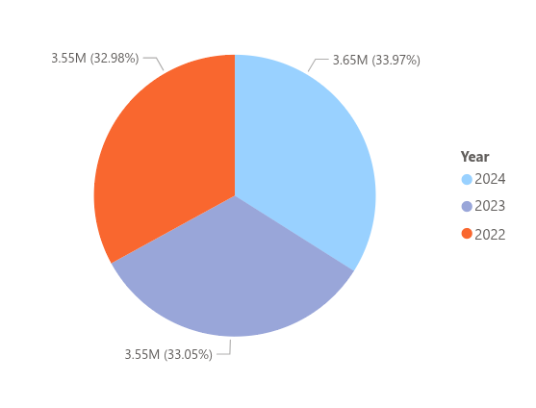
Year-Wise Total Export in Crores

Slide 10
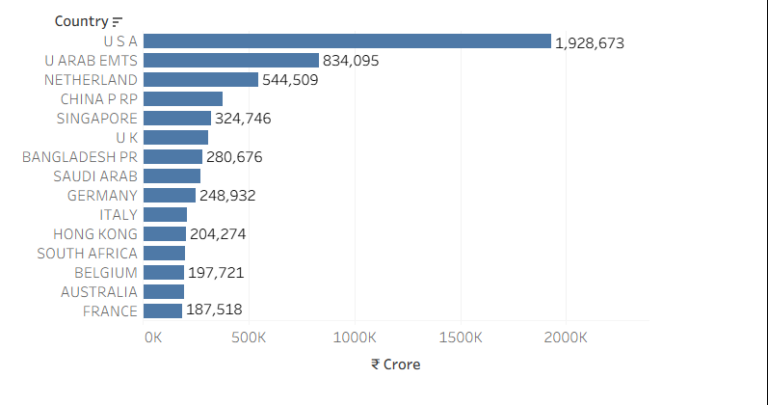
India Export To Top 15 Country

Slide 11
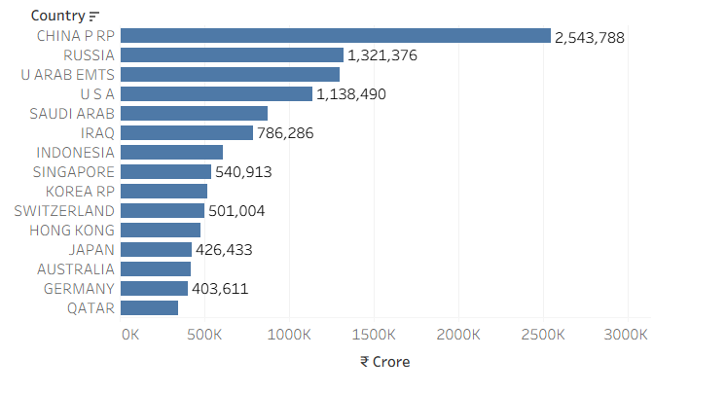
India Import From Top 15 Country

Slide 12
Reference
  https://www.commerce.gov.in/

Slide 13
Thank you

