Slide 1
PARVAM SDP Project
Web Development Journey: HTML to React
Project by: Narendra KUMAR H

Slide 2
Day 1 – HTML Basics
Introduction to HTML structure
Working with lists and tables
Creating a restaurant web page layout
Designing a simple table and form

Slide 3
Day 2 – Forms and Navigation
HTML forms and input fields
Validation and attributes
Adding navigation menus with links
Connecting pages together

Slide 4
Day 3 – Bootstrap Integration
Understanding Bootstrap grid system
Adding responsive design to web pages
Using Bootstrap components like navbar and cards
Enhancing UI of the restaurant project

Slide 5
Day 4 – JavaScript Fundamentals
Learning JavaScript basics
DOM manipulation and event handling
Interactive elements for the food project
Connecting JS logic with HTML structure

Slide 6
Day 5 – Restaurant Project using JavaScript
Dynamic food menu and order form
Calculating totals and displaying results
Enhancing UX with alerts and messages
Deploying the project locally

Slide 7
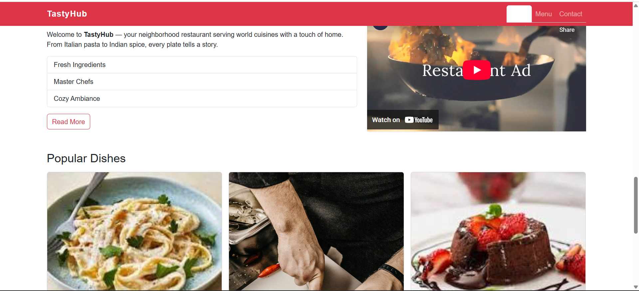
Restaurant website screenshot

Slide 8
Day 6 – React Introduction
Introduction to React and JSX
Setting up React app using Vite or CRA
Building restaurant project using React
Creating reusable components and managing state

Slide 9
Day 7 – Spices Company Project using React
Developing a company website for spices brand
Implementing multiple pages using React Router
Using props, hooks, and components effectively
Finalizing and presenting the full website

Slide 10
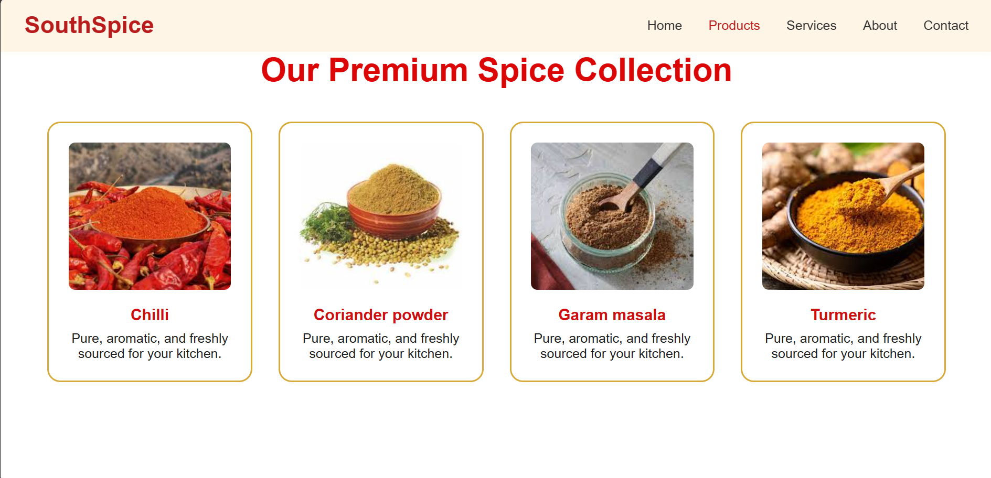
Spice website Screenshots

