Slide 1
BRAIN TUMOR DETECTION USING MULTIMODAL IMAGE FUSION TECHNIQUE
Under the supervision of Dr. M. Asha Rani
Presented by
M. Narendra Kumar (20011P0413)
Sai Amulya Iyyapu (20011P0421)
Thandra Vyshnavi (20011P0423)
Galithotti Nishant (20011P0424)

Slide 2
TABLE OF CONTENTS
Aim & Motivation
Literature Survey
Introduction
Methodology
Image Registration
Image Fusion
Image Segmentation
GUI Application
Output Demo
Comparison
Applications
Limitations
Conclusions
Future Scope
References

Slide 3
AIM & OBJECTIVES
Our aim is to develop an advanced algorithm and code for detecting brain tumors using multimodal image fusion techniques. By combining MRI and CT imaging, we aim to create a diagnostic tool that accurately identifies subtle abnormalities indicative of brain tumors.
The objectives of our project are:
To develop precise algorithm for fusing CT and MRI scans for brain tumor detection.
To implement landmark registration for accurate spatial alignment of MRI and CT scans.
To execute fusion with VGG-19 network for improved spatial and spectral features.
To apply watershed segmentation for precise tumor boundary delineation.
To craft GUI for seamless execution of all project steps. develop a code that when provided with multimodal images like CT scan image and MRI scan image detects the brain tumor by giving the fused image.

Slide 4
Introduction
A brain tumor is a mass or abnormal growth of cells within the brain or the central spinal canal. These tumors can be benign i.e., non-cancerous or malignant i.e., cancerous, and they can arise from different types of cells within the brain, including neurons, glial cells, and other supportive tissues. Brain tumors can manifest with a variety of symptoms, depending on their size, location, and rate of growth.
Multimodal imaging techniques involve the integration of multiple imaging modalities to provide a more comprehensive assessment of biological tissues or structures. These techniques combine the strengths of different imaging modalities, such as Magnetic Resonance Imaging (MRI), Computed Tomography (CT) to obtain complementary information about physiological processes, anatomy, and molecular characteristics.

Slide 5
LITERATURE REVIEW
“On the Performance of Deep Transfer Learning Networks for Brain Tumor Detection Using MR Images”:
Saif Ahmad and Pallab K. Choudhury's study demonstrated that the VGG-19-SVM model achieved 99.39% accuracy in brain tumor detection, highlighting the effectiveness of deep transfer learning methods.
“Image Classification of Brain Tumor Based on Enhanced VGG 19 CNN”:
Tian C and Zhao M introduced an enhanced VGG19 CNN model for accurately classifying CNS-pDLBCL and HGG from MRI images using transfer learning and SVM.
“Image Analysis for MRI-Based Brain Tumor Classification Using Deep Learning”:
Krisna Nuresa Qodri and team achieved high accuracy in MRI-based brain tumor classification using ResNet50 and VGG16 models with deep learning.
“Detection of Brain Tumor Using Digital Image Processing”:
Sheeba Khan’s research uses thresholding in digital image processing for MRI-based brain tumor detection, offering a simple, efficient GUI system for accurate tumor measurement.

Slide 6
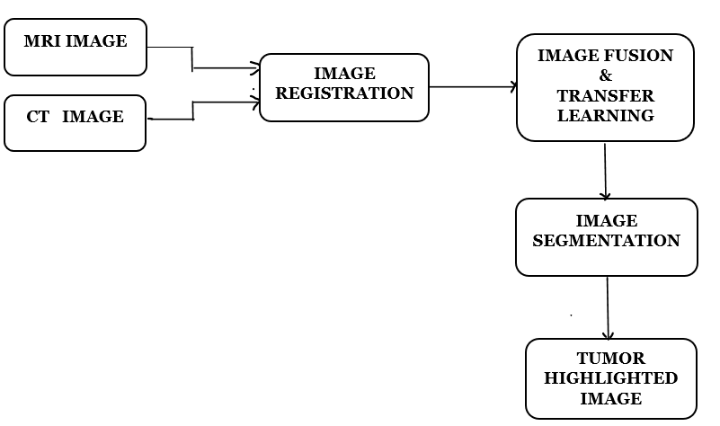
METHODOLOGY
Brain tumor detection using multimodal image fusion technique is a multi-step process that involves three basic stages Image Registration, Image Fusion and Image Segmentation.

Slide 7
Image Registration:
Image registration is the process of aligning two or more images into a common coordinate system.
Here Image Registration is performed using Procrustes Analysis with Landmark Registration.
Procrustes Analysis is a method to align shapes by removing differences in translation, rotation, and scaling.
It ensures that the shapes are optimally aligned by minimizing the sum of squared distances between corresponding points.
Landmark Registration uses corresponding points (landmarks) identified in each image to achieve alignment.
It Requires manual selection of corresponding points in the images to be registered.
The transformation matrix (transform) obtained from the Procrustes analysis is applied to the MRI landmarks.

Slide 8
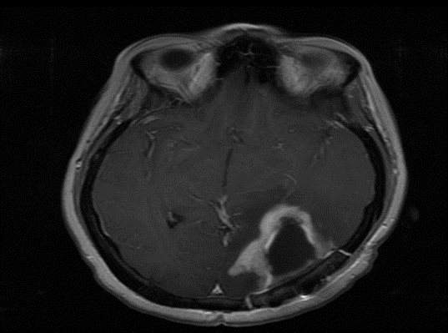
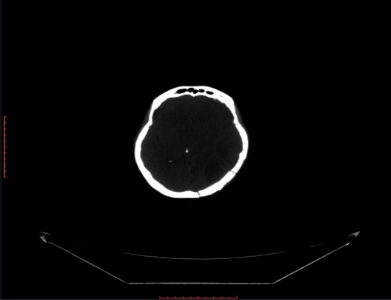
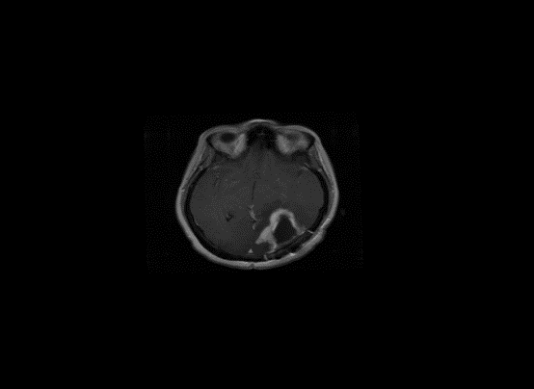
This transformation aligns the MRI landmarks with the CT landmarks, ensuring that corresponding landmarks are in the same spatial configuration.
MRI Image of a Patient CT Image of a Patient
MRI Registered Image

Slide 9
Image FUSION:
Image fusion combines information from multiple images to create a single, enhanced image with more comprehensive information.
Here image fusion combines the power of VGG19 feature extraction and wavelet transform decomposition to create highly detailed and informative fused images.
Image fusion is performed using the YCbCr color format, preserving detailed luminance information.
The discrete wavelet transform is applied to both a CT image and an MRI image, generating approximation and detailed coefficients in horizontal, vertical, and diagonal directions.
A VGG-19 model is implemented in PyTorch for fusion. It extracts features, and the fusion algorithm is applied to four pairs of coefficients (LL,LH,LV,LD)

Slide 10
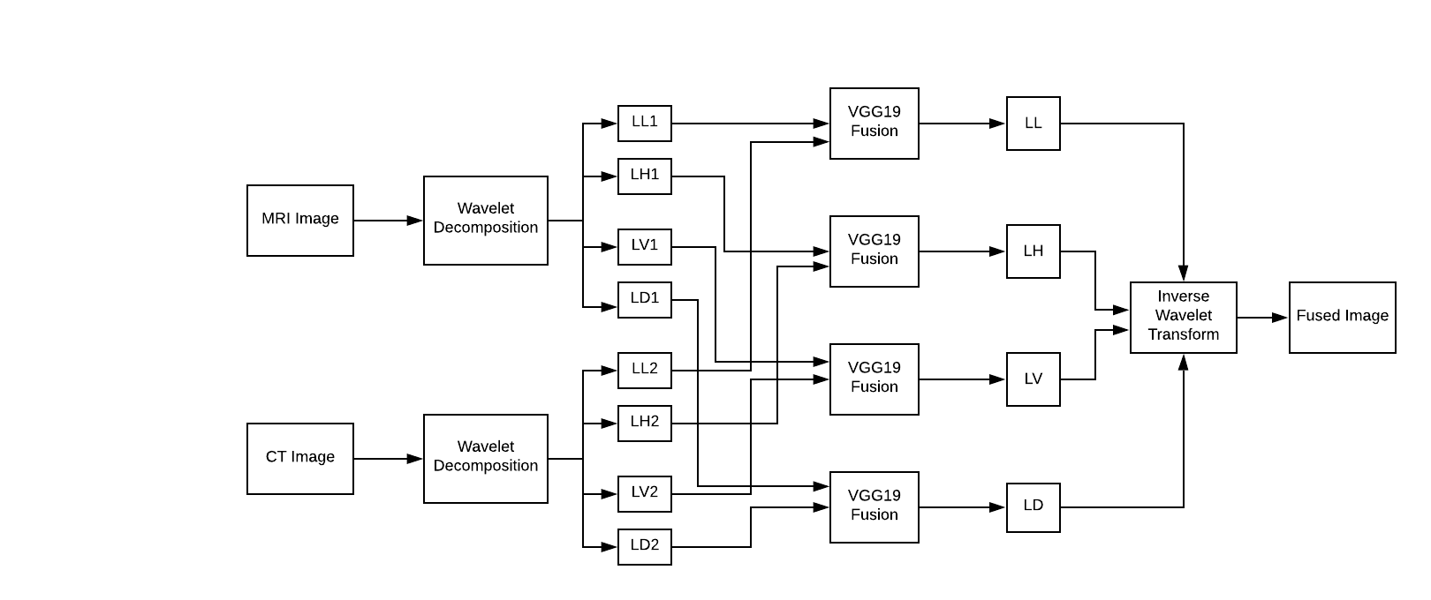
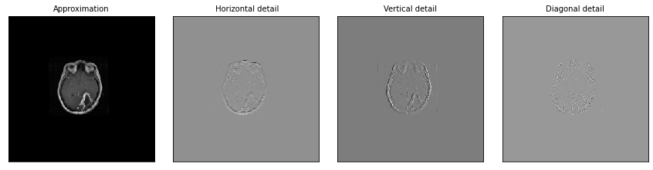
Process of Image Fusion:
MRI Image Decomposition:

Slide 11
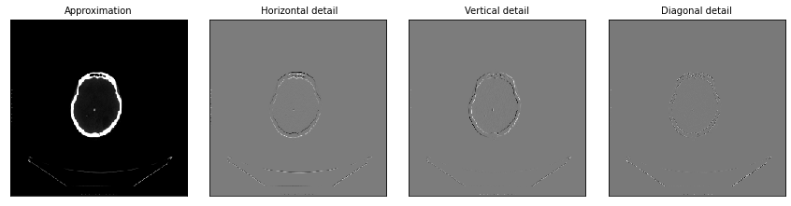
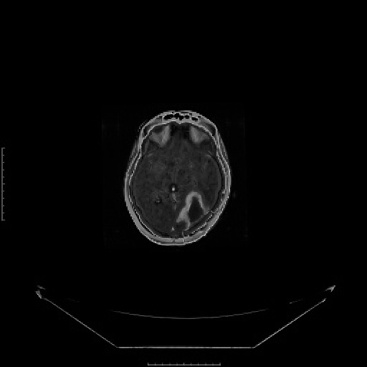
CT Image Decomposition:
Final Fused Image:

Slide 12
Image SEGMENTATION:
Image segmentation is the process of partitioning an image into multiple segments to simplify its representation or to aid in the identification of objects or regions within the image.
Here we have performed image segmentation using watershed algorithm.
The watershed algorithm is a powerful tool for image segmentation, particularly for delineating object boundaries.
It treats pixel intensity as topographic elevation and divides the image into catchment basins or segments based on intensity gradients.
The final segmented image is displayed, marking boundaries and highlighting different regions.
The segmented image and classification results can be used for monitoring the progression or regression of tumors over time.

Slide 13
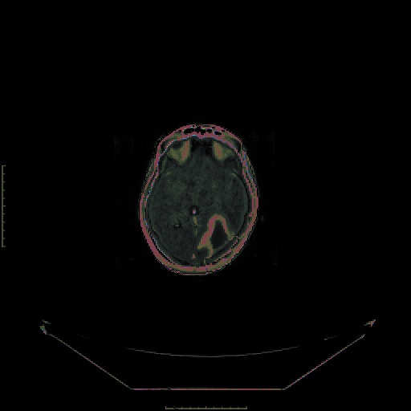
Following watershed segmentation, further processing steps are applied to refine the segmentation.
Techniques like morphological operations and distance transform may be used for noise removal and boundary smoothing.
The final output of the segmentation process is a set of segmented regions or objects within the image.
These segmented regions can then be analyzed further or visualized for interpretation.
Segmented Image:

Slide 14
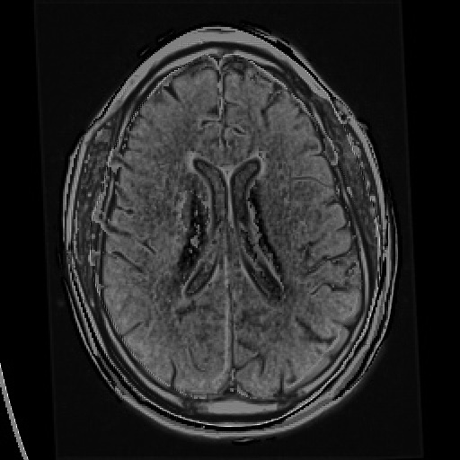
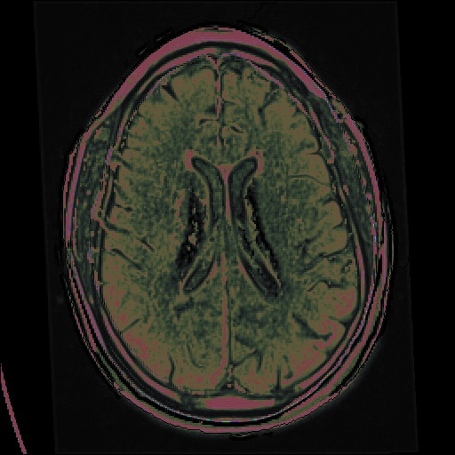
results & discussion
A Patient without Tumor:
Fused Image Segmented Image

Slide 15
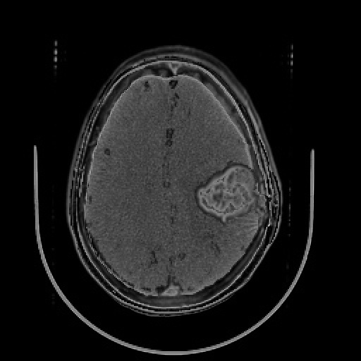
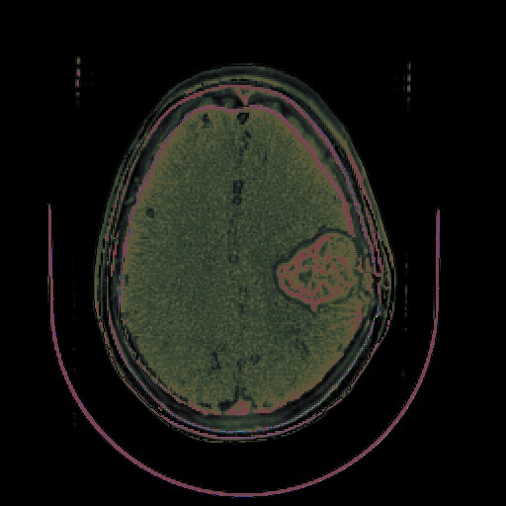
results & discussion
A Patient with Tumor:
Fused Image Segmented Image

Slide 16
GUI APPLICATION:
The Graphical User Interface (GUI) for the project is implemented. It will perform all the three tasks- Image Registration, Image Fusion, Image Segmentation on the input images and gives the final segmented image as output.
We have utilized a variety of essential libraries and modules in our script, they include Tkinter, PIL(Python Imaging Library), filedialog module, os module, numpy, matplotlib, OpenCV(cv2), imageio, scipy, argparse, torch, pywt.
Accepts medical imaging data, like MRI or CT scans as data input.
Provides a user-friendly interface for easy interaction with the tumor detection system.
Achieves high accuracy, sensitivity, and specificity in tumor detection.
Potential enhancements include integration with healthcare systems and continuous improvement in detection algorithms.

Slide 17
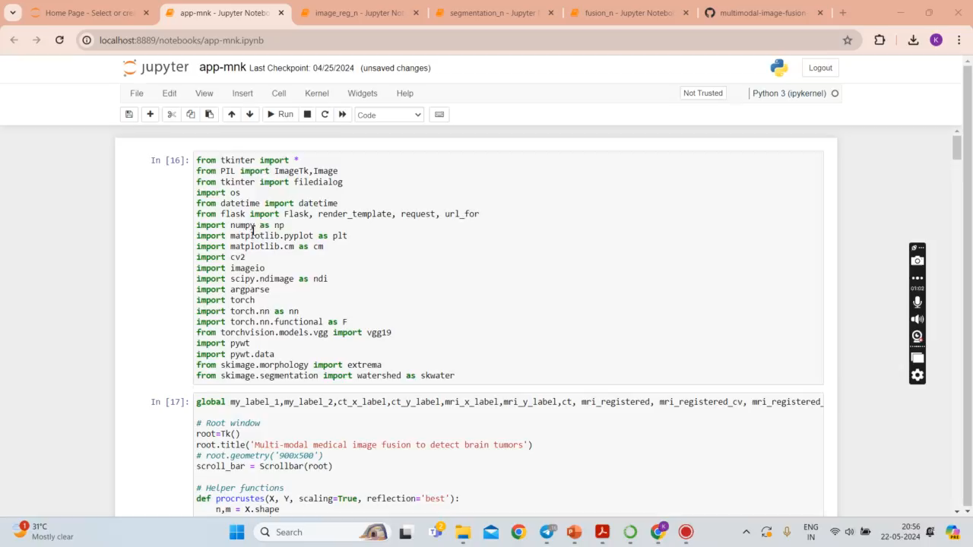
Output Video demo

Slide 18
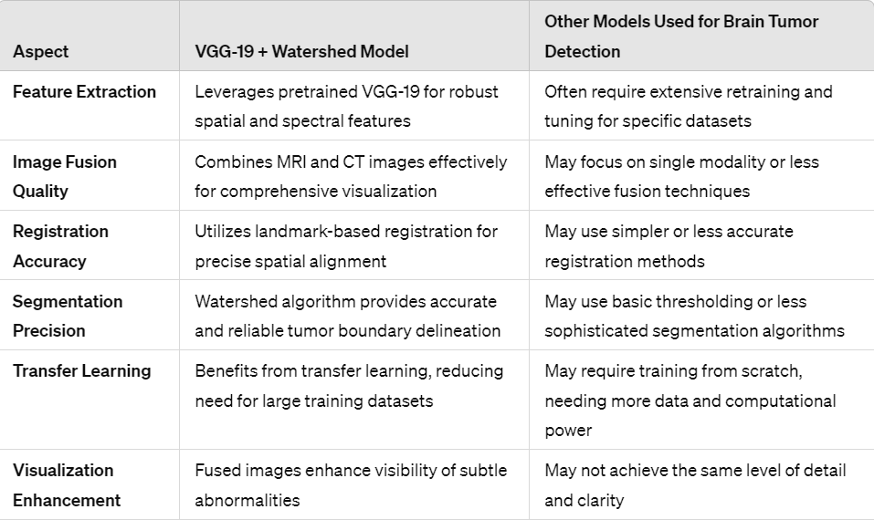
Comparison

Slide 19
APPLICATIONS:
Early Detection and Diagnosis
Precise Localization for Surgical Planning
Treatment Response Monitoring
Tailored Treatment Planning
Personalized Patient-Centric Care
Limitations:
Watershed Algorithm is sensitive to noise.
Obtaining High quality annotated MRI and CT images can be challenging.
Clinical Validation
Precisely delineating tumor boundaries is difficult.
Accurate Image Registration is critical.

Slide 20
Conclusions:
Effective Use of Pretrained Model (VGG-19)
Accurate Image Registration
Successful Integration of Multimodal Imaging
Better identification and delineation of subtle abnormalities
Precise Tumor Segmentation with Watershed Algorithm
GUI enabled seamless algorithm execution

Slide 21
Future scope:
Integration with Advanced Imaging Techniques
Telemedicine and Remote Diagnostics
Personalized Treatment Planning
Enhancing Diagnostic Precision
Computational Neuroscience
Pharmaceutical Research
Real-time Tumor Detection
Biomedical Engineering

Slide 22
REFERENCES
Enhancing Brain Tumor Detection on MRI Images Using an Innovative VGG19 Model Based Approach- Abdullah ŞENER, Burhan ERGEN - Sakarya University Journal of Science 27(5) – ISSN: 1301-4048, e-ISSN: 2147-835X – October -2023. [Pg No: 4 to 9]
On the Performance of Deep Transfer Learning Networks for Brain Tumor Detection Using MR Images- SAIF AHMAD and PALLAB K.CHOUDHURY, Volume-10, IEEE ACCESS.2022.3179376, June-2022. [Pg No: 5 to 12]
Image Classification of Brain Tumor Based on Enhanced VGG 19 Convolutional Neural Network- Tian C, Xi Y, Ma Y, Chen C, Wu C, Ru K, Li W and Zhao M- ISSN: 2640-1037 Volume 6, June-2023. [Pg No: 2 to 7]
Image Analysis for MRI-Based Brain Tumor Classification Using Deep Learning -Krisna Nuresa Qodri, Indah Soesanti, Hanung Adi Nugroho - IJITEE, Vol. 5, No. 1, March 2021. [Pg No: 2 to 8]
Detection of Brain Tumor Using Digital Image Processing- Journal of Health & Medical Informatics- Sheeba Khan- ISSN: 2157-7420- Research Article, Volume 13:06, 2022.

Slide 23
THANK YOU!

