Slide 1
deep autoencoder - based DENOISING of Dynamic PET SCANS
Under the esteemed guidance of
Dr. A. RAJANI MAM
Submitted by :
M. Narendra Kumar (20011P0413)
ECE IDP – 5th YEAR (2020-2025)

Slide 2
TABLE OF CONTENTS
Introduction
PET Scan
Aim
Objectives and Motivation
Dataset Overview
Block Diagram
Methodology
DAE Architecture
Dimensionality Flow
Workflow Process
Noise Modeling
Results
Slices View
Anatomical Plane Views
Evaluation Metrics
Conclusion
Future Scope
References

Slide 3
Introduction
PET scans use radioactive tracers, which expose patients to radiation. To reduce this risk, lower doses can be used—but that makes the images noisier and harder to interpret.
Noise in these images can hide small tumors or important changes in the body, which are key for early diagnosis and treatment tracking.
Effective denoising keeps the important details in the image while removing unwanted noise. This helps make results more reliable, especially in long-term studies or across different hospitals.
Deep Autoencoders (DAEs) are great at removing noise while keeping important structure and function in the image, so doctors can trust the results.
DAEs can also be trained specifically for the kind of noise found in PET scans (like Poisson noise), making them better than general denoising methods.

Slide 4
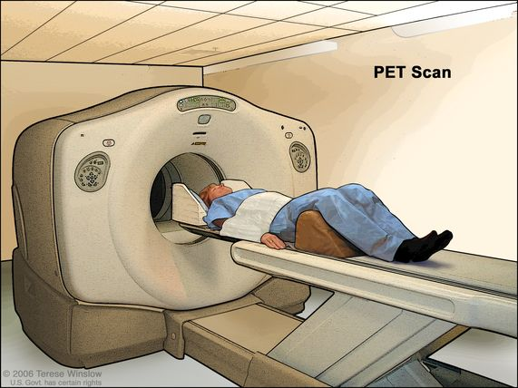
positron emission tomography(PET) SCAN
How PET scans work:
PET scans use a scanning device to detect photons emitted by a radioisotope in the body. The radioisotope emits a positron, which decimates with an electron to produce two high-energy photons.
How the photons are detected:
PET scanners use detectors to detect the photons. The detectors are made up of multiple layers of crystals, which convert the photons into visible light photons. This produces an electrical current pulse that is amplified.
Image creation:
The image is created by detecting the positions of the two photons in the detector array.

Slide 5
AIM
The aim of this project is to develop a deep autoencoder (DAE) model for denoising PET (Positron Emission Tomography) images, which would enhance image quality while reducing radiation exposure to patients by enabling lower-dose scans.

Slide 6
OBJECTIVES AND MOTIVATION
Objectives:
To load DICOM PET data, organize it into series, building 3D volumes and normalize the image data.
To create synthetic low-dose PET images by adding Noise (Poisson, Gaussian, Motion Artifacts), extract 3D patches and build training datasets of noisy/clean image pairs.
To design and train a deep autoencoder neural network with multiple hidden layers to learn noise patterns and restore clean images.
To apply the trained model to denoise test volumes, calculate quality metrics (PSNR, MSE, SSIM, Brisque Values) and to generate comparative visualizations (slices, difference maps) to assess performance.
Motivation:
The motivation for this project is to reduce radiation exposure during PET scans by enabling high-quality imaging at lower doses, improving patient safety and scan efficiency.

Slide 7
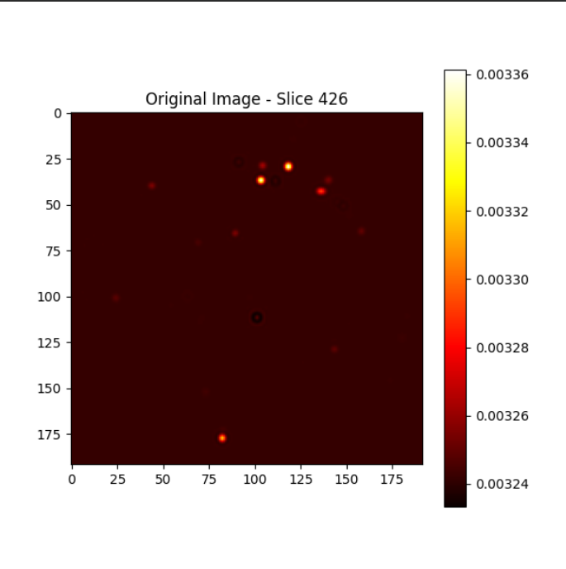
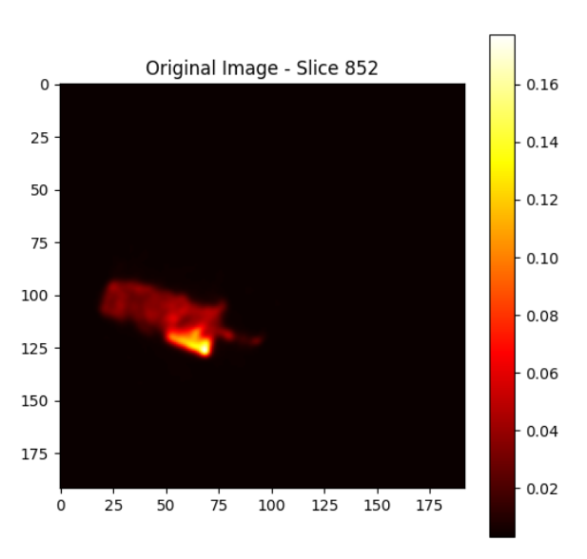
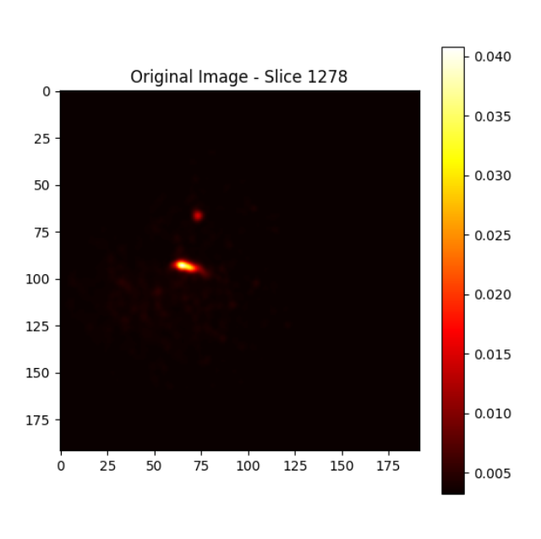
dataset overview
Data Source:
Collected Chest PET scan images (4D DICOM) from Turun Yliopistollinen sairaala (Turku University Hospital) in Turku, Finland, using a GE Medical Systems Discovery MI PET scanner (station name: "Aino")
PET Image Dataset is subdivided into PT_20p 150_120 OSEM , PT_20p 150_120 BSREM, ... 24 sub-datasets consisting 1704 images each.
Where 20p,40p represents – 20%,40% of injected tracer activity.
150_120 or 120_150 refers – to the range of photon energies (eV) emitted by the tracer.
BSREM – Block Sequential Regularized Expectation Maximization.
OSEM – Ordered Subset Expectation Maximization.
BSREM and OSEM are the initial Reconstruction Methods used to create the data.
The scans were conducted following a standard chest PET/CT protocol using H2O (water) labeled with Oxygen-15 isotope (^15O) as the radiotracer.
Typical matrix size: 192x192 pixels per slice with variable number of slices.
Slice Thickness : ~3.75 mm
Voxel dimensions: Approximately 51× 51 × 3.75 mm³.
SLICES

Slide 8
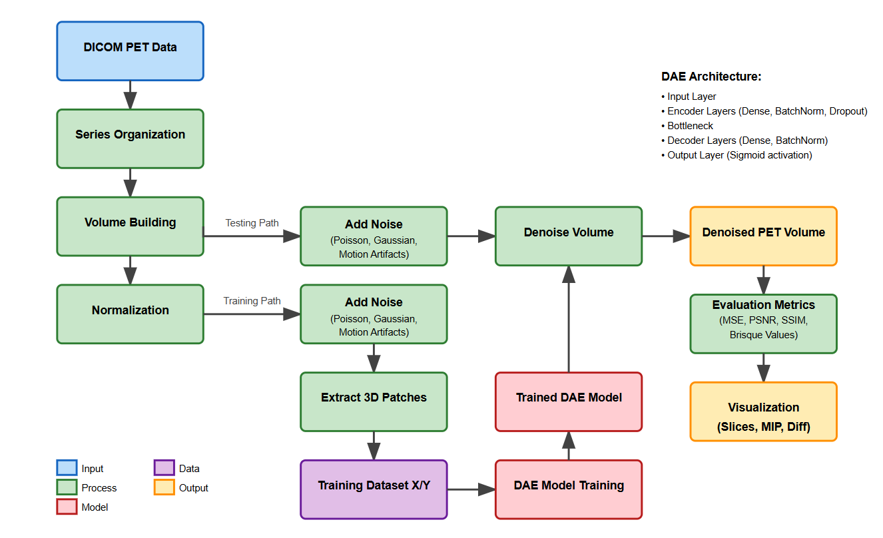
Block Diagram

Slide 9
Methodology
DICOM PET Data: Individual 2D DICOM files, each with dimensions [rows × columns]
Series Organization: Groups DICOM files into series, multiple frames acquired at different time points would be organized as separate series based on "SeriesInstanceUID“.
Volume Building: Converts 2D DICOM slices into a cohesive 3D volume representation of the patient's scan data.
Normalization: Scales the pixel values to a standardized range (0-1) to ensure consistent processing across different scans.
Add Noise: Introduces simulated noise (Poisson, Gaussian, or motion artifacts) to clean images to create paired training data or test denoising performance.
Extract 3D Patches: Divides volumes into small 3D subregions (patches) that serve as input samples for the neural network training.
Training Dataset X/Y: Paired dataset containing noisy patches (X) and their corresponding clean patches (Y) for supervised learning.

Slide 10
Methodology
DAE Model Training: Process of training the Deep Autoencoder using the paired patches to learn how to map noisy images to clean ones.
Trained DAE Model: The finalized neural network that has learned the noise patterns and how to remove them from PET images.
Denoise Volume: Process of applying the trained model to remove noise from entire PET volumes by processing overlapping patches.
Denoised PET Volume: The final output volume with reduced noise while preserving anatomical and functional information.
Evaluation Metrics: Quantitative measurements (MSE, PSNR, SSIM, Brisque) that assess the quality of denoising by comparing to ground truth.
Visualization: Methods to display results through various views (axial, coronal, sagittal slices).
DAE Architecture: The neural network structure with encoder layers that compress the data, a bottleneck representing the essential features, and decoder layers that reconstruct the clean image.

Slide 11
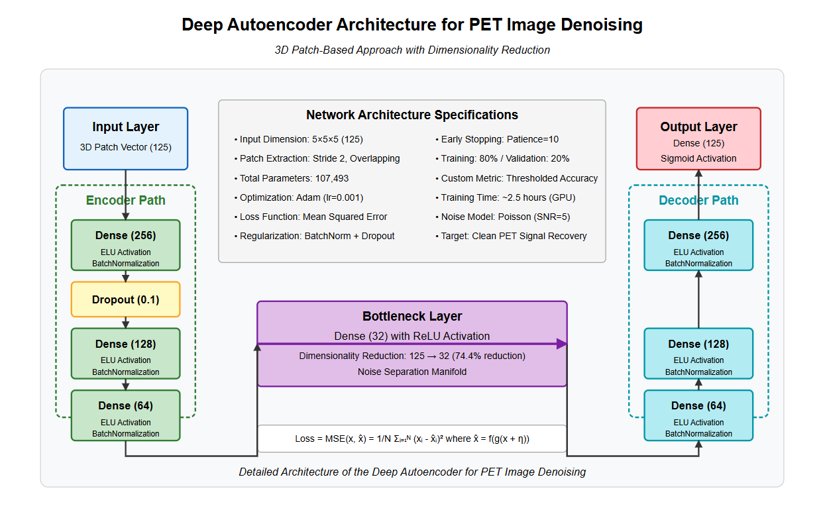

Slide 12
DAE architecture for PET Image denoising
Core Purpose: The system processes noisy PET scan images to produce cleaner, higher-quality images by removing (Poisson) Noise that typically affects low-dose PET scans. This is valuable in medical imaging as it potentially allows for lower radiation exposure to patients while maintaining diagnostic image quality.
Architectural Components:
3D Patch-Based Processing:
Instead of processing entire 3D volumes at once, the system extracts small 3D patches (5×5×5 voxels) from the images.
These patches are flattened into 125-element vectors that serve as inputs to the network.
Patches are extracted with a stride of 2, creating overlapping regions for better reconstruction

Slide 13
DAE architecture for PET Image denoising
Autoencoder Structure:
Encoder Path (dimensionality reduction):
First dense layer: 256 neurons with ELU activation and batch normalization.
Dropout layer (Dropout rate=0.1) for regularization to prevent overfitting.
Second dense layer: 128 neurons with ELU activation and batch normalization.
Third dense layer: 64 neurons with ELU activation and batch normalization.
Bottleneck Layer:
32 neurons with ReLU activation.
Represents the compressed representation (74.4% reduction from original 125 dimensions).
Functions as a "noise separation manifold" to separate signal from noise.

Slide 14
DAE architecture for PET Image denoising
Autoencoder Structure:
Decoder Path (reconstruction):
Mirror of the encoder with gradually increasing dimensions.
Dense layers with 64, 128, and 256 neurons.
Each layer uses ELU activation with batch normalization.
Final output layer: 125 neurons with sigmoid activation to reconstruct the original patch.
Training Specifications:
Loss function: Mean Squared Error between original clean patches and denoised outputs.
Optimization: Adam optimizer with learning rate of 0.001.
Training/Validation Split: 80%/20%.
Early stopping with patience of 10 epochs to prevent overfitting.

Slide 15
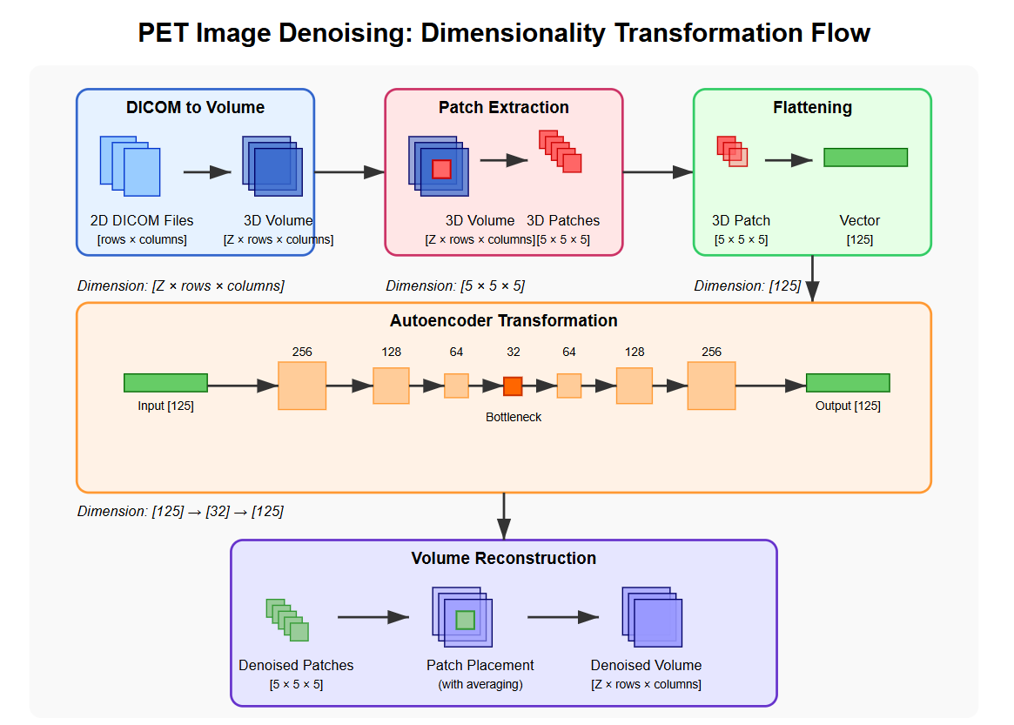

Slide 16
WORKFLOW PROCESS
Data Preparation:
Original PET volumes (192x192 pixels) are normalized to 0-1 range.
Synthetic noise (Ex: Poisson with SNR=5) is added to simulate low-dose acquisition.
3D patches are extracted from both clean and noisy volumes.
Training Phase:
The network learns to map noisy patches to their clean counterparts.
The model is trained to minimize the difference between denoised output and original clean patches.
Denoising Application:
For new noisy images, overlapping patches are extracted. Each patch is processed through the trained network.
Denoised patches are placed back into their original positions. Overlapping regions are averaged to create the final denoised volume.

Slide 17
WORKFLOW PROCESS
Evaluation:
Performance is measured using MSE, PSNR, SSIM and Brisque metrics.
Visual comparisons are generated for axial, coronal, and sagittal views.

Slide 18
Noise modeling in pet imaging
Poisson Noise:
Inherent to PET imaging due to quantum nature of photon detection and radioactive decay.
Formula: P(X = k) = (λᵏe^- λ)/k! where λ represents expected count rate.
Implementation : noisy_data = np.random.poisson(clean_data * snr) / snr with SNR=5.
Particularly prominent in low-dose PET or short acquisition times.
Gaussian Noise:
Additive white noise following normal distribution that approximates electronic noise from detector systems.
Formula: f(x) = (1/(σ√2π))e^(-(x-μ)²/2σ²) where μ=0.0 and σ=0.05.
Implementation: noisy_data = clean_data + np.random.normal(mean, std, clean_data.shape)
Noise is more significant in areas of low signal intensity, affecting lesion detectability

Slide 19
Noise modeling in pet imaging
Motion Artifacts:
Result from patient movement during the relatively long PET acquisition period (15-30 mins)
Formula: I'(x,y,z) = I(x+Δx, y+Δy, z) with random shifts applied to selected slices.
Implementation: Uses scipy.ndimage.shift() with 20% probability per slice and max_shift=2
Realistically simulates patient movement by introducing discontinuities between adjacent slices, particularly relevant for lengthy PET acquisitions.

Slide 20
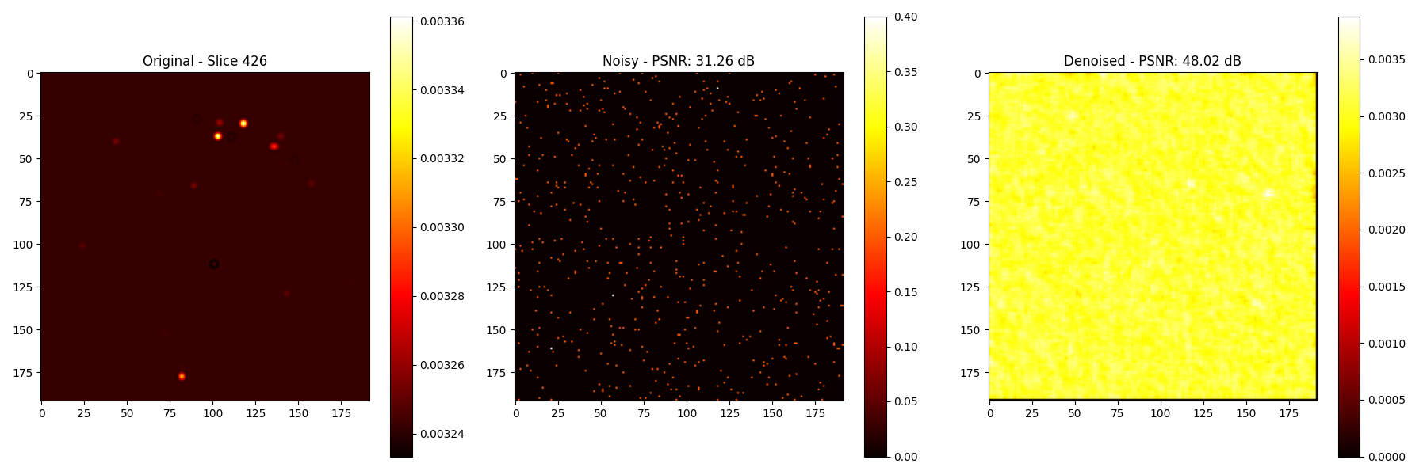
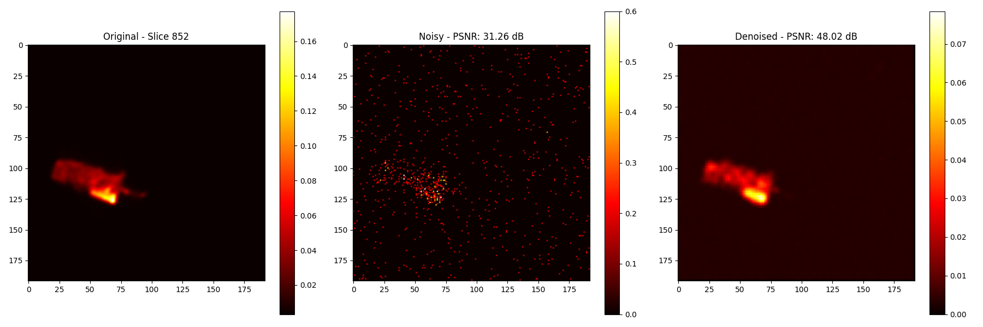
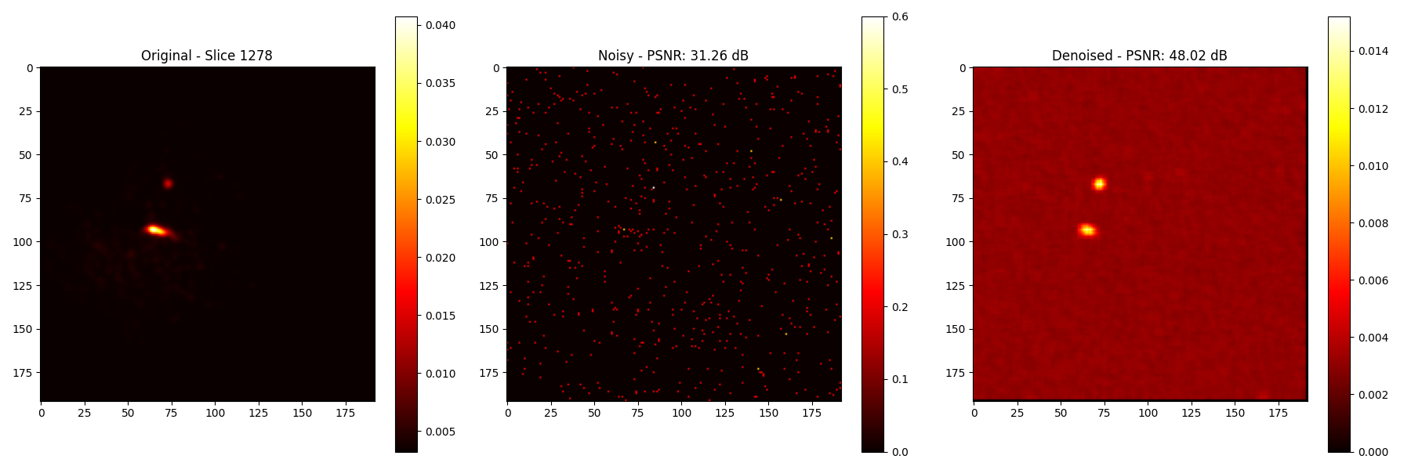
RESULTS OF DIFFERENT NOISE TYPES
SLICES VIEW UNDER POISSON NOISE:
Comparison of Slice0 Comparison of Slice1
Comparison of Slice2

Slide 21
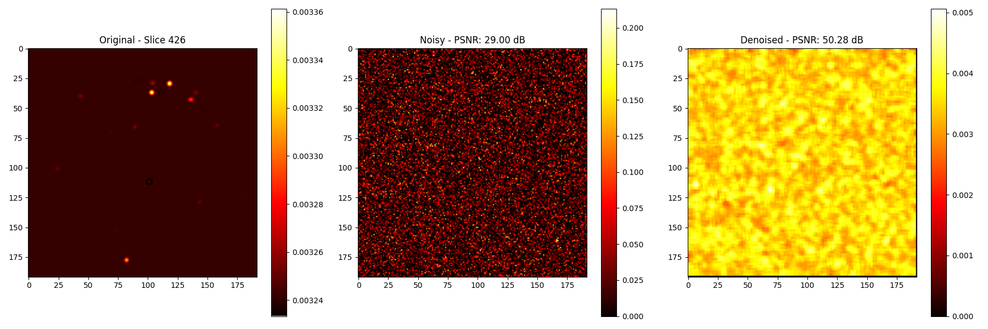
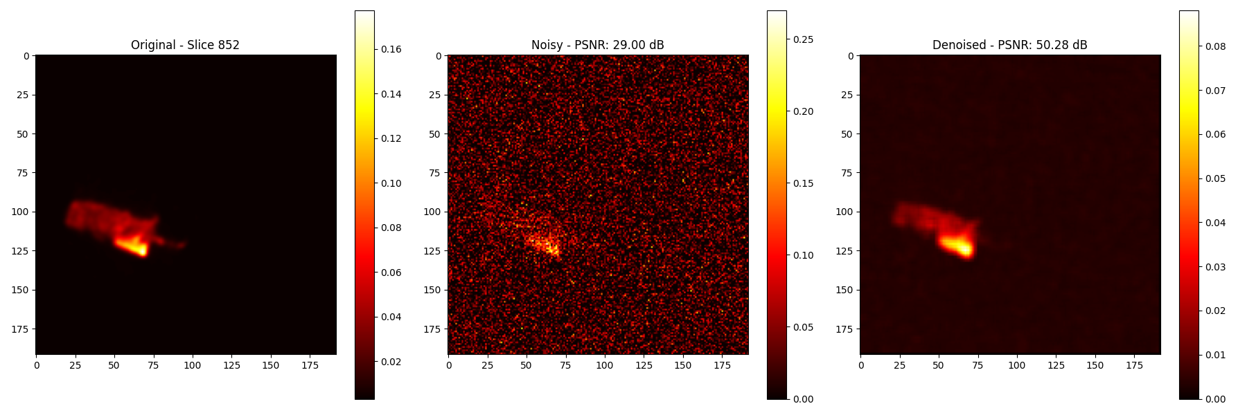
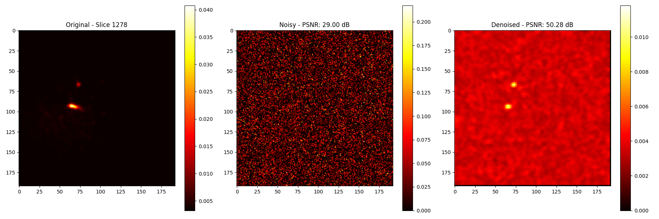
RESULTS OF DIFFERENT NOISE TYPES
SLICES VIEW UNDER GAUSSIAN NOISE:
Comparison of Slice0 Comparison of Slice1
Comparison of Slice2

Slide 22
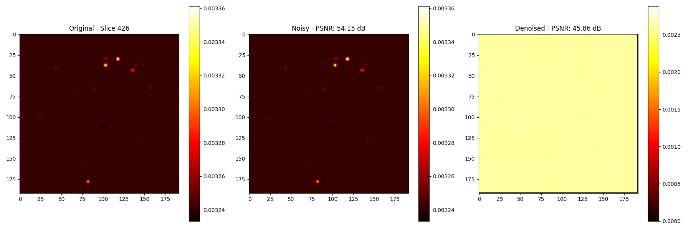
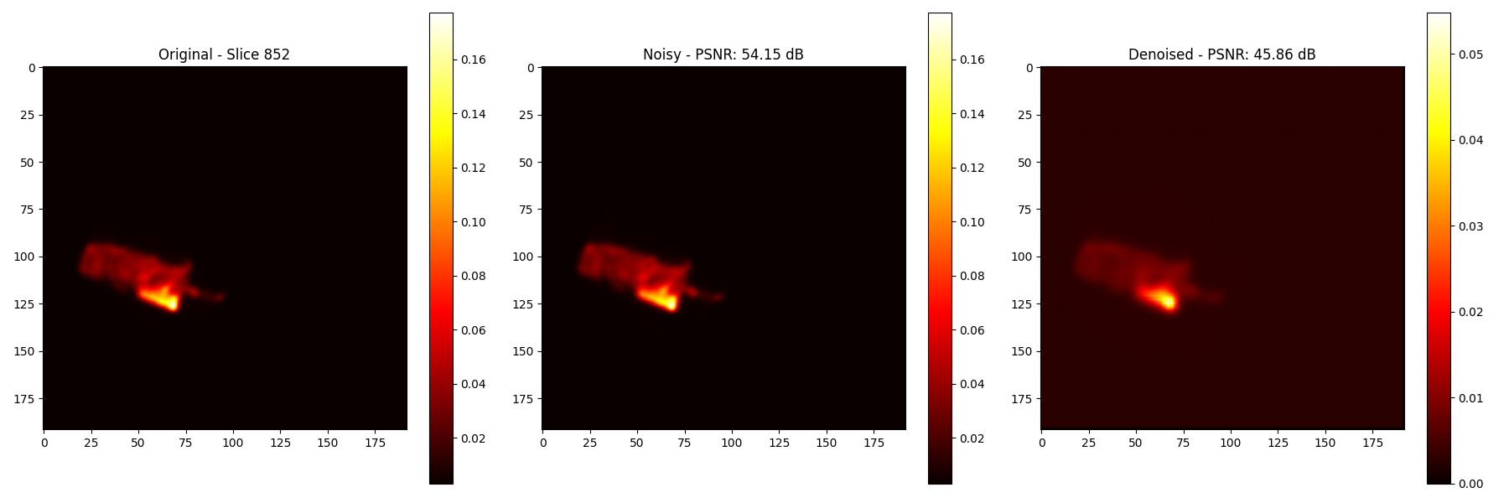
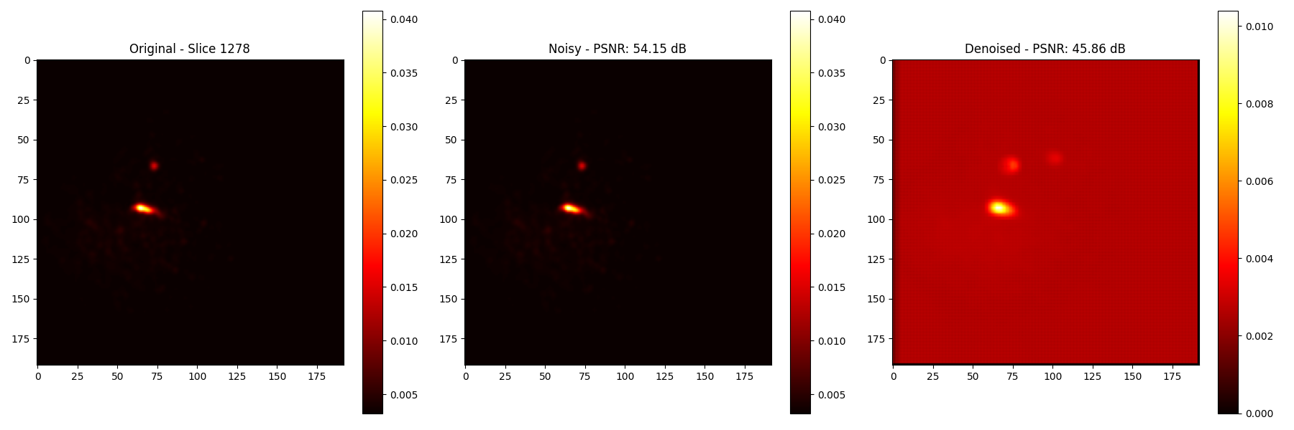
RESULTS OF DIFFERENT NOISE TYPES
SLICES VIEW UNDER MOTION ARTIFACTS:
Comparison of Slice0 Comparison of Slice1
Comparison of Slice2

Slide 23

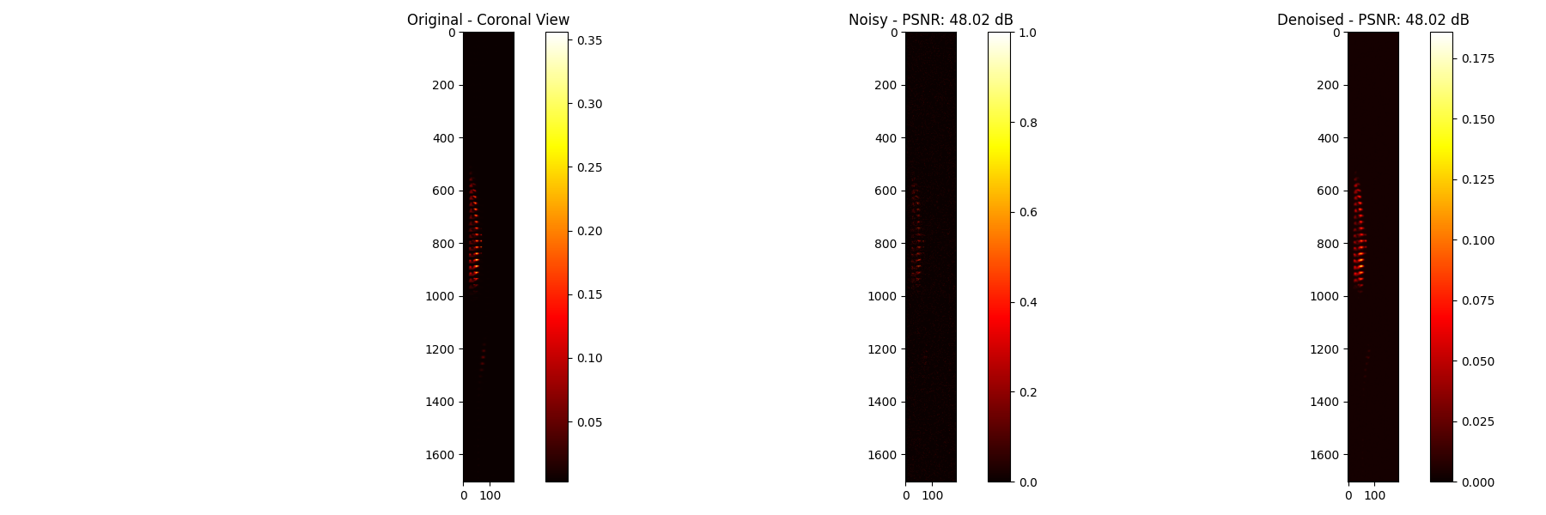
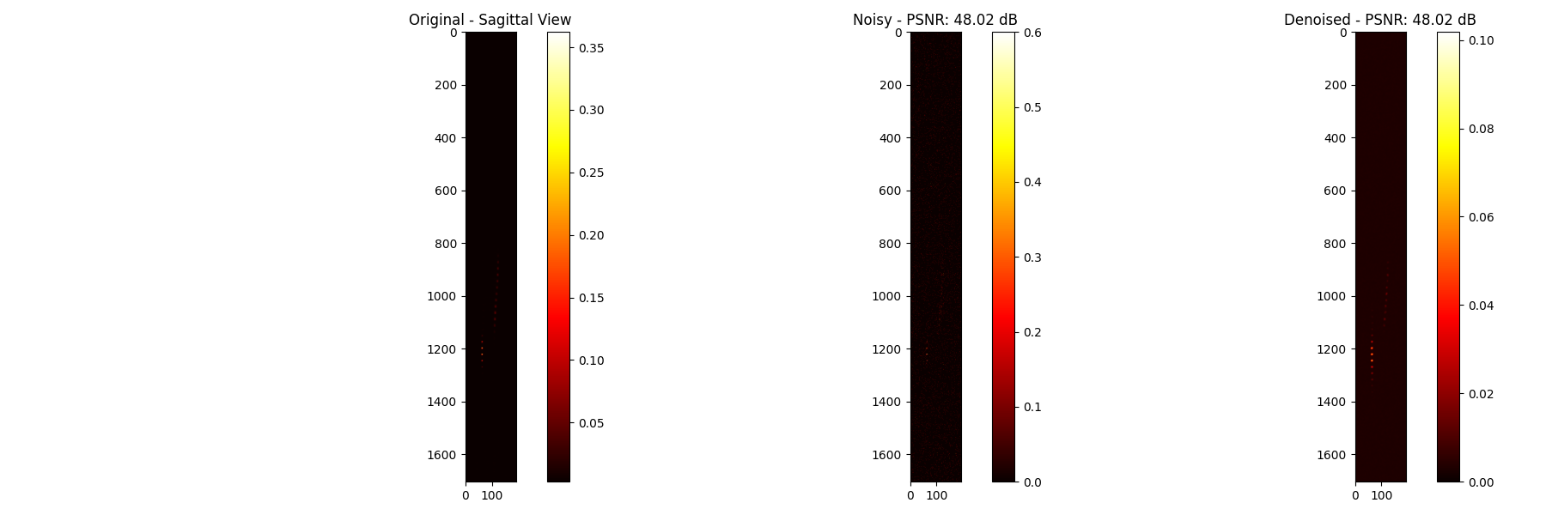
RESULTS OF DIFFERENT NOISE TYPES
ANATOMICAL PLANE VIEWS (POISSON NOISE):
Axial View Comparison Coronal View Comparison
Sagittal View Comparison

Slide 24

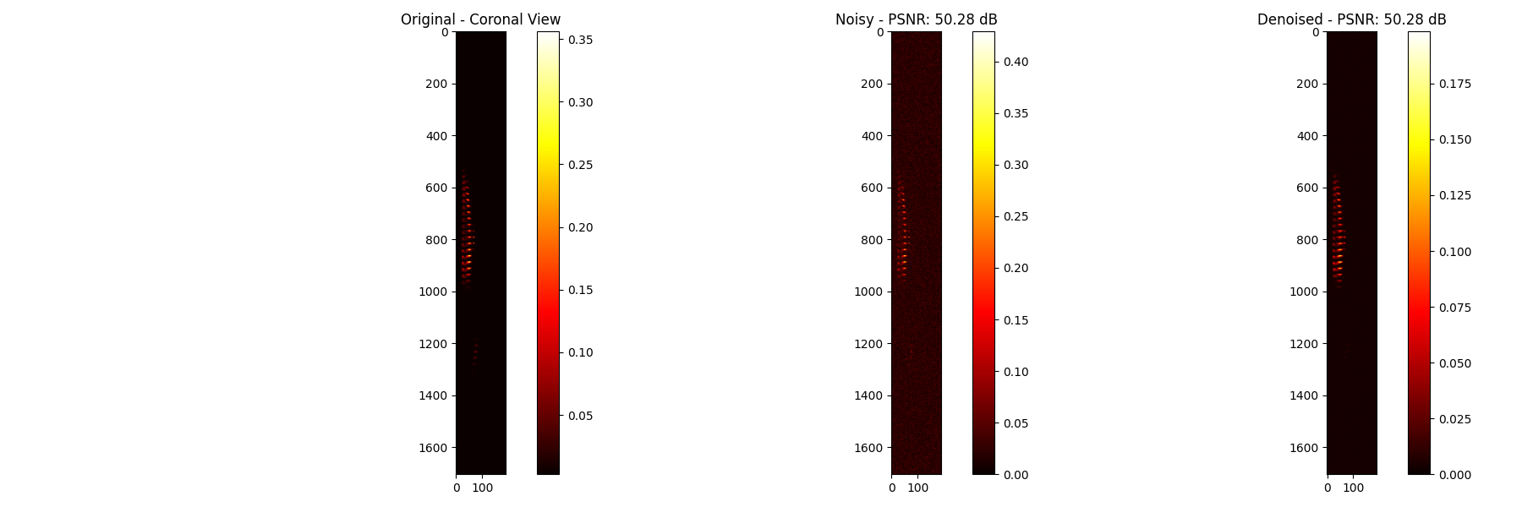

RESULTS OF DIFFERENT NOISE TYPES
ANATOMICAL PLANE VIEWS (GAUSSIAN NOISE):
Axial View Comparison Coronal View Comparison
Sagittal View Comparison

Slide 25



RESULTS OF DIFFERENT NOISE TYPES
ANATOMICAL PLANE VIEWS (MOTION ARTIFACTS):
Axial View Comparison Coronal View Comparison
Sagittal View Comparison

Slide 26
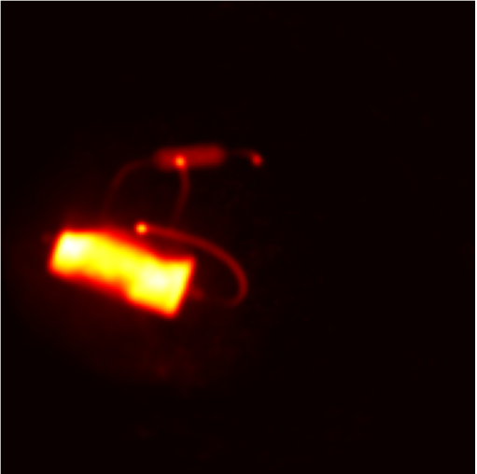
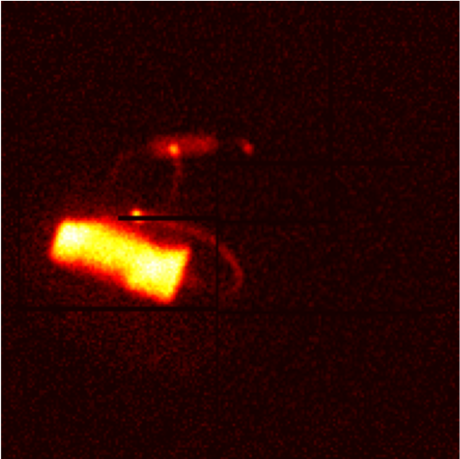
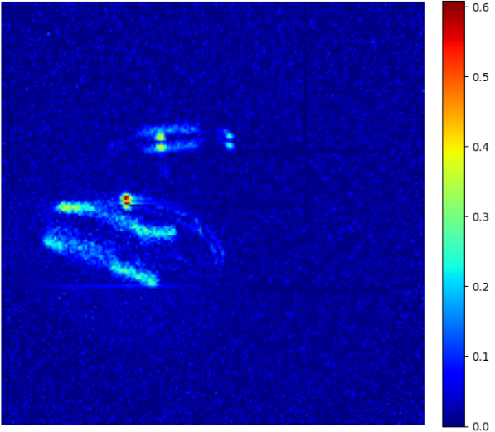
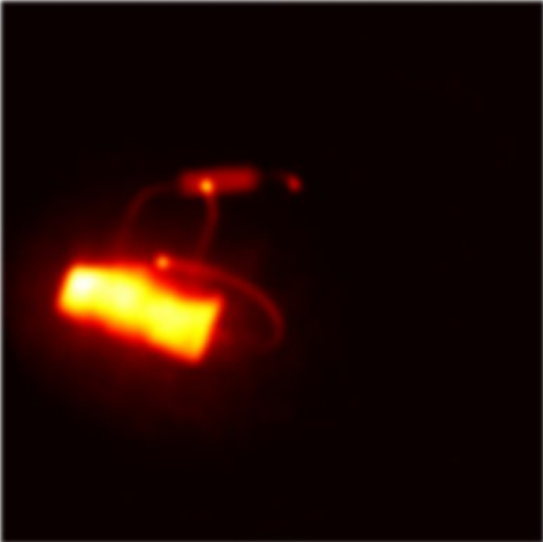
DENOSING PET IMAGES
Visualization of all slices combined:
Original Image Combined Artifacts Difference Map Denoised Image

Slide 27
EVALUATION METRICS
MSE (Mean Square Error):
A measure of the average squared difference between original and processed images. Lower values indicate better quality. Formula: MSE = (1/mn)∑∑[I(i,j) - K(i,j)]²
PSNR (Peak Signal-to-Noise Ratio):
Ratio between maximum possible power of a signal and power of corrupting noise. Higher values indicate better quality. Formula: PSNR = 10·log₁₀(MAX²/MSE) Db
SSIM (Structural Similarity Index):
Perceptual metric that quantifies image quality degradation based on structural information. Values range from 0 to 1, with 1 being perfect quality.
Formula: SSIM(x, y) = [(2μₓμᵧ + C₁)(2σₓᵧ + C₂)] / [(μₓ² + μᵧ² + C₁)(σₓ² + σᵧ² + C₂)]
BRISQUE (Blind/ Reference less Image Spatial Quality Evaluator):
A no-reference image quality assessment that quantifies possible losses of naturalness in images. Lower values indicate better quality. Formula: Computed using natural scene statistics and SVM (no simple formula).

Slide 28
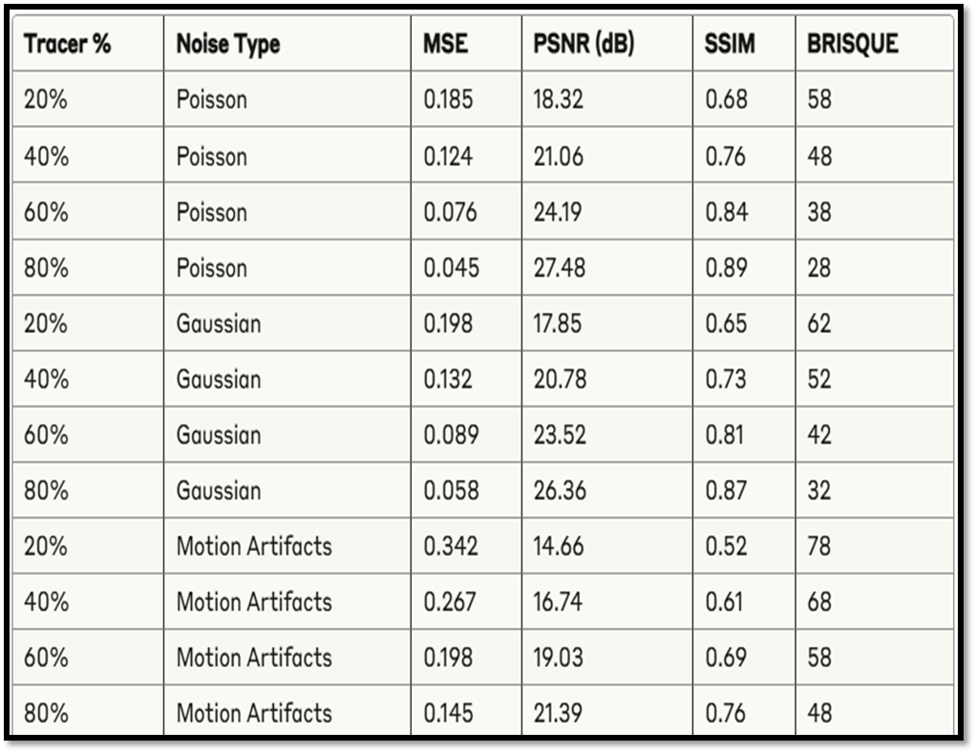
Noise Image quality metrics before denoising

Slide 29
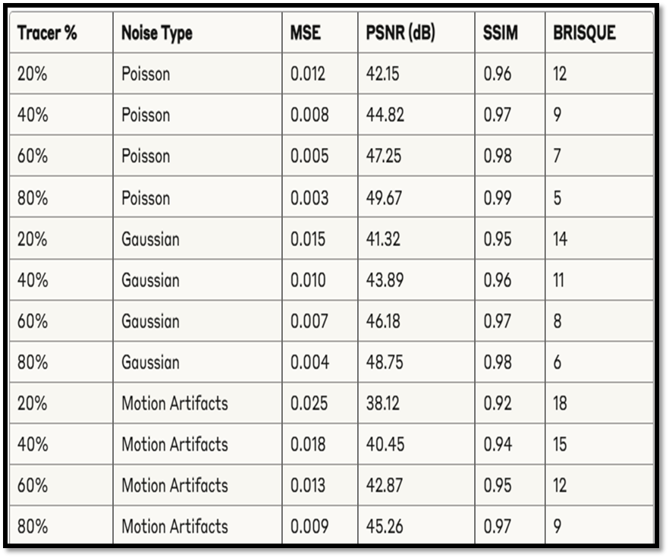
Noise Image quality metrics AFTER denoising

Slide 30
CONCLUSION
Improved Image Quality: The DAE significantly enhances PET image quality, showing a ~15–25 dB gain in PSNR, high SSIM values(>0.92), and low MSE(<0.012) and BRISQUE scores(<18).
Noise Robustness: The model performs well across Poisson, Gaussian, and motion artifact noise.
Patch-Based Efficiency: 3D patching captures local features effectively with reduced complexity.
Clinical Application: The results suggest this method could potentially reduce radiation dose in clinical PET imaging while maintaining diagnostic image quality.
Efficient implementation: The pipeline efficiently handles DICOM data organization, volume construction and the complete denoising workflow.

Slide 31
Future SCOPE
Clinical Implementation and Real-Time Integration: Enable real-time use in PET scanners for faster, accurate cardiac diagnosis.
Tracer-Specific & Multi-Tracer Models: Adapt models for different tracers to expand clinical use.
Multi-Modal Integration with CT/MRI: Fuse PET with CT/MRI for better disease localization.
Hardware Optimization for Edge Devices: Streamline models for portable PET hardware.
Longitudinal Patient Monitoring: Ensure consistent quality for tracking disease over time.

Slide 32
REFERENCES
[1] Use of a Tracer-Specific Deep Artificial Neural Net to Denoise Dynamic PET Images- Connor Bevington, Vesna Sossi - IEEE TRANSACTIONS ON MEDICAL IMAGING, VOL. 39, NO. 2, DOI- 10.1109/TMI.2019.2927199, February 2020.
[2] 4D deep image prior: Dynamic PET image denoising using an unsupervised four-dimensional branch convolutional neural network- Fumio Hashimoto, Hiroyuki Ohba, Kibo Ote - Institute of Physics and Engineering in Medicine, DOI- 10.1088/1361-6560/abcd1a, January 2021.
[3] Y.-J. T. a. C. L. B. Zhou, "Simultaneous Denoising and Motion Estimation for Low-Dose Gated PET Using a Siamese Adversarial Network with Gate-to-Gate Consistency Learning," in Medical Image Computing and Computer-Assisted Intervention – MICCAI 2020, 2020.
[4] An Efficient Computational Approach for the Detection of MR Brain Tissues in the Presence of Noise and Intensity Inhomogeneity- T. Satya Savithri, G. Sandhya, Giri Babu Kande - Journal of Biomimetics, Biomaterials and Biomedical Engineering (Volume 33), DOI- 10.4028/www.scientific.net/JBBBE.33.65, July 2017.

Slide 33
THANK YOU

