Slide 1
Hand Gesture Recognition using OpenCv on Raspberry Pi
The aim of our project is to create an interactive system that detects and recognizes hand gestures using open computer vision techniques and implement it on Raspberry Pi. The system aims to capture live video input from a webcam, process the frames and provide immediate feedback on the recognized gestures.
Under the esteemed guidance of Dr.M.Asha Rani Mam
BATCH -5
MADIREDDY NARENDRA KUMAR (20011P0413)
SAI AMULYA IYYAPU (20011P0421)
THANDRA VYSHNAVI (20011P0423)
GALITHOTTI NISHANT (20011P0424)
PEDAMALLA SAI CHAITHANYA (18011M2011)

Slide 2
Table of Contents:
Motivation
Objectives
Block Diagram and Methodology
Software and Hardware Requirements
Overview of Hand Gesture Recognition
Why Raspberry Pi?
Setting-up and Installation of Raspberry Pi OS
PuTTY and VNC Software
Audio Analysis and Visualization
Hand Gesture Recognition Output
Comparision of Implementation with and without Raspberry Pi
Applications
Conclusions
Future Scope
References

Slide 3
Motivation:
Our motivation for Hand Gesture Recognition is:
Image Processing
Influence of OpenCV and Raspberry Pi
Real-World Applications
Learning Opportunity
Long-Term Impact

Slide 4
Objectives:
Develop a robust code for hand gesture recognition that can accurately detect and recognize the hand gestures.
Simulation of the developed Python code in Visual Studio Code (VS Code).
Implementation of the simulated code on Raspberry Pi.
Generate a plot for the audio output received, in time and frequency domain using MATLAB Software.

Slide 5
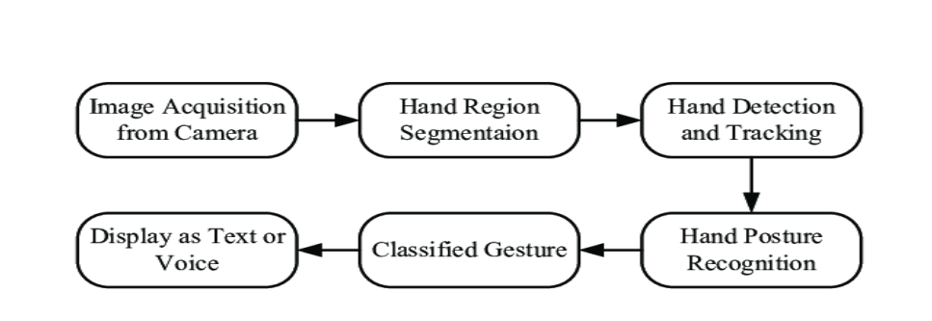
Block Diagram & Methodology
Hand gesture recognition is an emerging field enabling natural human-computer interaction by interpreting hand movements and configurations. OpenCV, with its powerful tools and Raspberry Pi compatibility, plays a vital role in implementing gesture recognition systems.
The various steps in the methodology for implementing Hand Gesture Recognition are:
Image Acquisition
Hand Region Segmentation
Hand Detection and Tracking
Hand Posture Recognition
Classified gesture
Display as Text or Voice

Slide 6
Software and Hardware Requirements
Software Requirements: Hardware Requirements:
Operating System - Raspberry Pi, 1. Raspberry Pi 4 Model B
- Windows 2. Processor (Intel® Core™ i5-8265U)
IDE – Visual Studio Code (VS Code) 3. HDMI cable and Ethernet Cable
Language Used – Python 4. Input Device (Mouse or keyboard)
Libraries Used: 5. Camera Module or USB Webcam
OpenCV 6. MicroSD Card and Card Holder
2. NumPy
3. Pygame
4. Imutils

Slide 7
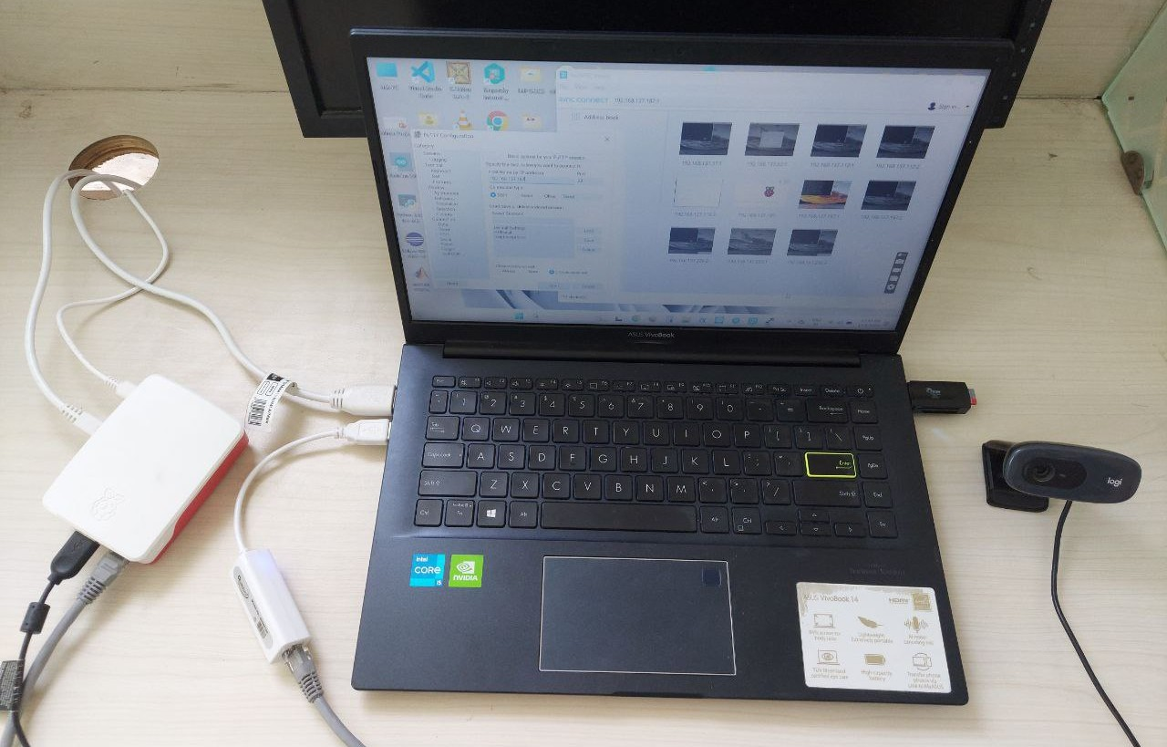
Arrangement of the Components

Slide 8
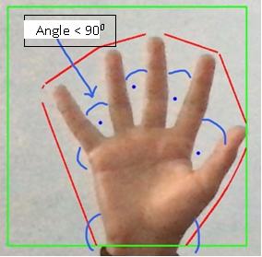
Overview of Hand Gesture Recognition
By harnessing OpenCV's capabilities in image processing, contour detection, and convex hull analysis, coupled with audio feedback from Pygame, we have created an interactive system capable of recognizing and responding to hand gestures in real-time. For this we have developed the code implemented with 4 different functions:
Contour Detection and Convex Hull
Defect Analysis and Gesture Recognition
Image Processing and ROI Definition
Textual Feedback and Gesture Display
Along with these functions we also have:
1. Real-time Gesture Recognition Loop
2. Initializing Pygame and Sound Effects
3. Defining Sound Files for Gestures
Gesture Recognition

Slide 9
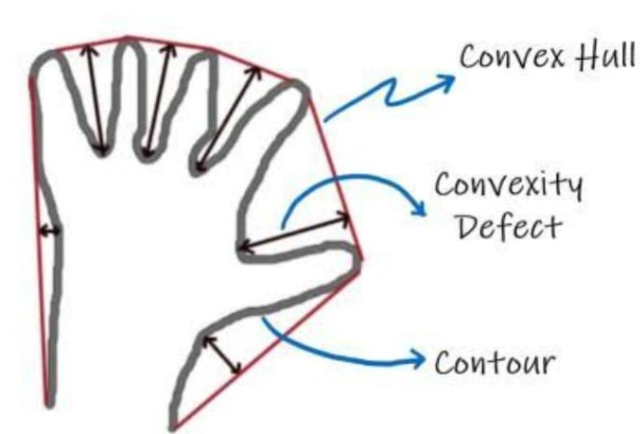
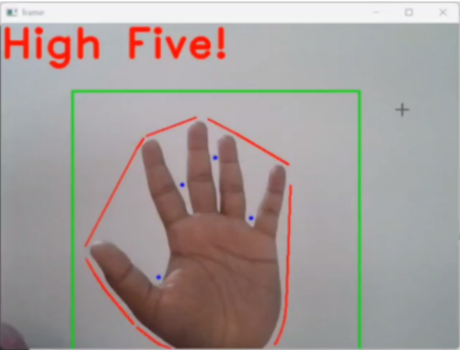
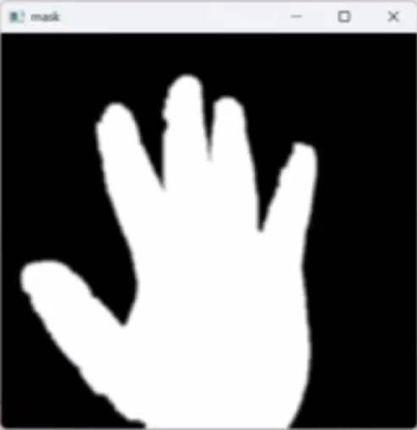
Overview of Hand Gesture Recognition
Here the 1st figure represents the basic algorithm that is followed in the implementation as explained earlier. The black outlined structure is the hand contour, the red outlined curve is the convex hull that is obtained from the contours_convex_hull() function from above.
The 2nd image is the frame output for a five finger gesture recognition giving the desired output display as “High Five!”. Here the green colored square is the Region Of Interest(ROI) that is being defined in our code. The 3rd figure is the mask image of the 2nd figure.
Figure -2 Figure-3
Figure-1

Slide 10
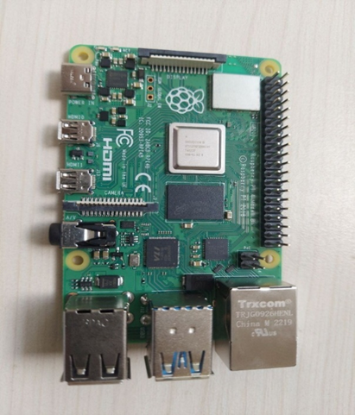
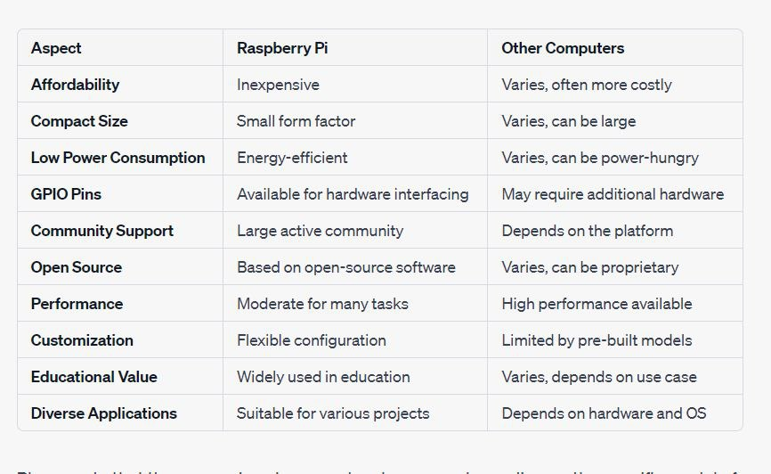
Why Raspberry Pi?
For implementation of this project Hand gesture recognition, we’ve looked at various computer hardware, and because of the below factors we’ve decided to implement the project on Raspberry Pi board.
Comparison between Raspberry Pi and Other Computers
Raspberry Pi 4 Model B

Slide 11
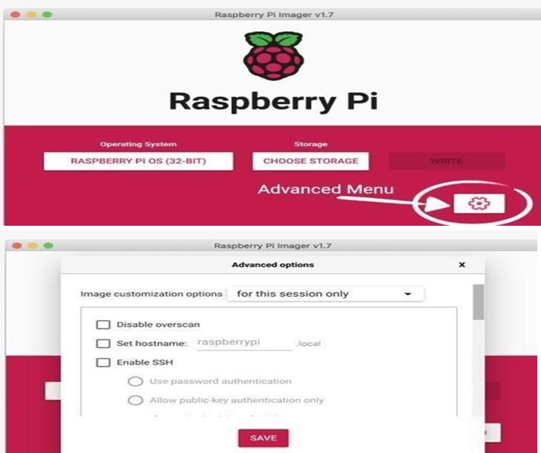
Setting-up and Installation of OS:
To set up a Raspberry Pi, we need a monitor, 8GB or larger micro SD card, network cable, webcam, HDMI Cable, USB to Lan port cable.
Installation of Raspberry Pi OS:
Download and install the Raspberry Pi Imager on the computer.
Insert the SD card into a card reader and connect it to the computer.
Open the Raspberry Pi Imager, choose your operating system, select your SD card and click on settings to set the username and password and click "Write”.
After completion of writing, create an SSH file in the SD card and eject it from the Computer.
Insert the SD card into your Raspberry Pi and power it on.
Raspberry Pi Imager

Slide 12
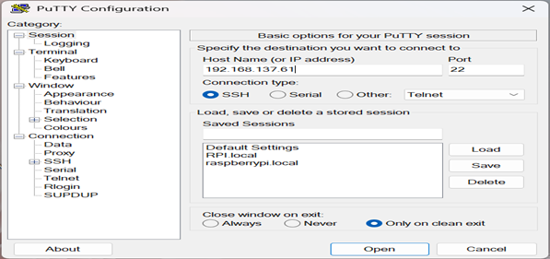
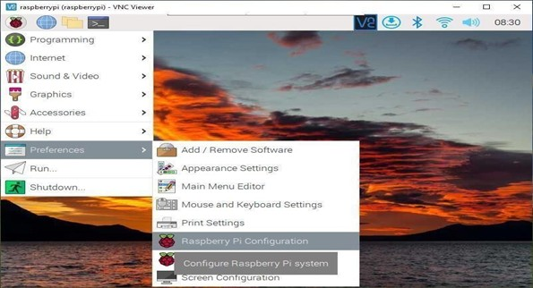
PuTTY and VNC Software:
We used PuTTY to set up a static IP address for our Raspberry Pi remotely.
VNC enabled us to remotely access the Raspberry Pi's graphical desktop, making it accessible without a physical monitor, keyboard, or mouse.

Slide 13
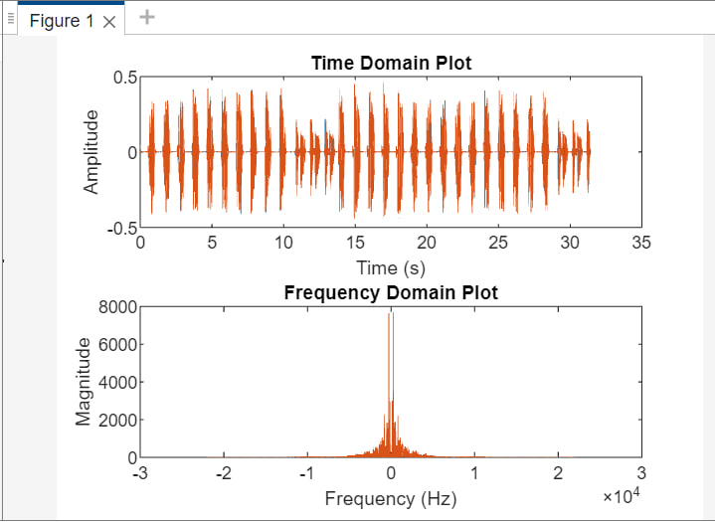
Audio Analysis and Visualization:
Using MATLAB, we process the audio data generated during the detection of hand gestures. This audio input, given to the vector generator captures the acoustic signals associated with various hand movements. Below is the time domain and frequency domain plots of the received audio output.

Slide 14
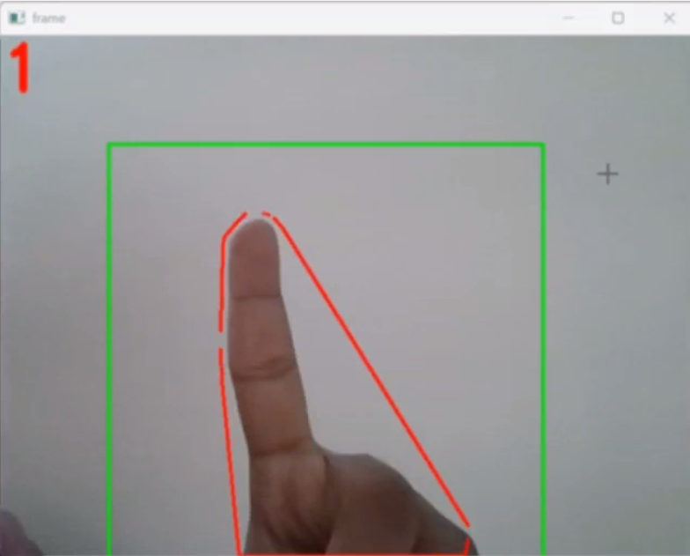
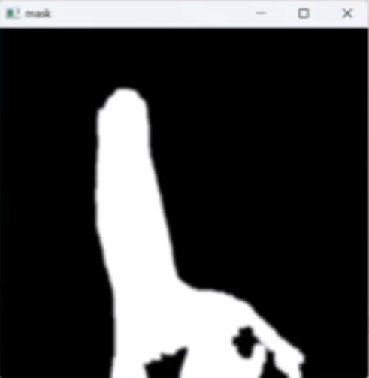
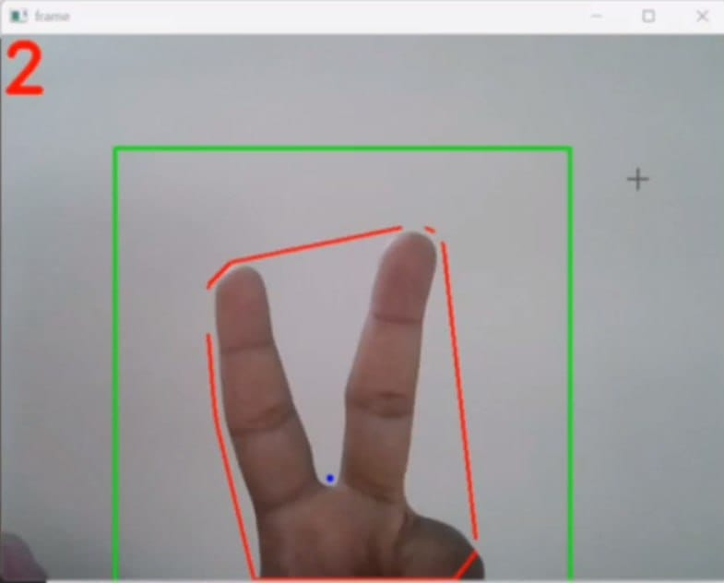
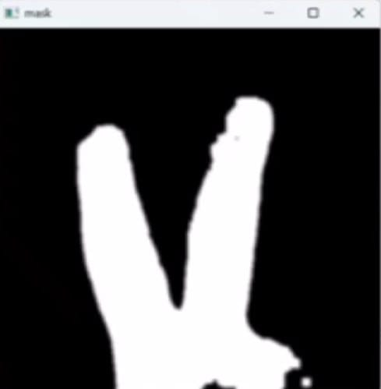
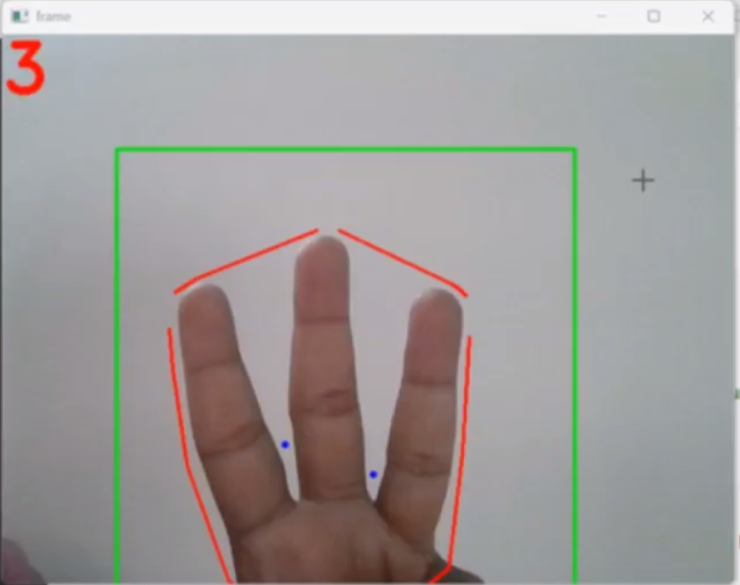
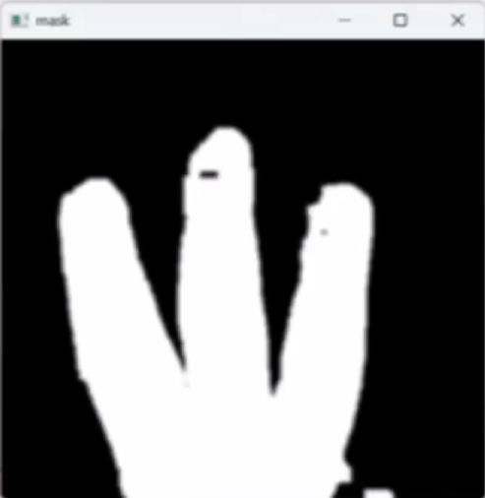
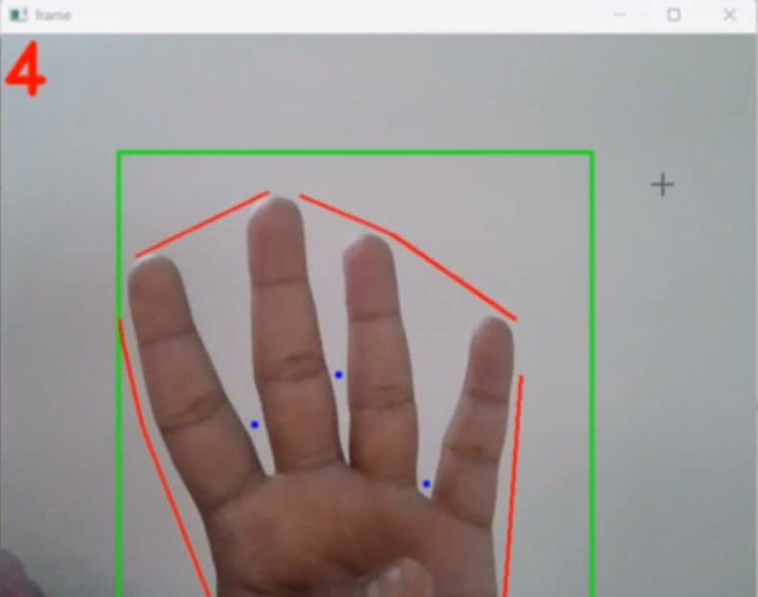
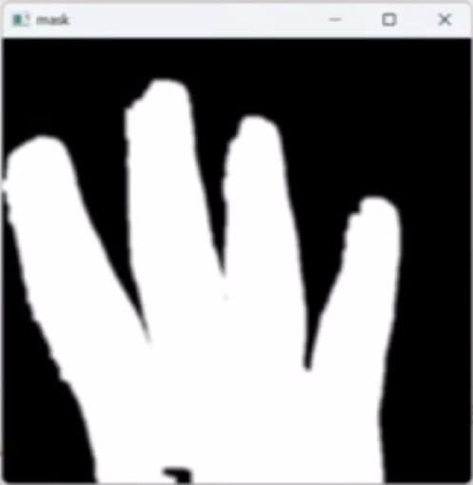
Hand Gesture Recognition Output:

Slide 15
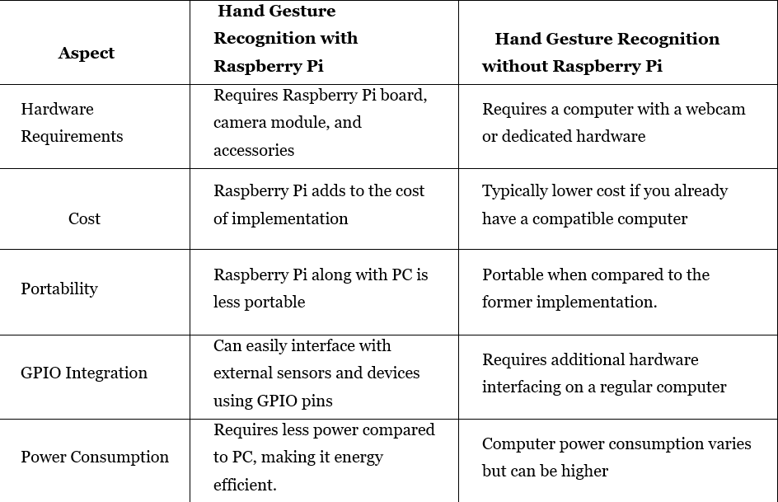
Comparison of Implementation with and without Raspberry Pi :

Slide 16
Applications:
Human-Computer Interaction (HCI)
Virtual Reality (VR) and Augmented Reality (AR)
Sign Language Interpretation
Healthcare and Rehabilitation
Gaming and Entertainment
Automotive Industry
Smart Home Control
Robotics
Accessibility and Assistive Technologies
Security and Authentication Systems

Slide 17
Conclusions:
In conclusion, this minor project focused on developing a hand gesture recognition system using OpenCV on the Raspberry Pi platform. Through this project, several outcomes and insights have been achieved:
System Development
Gesture Recognition Accuracy
Real-time Performance
Resource Optimization
Potential Applications

Slide 18
Future Scope:
Human-Computer Interaction (HCI)
Sign Language Interpretation
Gesture-Based Interaction in Augmented and Virtual Reality
Healthcare and Accessibility
Consumer Electronics
Security and Surveillance
Gaming and Entertainment
As technology advances and research in the field of computer vision and machine learning continues, hand gesture recognition is expected to become an integral part of our daily lives.

Slide 19
References:
Zhi-hua Chen, Jung-Tae Kim, Jianning Liang – “Real-Time Hand Gesture Recognition Using Finger Segmentation”. https://www.hindawi.com/journals/tswj/2014/267872/
Andrew D. Bagdanov, Alberto Del Bimbo, Lorenzo Seidenari, Lorenzo Usai, “Real-time hand status recognition from RGB-D imagery”. https://www.micc.unifi.it/seidenari/publication/icpr-12/icpr-12.pdf
https://www.researchgate.net/publication/284626785_Hand_Gesture_Recognition_A_Literature_Review
Hand Gesture Recognition: A Literature Review
https://core-electronics.com.au/guides/hand-identification-raspberry-pi/
https://www.scribd.com/document/472958515/Raspberry-Pi-Projects-Book-pdf
https://www.ijert.org/research/hand-gesture-recognition-system-to-control-soft-front-panels-IJERTV3IS120004.pdf
https://www.circuitbasics.com/raspberry-pi-zero-ethernet-gadget/
https://youtube.com/playlist?list=PLS1QulWo1RIa7D1O6skqDQ-JZ1GGHKK-K

