Slide 1

Event-Driven Automation with StackStorm
NarendraP
StackStorm: Event-Driven Automation Tool for DevOps and Infrastructure

Slide 2
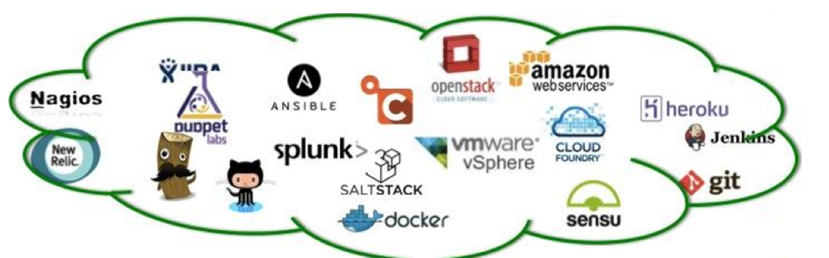

Introduction to StackStorm
StackStorm is an Open Source platform for integration and automation across services and tools.
Simply: DevOps Tools and Infrastructure Services
We can easily integrate and auomate all these tools using StackStorm adapters called sensors and actions.
StackStorm is primarily designed to focus on taking actions in response to events.
StackStorm: Event-Driven Automation Tool for DevOps and Infrastructure

Slide 3
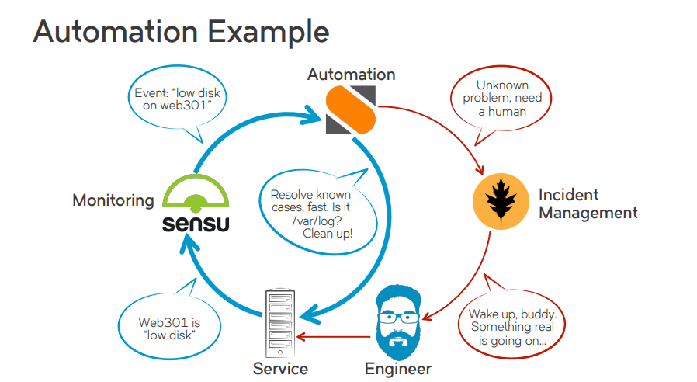
Simple Use Case
So, StackStorm is like IFTTT (If-This-Than-That) tool for DevOps and Infrastructure.
StackStorm: Event-Driven Automation Tool for DevOps and Infrastructure

Slide 4
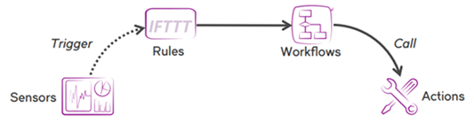
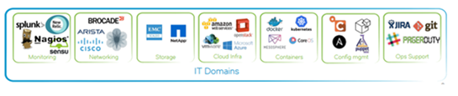
Concepts of StackStorm
Concepts:
Packs
Actions
Workflows
Rules
Triggers
Sensors
Webhooks
ChatOps
Why StackStorm for Automation ?
Open Source
Implemented with Python
StackStorm: Event-Driven Automation Tool for DevOps and Infrastructure

Slide 5
Prerequisites to Enroll this Course
Basic knowledge on Linux OS and Commands
Basics of YAML Scripting
Shell Scripting
Python Scripting
StackStorm: Event-Driven Automation Tool for DevOps and Infrastructure

Slide 6
Thank you

