Slide 1

Event-Driven Automation with StackStorm
NarendraP
StackStorm: Event-Driven Automation Tool for DevOps and Infrastructure

Slide 2
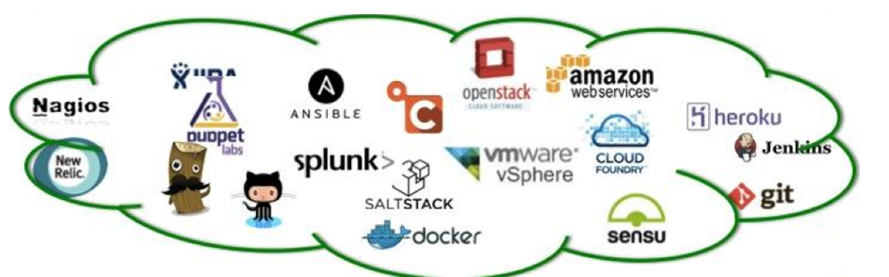

Introduction to StackStorm
StackStorm is an Open Source platform for integration and automation across services and tools.
Simply: DevOps Tools and Infrastructure Services
We can easily integrate and automate all these tools using StackStorm adapters called sensors and actions.
StackStorm is primarily designed to focus on taking actions in response to events.
StackStorm: Event-Driven Automation Tool for DevOps and Infrastructure

Slide 3

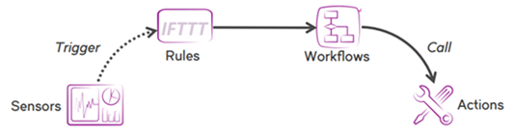
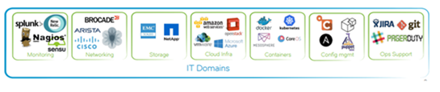
Event-Driven Automation with StackStorm
StackStorm
StackStorm: Event-Driven Automation Tool for DevOps and Infrastructure

Slide 4







Event-Driven Automation with StackStorm
It like IFTTT (If-This-Than-That) tool for DevOps and Infrastructure.
Pre-Defined Rules:
Event-1 (DDown) then Execute Start Docker Cmd
Event-2 (Hdown) then Execute Start Httpd Cmd
Unknown Event then Raise an Incident
DDown
HDown
Docker Httpd
StackStorm: Event-Driven Automation Tool for DevOps and Infrastructure

Slide 5

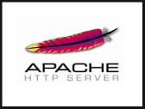

Simple Use Case-1
Send Notification on Auto-Remediation
Automation
Sensors
(To Identify the status of Httpd)
Action
StackStorm: Event-Driven Automation Tool for DevOps and Infrastructure

Slide 6


Simple Use Case-2
So, StackStorm is like IFTTT (If-This-Than-That) tool for DevOps and Infrastructure.
Send Notification
Automation
Sensors
(To Monitor instances)
Action
Terminate Instance if tags are not defined
StackStorm: Event-Driven Automation Tool for DevOps and Infrastructure

Slide 7
Concepts of StackStorm
Concepts:
Packs
Actions
Workflows
Rules
Triggers
Sensors
Webhooks
ChatOps
Why StackStorm for Automation ?
Open Source
Implemented with Python
StackStorm: Event-Driven Automation Tool for DevOps and Infrastructure

Slide 8
Prerequisites to Enroll this Course
Basic knowledge on Linux OS and Commands
Basics of YAML Scripting
Shell Scripting
Python Scripting
StackStorm: Event-Driven Automation Tool for DevOps and Infrastructure

Slide 9
Prerequisites to Enroll this Course
Basic knowledge on Linux OS and Commands
Basics of YAML Scripting
Shell Scripting
Python Scripting
StackStorm: Event-Driven Automation Tool for DevOps and Infrastructure

Slide 10
Thank you

