Slide 1







Survey Report
Narendra Reddy Molakala
19-Mar-2025

Slide 2



OUTLINE
Executive Summary
Introduction
Methodology
Results
Visualization – Charts
Dashboard
Discussion
Findings & Implications
Conclusion
Appendix

Slide 3

EXECUTIVE SUMMARY
Objective: Analyze trends in Current and Future Technology usage and their distribution across demographics using survey data
Data and tools
Survey_data_technology_normalized.csv
Survey_data_demographics.csv
IBM Cognos Analytics
JavaScript is the top Language that Respondents working with in the current Technology
MySQL is the top Database that Respondents working with in the current Technology
Repondents aged 25–35 lead in adopting emerging technologies.

Slide 4

INTRODUCTION
This report provides an in-depth analysis of current and future technology usage trends and their correlation with demographic patterns.
Designed to help organizations and stakeholders identify emerging technologies and target key demographic groups effectively.
Readers will gain:
Clear insights into current and emerging technology trends.
Understanding of key demographic adoption patterns.
Actionable recommendations to target strategic opportunities in technology adoption.

Slide 5

METHODOLOGY
Data Sources:
Survey_data_technology_normalized.csv
Survey_data_demographics.csv
Data collection:
https://stackoverflow.blog/2019/04/09/the-2019-stack-overflow-developer-survey-results-are-in/
Tools and Techniques
IBM Cognos Analytics
Google Looker studio

Slide 6
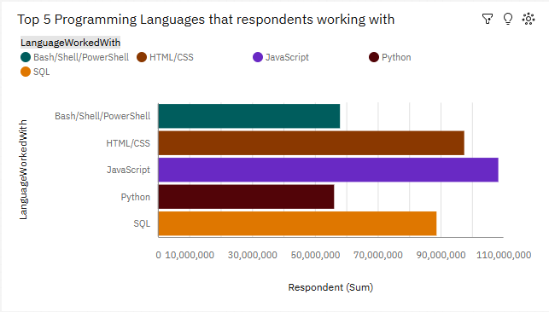
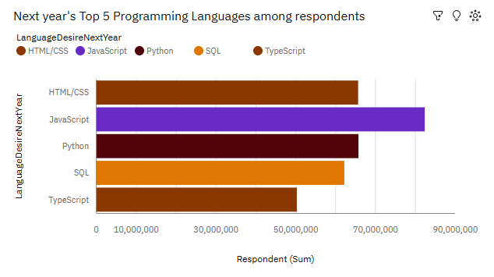
PROGRAMMING LANGUAGE TRENDS
Current Year
Next Year

Slide 7
PROGRAMMING LANGUAGE TRENDS - FINDINGS & IMPLICATIONS
Findings
JavaScript is the most widely used Programming Language, , with over 108 million respondents reporting experience.
HTML/CSS and SQL rank high, indicating their strong relevance in web development and data management.
TypeScript is gaining traction, reflecting its growing adoption in scalable web applications.
Implications
Organizations should prioritize JavaScript, Python, and SQL training to align with the most prevalent skillsets.
Investment in TypeScript resources can help teams build maintainable, large-scale applications.
Encouraging cross-functional skills, such as scripting knowledge (e.g., Bash/Shell), can boost productivity in software teams.

Slide 8
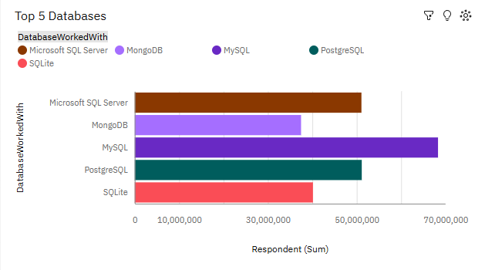
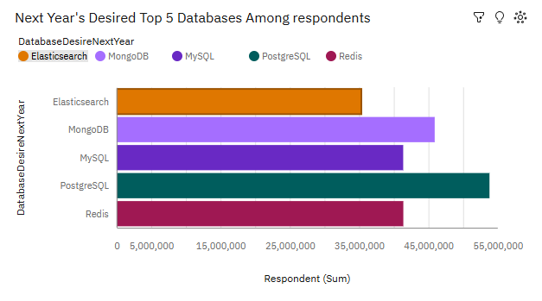
DATABASE TRENDS
Current Year
Next Year

Slide 9
DATABASE TRENDS - FINDINGS & IMPLICATIONS
Findings
MySQL is the most widely used Database with over 68 million respondents
PostgreSQL leads with over 53 million respondents, showcasing its popularity for reliability and open-source versatility.
Implications
Organizations should focus on PostgreSQL for its expanding use in transactional systems, web applications, and data warehousing.
The growing demand for MongoDB and Redis implies a shift toward scalable and flexible data models for high-performance applications.

Slide 10

DASHBOARD
Github link: https://github.com/NarendraReddy077/Data-Analytics-and-Visualization-Capstone-Project/blob/9f282e272344e796b68a6bcf8fc43a0eab5c80db/Dashboard.pdf
Cognos Dashboard link: https://us3.ca.analytics.ibm.com/bi/?perspective=dashboard&pathRef=.my_folders%2FSurvey_Data_Dashboard&action=view&mode=dashboard&subView=model000001956c1ec584_00000002

Slide 11
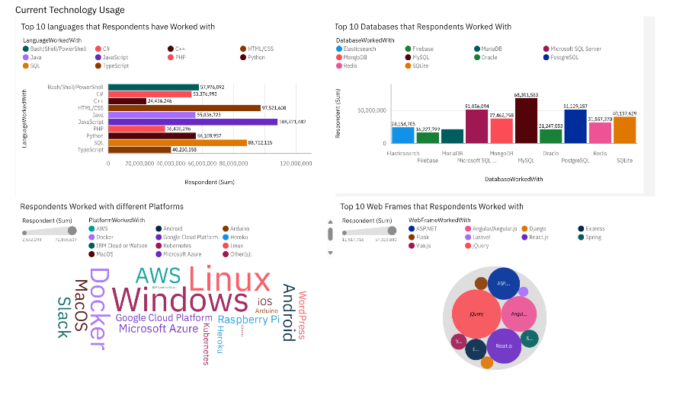
CURRENT TECHNOLOGY USAGE

Slide 12
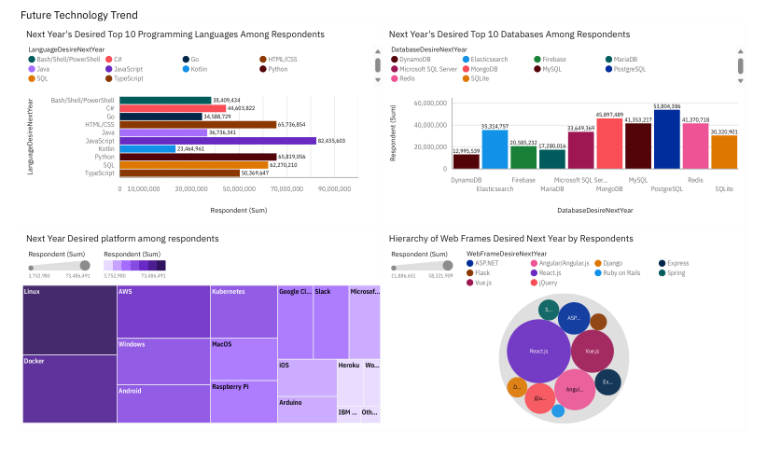
FUTURE TECHNOLOGY TREND

Slide 13
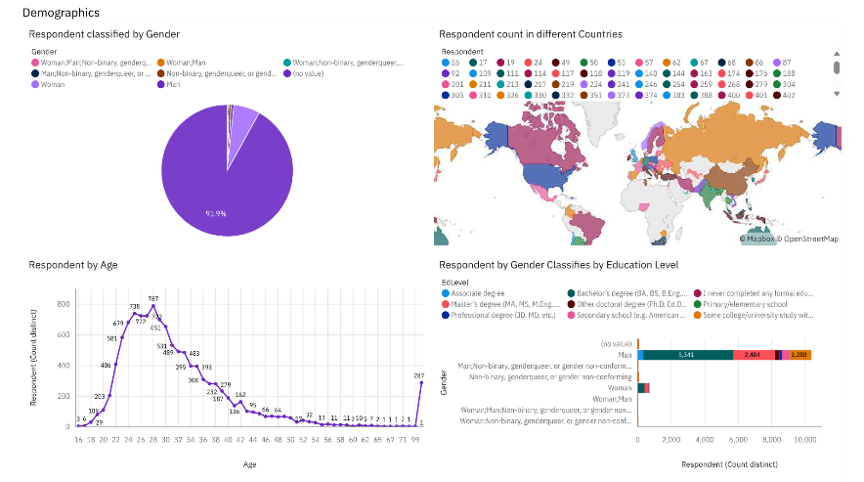
DEMOGRAPHICS

Slide 14
DISCUSSION
Programming Languages Trends:
JavaScript leads in popularity, followed by Python and HTML/CSS, signifying their relevance in web development and versatile programming needs.
Database Trends:
PostgreSQL and MongoDB dominate as preferred databases for reliability and scalability.
Demographics Insights:
The majority of respondents are aged 25–29 and predominantly male.
Bachelor's and Master’s degree holders form the largest share of respondents

Slide 15
OVERALL FINDINGS & IMPLICATIONS
Findings
JavaScript leads in popularity
PostgreSQL and MongoDB dominate as preferred databases for reliability and scalability.
The majority of respondents are aged 25–29 and predominantly male.
Implications
Invest in training for JavaScript, Python, and SQL to align with workforce trends.
Focus on PostgreSQL and MongoDB for database solutions to support modern applications.
Prioritize demographic groups (young professionals, Bachelor's/Master’s degree holders) in marketing and upskilling efforts.

Slide 16

CONCLUSION
Key trends in Programming Languages, Databases, and demographics insights were Identified.
JavaScript and Python lead as versatile and in-demand programming languages.
PostgreSQL and MongoDB dominate database preferences for scalability and flexibility.
Demographic insights reveal younger, urban professionals as the key adopters of emerging technologies.

Slide 17
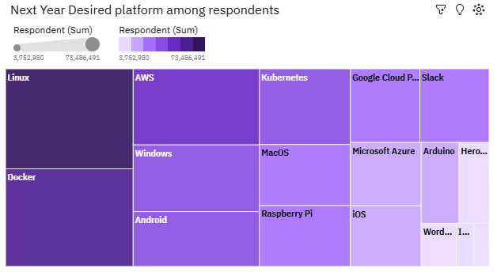

APPENDIX

Slide 18
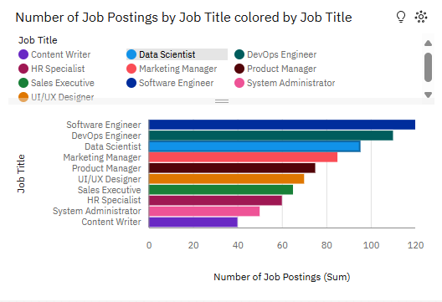
JOB POSTINGS

Slide 19
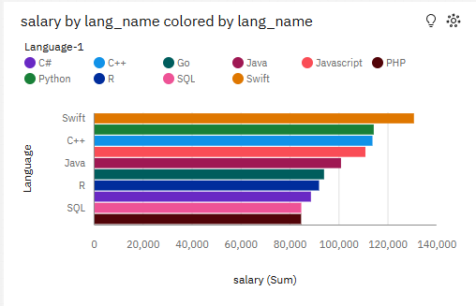
POPULAR LANGUAGES

