Slide 1

E-Commerce
Big Data Analysis

Slide 2
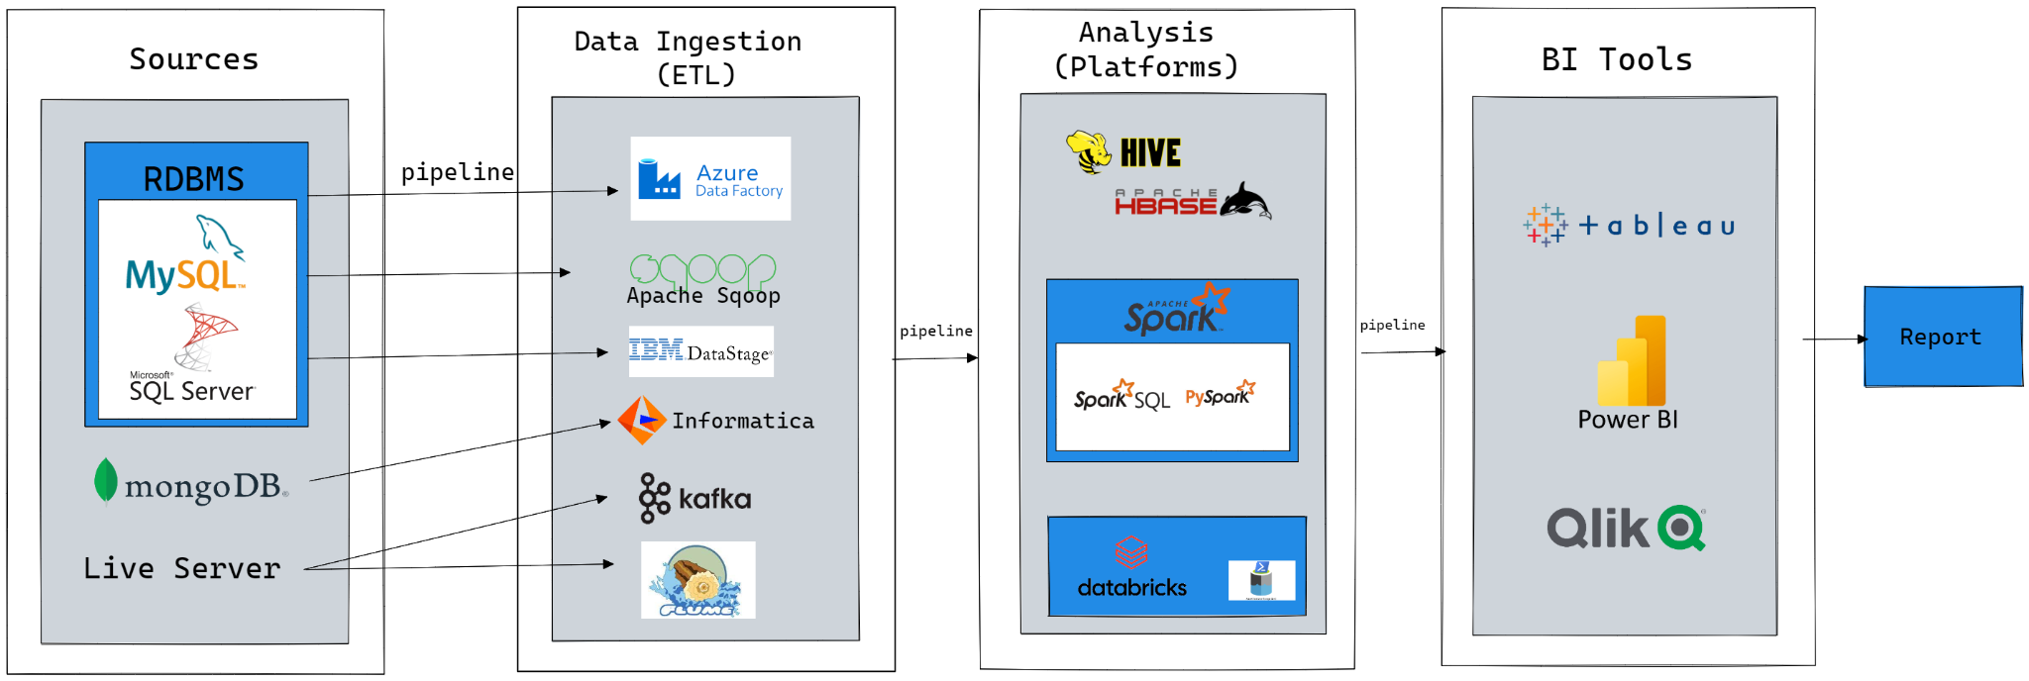
Big Data Architecture

Slide 3
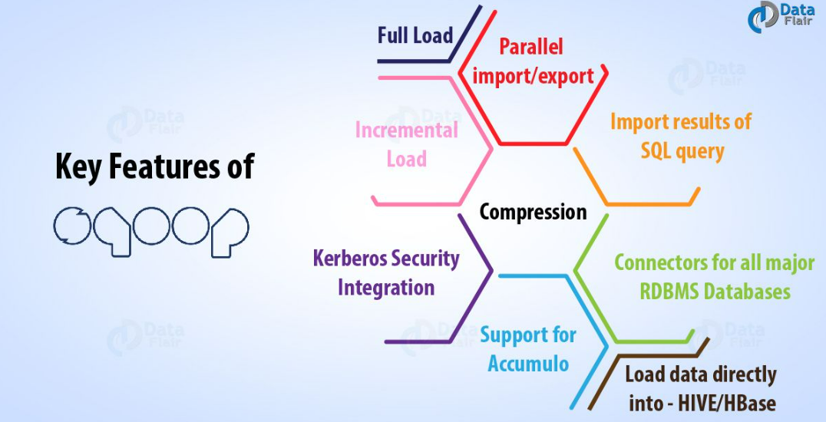
Apache Sqoop Key Features

Slide 4
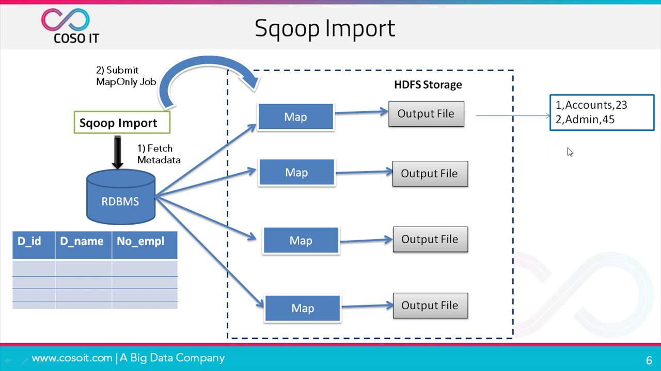
Apache Sqoop WorkFlow

Slide 5


What is Hive?
Apache Hive is often referred to as Data Warehousing infrastructure tool which is developed on the top of Hadoop file distributed system, used for processing and analysing large volume of structured, semi-structured data using Hive Query Language (HQL)

Slide 6
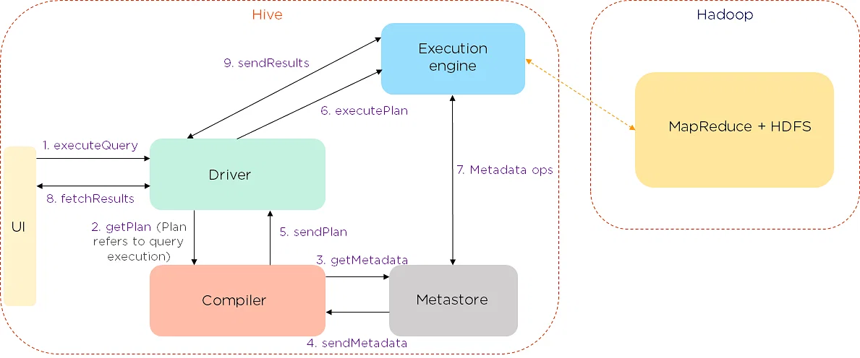
Hive Architecture

Slide 7

Apache Spark Job Execution

Slide 8




Apache Spark Key Features

Slide 9
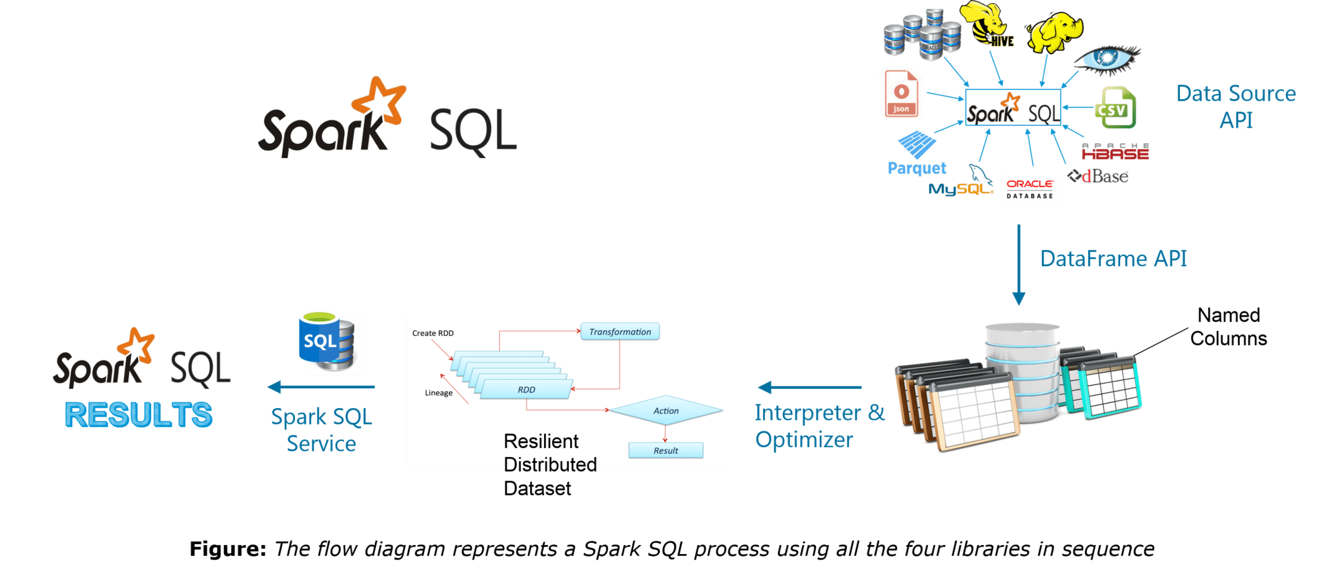
Spark SQL Pipeline
Notes:
Spark SQL - library built on top of Spark Core Execution Engine - uses JDBC/ODBC driver for executing SQL queries

Slide 10
UNDERSTANDING THE E-Commerce DATA:
Dataset has duplicate values.
Data in timestamp column is not formatted as per the default format, so we will format that as well
For quantity column we have counters instead of the exact value.
For example, if a customer had bought 2 quantities of the same product we have that data in two rows, in the first row the quantity is 1 and in the second row the quantity is 2. So we will only take the row with the total quantity.

Slide 11
Hive Queries
User Story 01. The monthly trend of sales:
hive> insert overwrite table monthly_sales select year(timestamp) as years, month(timestamp) as months, sum(payment) as sales from cecom where ostatus not in ('canceled', 'unavailable') group by year(timestamp), month(timestamp) order by months, years;
User Story 02: Which hour has more no. of sales?
hive> insert overwrite table hourly_most_sales select hours, sales from (select hour(timestamp) as hours, sum(quantity) as sales, rank() over(order by sum(quantity) desc) AS `max_sales` from cecom group by hour(timestamp)) t where max_sales = 1;
User Story 03. What are the most commonly used payment types?
hive> insert overwrite table common_paymenttype select paymenttype, count(oid) as tcount from cecom group by paymenttype order by tcount desc;
User Story 04: Count of Orders With each No. of Payment Installments
hive> insert overwrite table installment_count select installments, count(oid) as tcount from cecom group by installments;

Slide 12
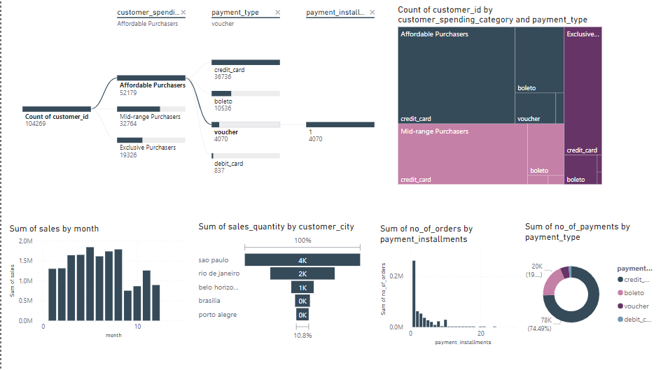
E-Commerce Dashboard

Slide 13
THANK YOU

