Slide 1
Secure Data Hiding in Images Using Steganography
CAPSTONE PROJECT
Presented By:
Student Name : Narendra Ramkrishna Shende
College Name & Department : Jhulelal institute of Technology In Computer Science & Engineering

Slide 2
OUTLINE
Problem Statement
Technology used
Wow factor
End users
Result
Conclusion
Git-hub Link
Future scope

Slide 3
Problem Statement
Traditional data transmission methods are vulnerable to cyber threats, leading to unauthorized access and data breaches. This project aims to enhance security by implementing steganography, which hides secret messages inside images, making it difficult for hackers to detect confidential information.

Slide 4
Technology used
Programming Language: Python
Libraries: OpenCV, NumPy, PIL
Platform: Windows/Linux
Encryption Technique: Pixel Manipulation

Slide 5
Wow factors
High Security: Encrypts and hides data within images, making it undetectable.
Lightweight & Fast: Efficient encoding and decoding with minimal computation.
User-Friendly: Simple UI for encryption and decryption processes.
Multi-Layer Protection: Password-based access control for decryption.

Slide 6
End users
Government Agencies: Secure communication for intelligence and military.
Journalists & Activists: Safe data transmission in high-risk environments.
Healthcare Industry: Secure patient data exchange.
Corporate Sector: Protection of confidential business communications.

Slide 7
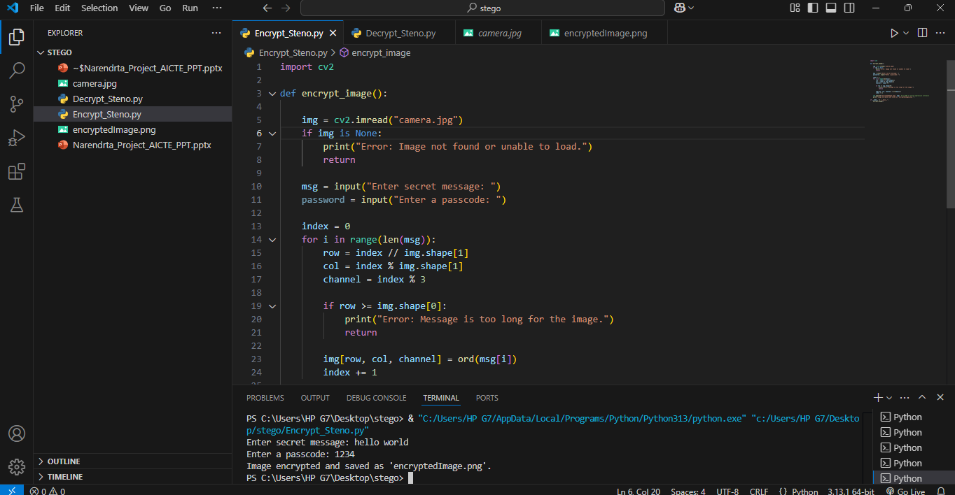
Results

Slide 8
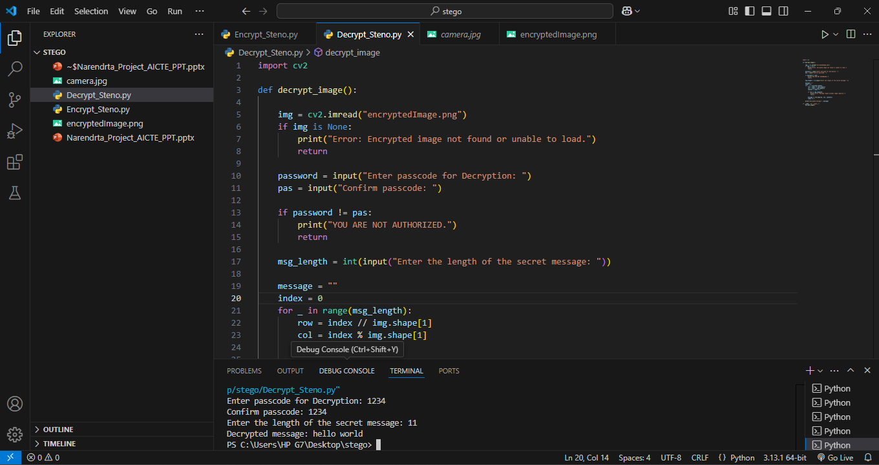

Slide 9
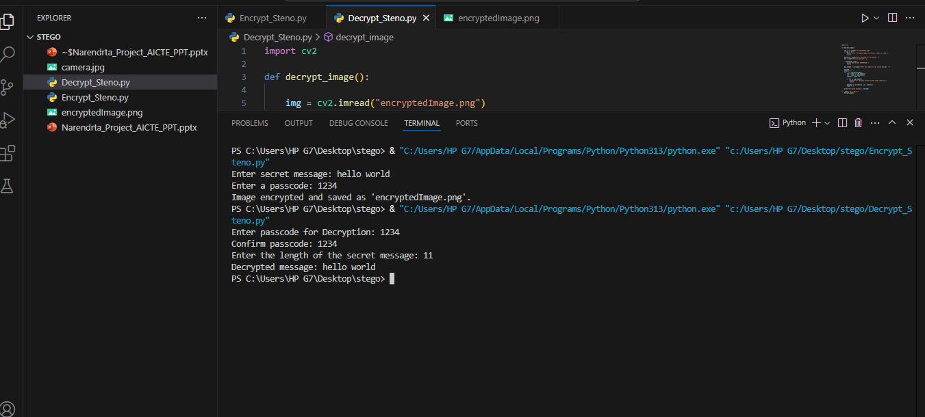

Slide 10
Conclusion
This project demonstrates the power of steganography in securing sensitive data by concealing messages within images. By adopting this technique, cybersecurity can be significantly improved, ensuring that only authorized individuals can retrieve the hidden information. The system is lightweight, efficient, and serves as a powerful tool for confidential communication.

Slide 11
GitHub Link
https://github.com/NarendraShende/Stegno_Project.git

Slide 12
Future scope(optional)
AI-Based Detection Prevention: Implementing AI to counter steganalysis attacks.
Cloud Integration: Secure storage and sharing of steganographic images over cloud platforms.
Multi-Format Support: Expanding support for videos and audio files.
Mobile App Development: Bringing this security solution to mobile devices.

Slide 13
THANK YOU

