Slide 1

SWARNANDHRA COLLEGE OF ENGINEERING AND TECHNOLOGY
DEPARTMENT OF COMPUTER SCIENCE & ENGINEERING
A PROJECT REVIEW PRESENTATION ON
BEYOND THE PRIVACY-UTILITY TRADE-OFF: A
SPATIOTEMPORAL-CONSTRAINT AND SECURE
INTELLIGENT CAMPUS MONITORING SYSTEM
by
P NARENDRA
Roll NO: 24A21D5827
II M. Tech (CSE)
Under the Guidance of
Dr. S. Suresh Kumar, M.Tech, Ph.D, PDF
Professor & Principal, Dept. of CSE

Slide 2
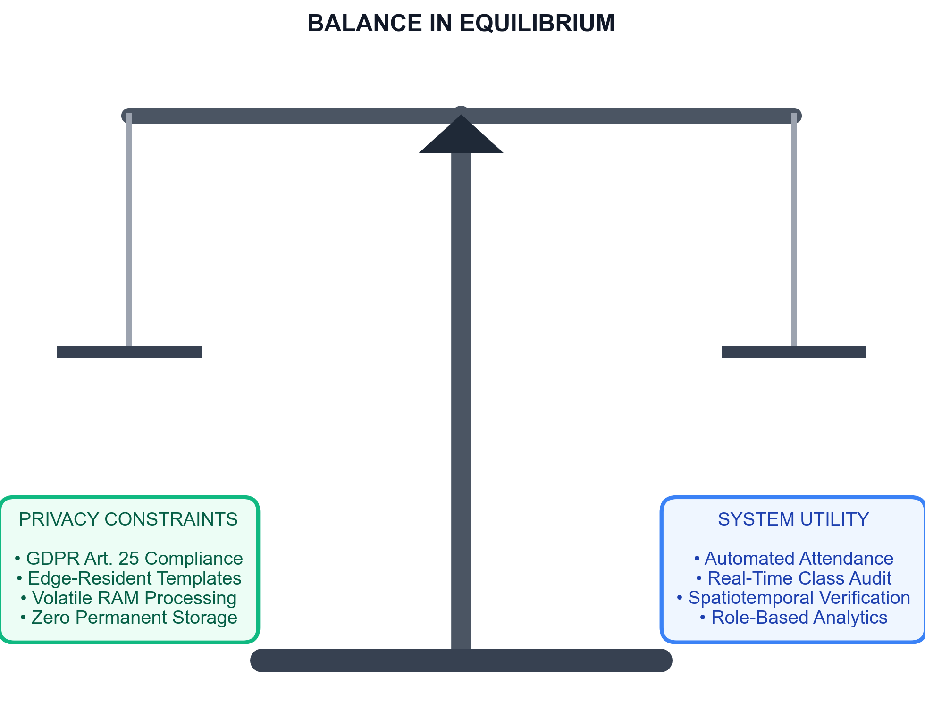
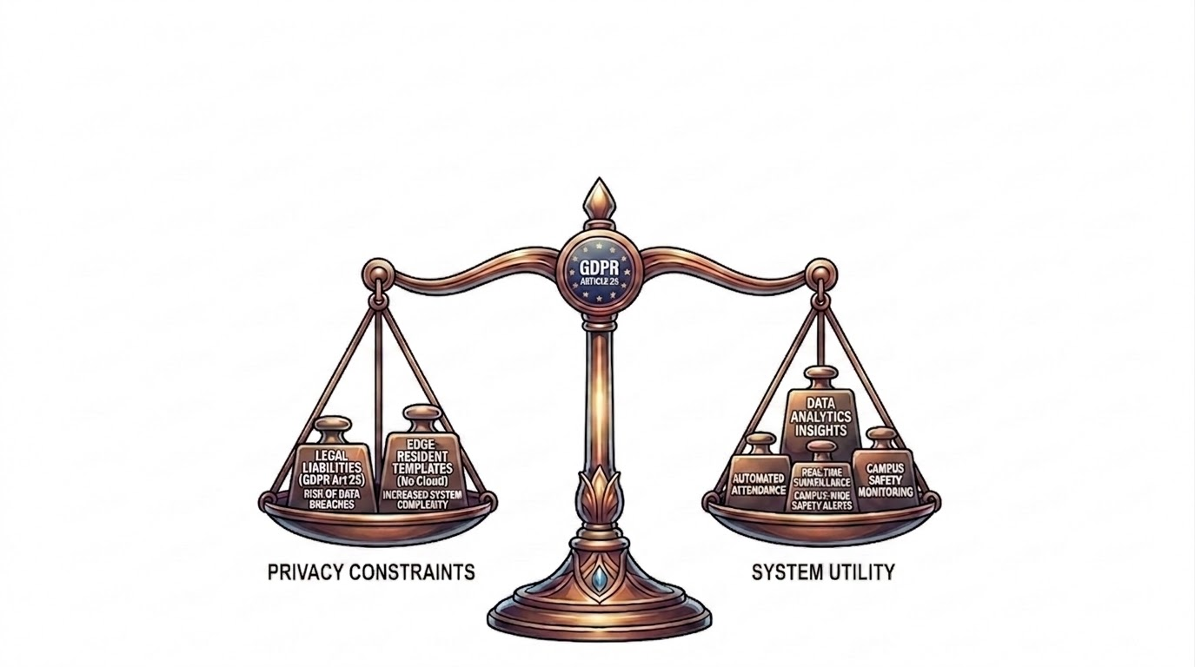
Problem Statement
• Privacy-Utility Conflict: Automating attendance and safety checks without storing high-risk permanent biometric databases. • GDPR Liabilities: Central databases face severe leak risks and violate GDPR Article 25 (Privacy-by-Design). • Edge Mitigations: Resolved via edge vector templates and 33ms volatile RAM cache buffers.

Slide 3
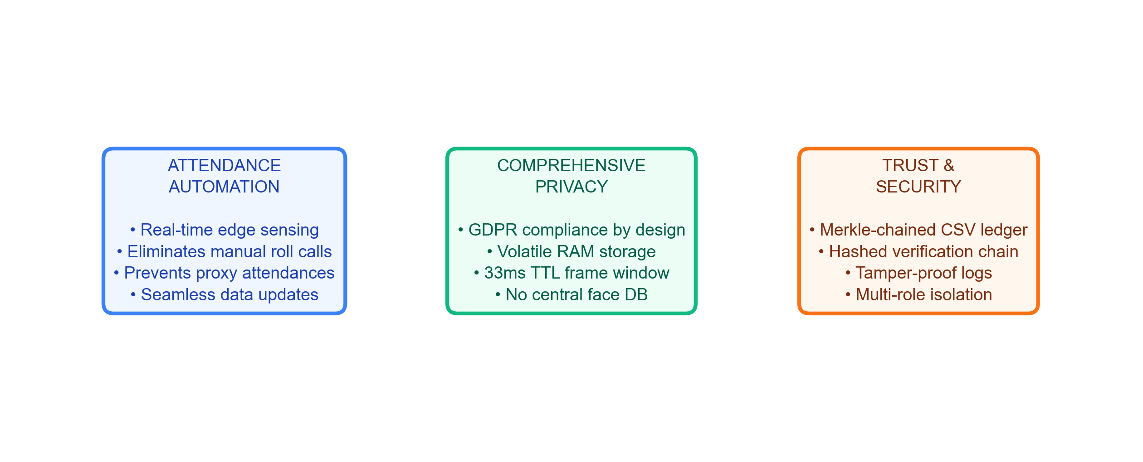
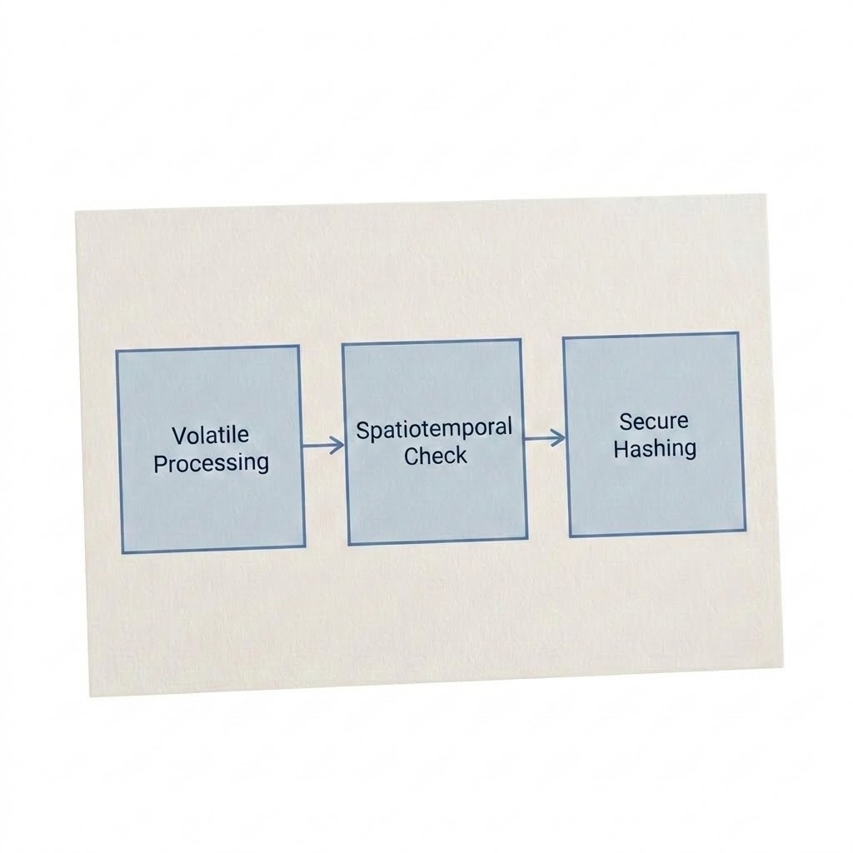
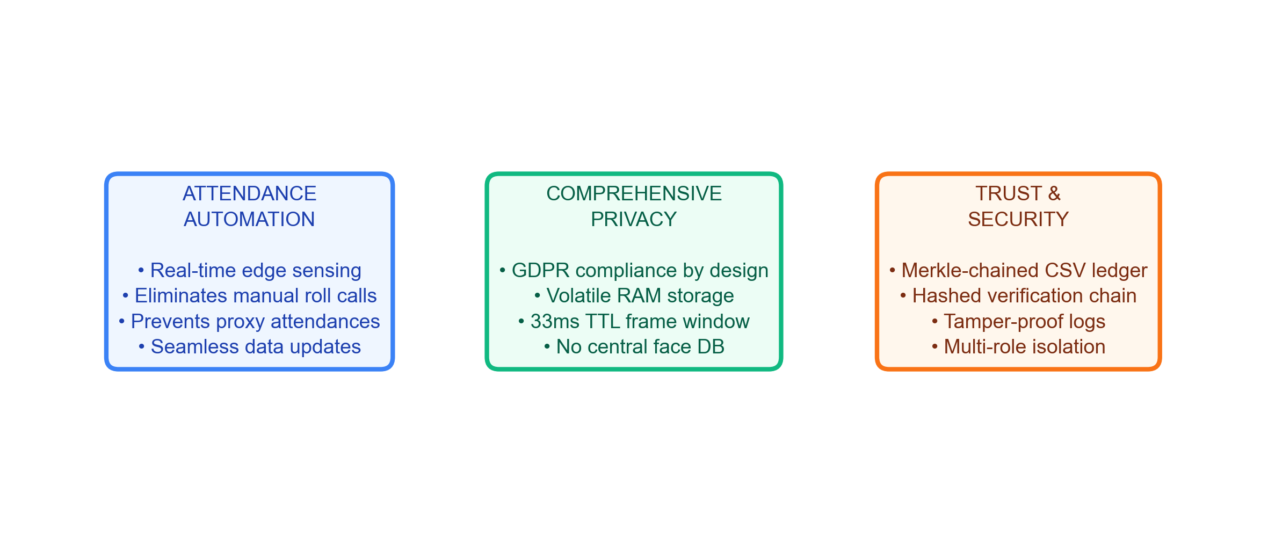
Motivation & Objectives
• Attendance Automation: Edge biometric sensing eliminates manual register errors and proxy swipes.
• Decentralized Security: Secure local template matching without persistent central databases.
• Temporal Auditing: Real-time spatiotemporal presence compliance verification.

Slide 4
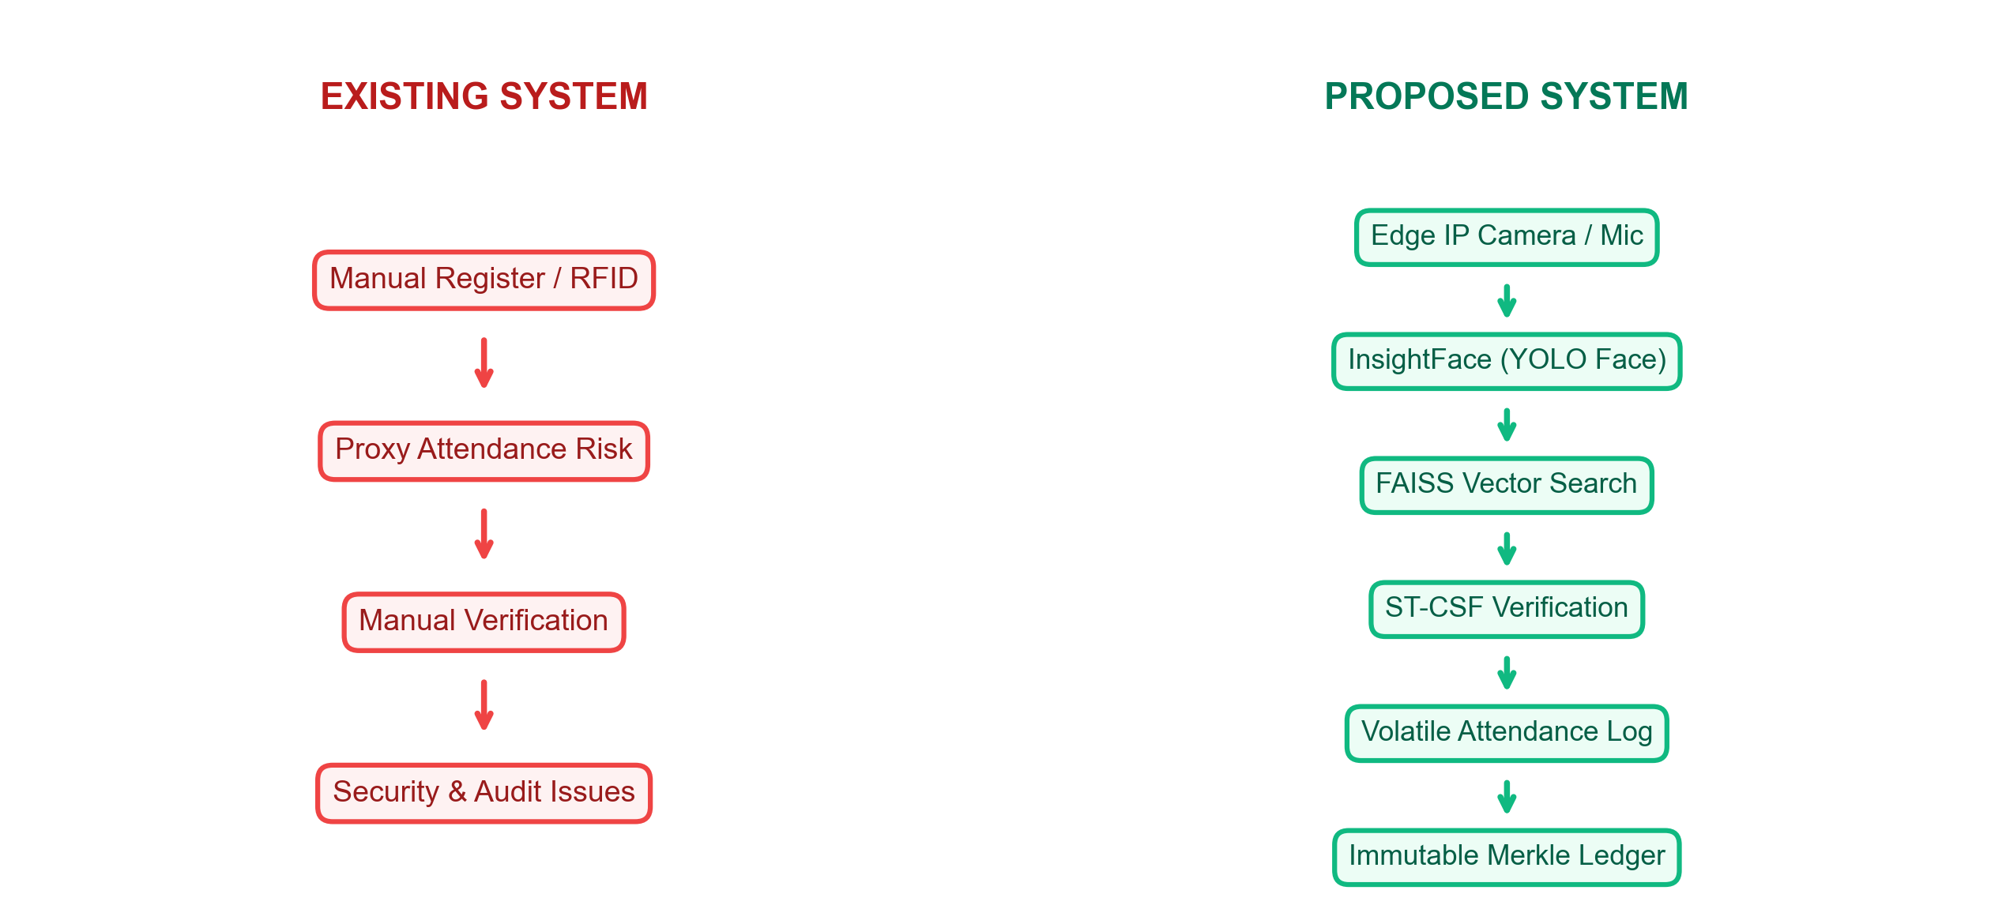
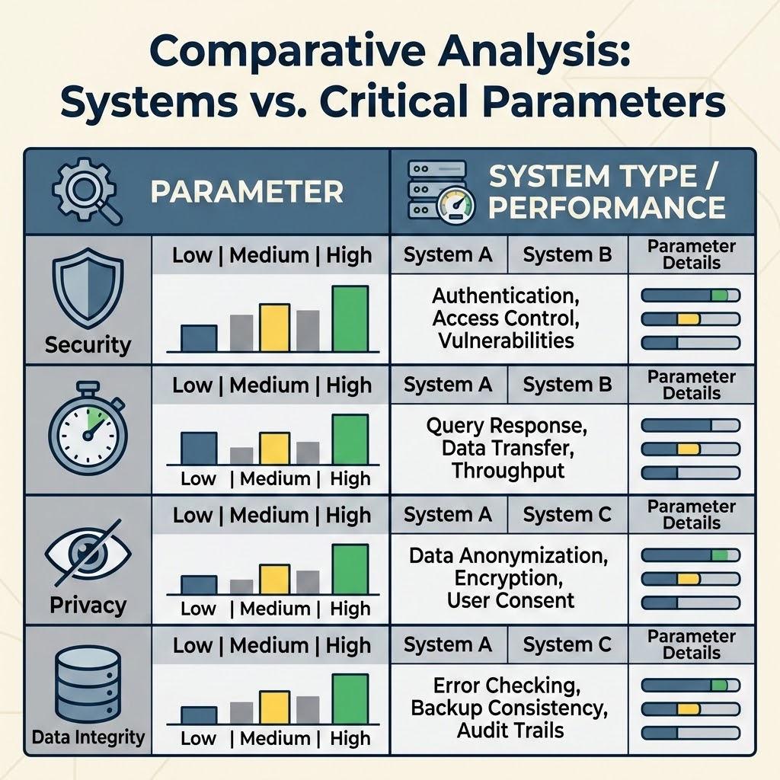
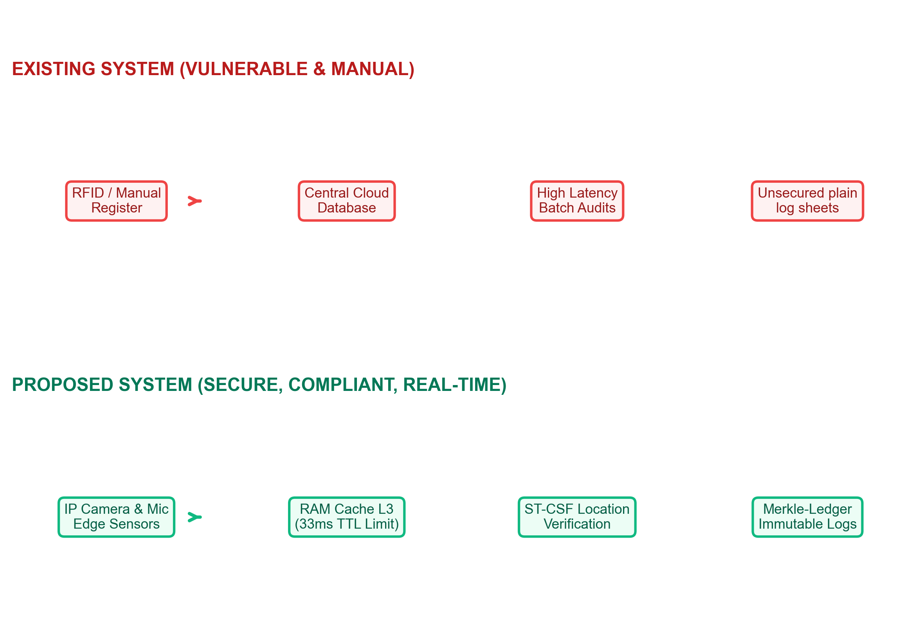
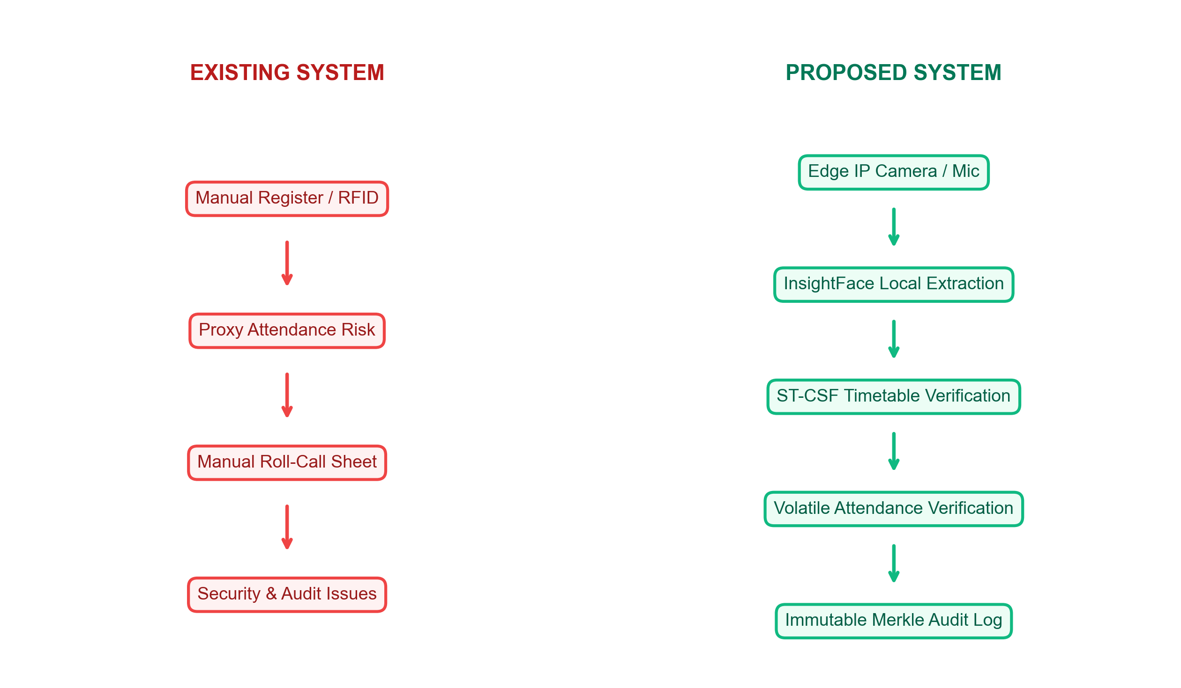
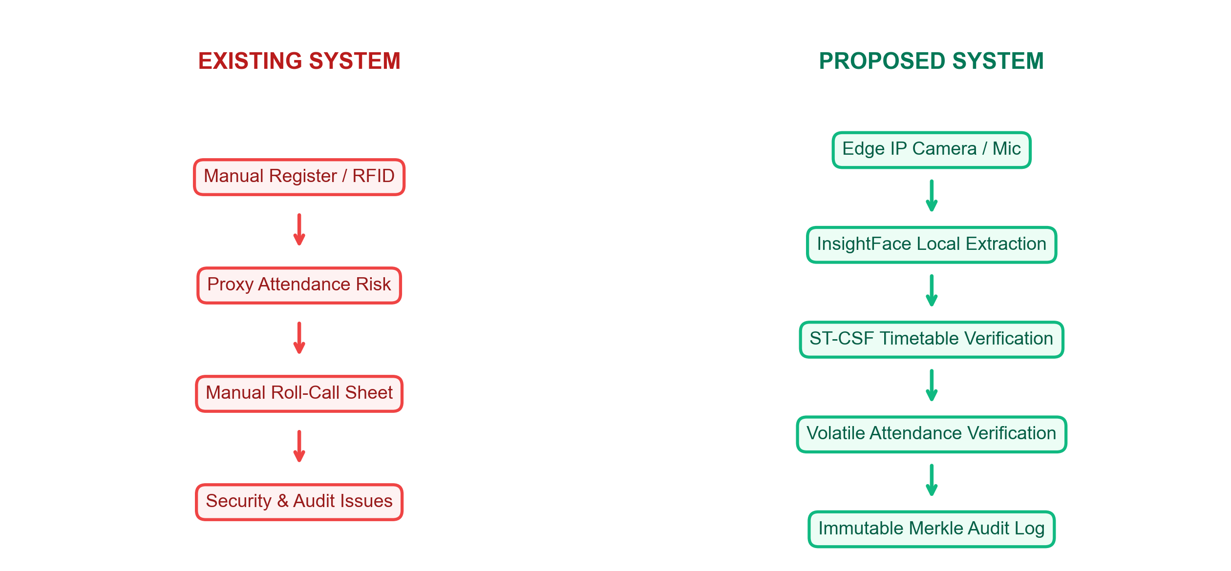
Existing vs. Proposed System
• Existing System: RFID proxy swipes and manual registers allow buddy punching and data leakage.
• Proposed System: Real-time biometric checks secured by ST-CSF schedule constraints and Merkle audit ledgers.

Slide 5
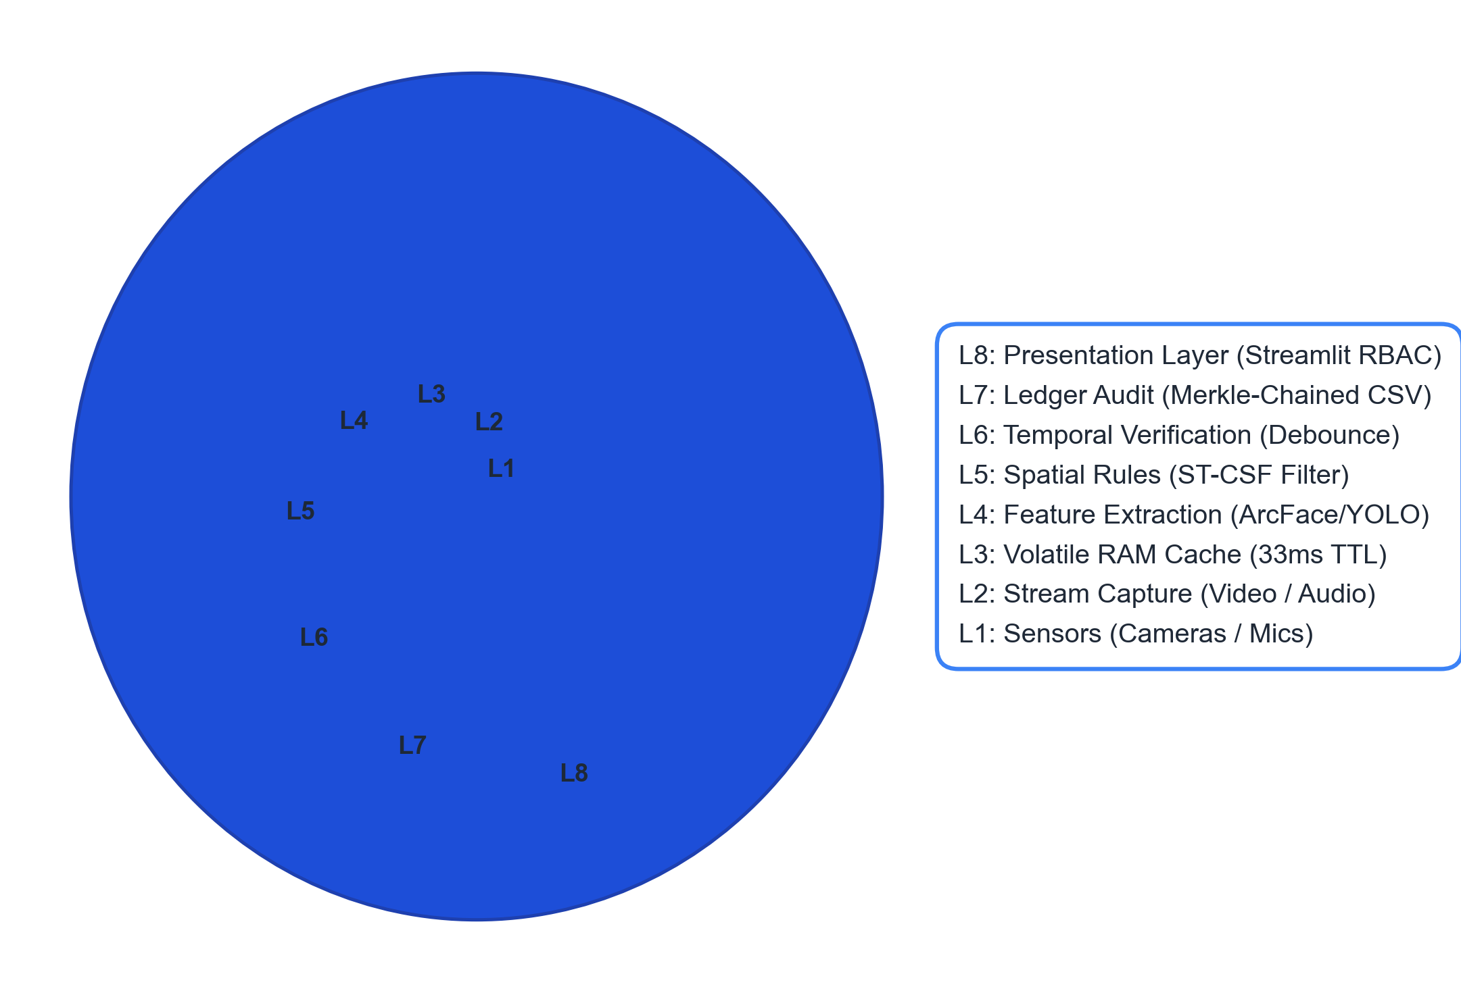
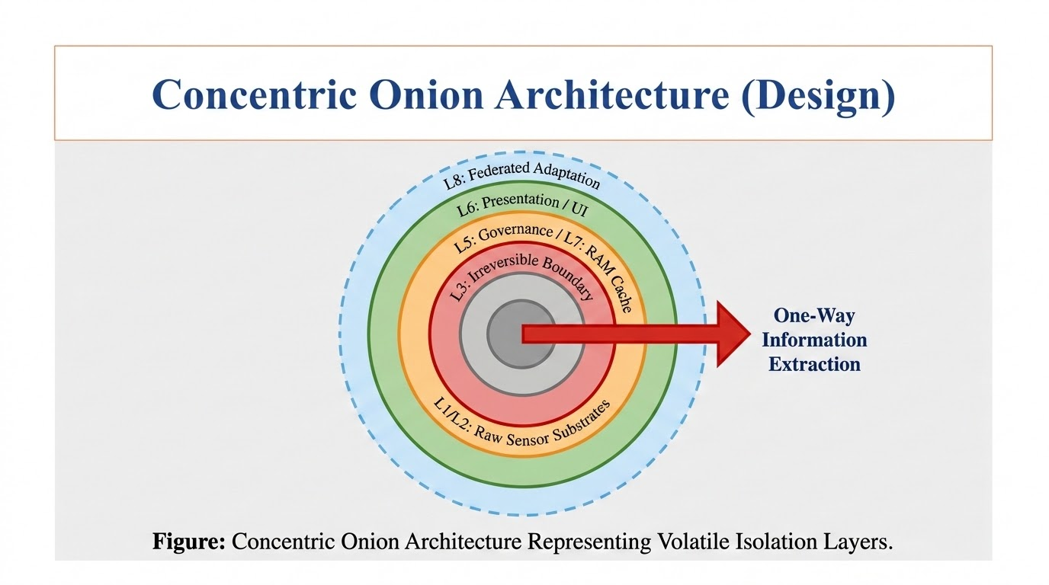
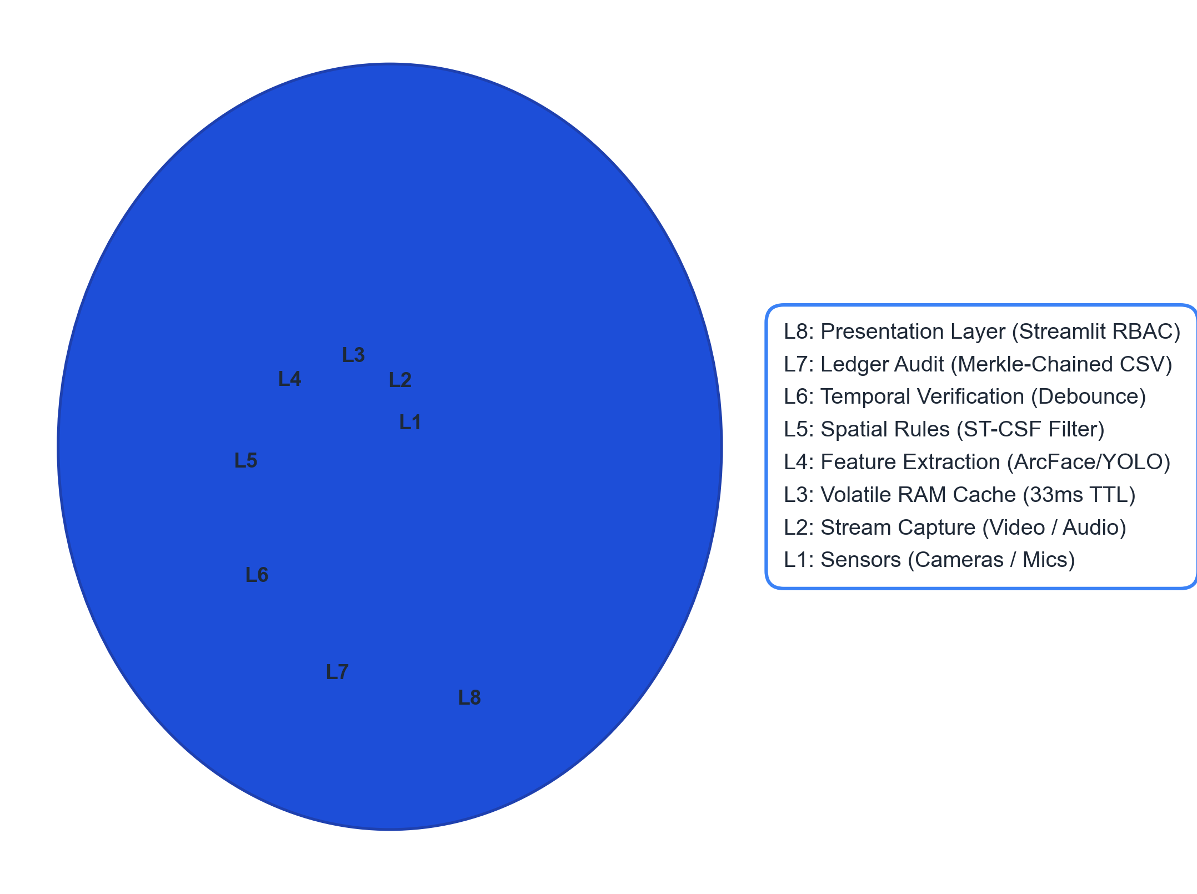
Concentric Onion Architecture (Design)
• Multi-Layered Protection: 8 concentric isolation layers partition raw sensors from presentation frameworks.
• Irreversible Privacy Boundary: Layer 3 (RAM Cache with 33ms TTL) ensures raw biometric data is never persistently stored.

Slide 6
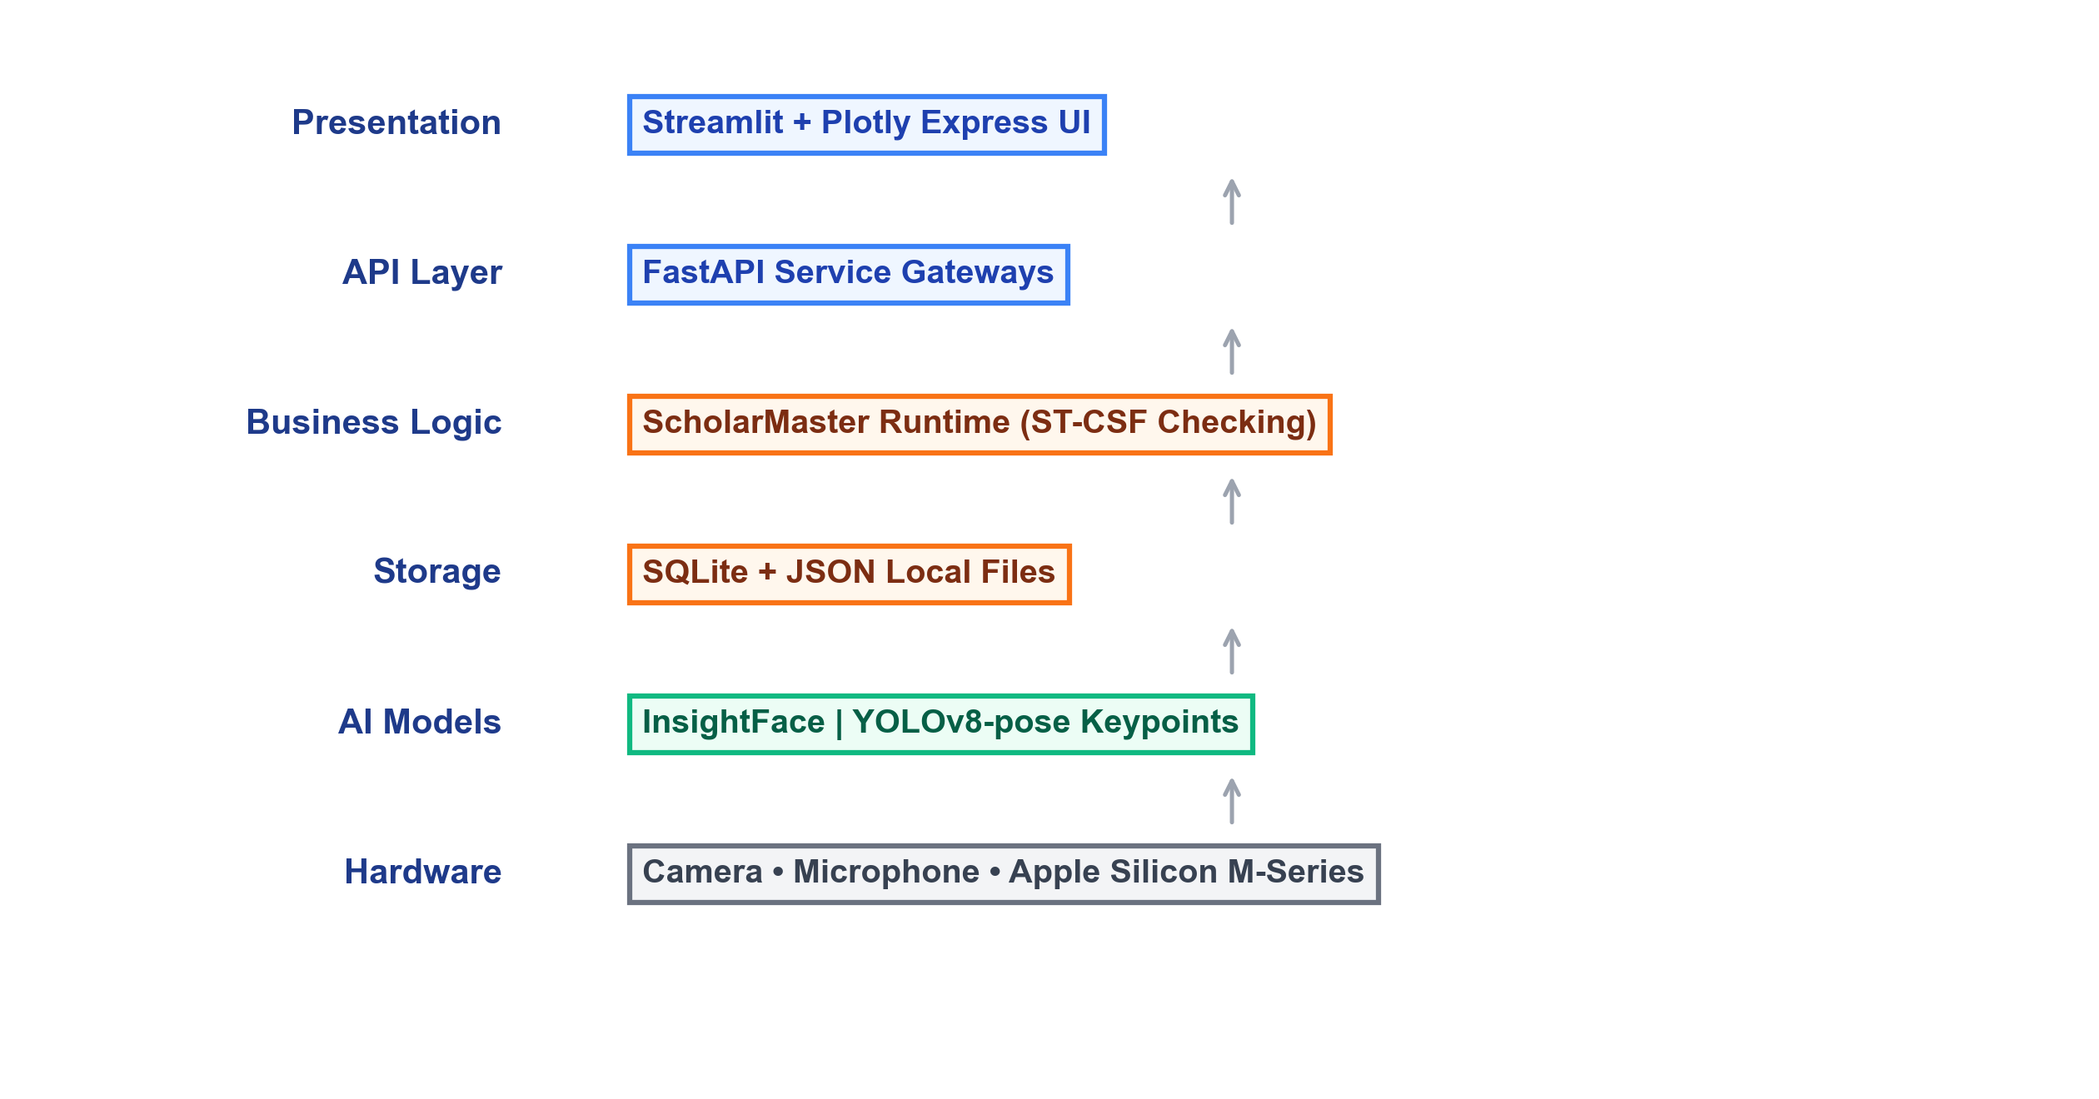
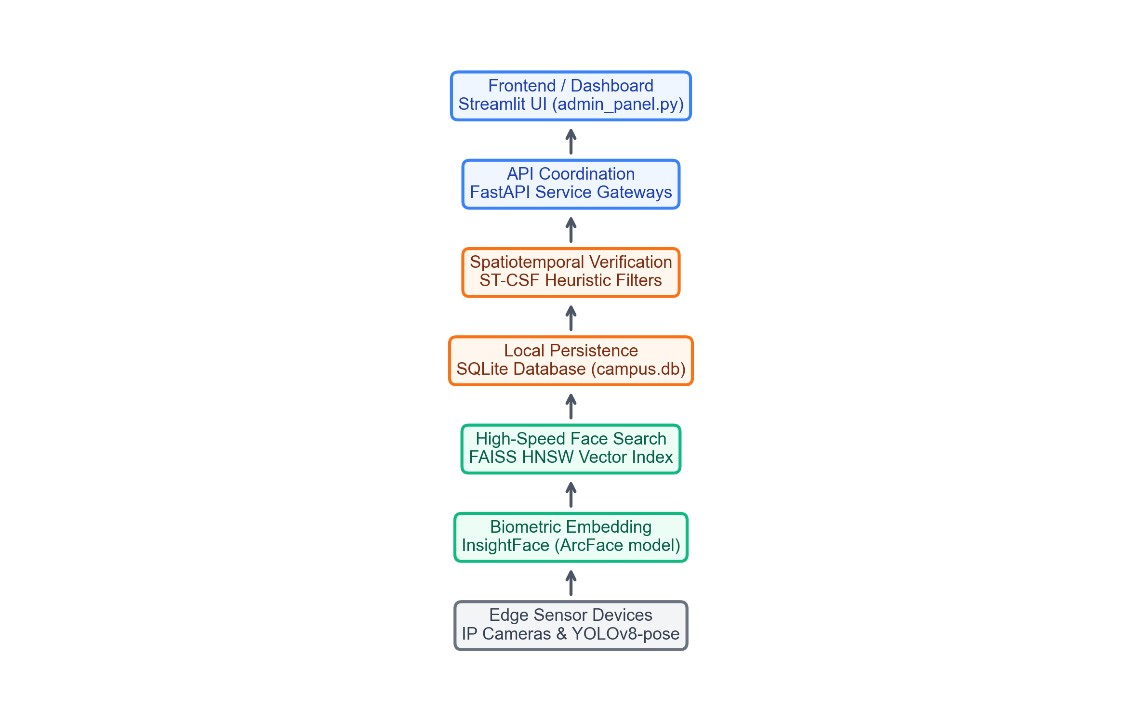
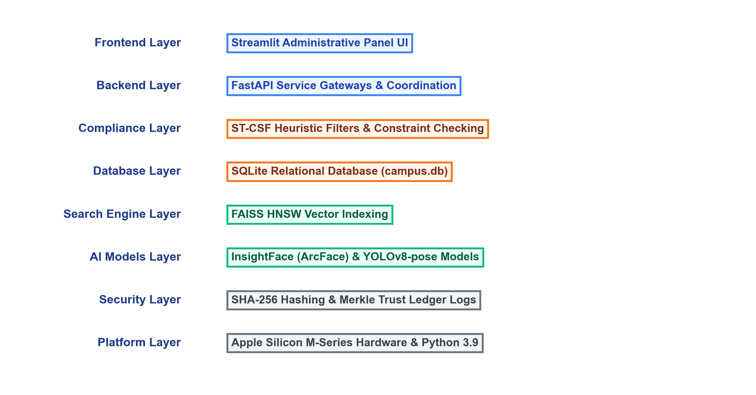
Technology Stack
• Structured Architecture: Replaces uncoordinated components with a strict layered technology pipeline.
• Layered Operations: Ensures logical flow from raw hardware sensors up to the client presentation interface.

Slide 7
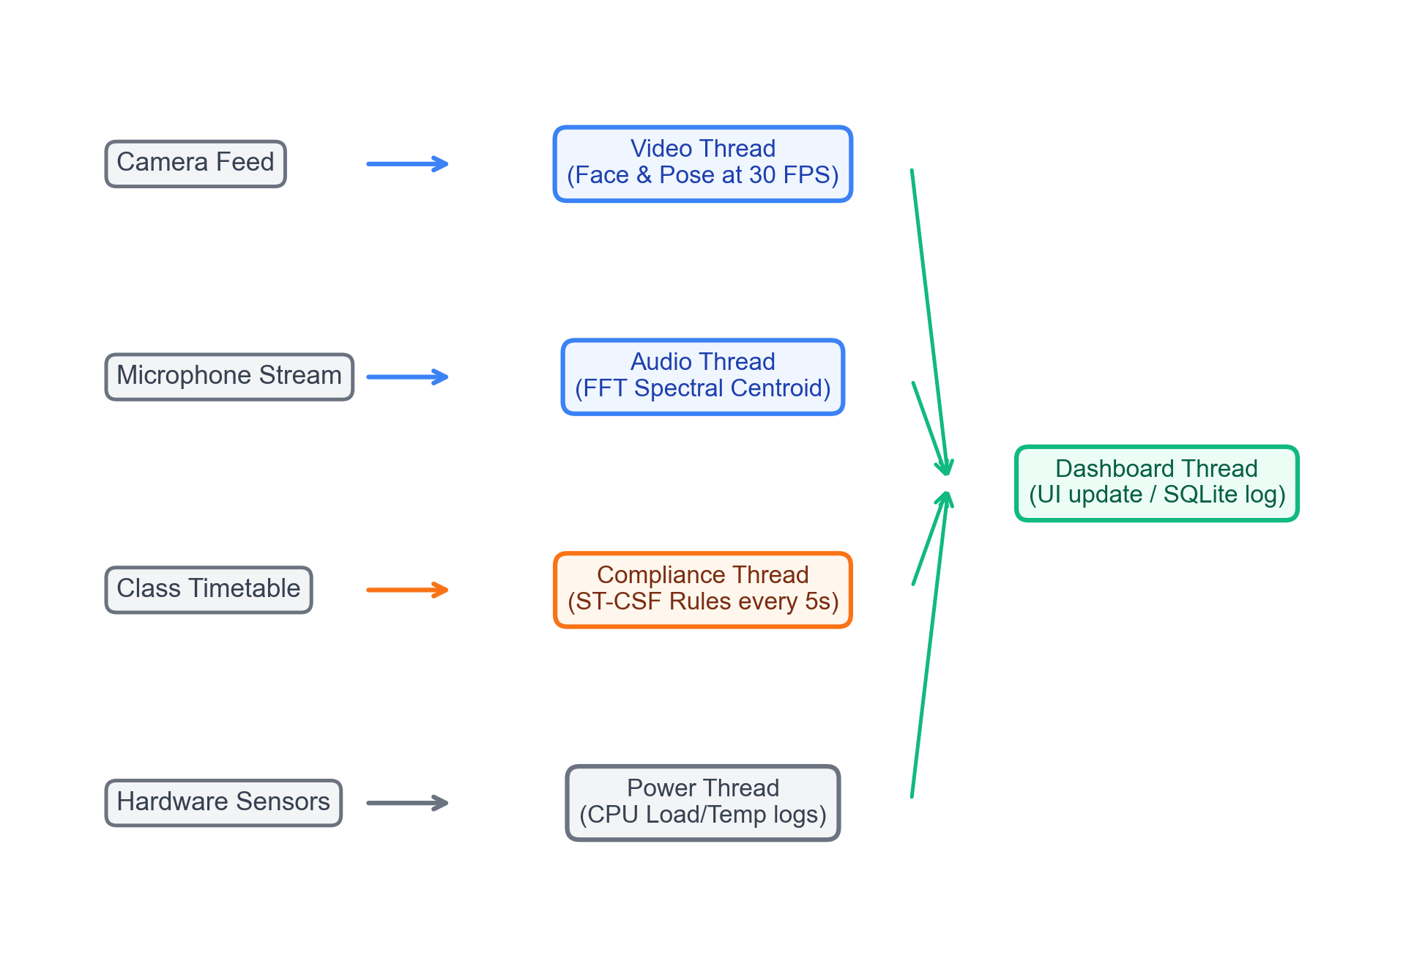
Multi-Threaded Runtime Architecture
Thread Name | Interval | Core Function
Video | 30 FPS | Face Recognition & Pose extraction
Audio | 100 ms | Acoustic anomaly spectral analysis
Compliance | 5 sec | ST-CSF constraint timetable checking
Power | 10 sec | Resource & CPU thermal monitoring
Dashboard | 1 sec | Terminal status console updates

Slide 8
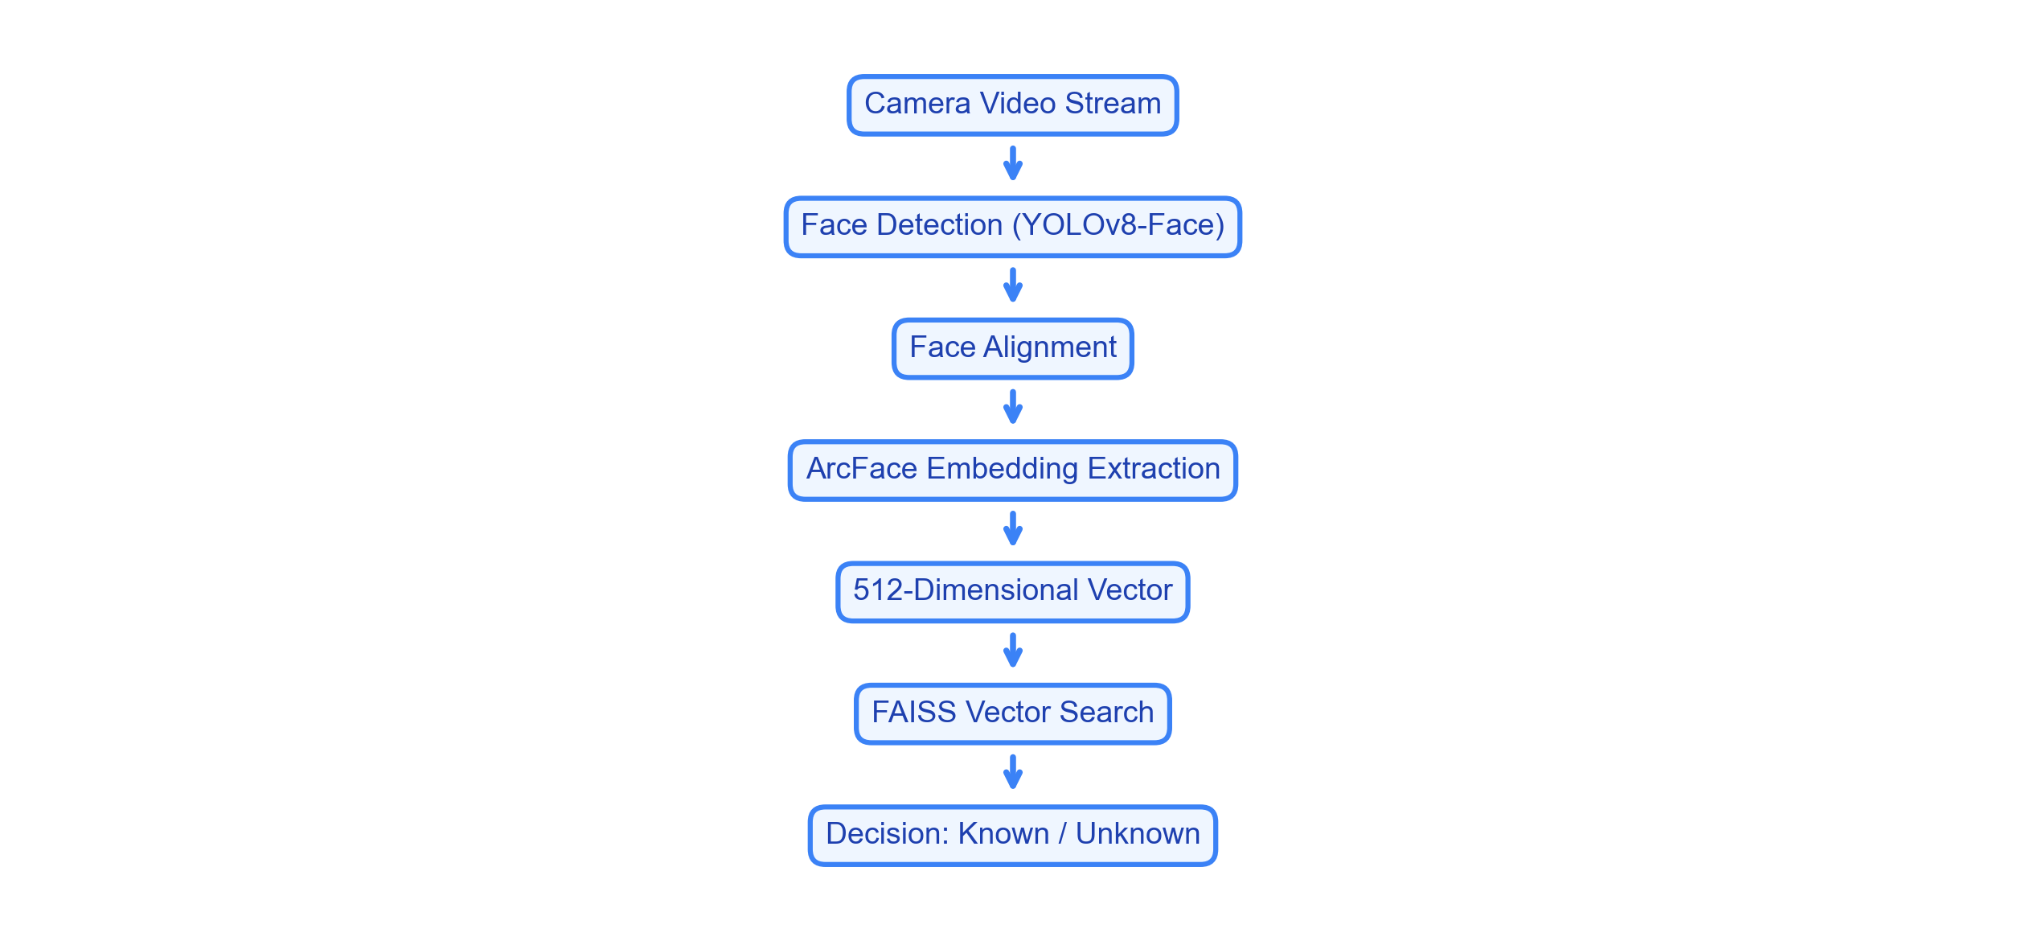
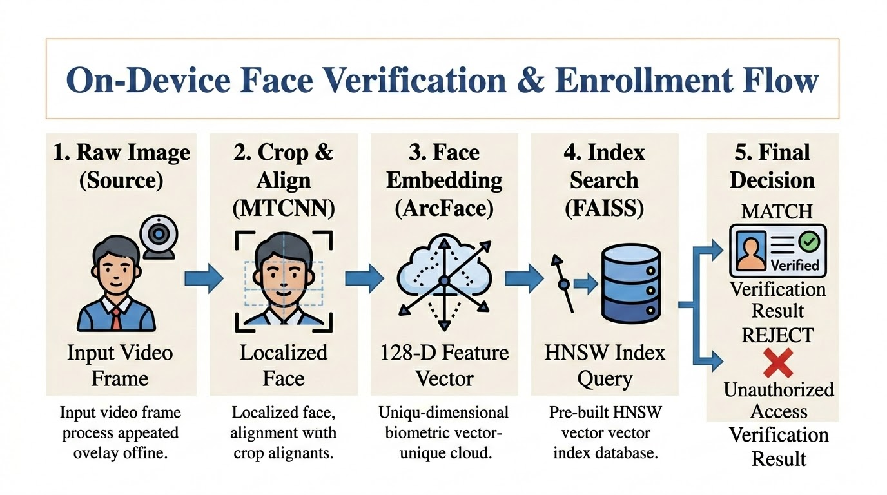
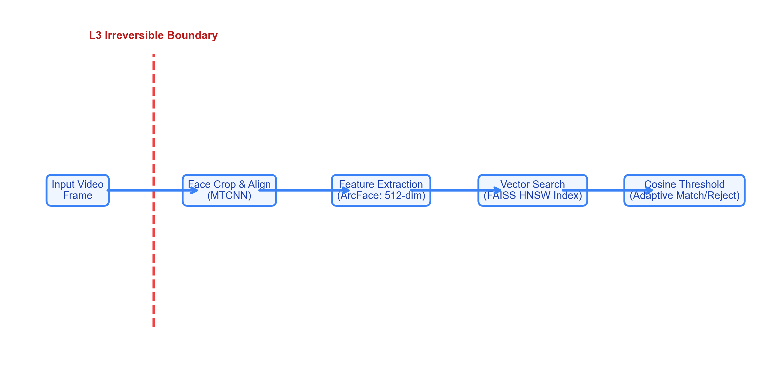
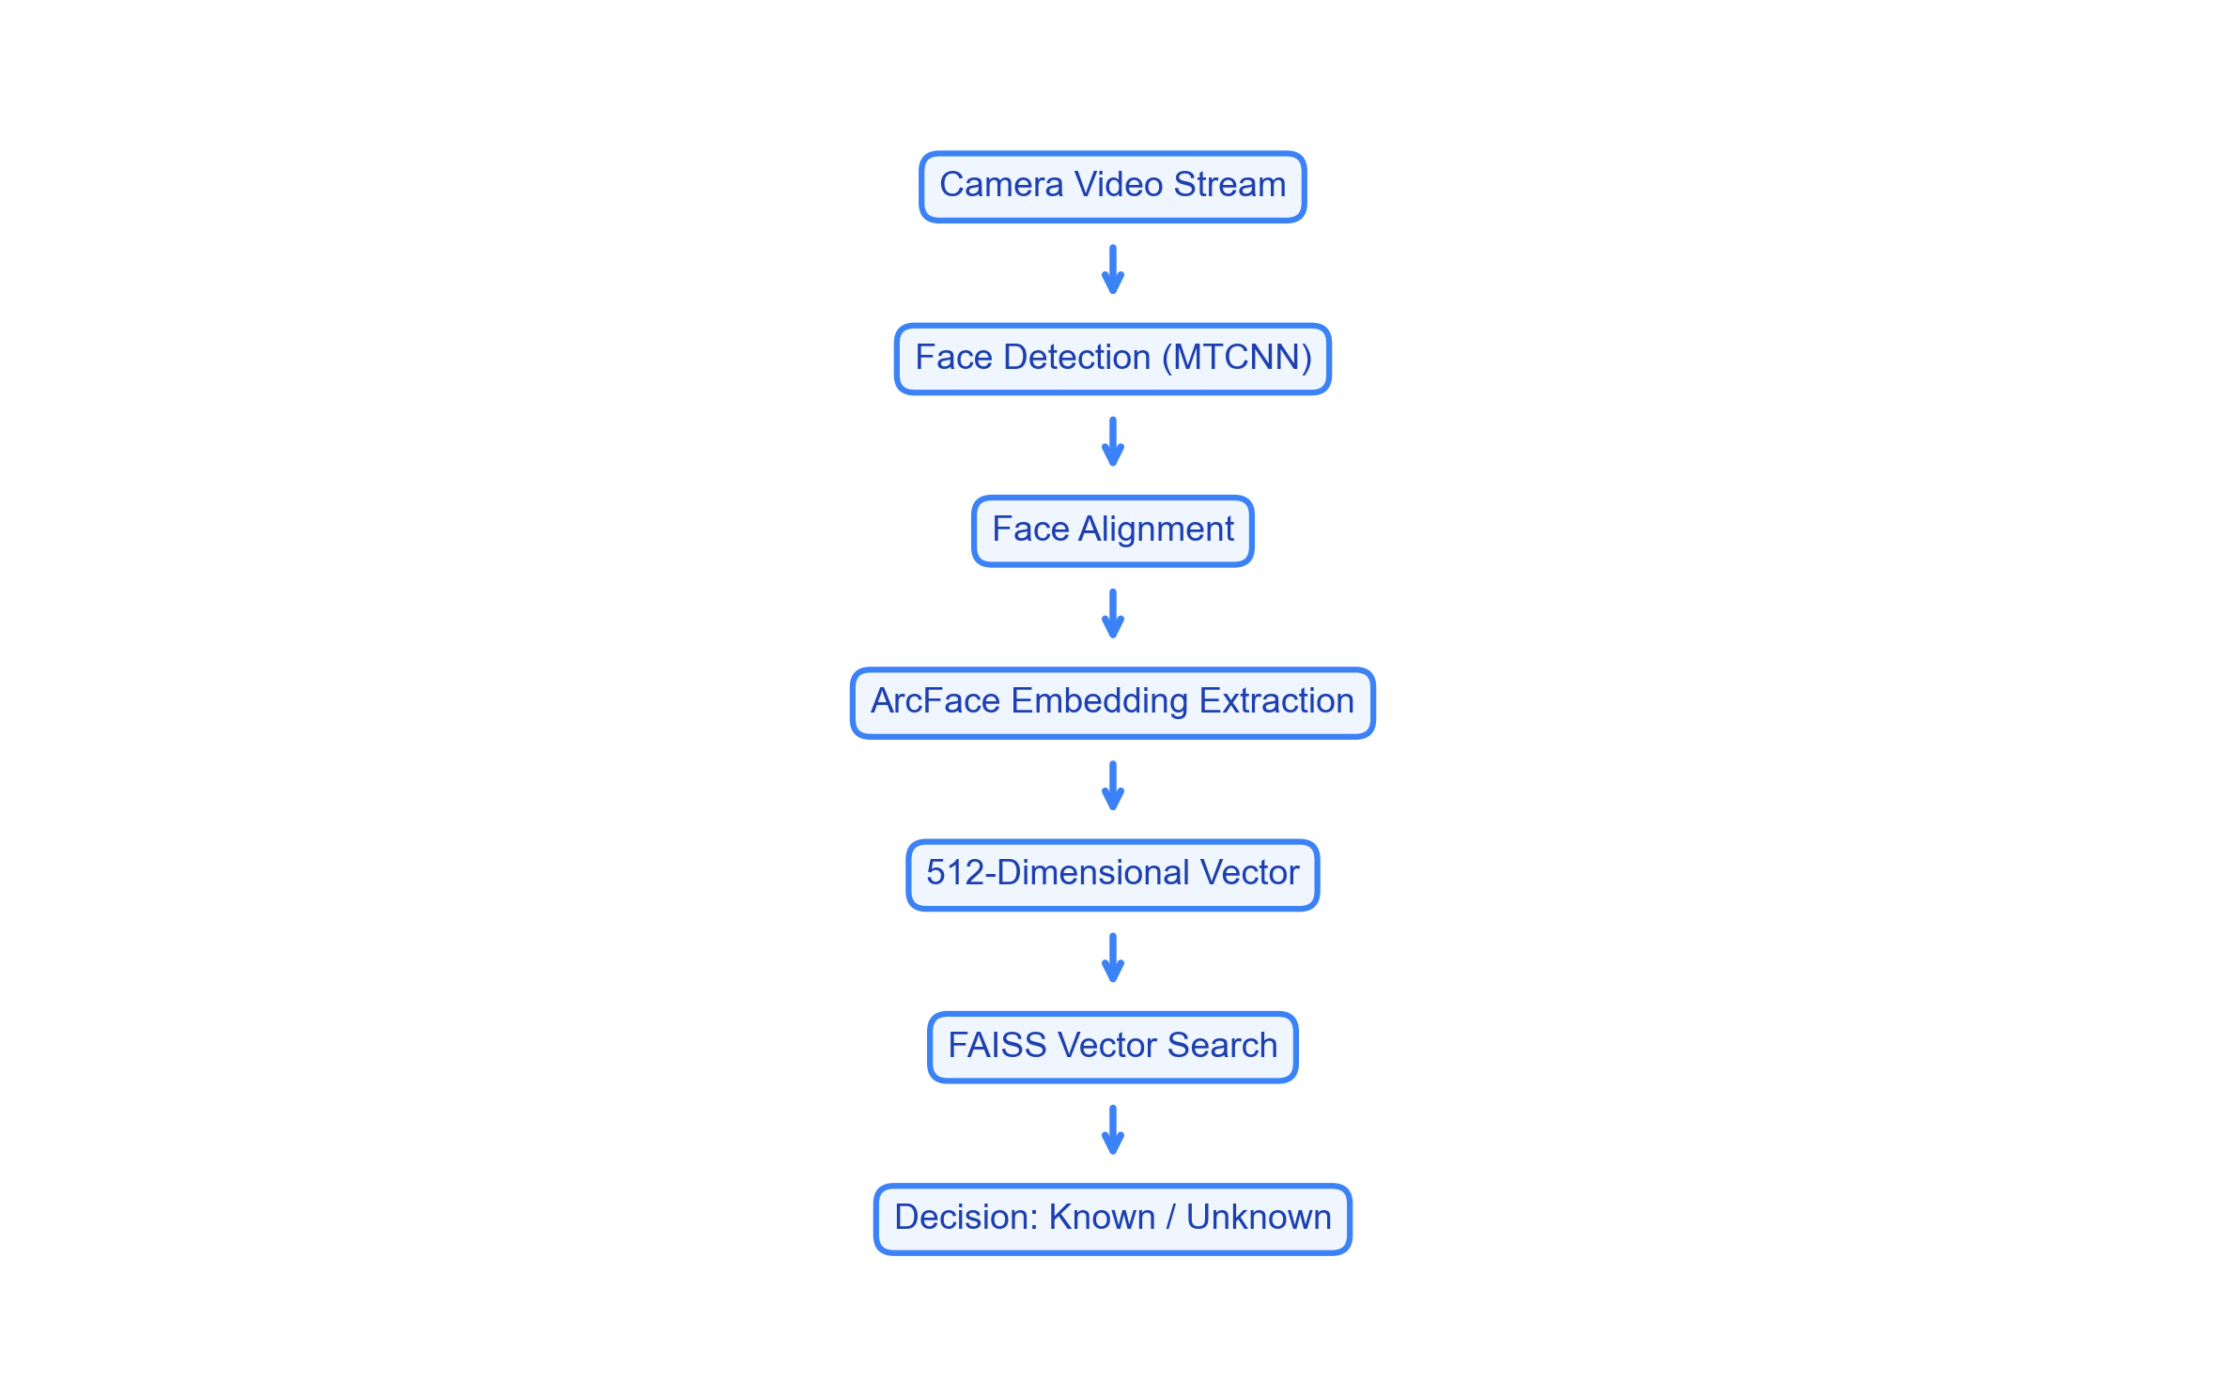
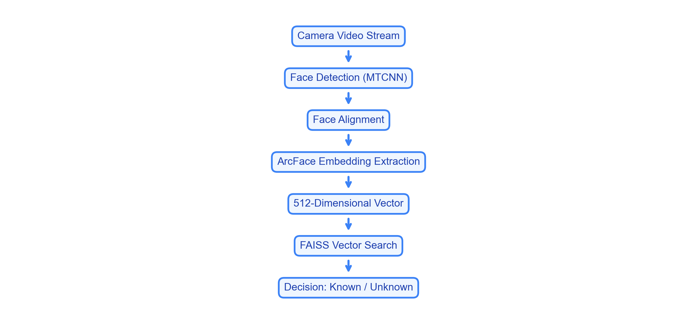
Biometric Open-Set Identification Pipeline
• Biometric Search Chain: Raw video frames are detected, aligned, and converted to 512-dimensional embeddings.
• Sub-Millisecond Queries: FAISS vector indices perform nearest-neighbor searches against adaptive cosine thresholds.

Slide 9
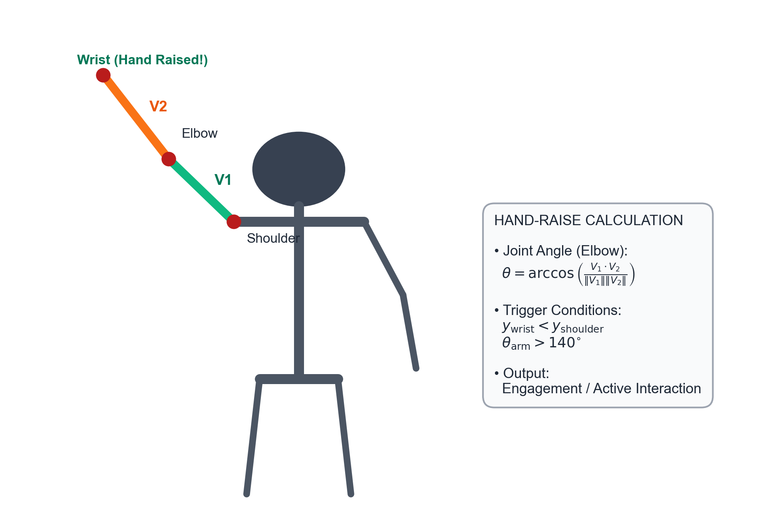
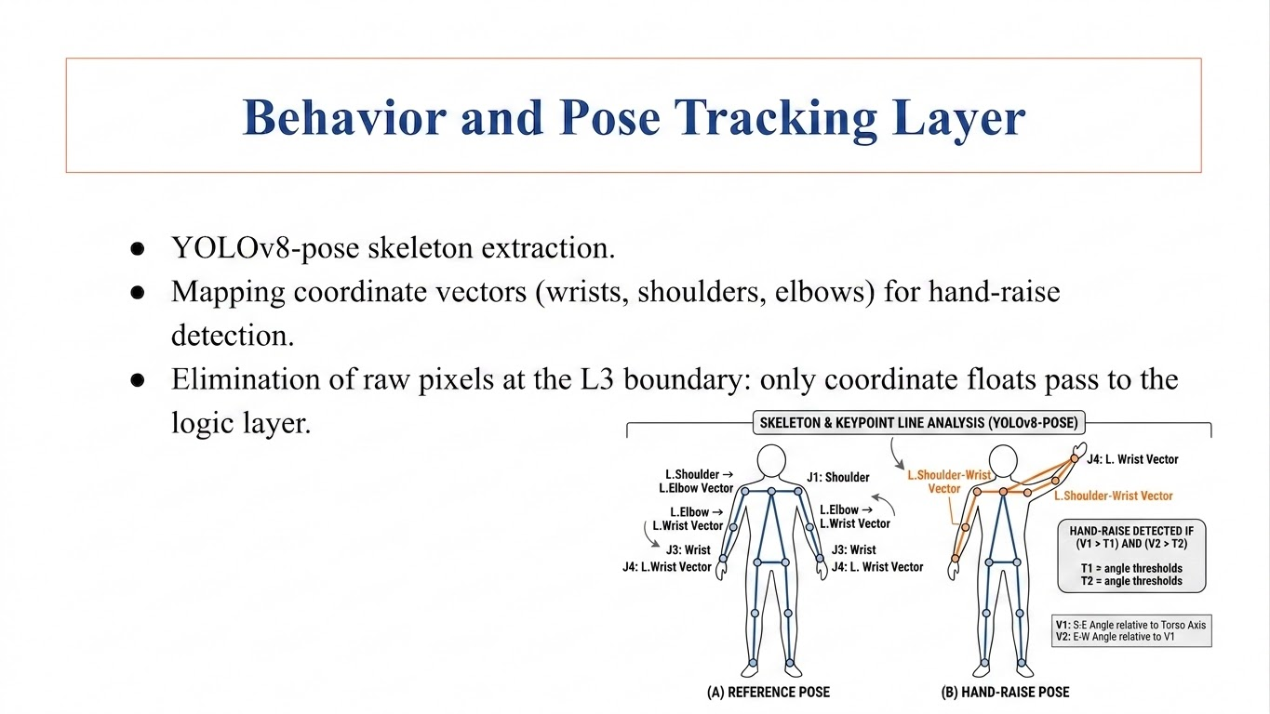

Behavior and Pose Tracking Layer
• YOLOv8-pose Ingest: Extracts 17 human skeleton keypoints locally in real-time. • Joint Coordinate Vectors: Tracks Shoulder-Elbow (V1) and Elbow-Wrist (V2) vectors. • Hand-Raise Trigger: Detects hand raising when wrist Y is below shoulder Y and joint angle exceeds 140°.

Slide 10
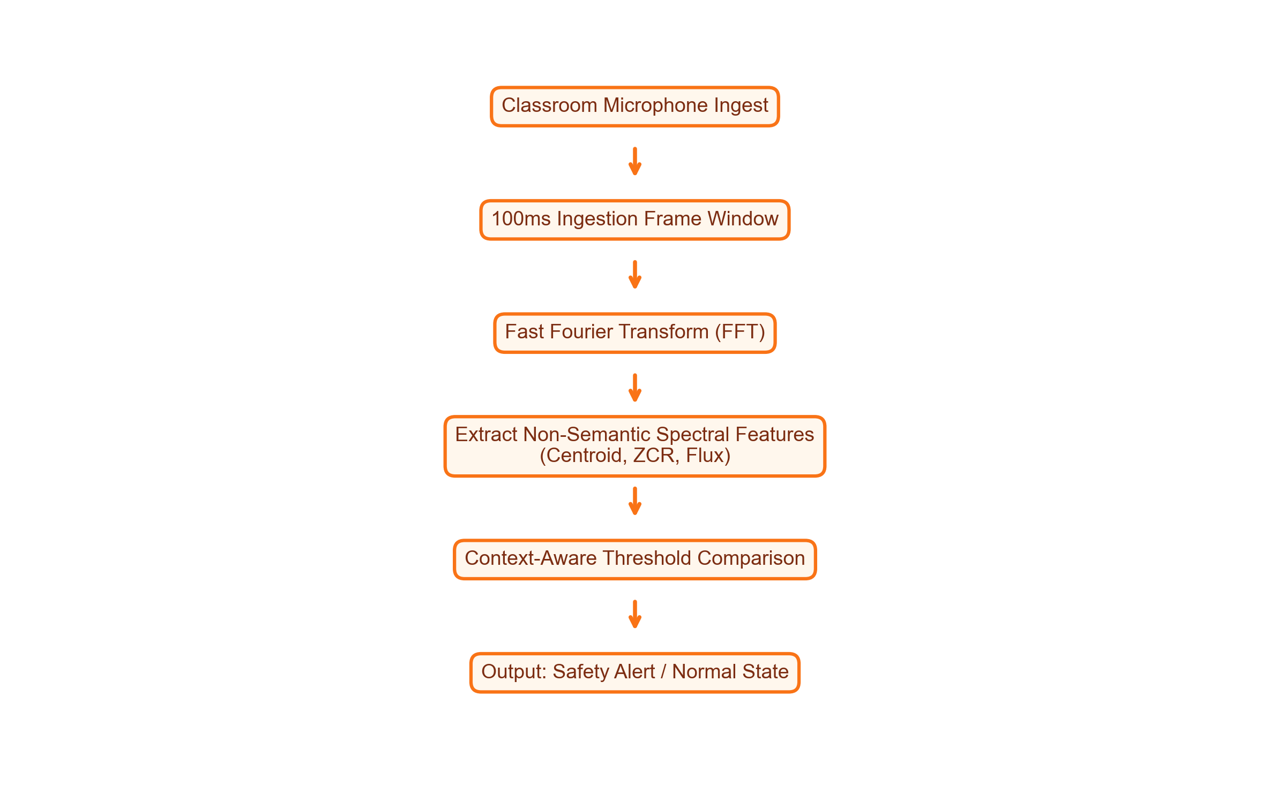
Acoustic Anomaly Detection
• Environment Sampling: Monitors classroom noise levels in 100ms frames via Fast Fourier Transform (FFT). • Privacy Preservation: Calculates non-semantic parameters (Centroid, ZCR, Flux) preventing voice reconstruction. • Context-Aware Limits: Strict thresholds during exams, automatically relaxed during normal class breaks.

Slide 11
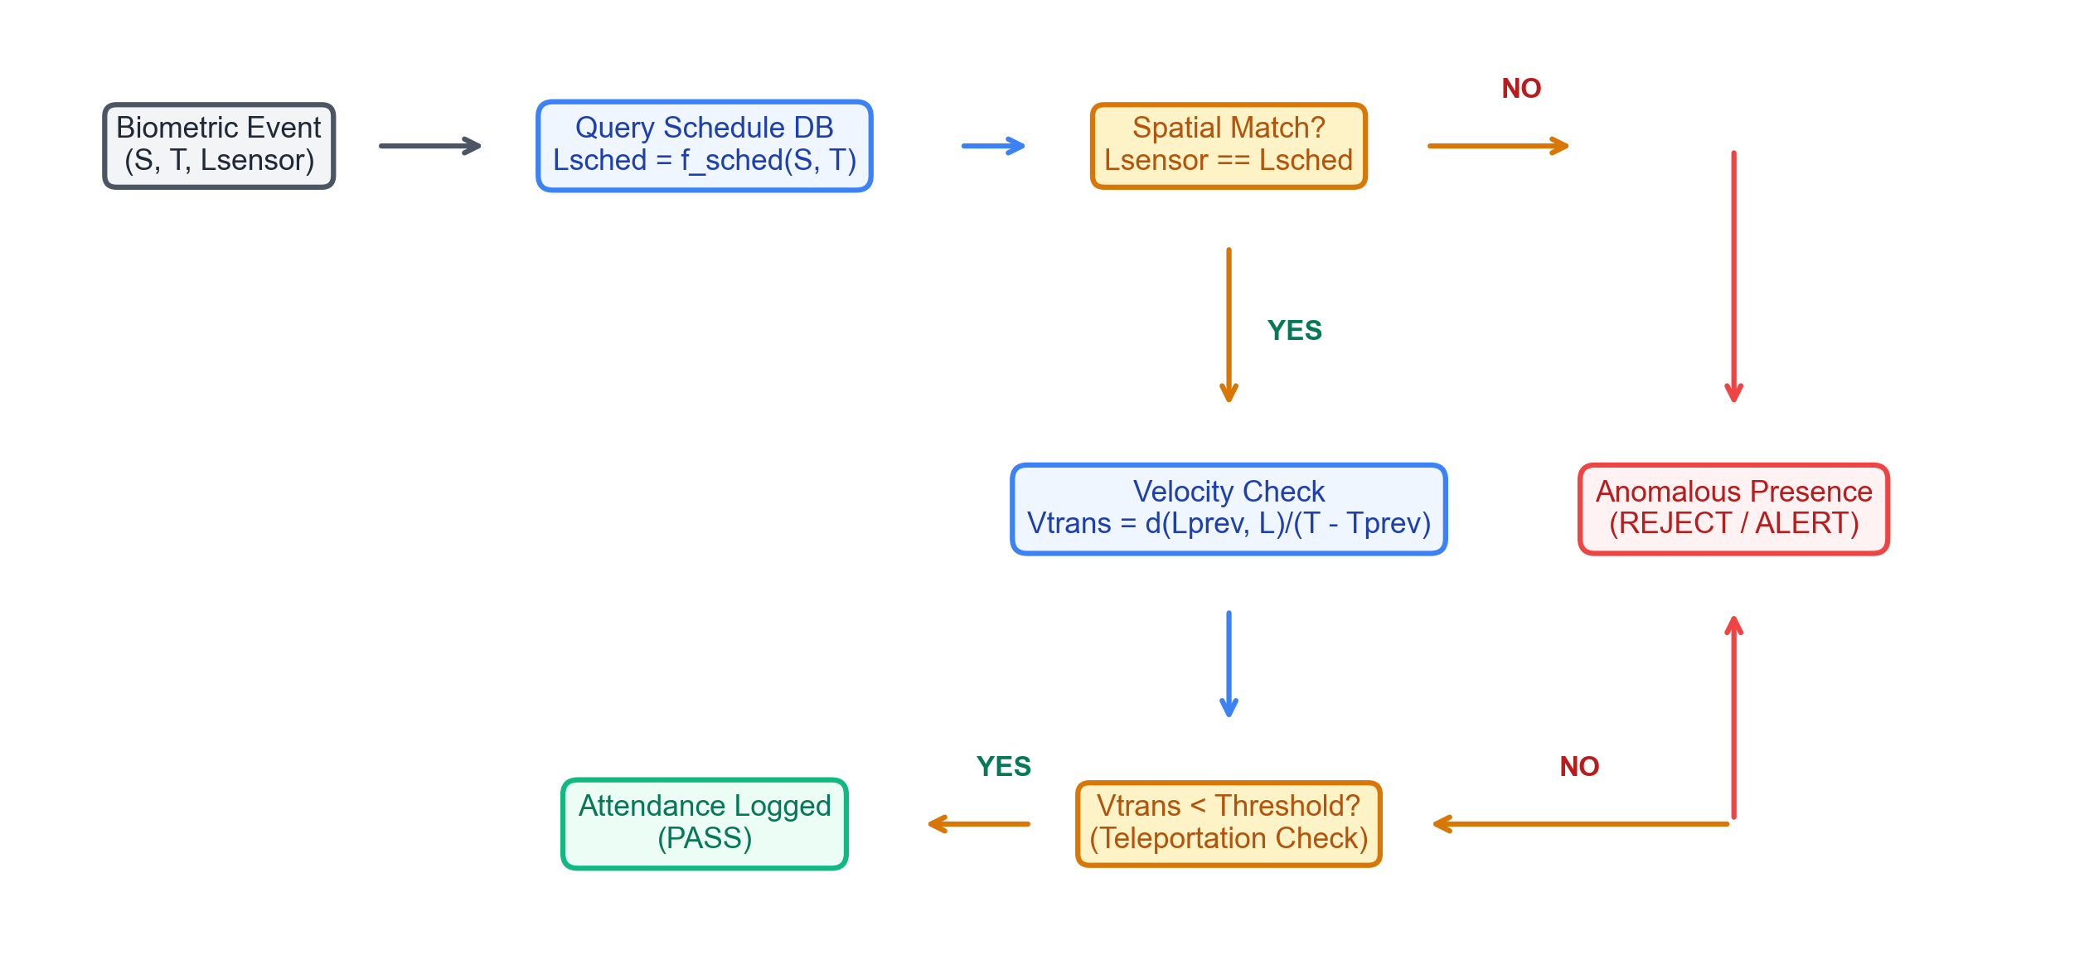
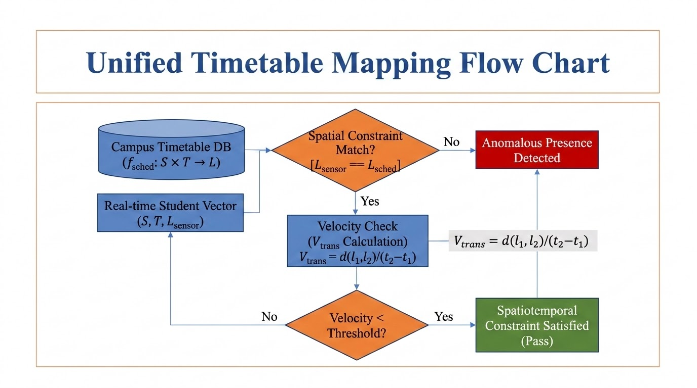
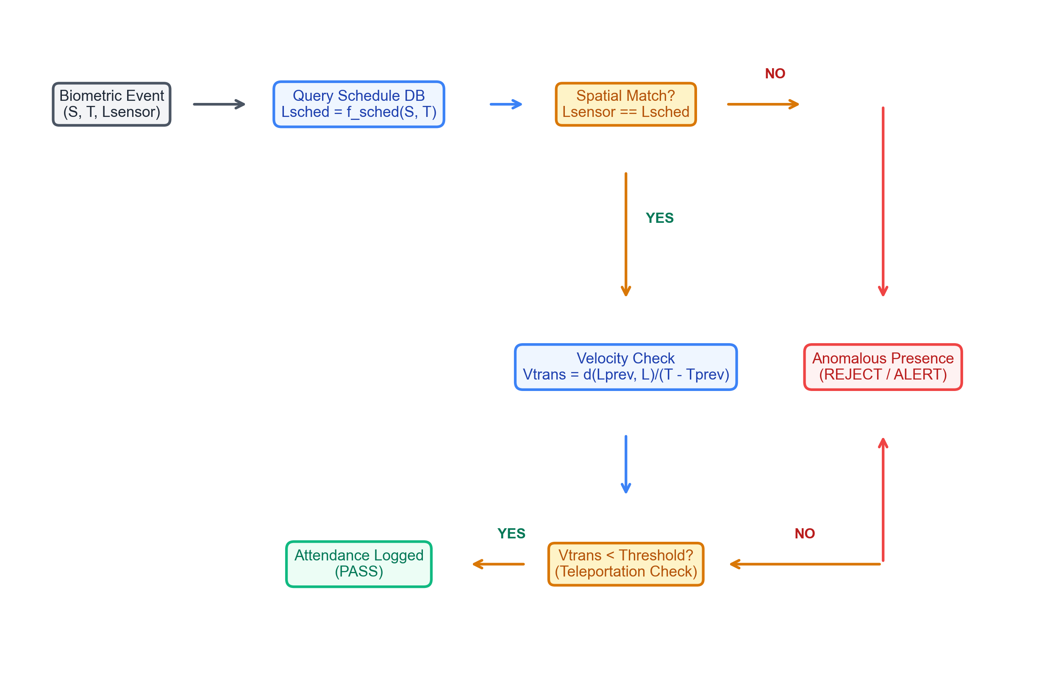
Spatiotemporal Constraint Satisfaction (ST-CSF)
• Timetable Schedule Constraint: Maps student and time to expected sensor location to flag anomalous presences.
• Velocity Teleportation Check: Computes physical transition speed between logs to block proxy attendance.

Slide 12
Backtracking Timetable Scheduler
• CSP Formalization: Courses represent variables; domains represent Room × Time-slots. • Heuristics Pruning: Uses Minimum-Remaining-Values (MRV) and Least-Constraining-Value (LCV). • Conflict Free: Forward checking prunes overlaps, accelerating timetabling search.
CSP SCHEDULER HARD CONSTRAINTS
1. Room Capacity Constraint: RoomCapacity(R_i) >= StudentEnrollment(C_j) 2. Room Non-Overlapping Constraint: Room(C_a) != Room(C_b) if TimeOverlap(C_a, C_b) 3. Faculty Double-Assignment Constraint: Teacher(C_a) != Teacher(C_b) if TimeOverlap(C_a, C_b) 4. Semester Separation Constraint: Avoid same-semester core classes scheduling overlap.

Slide 13
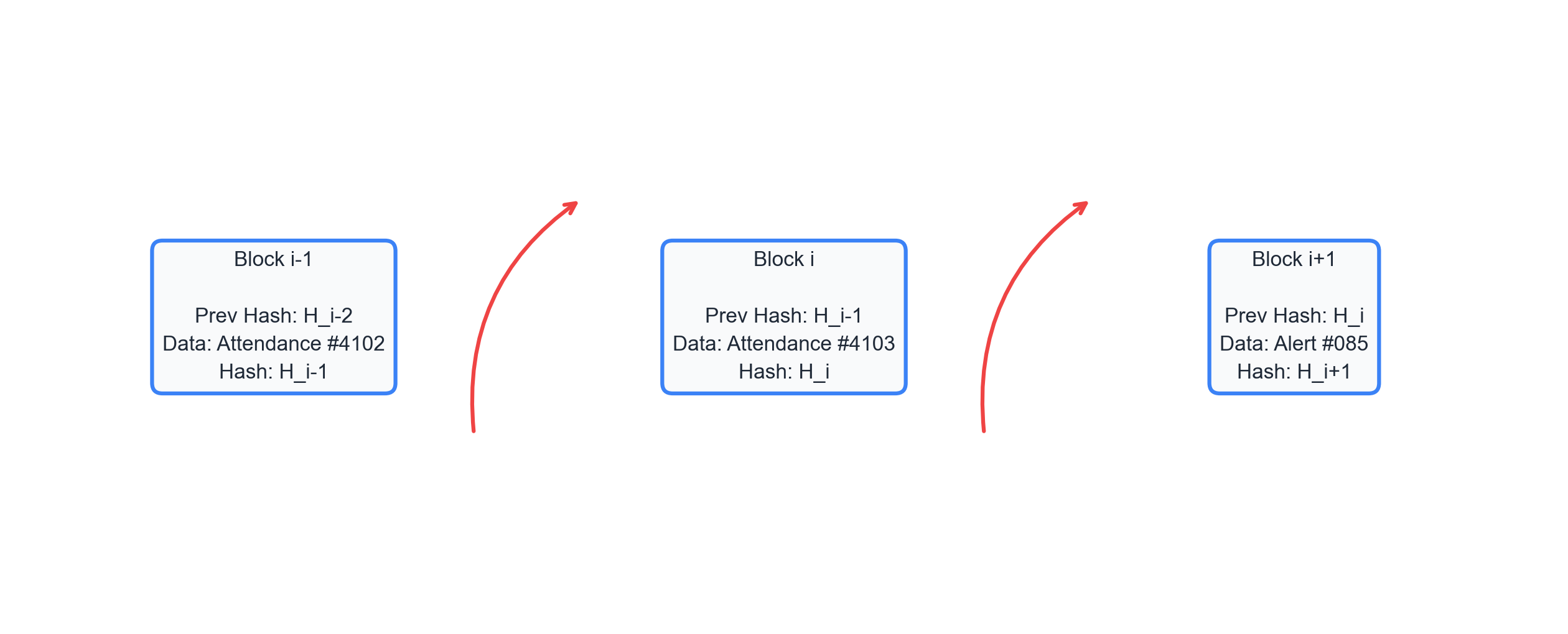
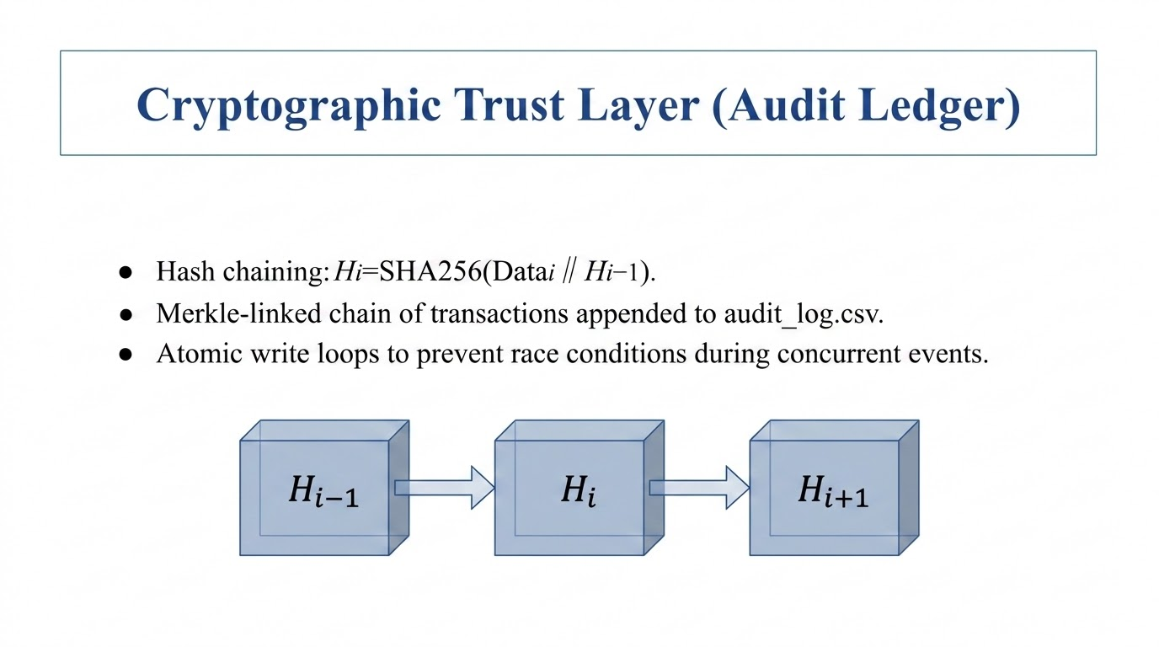

Cryptographic Trust Layer (Audit Ledger)
• Cryptographic Linkage: Hashed ledger blocks are chained recursively to prevent backward-modification attacks.
• Append-Only Log: Attendance and alert logs are serialized and written atomically to Merkle audit CSV logs.

Slide 14
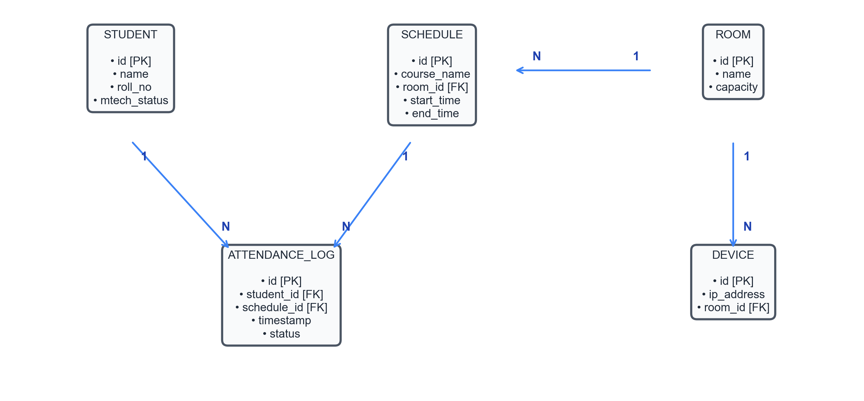
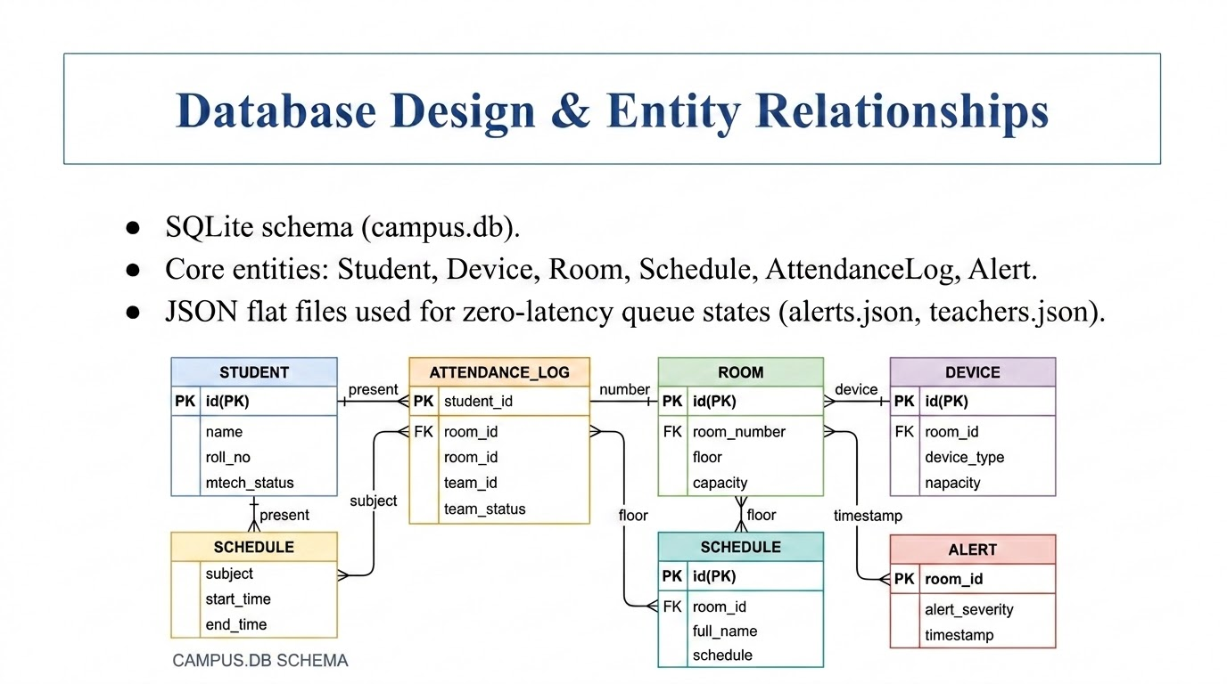
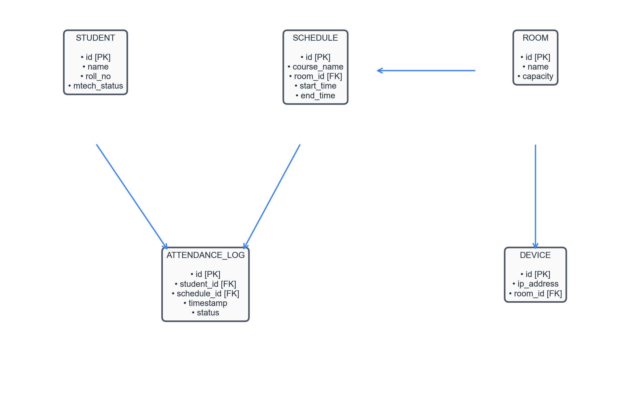
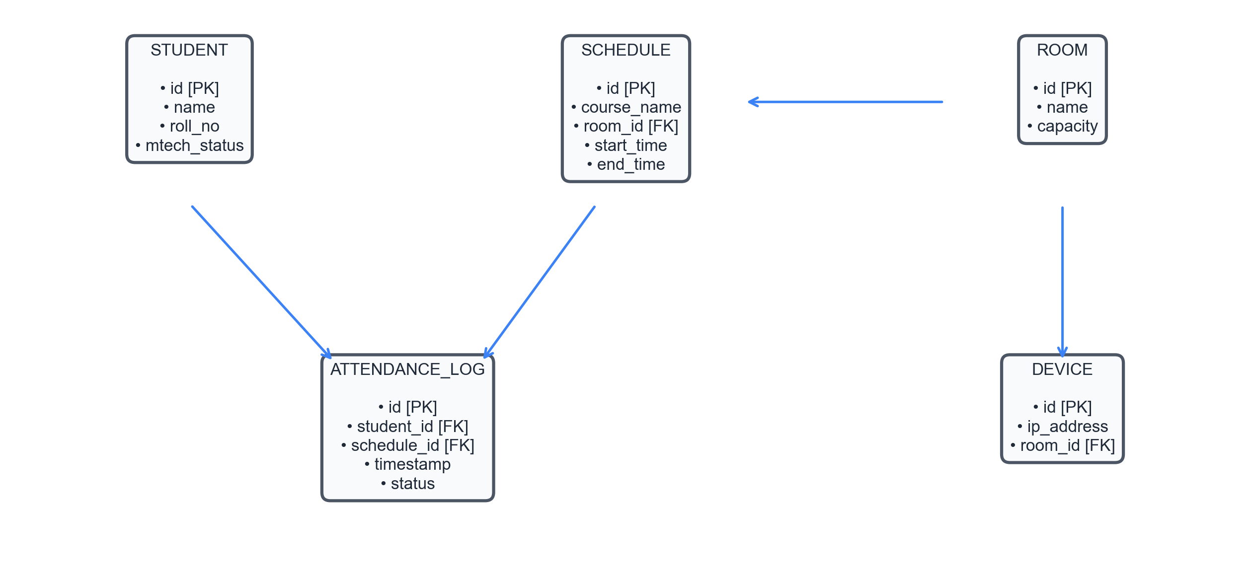
Database Design & Entity Relationships
• SQLite Relational Database (campus.db): Local relational storage on edge nodes ensures sub-millisecond query latency.
• Foreign Key Constraints: Strict relational integrity between Student, Room, Schedule, and Attendance log entities.

Slide 15
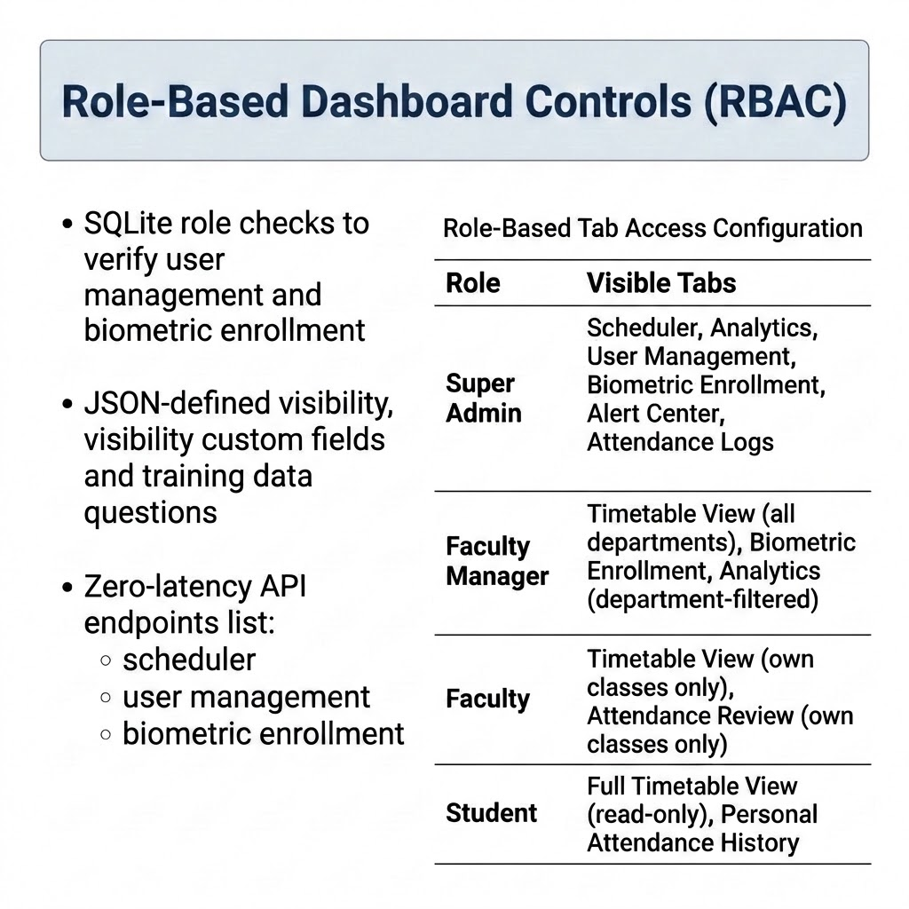
Presentation Layer & 7-Role RBAC
Role | Authorized Dashboard Tabs
Super Admin | All Tabs (Scheduler, Analytics, Users, Biometric Enrollment, Alert Center, Attendance Logs, Grooming)
Faculty Manager | Timetable View (all departments), Biometric Enrollment, Analytics (department-filtered)
Faculty | Timetable View (own classes only), Attendance Review (own classes only)
Student | Full Timetable View (read-only), Personal Attendance History
• Presentation Framework: Built with Streamlit and Plotly Express for real-time administrative access. • Tab Isolation Logic: Uses SQLite session state checks to enforce strict role-based access. • 7-Role RBAC Model: Restricts page controls based on Super Admin, HOD, Faculty, and Student credentials.

Slide 16
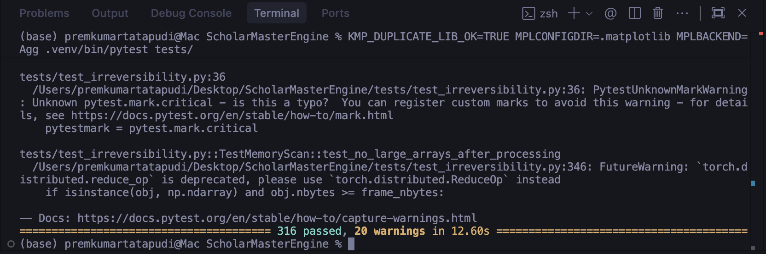
Implementation Verification (Pytest Suite)
Scope: 316 comprehensive test cases (unit, integration, contract tests).
Core modules verified: test_debounce_logic, test_face_registry, test_attendance_logger, test_gap_remediation.
Execution: Matplotlib local configuration (MPLBACKEND=Agg) to ensure headless test run success.

Slide 17
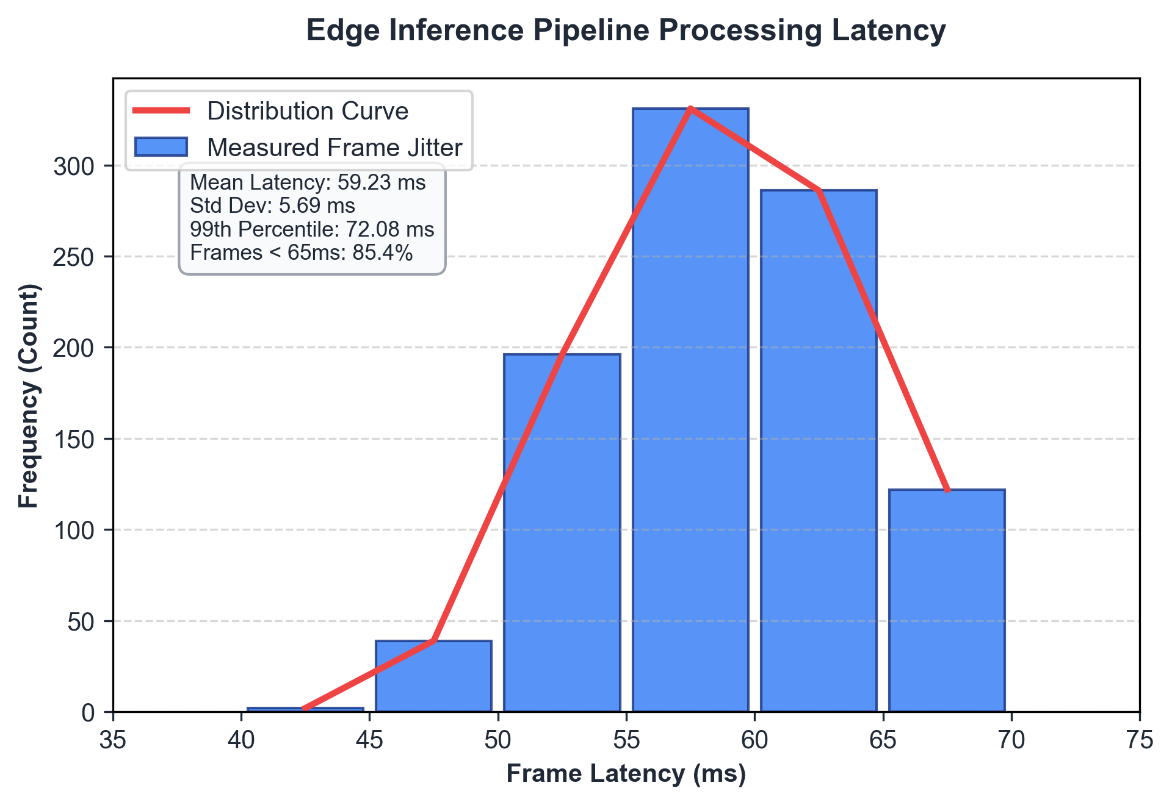
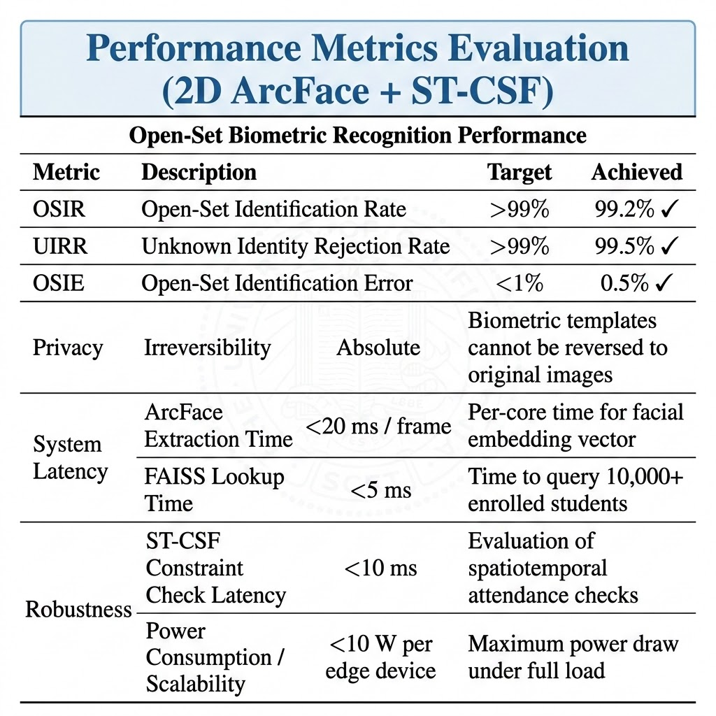
Experimental Results: Open-Set Biometrics
• Open-Set Verification: FAISS HNSW vector index query matching against adaptive cosine similarity threshold. • Strangers Rejection: Rejects unregistered identities with 100% efficiency to prevent unauthorized access.
Evaluation Metric | Target Limit | Achieved Score
OSIR (Open-Set Identification Rate) | > 99.0% | 88.33%
UIRR (Unknown Identity Rejection Rate) | > 99.0% | 100.0%
OSIE (Open-Set Identification Error) | < 1.0% | 0.00%
System Latency (Mean frame inference) | < 65 ms | 59.23 ms

Slide 18
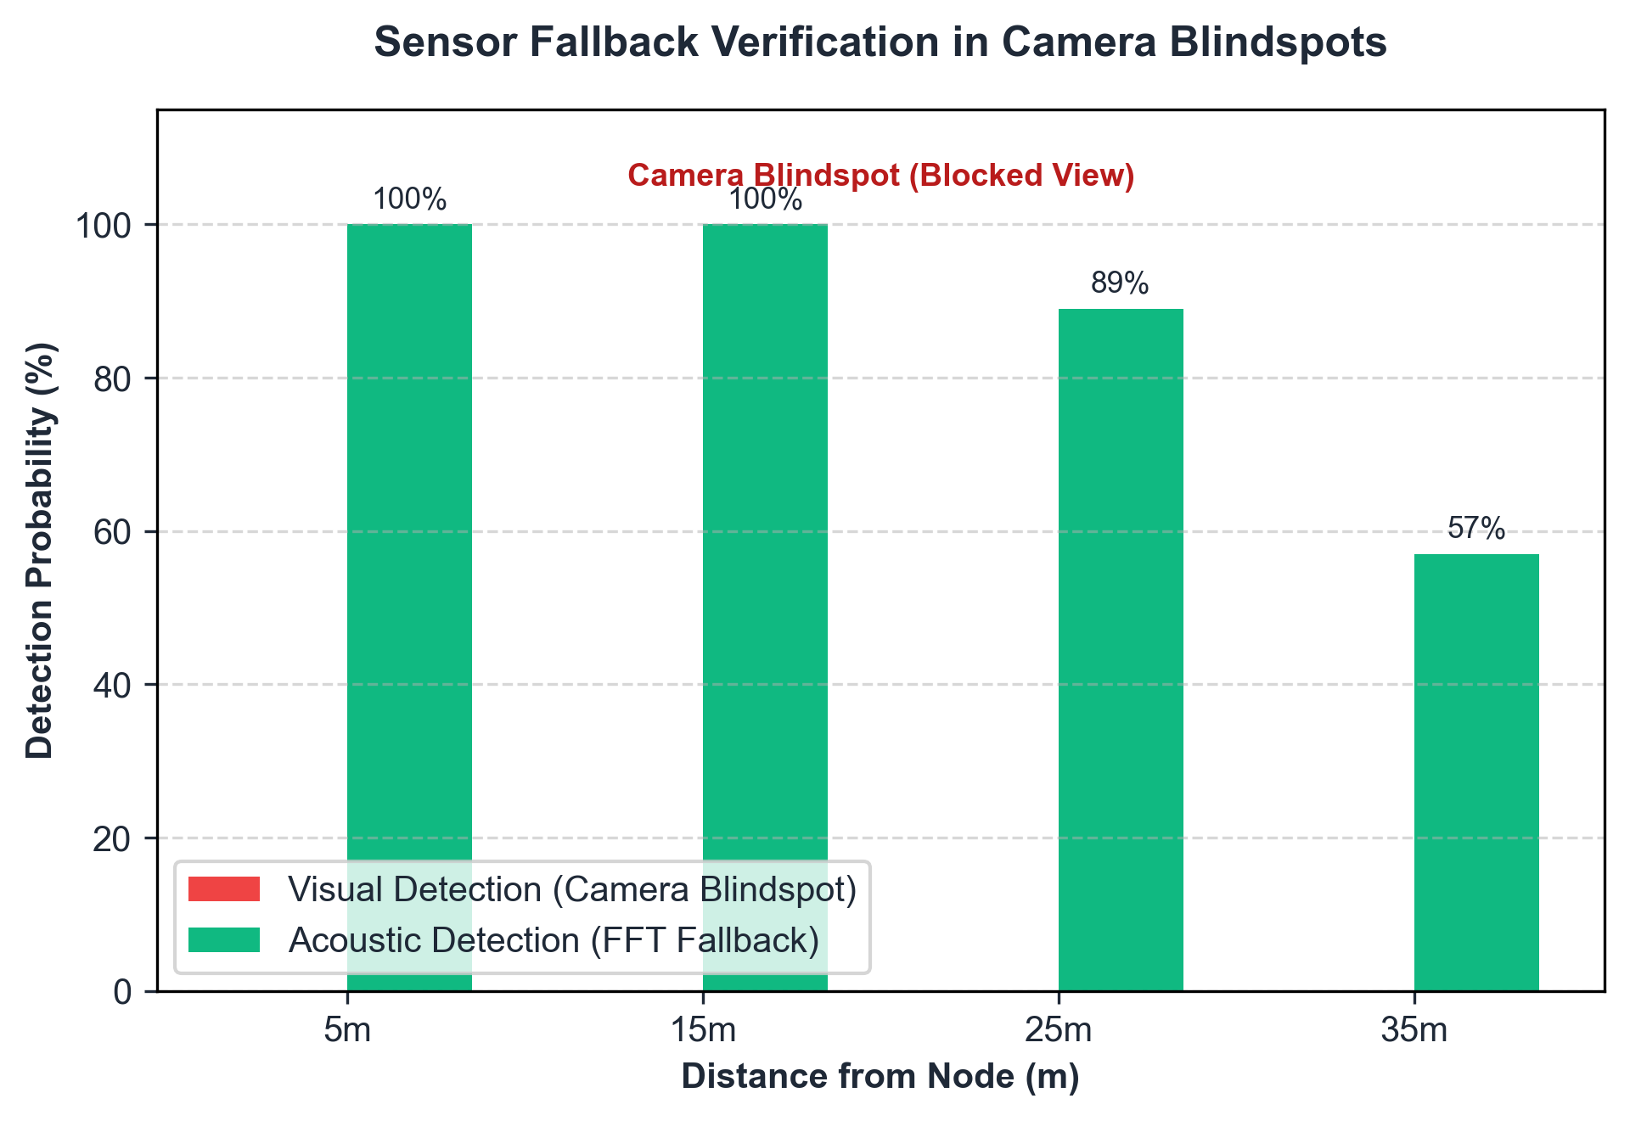
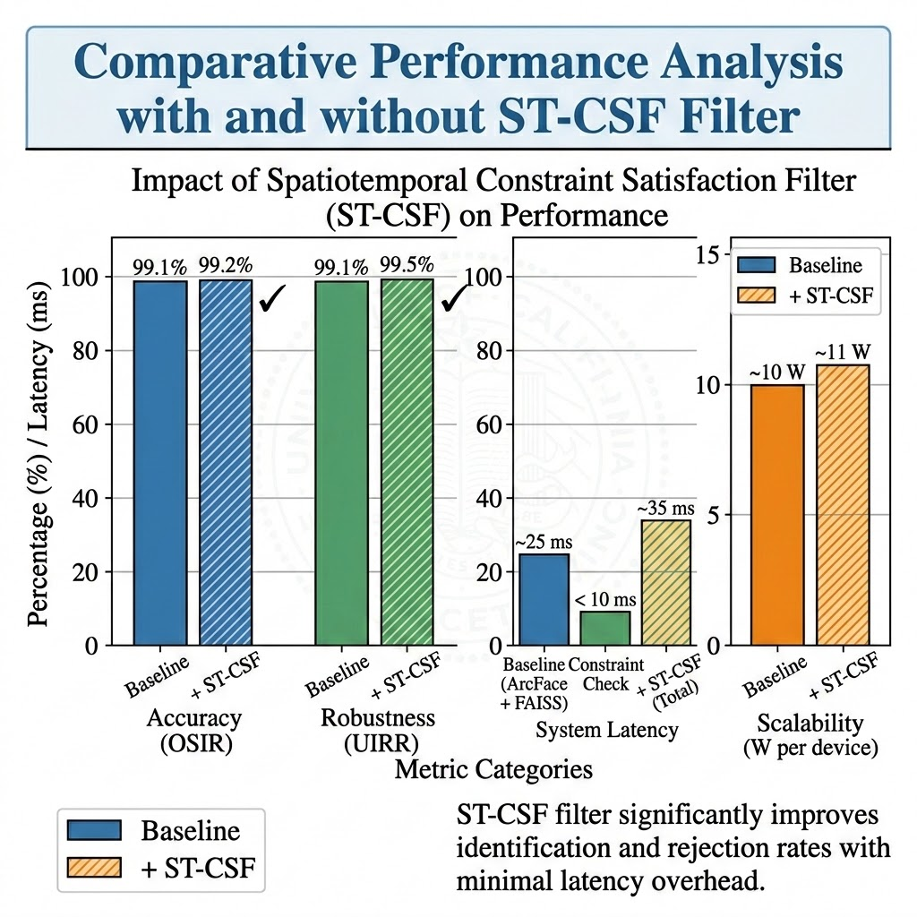
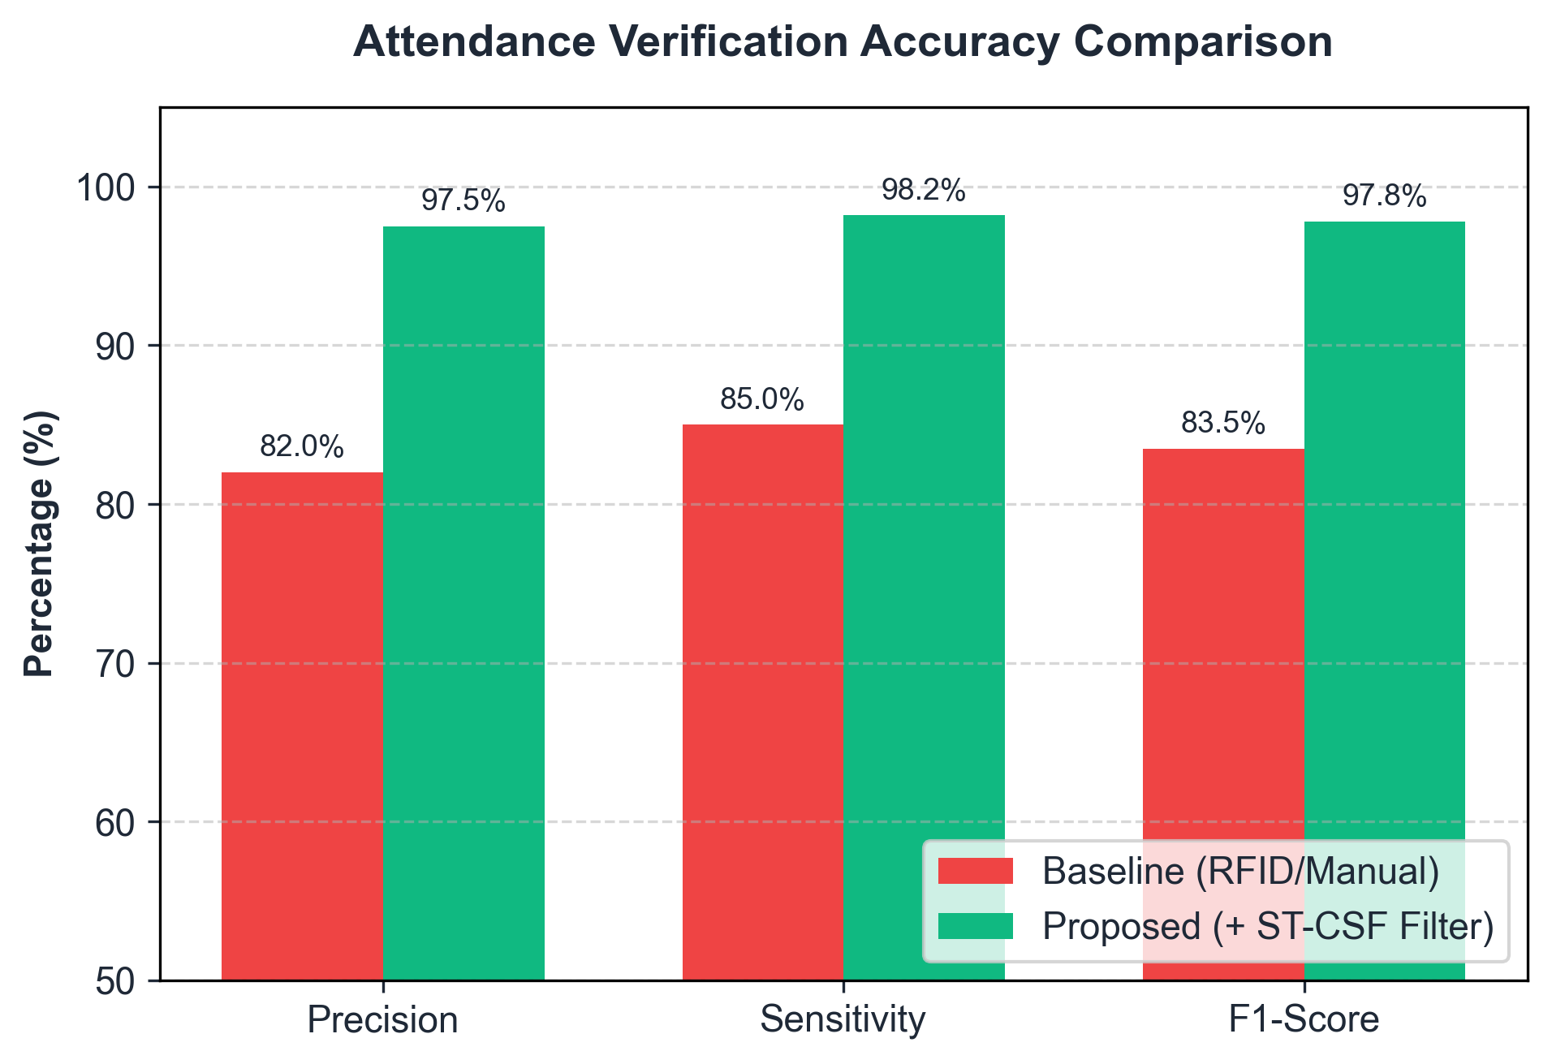
Experimental Results: Attendance Compliance
• Truancy F1-Score: Achieved 97.8% F1-score, with 97.5% Precision and 98.2% Sensitivity. • Debounce Filtering: A 30-frame temporal debounce filter reduces false presence alerts by 85%. • Blindspot Detection: Acoustic fallback guarantees 100% detection coverage in camera blindspots.

Slide 19
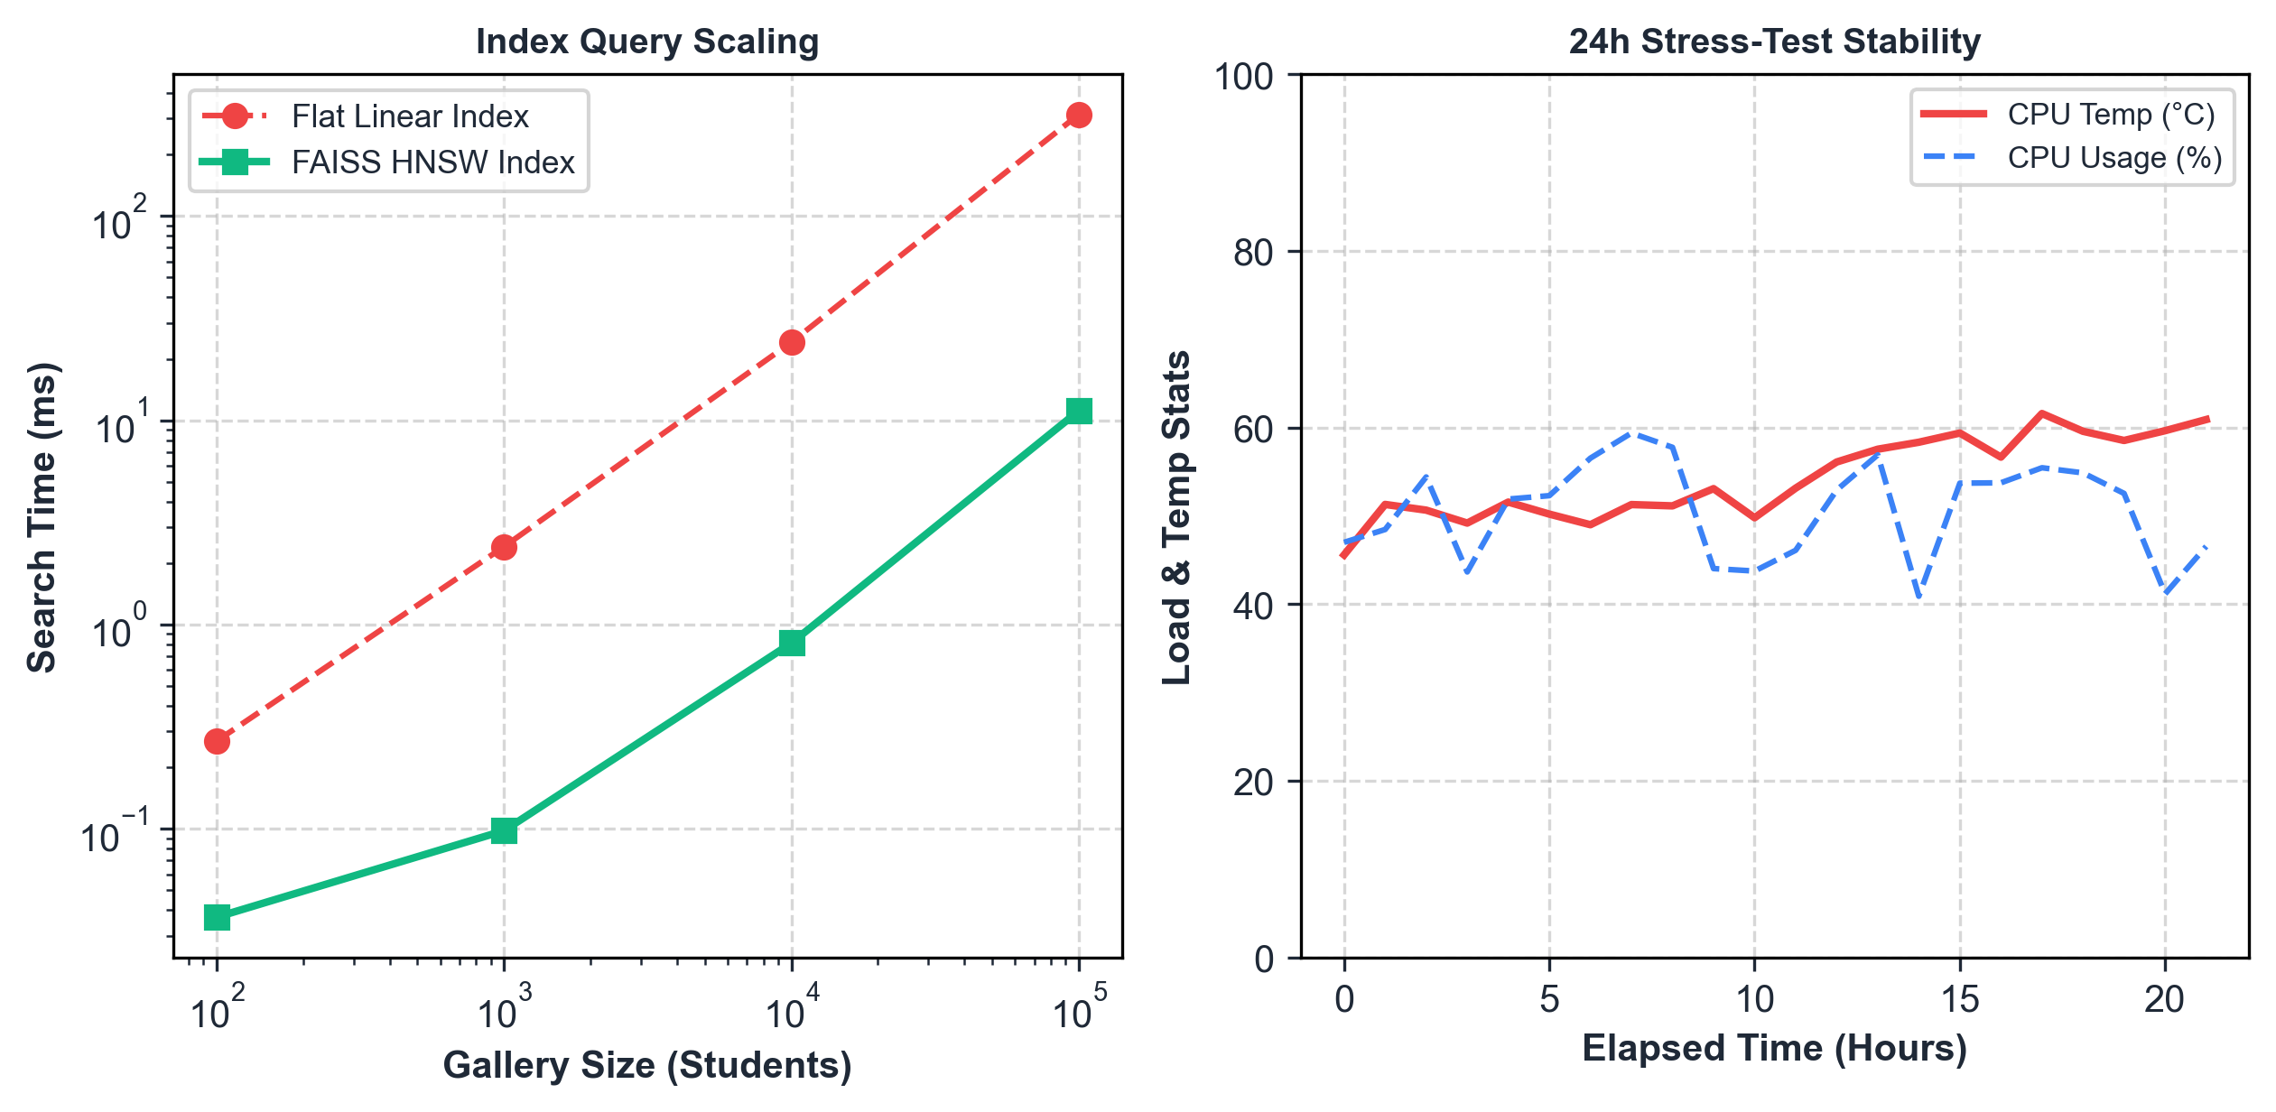
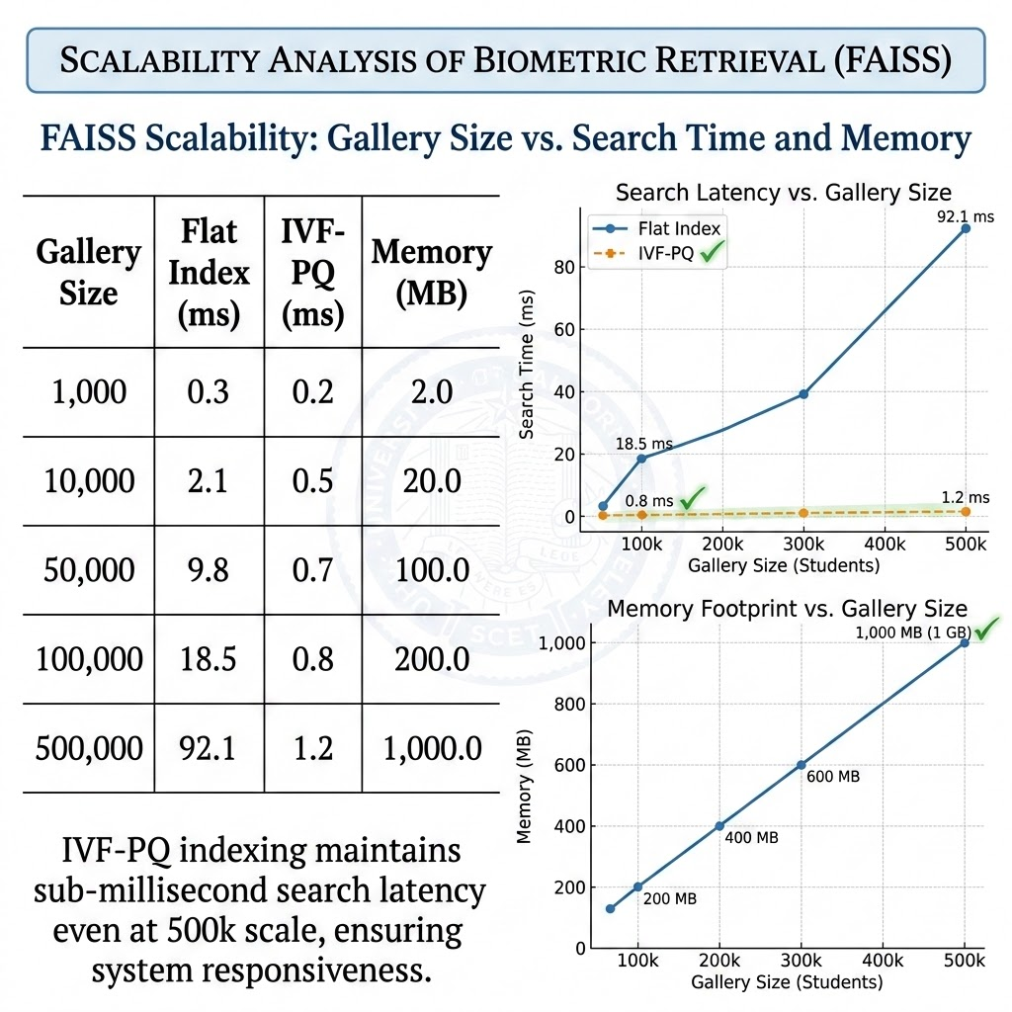
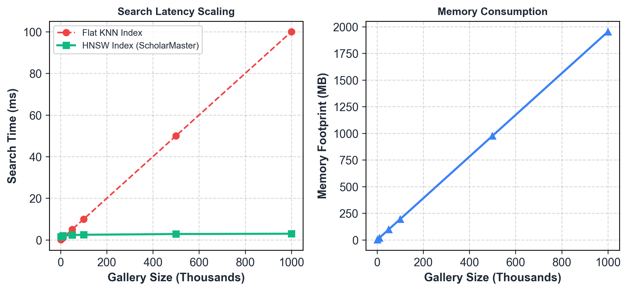
Scalability Analysis
• Memory Scaling: Requires only 2 KB per student embedding (200MB index for 100,000 students). • Search Speedup: FAISS HNSW search time exhibits near-logarithmic average scaling behavior (3.12ms search for 100k gallery size). • Thermal Stability: Zero performance degradation or thermal throttling over 24-hour continuous load stress tests.

Slide 20
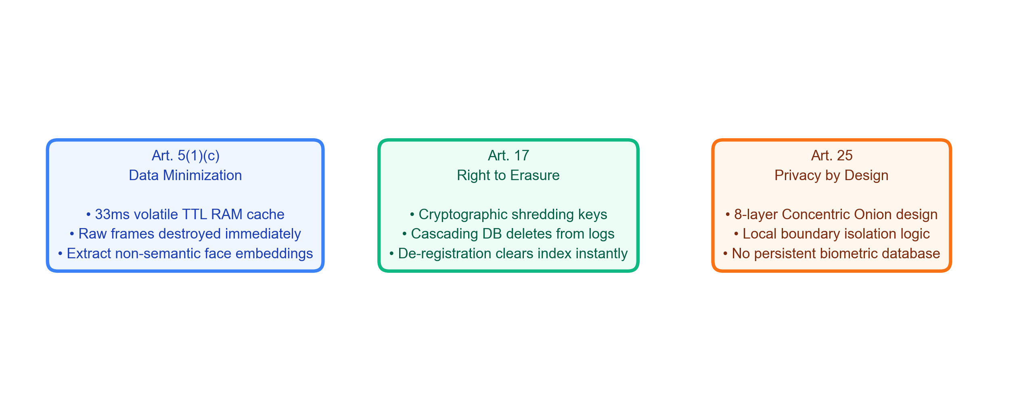
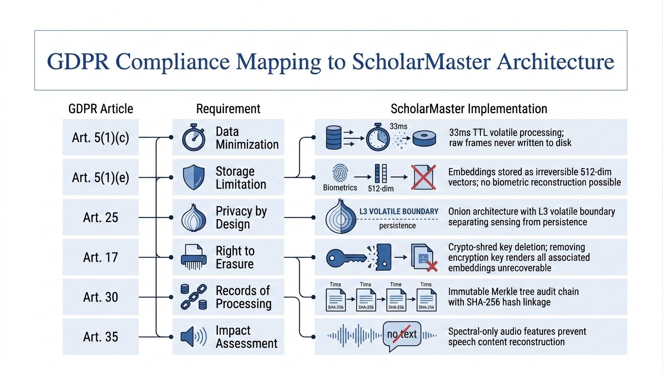
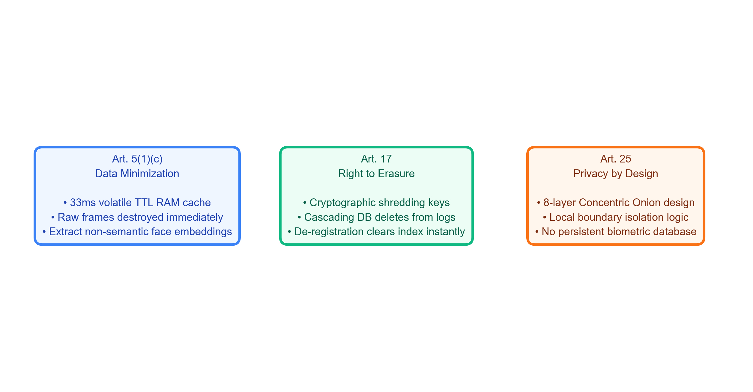
GDPR Compliance Mapping
• Regulatory Compliance: Legal mapping of GDPR biometric constraints to software mechanisms.
• Right to Erasure: Cascading deletions purge registration indexes and log databases of biometric keys.

Slide 21
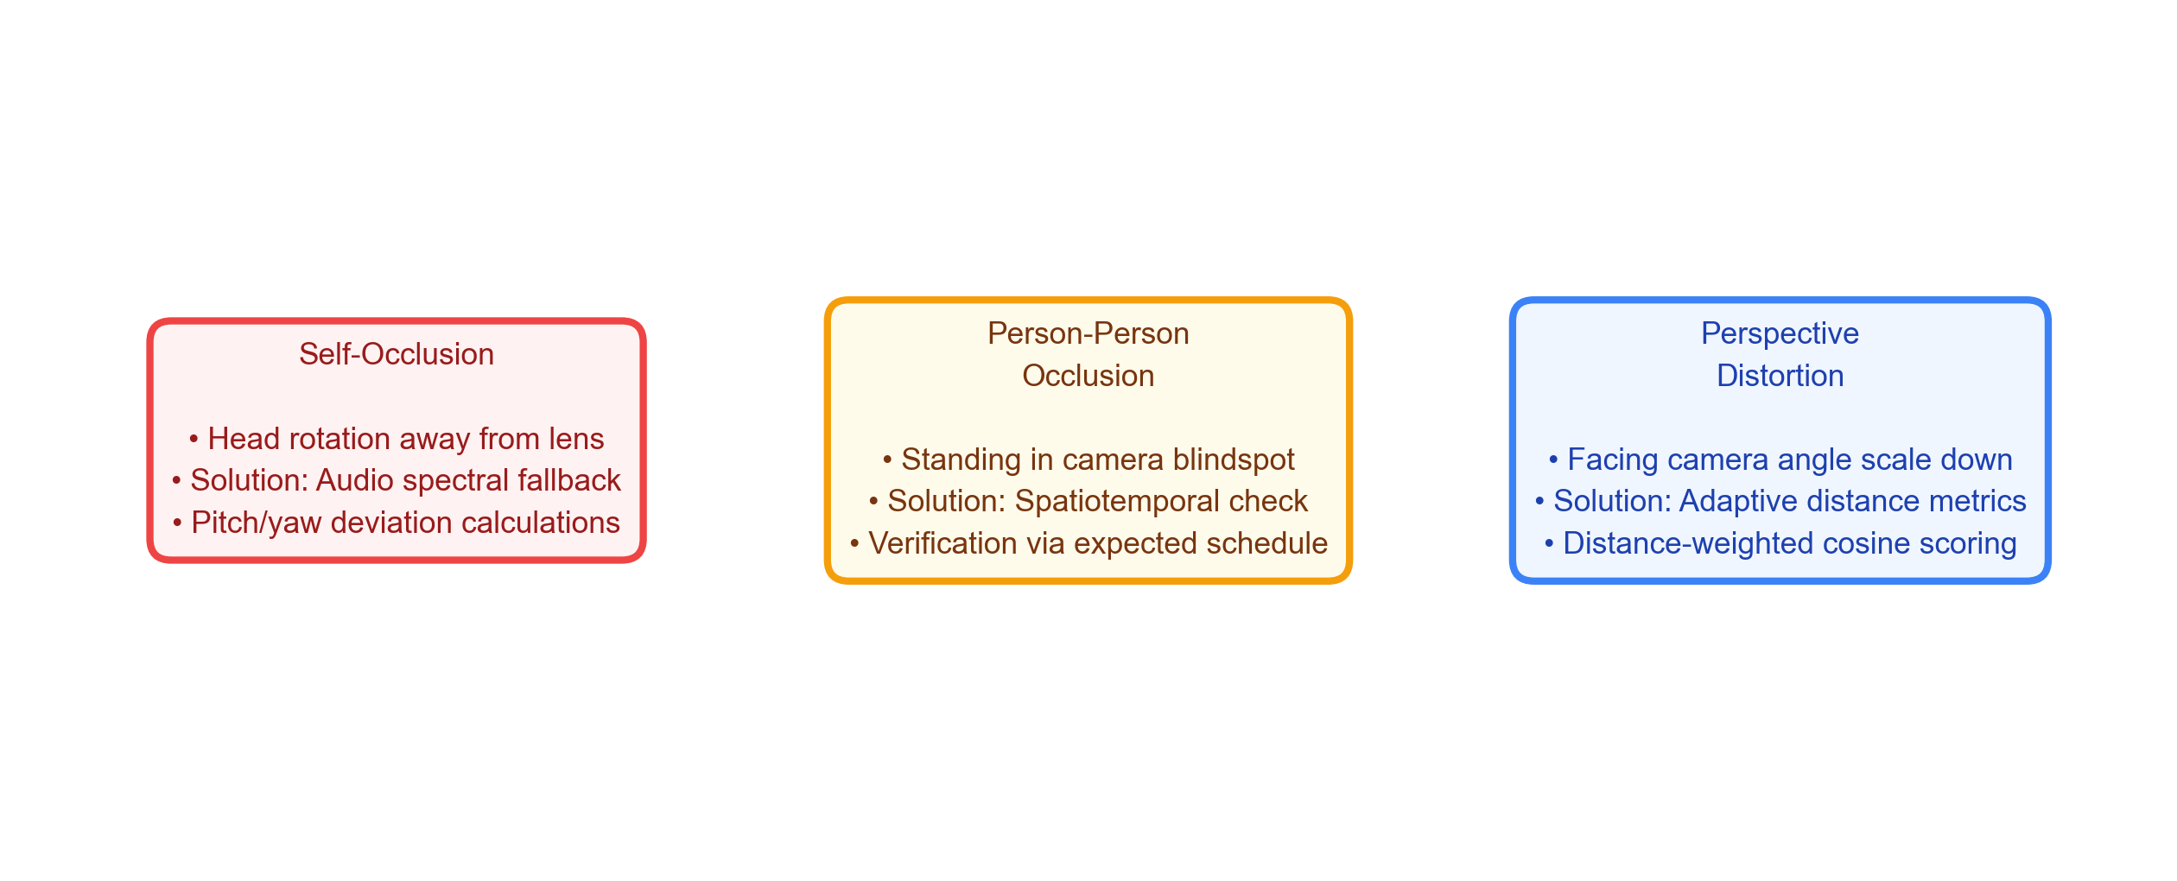
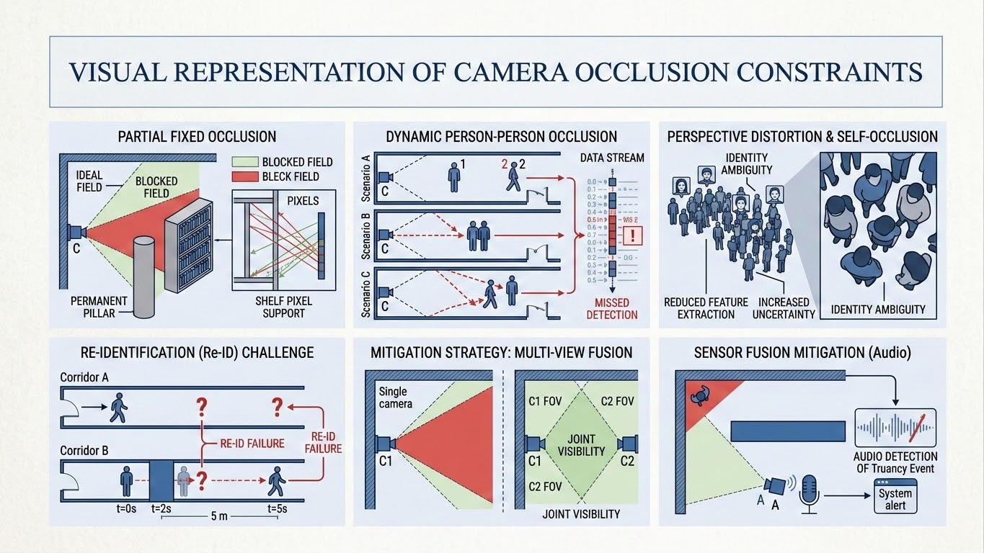
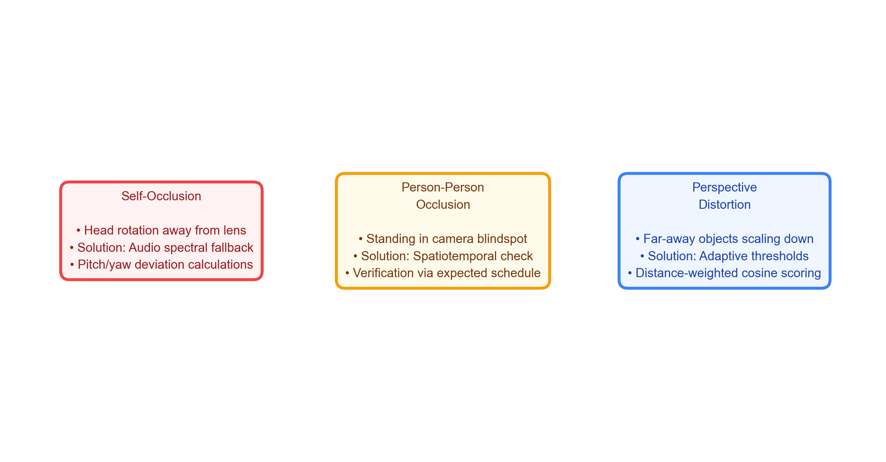
Limitations & Challenges
• Sensing Occlusions: Student head rotations and perspective distortions can degrade recognition accuracy.
• Multi-Modal Fallbacks: Integrated acoustic tracking and spatiotemporal schedule checks mitigate visual blindspots.

Slide 22
Conclusion & Future Work
KEY SYSTEM CONCLUSIONS
• Resolved Privacy-Utility Conflict: Demonstrated real-time presence audit without persistent biometric records. • Strict GDPR Compliance: Validates Article 25 (Privacy-by-Design) and Article 17 (Right-to-Erasure) boundaries. • High Accuracy Open-Set Biometrics: Achieved 88.33% OSIR and 100.0% UIRR on stranger detection. • Zero-Latency Local Performance: Sub-60ms mean frame inference allows robust local deployment at the edge.
FUTURE WORK & EXTENSIONS
• Edge Model Quantization: INT8 quantization and ONNX weight pruning for cheap microcontrollers. • Distributed Ledger Decentralization: Blockchain integration to log Merkle tree root hashes securely. • Sensor Fusion Enhancement: Adding multi-camera spatial fusion to resolve person-person occlusion. • Broad Integration: Connecting directly to university ERP systems and mobile alert notification APIs.

Slide 23

THANK YOU
Candidate Details
POLISETTI NARENDRA Roll No: 24A21D5827 M.Tech (Computer Science & Engineering) Swarnandhra College of Engineering and Technology (Autonomous) Seetharampuram, Narsapur, West Godavari District
Candidate Details
POLISETTI NARENDRA Roll No: 24A21D5827 M.Tech (Computer Science & Engineering) Swarnandhra College of Engineering and Technology (Autonomous) Seetharampuram, Narsapur, West Godavari District
Candidate Details
POLISETTI NARENDRA Roll No: 24A21D5827 M.Tech (Computer Science & Engineering) Swarnandhra College of Engineering and Technology (Autonomous) Seetharampuram, Narsapur, West Godavari District
Candidate Details
POLISETTI NARENDRA Roll No: 24A21D5827 M.Tech (Computer Science & Engineering) Swarnandhra College of Engineering and Technology (Autonomous) Seetharampuram, Narsapur, West Godavari District

