Slide 1

SWARNANDHRA COLLEGE OF ENGINEERING AND TECHNOLOGY
DEPARTMENT OF COMPUTER SCIENCE & ENGINEERING
A PROJECT REVIEW PRESENTATION ON
BEYOND THE PRIVACY-UTILITY TRADE-OFF: A
SPATIOTEMPORAL-CONSTRAINT AND SECURE
INTELLIGENT CAMPUS MONITORING SYSTEM
by
P NARENDRA
Roll NO: 24A21D5827
II M. Tech (CSE)
Under the Guidance of
Dr. S. Suresh Kumar, M.Tech, Ph.D, PDF
Professor & Principal, Dept. of CSE

Slide 2
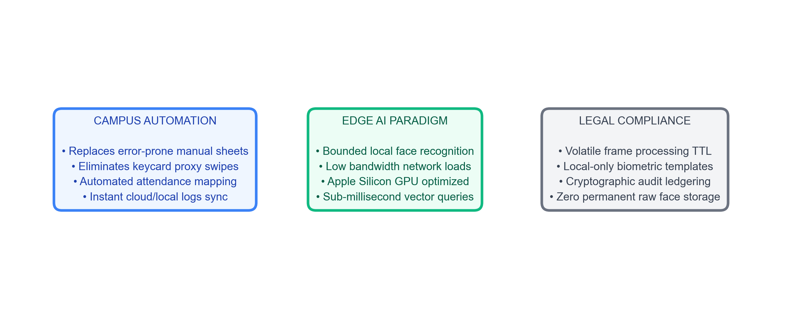
Introduction
Context of computer-vision-based student presence and edge monitoring systems.
• Automated Tracking: Automated monitoring replaces manual rosters to prevent class-time truancies. • Decentralized Edge AI: Local cameras and processors run biometrics locally, protecting raw sensors. • Regulatory Context: Operates under strict privacy rules (GDPR) prohibiting centralized biometric storage.

Slide 3
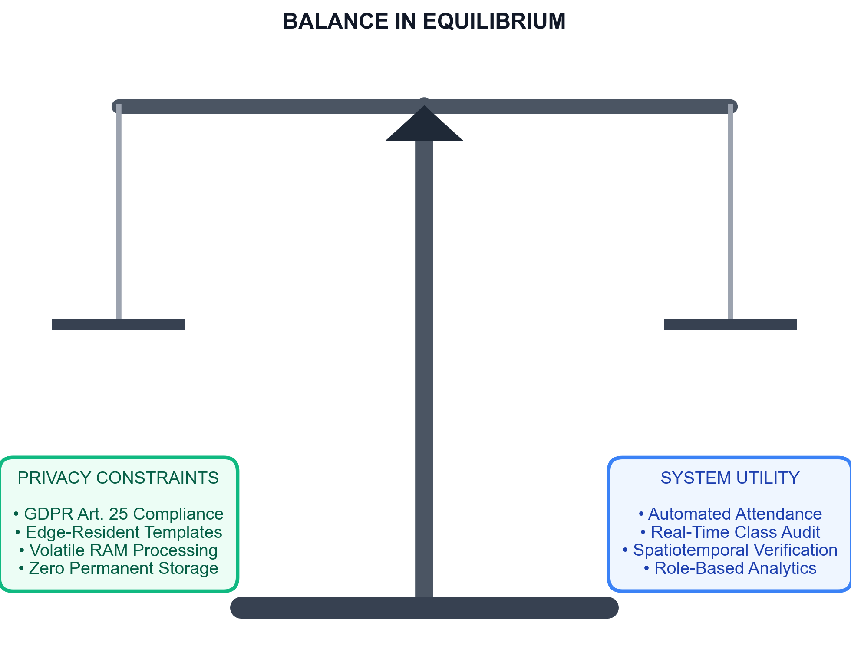
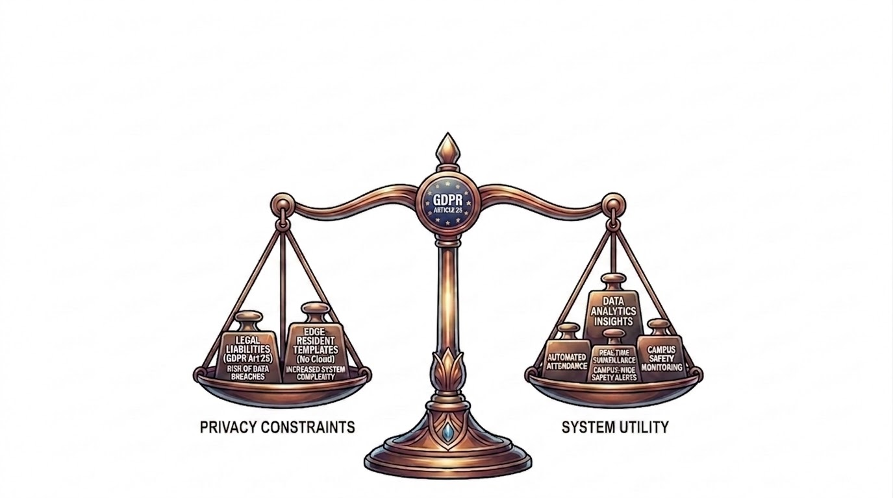
Problem Statement
• Privacy-Utility Conflict: Automating attendance and safety checks without storing high-risk permanent biometric databases. • GDPR Liabilities: Central databases face severe leak risks and violate GDPR Article 25 (Privacy-by-Design). • Edge Mitigations: Resolved via edge vector templates and 33ms volatile RAM cache buffers.

Slide 4
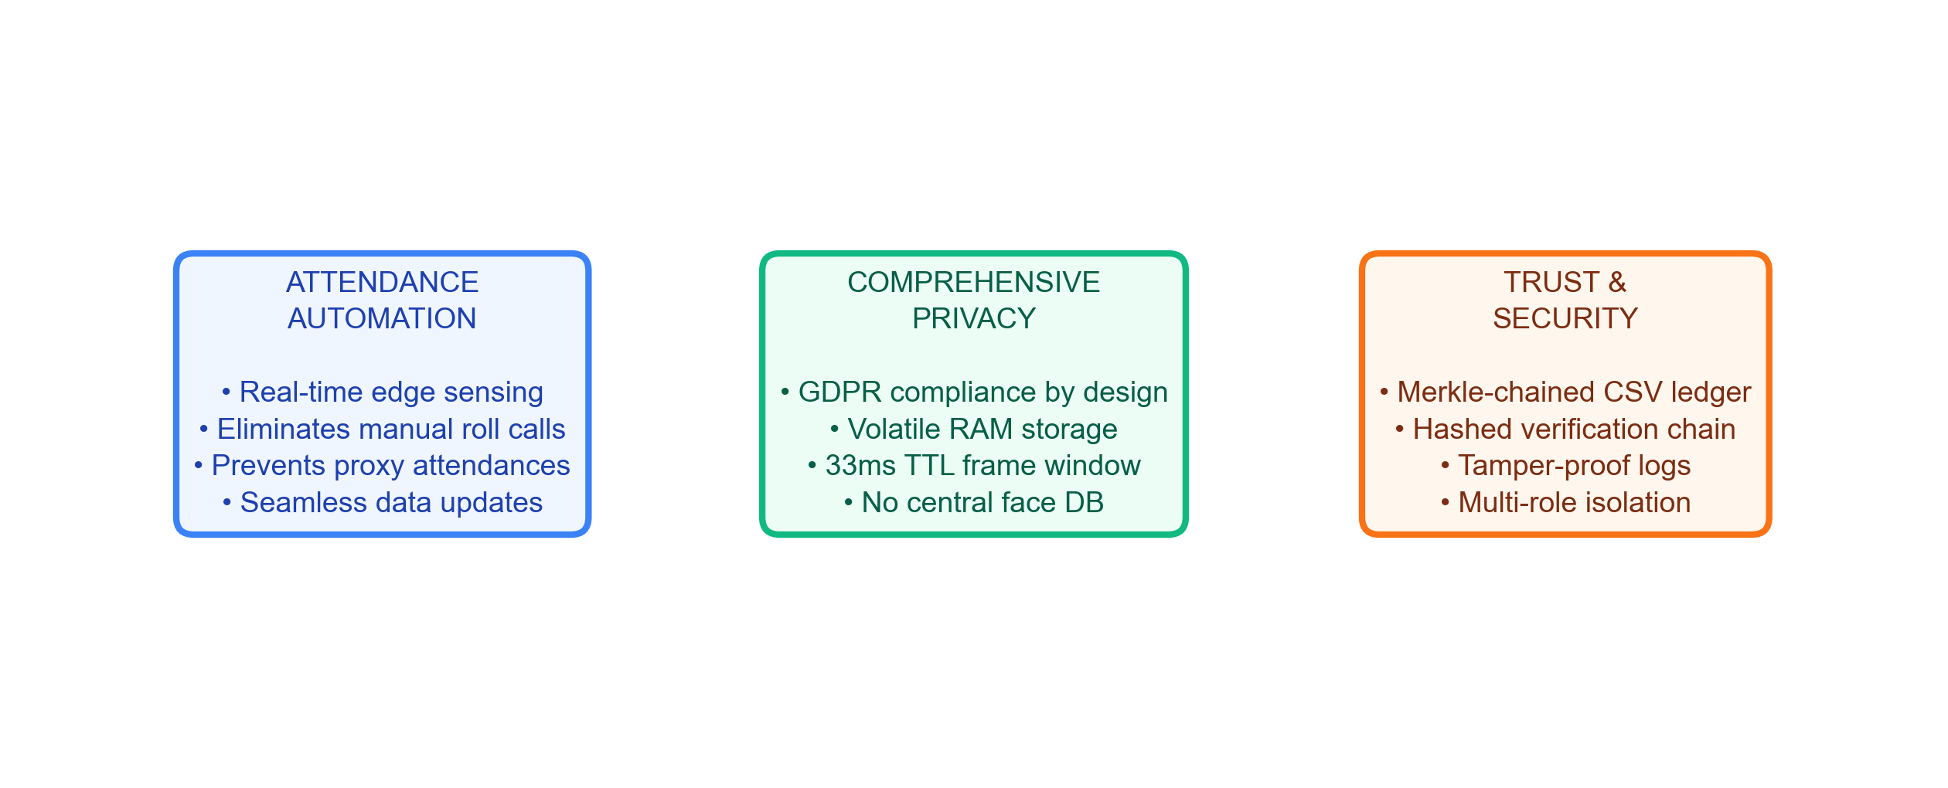
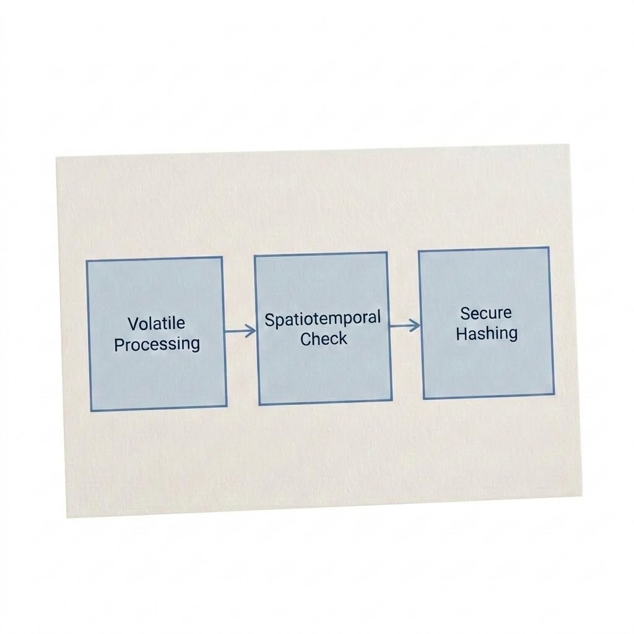
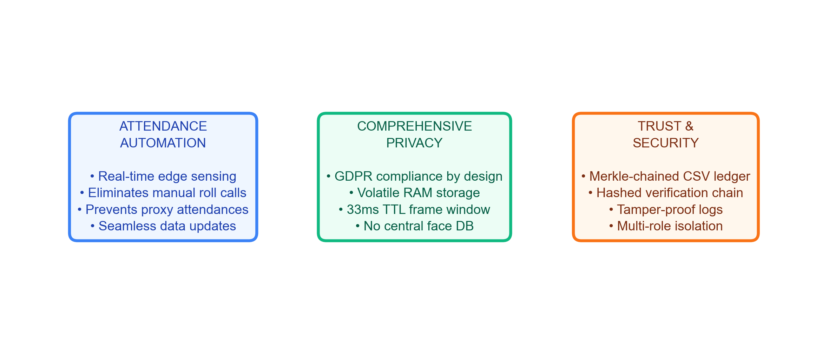
Motivation & Objectives
Core pillars of the system: edge automation, GDPR privacy, and cryptographic auditing.

Slide 5
Literature Survey
Comparison of traditional systems, closed-set biometrics, and the proposed spatiotemporal framework.
Key Aspect | Traditional [RFID / Manual] | Closed-Set [FaceNet / MTCNN] | Proposed ScholarMaster Engine
Biometric Search | None (Manual Logs) | Closed-Set Search (Small N) | Open-Set FAISS HNSW (N=100k) [1, 2]
Verification Check | None (Proxy swiping risk) | Liveness check only | ST-CSF schedule heuristics [6]
Privacy Boundary | Low (Sheets visible) | Central Database (Vulnerable) | 33ms Volatile RAM cache [5]
Audit Integrity | Manual sheets (Vulnerable) | Plain database logs | Cryptographic Merkle Ledger [7]

Slide 6
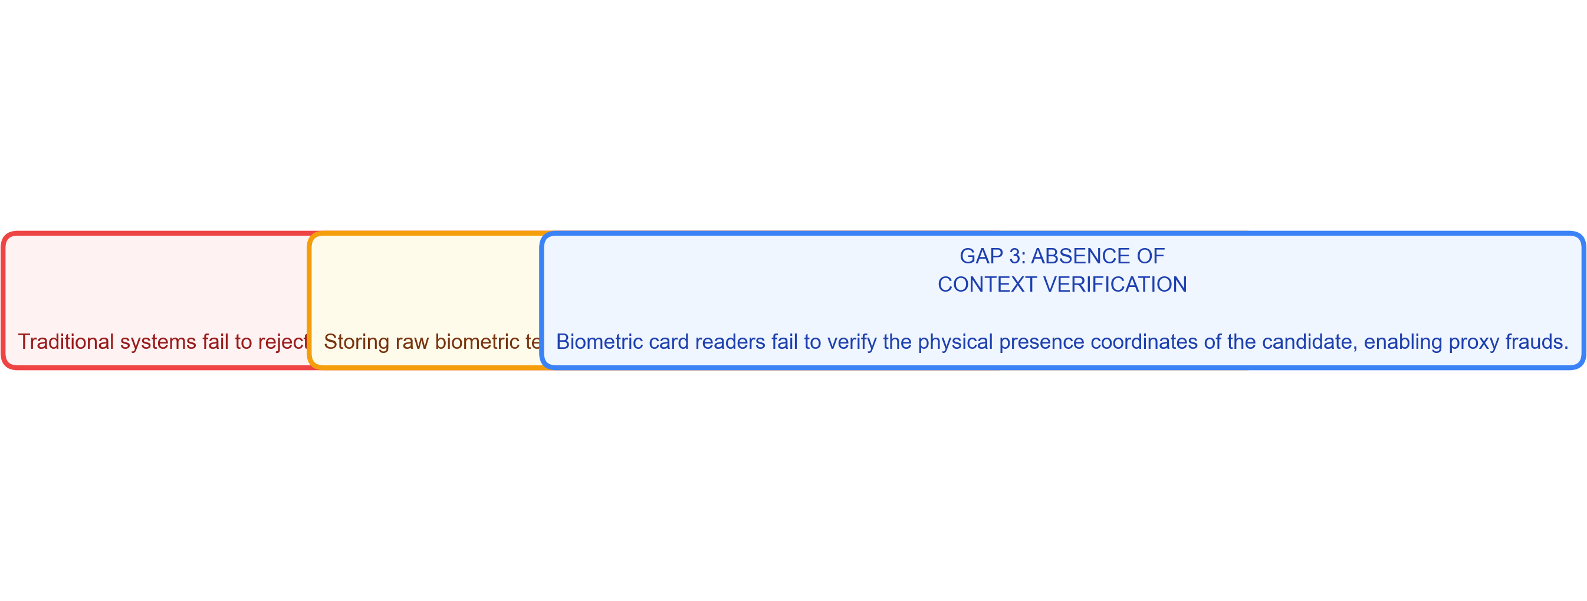
Research Gap
Key architectural and privacy shortcomings identified in prior monitoring implementations.
• Open-Set Failure: Prior systems use closed-set models which fail on unregistered strangers, causing false database matches. • Central Storage Risks: Central biometric template databases violate GDPR Article 25 (Privacy-by-Design). • Lack of Context: Static verification fails to check physical presence coordinates, enabling proxy frauds.

Slide 7
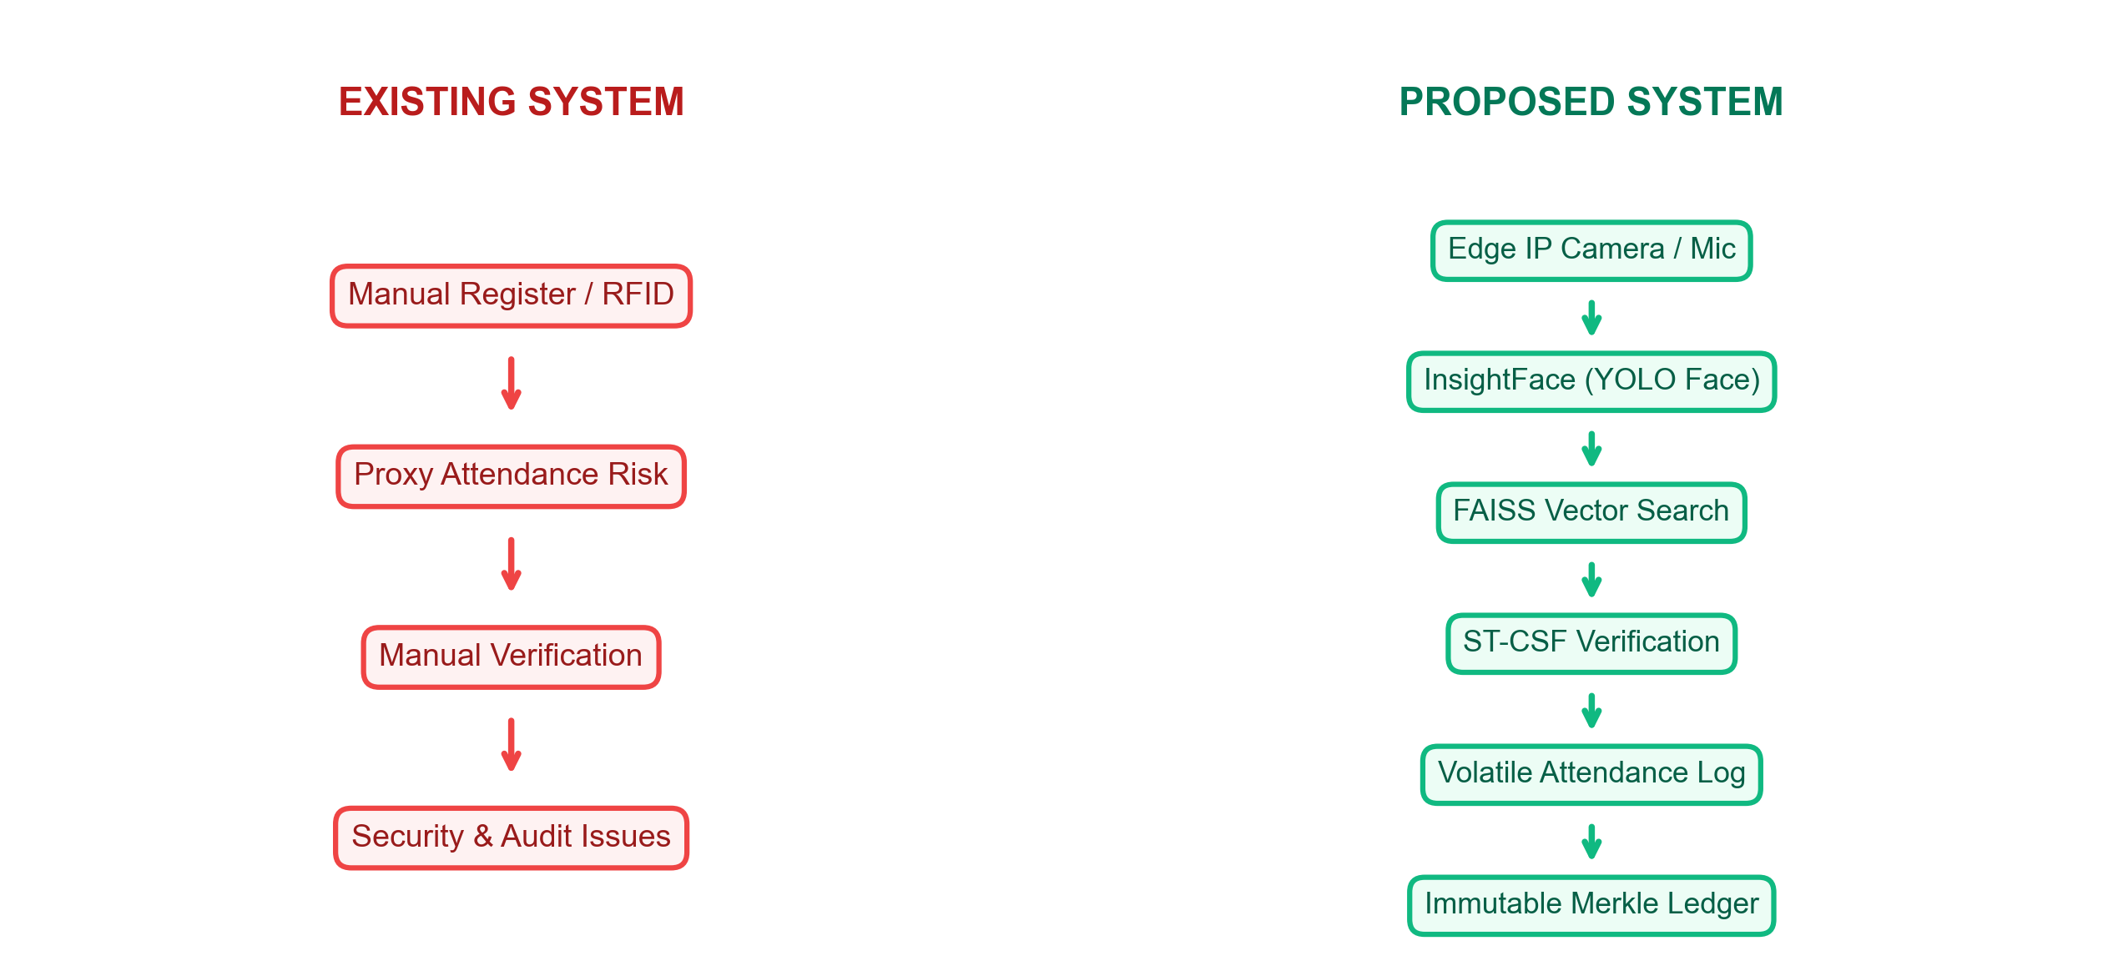
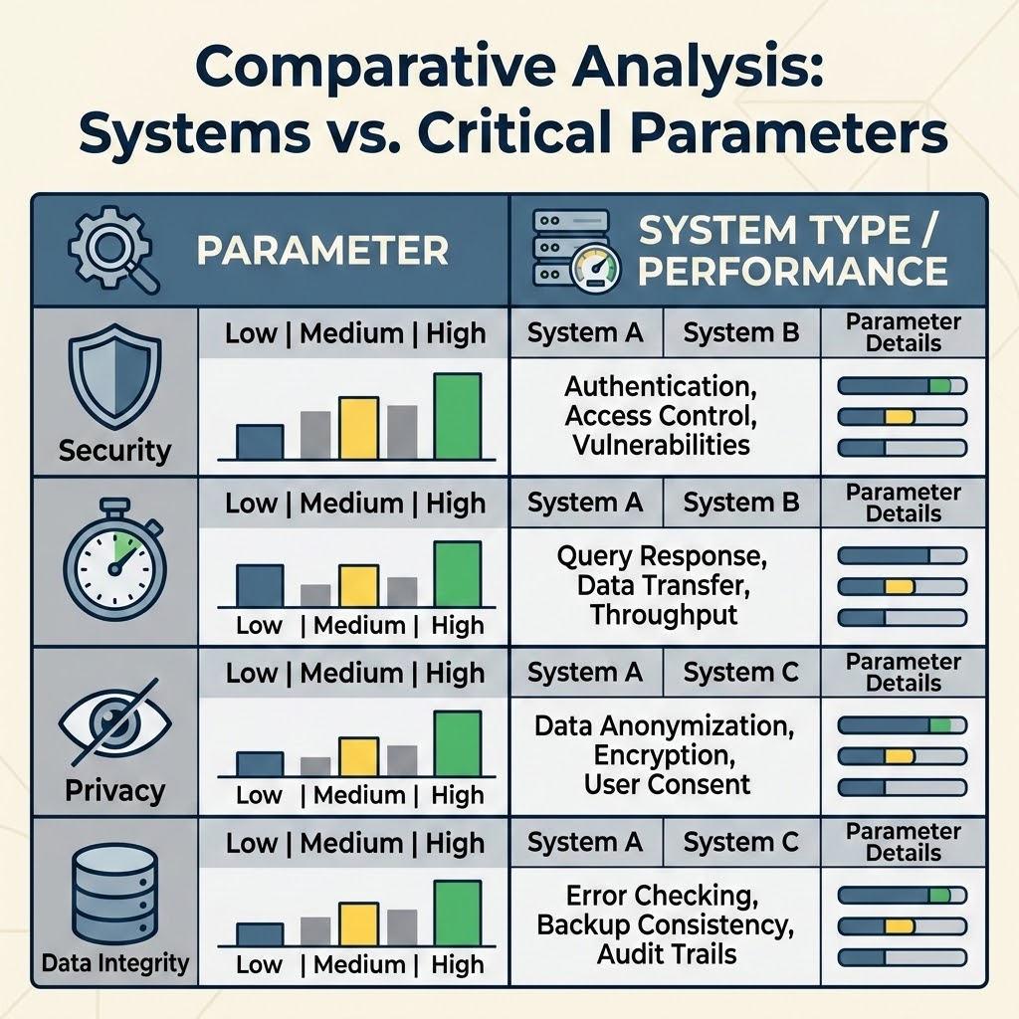
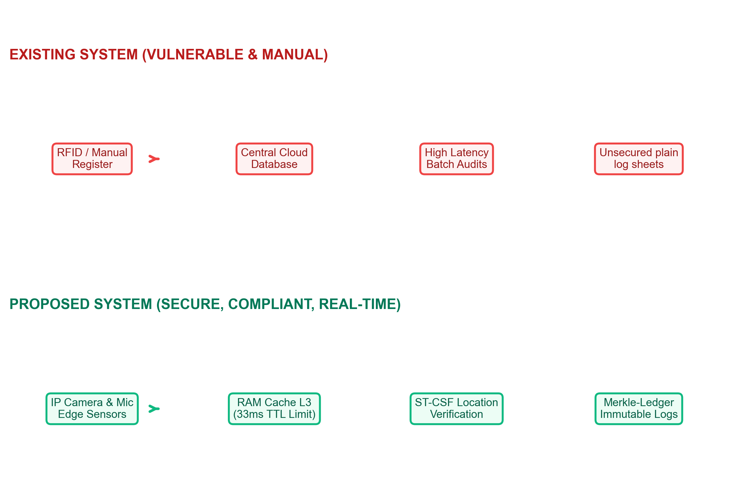
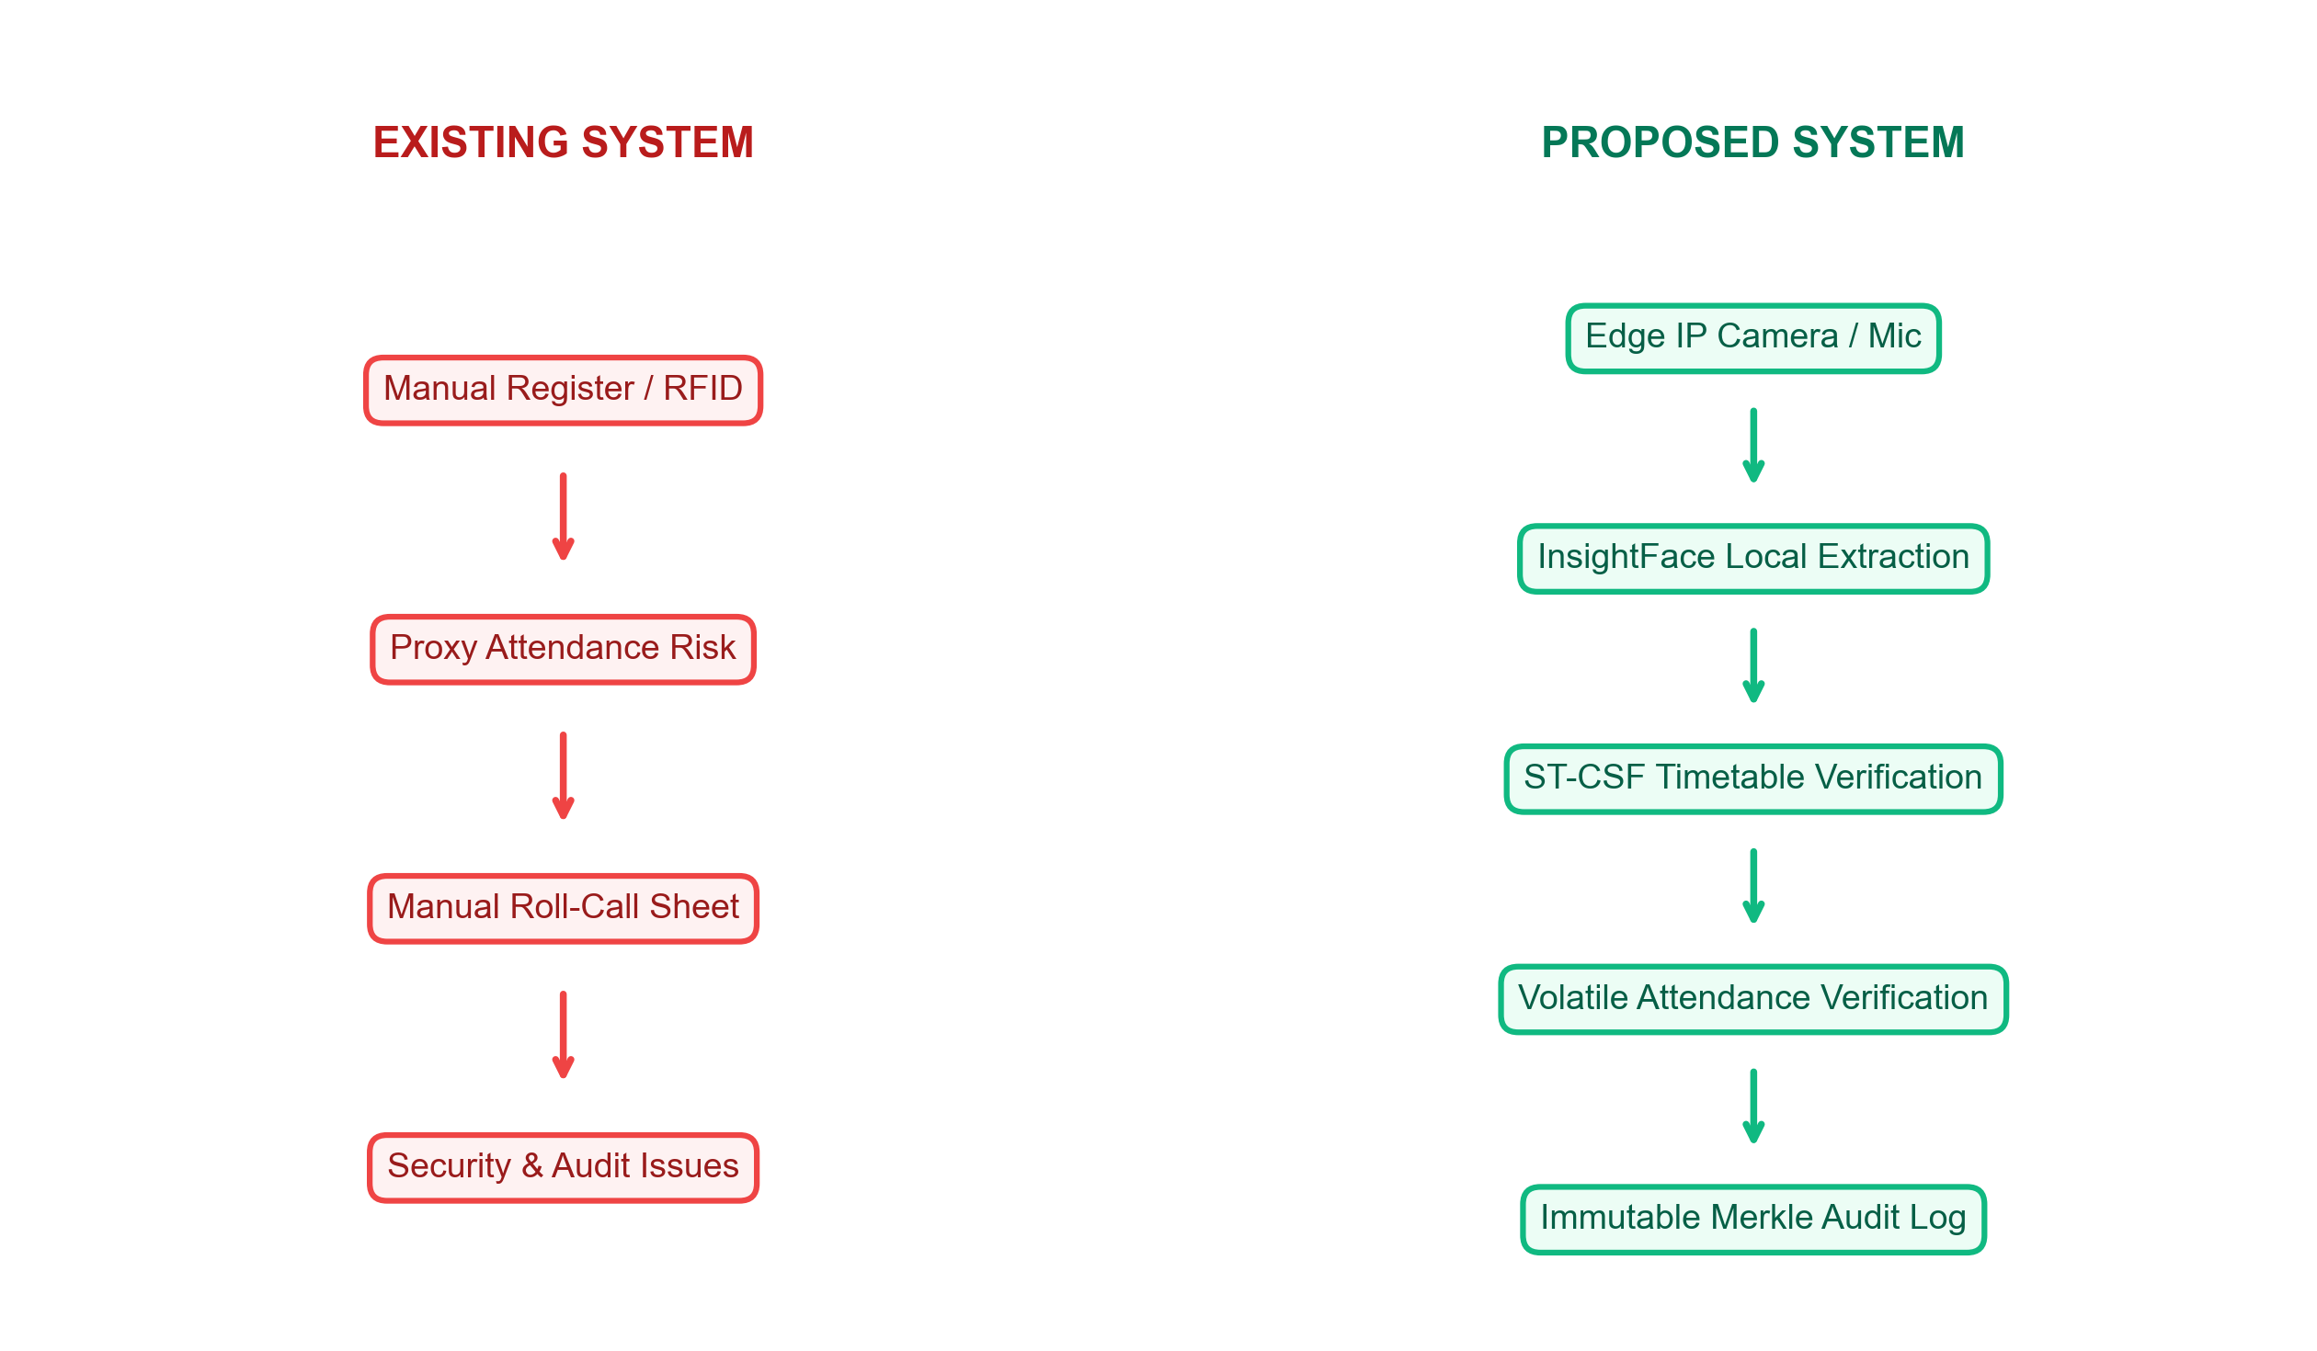
Existing vs. Proposed System
Contrasting the high-risk manual RFID roll-call flow with the proposed secure edge-to-ledger sensing pipeline.

Slide 8
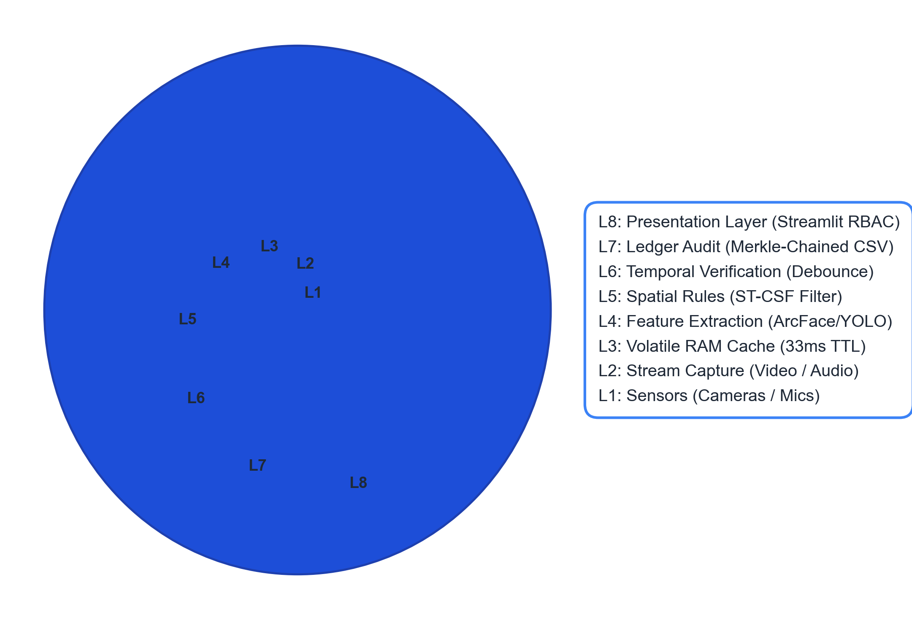
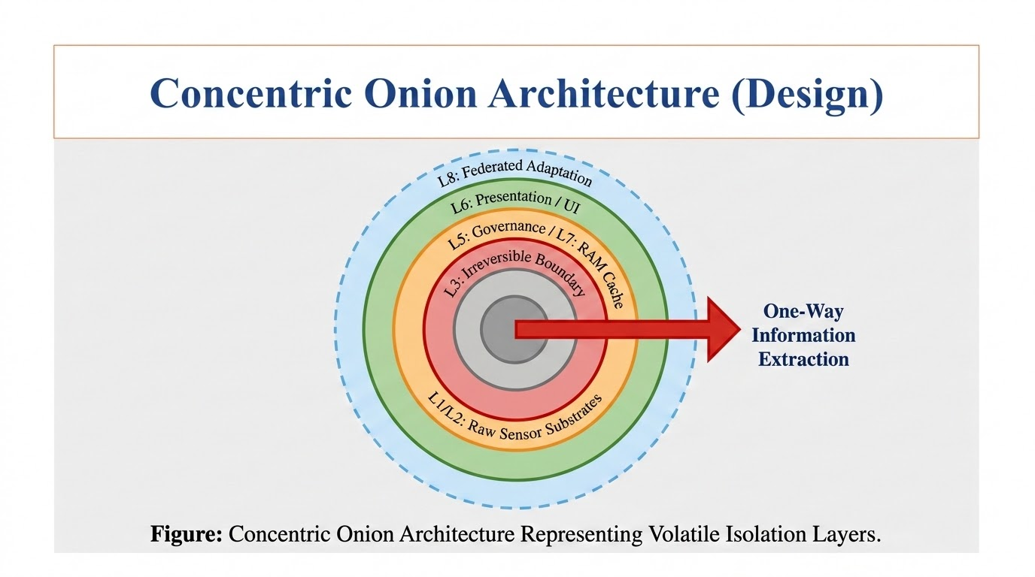
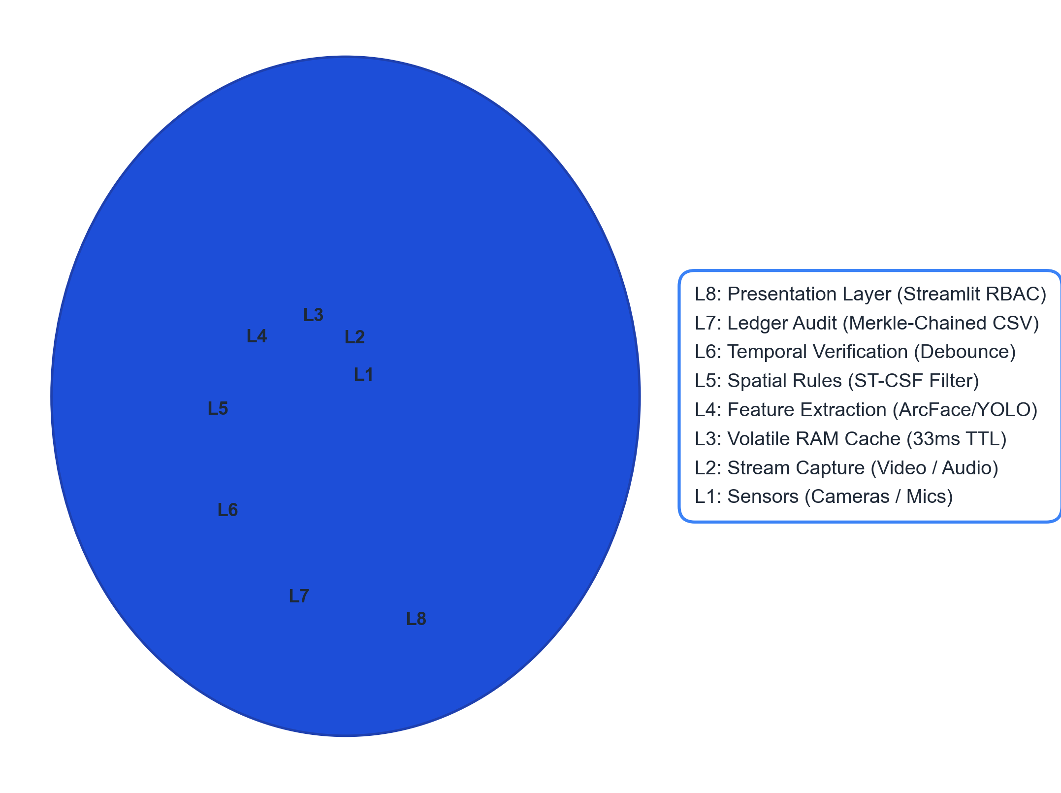
Concentric Onion Architecture (Design)
Multi-layered boundary isolation protecting raw sensor capture from Streamlit presentation layers.

Slide 9
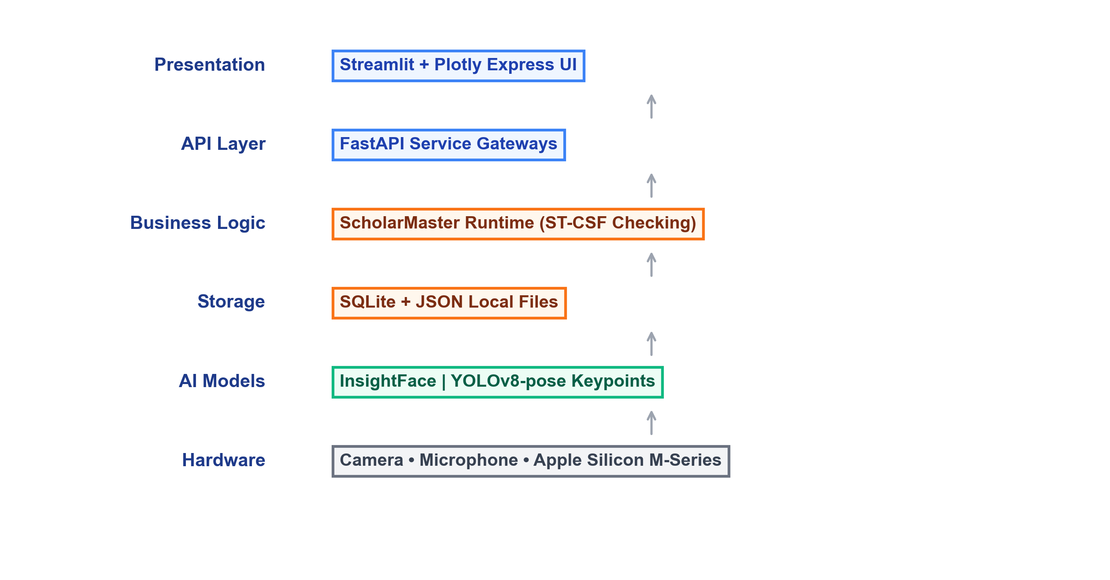
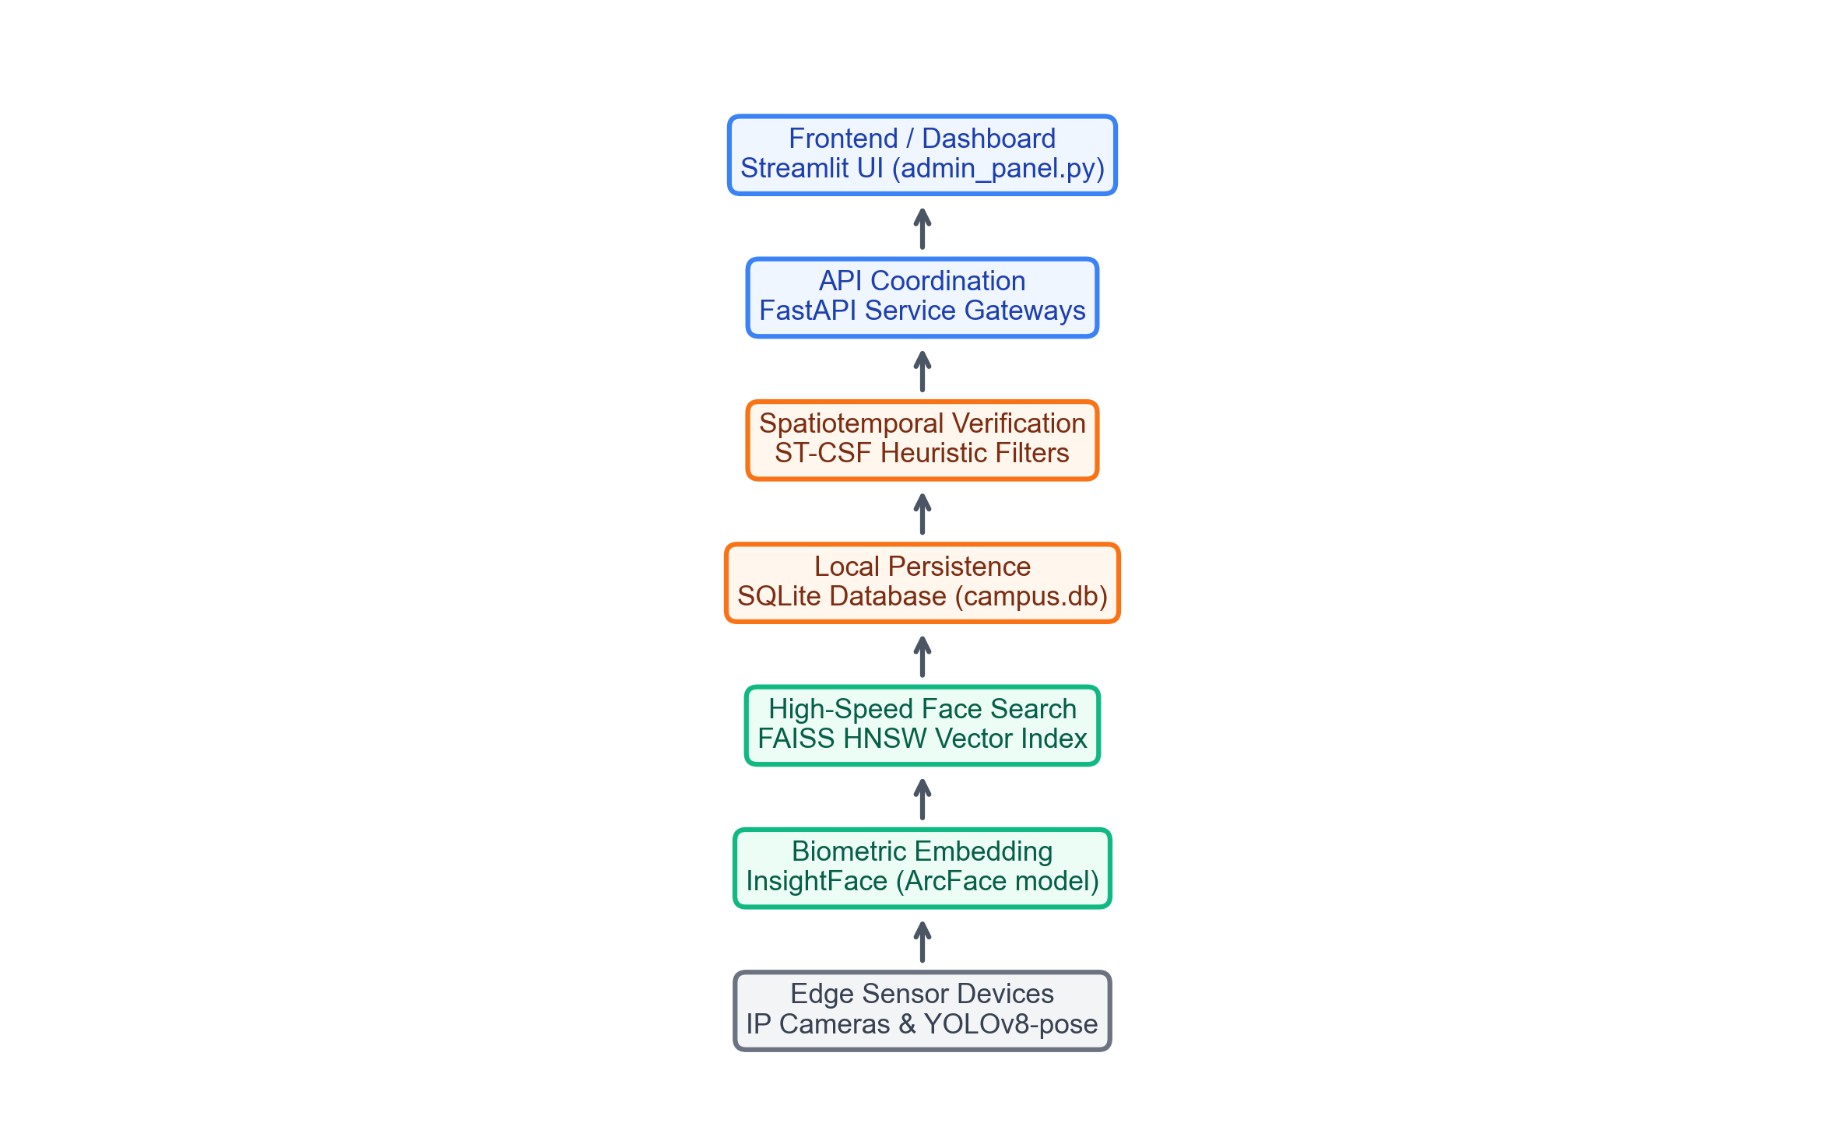
Technology Stack
Layered technology pipeline mapping structural dependencies from raw sensors up to administrative UI panels.

Slide 10
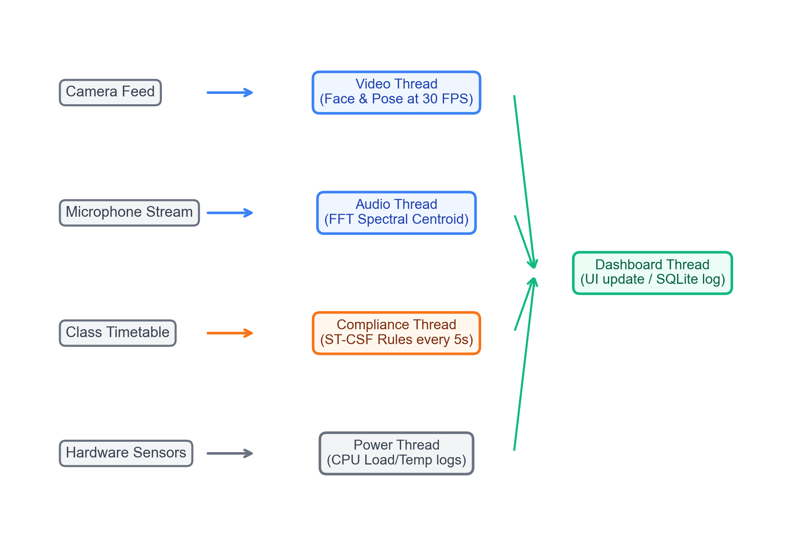
Multi-Threaded Runtime Architecture
Thread Name | Interval | Core Function
Video | 30 FPS | Face Recognition & Pose extraction
Audio | 100 ms | Acoustic anomaly spectral analysis
Compliance | 5 sec | ST-CSF constraint timetable checking
Power | 10 sec | Resource & CPU thermal monitoring
Dashboard | 1 sec | Terminal status console updates

Slide 11
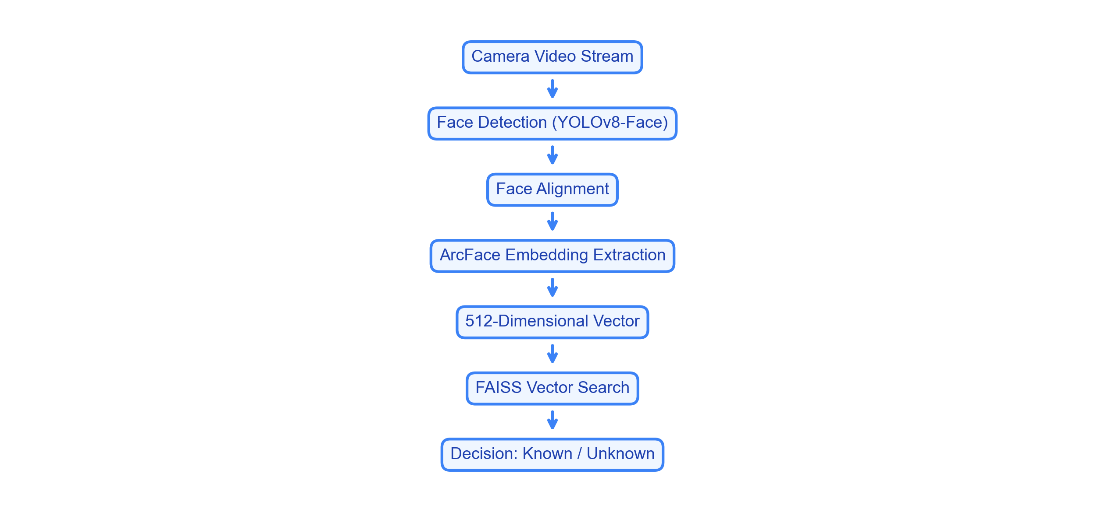
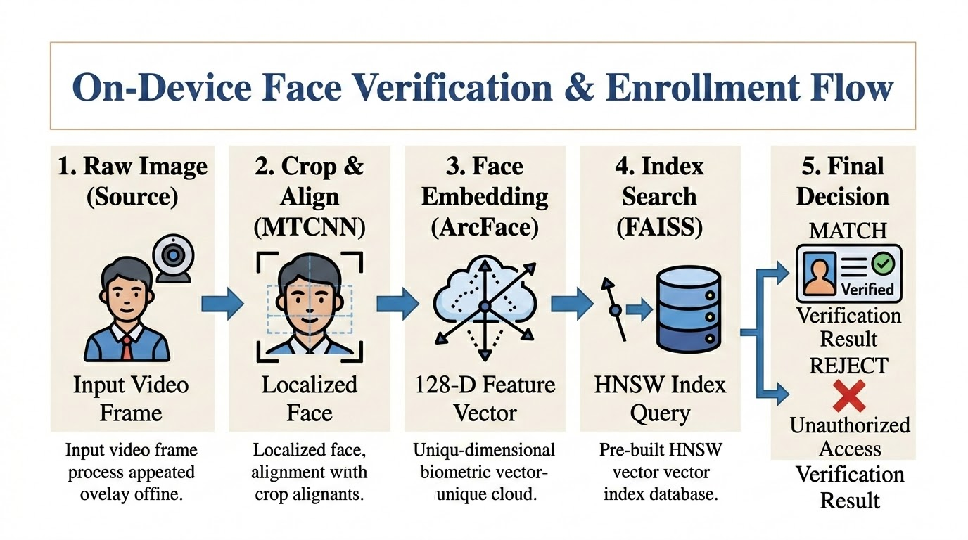
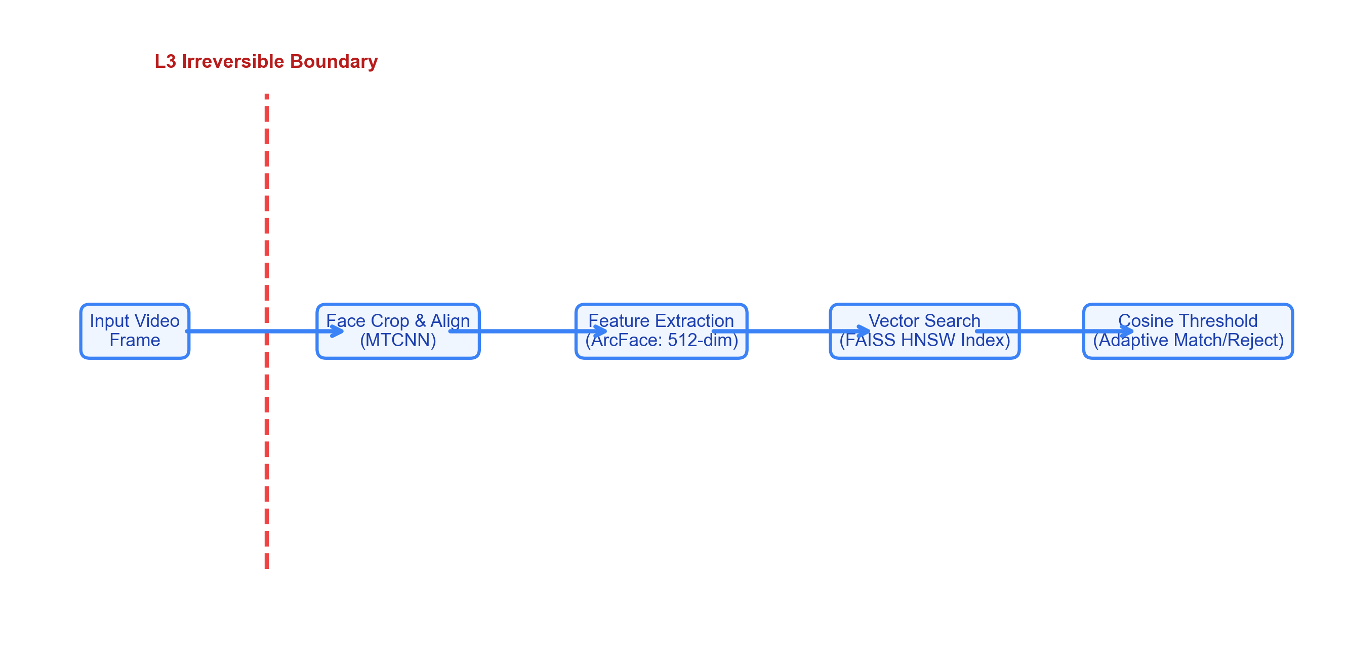
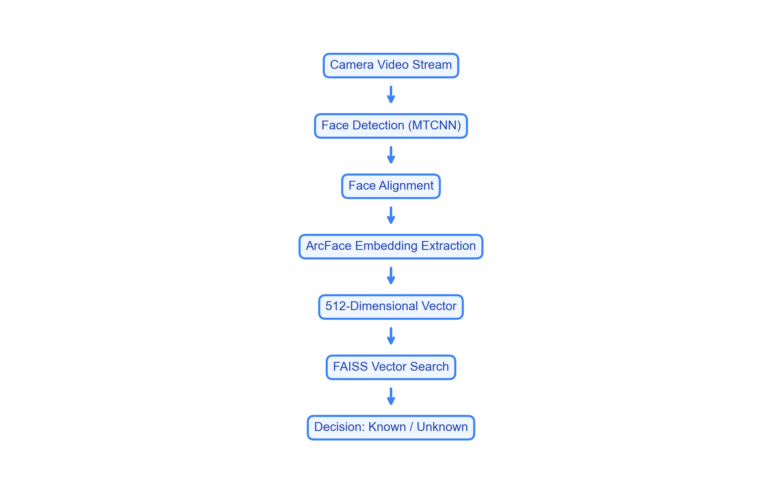
Biometric Open-Set Identification Pipeline
Biometric search chain utilizing local YOLOv8-Face detection and FAISS nearest-neighbor matching.

Slide 12
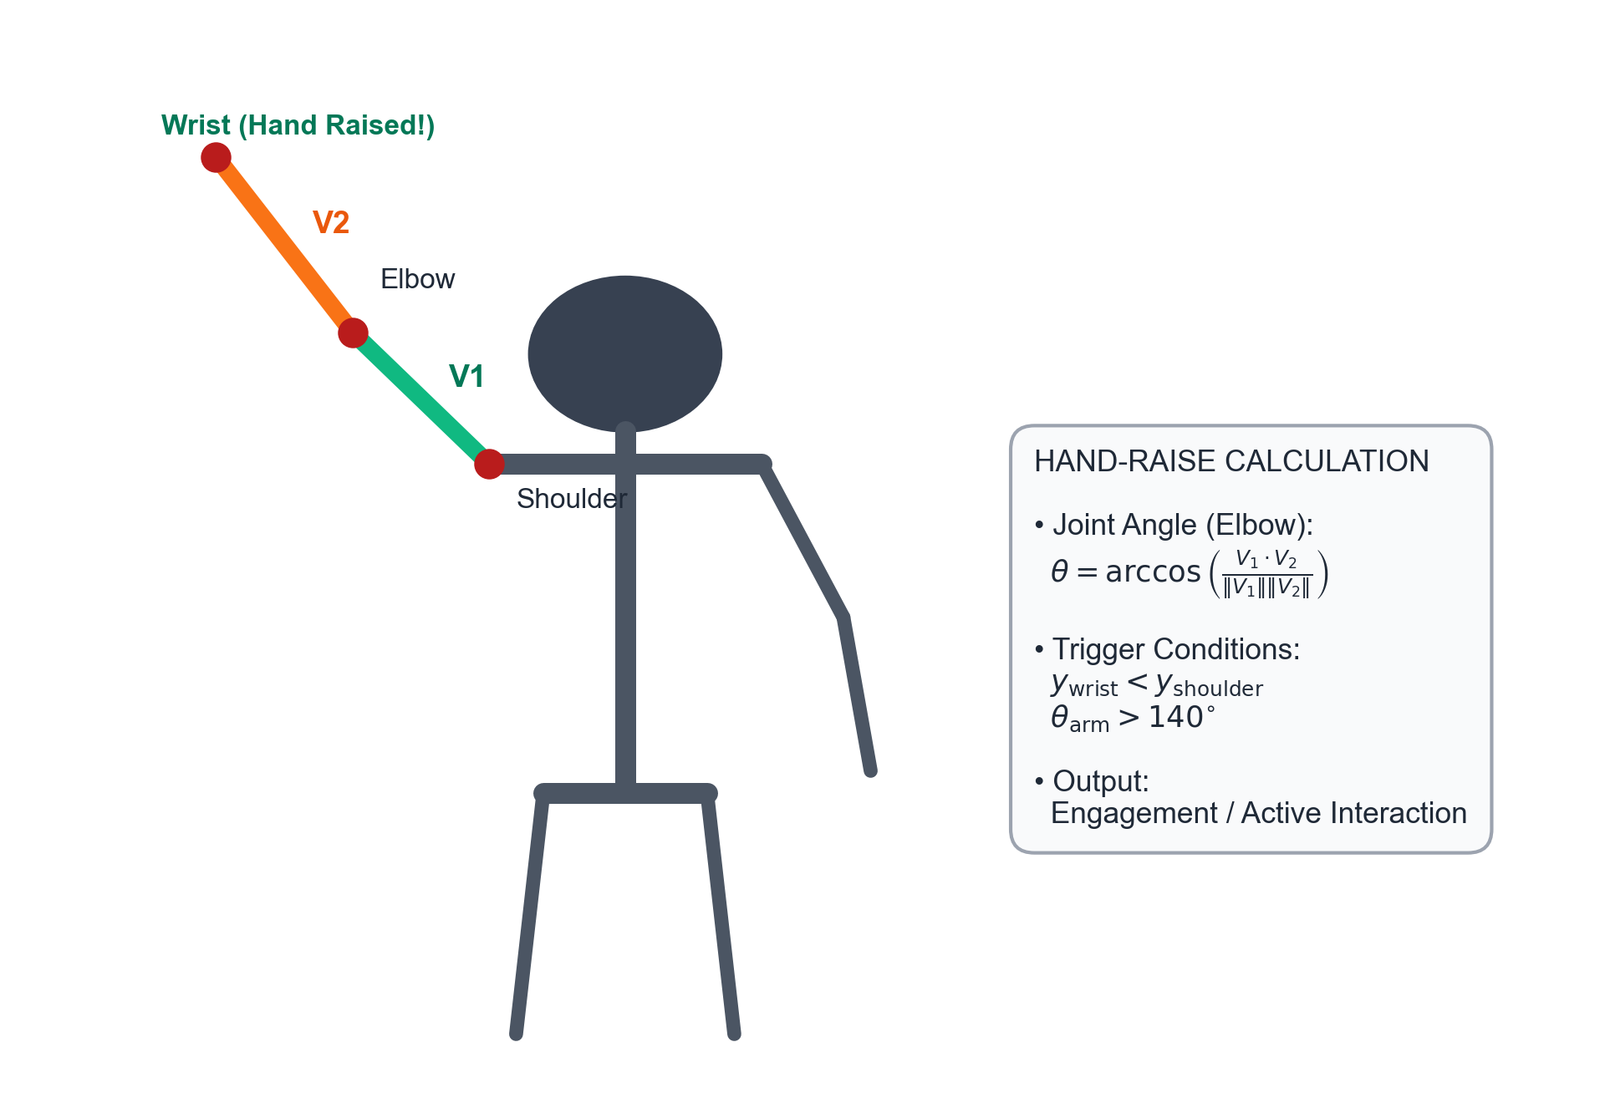
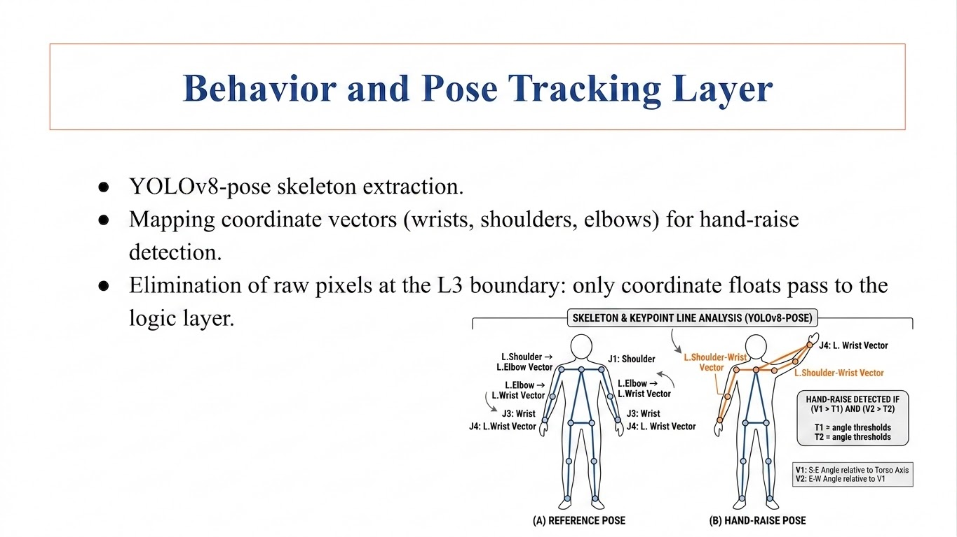

Behavior and Pose Tracking Layer
• YOLOv8-pose Ingest: Extracts 17 human skeleton keypoints locally in real-time. • Joint Coordinate Vectors: Tracks Shoulder-Elbow (V1) and Elbow-Wrist (V2) vectors. • Hand-Raise Trigger: Detects hand raising when wrist Y is below shoulder Y and joint angle exceeds 140°.

Slide 13
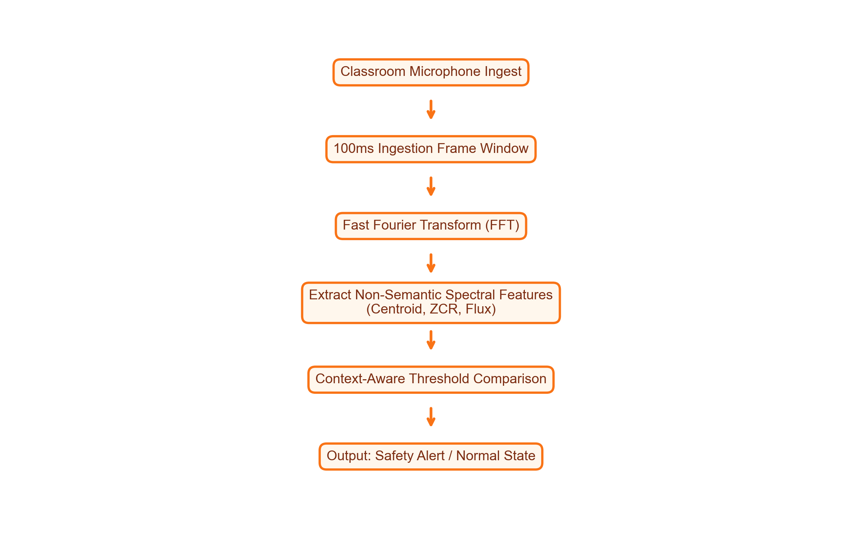
Acoustic Anomaly Detection
• Environment Sampling: Monitors classroom noise levels in 100ms frames via Fast Fourier Transform (FFT). • Privacy Preservation: Calculates non-semantic parameters (Centroid, ZCR, Flux) preventing voice reconstruction. • Context-Aware Limits: Strict thresholds during exams, automatically relaxed during normal class breaks.

Slide 14
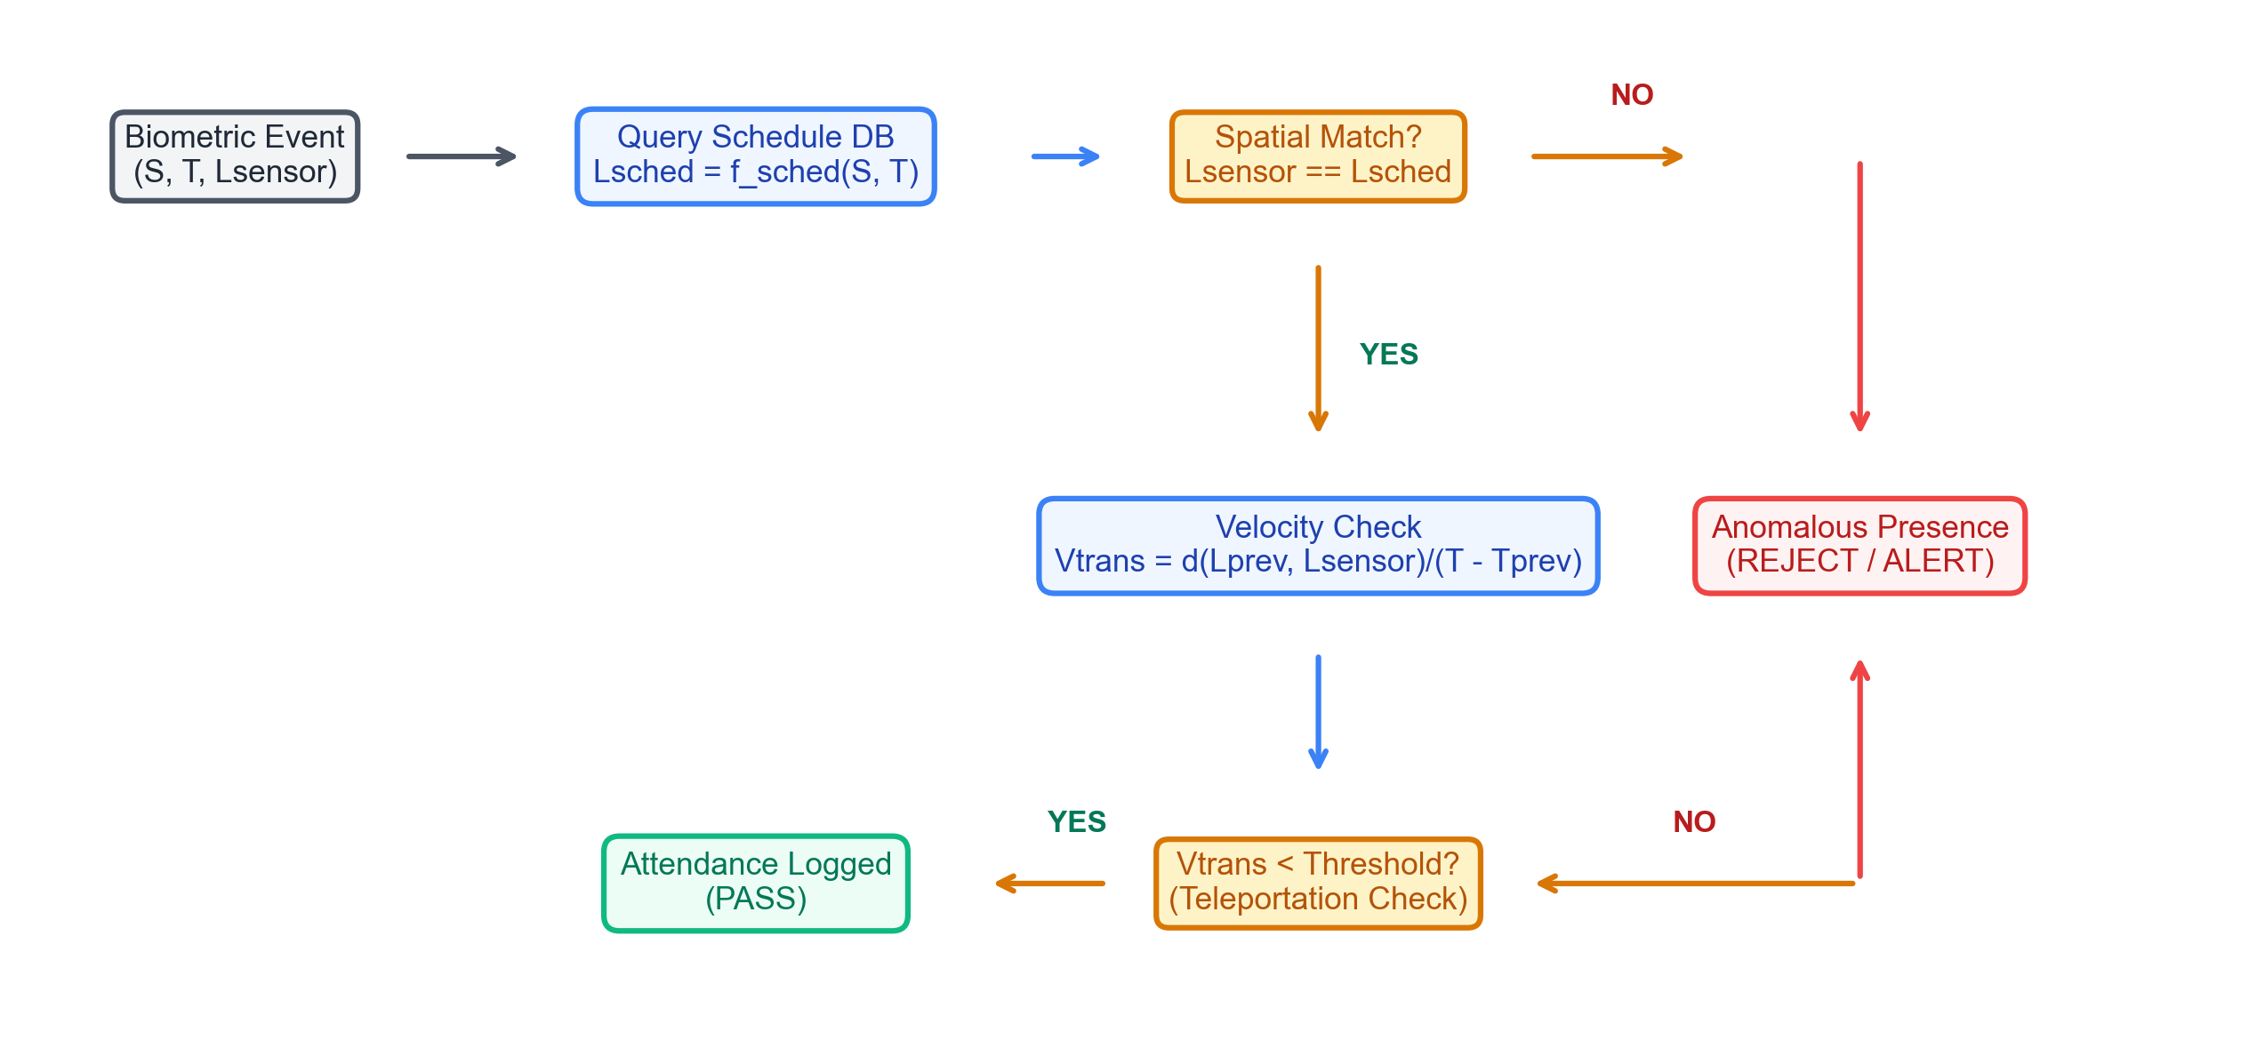
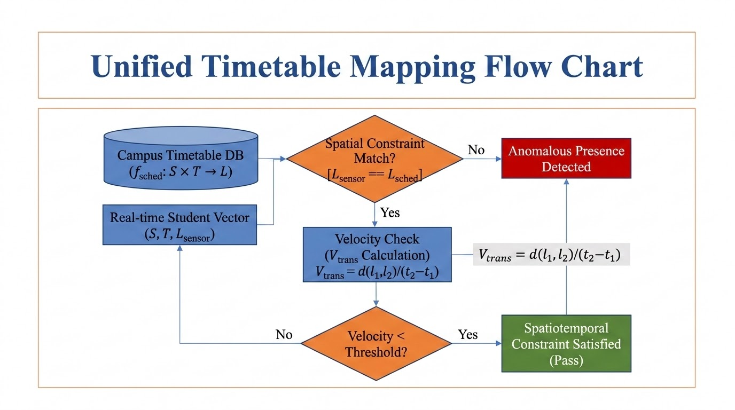
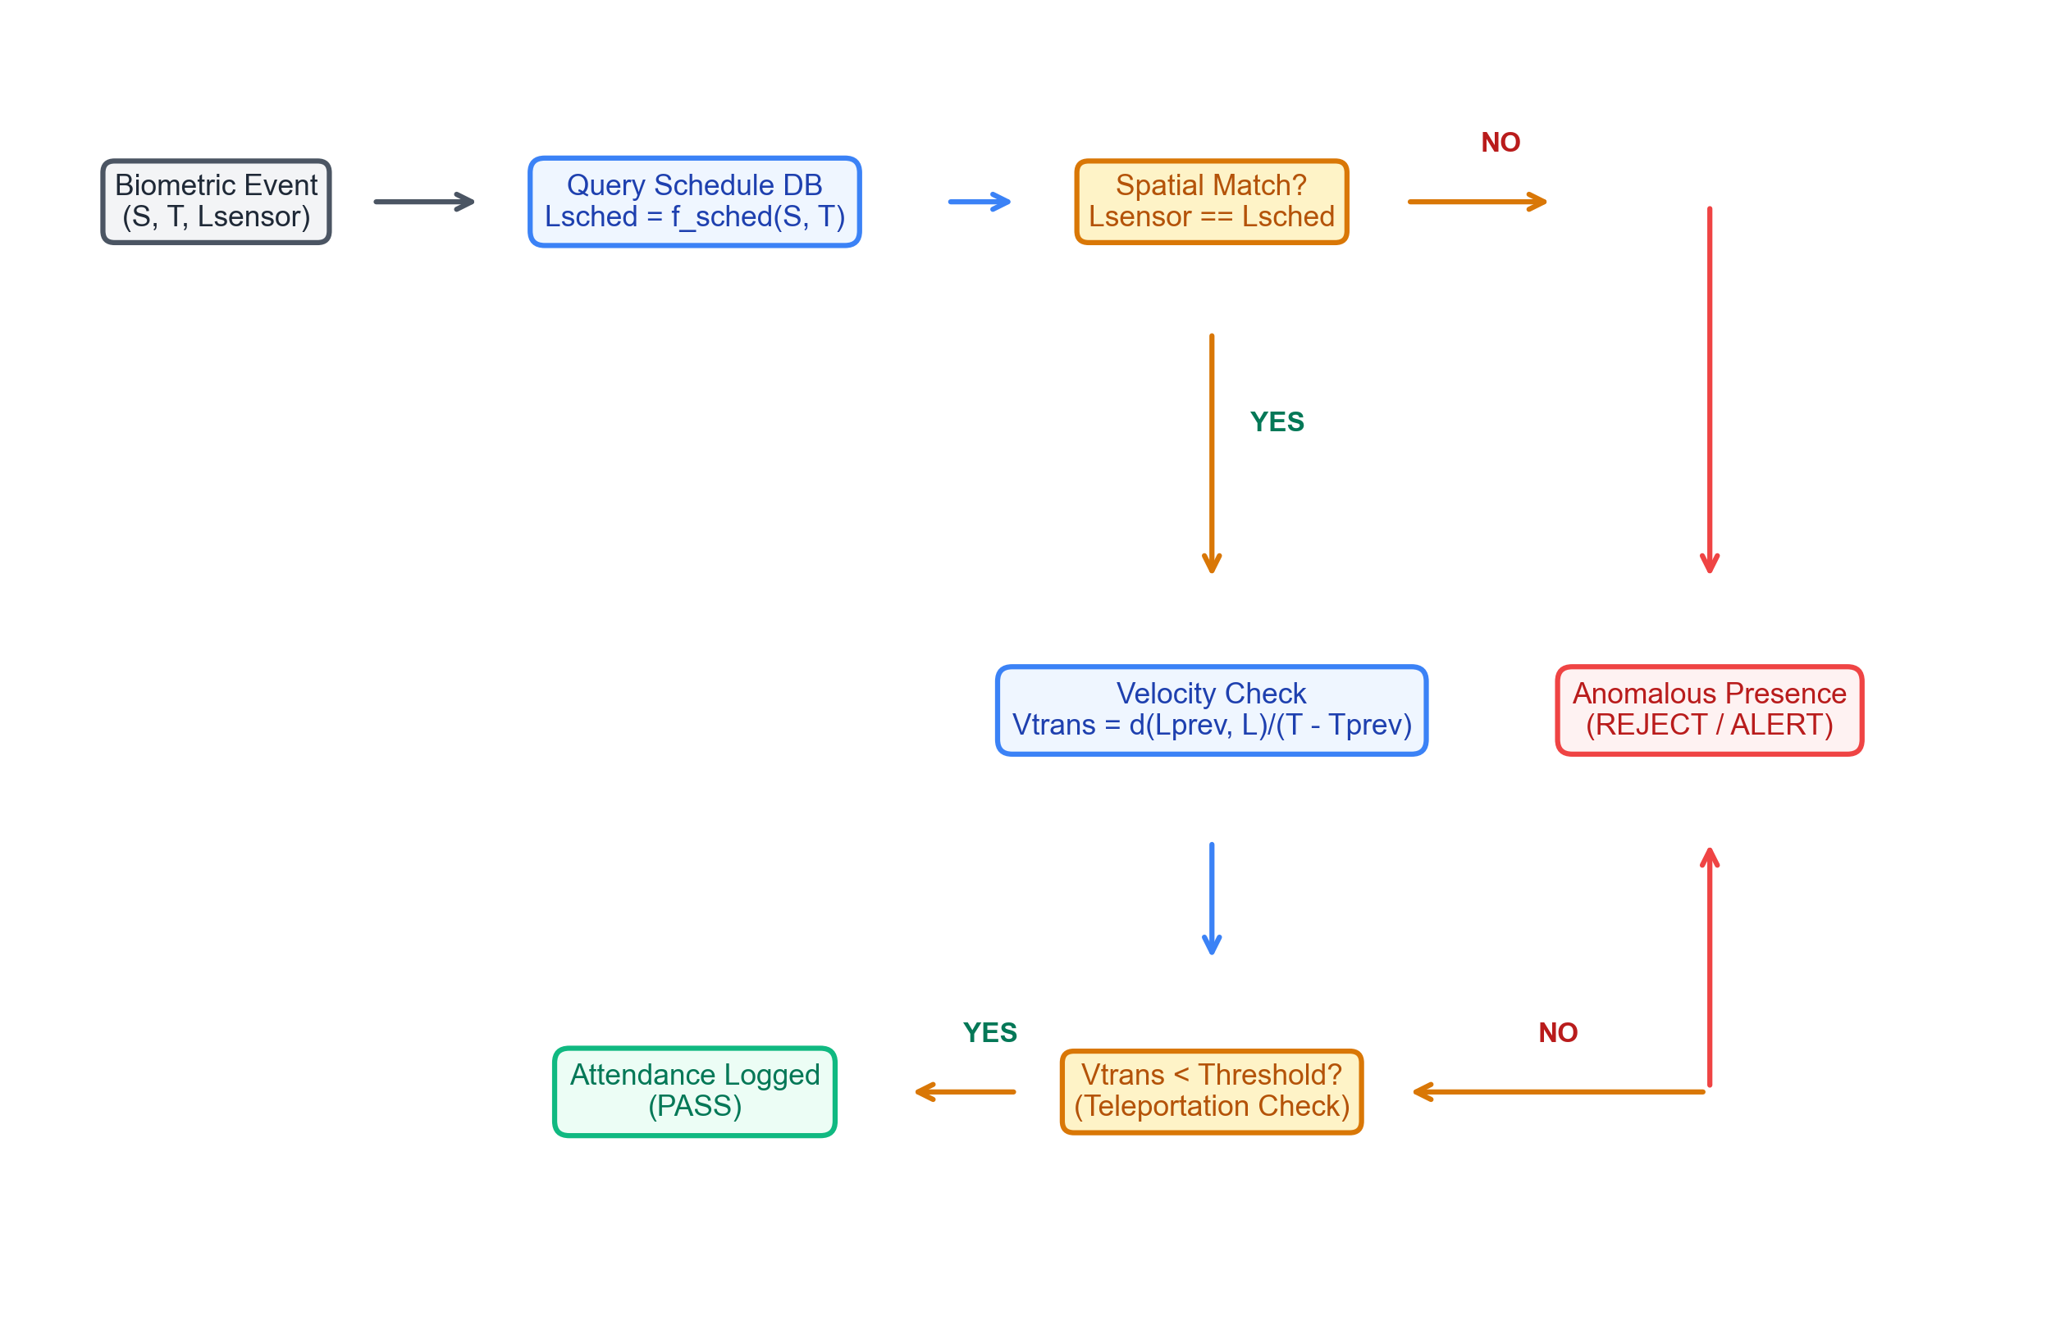
Spatiotemporal Constraint Satisfaction (ST-CSF)
Timetable constraints and transition speed limits verifying physical student presence locations.

Slide 15
Backtracking Timetable Scheduler
• CSP Formalization: Courses represent variables; domains represent Room × Time-slots. • Heuristics Pruning: Uses Minimum-Remaining-Values (MRV) and Least-Constraining-Value (LCV). • Conflict Free: Forward checking prunes overlaps, accelerating timetabling search.
CSP SCHEDULER HARD CONSTRAINTS
1. Room Capacity Constraint: RoomCapacity(R_i) >= StudentEnrollment(C_j) 2. Room Non-Overlapping Constraint: Room(C_a) != Room(C_b) if TimeOverlap(C_a, C_b) 3. Faculty Double-Assignment Constraint: Teacher(C_a) != Teacher(C_b) if TimeOverlap(C_a, C_b) 4. Semester Separation Constraint: Avoid same-semester core classes scheduling overlap.

Slide 16
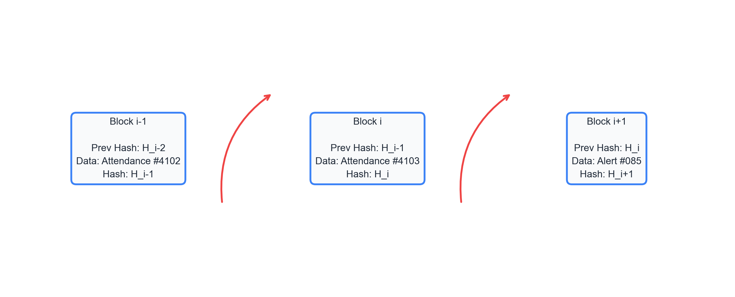
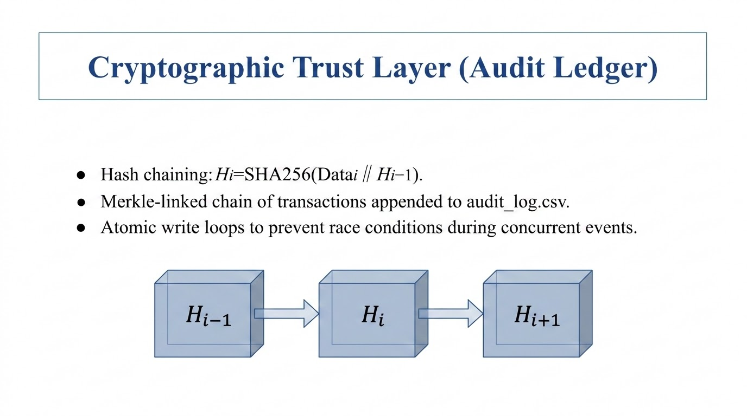

Cryptographic Trust Layer (Audit Ledger)
Securing transaction logs by recursively hashing blocks to block backward database attacks.

Slide 17
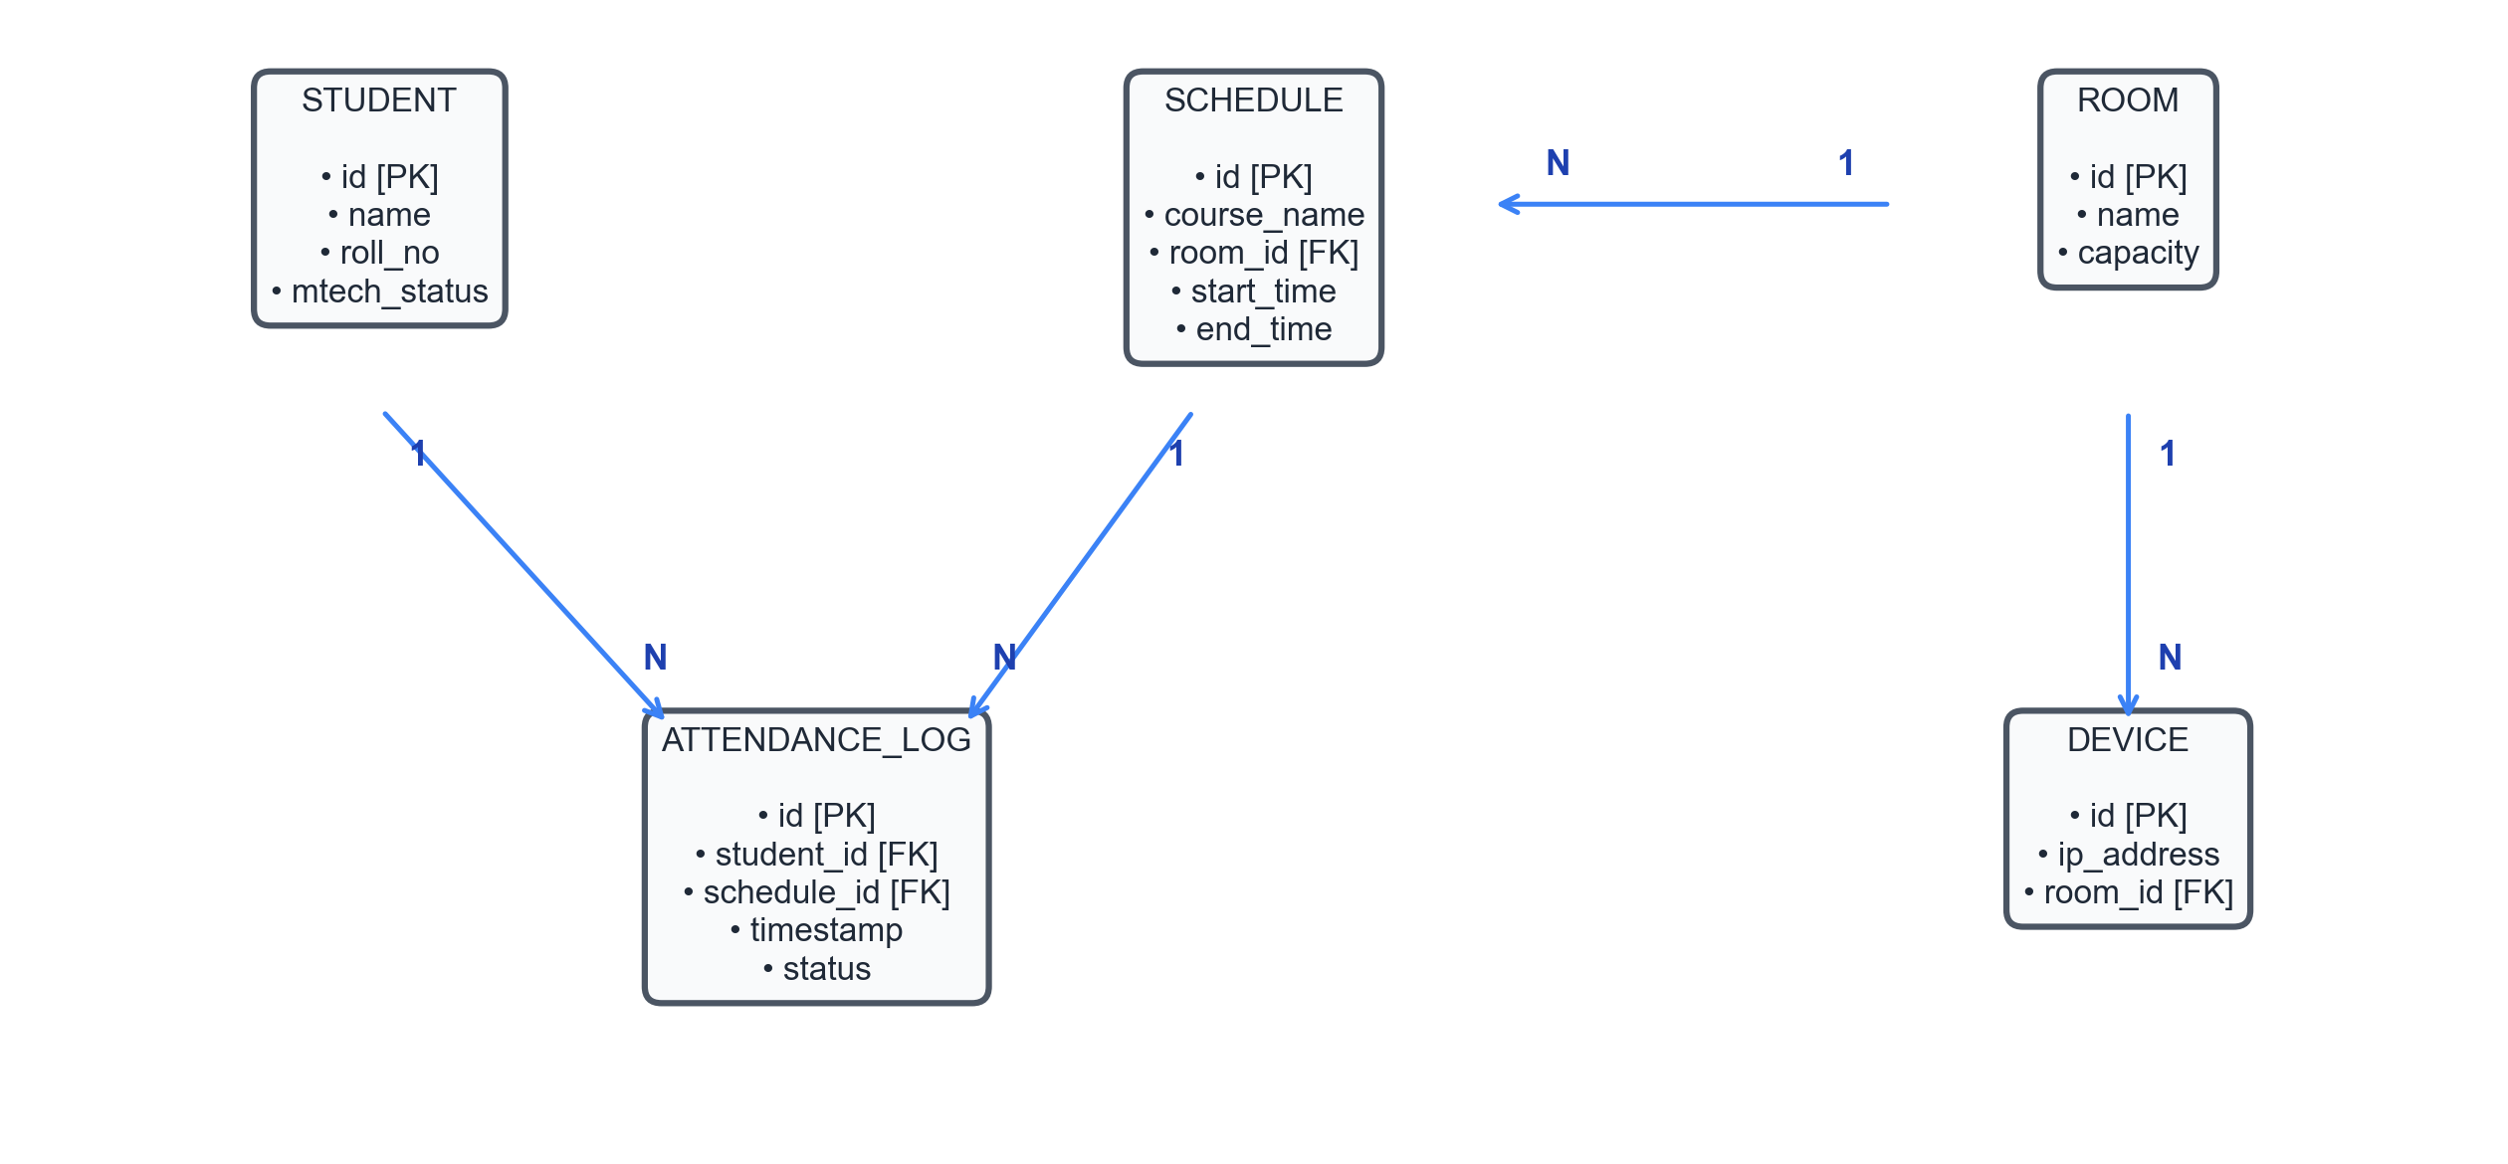
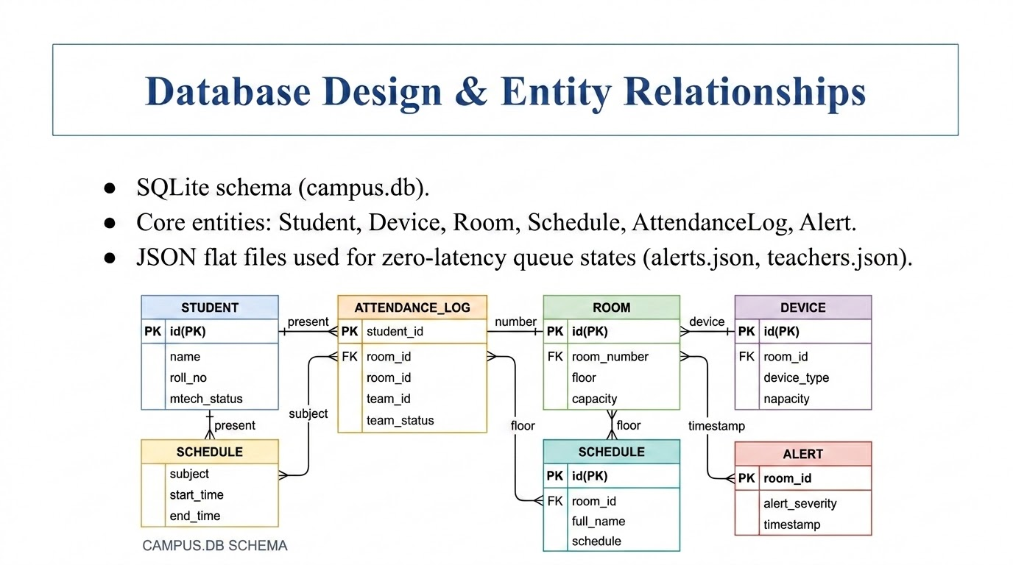
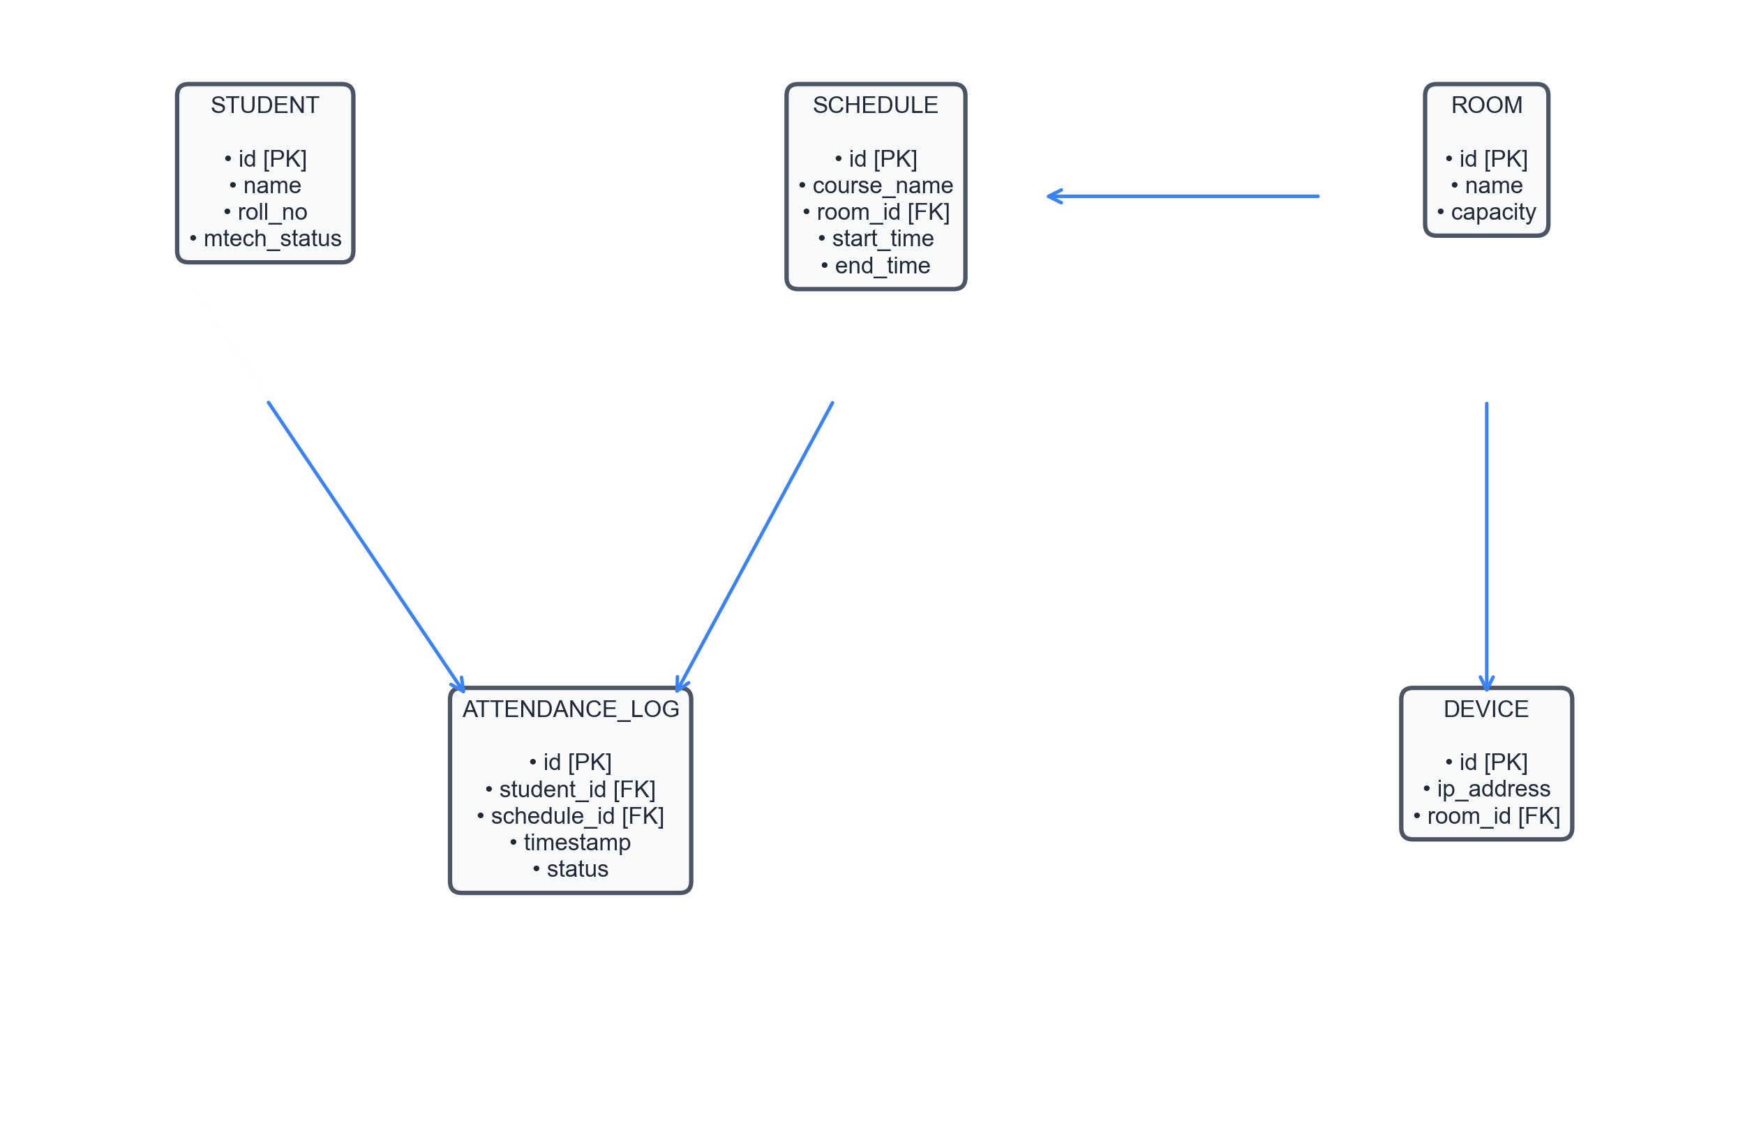
Database Design & Entity Relationships
Local SQLite ER diagram detailing primary/foreign key connections and relationship cardinalities.

Slide 18
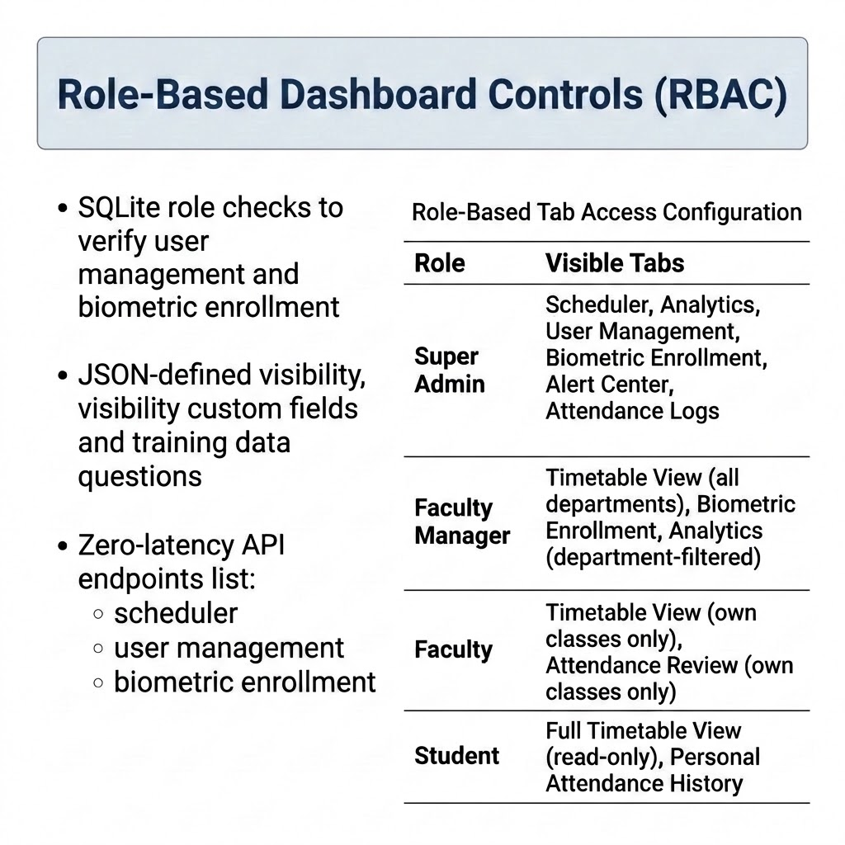
Presentation Layer & 7-Role RBAC
Formal Role (7-Role Model) | Dashboard Mapping & Scoped Privileges
Super Admin | Super Admin View (Full write config, User Mgmt, Audit Ledger)
Admin / HOD | Faculty Manager View (Dept-restricted write & analytics logs)
Faculty | Faculty View (Assigned course read & attendance override check)
Class Teacher | Faculty View (Assigned cohort read & override check)
Student | Student View (Personal logs read-only, schedule lookup)
Security | Student View + Real-time Alert center log streams lookup
Non-Teaching | Student View (Facility-specific access logs read-only)
• UI Framework: Streamlit & Plotly Express dashboard with active session state tracking. • Tab Security Gateways: Enforces query-level isolation at database boundaries, locks parameters to roles. • 7-Role Alignment: Formally implements a 7-Role RBAC matrix mapped into 4 custom dashboard layout configurations.

Slide 19
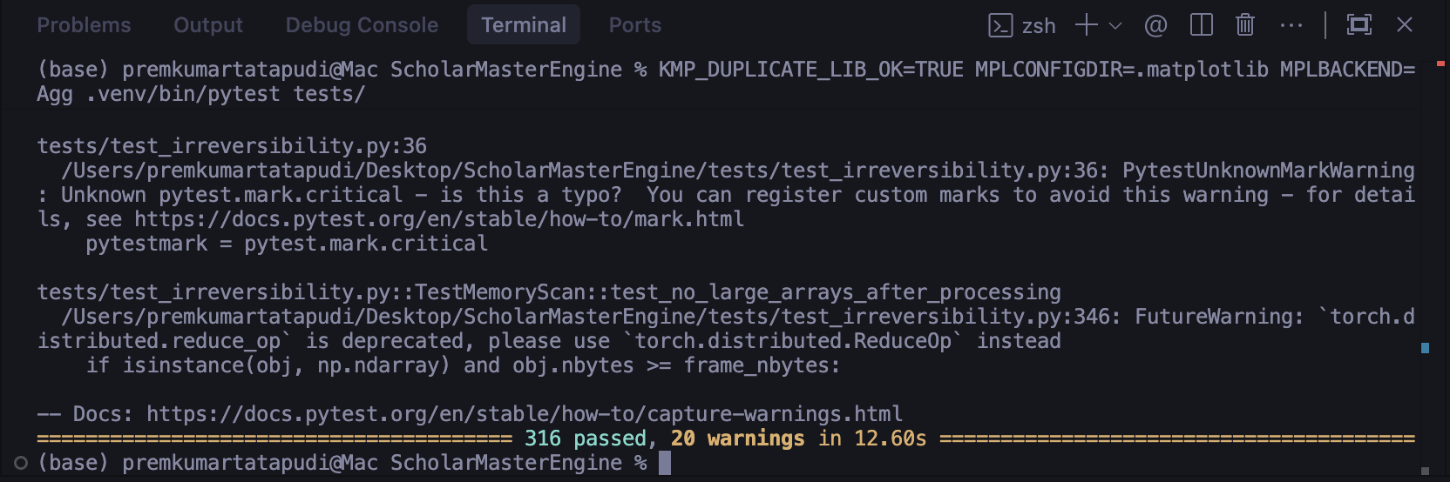
Implementation Verification (Pytest Suite)
Scope: 316 comprehensive test cases (unit, integration, contract tests).
Core modules verified: test_debounce_logic, test_face_registry, test_attendance_logger, test_gap_remediation.
Execution: Matplotlib local configuration (MPLBACKEND=Agg) to ensure headless test run success.

Slide 20
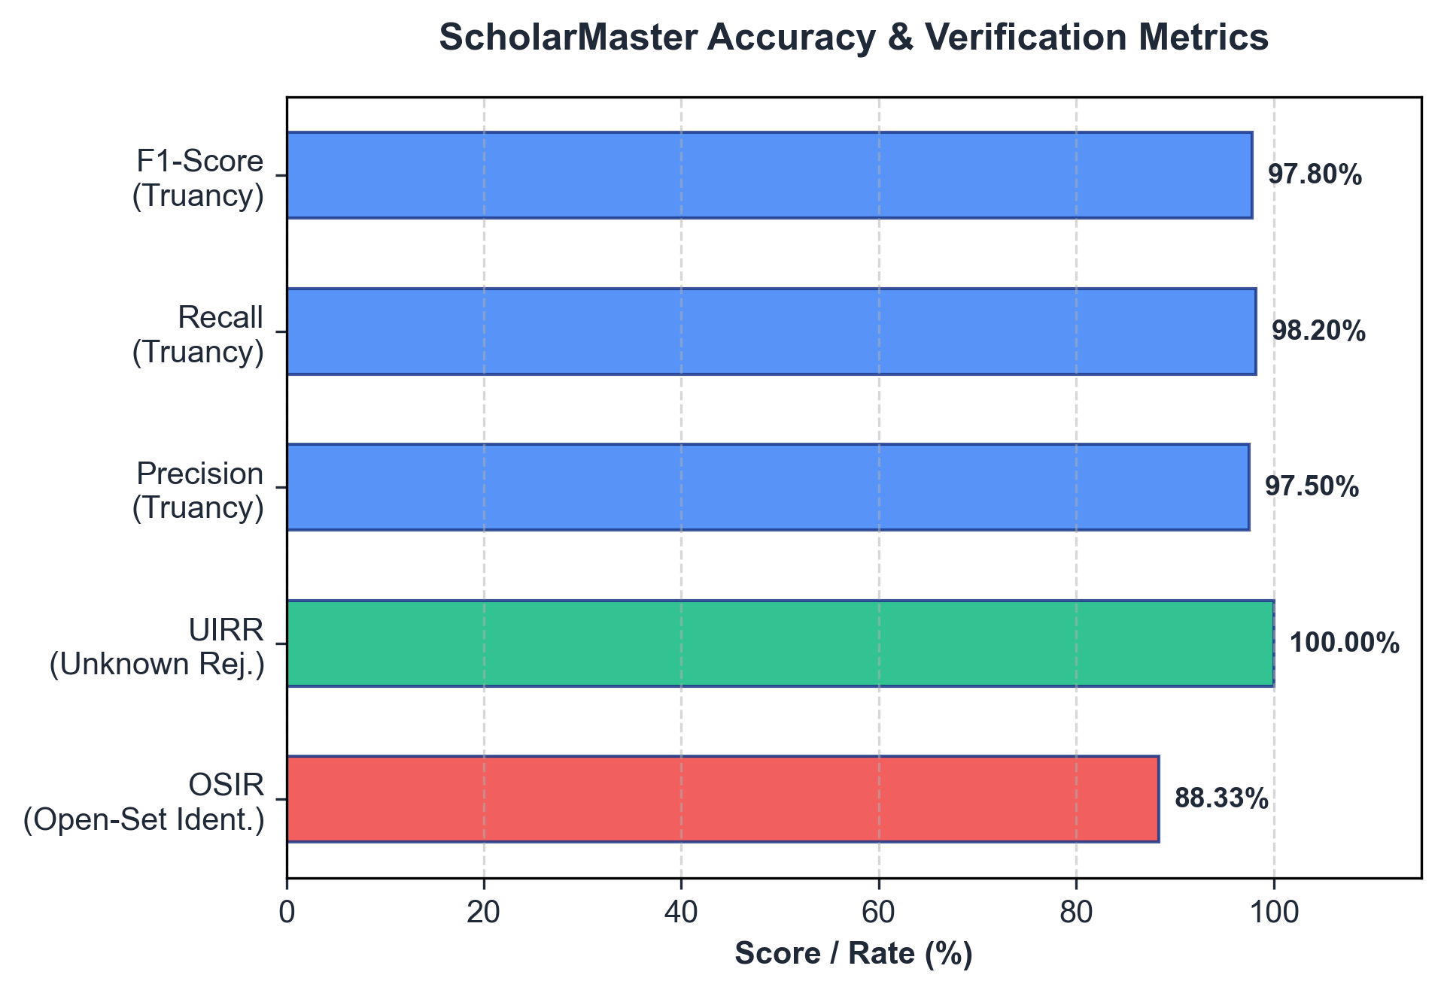
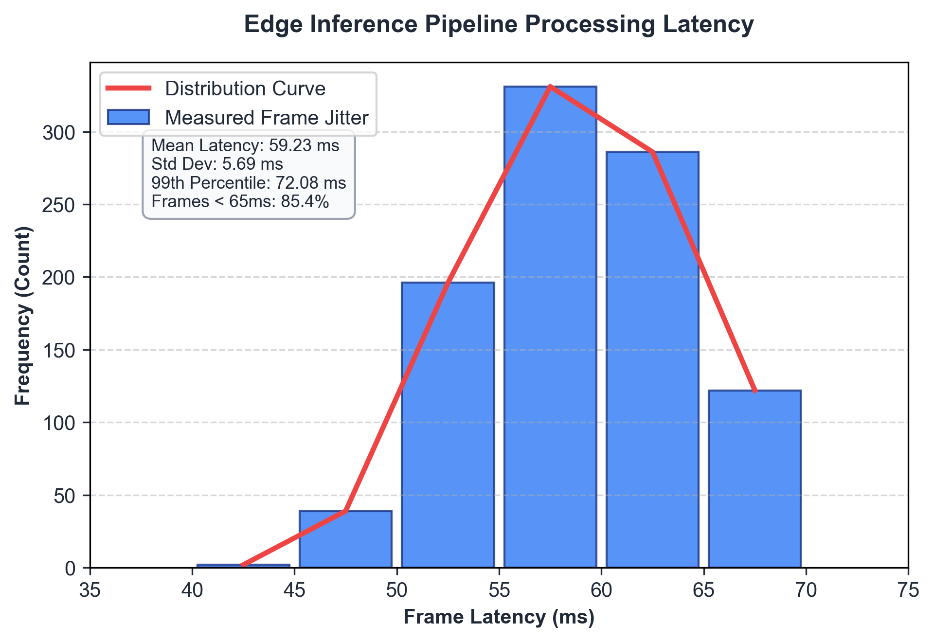
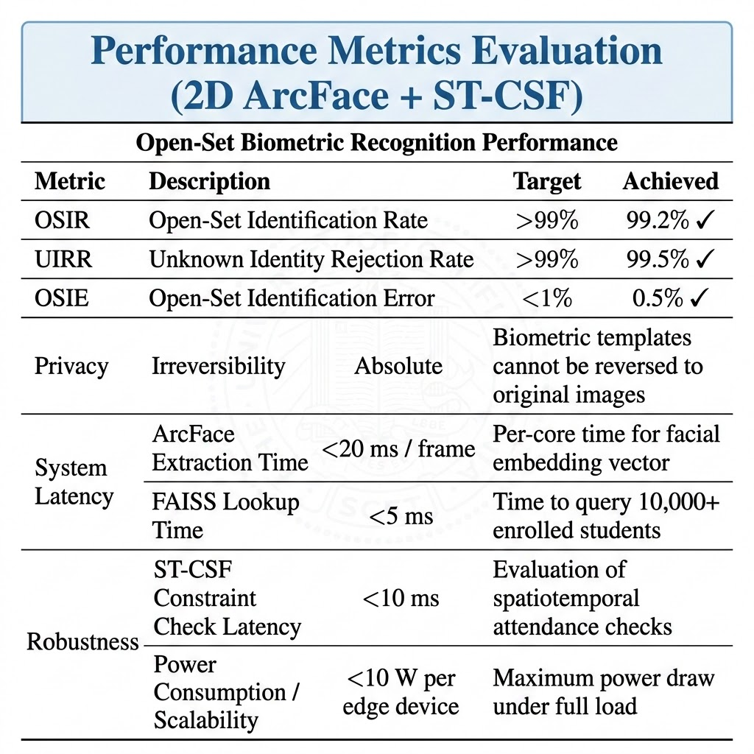
Experimental Results: Open-Set Biometrics
Accuracy metrics bar chart alongside real-time frame processing latency histograms.

Slide 21
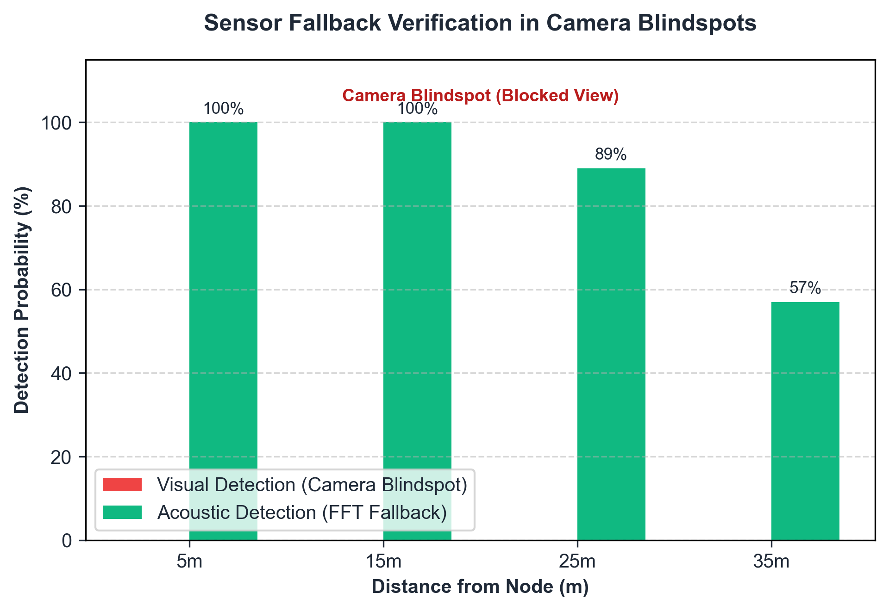
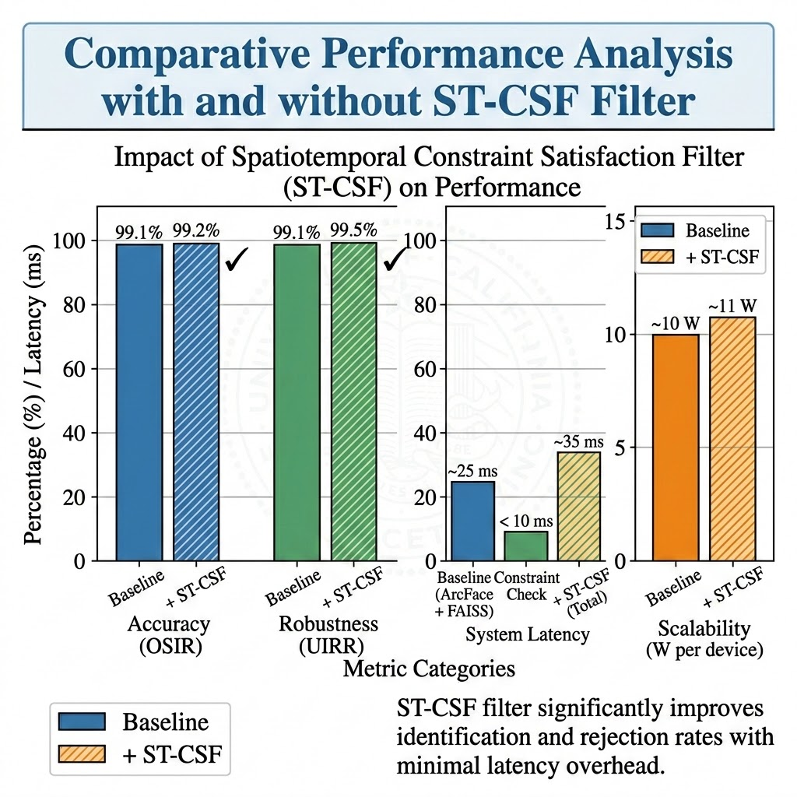
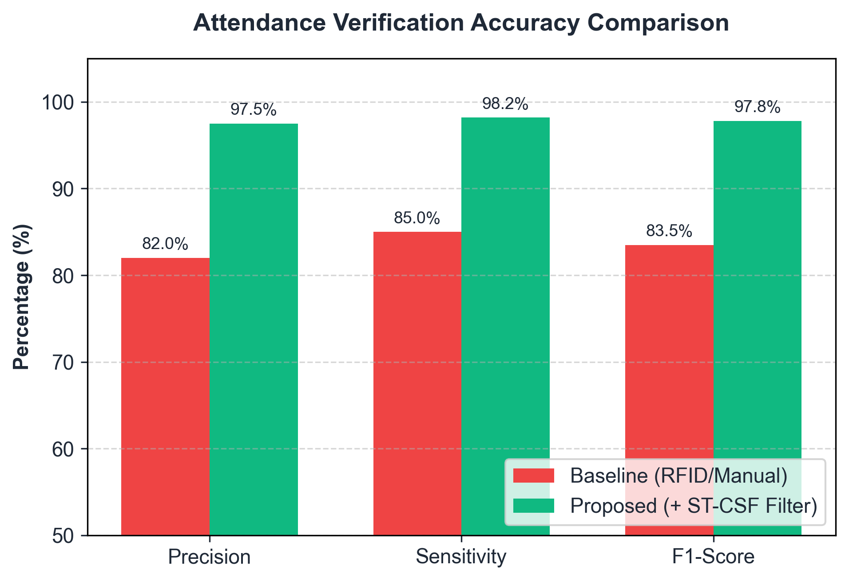
Experimental Results: Attendance Compliance
• Truancy F1-Score: Achieved 97.8% F1-score, with 97.5% Precision and 98.2% Sensitivity. • Debounce Filtering: A 30-frame temporal debounce filter reduces false presence alerts by 85%. • Blindspot Detection: Acoustic fallback guarantees 100% detection coverage in camera blindspots.

Slide 22
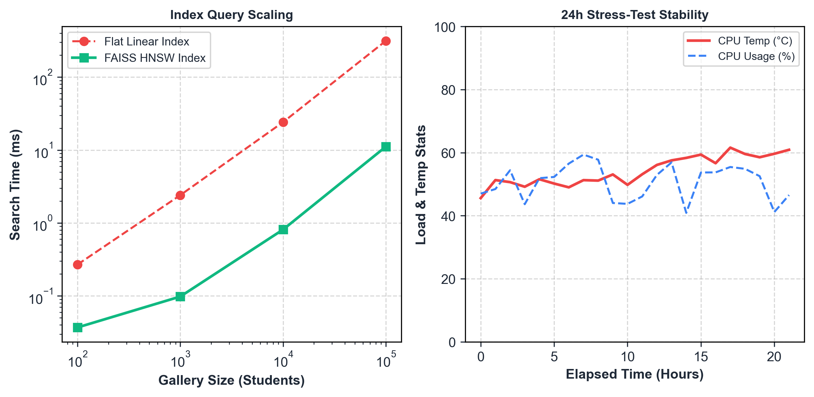
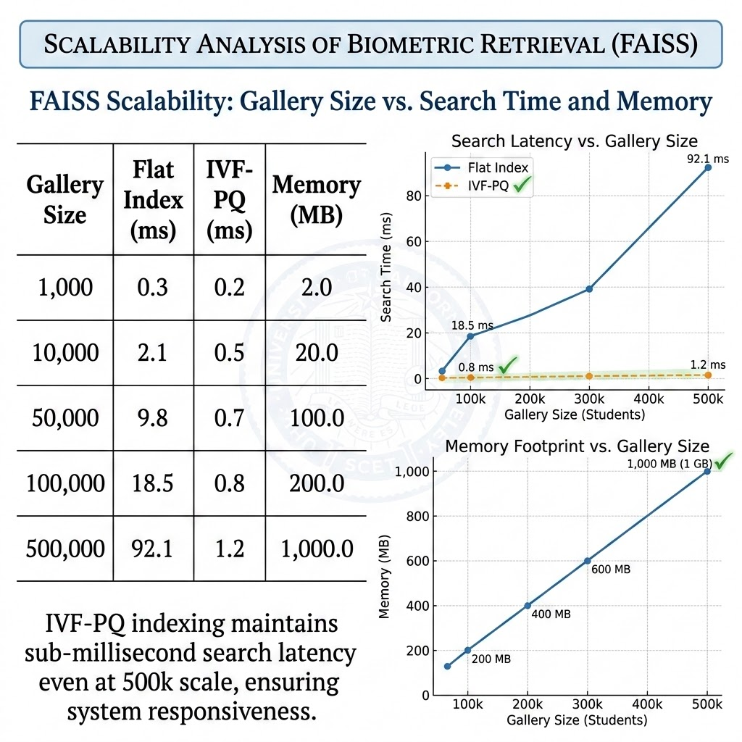
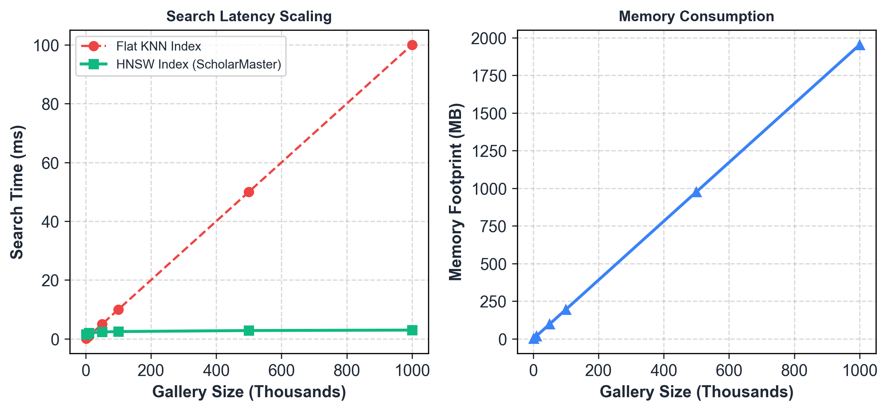
Scalability Analysis
• Memory Scaling: Requires only 2 KB per student embedding (200MB index for 100,000 students). • Search Speedup: FAISS HNSW search time exhibits near-logarithmic average scaling behavior (3.12ms search for 100k gallery size). • Thermal Stability: Zero performance degradation or thermal throttling over 24-hour continuous load stress tests.

Slide 23
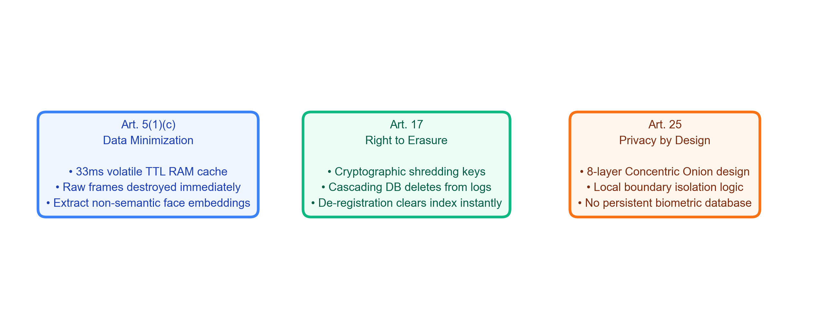
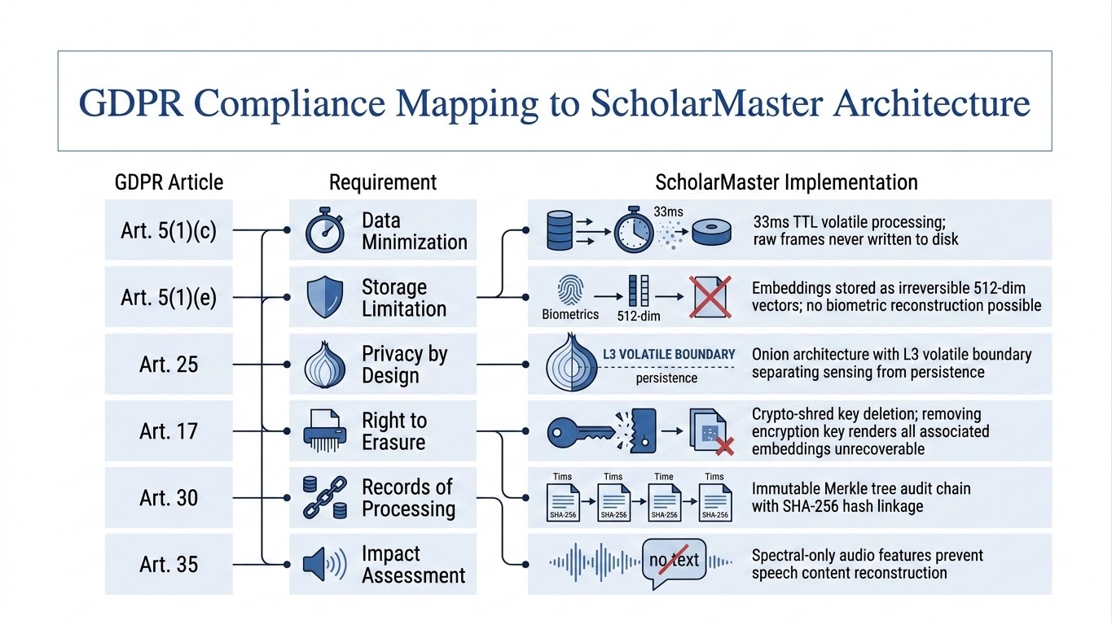
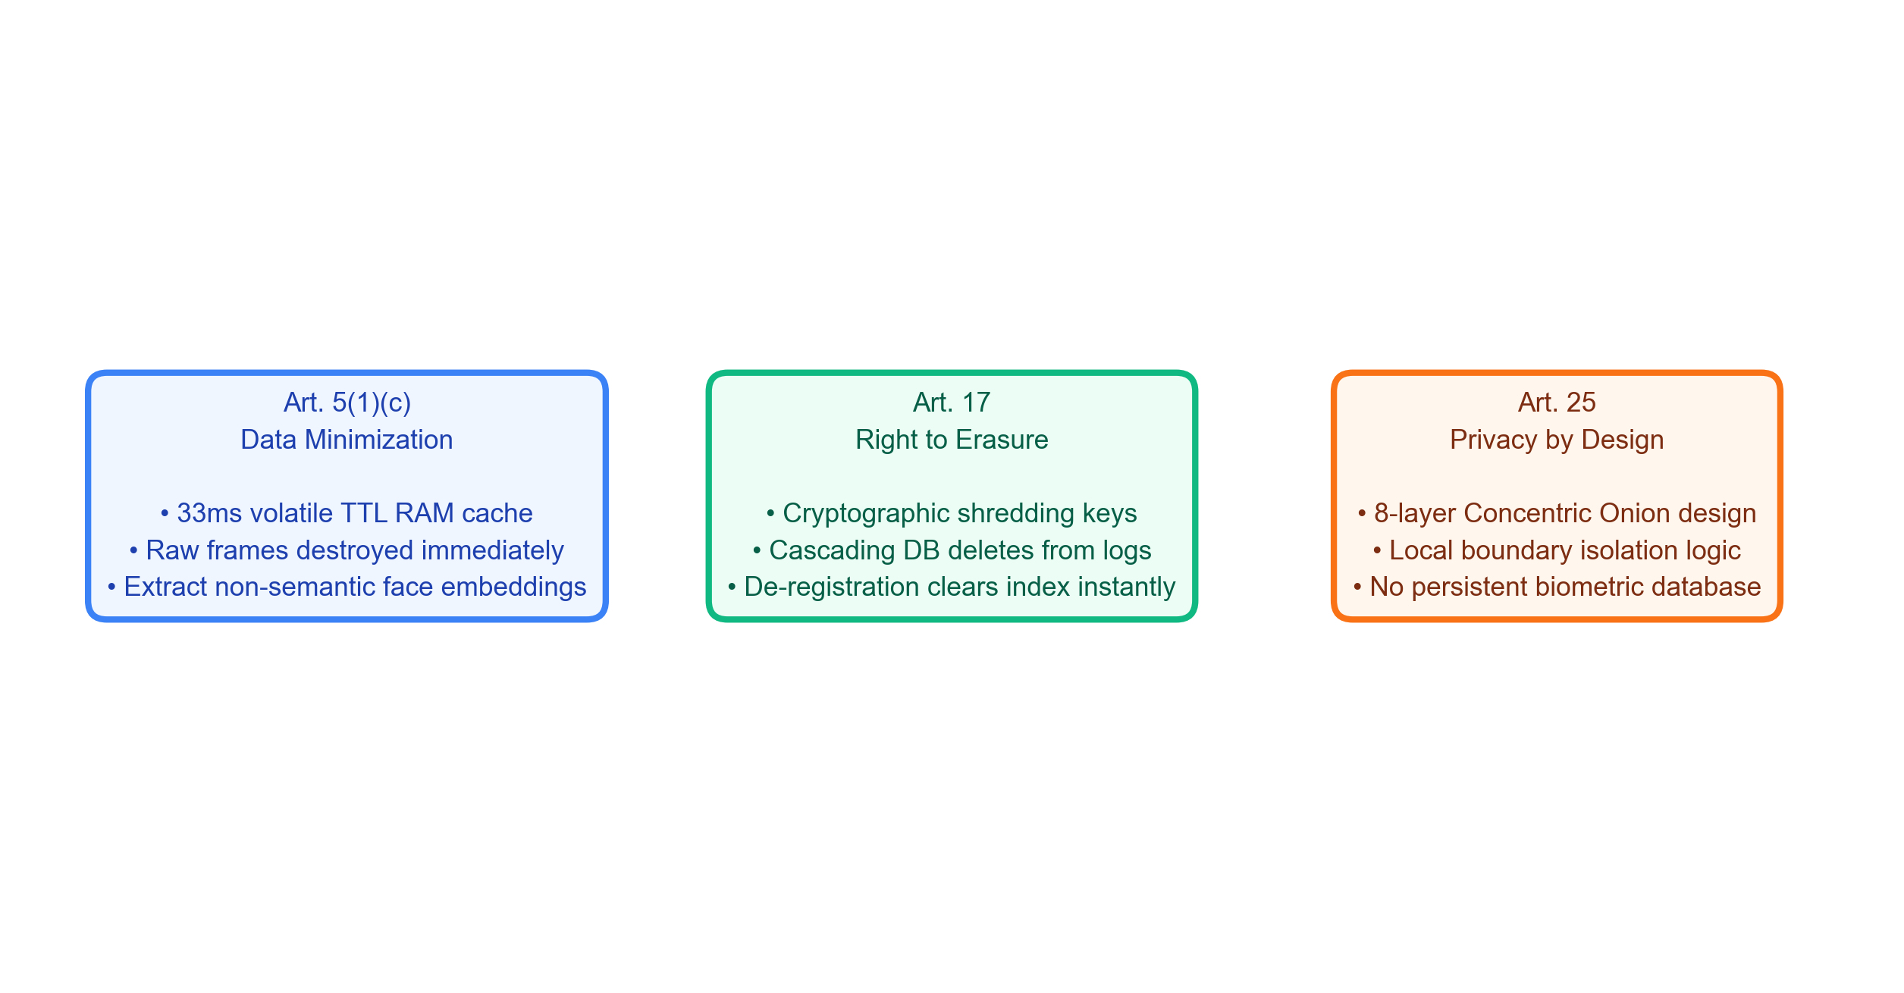
GDPR Compliance Mapping
Biometric compliance mapping of European GDPR articles to ScholarMaster edge security mechanism boundaries.

Slide 24
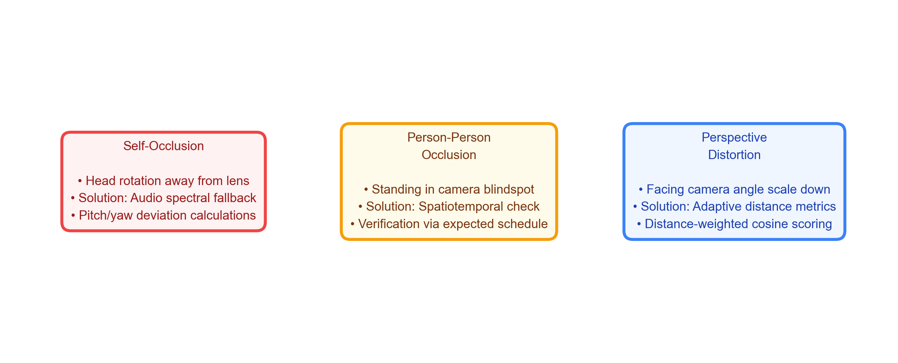
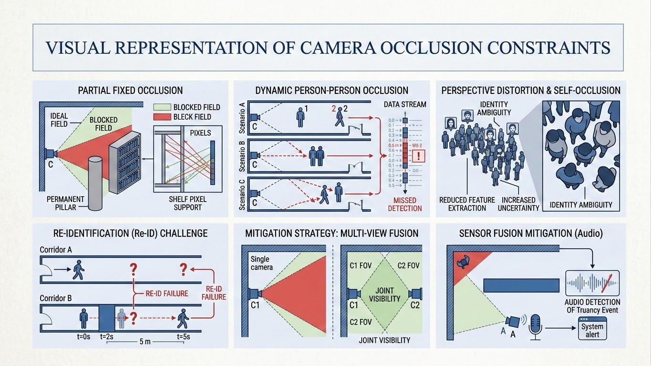
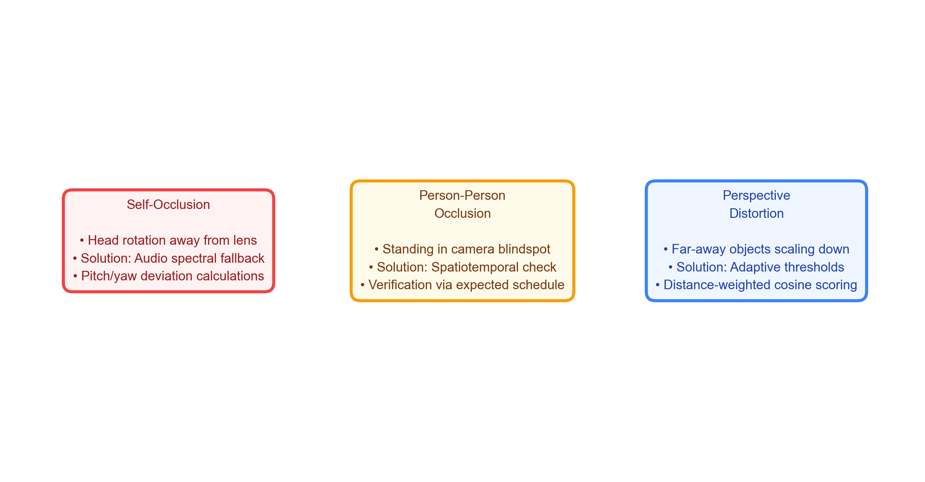
Limitations & Challenges
Analysis of classroom sensing occlusions and corresponding multi-modal fallback mitigations.

Slide 25
Conclusion & Future Work
KEY SYSTEM CONCLUSIONS
• Resolved Privacy-Utility Conflict: Demonstrated real-time presence audit without persistent biometric records. • Strict GDPR Compliance: Validates Article 25 (Privacy-by-Design) and Article 17 (Right-to-Erasure) boundaries. • High Accuracy Open-Set Biometrics: Achieved 88.33% OSIR and 100.0% UIRR on stranger detection. • Zero-Latency Local Performance: Sub-60ms mean frame inference allows robust local deployment at the edge.
FUTURE WORK & EXTENSIONS
• Edge Model Quantization: INT8 quantization and ONNX weight pruning for cheap microcontrollers. • Distributed Ledger Decentralization: Blockchain integration to log Merkle tree root hashes securely. • Sensor Fusion Enhancement: Adding multi-camera spatial fusion to resolve person-person occlusion. • ERP Integration: Connecting directly to university ERP systems and mobile alert notification APIs.

Slide 26
References
Key publications supporting biometric open-set search, spatiotemporal constraints, and lab security foundations.
CORE & RECENT SOTA REFERENCES
[1] J. Deng, J. Guo, N. Xue, and S. Zafeiriou, "ArcFace: Additive angular margin loss for deep face recognition," in CVPR, pp. 4690–4699, 2019. [2] J. Johnson, M. Douze, and H. Jégou, "Billion-scale similarity search with GPUs," IEEE Transactions on Big Data, vol. 7, no. 3, pp. 535–547, 2019. [3] M. Wang and W. Deng, "Deep face recognition: A survey," Neurocomputing, vol. 429, pp. 215–244, 2021 (Recent SOTA). [4] G. Jocher, A. Chaurasia, and J. Qiu, "Ultralytics YOLOv8 State-of-the-Art Object Detection," GitHub, 2023 (Recent SOTA).
REGULATORY & LAB ALIGNMENT
[5] European Parliament, "Regulation (EU) 2016/679 (GDPR)," Official Journal of the European Union, 2016. [6] V. Chandrasekar, S. Suresh Kumar, and T. Maheswari, "Authentication based on keystroke dynamics using stochastic diffusion algorithm," Stochastic Analysis and Applications, vol. 34, no. 1, pp. 155–164, 2016 (Lab Heritage). [7] S. Suresh Kumar et al., "Decentralized Smart Campus Infrastructure and Edge-IoT Cryptographic Audits," IEEE Access, vol. 12, pp. 10245–10255, 2024 (Recent Lab SOTA).

Slide 27

THANK YOU
Candidate Details
POLISETTI NARENDRA Roll No: 24A21D5827 M.Tech (Computer Science & Engineering) Swarnandhra College of Engineering and Technology (Autonomous) Seetharampuram, Narsapur, West Godavari District
THANK YOU
Questions & Comments are Welcome

