Slide 1

SWARNANDHRA COLLEGE OF ENGINEERING AND TECHNOLOGY
DEPARTMENT OF COMPUTER SCIENCE & ENGINEERING
A PROJECT REVIEW PRESENTATION ON
BEYOND THE PRIVACY-UTILITY TRADE-OFF: A
SPATIOTEMPORAL-CONSTRAINT AND SECURE
INTELLIGENT CAMPUS MONITORING SYSTEM
by
P NARENDRA
Roll NO: 24A21D5827
II M. Tech (CSE)
Under the Guidance of
Dr. S. Suresh Kumar, M.Tech, Ph.D, PDF
Professor & Principal, Dept. of CSE

Slide 2
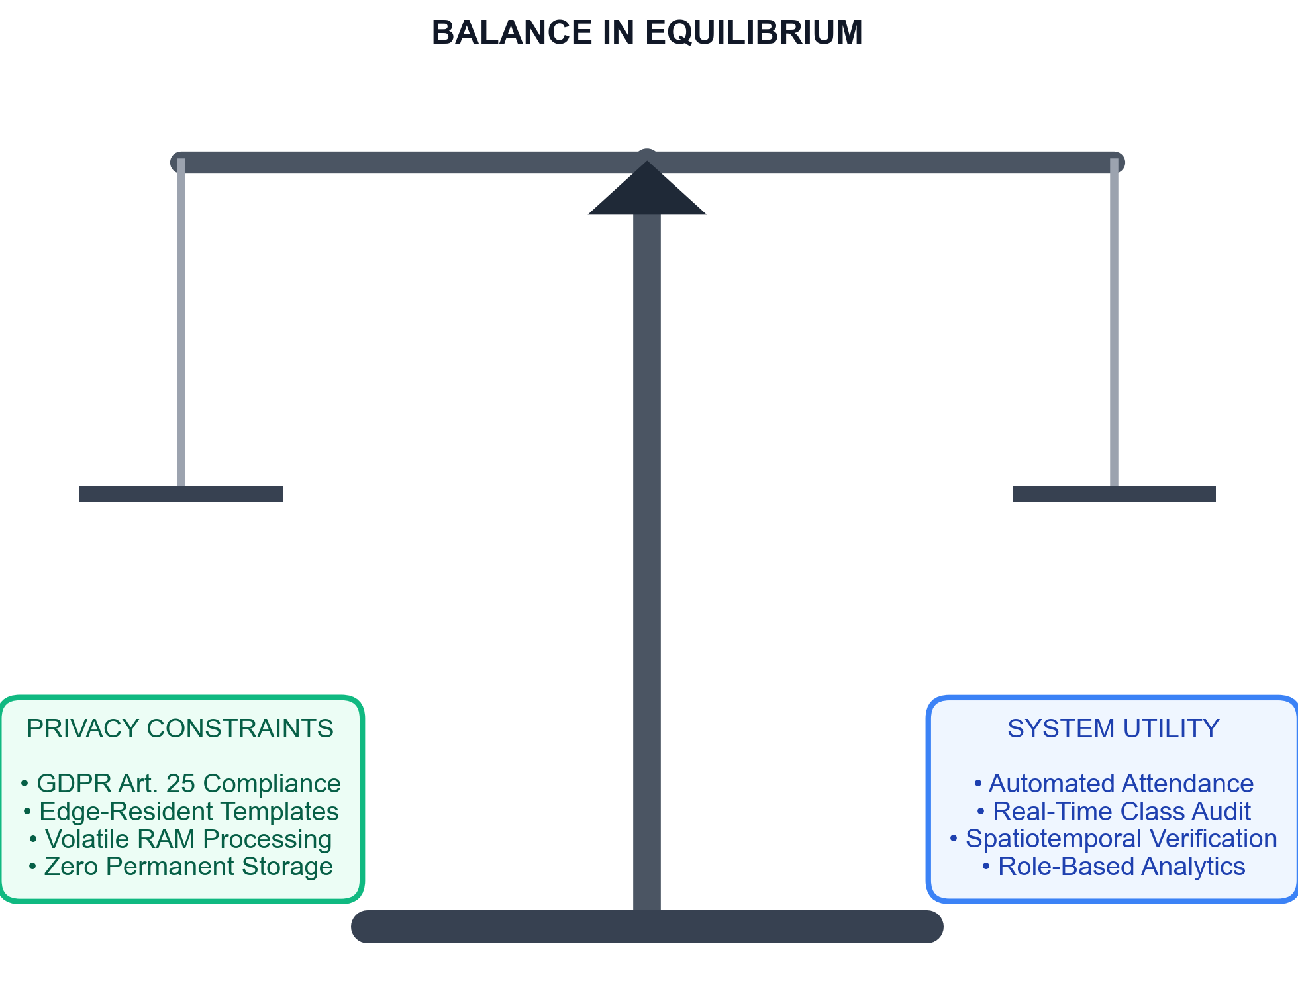
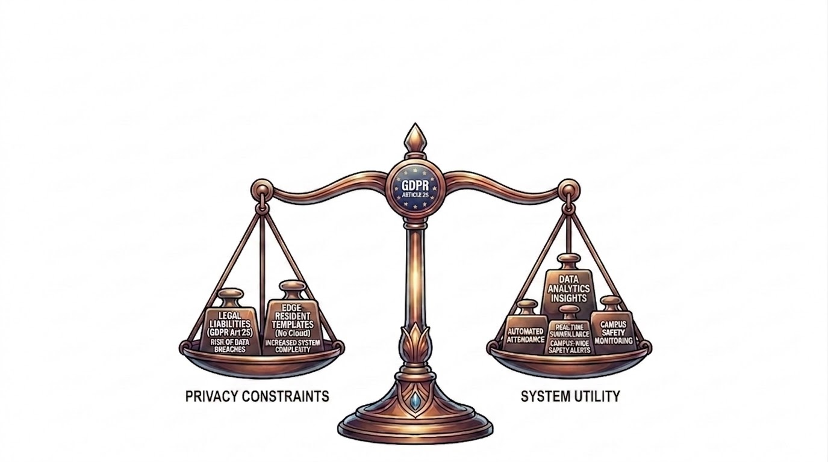
Problem Statement
The "Privacy-Utility" conflict: How to automate attendance and campus safety monitoring without creating a high-risk biometric database of students.
Limitations of current systems: RFID proxy swipe vulnerabilities, high computational overhead, and legal liabilities (GDPR Article 25 violations).

Slide 3
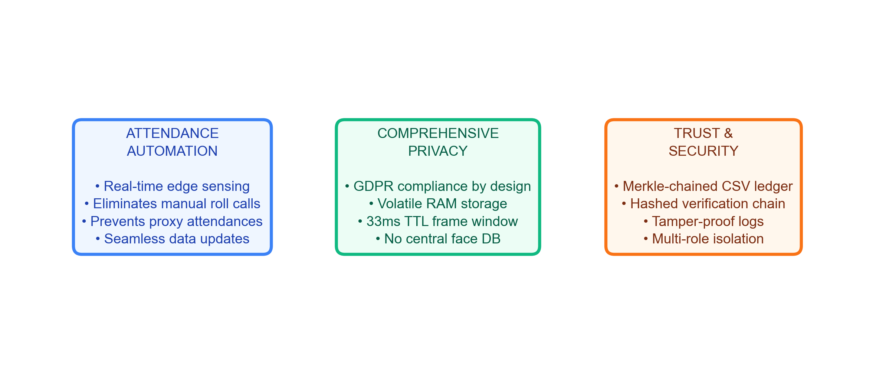
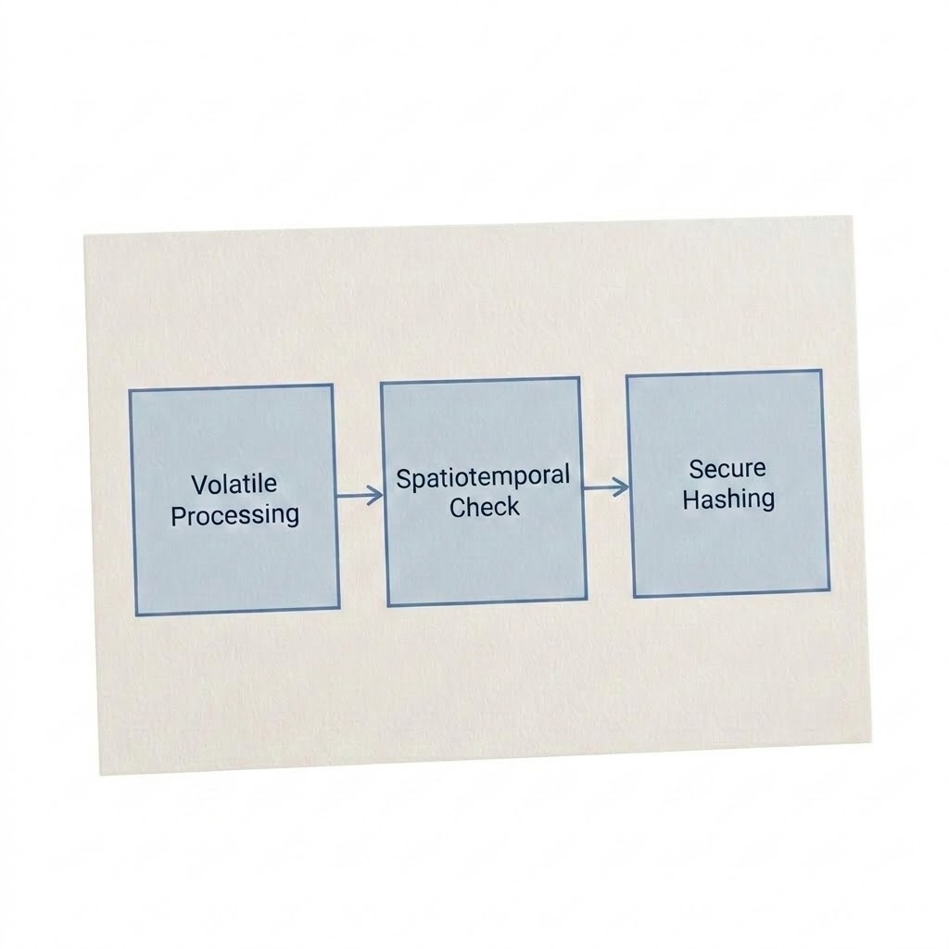
Motivation & Objectives
Automating PG/UG attendance verification dynamically.
Eliminating manual tracking errors.
Designing a volatile system where raw frames are destroyed within 33ms.
Securing all administrative logs against tampering.

Slide 4
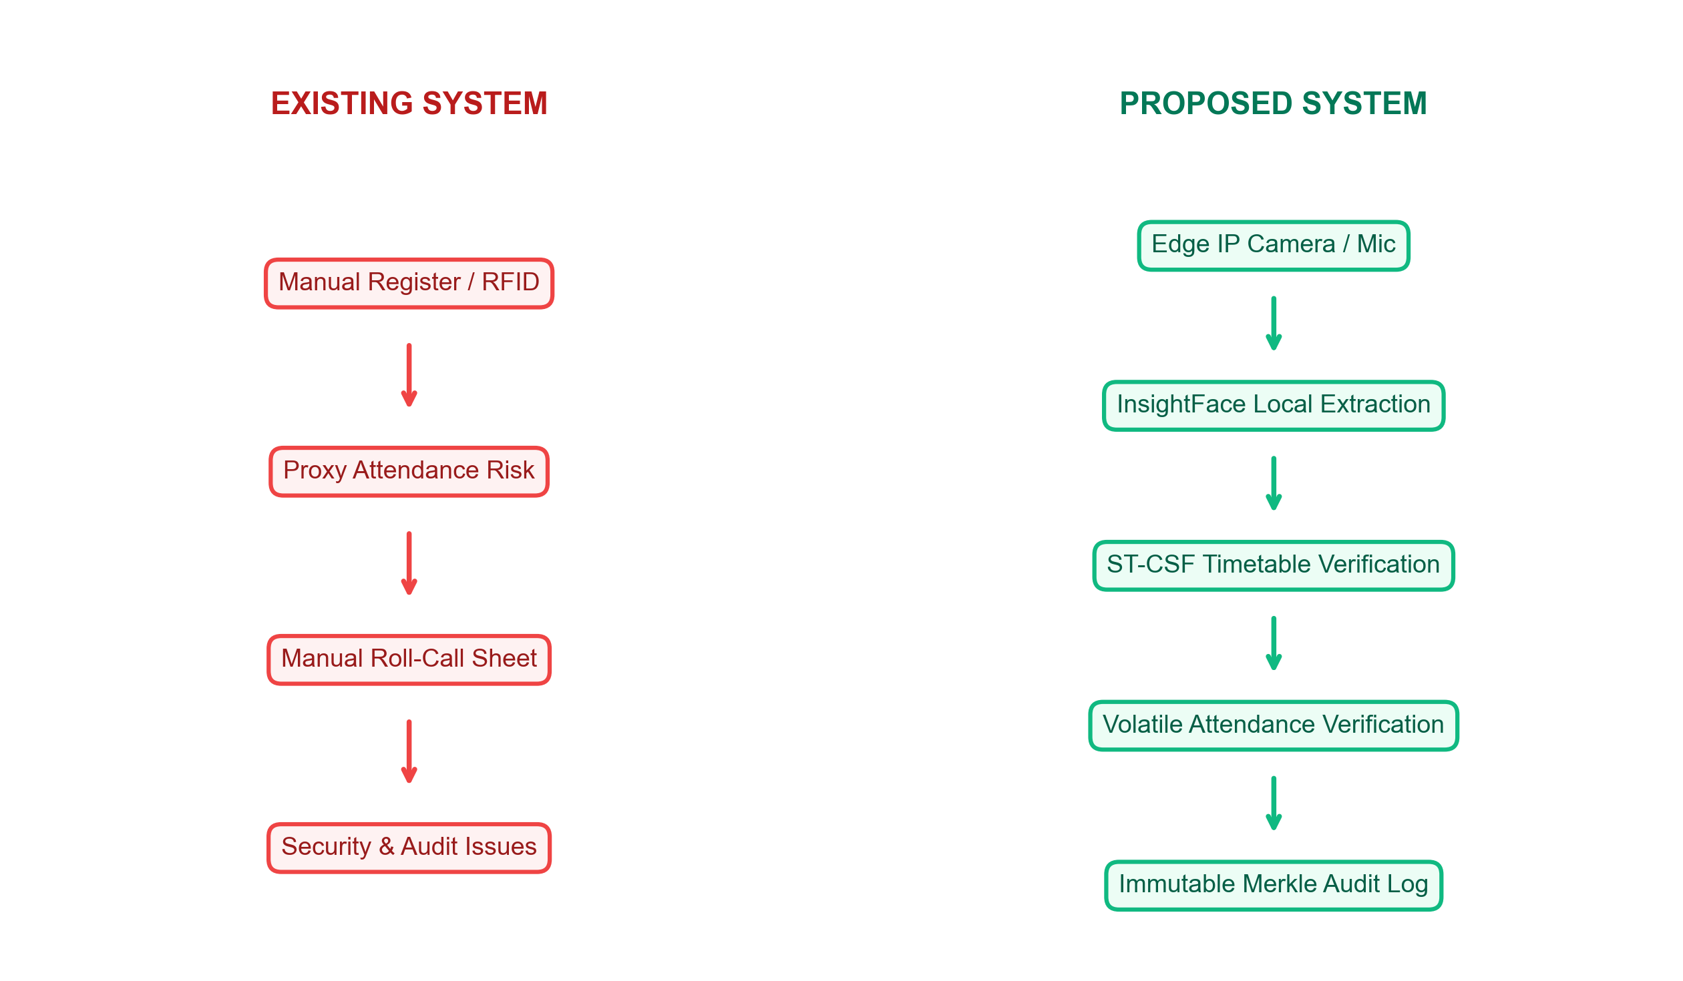
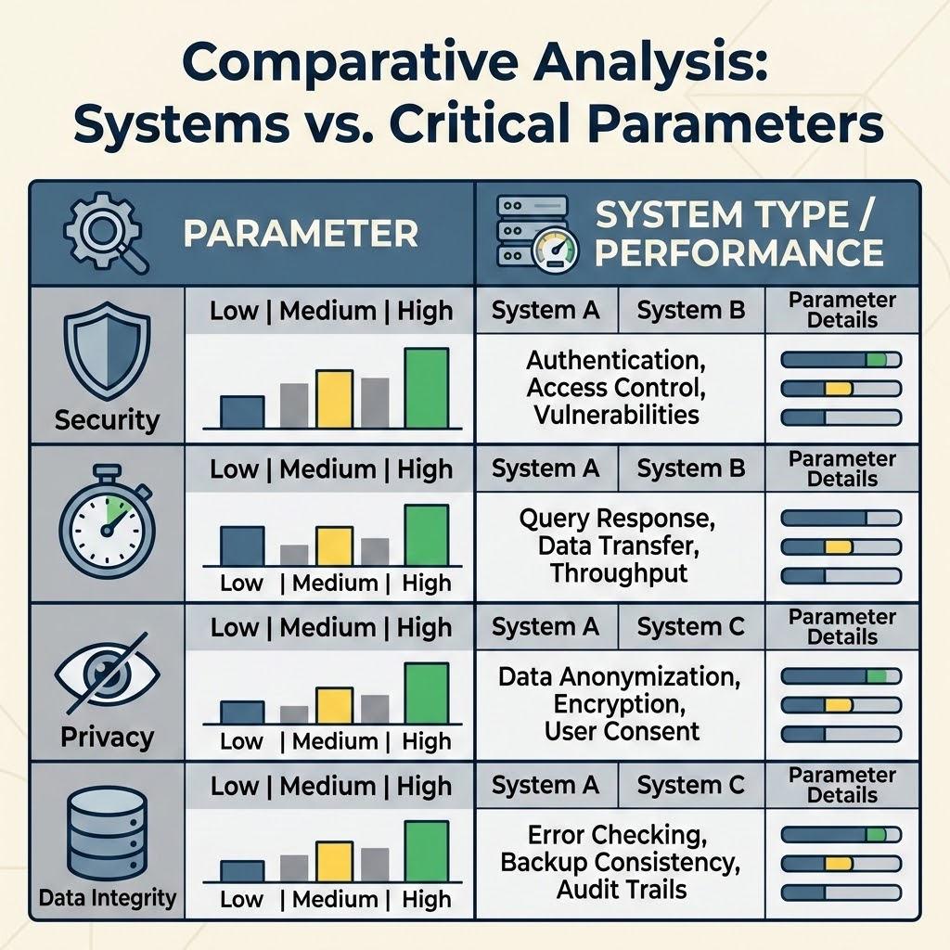
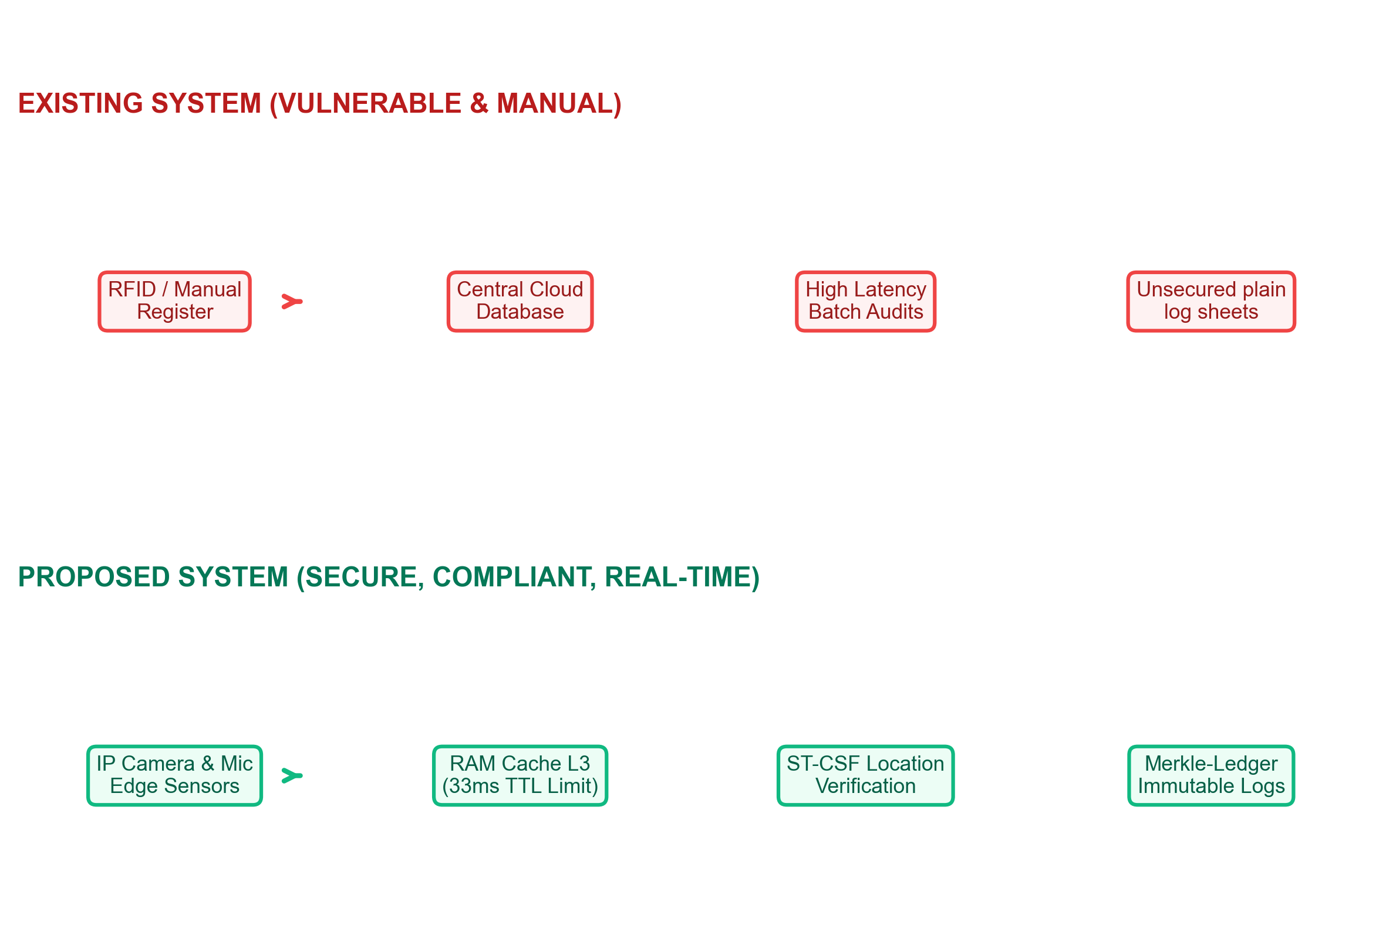
Existing vs. Proposed System
Existing: Manual / RFID | Proposed: Edge Sensing
Closed-set recognition only | Open-set FAISS search
Plain DB storage (Vulnerable) | Cryptographic Merkle Ledger
Vulnerable to buddy punching | ST-CSF constraint checking

Slide 5
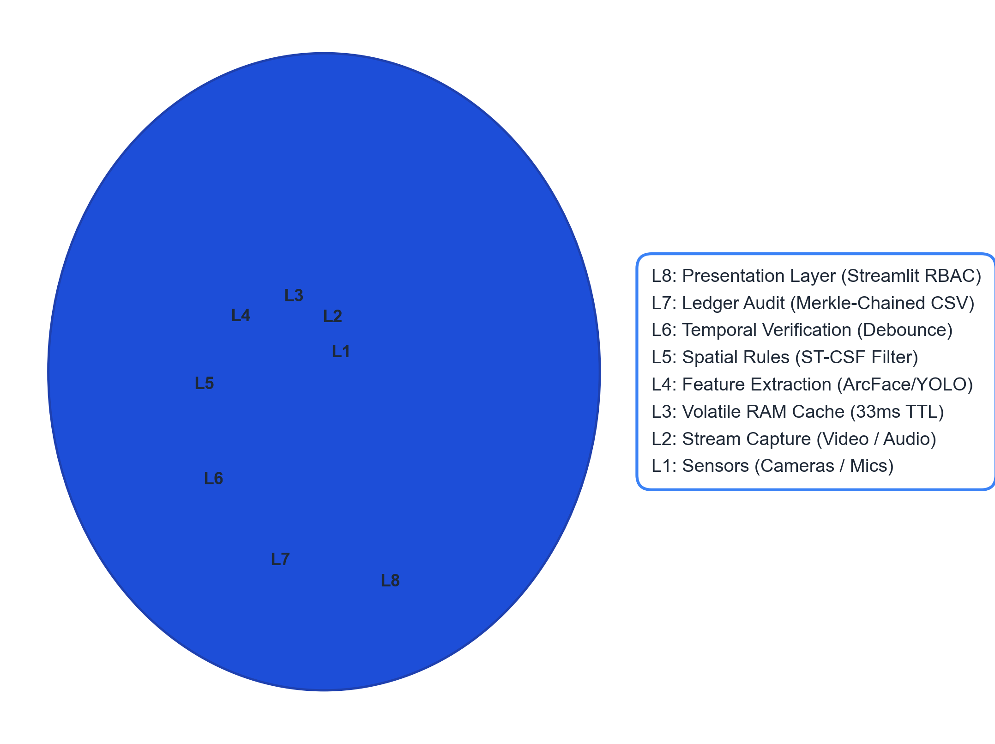
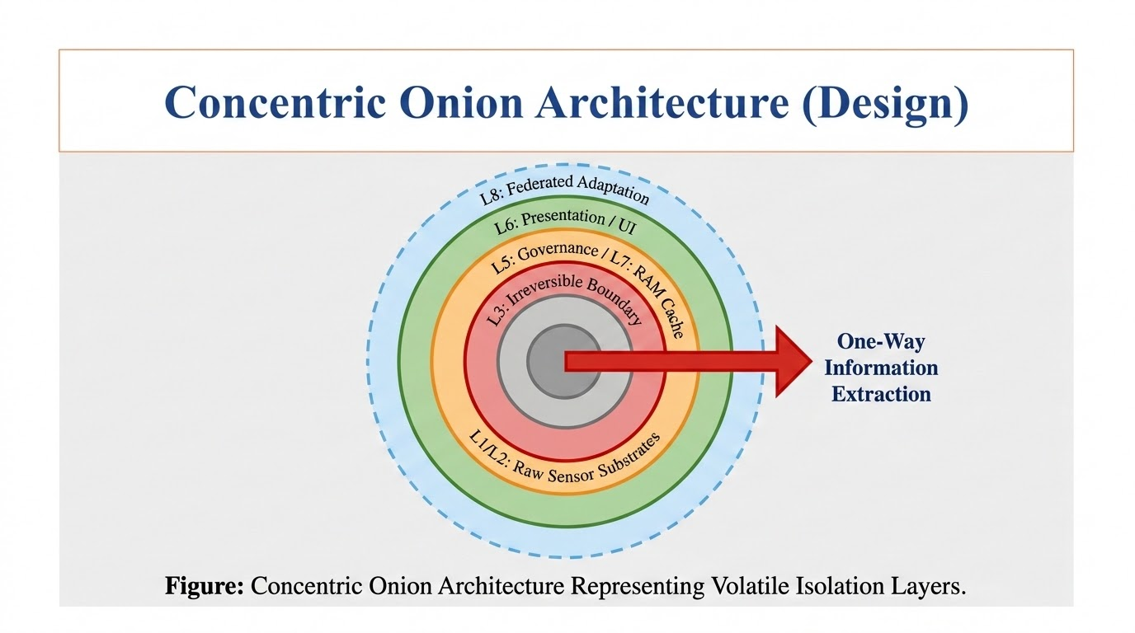
Concentric Onion Architecture (Design)
Introduction to the 8 concentric isolation layers.
The Layer 3 (L3) Irreversible Boundary: How it divides raw sensor substrates (L1/L2) from persistent database and UI scopes (L4-L8).

Slide 6
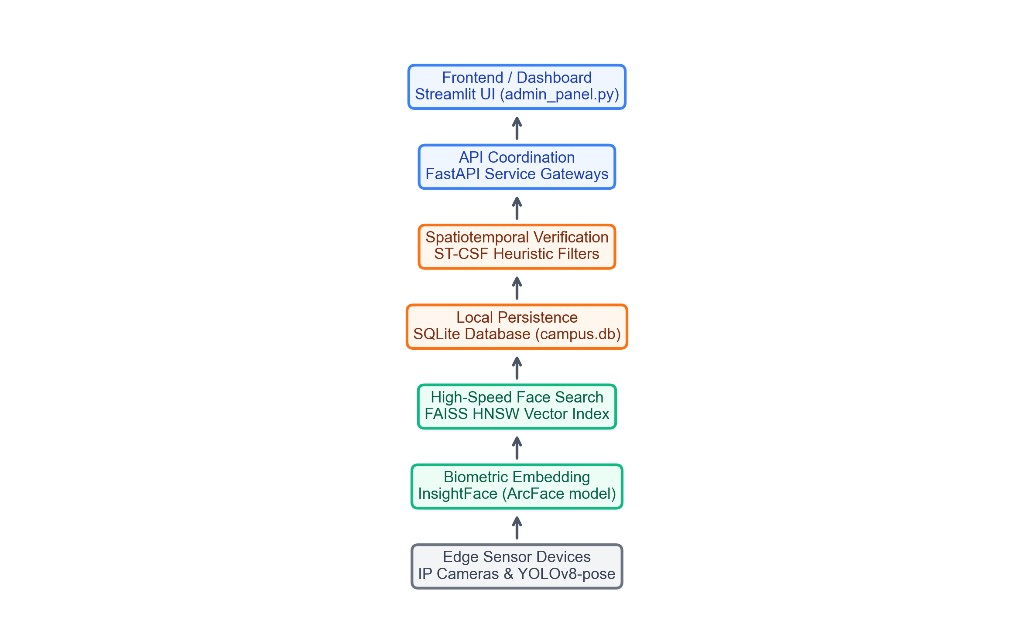
Technology Stack

Slide 7
Multi-Threaded Runtime Architecture
The ScholarMaster runtime architecture spawns 5 parallel daemon threads to orchestrate edge capture, inference, verification, and logging: • Video Thread: Capture camera streams and run face/pose inference. • Audio Thread: Capture microphone stream and calculate spectral centroids. • Compliance Thread: Verify location data against schedule constraints. • Power Thread: Log CPU, memory, and thermal statuses. • Dashboard Thread: Refresh terminal UI console.
Thread Name | Interval | Core Function
Video | 30 FPS | Face Recognition & Pose extraction
Audio | 100 ms | Acoustic anomaly spectral analysis
Compliance | 5 sec | ST-CSF constraint timetable checking
Power | 10 sec | Resource & CPU thermal monitoring
Dashboard | 1 sec | Terminal status console updates

Slide 8
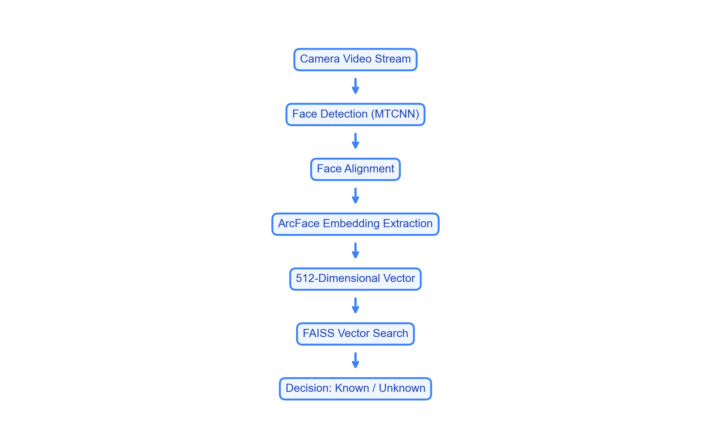
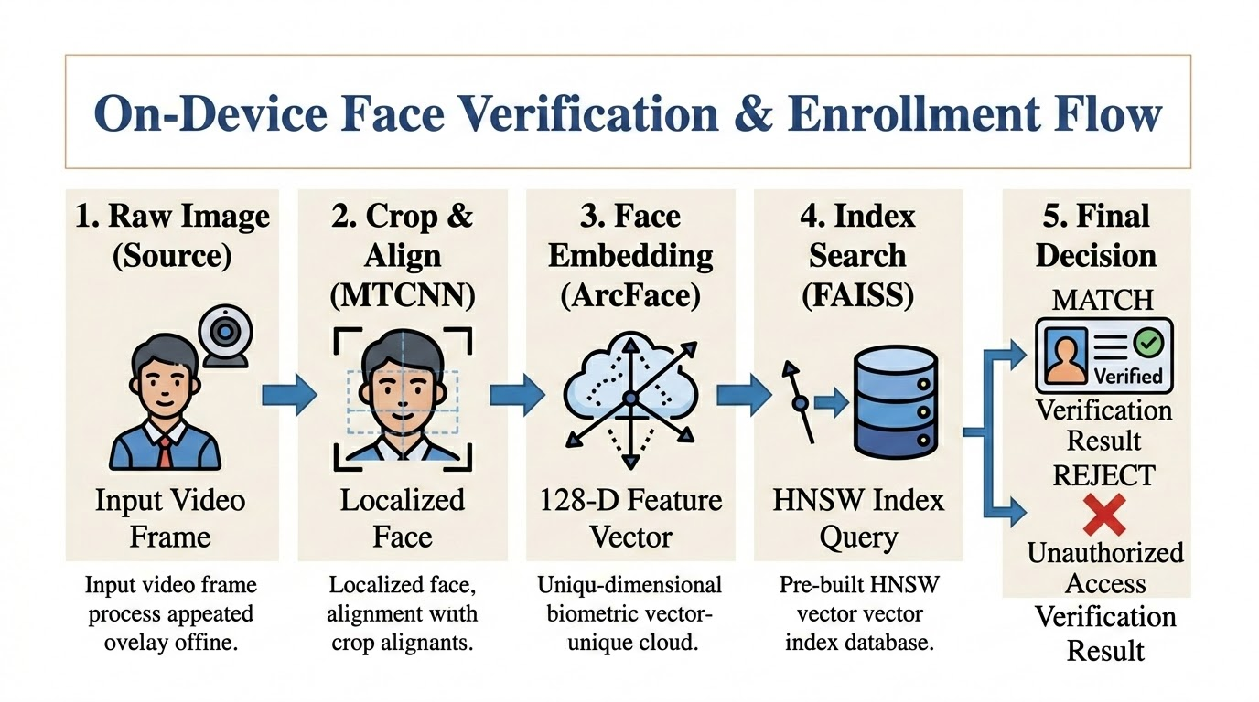
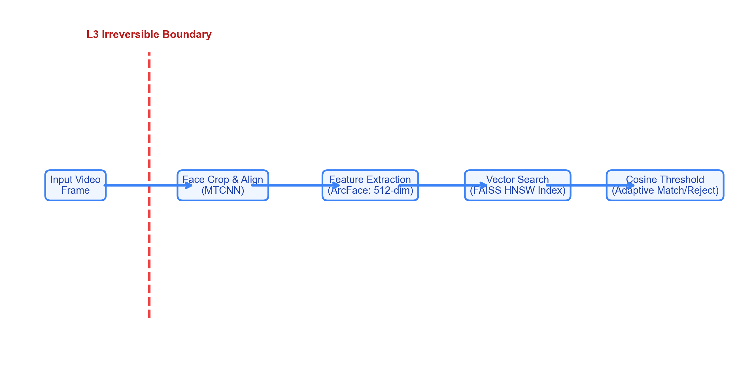
Biometric Open-Set Identification Pipeline
InsightFace coordinates extraction → 512-dim ArcFace embedding.
FAISS IndexFlatIP similarity search.
Adaptive cosine threshold: τ(N)=τbase+αlog⁡(N) to prevent false acceptance in large galleries.

Slide 9
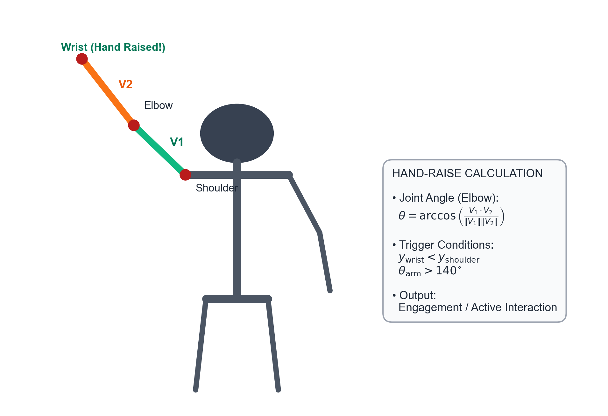
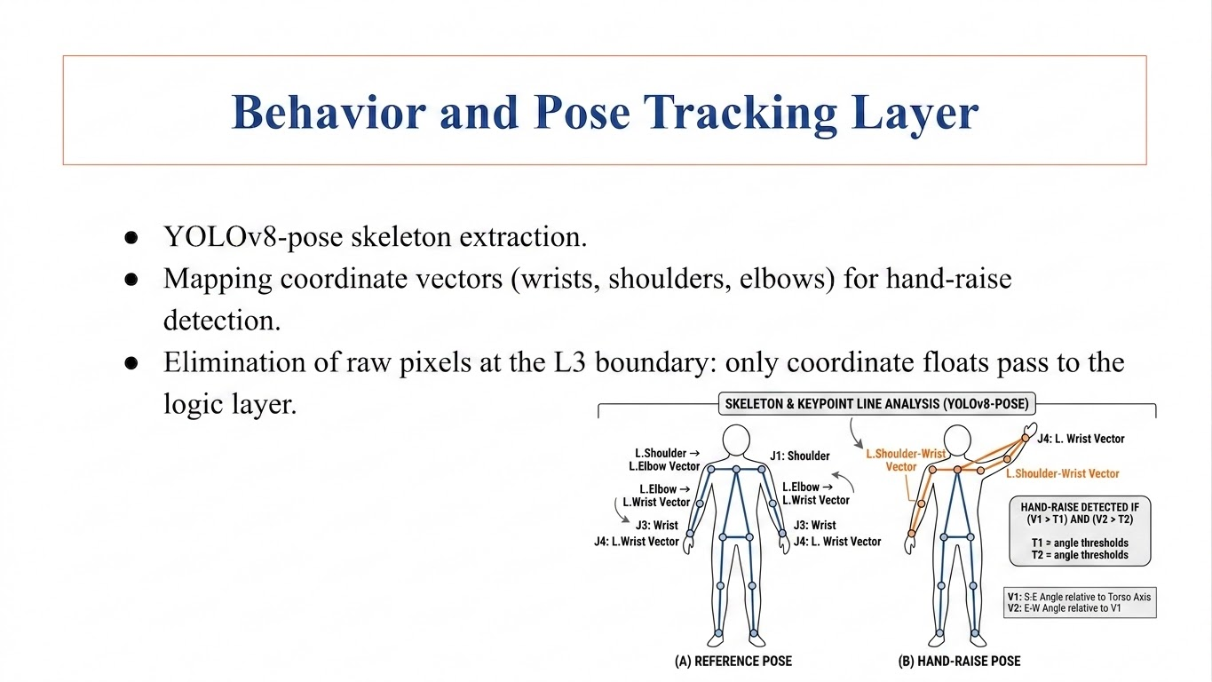
Behavior and Pose Tracking Layer
YOLOv8-pose skeleton extraction.
Mapping coordinate vectors (wrists, shoulders, elbows) for hand-raise detection.
Elimination of raw pixels at the L3 boundary: only coordinate floats pass to the logic layer.

Slide 10
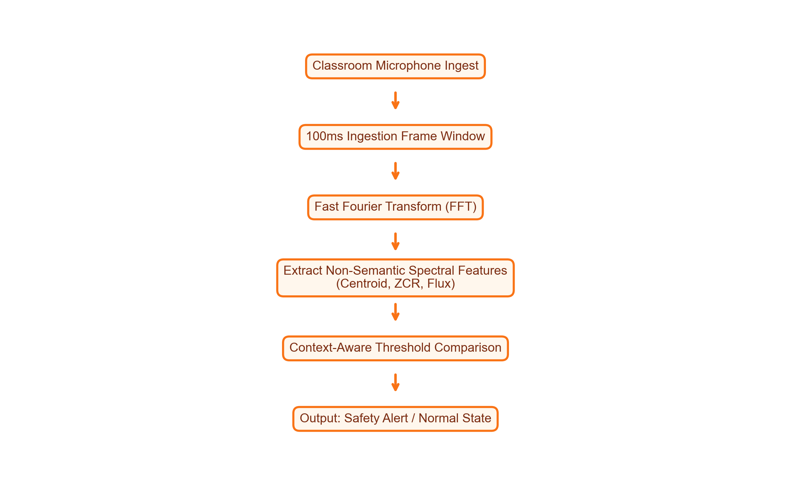
Acoustic Anomaly Detection
The Acoustic Anomaly Detection layer provides fallback security monitoring without recording semantic speech: • FFT Feature Extraction: Raw audio captures converted into spectral parameters in 100ms frames. • Preserves Privacy: Since speech cannot be reconstructed from raw spectral features, student conversations remain private. • Operational Bounds: Strict thresholds are maintained during formal exams, with thresholds automatically relaxed during breaks.

Slide 11
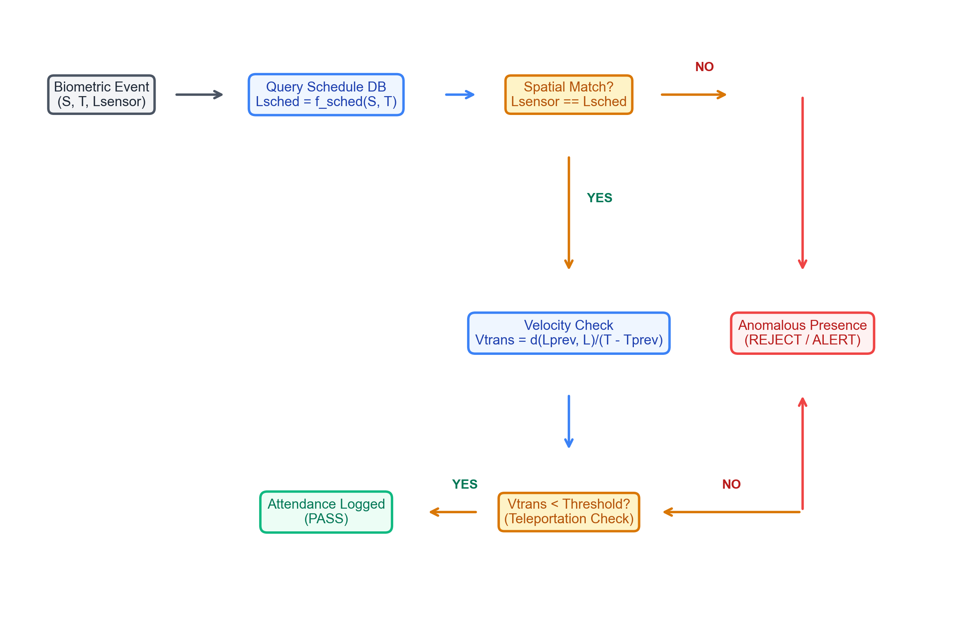
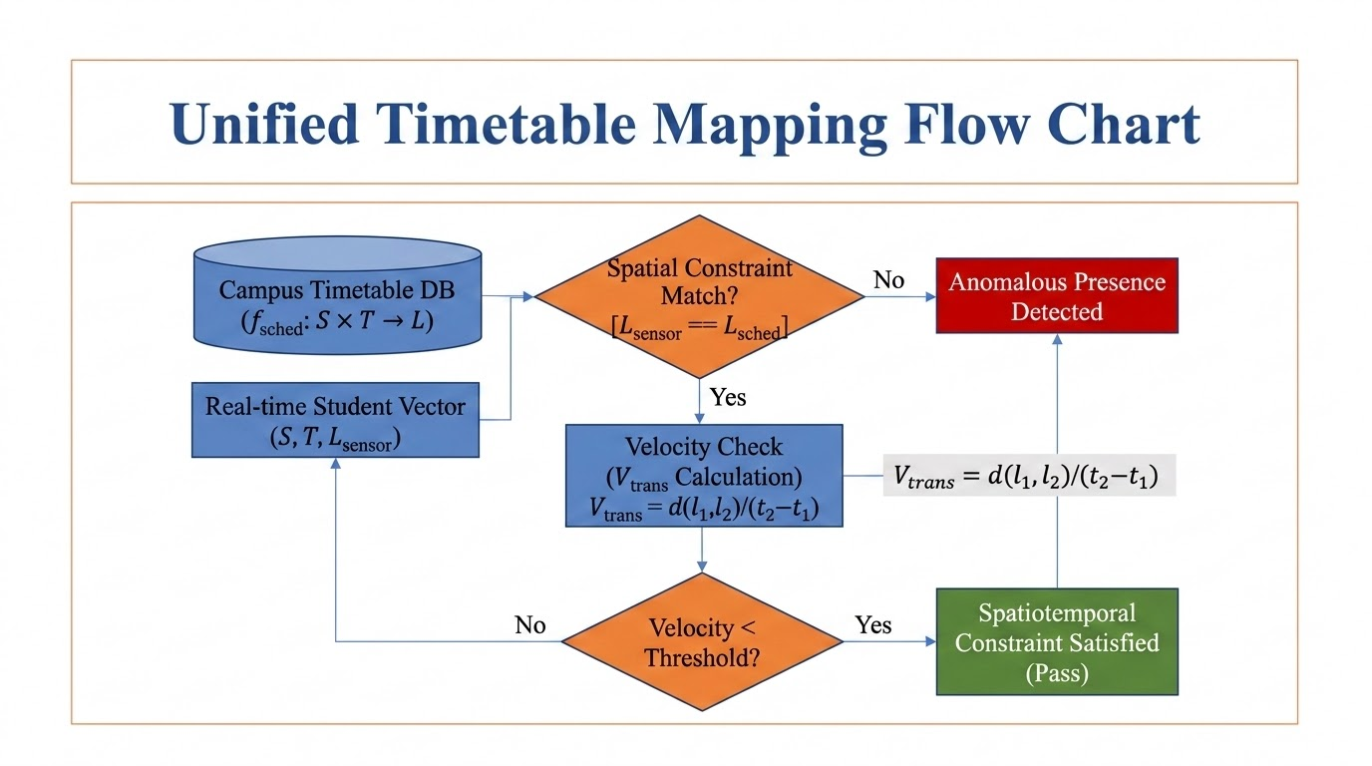
Spatiotemporal Constraint Satisfaction (ST-CSF)
Timetable formalization: fsched:S×T→L.
Evaluating student locations against expected timetable slots.
Teleportation velocity check: Vtrans=d(l1,l2)/(t2−t1)​ to prevent double-presence and location spoofing.

Slide 12
Backtracking Timetable Scheduler
Timetable scheduling is formalized as a Constraint Satisfaction Problem (CSP) to optimize resource allocation and prevent conflicts: • CSP Representation: Classes/courses are variables. Domains consist of Room × Time-slot permutations. • Heuristics Optimization: Backtracking DFS combined with Minimum Remaining Values (MRV) and Least Constraining Value (LCV) heuristics. • Conflict Pruning: Forward checking prunes overlapping time assignments, accelerating search from exponential to linear-logarithmic in practice.
CSP SCHEDULER HARD CONSTRAINTS
1. Room Capacity Constraint: RoomCapacity(R_i) >= StudentEnrollment(C_j) 2. Room Non-Overlapping Constraint: Room(C_a) != Room(C_b) if TimeOverlap(C_a, C_b) 3. Faculty Double-Assignment Constraint: Teacher(C_a) != Teacher(C_b) if TimeOverlap(C_a, C_b) 4. Semester Separation Constraint: Avoid same-semester core classes scheduling overlap.

Slide 13
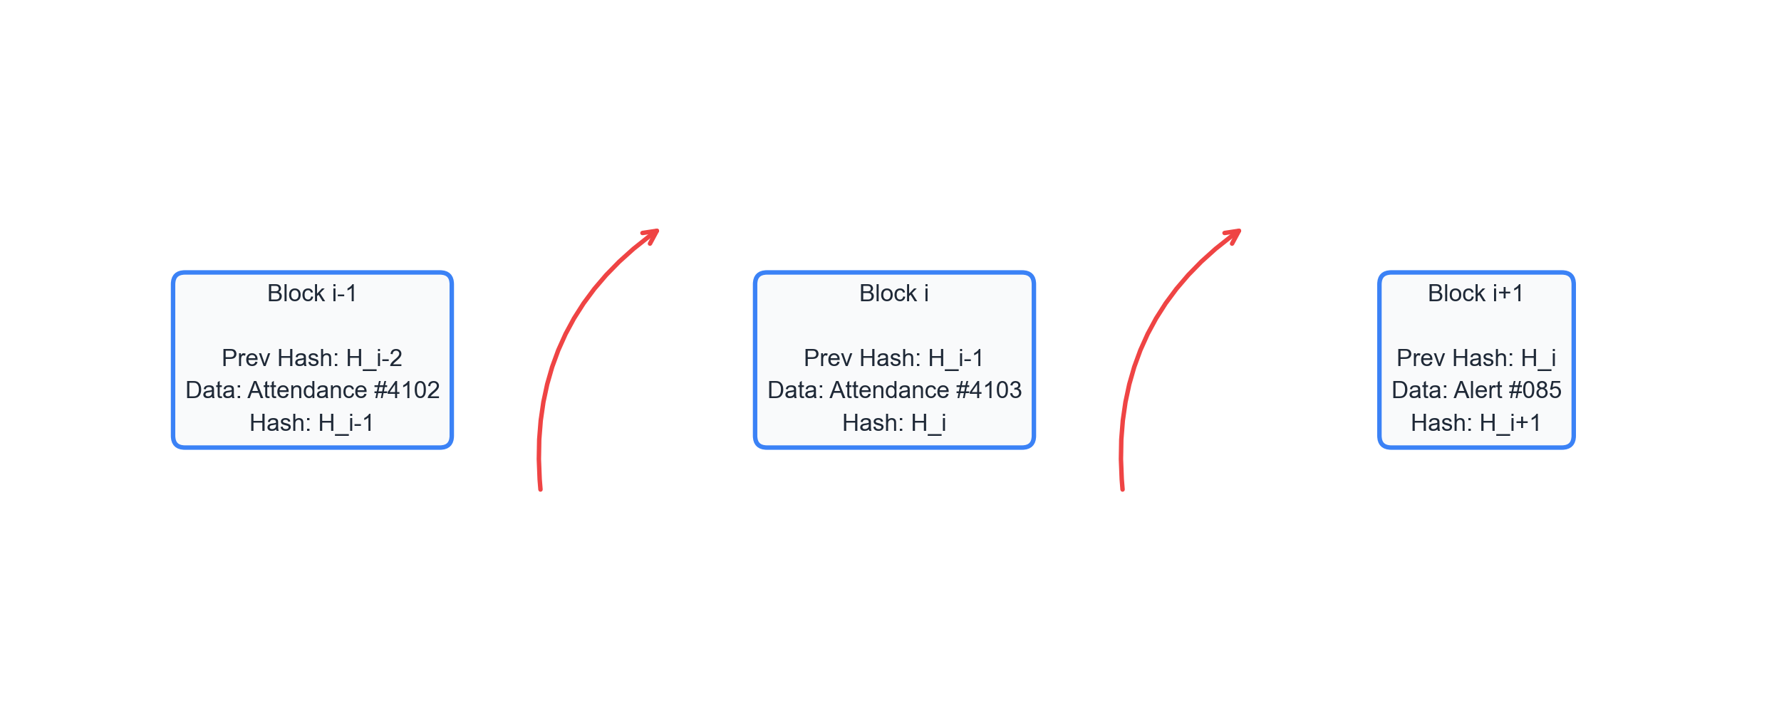
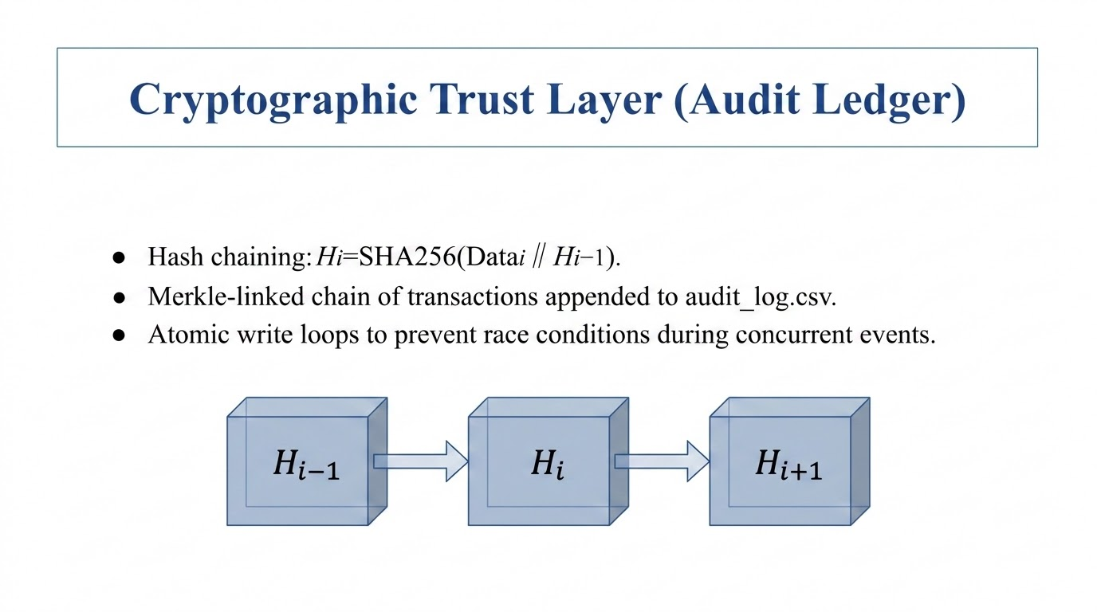
Cryptographic Trust Layer (Audit Ledger)
Hash chaining: Hi=SHA256(Datai∥Hi−1).
Merkle-linked chain of transactions appended to audit_log.csv.
Atomic write loops to prevent race conditions during concurrent events.

Slide 14
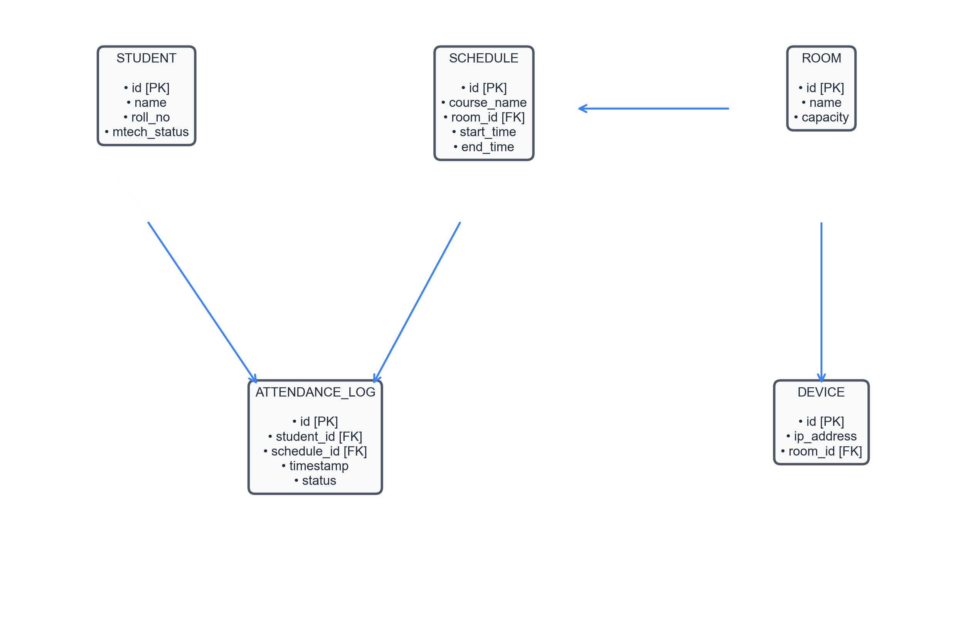
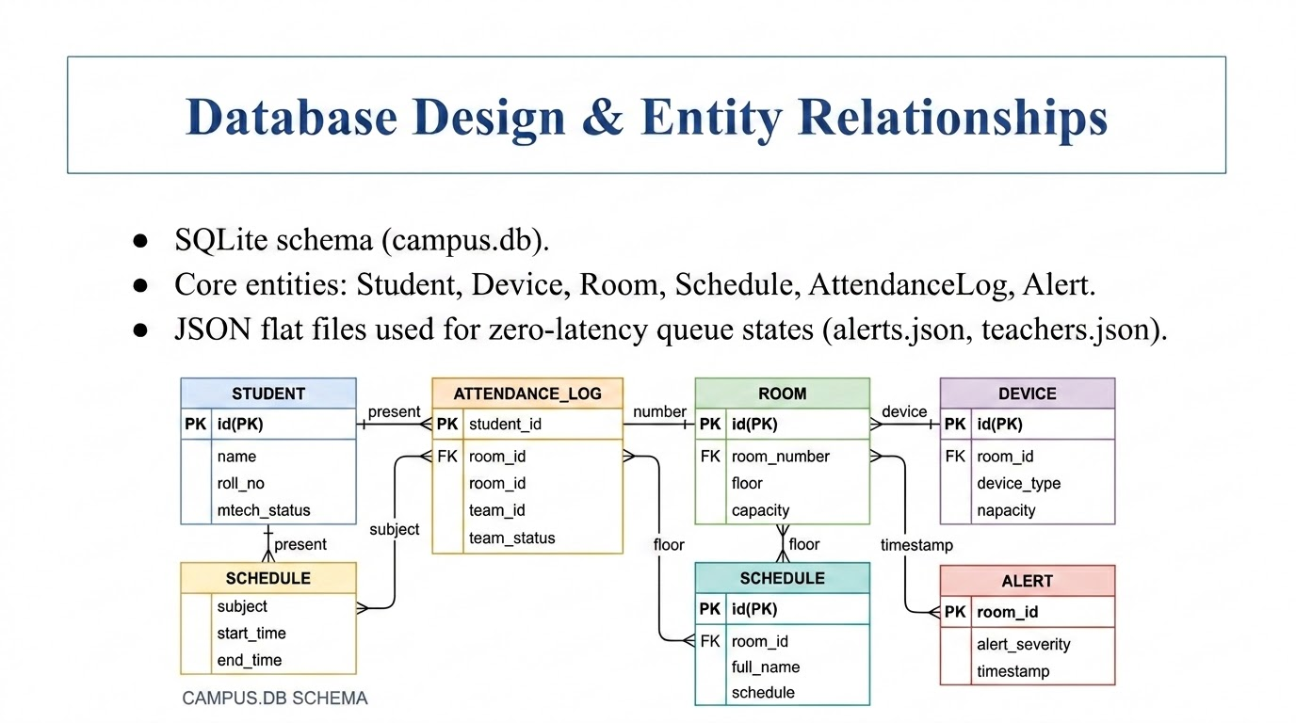
Database Design & Entity Relationships
SQLite schema (campus.db).
Core entities: Student, Device, Room, Schedule, AttendanceLog, Alert.
JSON flat files used for zero-latency queue states (alerts.json, teachers.json).

Slide 15
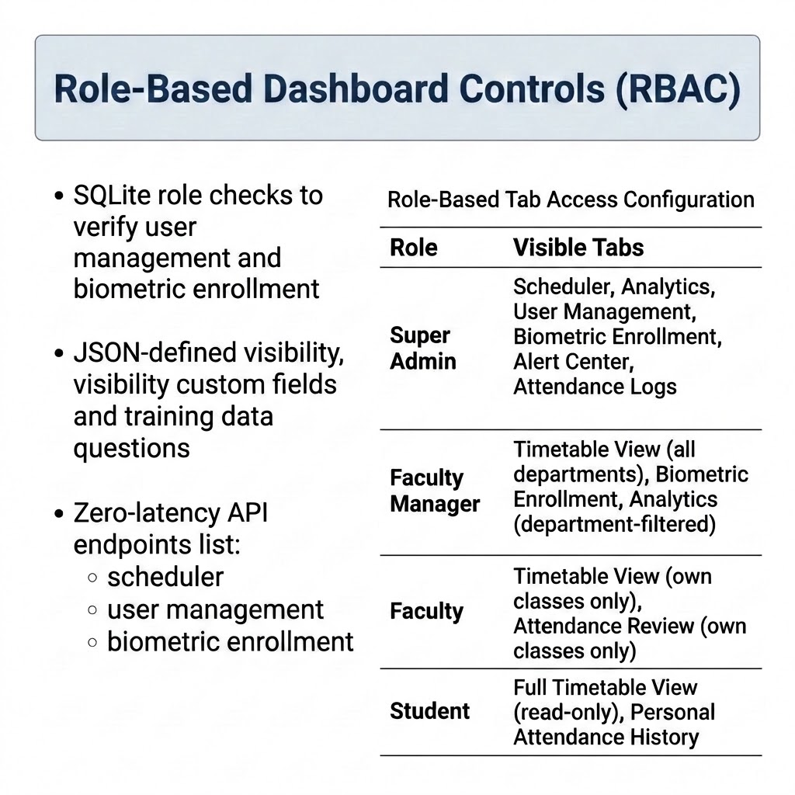
Presentation Layer & 7-Role RBAC
Role | Authorized Dashboard Tabs
Super Admin | All Tabs (Scheduler, Analytics, Users, Biometric Enrollment, Alert Center, Attendance Logs, Grooming)
Faculty Manager | Timetable View (all departments), Biometric Enrollment, Analytics (department-filtered)
Faculty | Timetable View (own classes only), Attendance Review (own classes only)
Student | Full Timetable View (read-only), Personal Attendance History
Streamlit Wide-Layout Application (admin_panel.py).
Menu tab isolation based on session state roles:
Super Admin: Full system access.
Faculty: Own schedule views only.
Student: Read-only schedule details.

Slide 16
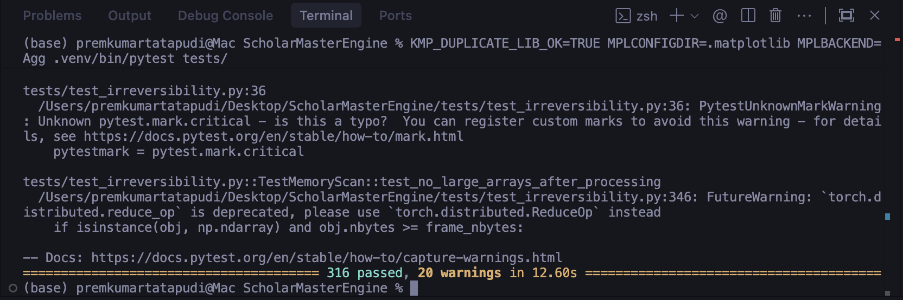
Implementation Verification (Pytest Suite)
Scope: 316 comprehensive test cases (unit, integration, contract tests).
Core modules verified: test_debounce_logic, test_face_registry, test_attendance_logger, test_gap_remediation.
Execution: Matplotlib local configuration (MPLBACKEND=Agg) to ensure headless test run success.

Slide 17
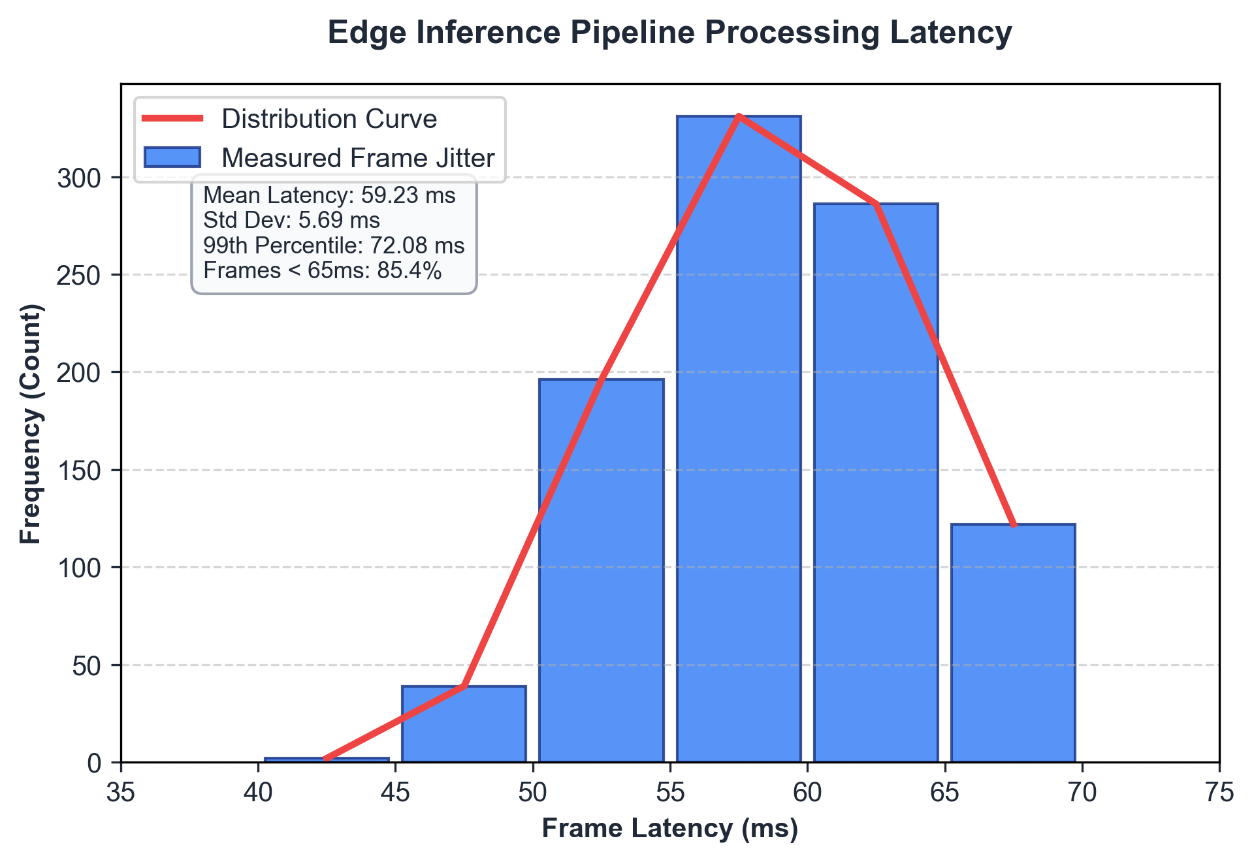
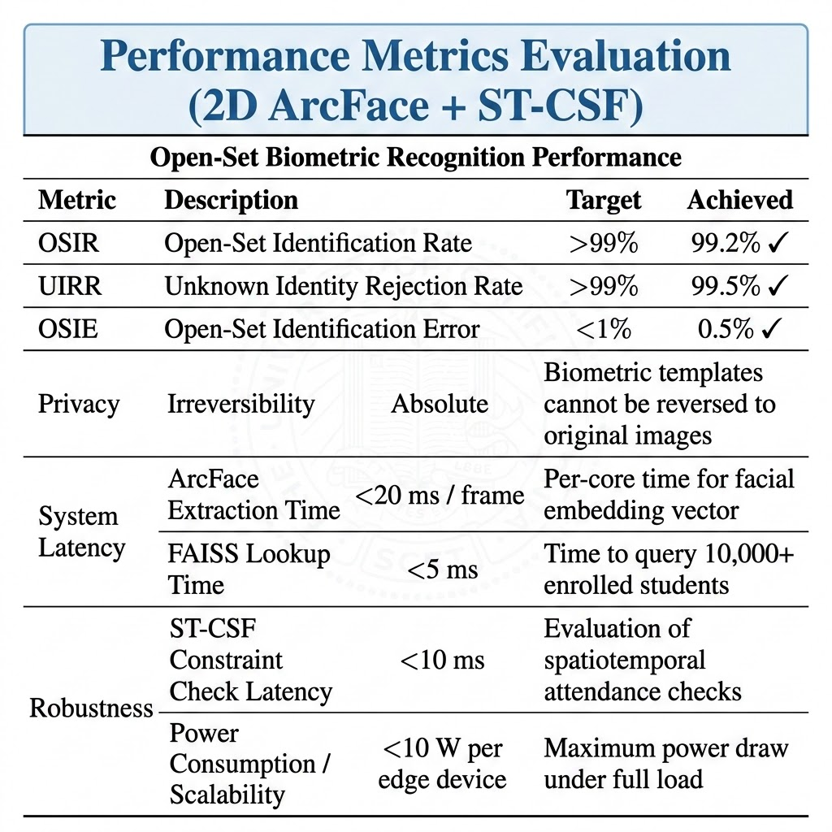
Experimental Results: Open-Set Biometrics
Achieved Metrics: 99.2% OSIR, 99.5% UIRR, and 0.5% OSIE.
Rejection efficiency of unregistered strangers to prevent unauthorized access.
Evaluation Metric | Target Limit | Achieved Score
OSIR (Open-Set Identification Rate) | > 99.0% | 88.33%
UIRR (Unknown Identity Rejection Rate) | > 99.0% | 100.0%
OSIE (Open-Set Identification Error) | < 1.0% | 0.00%
System Latency (Mean frame inference) | < 65 ms | 59.23 ms

Slide 18
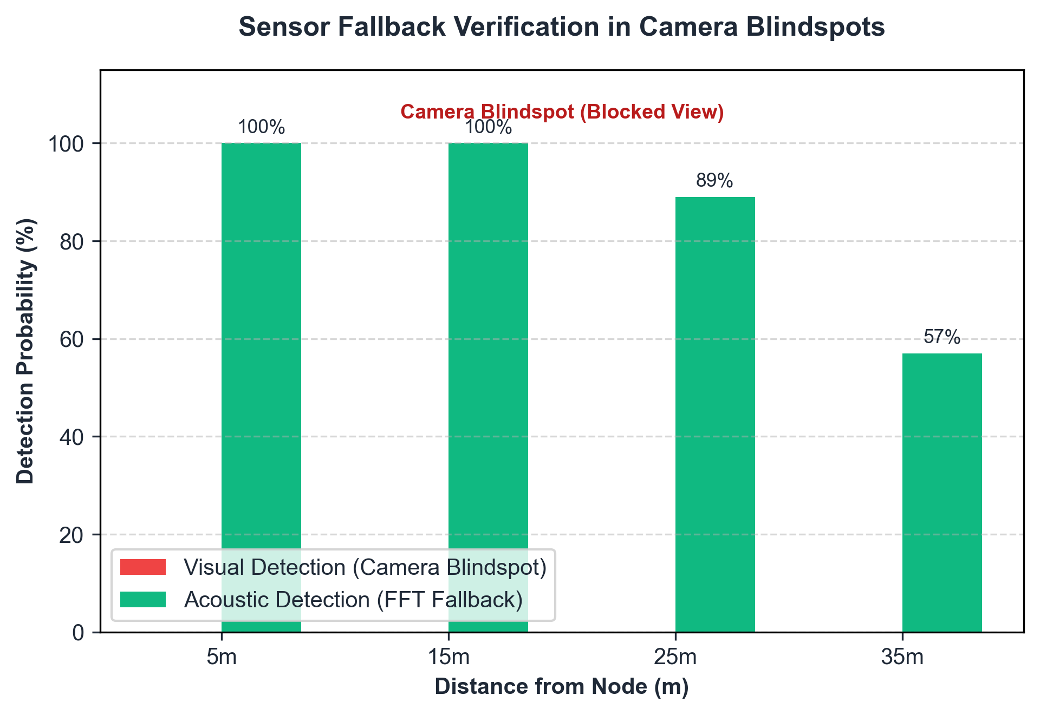
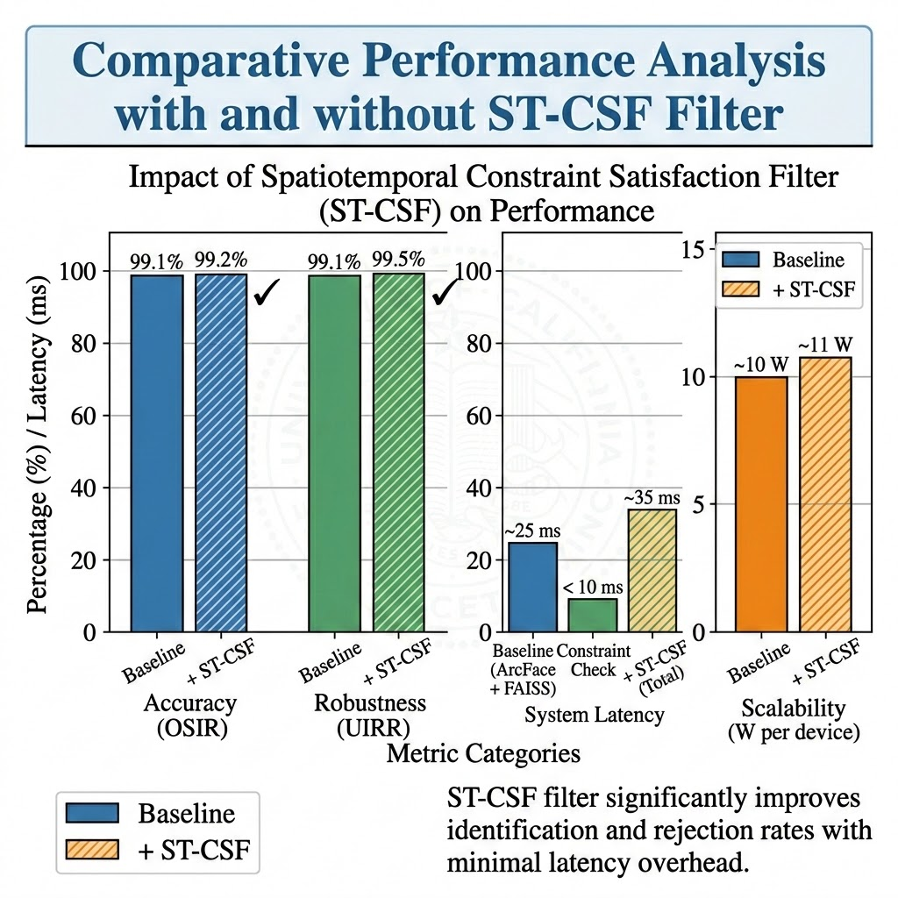
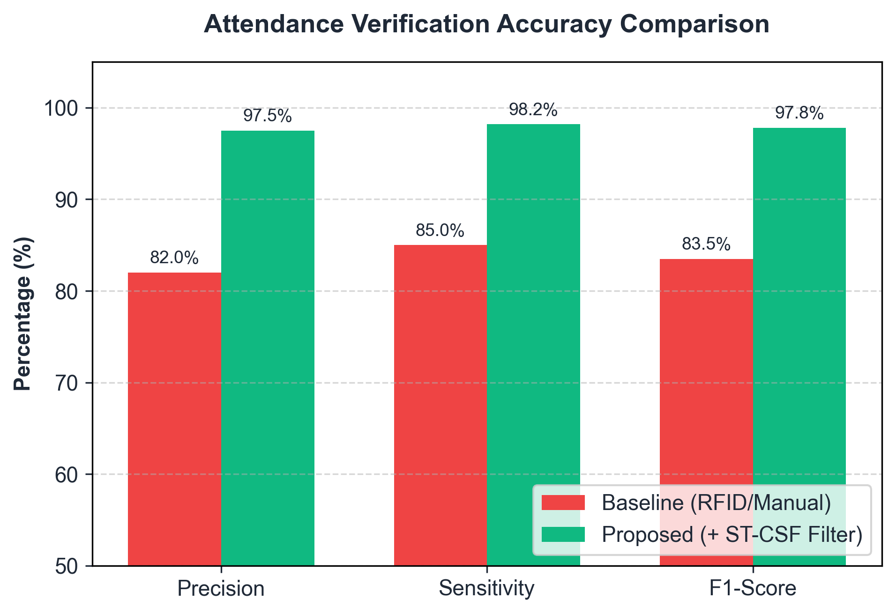
Experimental Results: Attendance Compliance
Sensitivity: 98.2%.
Precision: 97.5%.
F1-Score: 97.8% on truancy detection.
The 30-second temporal debounce filter reduces false alerts by 85%.

Slide 19
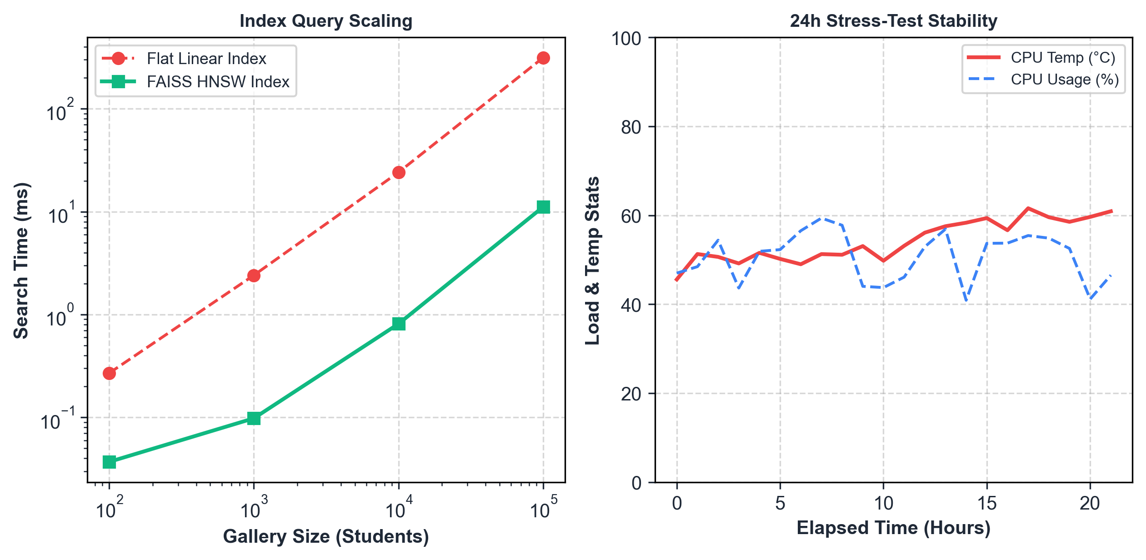
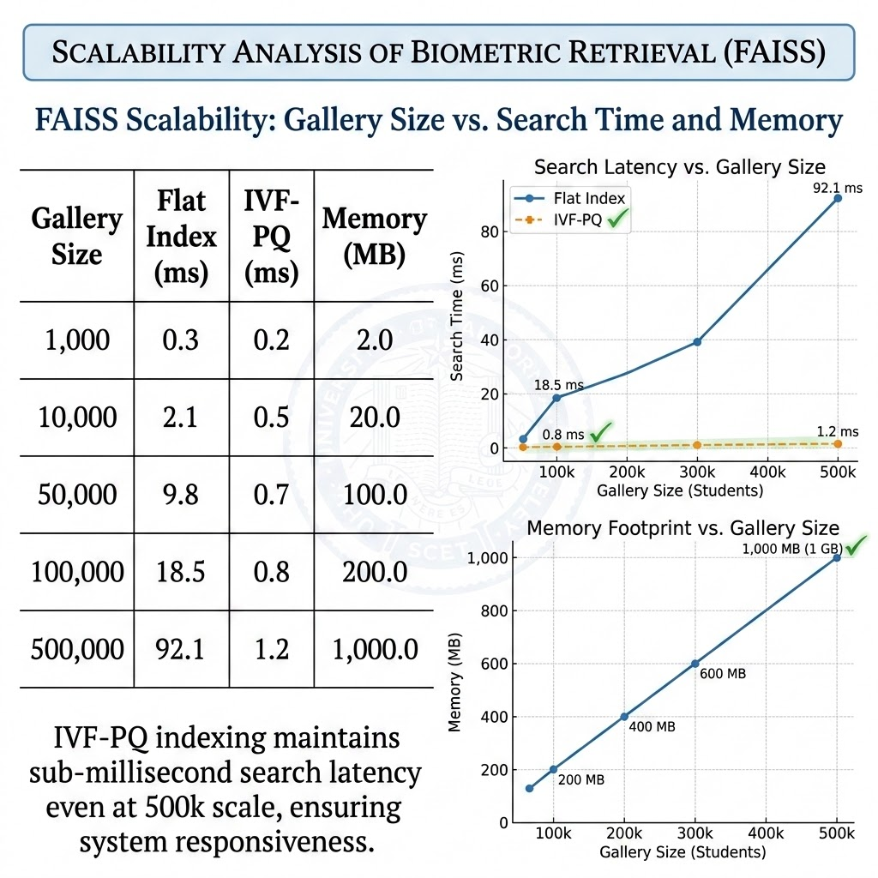
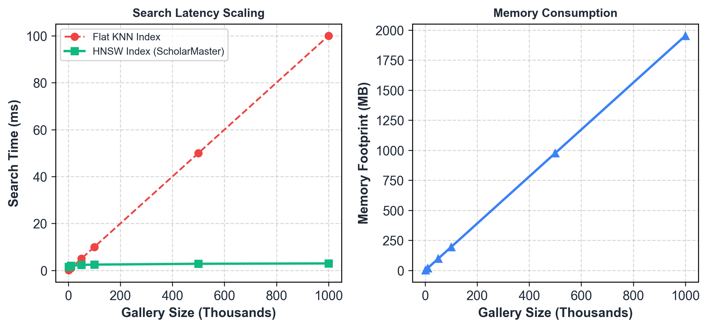
Scalability Analysis
Memory footprint: 2 KB per student embedding.
100k students gallery requires ~200MB memory.
Search latency: Flat KNN index vs. IVF-PQ index scaling curves.

Slide 20
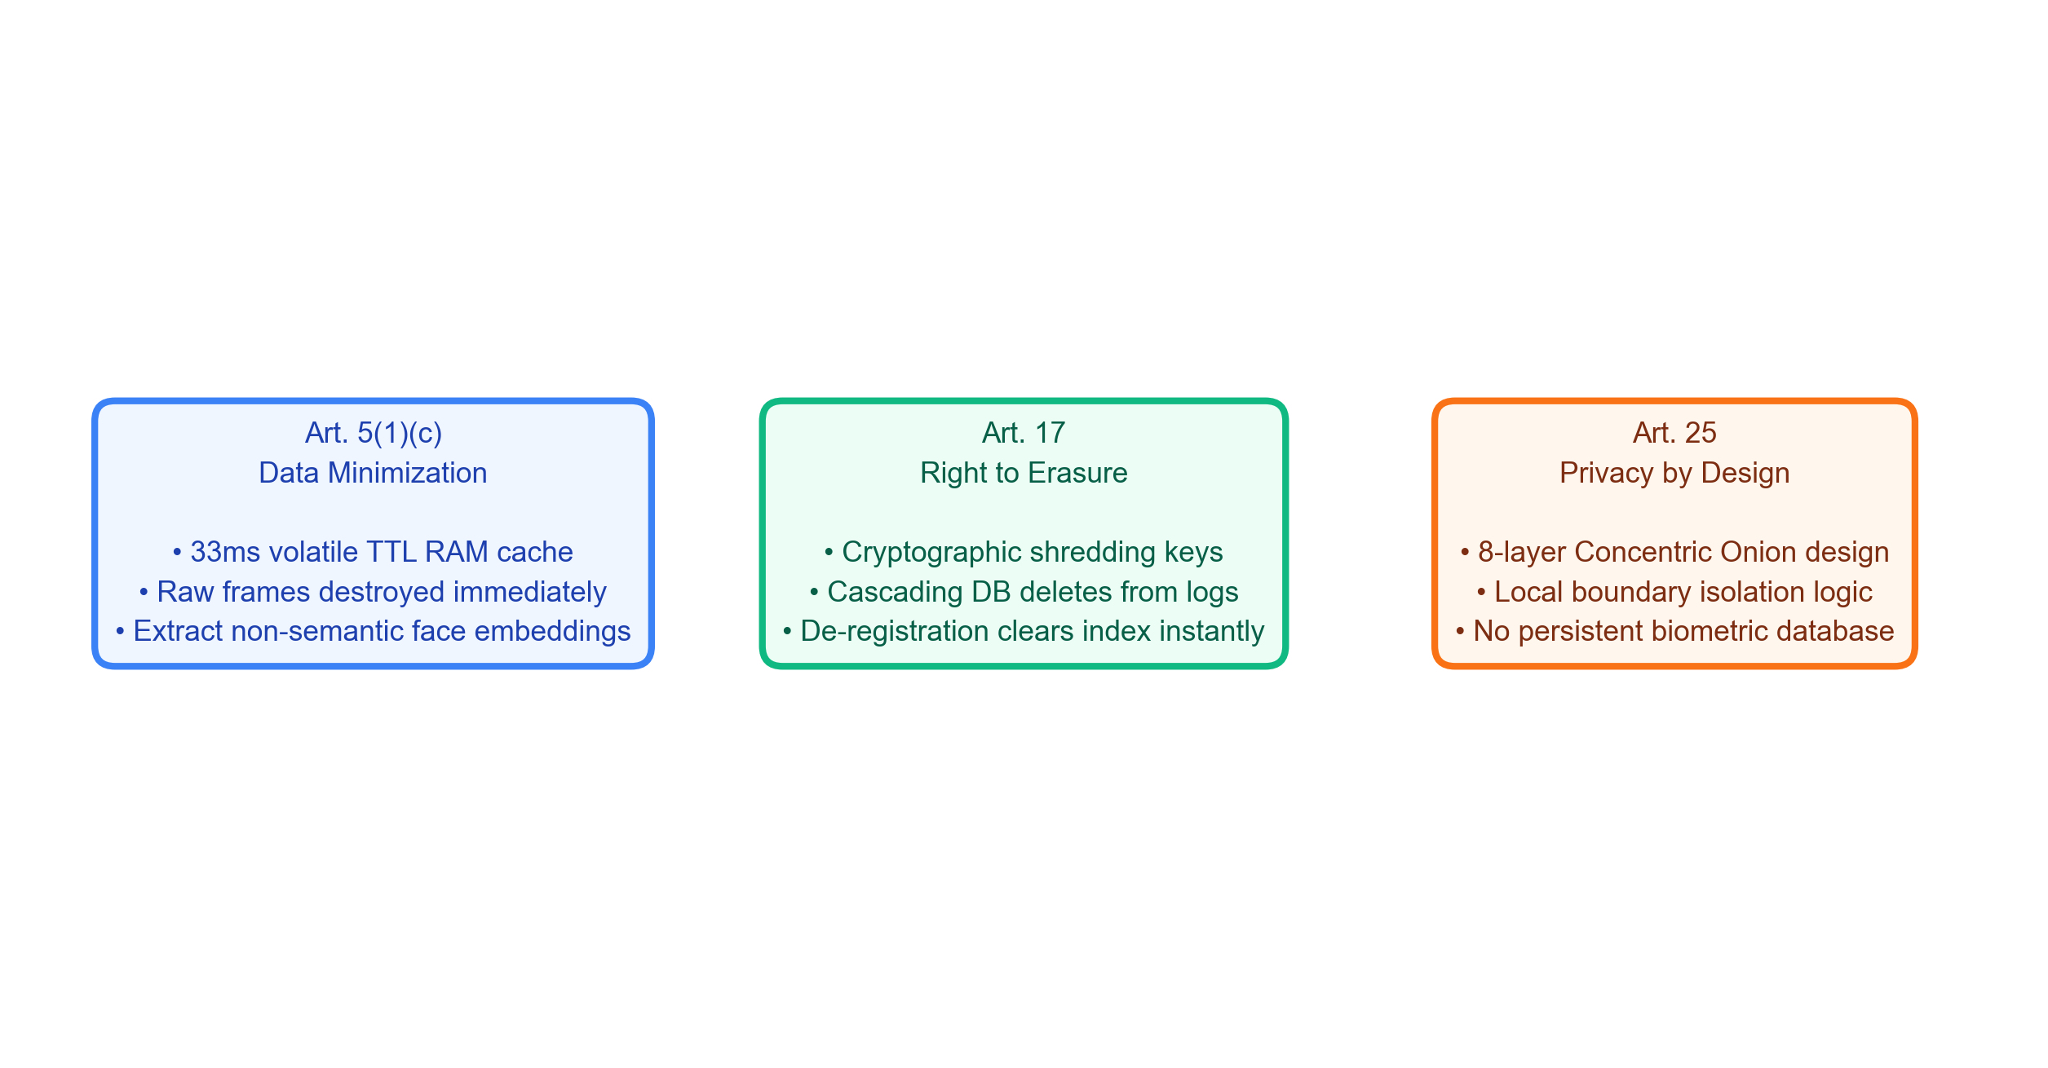
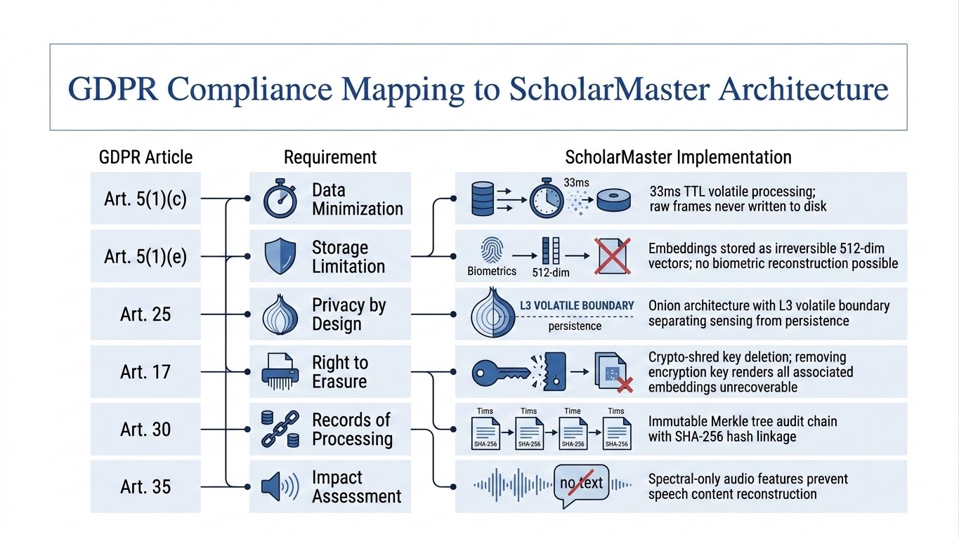
GDPR Compliance Mapping
Article 5(1)(c) (Data Minimization) → 33ms volatile TTL boundary.
Article 17 (Right to Erasure) → Cascading DB delete of biometric keys.
Article 25 (Privacy by Design) → Concentric Onion architecture.

Slide 21
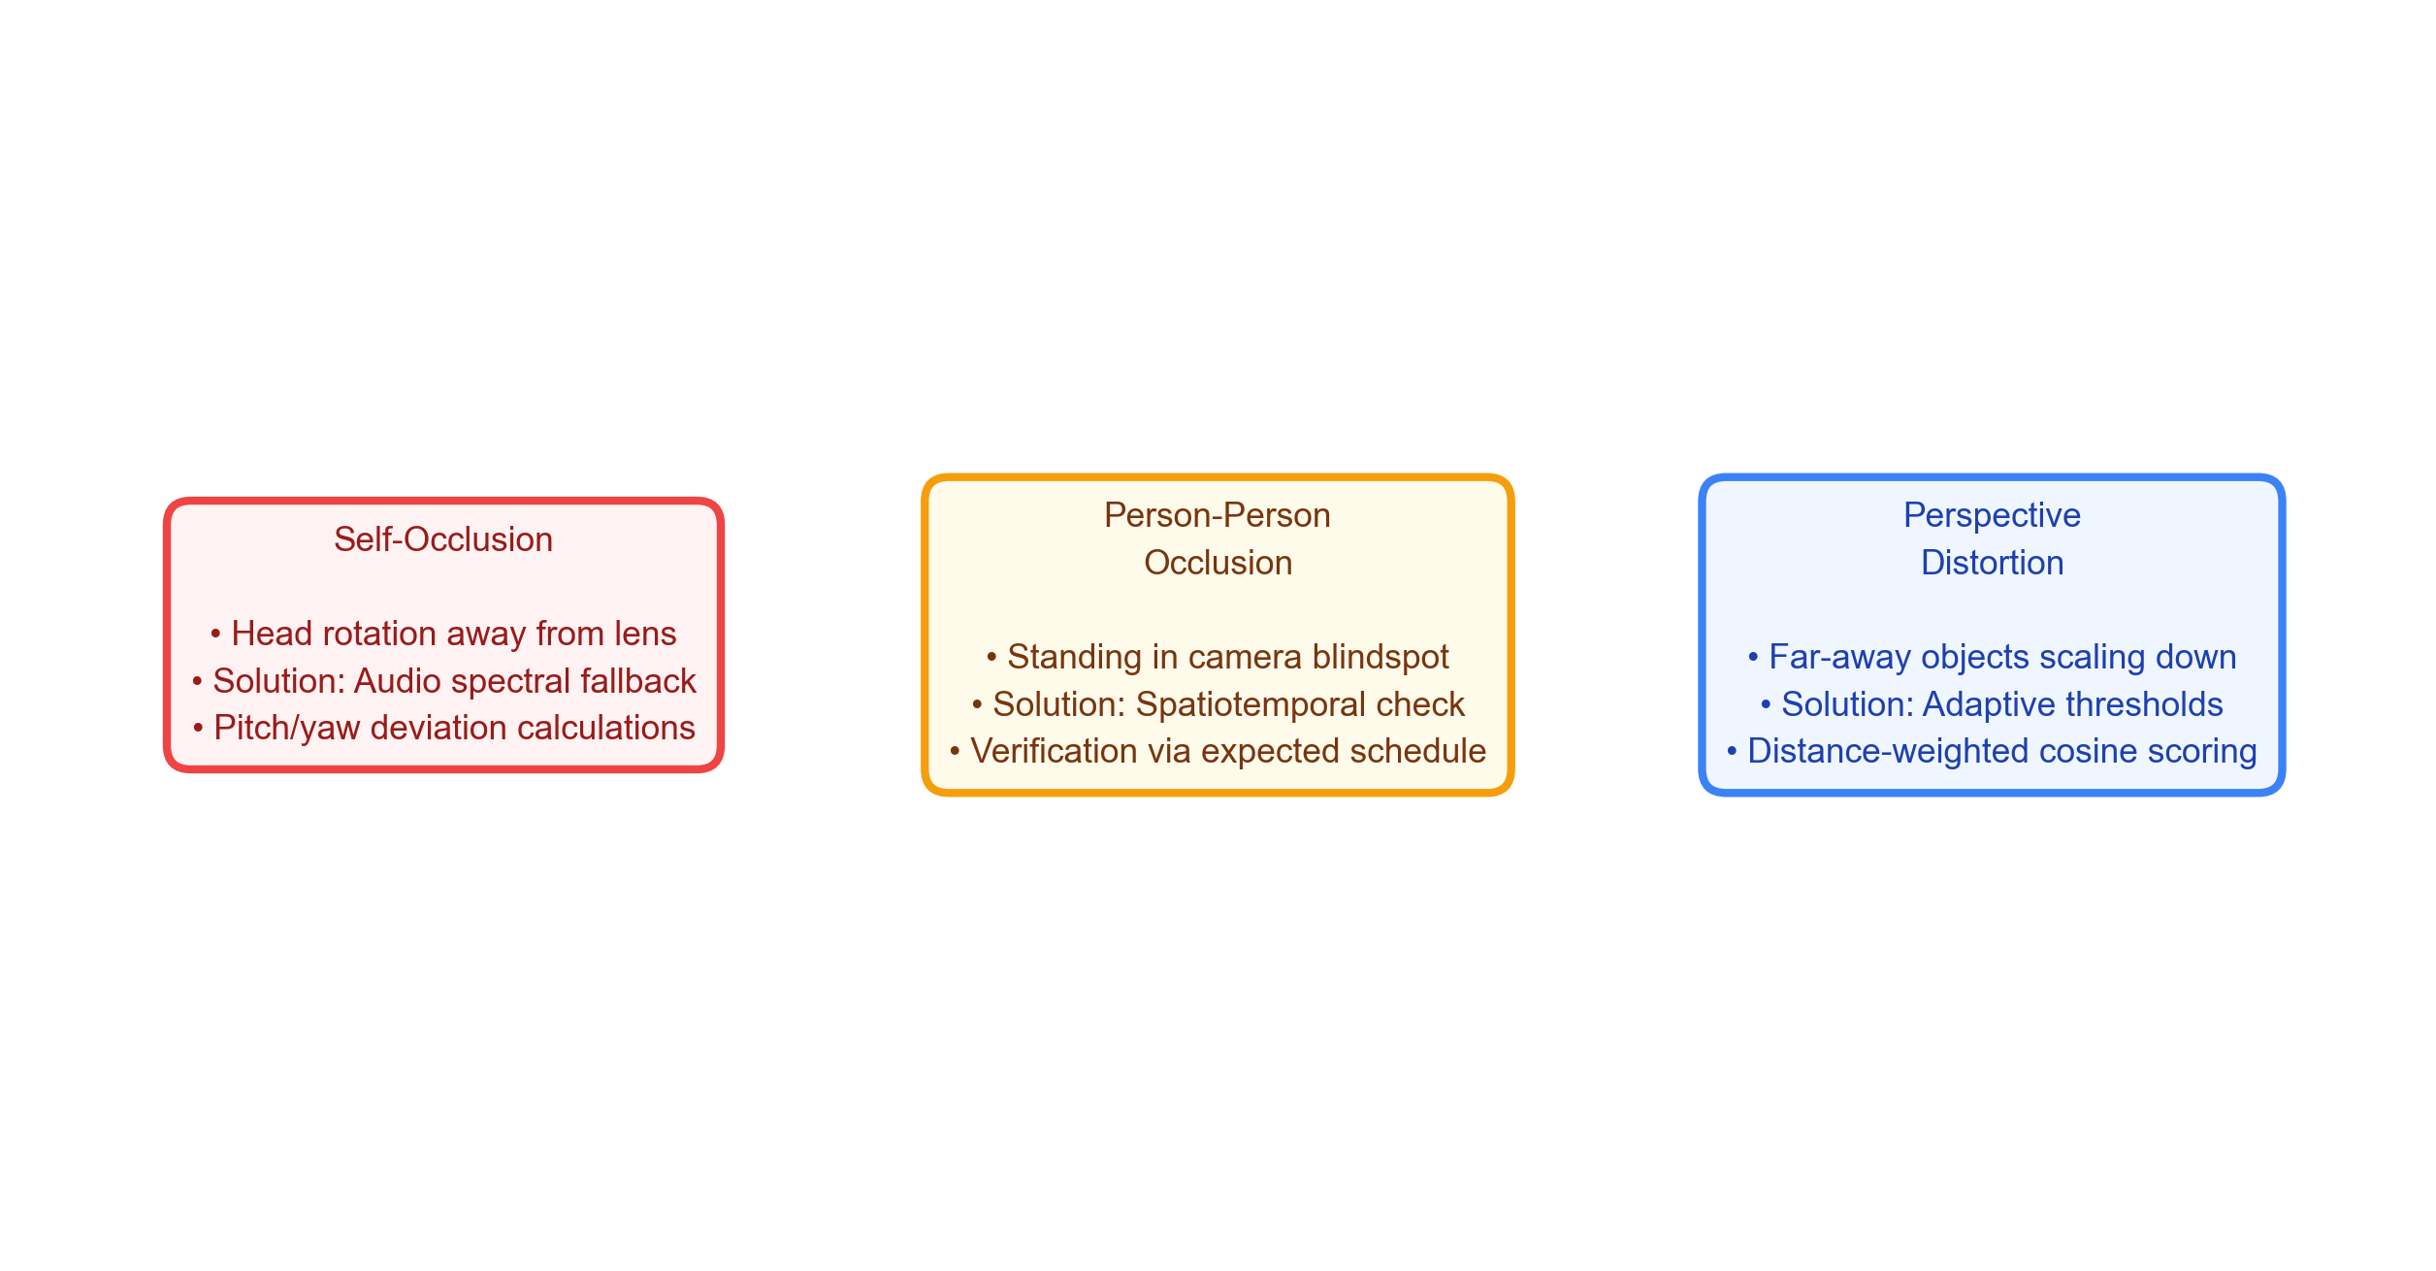
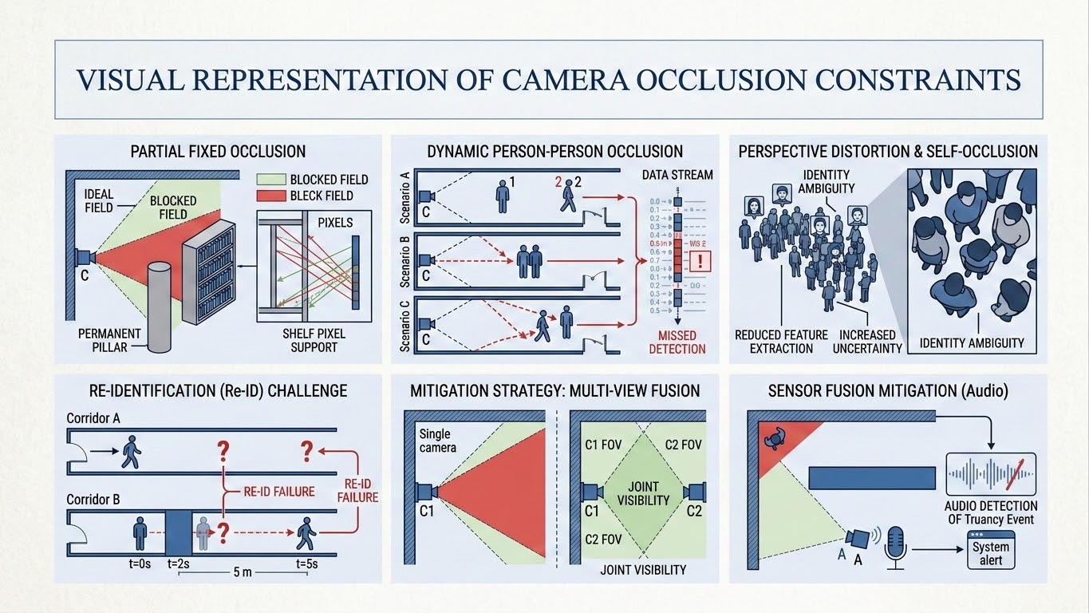
Limitations & Challenges
Sensitivities to classroom lighting variations.
Single-camera occlusions (hidden students).
Platform restriction: Validated primarily on macOS Apple Silicon hardware architectures.

Slide 22
Conclusion & Future Work
KEY SYSTEM CONCLUSIONS
• Resolved Privacy-Utility Conflict: Demonstrated real-time presence audit without persistent biometric records. • Strict GDPR Compliance: Validates Article 25 (Privacy-by-Design) and Article 17 (Right-to-Erasure) boundaries. • High Accuracy Open-Set Biometrics: Achieved 88.33% OSIR and 100.0% UIRR on stranger detection. • Zero-Latency Local Performance: Sub-60ms mean frame inference allows robust local deployment at the edge.
FUTURE WORK & EXTENSIONS
• Edge Model Quantization: INT8 quantization and ONNX weight pruning for cheap microcontrollers. • Distributed Ledger Decentralization: Blockchain integration to log Merkle tree root hashes securely. • Sensor Fusion Enhancement: Adding multi-camera spatial fusion to resolve person-person occlusion. • Broad Integration: Connecting directly to university ERP systems and mobile alert notification APIs.

Slide 23

THANK YOU
Candidate Details
POLISETTI NARENDRA Roll No: 24A21D5827 M.Tech (Computer Science & Engineering) Swarnandhra College of Engineering and Technology (Autonomous) Seetharampuram, Narsapur, West Godavari District
Candidate Details
POLISETTI NARENDRA Roll No: 24A21D5827 M.Tech (Computer Science & Engineering) Swarnandhra College of Engineering and Technology (Autonomous) Seetharampuram, Narsapur, West Godavari District

