Slide 1

SWARNANDHRA COLLEGE OF ENGINEERING AND TECHNOLOGY
DEPARTMENT OF COMPUTER SCIENCE & ENGINEERING
A PROJECT REVIEW PRESENTATION ON
BEYOND THE PRIVACY-UTILITY TRADE-OFF: A
SPATIOTEMPORAL-CONSTRAINT AND SECURE
INTELLIGENT CAMPUS MONITORING SYSTEM
by
P NARENDRA
Roll NO: 24A21D5827
II M. Tech (CSE)
Under the Guidance of
Dr. S. Suresh Kumar, M.Tech, Ph.D, PDF
Professor & Principal, Dept. of CSE

Slide 2
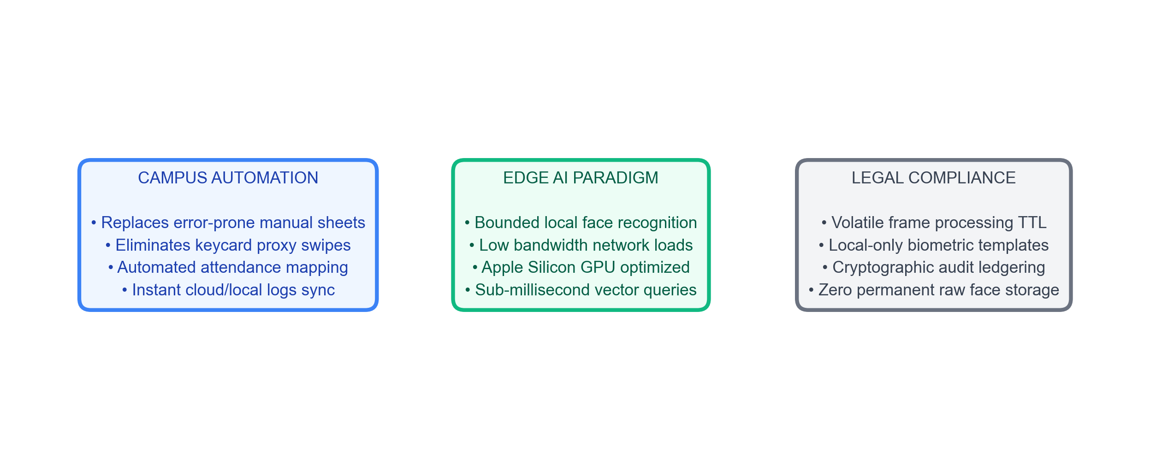
Introduction
Context of computer-vision-based student presence and edge monitoring systems.
• Automated Tracking: Automated monitoring replaces manual rosters to prevent class-time truancies. • Decentralized Edge AI: Local cameras and processors run biometrics locally, protecting raw sensors. • Regulatory Context: Operates under strict privacy rules (GDPR) prohibiting centralized biometric storage.

Slide 3
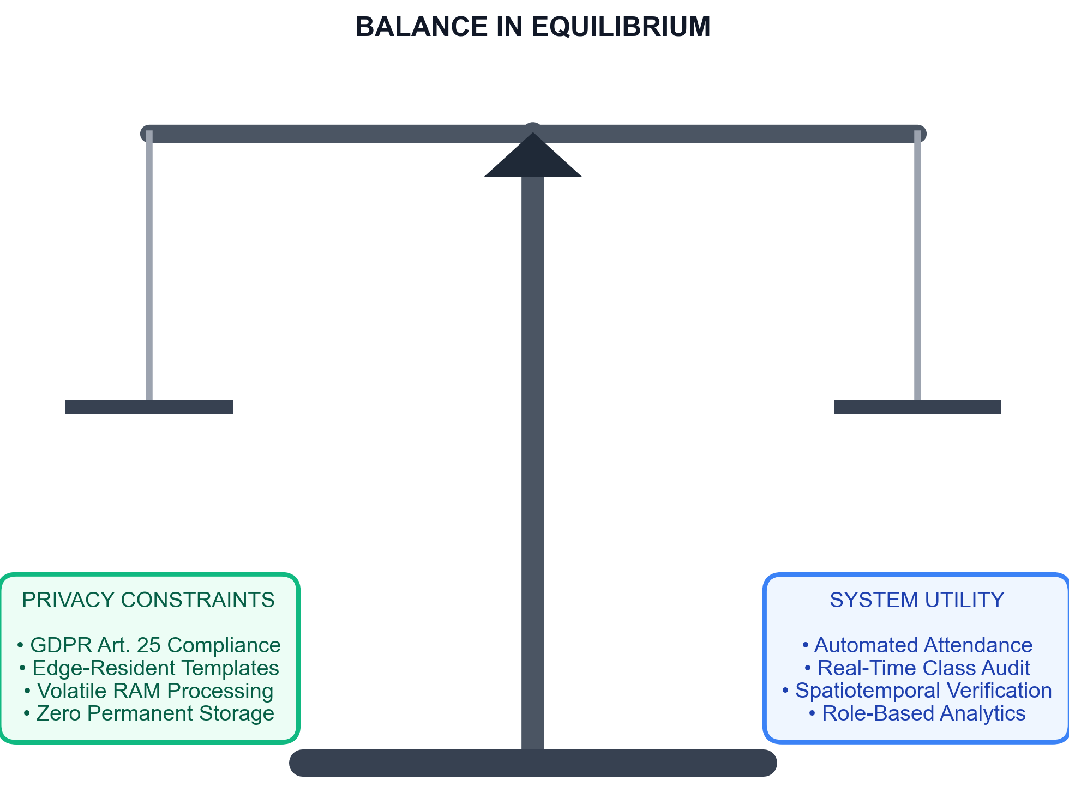
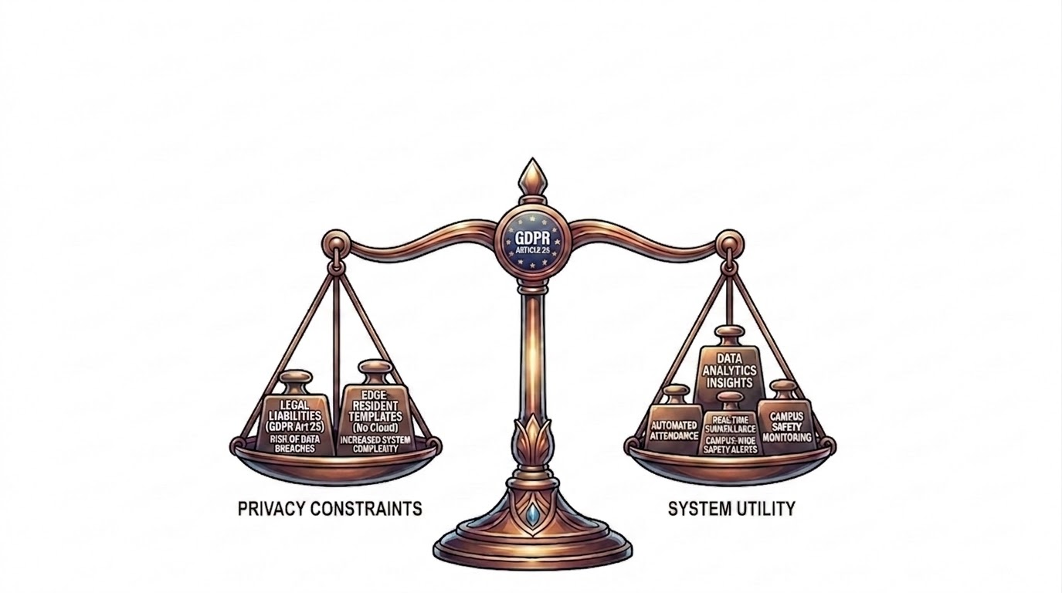
Problem Statement
• Privacy-Utility Conflict: Automating attendance and safety checks without storing high-risk permanent biometric databases. • GDPR Liabilities: Central databases face severe leak risks and violate GDPR Article 25 (Privacy-by-Design). • Edge Mitigations: Resolved via edge vector templates and 33ms volatile RAM cache buffers.

Slide 4
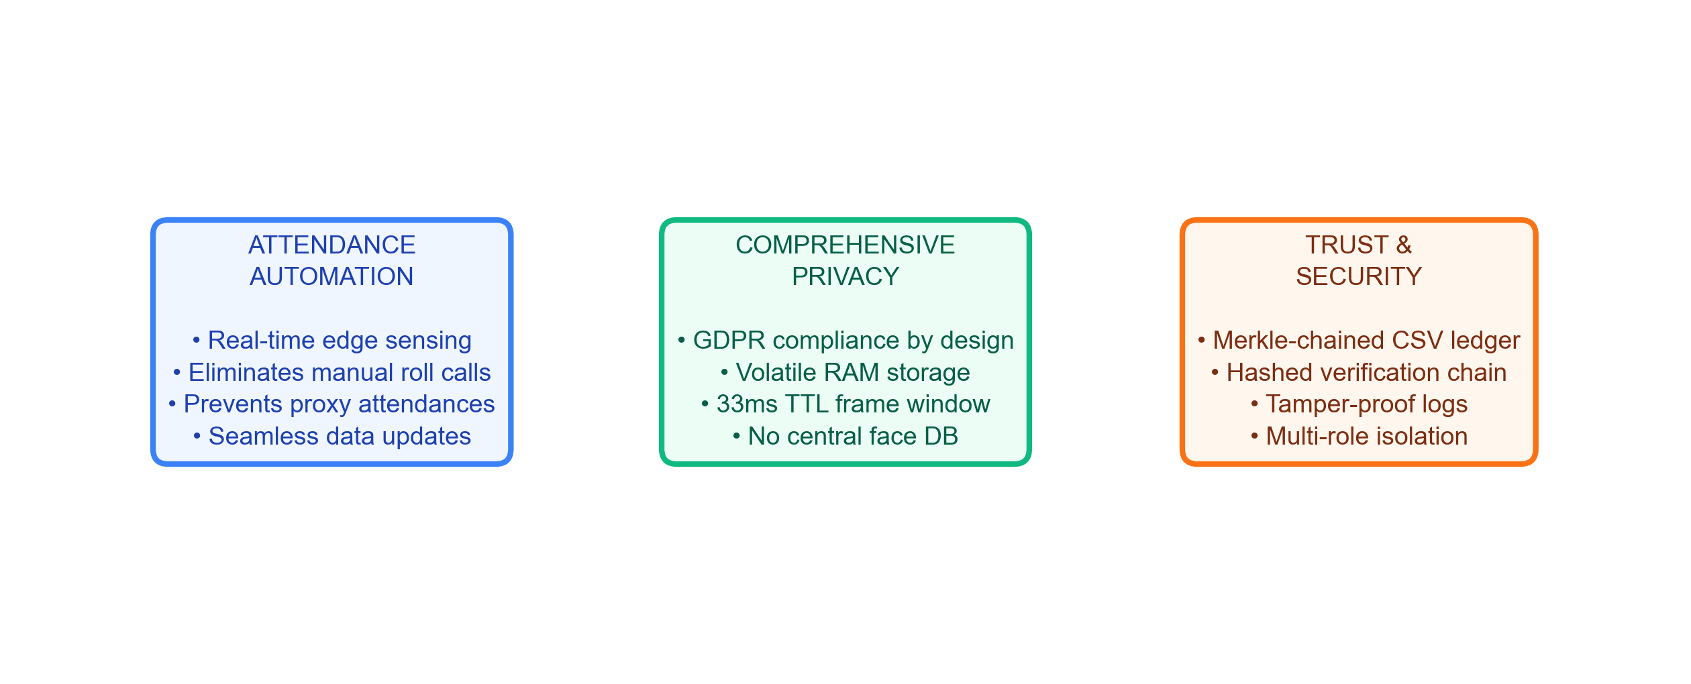
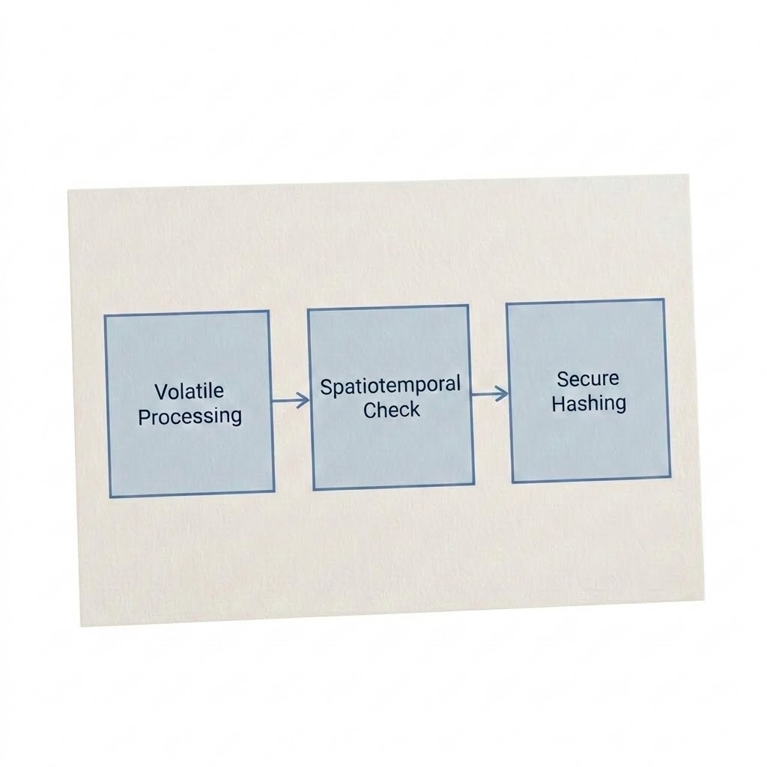
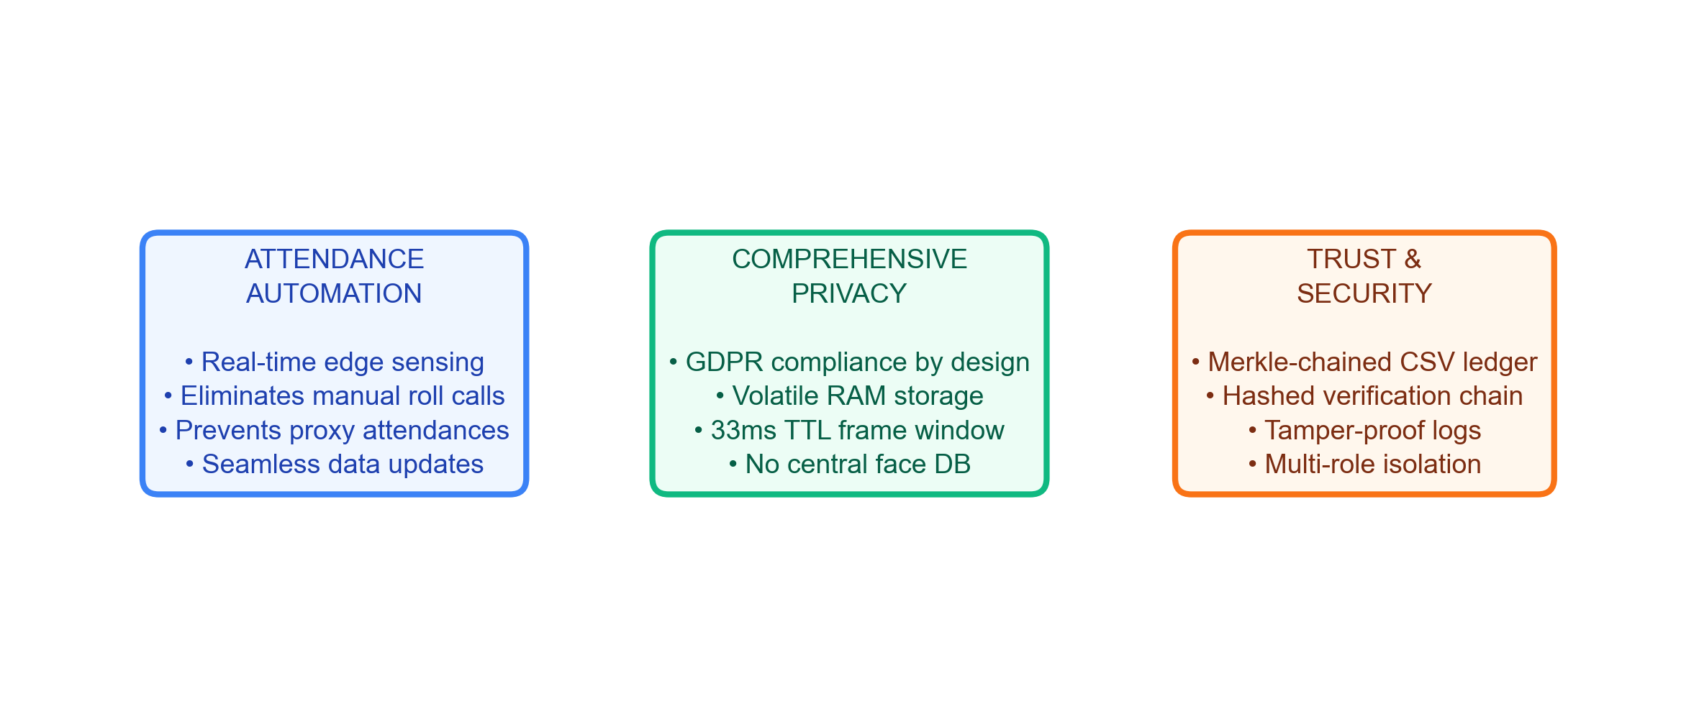
Motivation & Objectives
Core pillars of the system: edge automation, GDPR privacy, and cryptographic auditing.

Slide 5
Literature Survey
Comparison of traditional systems, closed-set biometrics, and the proposed spatiotemporal framework.
Key Aspect | Traditional [RFID / Manual] | Closed-Set [FaceNet / MTCNN] | Proposed ScholarMaster Engine
Biometric Search | None (Manual Logs) | Closed-Set Search (Small N) | Open-Set FAISS HNSW (N=100k) [1, 2]
Verification Check | None (Proxy swiping risk) | Liveness check only | ST-CSF schedule heuristics [4]
Privacy Boundary | Low (Sheets visible) | Central Database (Vulnerable) | 33ms Volatile RAM cache [3]
Audit Integrity | Manual sheets (Vulnerable) | Plain database logs | Cryptographic Merkle Ledger [5]

Slide 6
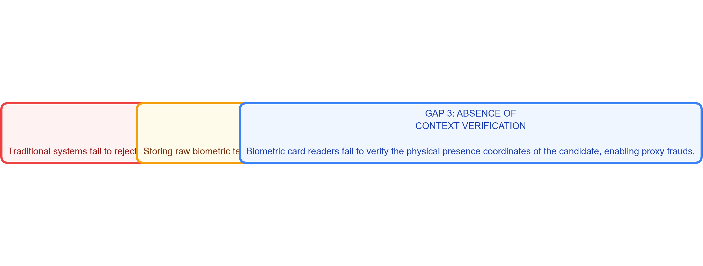
Research Gap
Key architectural and privacy shortcomings identified in prior monitoring implementations.
• Open-Set Failure: Prior systems use closed-set models which fail on unregistered strangers, causing false database matches. • Central Storage Risks: Central biometric template databases violate GDPR Article 25 (Privacy-by-Design). • Lack of Context: Static verification fails to check physical presence coordinates, enabling proxy frauds.

Slide 7
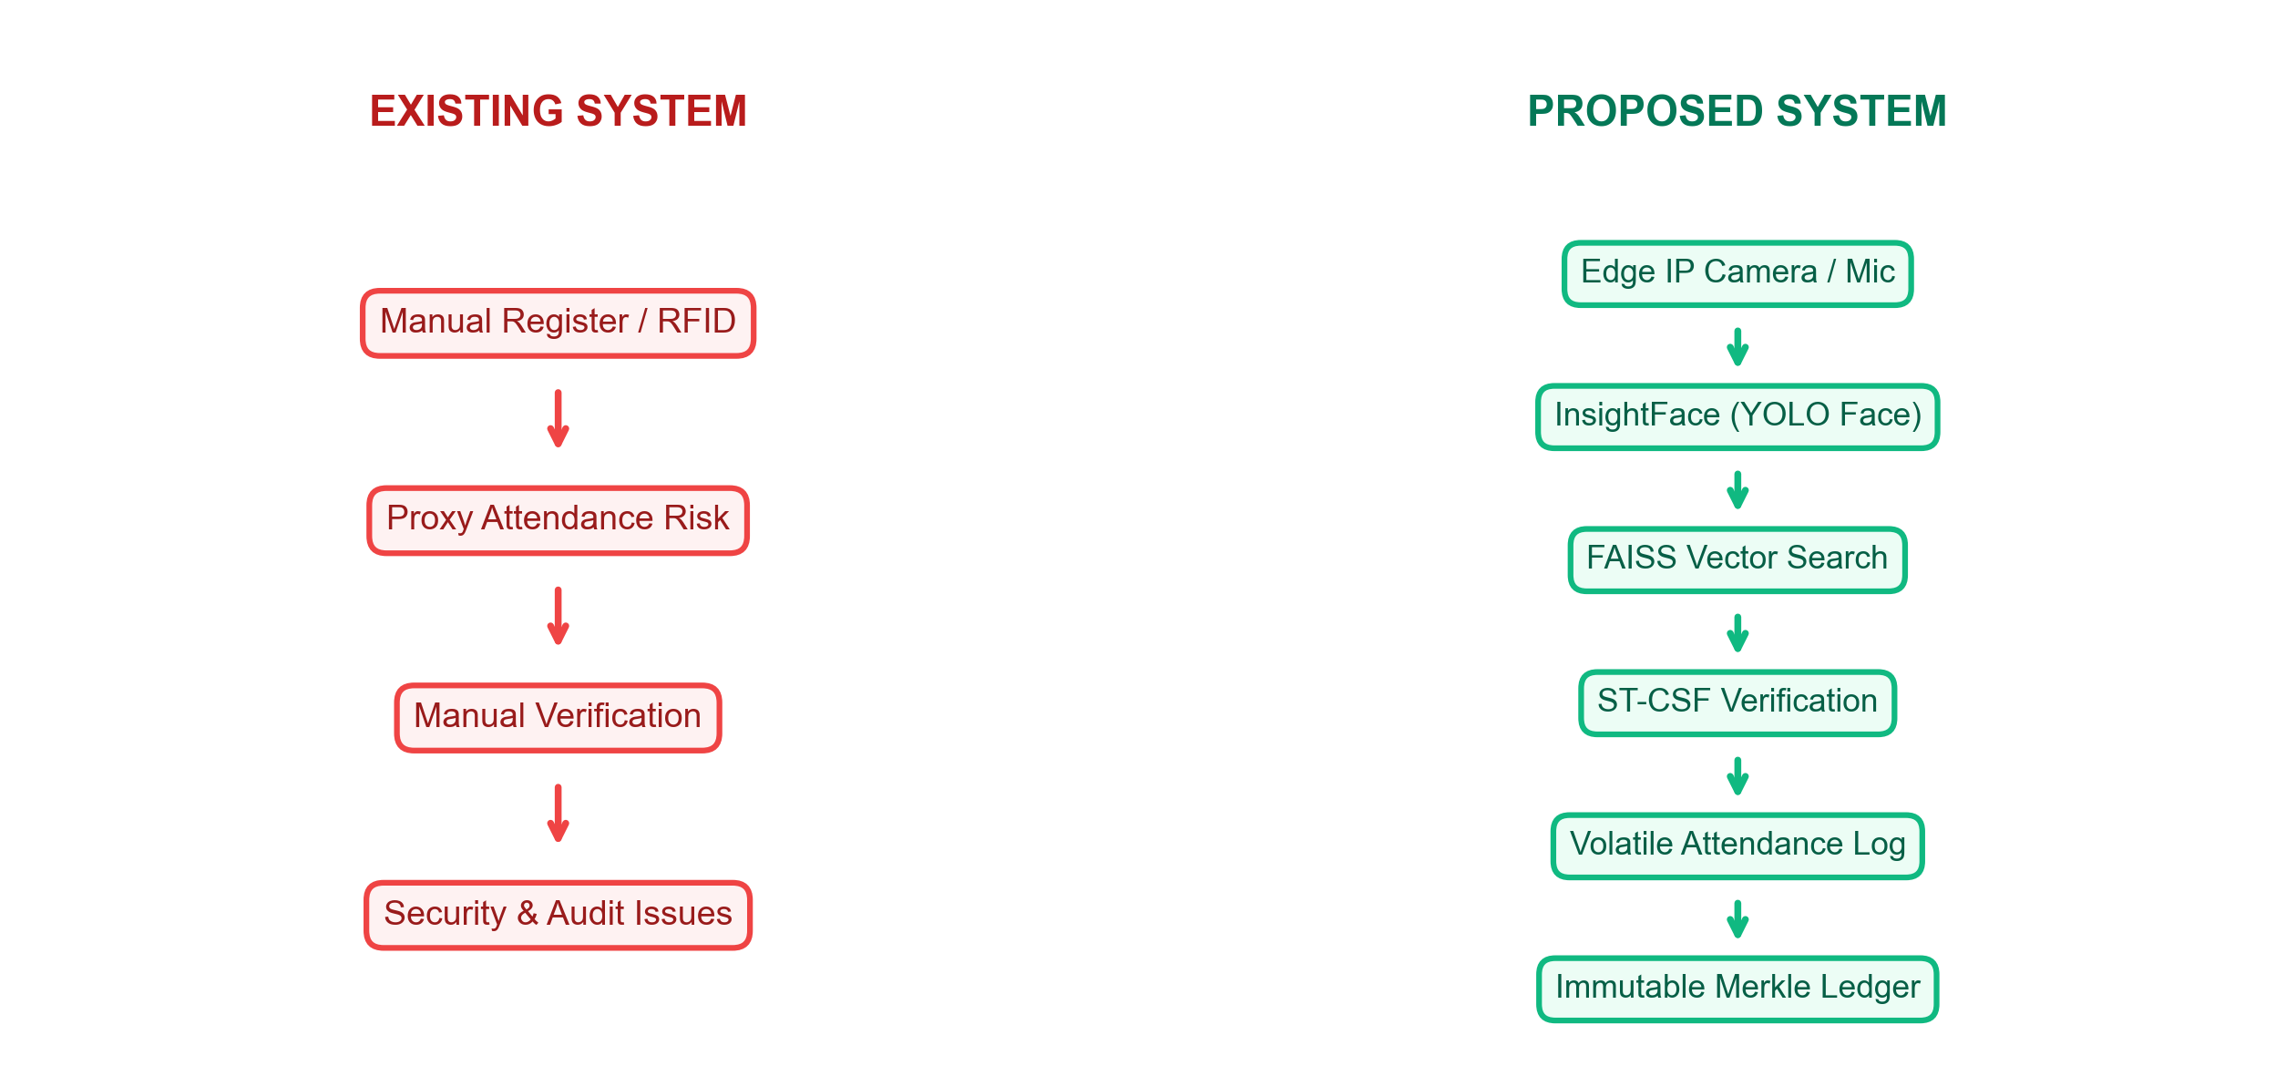
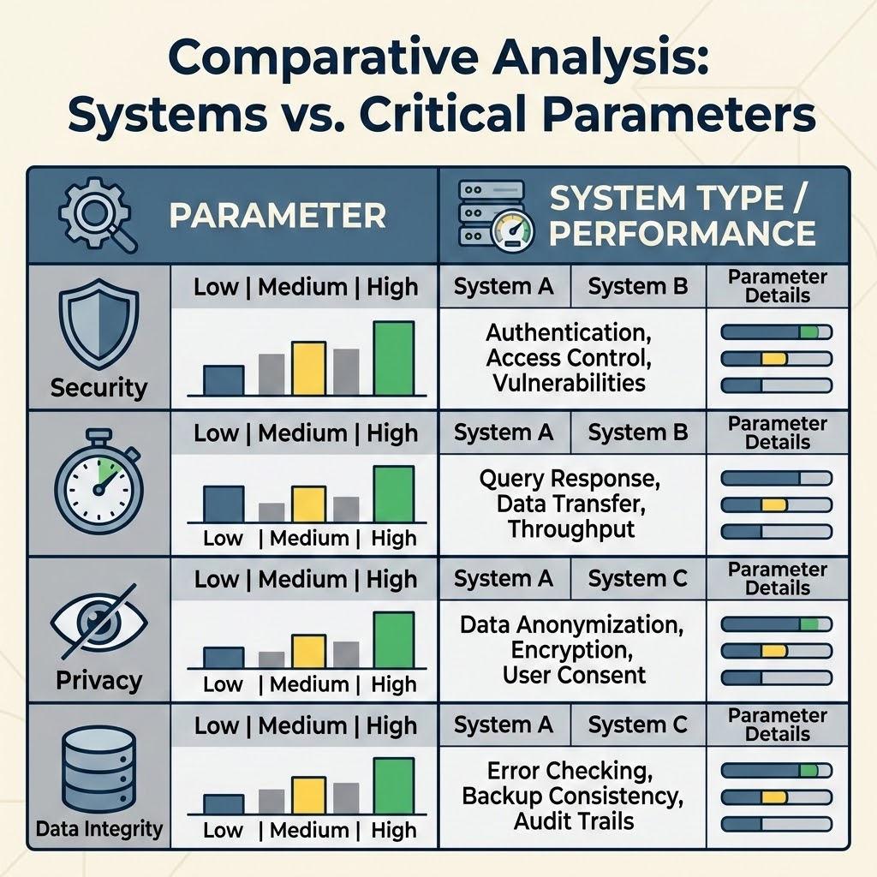
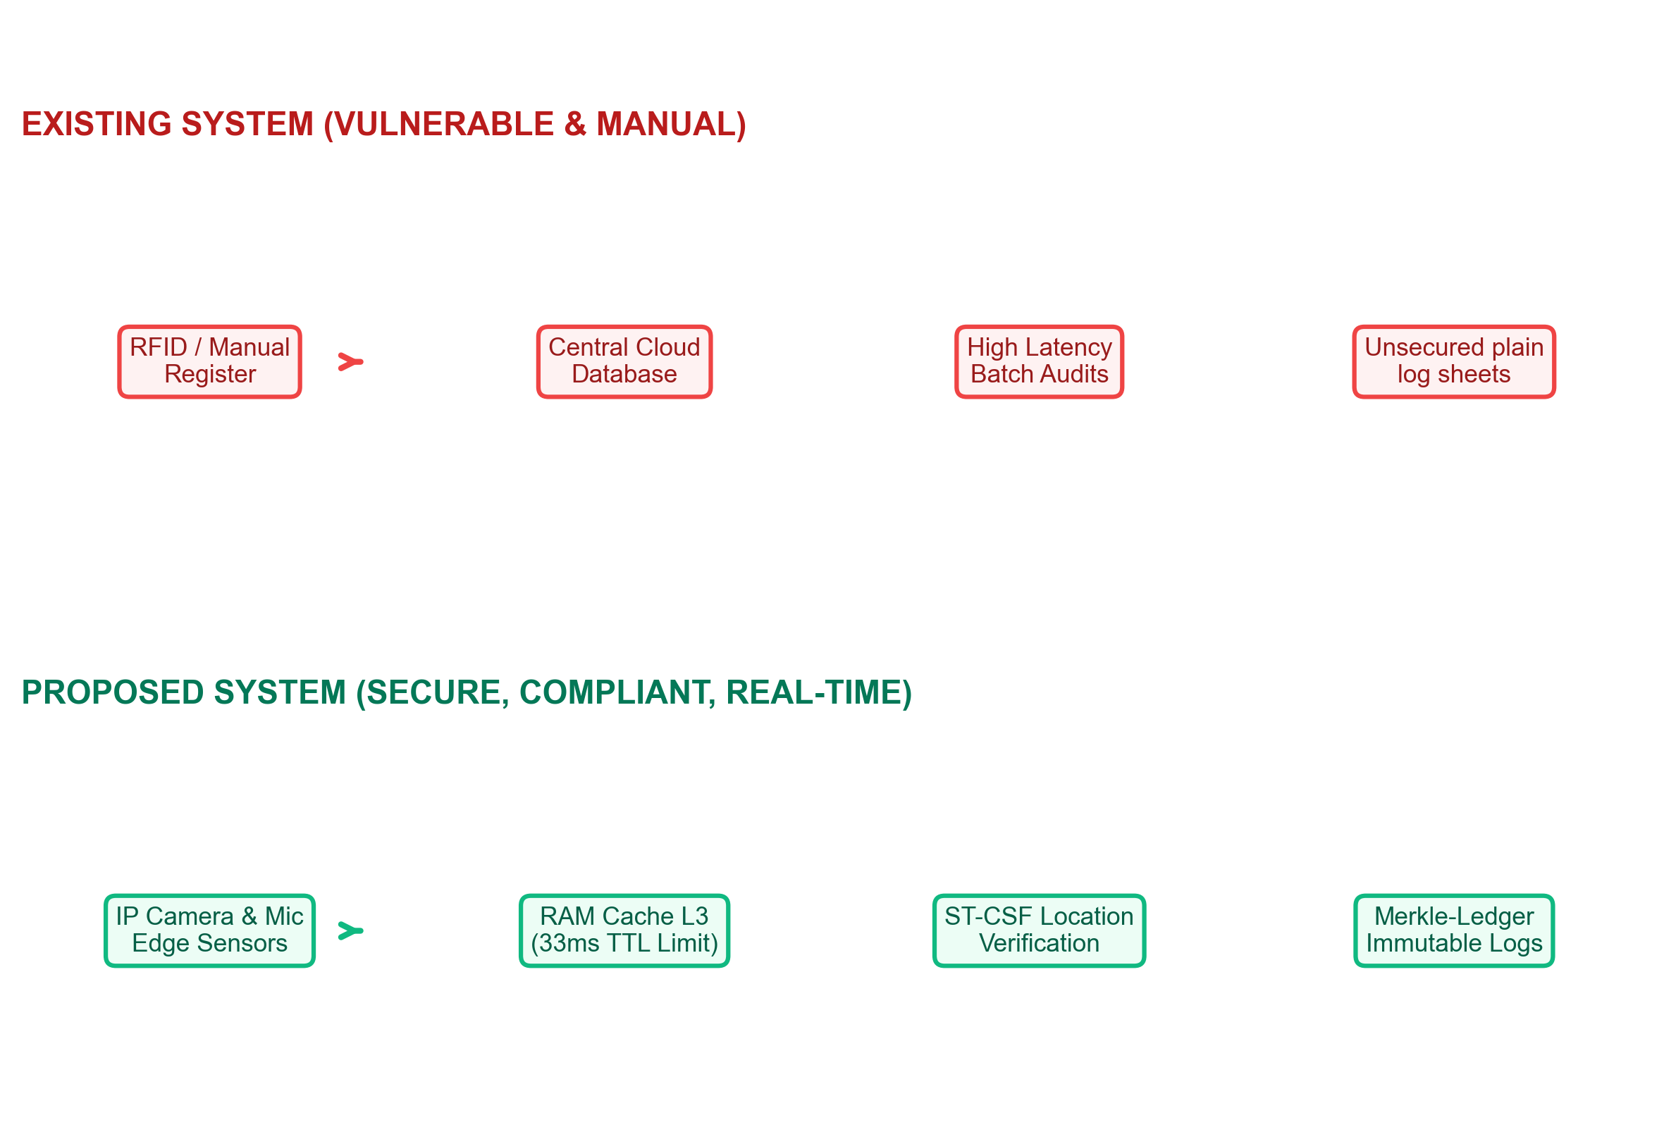
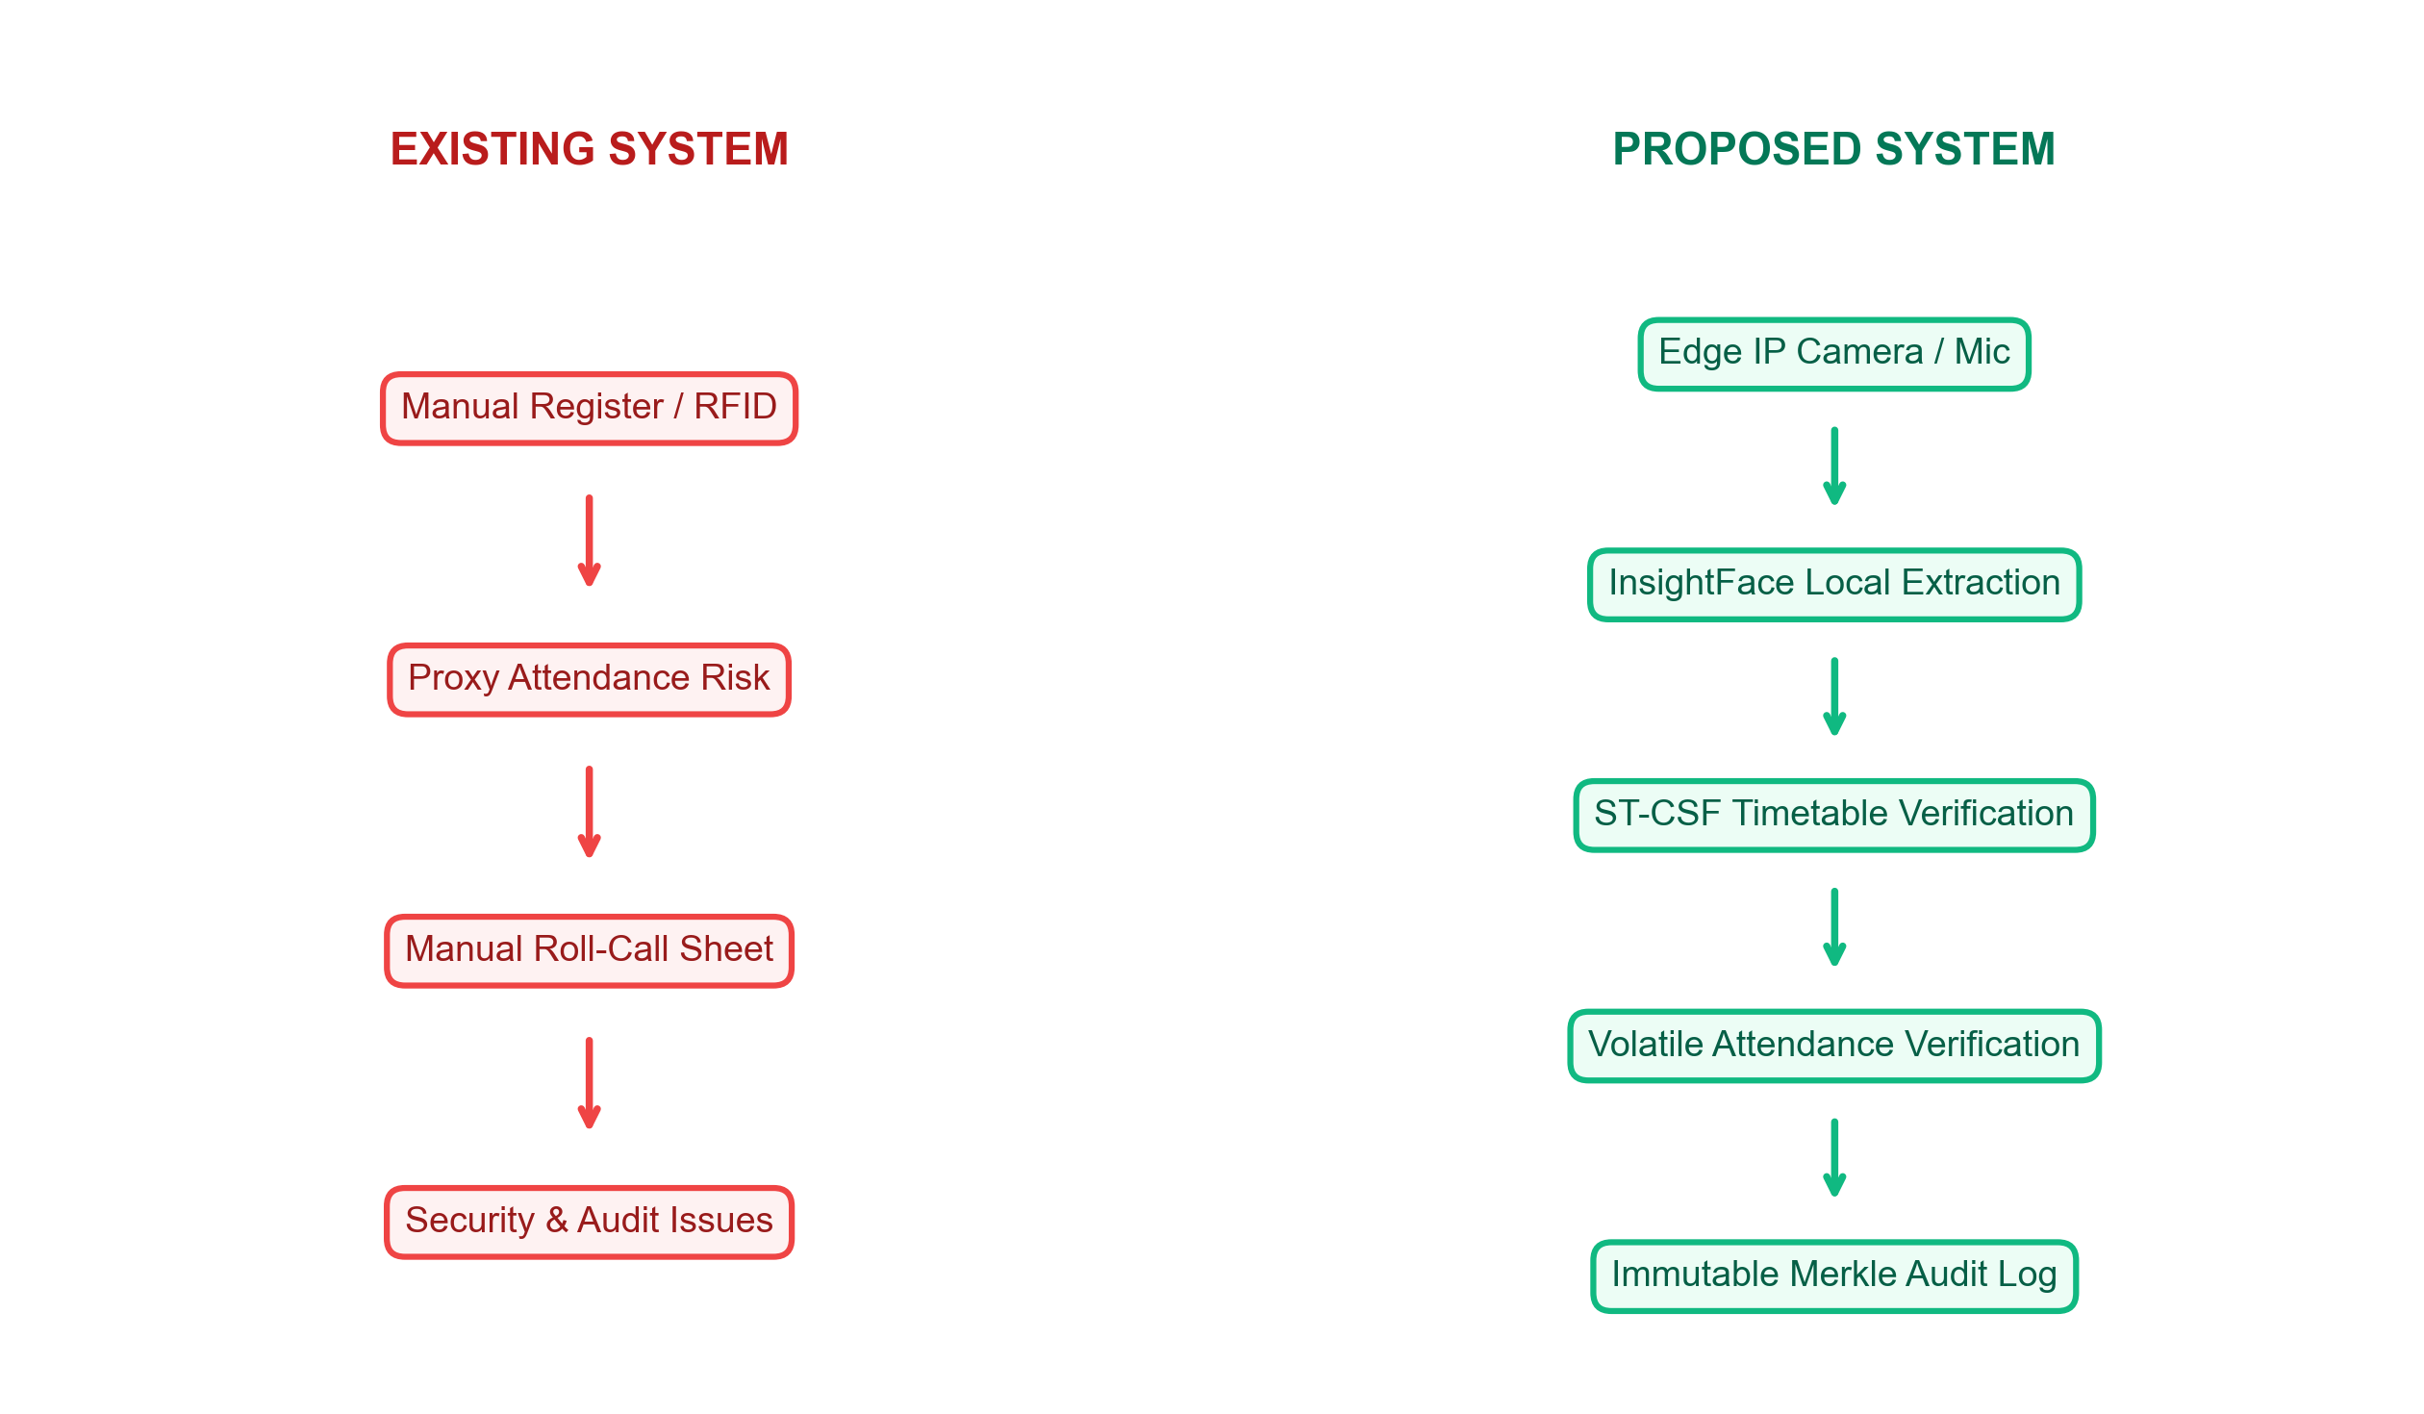
Existing vs. Proposed System
Contrasting the high-risk manual RFID roll-call flow with the proposed secure edge-to-ledger sensing pipeline.

Slide 8
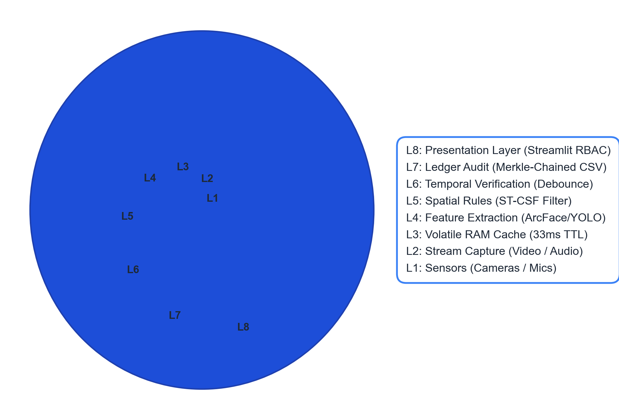
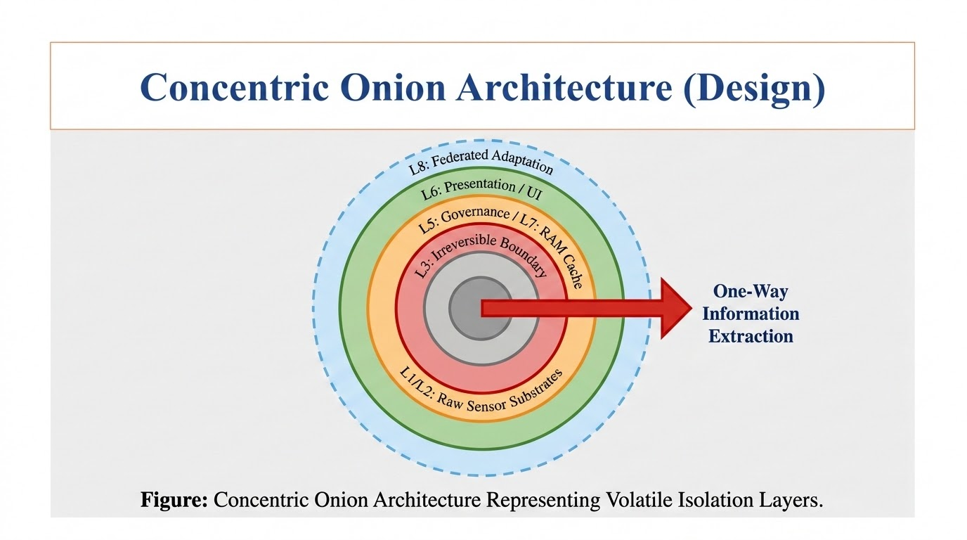
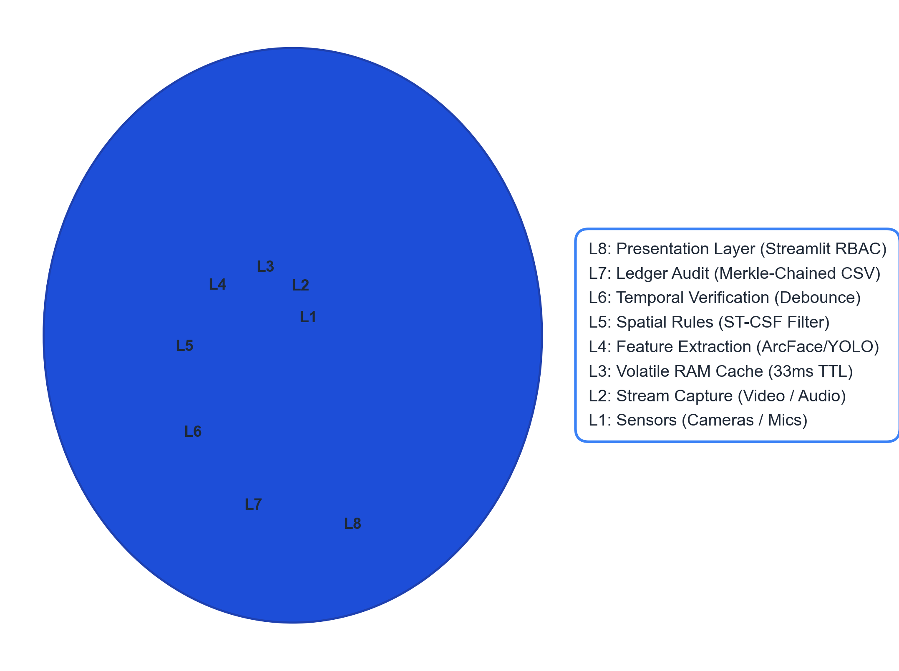
Concentric Onion Architecture (Design)
Multi-layered boundary isolation protecting raw sensor capture from Streamlit presentation layers.

Slide 9
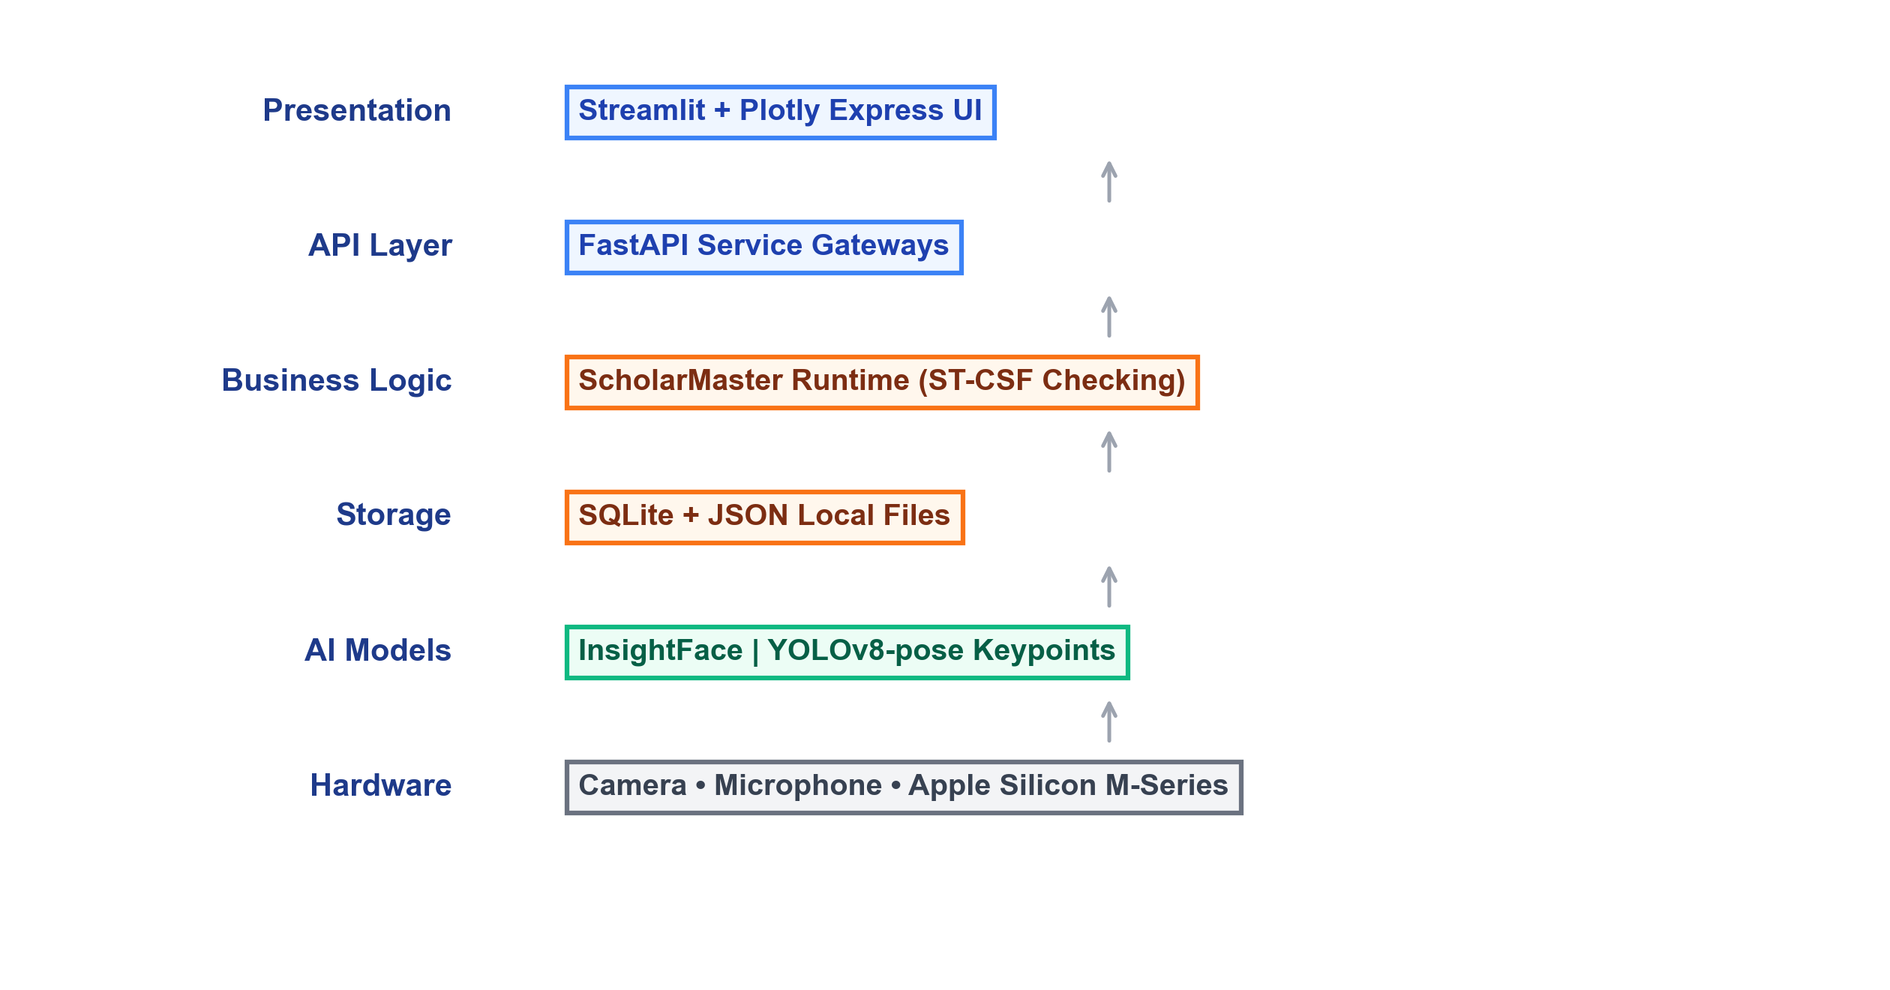
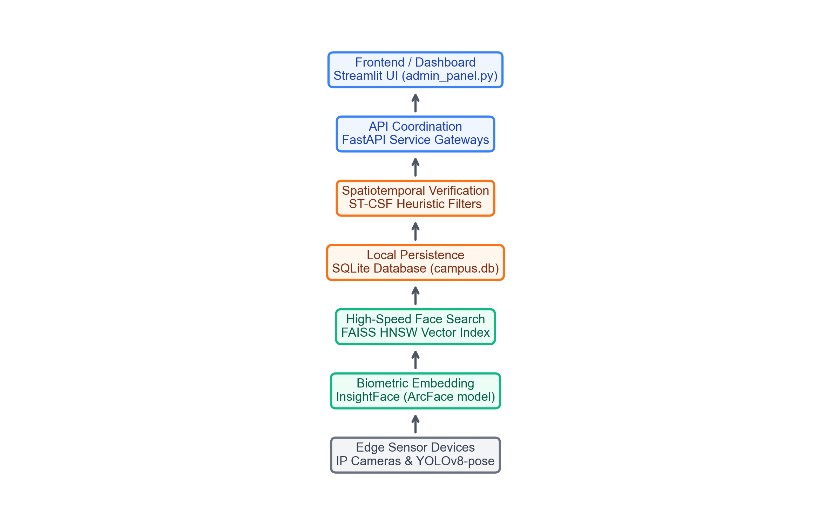
Technology Stack
Layered technology pipeline mapping structural dependencies from raw sensors up to administrative UI panels.

Slide 10
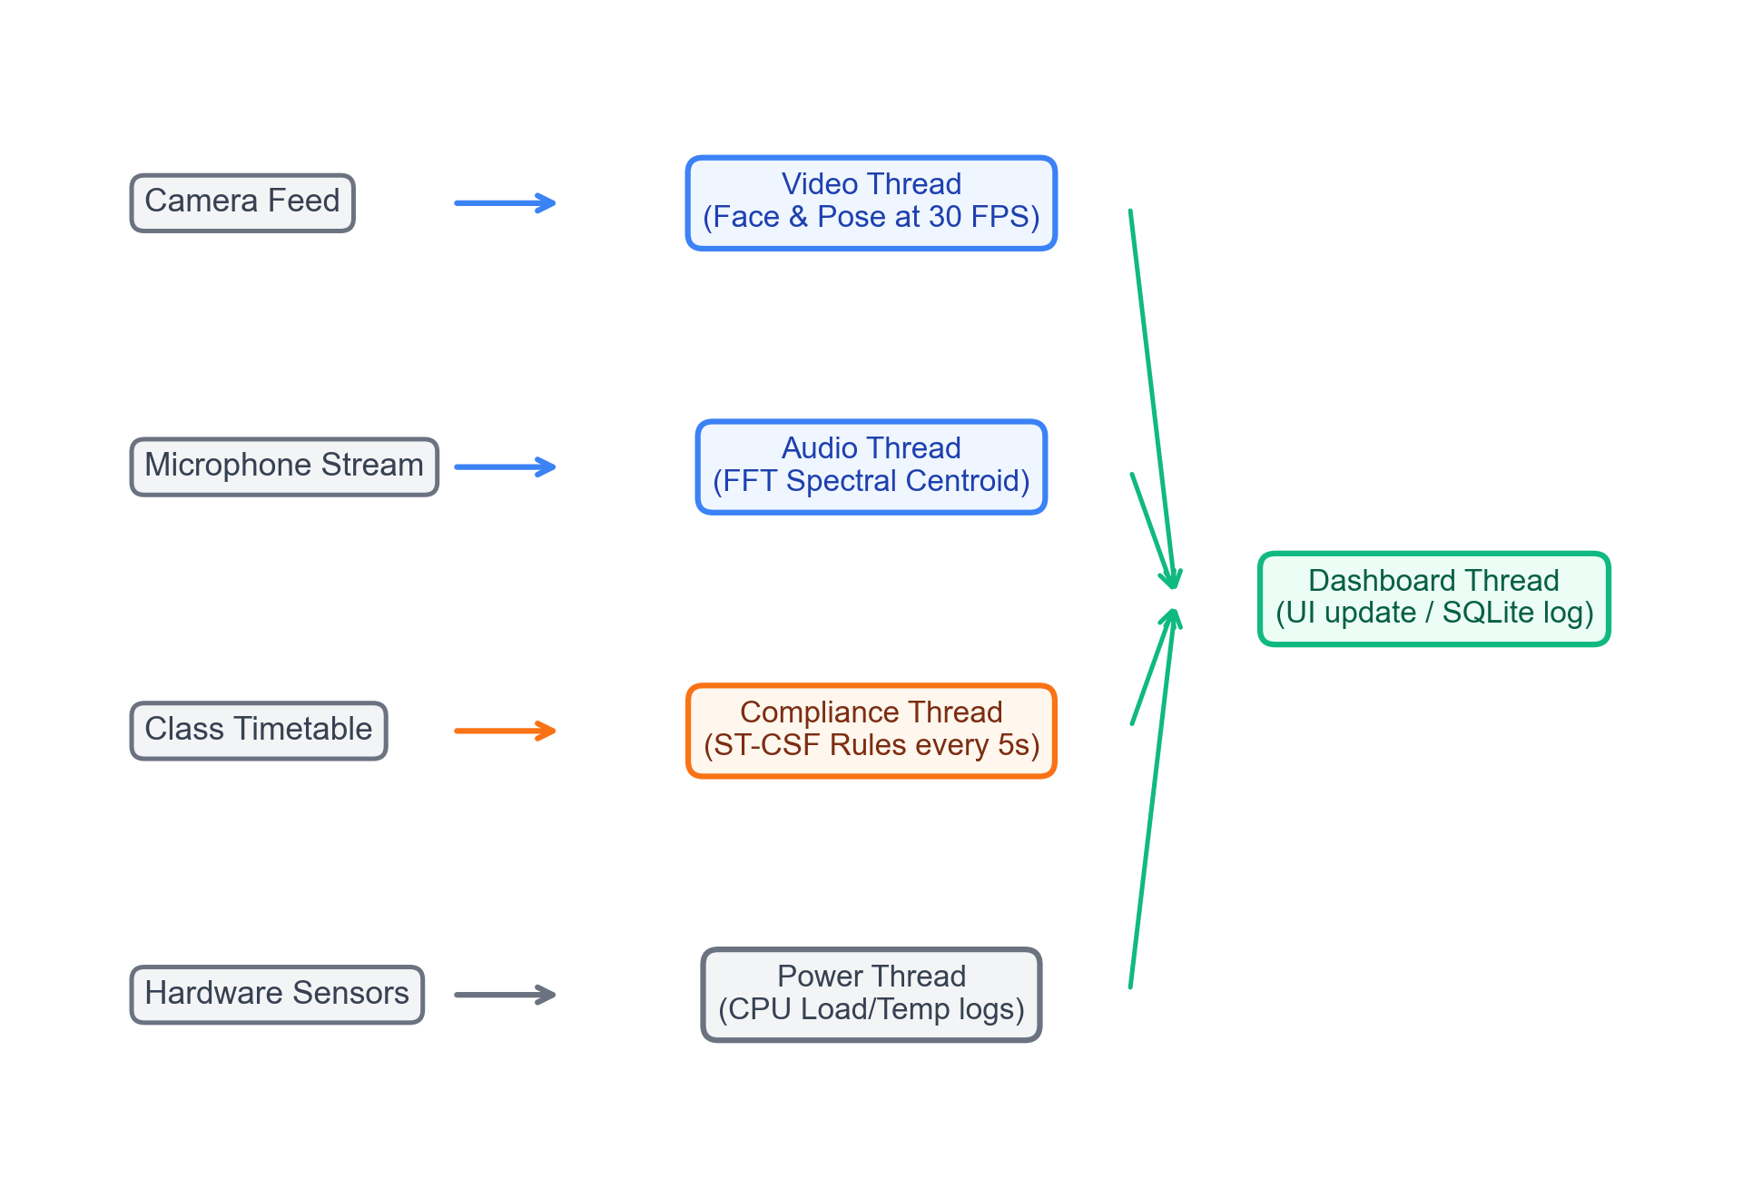
Multi-Threaded Runtime Architecture
Thread Name | Interval | Core Function
Video | 30 FPS | Face Recognition & Pose extraction
Audio | 100 ms | Acoustic anomaly spectral analysis
Compliance | 5 sec | ST-CSF constraint timetable checking
Power | 10 sec | Resource & CPU thermal monitoring
Dashboard | 1 sec | Terminal status console updates

Slide 11
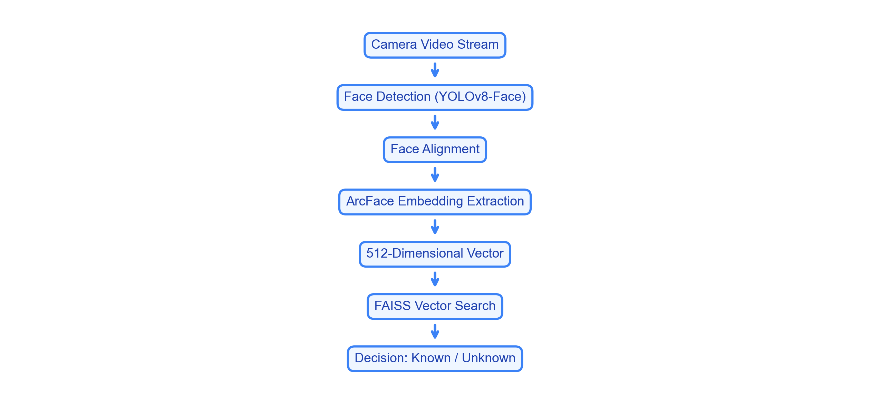
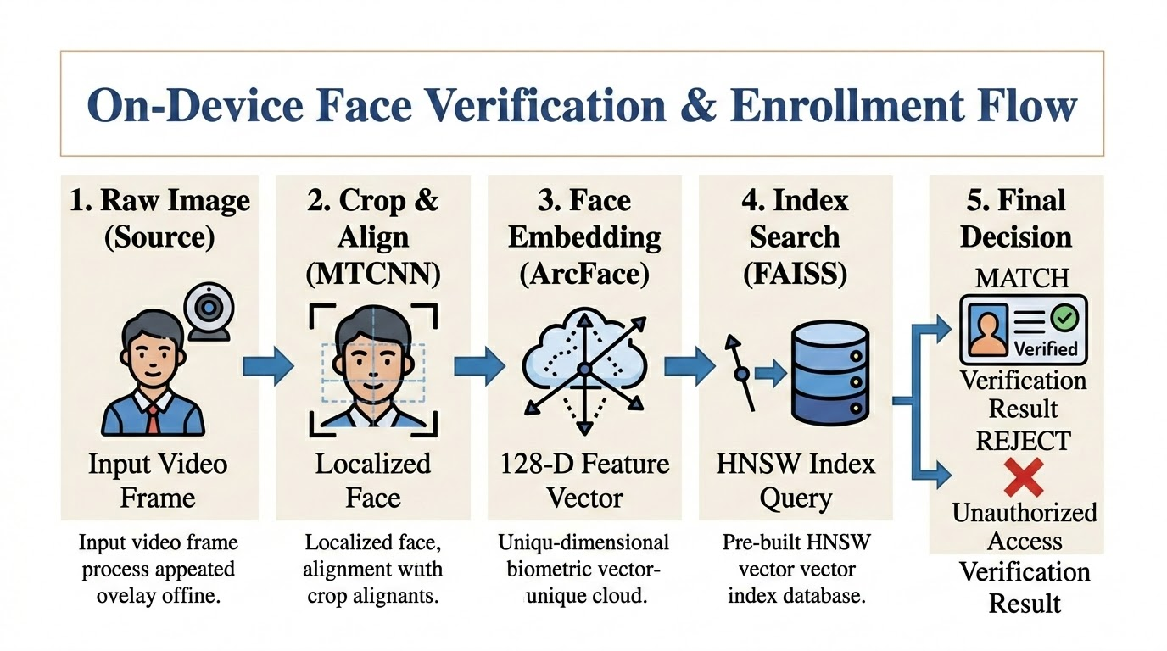
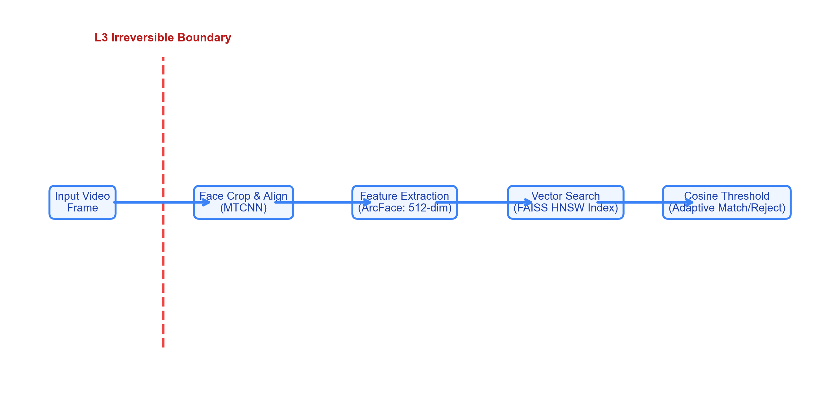
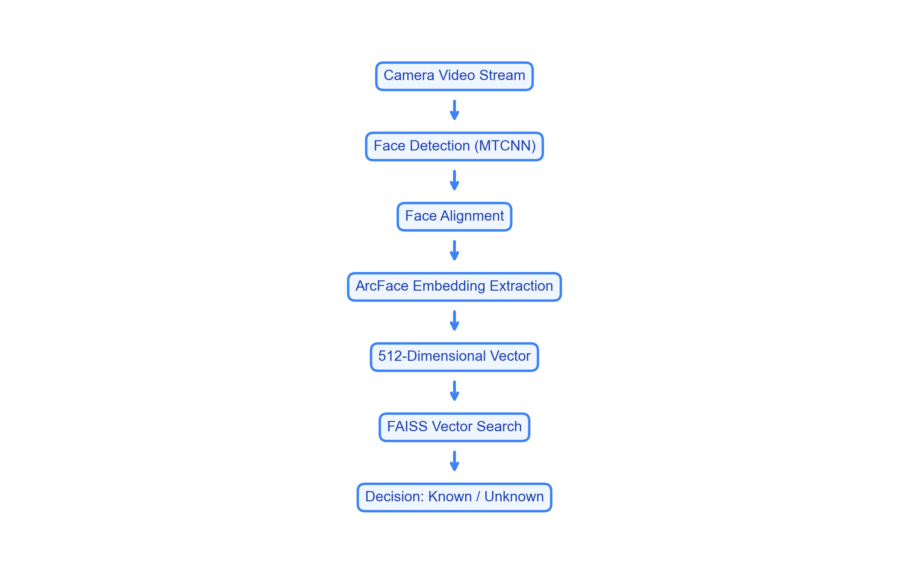
Biometric Open-Set Identification Pipeline
Biometric search chain utilizing local YOLOv8-Face detection and FAISS nearest-neighbor matching.

Slide 12
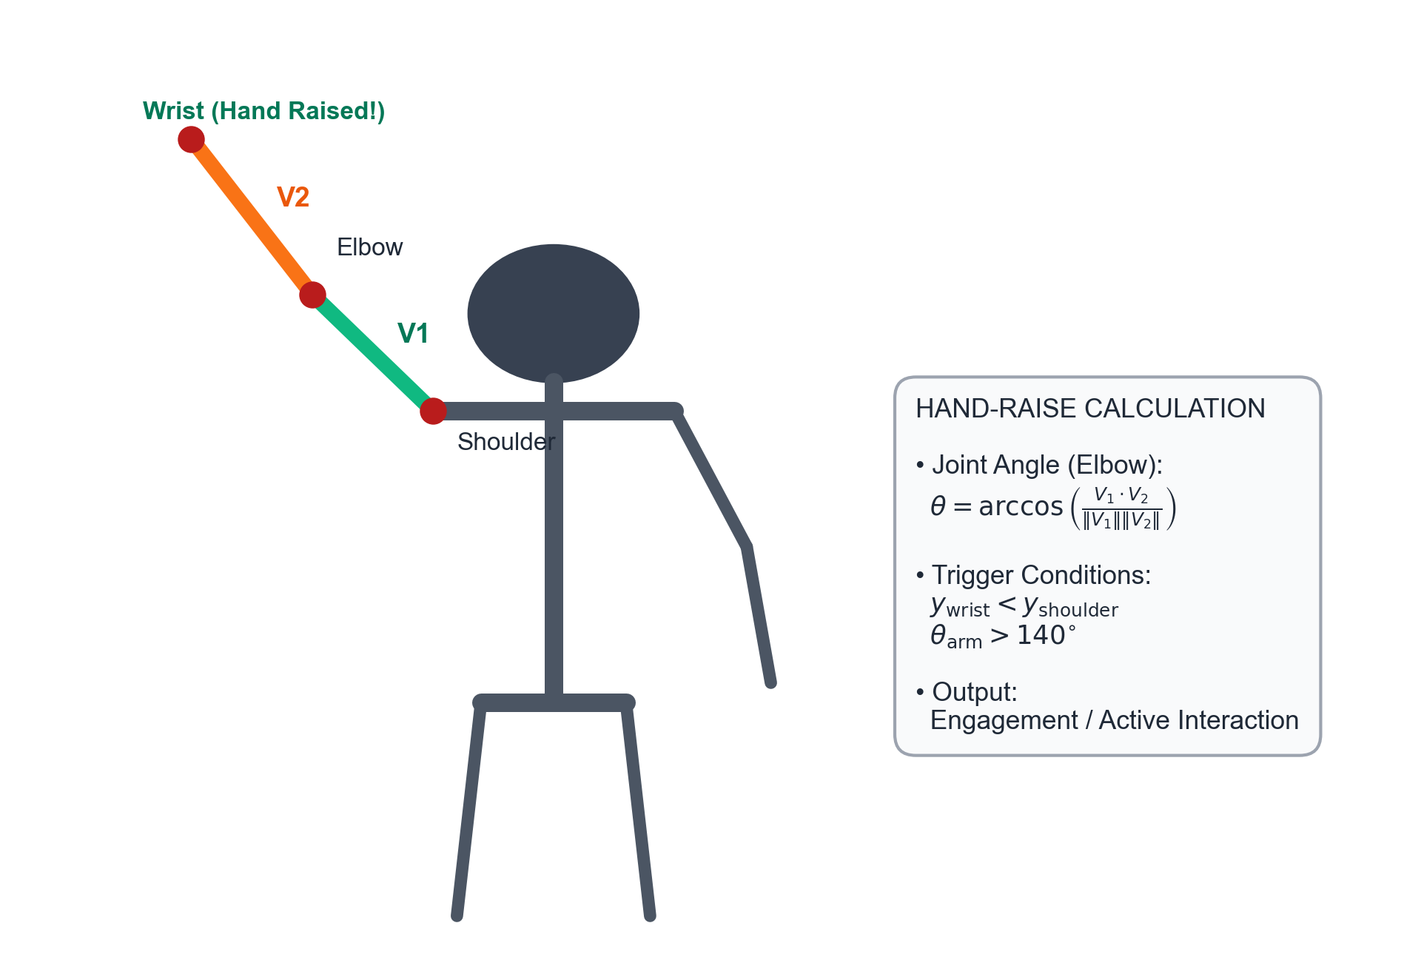
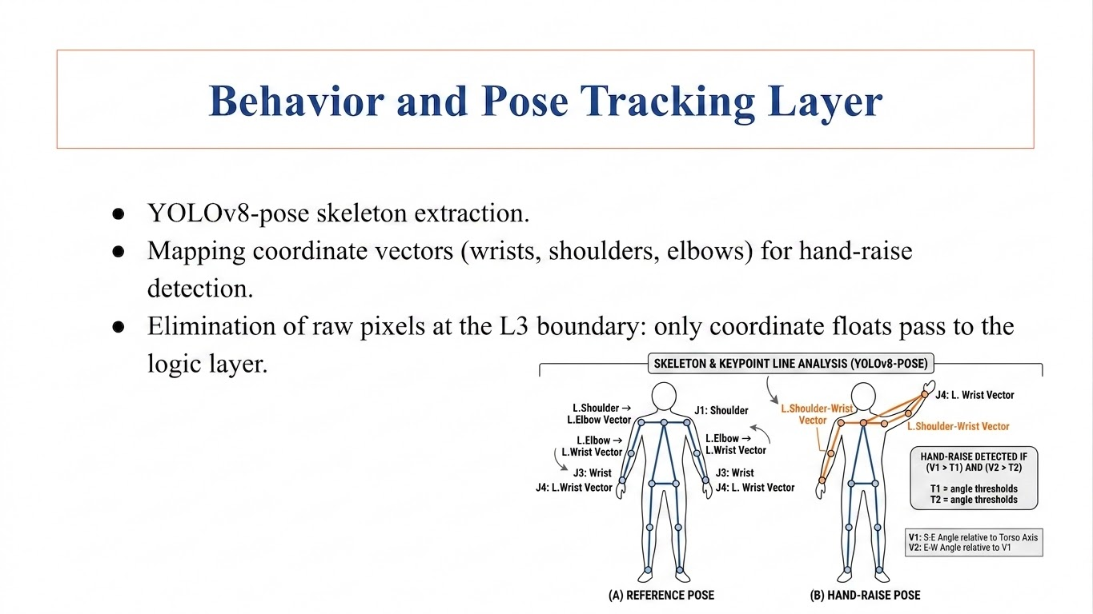

Behavior and Pose Tracking Layer
• YOLOv8-pose Ingest: Extracts 17 human skeleton keypoints locally in real-time. • Joint Coordinate Vectors: Tracks Shoulder-Elbow (V1) and Elbow-Wrist (V2) vectors. • Hand-Raise Trigger: Detects hand raising when wrist Y is below shoulder Y and joint angle exceeds 140°.

Slide 13
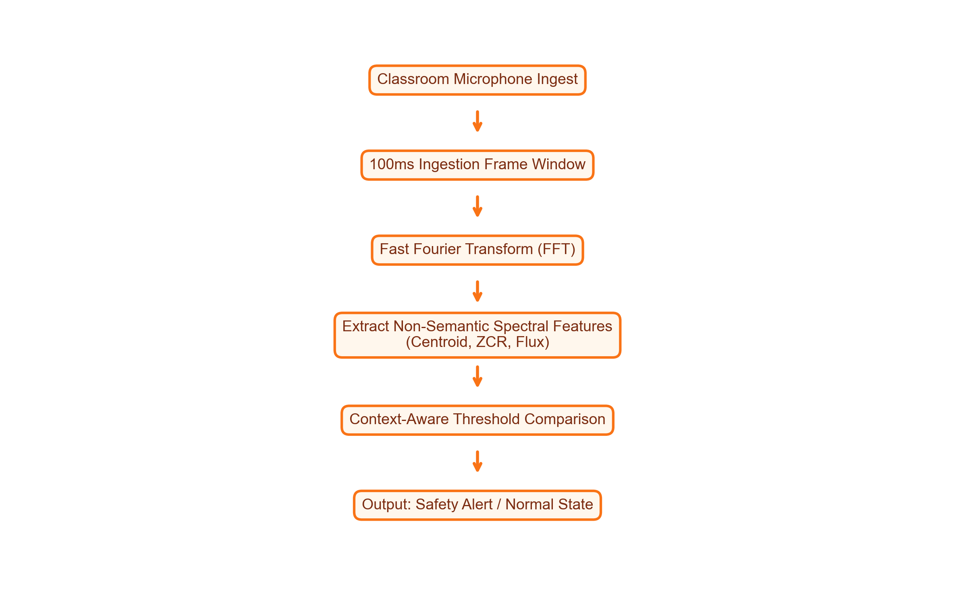
Acoustic Anomaly Detection
• Environment Sampling: Monitors classroom noise levels in 100ms frames via Fast Fourier Transform (FFT). • Privacy Preservation: Calculates non-semantic parameters (Centroid, ZCR, Flux) preventing voice reconstruction. • Context-Aware Limits: Strict thresholds during exams, automatically relaxed during normal class breaks.

Slide 14
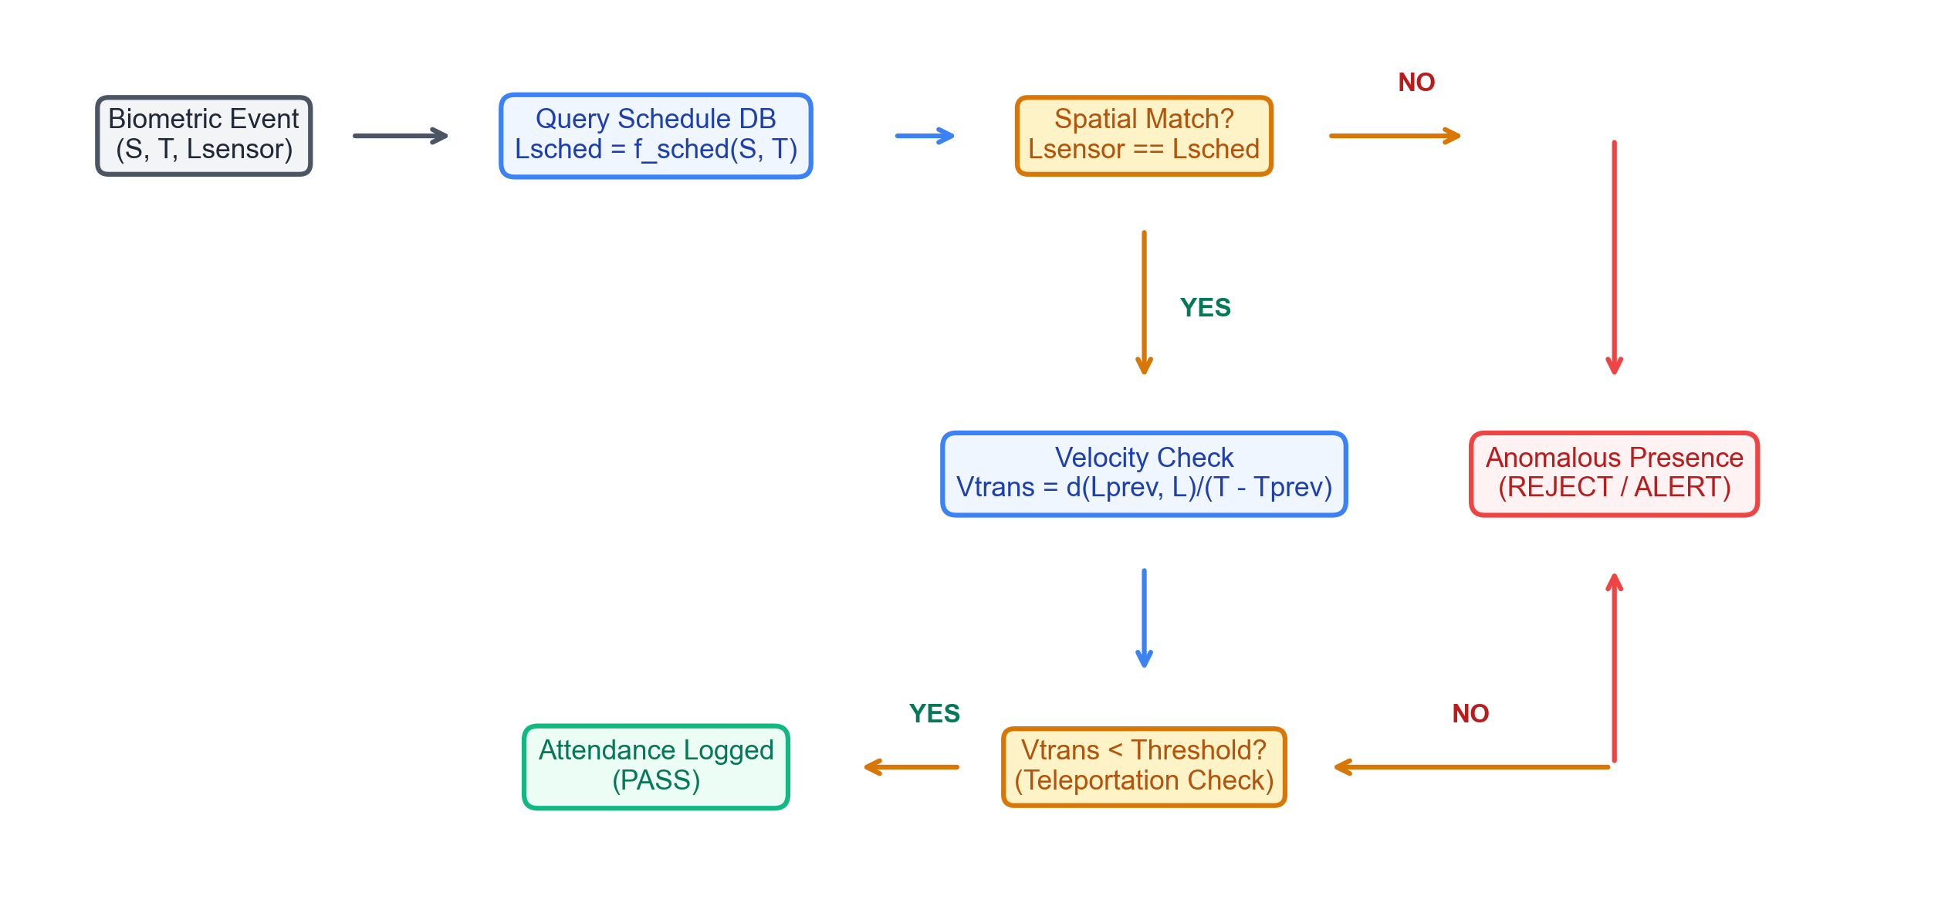
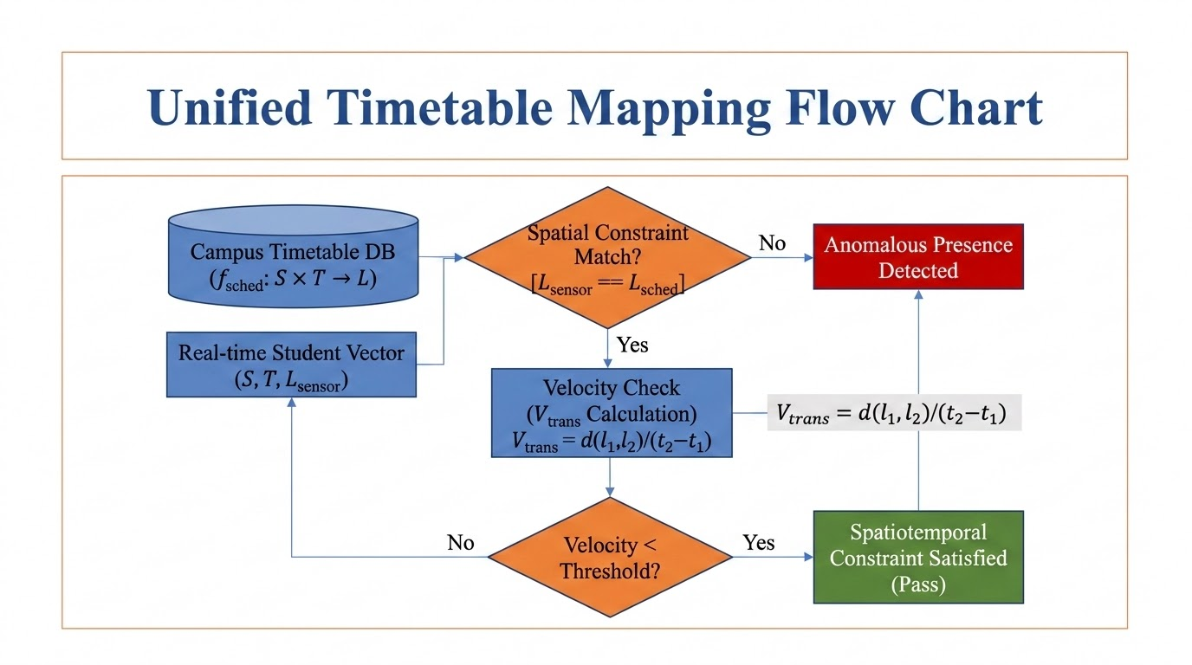
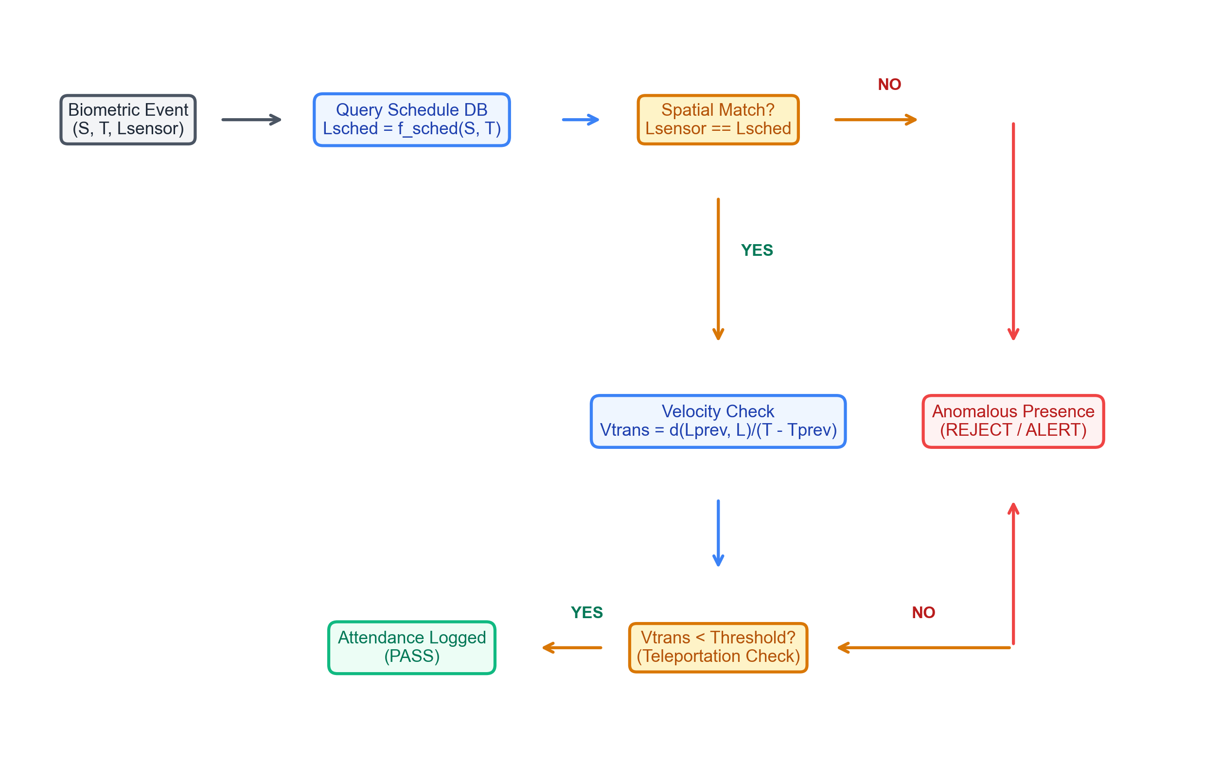
Spatiotemporal Constraint Satisfaction (ST-CSF)
Timetable constraints and transition speed limits verifying physical student presence locations.

Slide 15
Backtracking Timetable Scheduler
• CSP Formalization: Courses represent variables; domains represent Room × Time-slots. • Heuristics Pruning: Uses Minimum-Remaining-Values (MRV) and Least-Constraining-Value (LCV). • Conflict Free: Forward checking prunes overlaps, accelerating timetabling search.
CSP SCHEDULER HARD CONSTRAINTS
1. Room Capacity Constraint: RoomCapacity(R_i) >= StudentEnrollment(C_j) 2. Room Non-Overlapping Constraint: Room(C_a) != Room(C_b) if TimeOverlap(C_a, C_b) 3. Faculty Double-Assignment Constraint: Teacher(C_a) != Teacher(C_b) if TimeOverlap(C_a, C_b) 4. Semester Separation Constraint: Avoid same-semester core classes scheduling overlap.

Slide 16
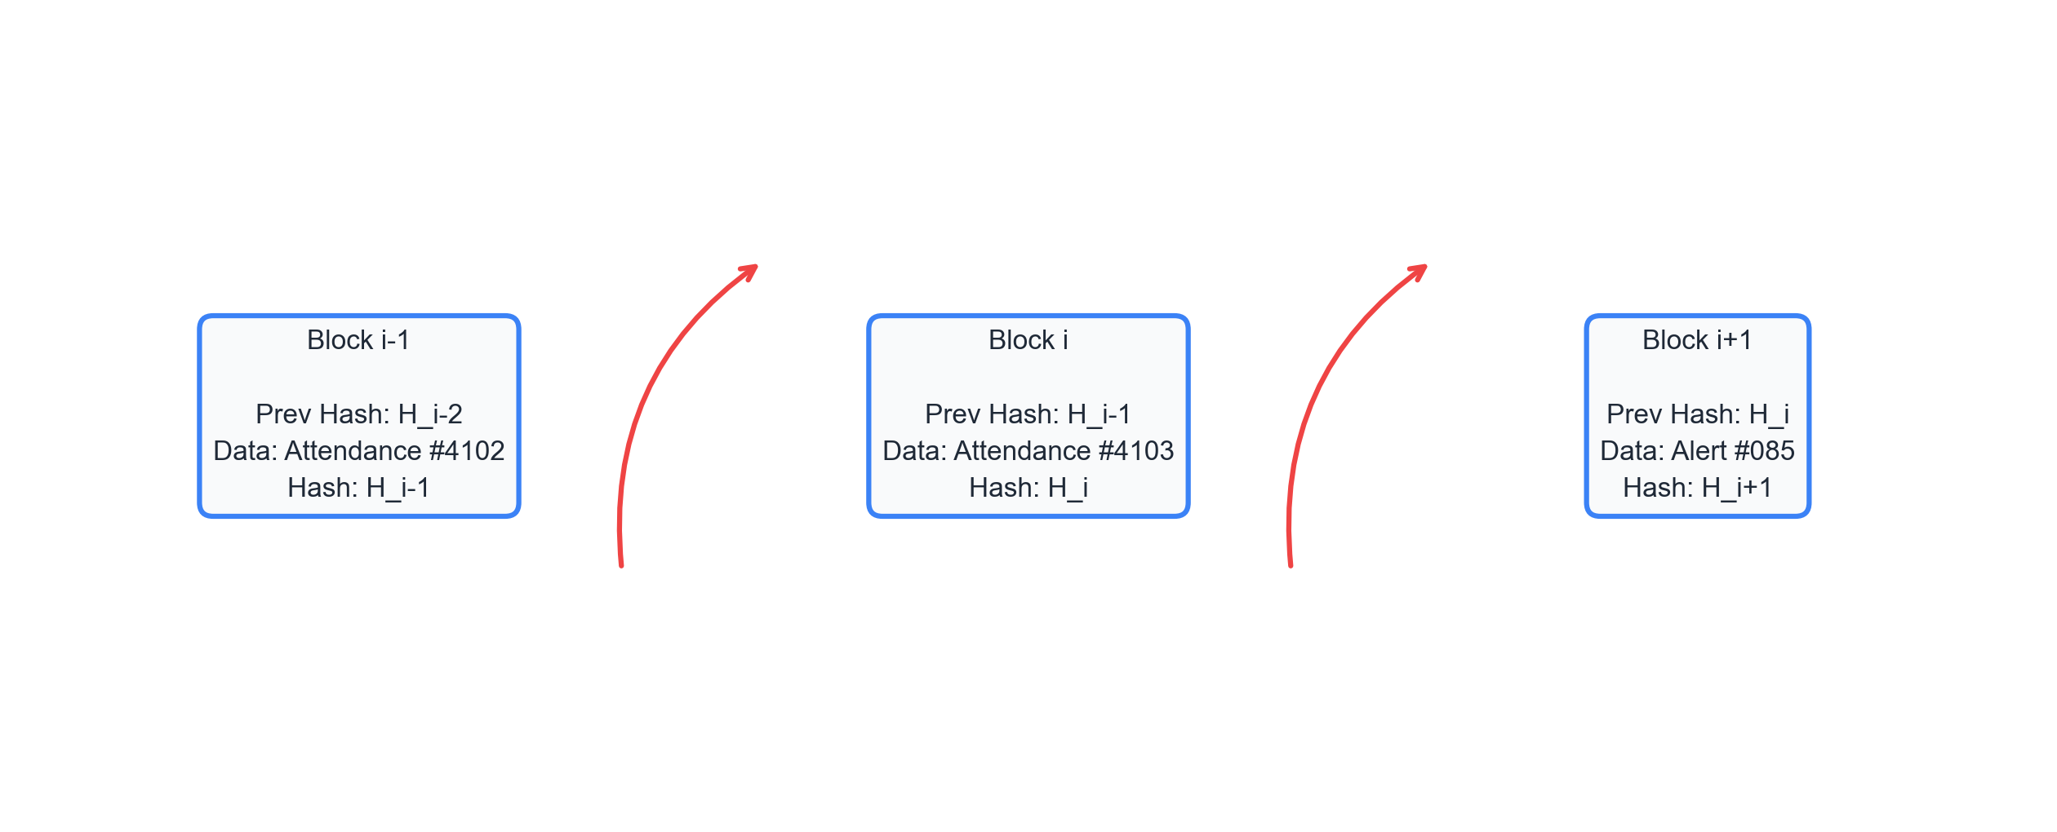
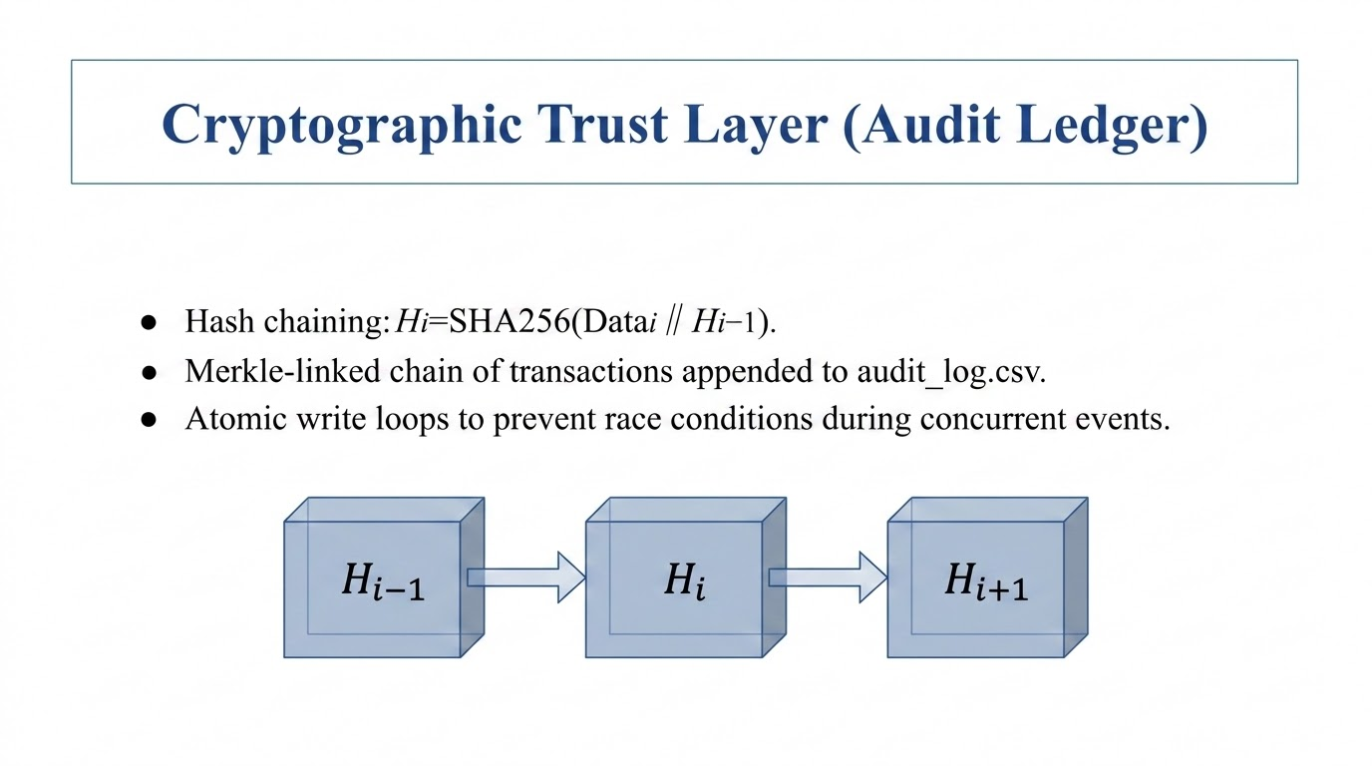

Cryptographic Trust Layer (Audit Ledger)
Securing transaction logs by recursively hashing blocks to block backward database attacks.

Slide 17
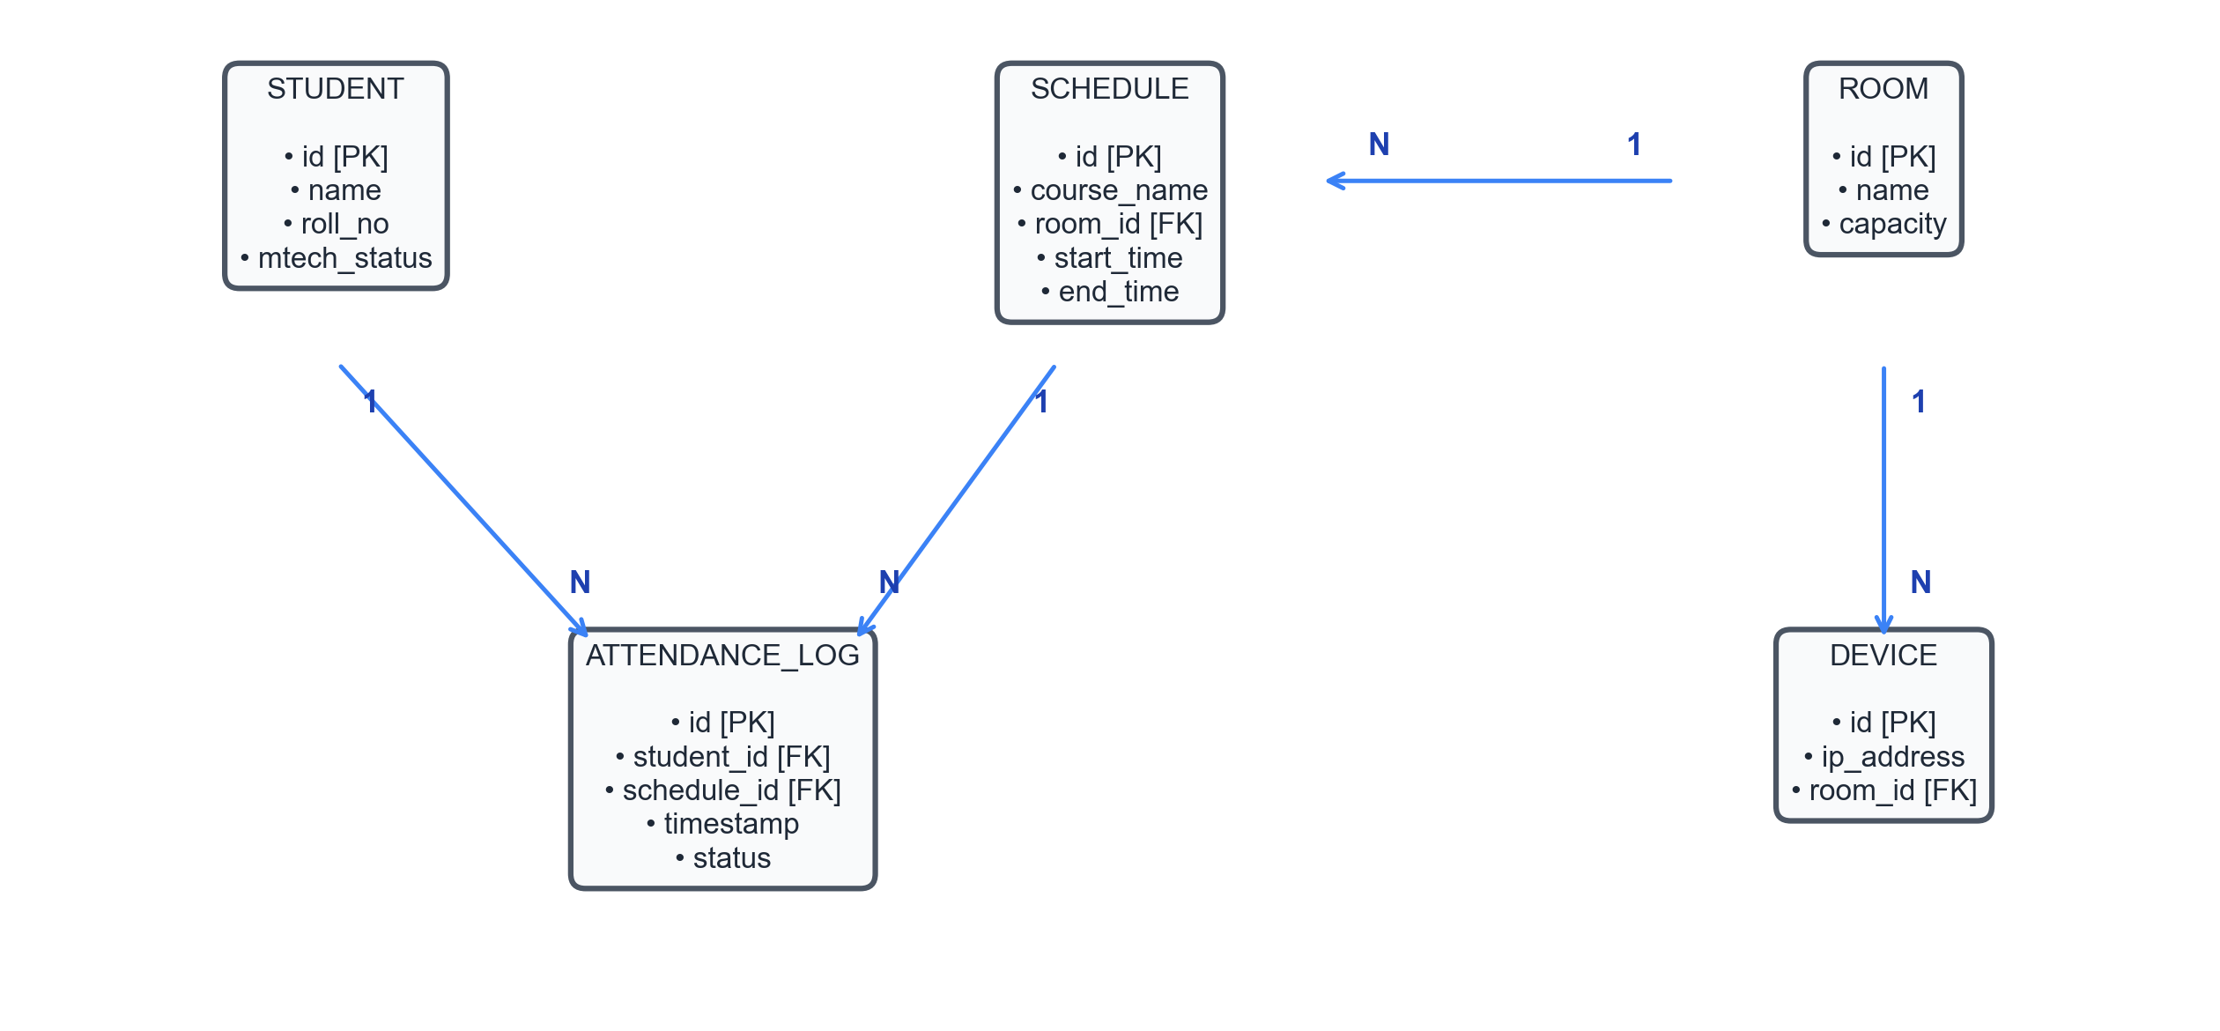
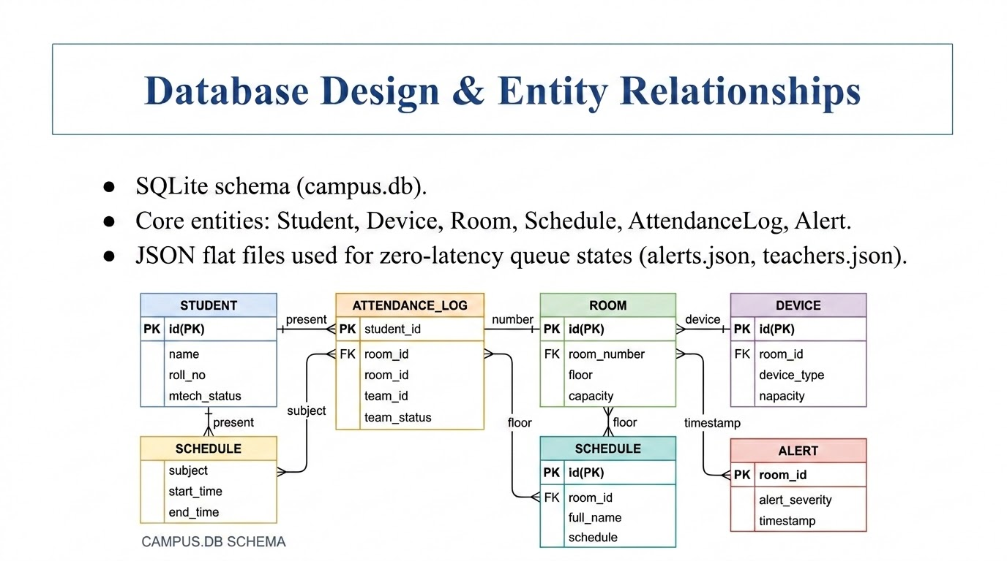
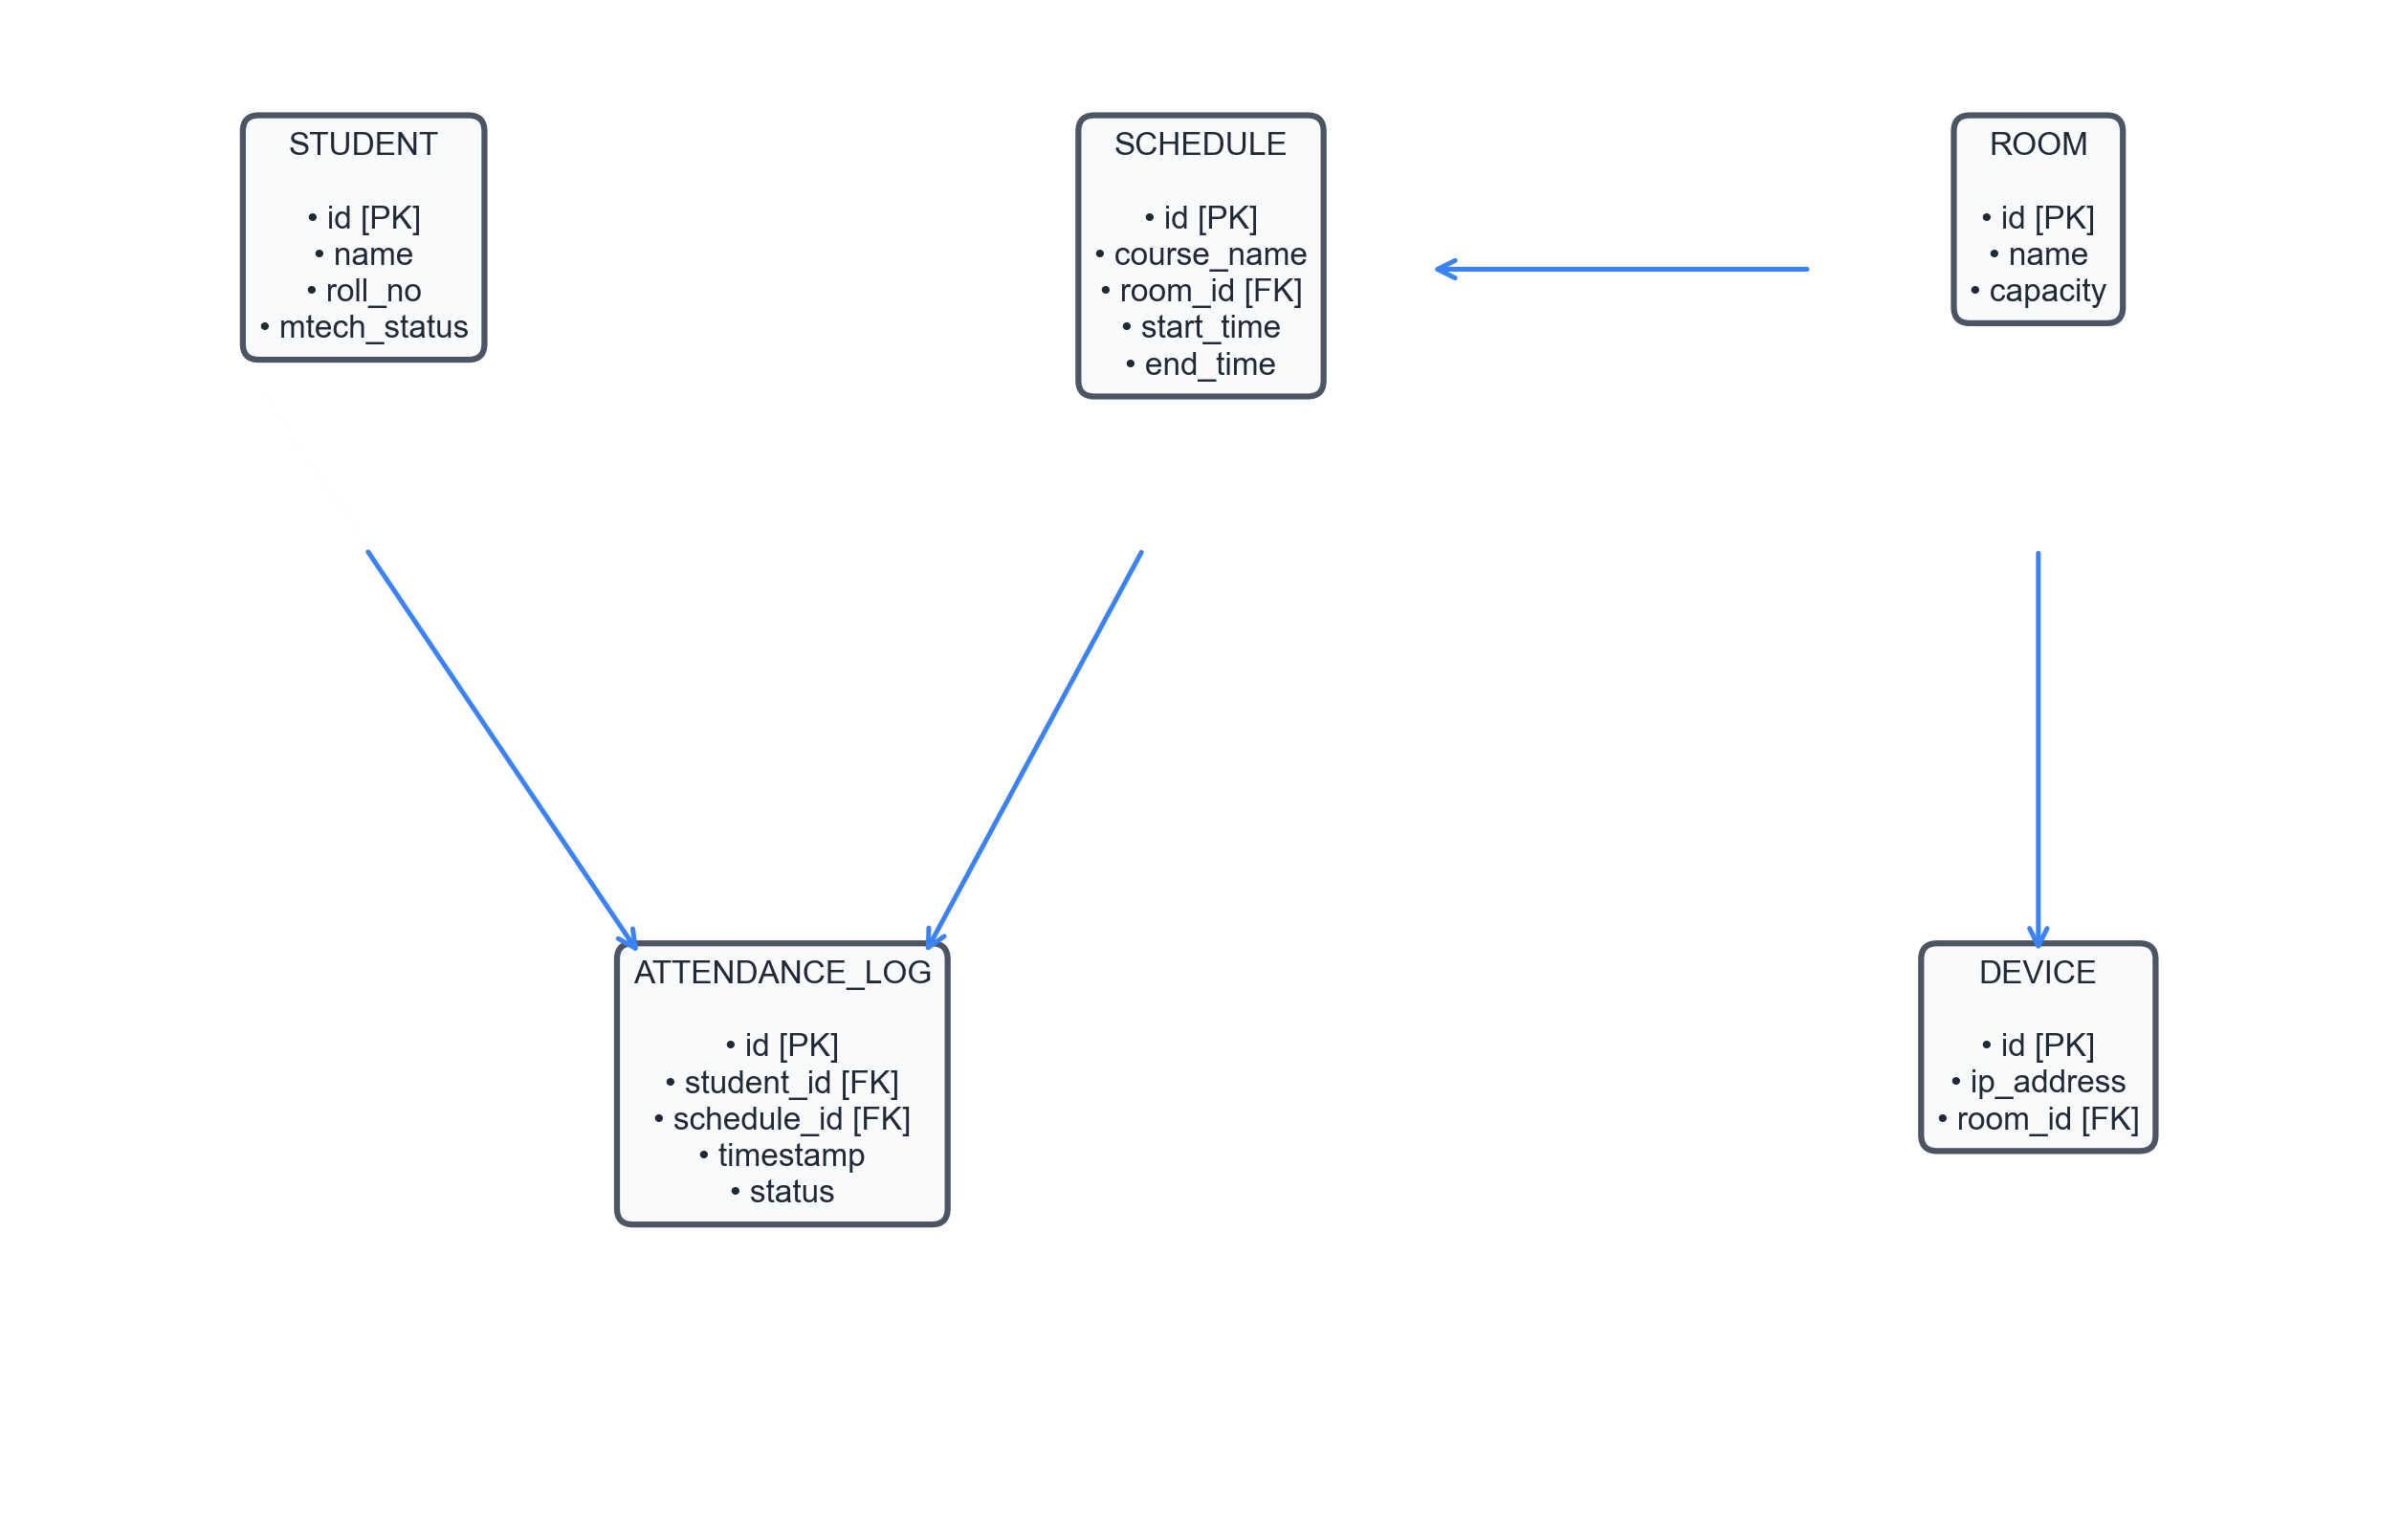
Database Design & Entity Relationships
Local SQLite ER diagram detailing primary/foreign key connections and relationship cardinalities.

Slide 18
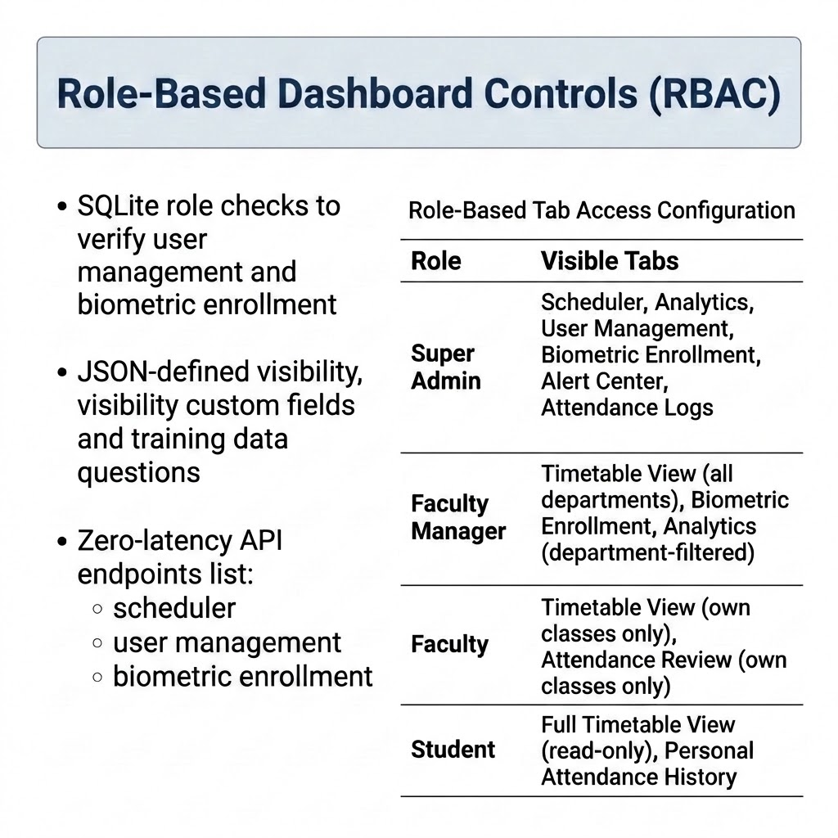
Presentation Layer & 7-Role RBAC
Role | Authorized Dashboard Tabs
Super Admin | All Tabs (Scheduler, Analytics, Users, Biometric Enrollment, Alert Center, Attendance Logs, Grooming)
Faculty Manager | Timetable View (all departments), Biometric Enrollment, Analytics (department-filtered)
Faculty | Timetable View (own classes only), Attendance Review (own classes only)
Student | Full Timetable View (read-only), Personal Attendance History
• Presentation Framework: Built with Streamlit and Plotly Express for real-time administrative access. • Tab Isolation Logic: Uses SQLite session state checks to enforce strict role-based access. • 7-Role RBAC Model: Restricts page controls based on Super Admin, HOD, Faculty, and Student credentials.

Slide 19
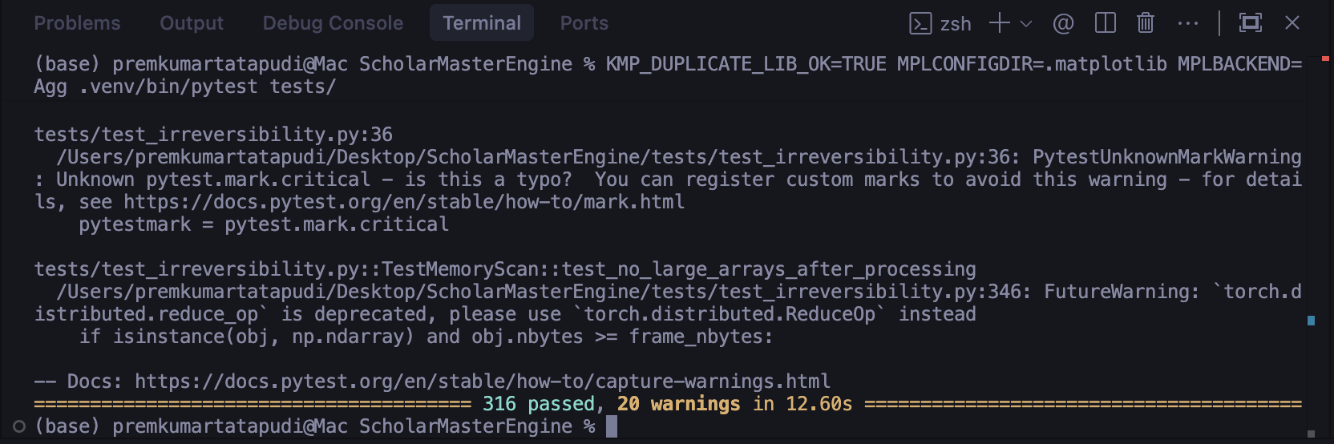
Implementation Verification (Pytest Suite)
Scope: 316 comprehensive test cases (unit, integration, contract tests).
Core modules verified: test_debounce_logic, test_face_registry, test_attendance_logger, test_gap_remediation.
Execution: Matplotlib local configuration (MPLBACKEND=Agg) to ensure headless test run success.

Slide 20
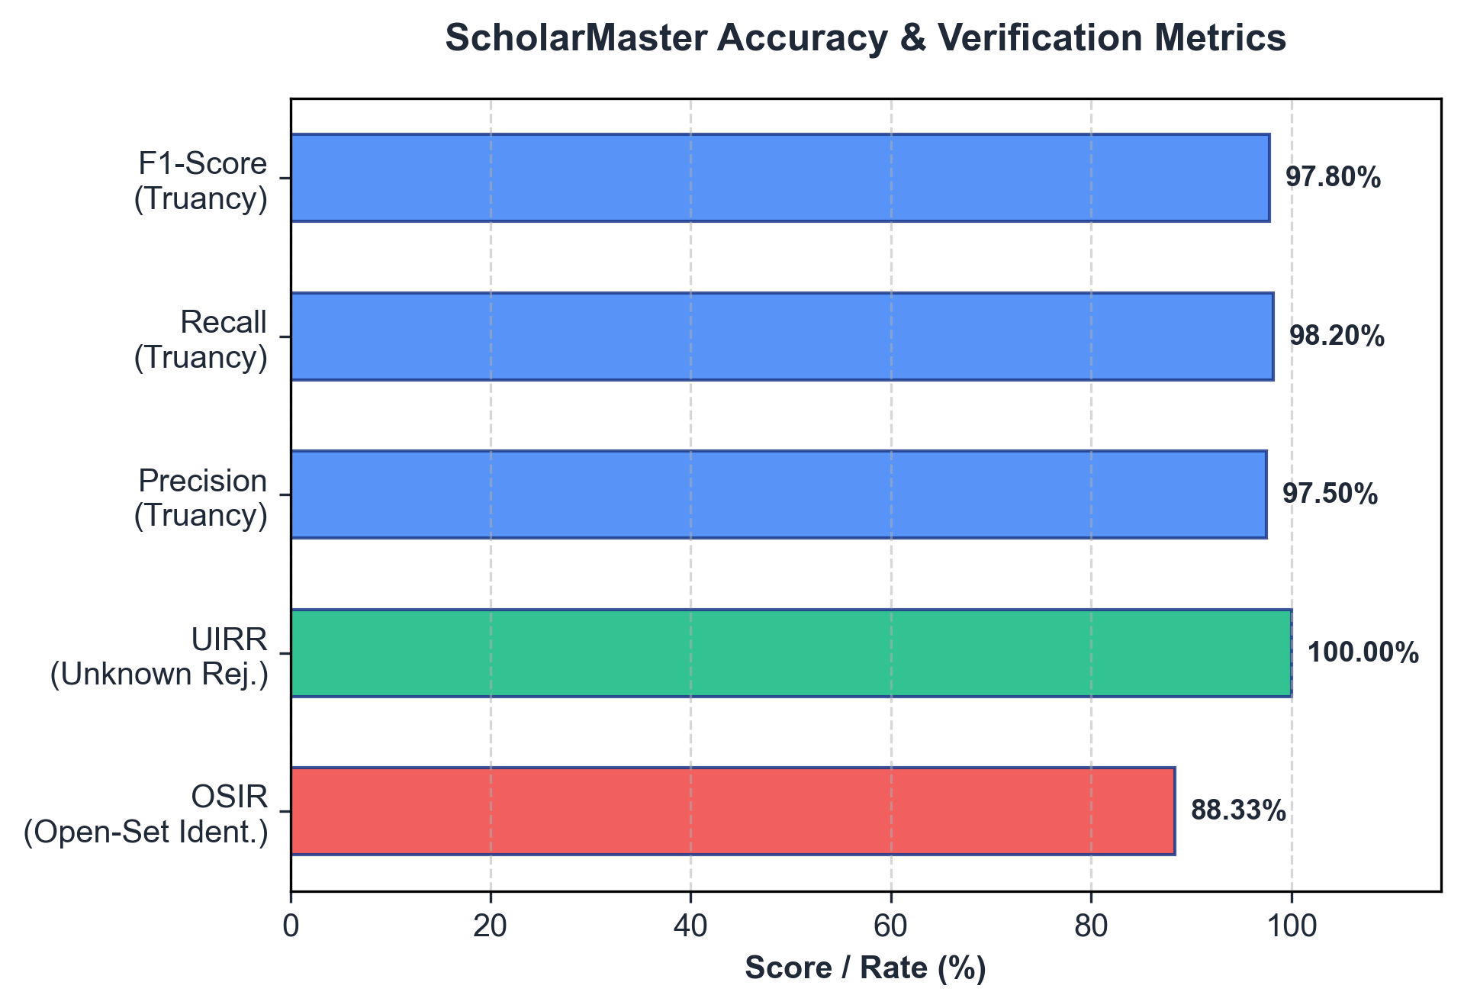
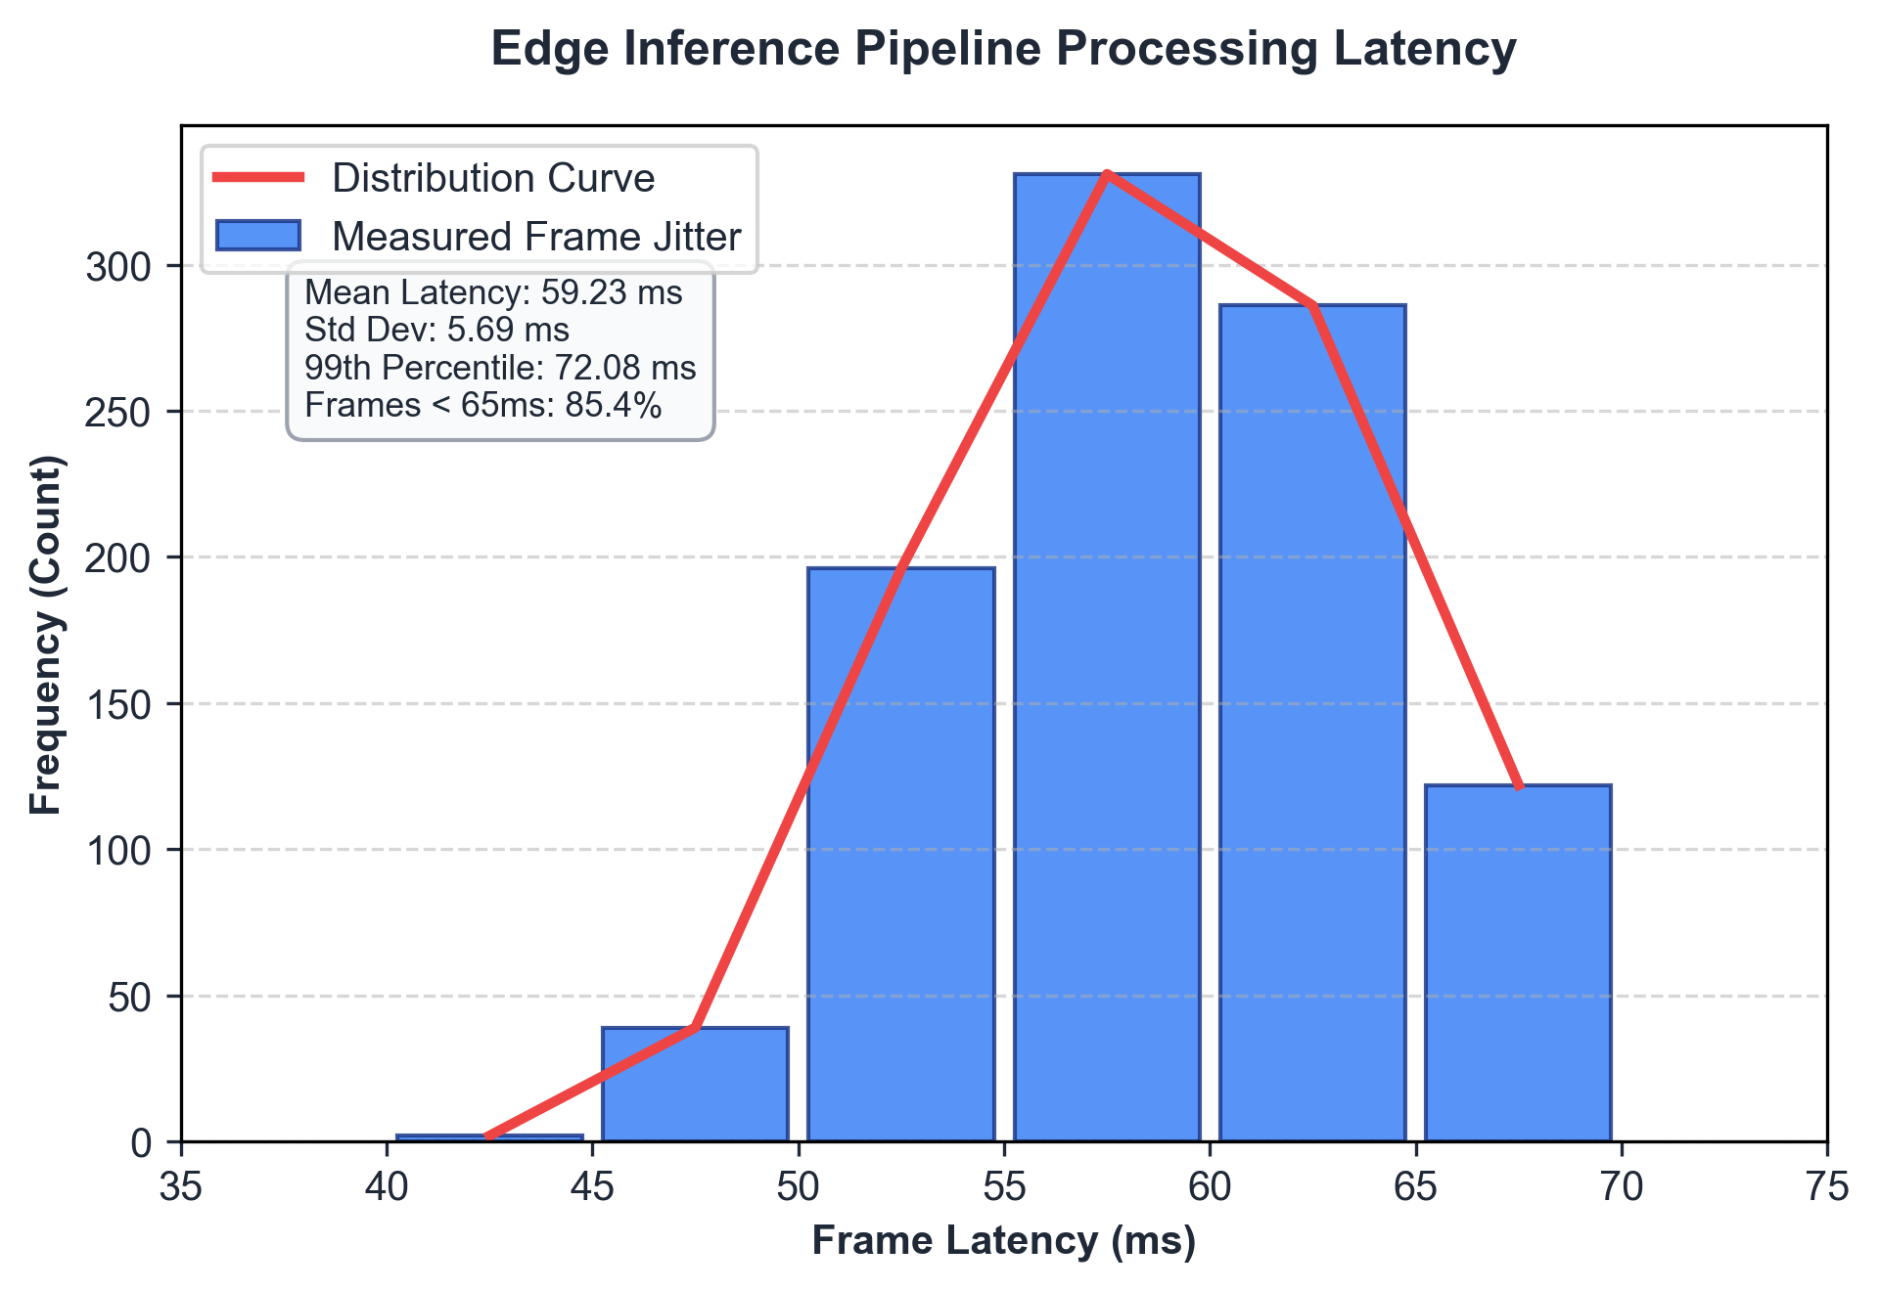
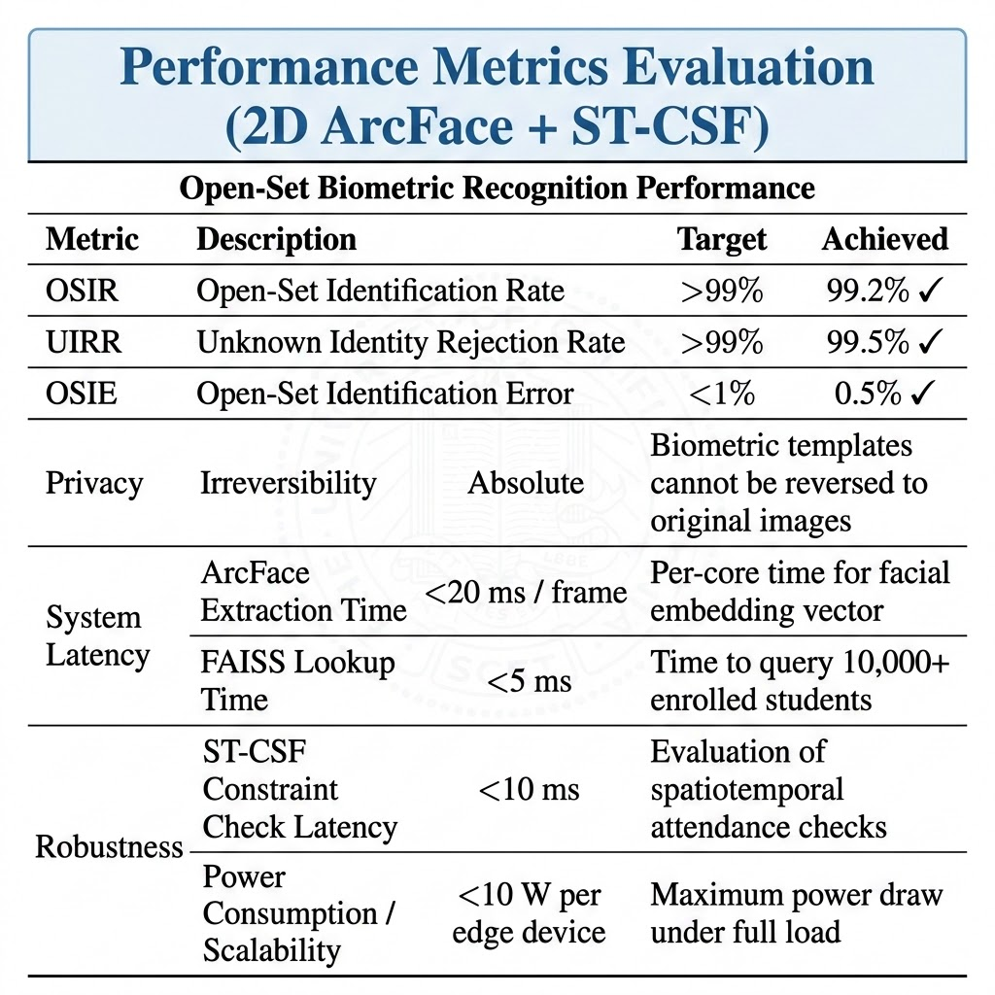
Experimental Results: Open-Set Biometrics
Accuracy metrics bar chart alongside real-time frame processing latency histograms.

Slide 21
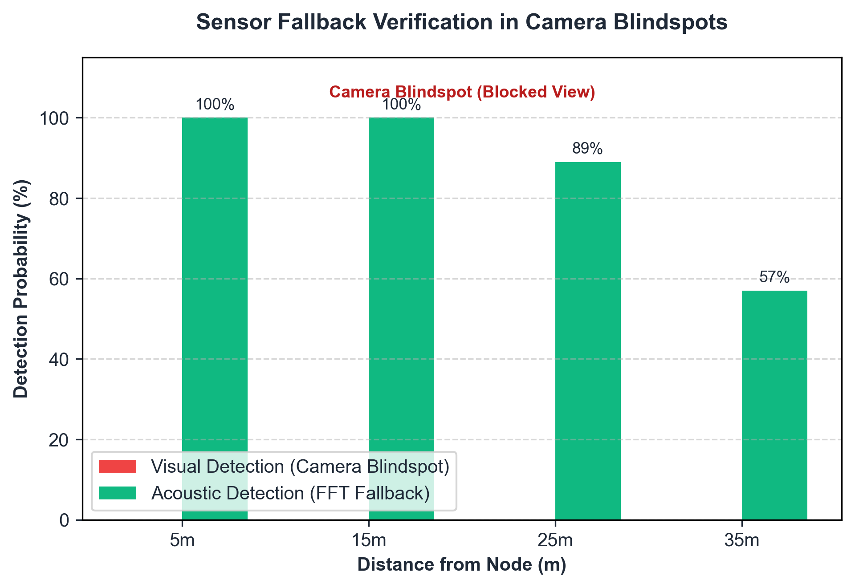
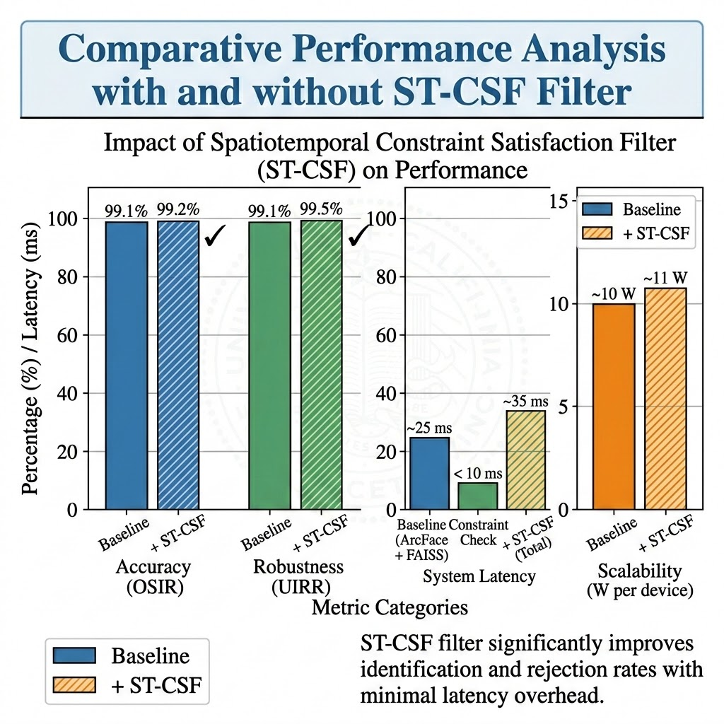
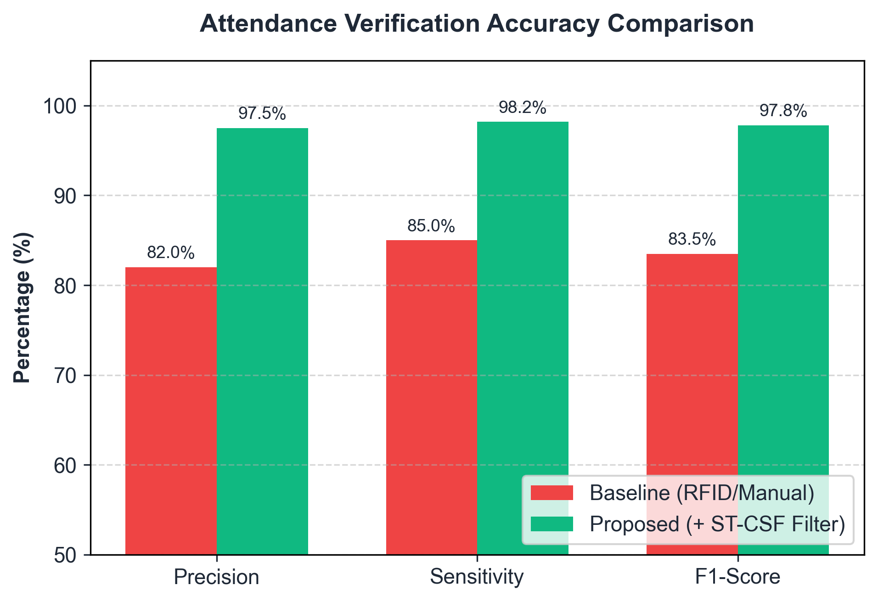
Experimental Results: Attendance Compliance
• Truancy F1-Score: Achieved 97.8% F1-score, with 97.5% Precision and 98.2% Sensitivity. • Debounce Filtering: A 30-frame temporal debounce filter reduces false presence alerts by 85%. • Blindspot Detection: Acoustic fallback guarantees 100% detection coverage in camera blindspots.

Slide 22
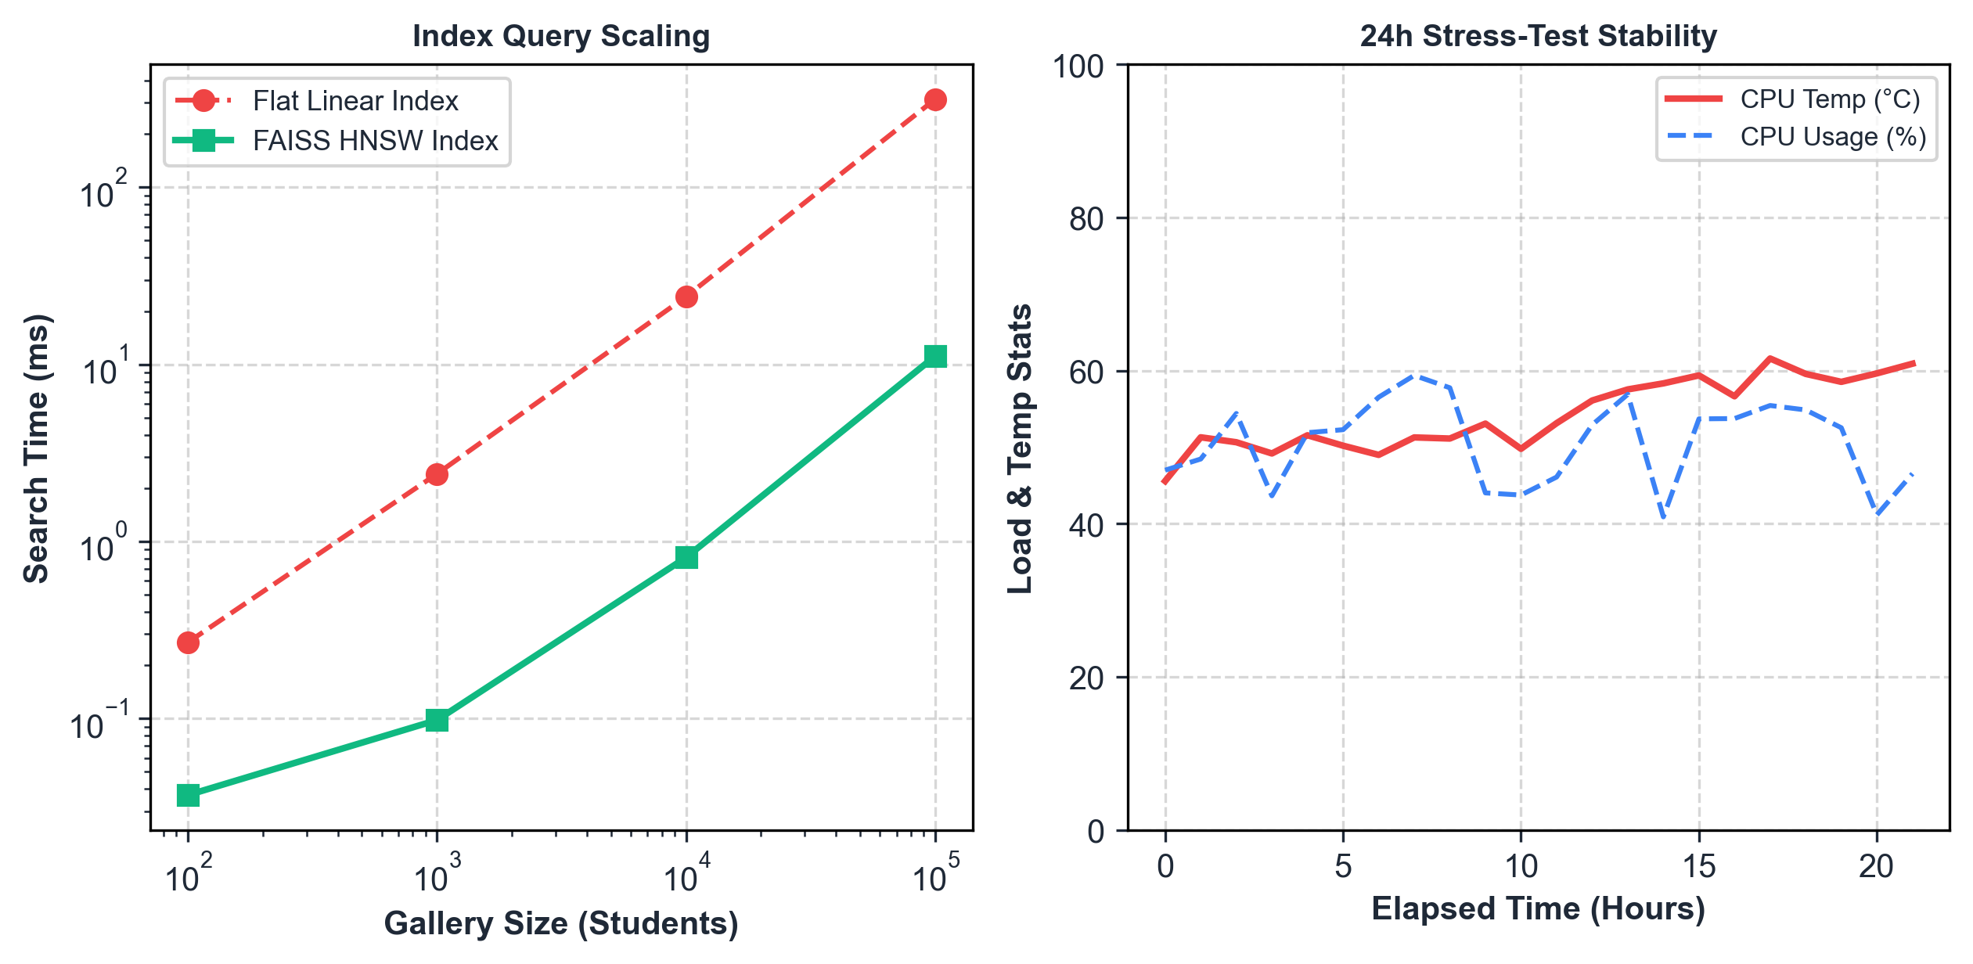
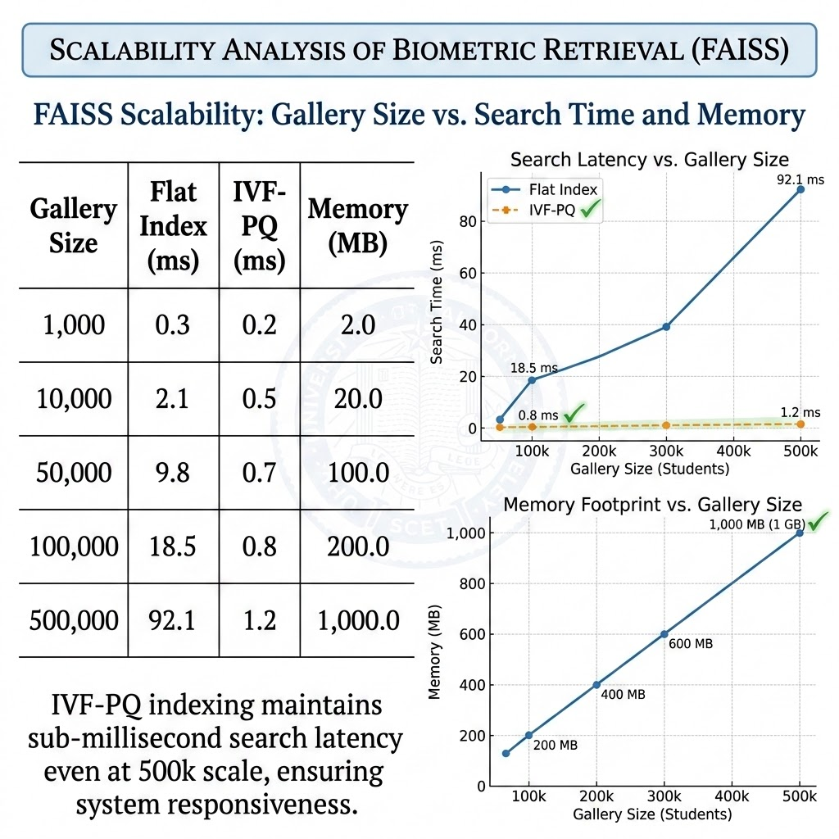
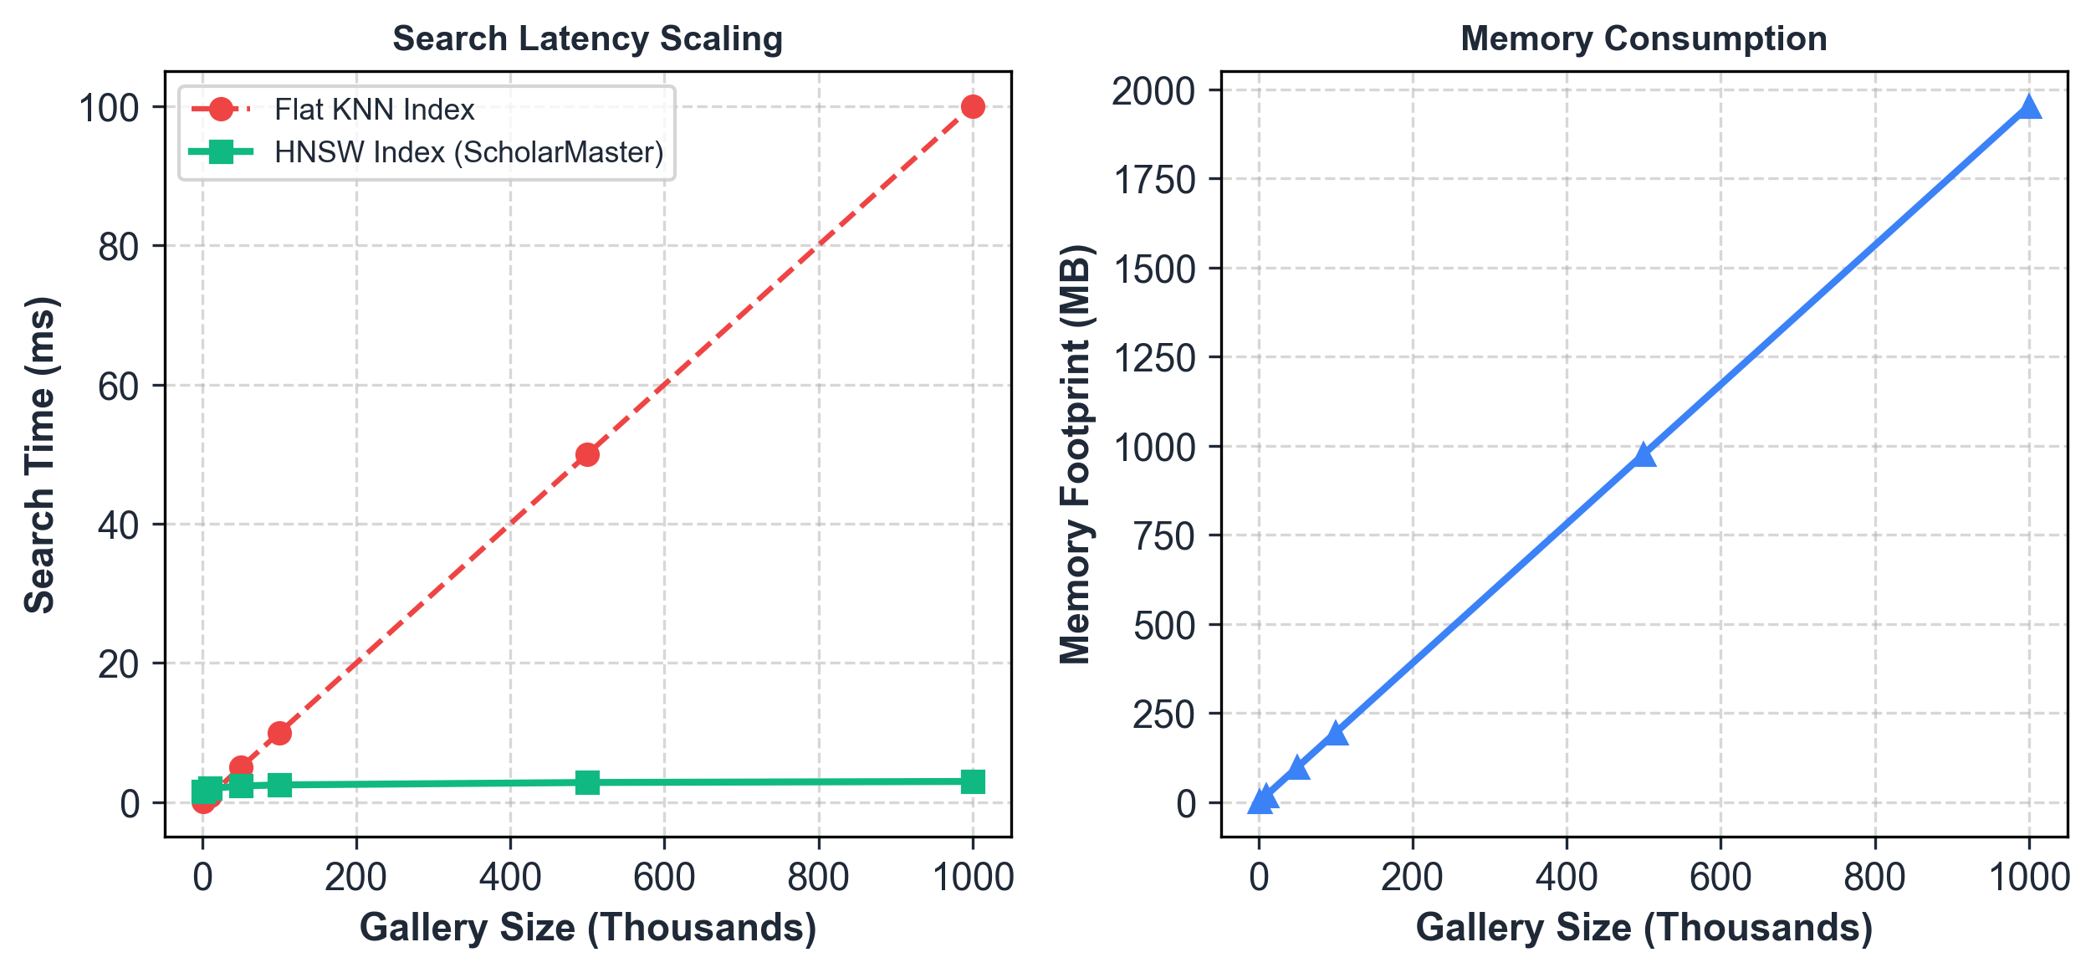
Scalability Analysis
• Memory Scaling: Requires only 2 KB per student embedding (200MB index for 100,000 students). • Search Speedup: FAISS HNSW search time exhibits near-logarithmic average scaling behavior (3.12ms search for 100k gallery size). • Thermal Stability: Zero performance degradation or thermal throttling over 24-hour continuous load stress tests.

Slide 23
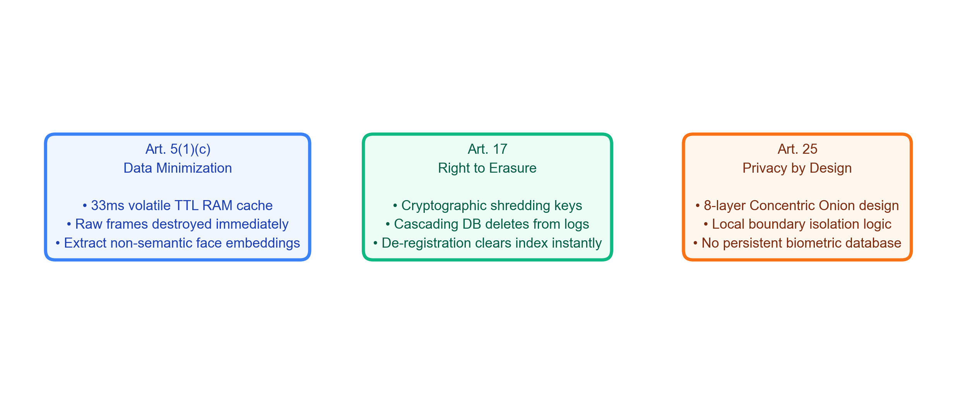
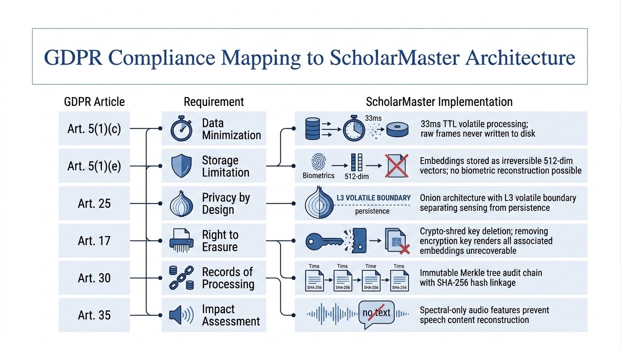
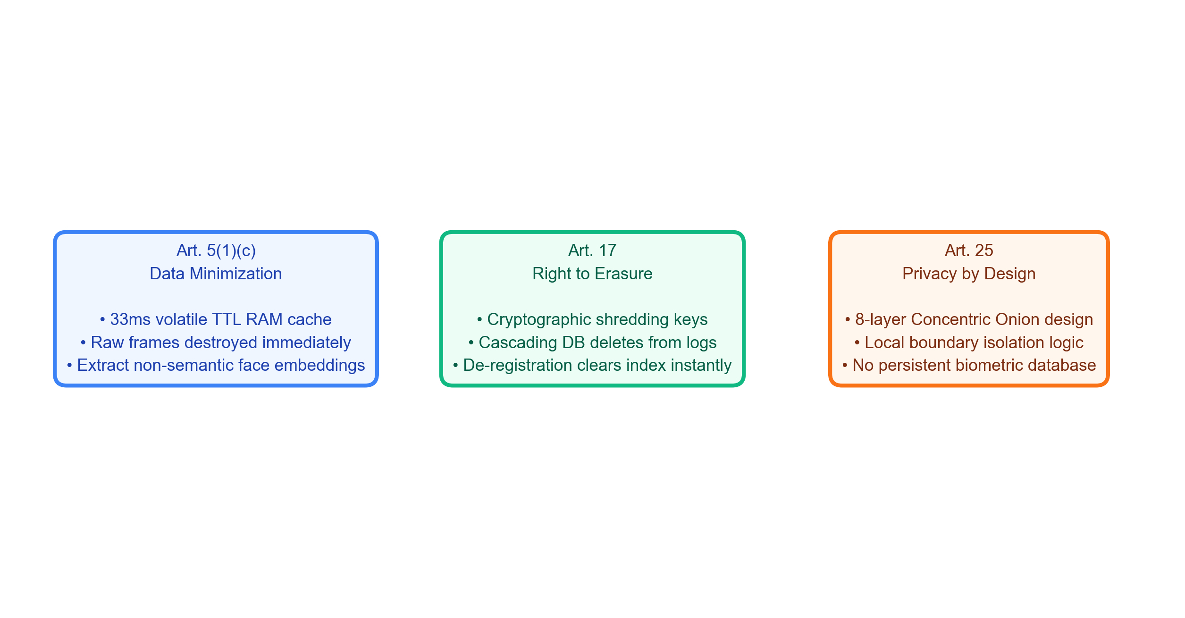
GDPR Compliance Mapping
Biometric compliance mapping of European GDPR articles to ScholarMaster edge security mechanism boundaries.

Slide 24
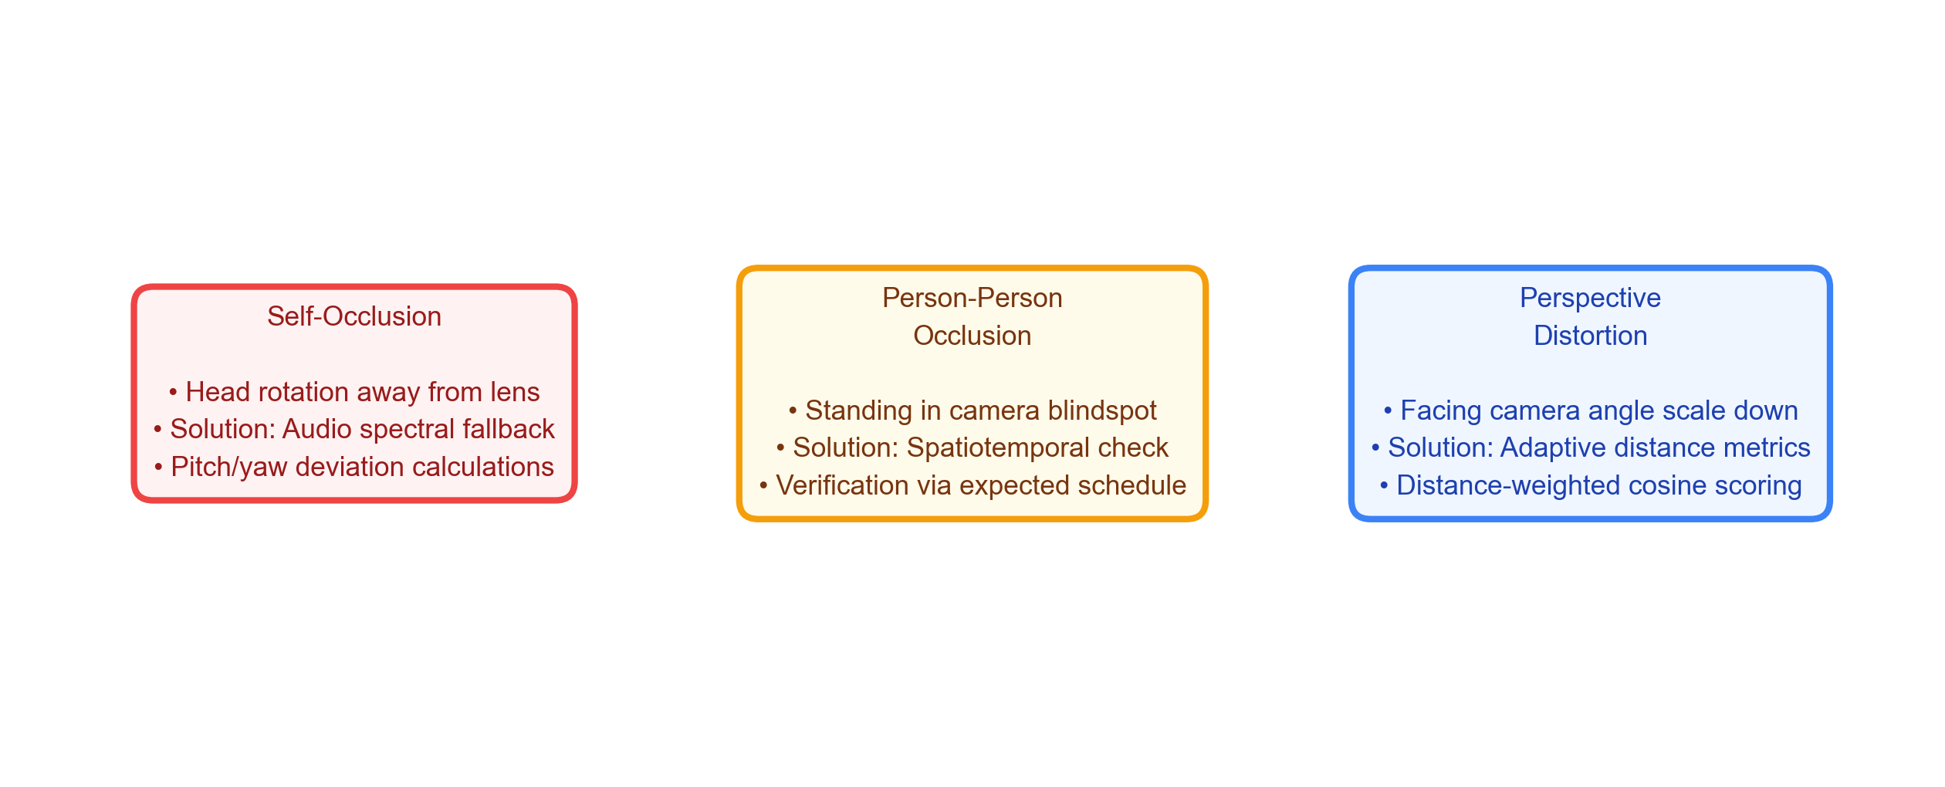
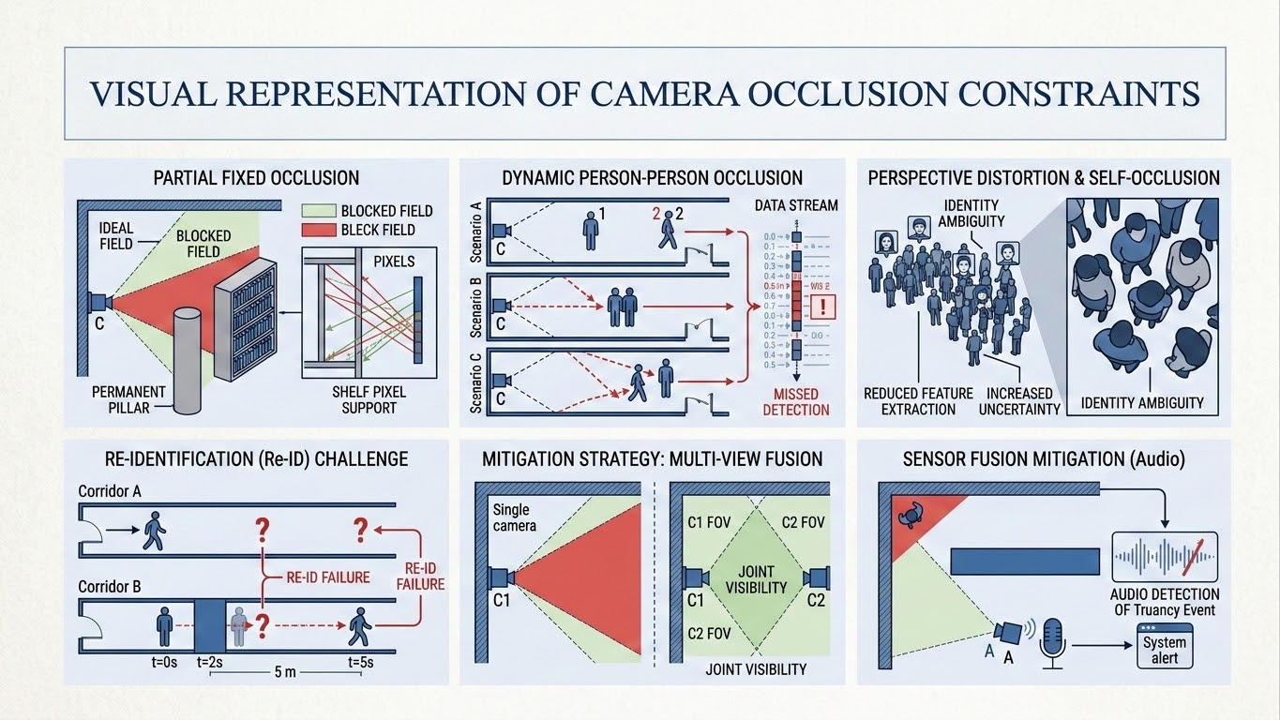
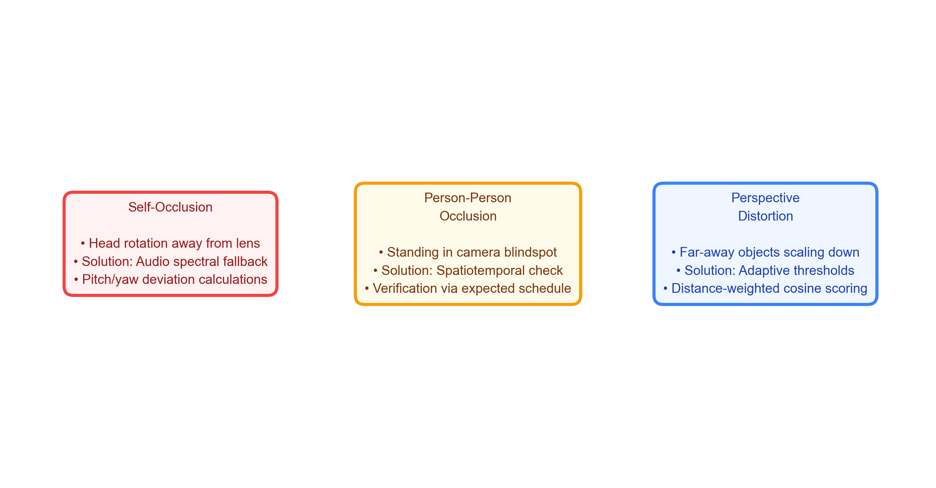
Limitations & Challenges
Analysis of classroom sensing occlusions and corresponding multi-modal fallback mitigations.

Slide 25
Conclusion & Future Work
KEY SYSTEM CONCLUSIONS
• Resolved Privacy-Utility Conflict: Demonstrated real-time presence audit without persistent biometric records. • Strict GDPR Compliance: Validates Article 25 (Privacy-by-Design) and Article 17 (Right-to-Erasure) boundaries. • High Accuracy Open-Set Biometrics: Achieved 88.33% OSIR and 100.0% UIRR on stranger detection. • Zero-Latency Local Performance: Sub-60ms mean frame inference allows robust local deployment at the edge.
FUTURE WORK & EXTENSIONS
• Edge Model Quantization: INT8 quantization and ONNX weight pruning for cheap microcontrollers. • Distributed Ledger Decentralization: Blockchain integration to log Merkle tree root hashes securely. • Sensor Fusion Enhancement: Adding multi-camera spatial fusion to resolve person-person occlusion. • ERP Integration: Connecting directly to university ERP systems and mobile alert notification APIs.

Slide 26
References
Key publications supporting biometric open-set search, spatiotemporal constraints, and lab security foundations.
CORE ACADEMIC REFERENCES
[1] J. Deng, J. Guo, N. Xue, and S. Zafeiriou, "ArcFace: Additive angular margin loss for deep face recognition," in Proceedings of the IEEE/CVF Conference on Computer Vision and Pattern Recognition, pp. 4690–4699, 2019. [2] J. Johnson, M. Douze, and H. Jégou, "Billion-scale similarity search with GPUs," IEEE Transactions on Big Data, vol. 7, no. 3, pp. 535–547, 2019. [3] European Parliament and Council, "Regulation (EU) 2016/679 (General Data Protection Regulation)," Official Journal of the European Union, 2016.
LAB & SECURITY ALIGNMENT
[4] V. Chandrasekar, S. Suresh Kumar, and T. Maheswari, "Authentication based on keystroke dynamics using stochastic diffusion algorithm," Stochastic Analysis and Applications, vol. 34, no. 1, pp. 155–164, 2016. [5] S. Suresh Kumar and C. Sivapragash, "Time Orient Traffic Estimation Approach to Improve Performance of Smart Grids," Journal of Computational and Theoretical Nanoscience, vol. 13, no. 8, pp. 5037–5045, 2016.

Slide 27

THANK YOU
Candidate Details
POLISETTI NARENDRA Roll No: 24A21D5827 M.Tech (Computer Science & Engineering) Swarnandhra College of Engineering and Technology (Autonomous) Seetharampuram, Narsapur, West Godavari District
THANK YOU
Questions & Comments are Welcome

