Slide 1
Presentation on Loan EDA case study
Narendhra Nadh
Neerja Mudgal

Slide 2
Purpose
Loan risk analysis will help the company which specializes in lending various types of loans to urban customers. When the company receives a loan application, make a decision for loan approval based on the applicant's profile. Which control loss of business to the company and avoid financial losses of the company

Slide 3
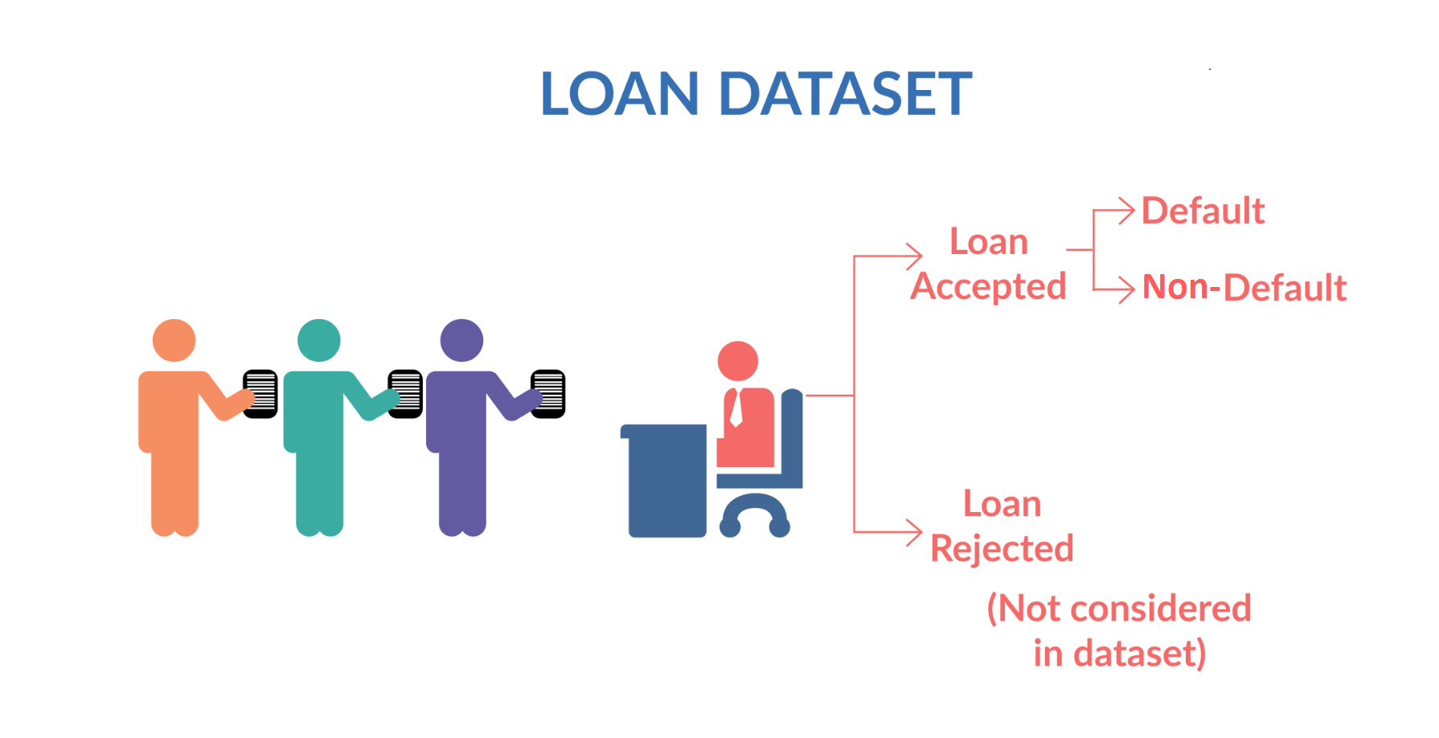

Slide 4
Steps of analysis
Data Understanding and Sourcing
Data Wrangling
Check for Data quality issue
Data Visualization and analysis based on Univariate and Bivariate analysis and correlation
Conclusion

Slide 5
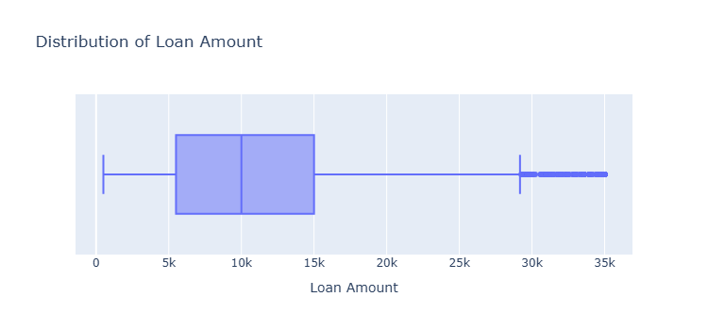
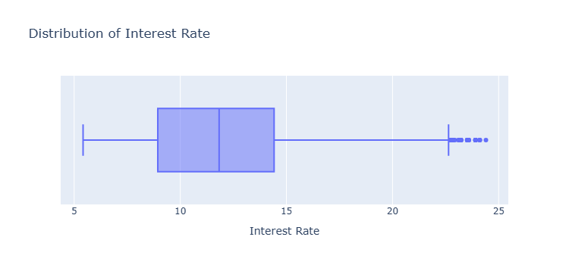
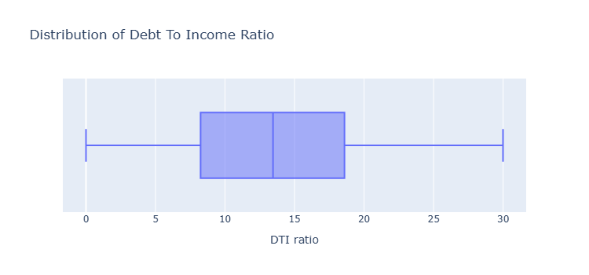
Data Analysis in continuous application data

Slide 6
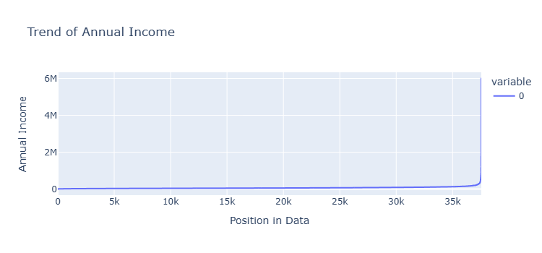
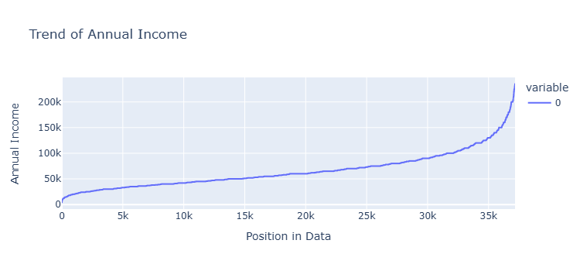

Slide 7
Univariate Analysis
Univariate Analysis is a type of data visualization where we visualize only a single variable at a time. Univariate Analysis helps us to analyze the distribution of the variable present in the data so that we can perform further analysis.
Bivariate analysis
Bivariate analysis is the simultaneous analysis of two variables. It explores the concept of the relationship between two variable whether there exists an association and the strength of this association or whether there are differences between two variables and the significance of these differences.
The main three types we will see here are:
Categorical v/s Numerical
Numerical V/s Numerical
Categorical V/s Categorical data
Segmented univariate
Analysis can help to identify differences and similarities within the data across different segments, and can provide insights into the factors that drive customer behavior or product performance.

Slide 8
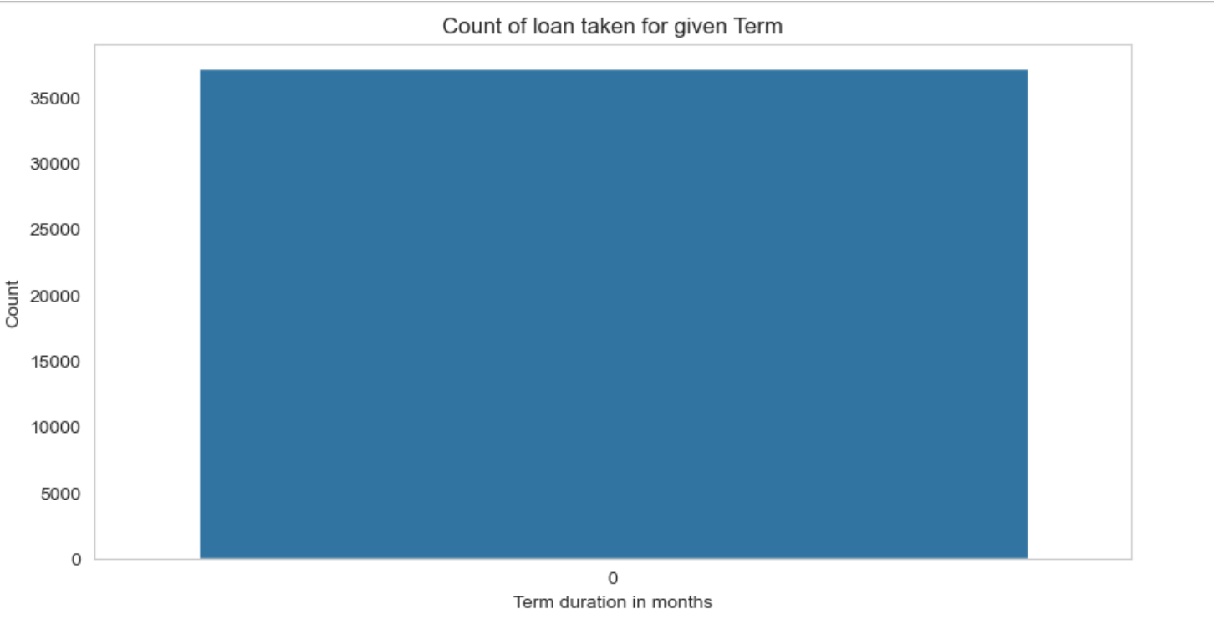
Univariate Analysis

Slide 9
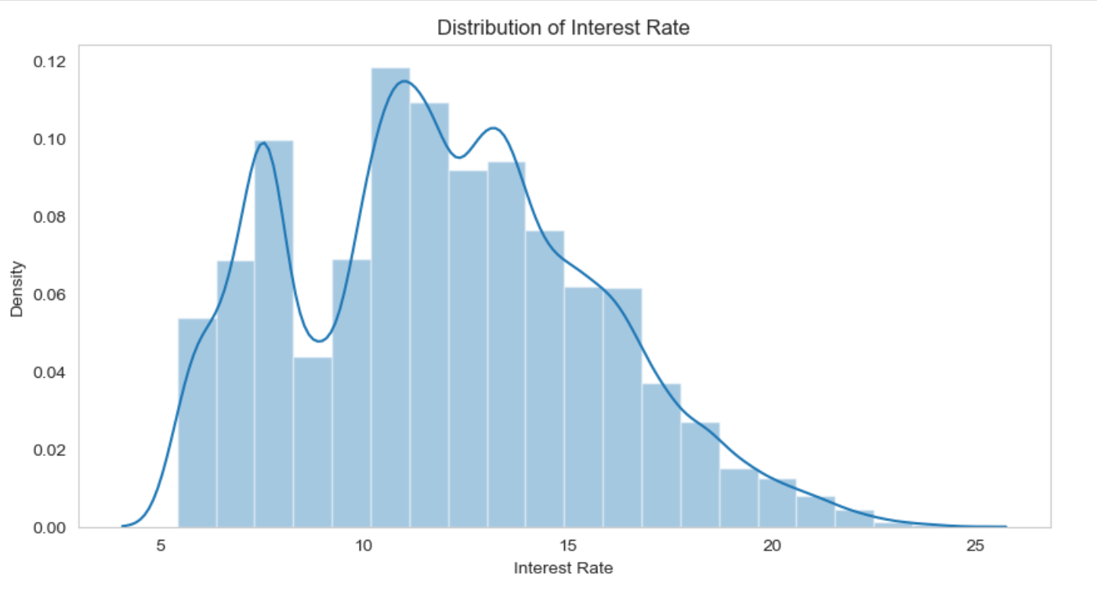

Slide 10
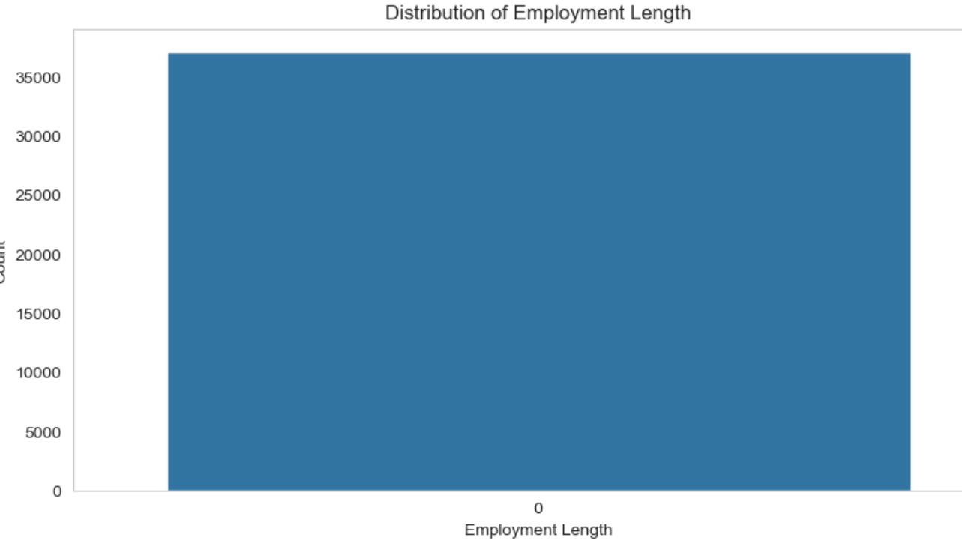

Slide 11
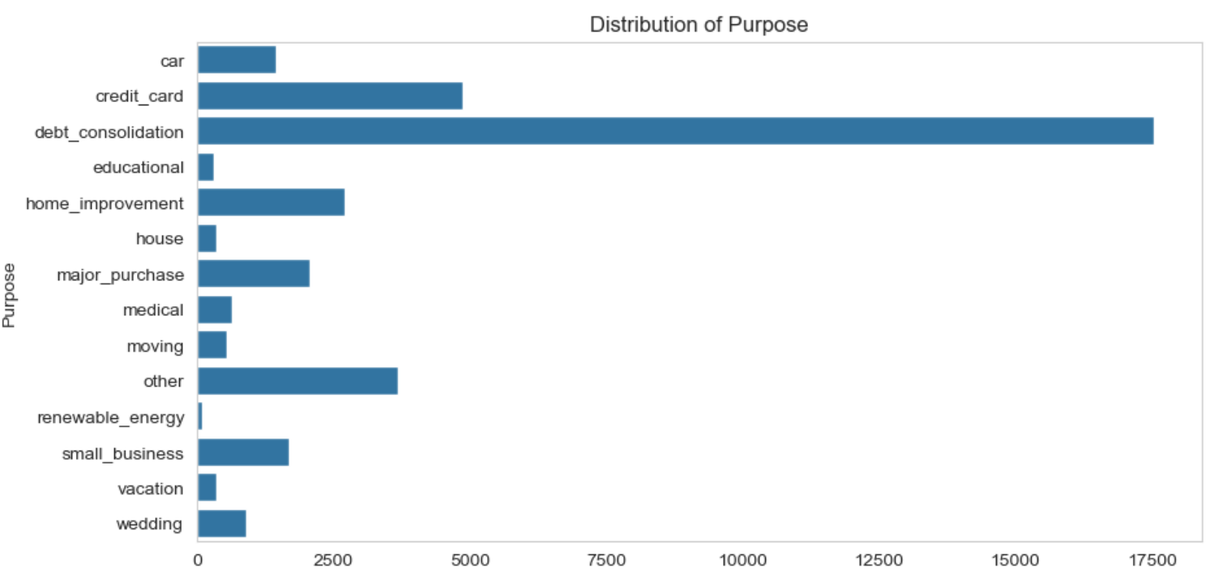

Slide 12
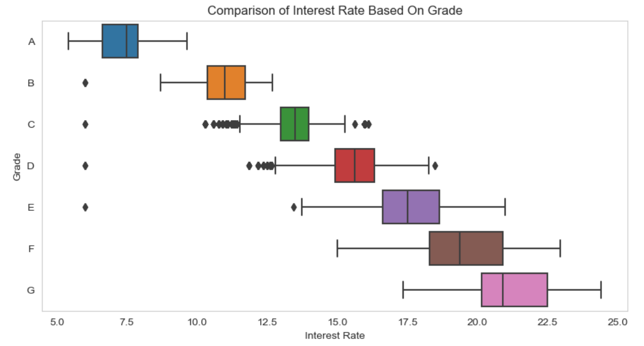
Bivariate Analysis

Slide 13
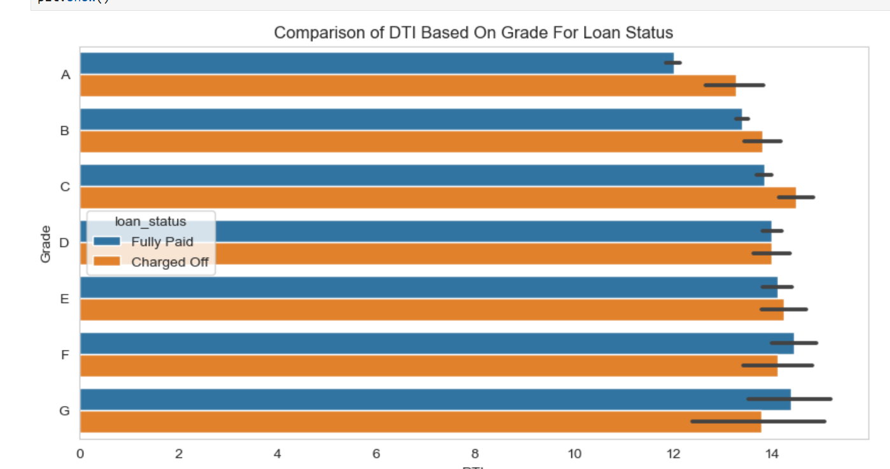

Slide 14
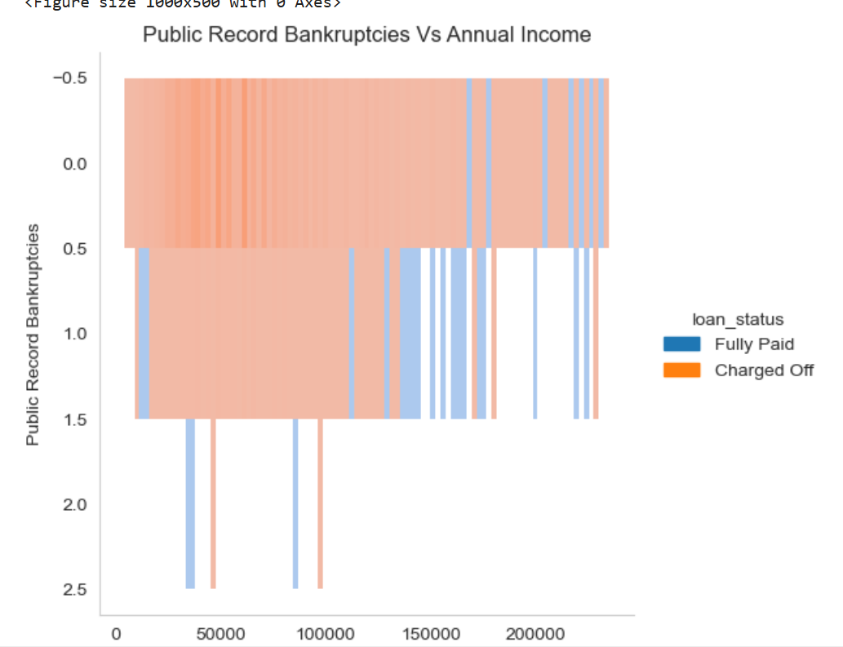

Slide 15
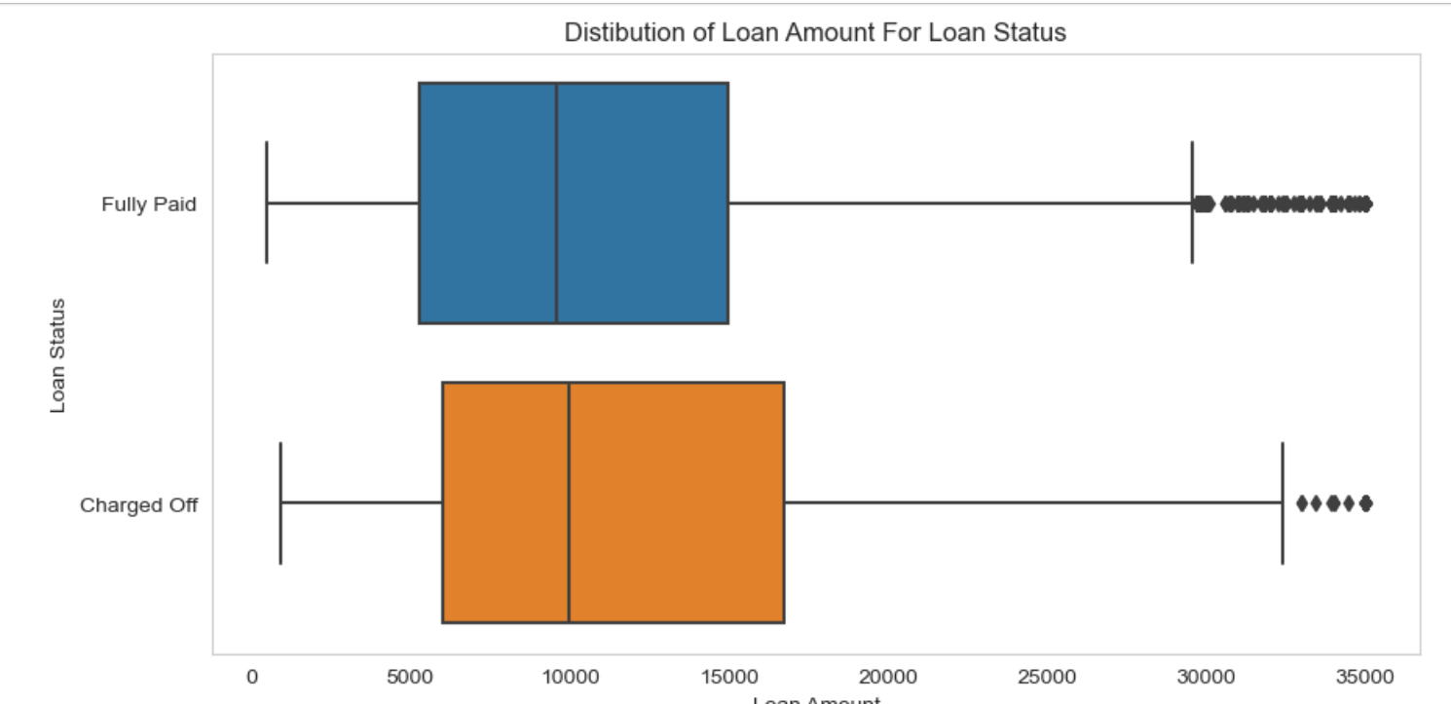
Segment Analysis

Slide 16
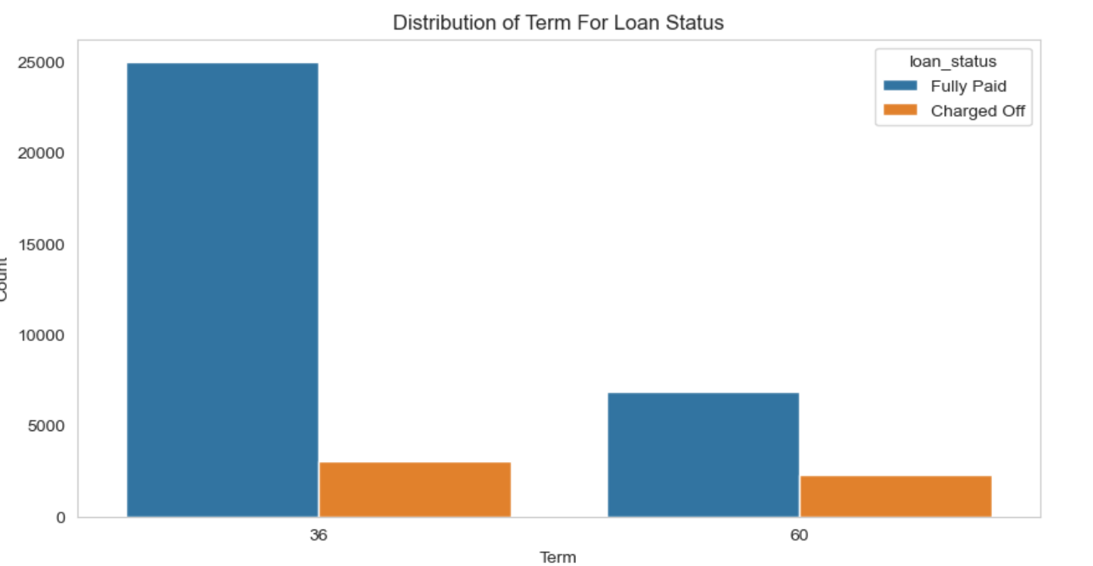

Slide 17
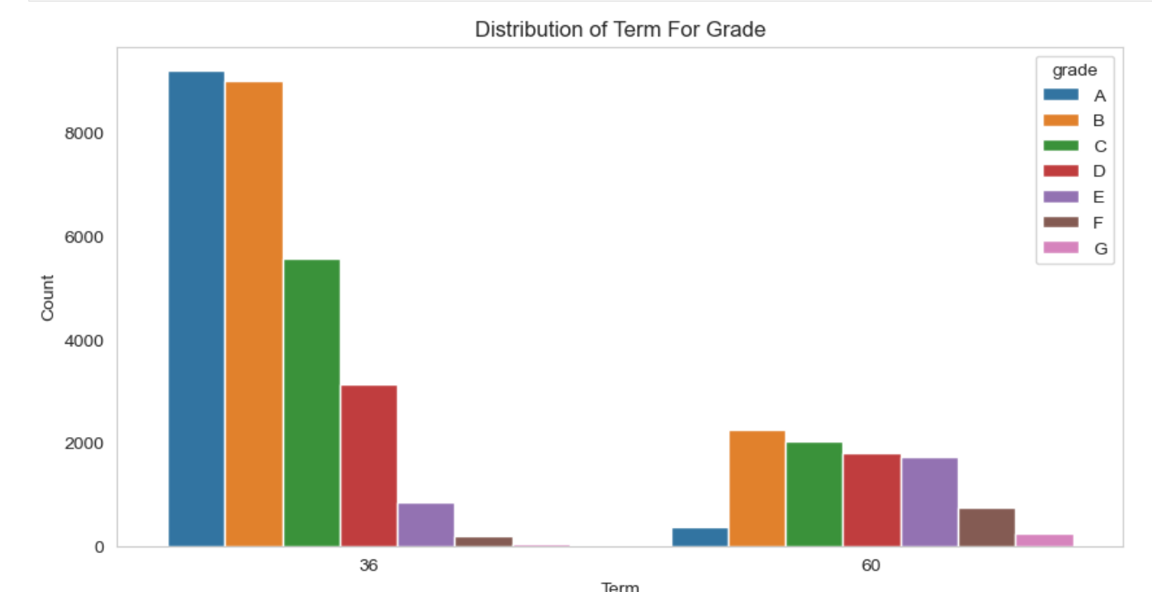

Slide 18
Case Summary
All the below variables were established in analysis of Application dataframe as leading to default. Checked these against the Approved loans which have defaults, and it proves to be correct.
The data given below contains information about past loan applicants and whether they ‘defaulted’ or not. The aim is to identify patterns which indicate if a person is likely to default, which may be used for taking actions such as denying the loan, reducing the amount of loan, lending (to risky applicants) at a higher interest rate, etc.

